Slide 1

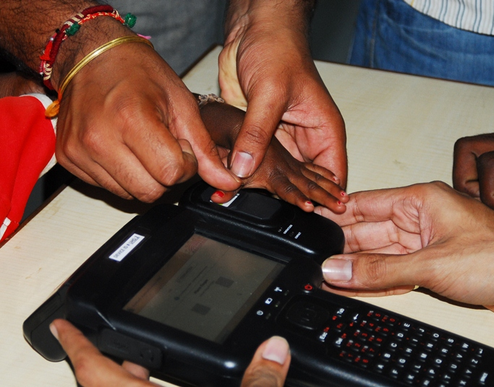
Aadhaar Enabled Applications
December 2015
H.C. Agrawal
DDG
Application & Authentication Division
Unique Identification Authority of India
Notes:
1

Slide 2
Aadhaar Vision
To empower residents of India with a unique identity and a digital platform to authenticate anytime, anywhere

Slide 3
Overview of Aadhaar
UIDAI was established by Govt. of India in 2009 as attached office under the then Planning Commission. Now placed under Department of Electronics & Information Technology (DietY)
Aadhaar ensures Uniqueness through biometric attributes (Fingerprint/ Iris)
About 95 Crore Aadhaar numbers issued as on date
Aadhaar Saturation among Adult population is about 90%
UIDAI offers “Authentication” and “e-KYC” services
Online authentication platform is capable of handling 10 Crore transactions per day
Since inception of Aadhaar authentication services, more than 110 Crore Aadhaar Authentication transactions have taken place including 6.5 Crore eKYC transactions

Slide 4
Features of Aadhaar
Random 12-digit Number – No Intelligence, No Profiling
All Residents – Including Children
No Guarantee to Citizenship, Rights, Entitlements
Uniqueness – Ensured through biometric attributes
Security and Privacy of Information Collected
Ubiquitous Online Authentication – From no ID to Online ID
Only a Number – No Smart Cards

Slide 5
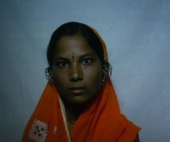

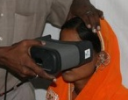
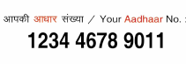
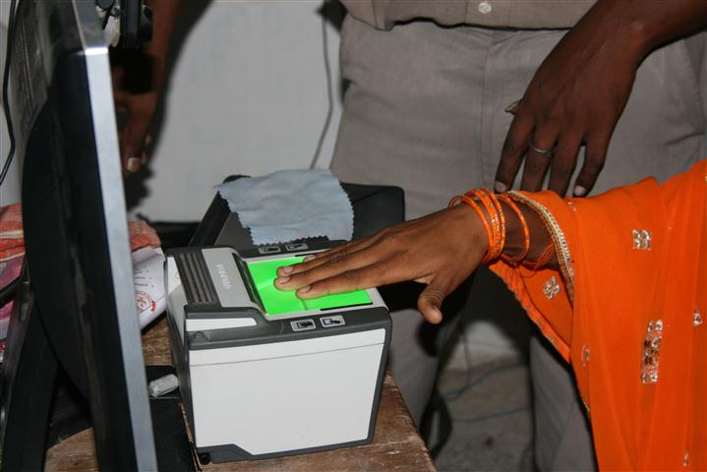
4 demographics + biometrics = 1 unique Aadhaar number
Photo
Name
Address
Gender
Date of birth
Optional:
Mobile
Email
Both
iris
1 person⬄1 number
10 finger-
prints
Basic demographic data and biometrics stored
Standardized identity attributes
No duplicates(1:N check)
Minimal demographic data collected
UID = 1568 3647 6218
5

Slide 6
Update details in Aadhaar
  All the details including demographics, biometrics and photo can be updated by the resident
PECs / Aadhaar Kendra
  Details can be updated after biometric authentication and with required documents at any of the PEC
  Update Client Lite is available for updating mobile, email & consent
  SSUP (Self Service Update Portal)
  Requires registered mobile number for OTP
  Demographics including mobile, email can be updated
By Post
  Resident can also send demographics update request by Post
Mobile Update API
  Made available to selected AUAs / Enrolment Agencies
  Resident can update Mobile, Email & consent easily

Slide 7
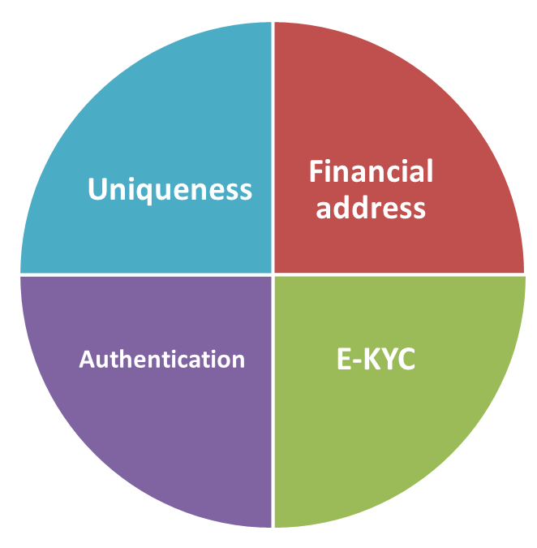
Value Propositions
A robust ID utility in the country
Cleaning existing service delivery databases via uniqueness
Enabler for efficient delivery of services

Slide 8
Uniqueness
A lifelong 12-digit unique number which can act as a primary identifier throughout the life of an individual. Uniqueness ensured through biometrics
The Aadhaar platform using the world’s most sophisticated technology ensures that every resident gets one and only one number.

Slide 9
Authentication (Online verification)
Authentication is on-line verification of a person’s identity anywhere in the country by various means (Biometric – Fingerprint and Iris, demographic, and One Time Password to registered mobile phone or email id)

Slide 10
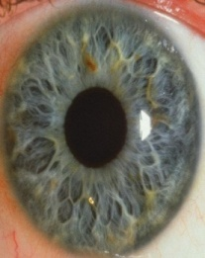

Authentication
BIOMETRIC
YES
or
NO
and/or
Demogrpahic
NAME, GENDER, DoB . . .
Aadhaar No:
2222 3333 4444
and/or
Electronic
OTP

Slide 11
E-KYC platform
e-KYC Services provide a platform for electronic verification of Identity and Address in electronic format for instant, efficient and secure service delivery
Notes:
11

Slide 12
e-KYC
BIOMETRIC
Name
Date of Birth
Gender
Address
Photograph
and/or
Aadhaar No:
2222 3333 4444
Electronic
OTP

Slide 13





Aadhaar Authentication – Participants & Transaction
Aadhaar Holders
Residents who have obtained their Aadhaar number
Authentication Devices
Point of initiation of Aadhaar authentication transaction e.g., PCs, kiosks, handheld devices etc
Authentication User Agency (AUA)
Agency that uses Aadhaar authentication to enable its services
Authentication Request
1
2
3
4
Aadhaar Holder
Authentication Devices
AUA
ASA
Yes / No Response
UIDAI’s
CIDR
7
6
5
Service Delivery
Necessary Updates
& Confirmation
Authentication Service Agency (ASA)
Agency that has secured leased line connectivity with CIDR
Unique Identification Authority of India
Offers online authentication
Sub Auth. User Agency (Sub AUA)
Agencies that access Aadhaar authentication through an existing AUA

Slide 14
Aadhaar as Financial Address
Department 1
Name | Aadhaar | Amount
Sachin | 2567 8765 4567 | 1000
Rahul | 4252 6537 6655 | 1500
Department 2
Name | Aadhaar | Amount
Sachin | 2567 8765 4567 | 800
Rahul | 4252 6537 6655 | 200
Sponsor Bank 1
Sponsor Bank 2
NPCI
Aadhaar | Bank
2567 8765 4567 | SBI
4252 6537 6655 | ICICI
ICICI
SBI
Name | Aadhaar | AC No
Rahul | 4252 6537 6655 | 56742344
Name | Aadhaar | AC No
Sachin | 2567 8765 4567 | 12345678
Rahul
Sachin
ICICI AC No | 56742344
Credit / Dept 1 | Rs 1500
Credit /Dept 2 | Rs 200
SBI AC No | 12345678
Credit / Dept 1 | Rs 1000
Credit /Dept 2 | Rs 800

Slide 15
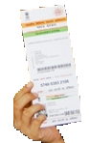
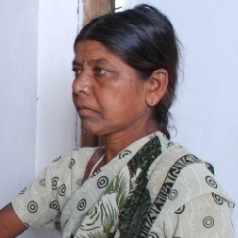
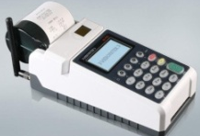


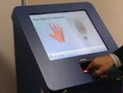
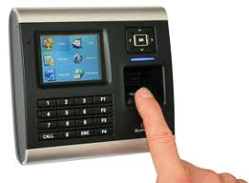



End-to-End Direct Benefit Transfer Enabled by Aadhaar
Pension
Bank
Radha 111122223333
xxxcccc
----- -----
1111 2222 3333
2. Aadhaar as KYC to open bank account
MGNREGA
Radha 111122223333
xxxxx
Aadhaar Payment Bridge
yyyyy
----- -----
Scholarship
3. Aadhaar as a payment destination
- Bank Account portability
- Many schemes, one Aadhaar linked
bank account
1111 2222 3333
Radha 111122223333
xxxxx
----- -----
1. Aadhaar to
de-duplicate databases
4. Withdraw from any MicroATM – Choice and Convenience
5. Auditability and traceability of transaction

Slide 16
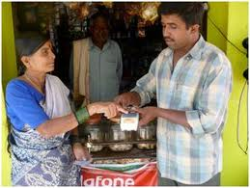
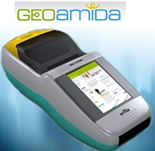

Aadhaar enabled micropayments for inclusive banking
Business Correspondents
Micro-ATM
Aadhaar authentication
Inclusive banking
Deposit
Remittance
Seeding
Balance enquiry
Withdrawal
A/c Opening
Notes:
This is part of the solution

Slide 17
Biometric Auth Transactions (In Lakh)

Slide 18
Major Aadhaar Enabled Applications
Disbursement of MGNREGA wages
Banks, PMJDY and BCs
AePDS
Pahal - LPG
Disbursement of Pension
Jeevan Pramaan
Income Tax: e-filing
Notes:
Make 4 categories - Live, priority, PoC, Concept – color code

Slide 19
Aadhaar Enabled Public Distribution System
Digitization of Ration cards and linking with Aadhaar
Distribution of Ration at Fair Price Shop (FPS) on biometric authentication of the beneficiary
Elimination of duplicates and fake identities
Pilot Implemented at all 2155 FPS in Krishna District in Andhra Pradesh
  Estimated Annual Savings of Rs 96.62Cr (Reported Krishna distt) (4.4 Lakhs/FPS)
  Full portability – beneficiary may draw ration from any FPS
  Rolled out in all 13 districts in AP
Other states are in the process to implement Aadhaar Enabled Public Distribution System

Slide 20
MGNREGS
Digitization and linking of MGNREGS job cards with Aadhaar
Seeding of corresponding bank account of MGNREGS workers with Aadhaar
Credit of MGNREGS wages in beneficiary’s Aadhaar linked bank account over Aadhaar Payment Bridge
Cash payment using Biometric Authentication
Status:
Implemented in 300 districts
Out of 9.5 crore Active MGNREGS workers, more than 53% are seeded with Aadhaar
So far 2.84 Crore payments transactions made using Aadhaar Payment Bridge
Benefits:
Money reaching to beneficiary directly in his account
Beneficiary can withdraw his money through BC in his village
Beneficiary’s time & money is saved

Slide 21
Direct Benefit Transfer in LPG
Linking of LPG connection with Aadhaar
Seeding of corresponding bank account of the beneficiary with Aadhaar
Credit of LPG subsidy in beneficiary’s Aadhaar linked bank account over Aadhaar Payment Bridge
Direct Benefit Transfer Scheme in LPG implemented across India
60% of 16.33 crore Beneficiaries have been seeded with Aadhaar
Around 5.6 Crore Transactions every month over APB
Around 66.3 Crore Transactions using Aadhaar Payment Bridge (APB) so far
Account based transfer scheme for remaining beneficiaries
Give up Subsidy facility

Slide 22
Prime Minister Jan-Dhan Yojna
19.6 crore Bank accounts opened since the launch of PMJDY
8.32 Crore PMJDY accounts have been seeded with Aadhaar
Banks have opened 1.57 crore accounts using eKYC
Direct Benefit Transfer of various Government schemes in PMJDY account of the beneficiary

Slide 23
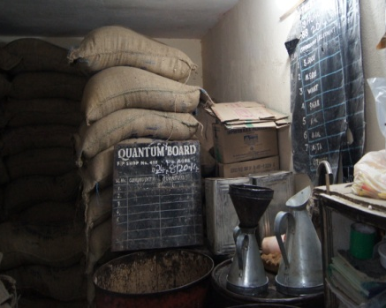
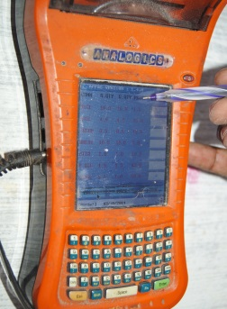
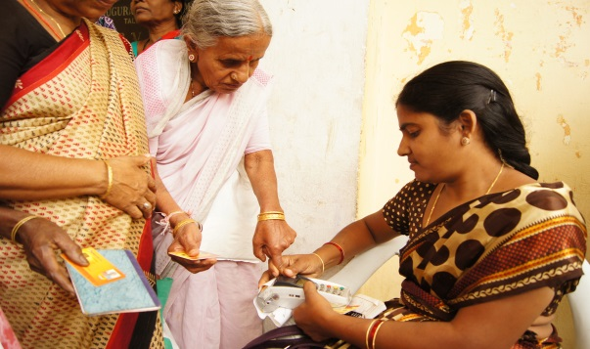
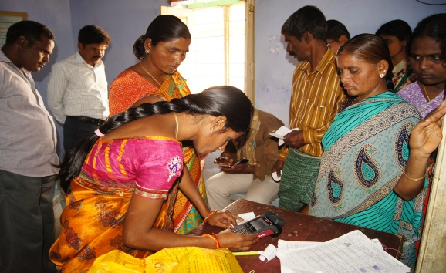
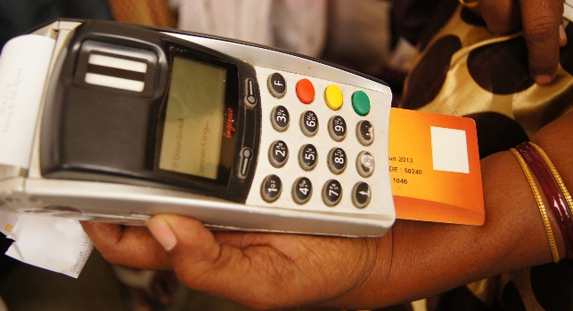
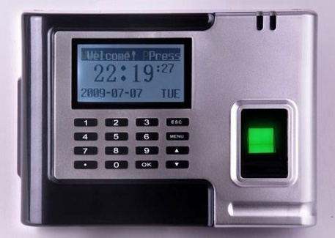
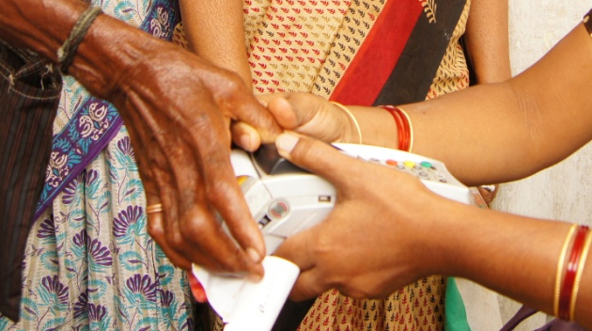
Applications using Aadhaar Biometrics Authentication
Service delivery agencies authenticate residents using one of the biometric, either iris or fingerprint at the point of delivery.
Biometric authentication is used for:
Providing Ration at PDS
Pension Payments
MGNREGS Payments
Financial Transactions
Managing Attendance
Adding New Beneficiaries
Notes:
23

Slide 24
Aadhaar integration in Income Tax
Income Tax using Auth, e-KYC & Seeding
Seeding of Aadhaar in PAN database by demographic authentication
e-filing of Income Tax return by OTP based Aadhaar Authentication
Services started on 13th July 2015
More than 50 Lakh tax payers filed return using Aadhaar

Slide 25
Aadhaar integration in Income Tax
Benefits to Residents:
  No need to send paper copy of Acknowledgement
  Assured receipt of Acknowledgement
  Money & Time saving to submit Acknowledgement
Benefits to Income Tax Dept:
  Processing of Acknowledgement not required
  No need of Data Entry of Acknowledgement
  No Paper Record Management for Acknowledgement
  Green initiative by saving paper

Slide 26
OPD registration in AIIMS using Aadhaar
AIIMS launched Aadhaar based online registration and appointment portal on 11th June 2015
Patient can now register online and take an appointment using Aadhaar based OTP authentication
Benefits to Residents:
  Ease of OPD Registration, scheduling appointment
  Less waiting time
  Money & Time saving for multiple visits to hospital
Benefits to AIIMS:
  Increased trust due to transparent online system & use of Aadhaar as Unique Identifier in the database
  Easy queue management

Slide 27
Aadhaar Enabled Applications…
Passport Seva Kendra
eSign
Aadhaar Enabled Biometric Attendance
Scholarships
Land & Property Registration
Online Insurance
Recruitment
Loan Approval
SIM Card Issuance
Notes:
Make 4 categories - Live, priority, PoC, Concept – color code

Slide 28
Thank You!!
harish.agrawal@uidai.net.in

