Slide 1
Government of Andhra Pradesh

Slide 2
CM Core Dashboard

Slide 3
Overview
The Chief Minister’s Dashboard provides a real time snapshot of various departments in the government.
The Dashboard is open to the public, thereby promoting transparency and accountability within the government
The Dashboard monitors department and services and identifies areas for improvement
Emphasis is placed on automation and computerization of departments. Data from respective department portals are displayed on the Dashboard

Slide 4
Automation
Field
Ground level data
Data collected from districts, mandals and villages
Department
Data is assimilated and categorized
Automated data capture ensures direct collection of data from field levels
Dashboard
Select data from department portals appear on the Dashboard
Live and automated updates of data is done at pre-set frequency

Slide 5
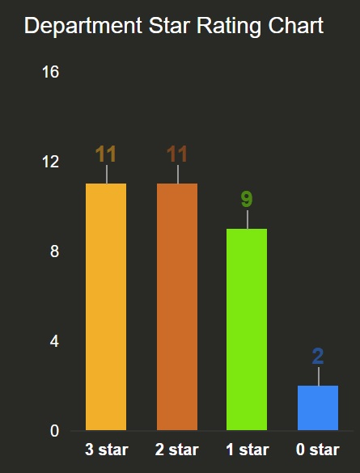
Star Rating
Departments are rated on a scale of 0-3 stars based on overall points acquired across four parameters
Data Collection – collection of data from the field/ground level. The accuracy, automation and frequency of data collection are measured
Real Time Governance – Historical data, response time and descriptive analytics are considered
Granularity – lower and in depth the level of data collection, the higher the points awarded
Adherence to Dashboard Guidelines – the relevance and accuracy of data is assessed

Slide 6
Street Lights

Slide 7
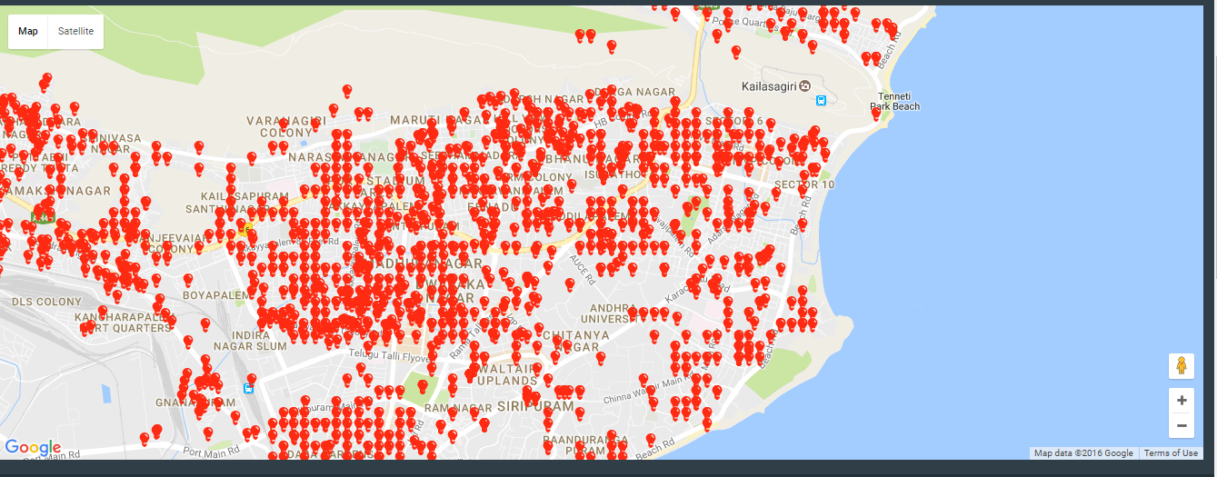
Live Tracking of Streetlights

Slide 8
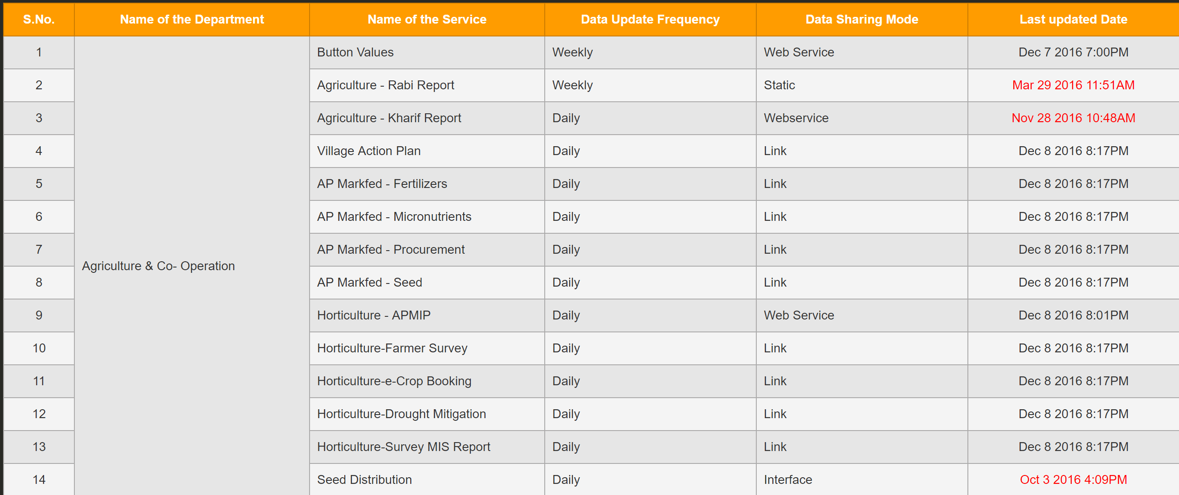
Frequency Updates
Every department has its own set frequency for data update
The data collected at the field level is sent to the dashboard either manually or electronically. Emphasis is placed on automated data sharing via weblink

Slide 9
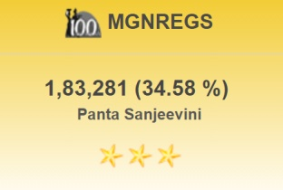
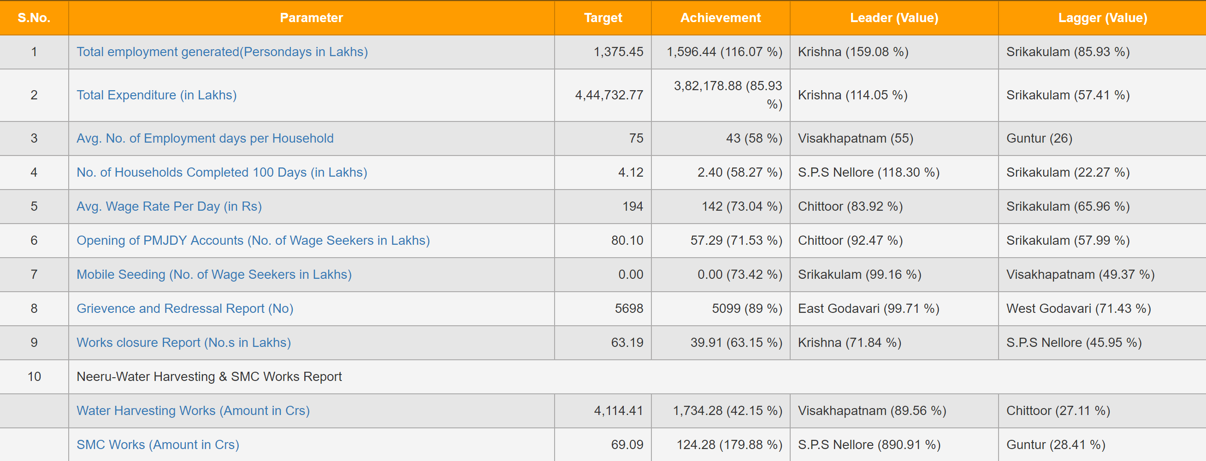
Emphasis on Key Performance Indicators
Overview
District Summary
Target and achievements
KPI

Slide 10
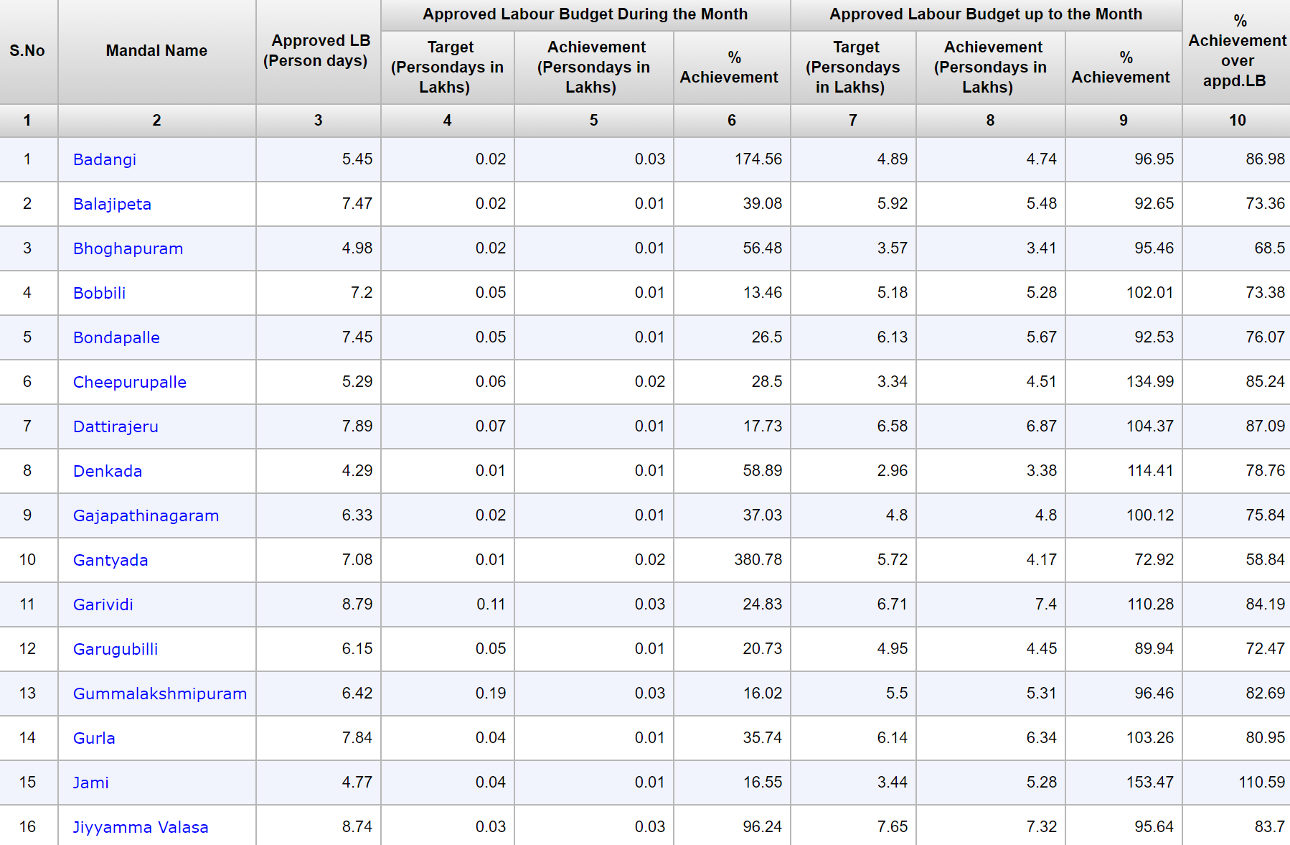
Drilldown
Department > KPI > District > Mandal/Panchayat

Slide 11
Department Data
Department Name
Summary
Star Rating

Slide 12
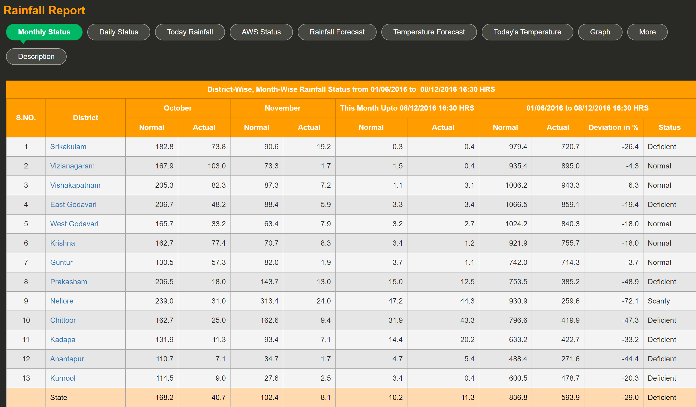
In Depth Department Analysis – Key Indicators

Slide 13
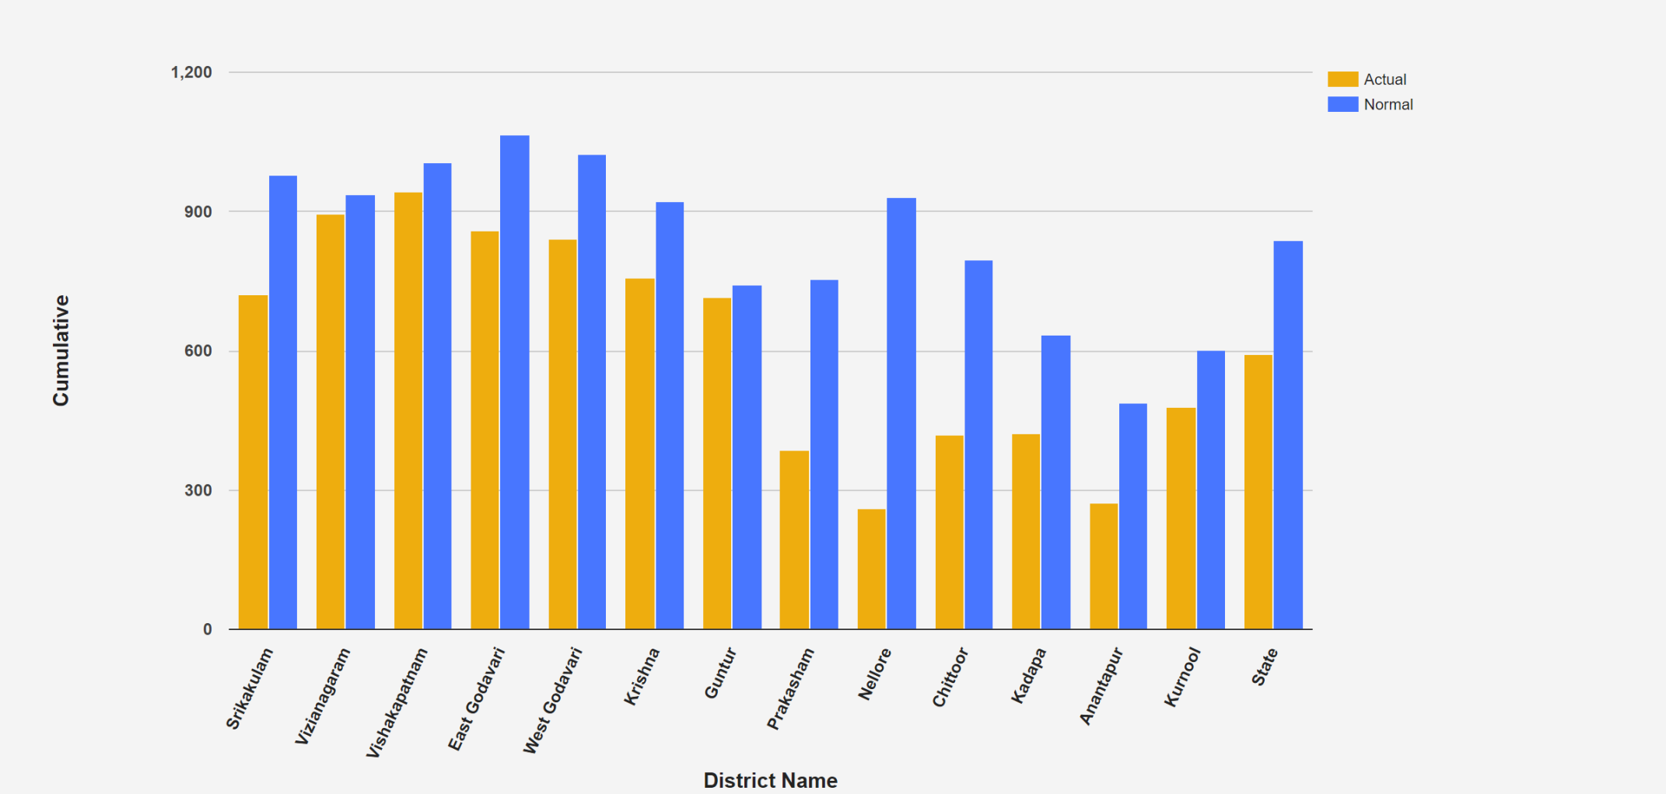
Department Analytics

Slide 14
Thank You

