Slide 1




Sewa Kendras in the state of Punjab
Punjab State
e-Governance Society,
Department of
Governance Reforms, Punjab
May, 2015

Slide 2



Slide 3
Any state that needs to grow has to keep the citizens at the centre of
all policy formulations
01

Slide 4
Why we needed to invest in Sewa Kendras
Challenges and issues with Common Service Centers
Average ambience of the center in look and feeling resulted in average citizen experience.
Limited Infrastructure , internet connectivity.
Non-Standardized service delivery across the State.
Non availability of DG sets, Power back-up, Air conditioned environment.
Limited investment for manpower, maintenance by VLEs.
No queue management process.
No attendance process and dependency on only one VLE in one CSC.
VLEs had limited interest in training and thus had poor citizen handling skills .
VLEs were not interested in applying services with manual backend as it involved hiring of runners.

Slide 5
Current landscape of Citizen Centric Service Delivery
Punjab Government extends its services to citizens and businesses through following Service Delivery Channels
SUWIDHA Centers
SAANJH Kendras
State Transport Service Counters
Local Government Counters
Gram Suwidha Kendras
FARD Kendras

Slide 6
Need for Unified Service Delivery Centers
The average coverage is 45000 population per center
Delay in delivery of services, Long waiting time
Lack of Monitoring mechanism
Duplication of physical infrastructure, manpower wastage, overloading as well as under-utilization of resources

Slide 7
Need for Unified Service Delivery Centers
Multiple front end delivery channels like SUWIDHA, FARD Kendras, Saanjh Kendras, Transport etc., leads to confusion among citizens as to which service can be availed from where!
Monetary loss to the citizens in the form of wastage of time, loss of wages & productivity, transport cost etc

Slide 8

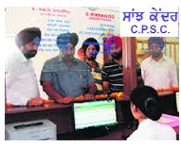


Citizen Service Delivery Approach
Front End
Portal
Call Centre/SMS
Delivery Centre
Department Backend
Power
Food Supply
Transport
SC/BC Welfare
Social Security
Personnel
Health
Home
Local Government
Revenue
Housing & Urban Development
Education

Slide 9
Objectives
Do away with current approach of departments working in silos and having their separate service delivery channels
Optimization of manpower and resources engaged in service delivery mechanism
Provide efficient and cost effective methods of service delivery to departments
Enable the government departments to focus on their core functions and responsibilities
Bring uniformity across State in service delivery mechanism

Slide 10
Desired outcomes
One stop shop to avail the entire gamut of citizen centric services of all the departments under one roof
Strategically located Sewa Kendras
Electronic Queue Management System (EQMS) to minimize the waiting time for citizens
Reduction in lead time involved in availing the services
Drive down service delivery and communication costs
Robust online management information system (MIS) reporting

Slide 11
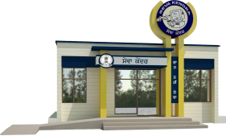
About Sewa Kendra
1758 rural Sewa Kendra's
389 urban Sewa Kendra's
  Type 1 : 6 counters per centre + 1 additional counter
  Type 2 : 3 counters per centre + 1 additional counter
  Type 3 : 1 counters per centre + 1 additional counter
  Delivery of all services covered under RTS in time bound manner
  Good ambience and Amenities for citizens
  Covering cluster of 8000-10000 (tentatively) in rural areas
  Covering 1.5 to 2 Square Kilometres (tentatively) in urban areas
  Integrated with individual department systems

Slide 12




Scenario for Service Delivery through SEWA Kednras
(With End to end Back end Automation)
Citizen
State Data Centre
Power
Transport
SUWIDHA
SSDG
Education
Transport
Social Security
Health
E-District
Food Supply
SC-BC
Personnel
Home
PAWAN/Internet
SEWA Kendra

Slide 13

Scenario for Service Delivery through SEWA Kednras
(with Manual Back end )
Citizen
Power
Transport
Social Security
Health
Food Supply
SC-BC
SEWA Kendra
Personnel
Home

Slide 14
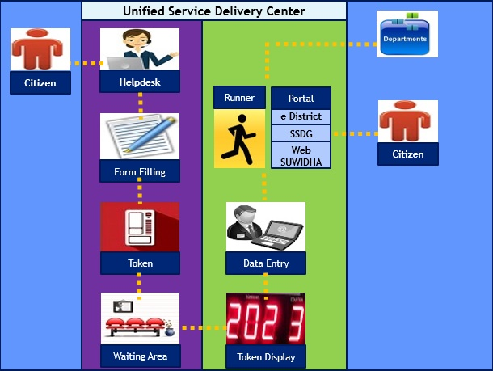
Service Delivery Model at Sewa Kendras

Slide 15
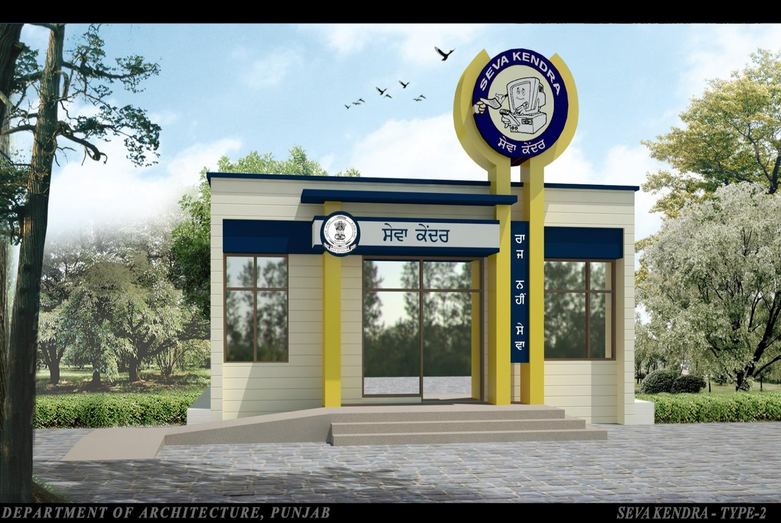
Front View

Slide 16
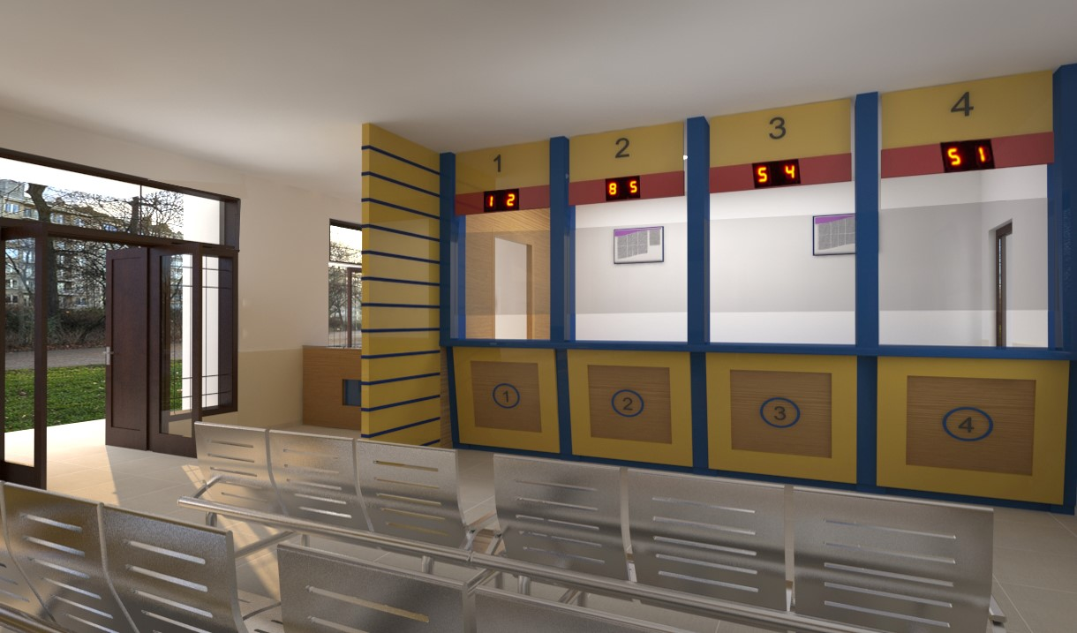
Inside View

Slide 17
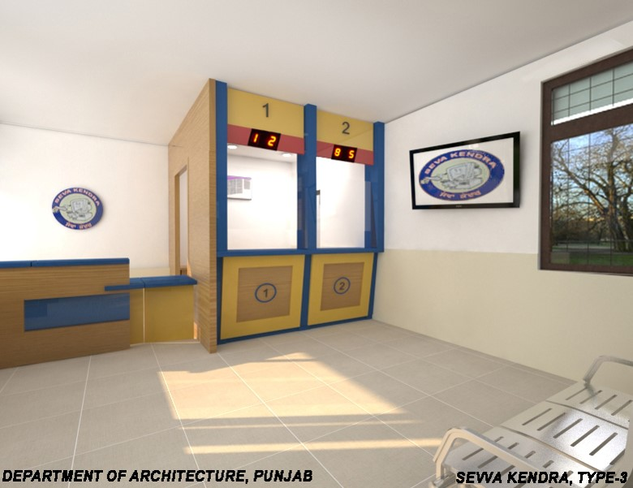
Inside View

Slide 18
Facilities at SEWA Kendras
Item | Sewa Kendras Type I | Sewa Kendras Type II | Sewa Kendras Type III
No. of Counters per Sewa Kendra (Minimum) | 6 | 3 | 1
Approximate Area (Sq. Ft) | 1000 | 800 | 400
3 Seater Waiting Bench | 3 | 2 | 1
Staff Chairs (for staff and security guards) | 10 | 8 | 2
Electrical appliances (e.g. Fan, Tube light, Bulb, etc.) | As Required | As Required | As Required

Slide 19
Facilities at SEWA Kendras
Item | Sewa Kendras Type I | Sewa Kendras Type II | Sewa Kendras Type III
Form filling table | As Required | As Required | As Required
Air Conditioner – 1.5 tons capacity | 2 | 2 | 1
Almirah/Storage cabinets etc. | As Required | As Required | As Required

Slide 20
Facilities at SEWA Kendras
Item | Sewa Kendras Type I | Sewa Kendras Type II | Sewa Kendras Type III
Almirah/Storage cabinets etc. | As Required | As Required | As Required
Helpdesk Counter | 1 | 1 | 0
Suggestion/ Feedback Box/Display Board | 1 | 1 | 1

Slide 21
Facilities at SEWA Kendras
Item | Sewa Kendras Type I | Sewa Kendras Type II | Sewa Kendras Type III
Electrical Cabling & Laying of Network Conduit pipe | As Required | As Required | As Required
Connectivity to SDC
Power Connection | 1 | 1 | 1
DG Set (15/10/7.5 KVA for Type I/II/III) | 1 | 1 | 1

Slide 22
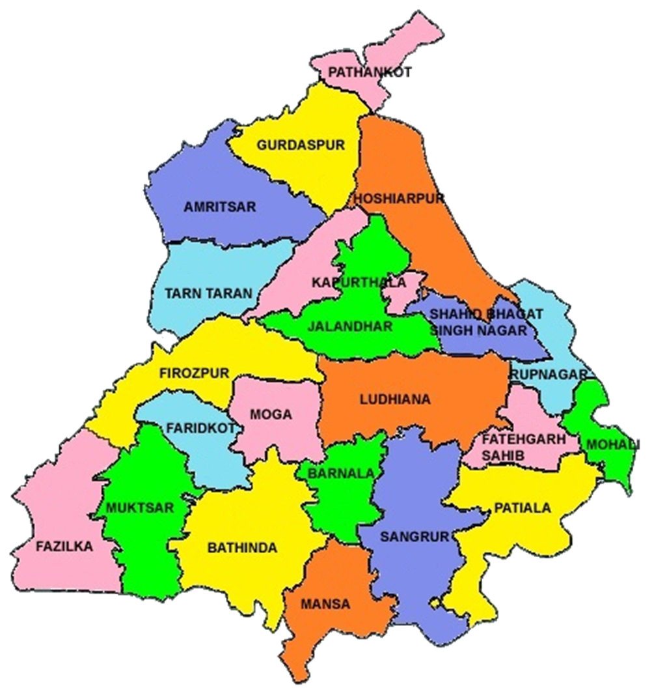
Geographic Areas of Zones
Zone No. 1
  Amritsar
  Gurdaspur
  TarnTaran
  Pathankot
  Hoshiarpur
  Jalandhar
  Kapurthala
  SBS Nagar
Zone No. 2
  Sangrur
  Barnala
  Patiala
  Fatehgarh Sahib
  Ludhiana
  Rupnagar
  SAS Nagar
Zone No. 1
Zone No. 3
  Faridkot
  Fazilka
  Ferozepur
  Moga
  Shri Muktsar Sahib
  Bathinda
  Mansa
Zone
No. 2
Zone No. 3

Slide 23
SEWA Kendras
State invested more than Rs. 500 Crores in infrarstructure
First time an organization involved in management of visas of many countries have taken the management of citizen service centers. M/s BLS International
All Sewa Kendras fully furnished by State agencies like PWD etc.
All Sewa Kendras are having same façade, facilities
Strategically located for the citizens.
Rigorous monitoring by the Honble Dy. CM and Worthy Chief Secretary
Employed more than 5000 manpower by service operator
More than 5,00,000 Training hours spent on employees of M/s BLS International.
Computing Infrastructure of 5000 computer nodes along with peripherals connected with leased lines/Broadbands.
Average 25000 citizen service transactions daily with 77 citizen services being delivered.

Slide 24
Scope of work for Service Operator
Manpower Deployment
IT Infrastructure and Services
Operations
Maintenance
Management

Slide 25
Scope of Work
Supply, Installation and Configuration of hardware, software, networking and other peripherals at Sewa Kendras
Service Delivery at Sewa Kendras
Manpower Deployment & Training for each zone
Operation of existing SUWIDHA Center in each zone
Transaction management for each zone
Security & Insurance of Assets of Sewa Kendras for each zone
Consumables Management

Slide 26
IT Infrastructure & Services
Supply, Installation and Configuration of hardware, software, networking and other peripherals at Sewa Kendras
Maintenance of hardware and software during contract period.

Slide 27
IT Infrastructure & Services
S. No. | Component | Units required
 |  | Sewa Kendras Type I | Sewa Kendras Type II | Sewa Kendras Type III
 |  | (Qty) | (Qty) | (Qty)
1. | Desktops | 7 | 4 | 1
2. | Printers | 7 | 4 | 1
3. | Scanners | 6 | 3 | 1
4. | LAN Switch – 24 Ports PoE with one OFC port | 1 | 1 | 1
5. | 2 TB SATA HDD | 1 | 1 | 1
6. | Network Rack | 1 | 1 | 1

Slide 28
IT Infrastructure & Services
S. No. | Component | Units required
 |  | Sewa Kendras Type I | Sewa Kendras Type II | Sewa Kendras Type III
 |  | (Qty) | (Qty) | (Qty)
7. | UPS (10/5/3 KVA for Type I/II/III) | 1 | 1 | 1
8. | CCTV Fixed Camera | 2 | 2 | 2
9. | NVR | 1 | 1 | 1
10. | Token Management System | 1 | 1 | 0
11. | Biometric Attendance System | 1 | 1 | 1
12. | Digital Camera with Tripod Stand | 6 | 3 | 1
13. | Digital Slate with Digital Pen | 6 | 3 | 1

Slide 29
Manpower Deployment
S. No. | Positions | Minimum Manpower Requirement
 |  | Sewa Kendras Type I | Sewa Kendras Type II | Sewa Kendras Type III
1. | Zone Project Coordinator | 1 for each zone
2. | District Program Manager | 1 in each District
3. | Asst. District Program Manager | 1 in each District
4. | Operators for Counter | 6 | 3 | 1
5. | Center Coordinator cum Facilitator | 1 | 1 | 0
6. | Attendant cum Helper cum Runner | 1 per Kendra | 1 per 5 Kendras | 1 per 5 Kendras
7. | Security Guard | 1 | 1 | -

Slide 30
Responsibility of Service Operator
SEWA Kendra

Slide 31
Service Operator Roles & Responsibilities
Hardware Management
Procurement & Installation of the ICT hardware, Software and peripherals Insurance for all the assets including hardware (IT and Non-IT), software, networks etc. Devising a computerized call back/IVRS feedback mechanism for obtaining feedback from citizens Maintenance of DG set & a complete log book for DG Set & recording comprehensive date wise detail

Slide 32
Service Operator Roles & Responsibilities
Service Management
Providing consumables and any other goods or articles required from time to time for delivering the service Recruitment, training (including regular and periodic training) and controlling the manpower required to be deployed at Sewa Kendras. Coordination with Departments, connectivity service providers etc. to ensure service

Slide 33
Service Operator Roles & Responsibilities
Service Management
Establishing security services at all the sites for protection of Assets Devise service specific Standard Operating Procedures (SOPs) Ensure that there is no unauthorized form being sold or agents working in collusion with manpower from Sewa Kendras

Slide 34
Operational Requirements
Sewa Kendras shall be operational for 6 days a week
Providing Services to citizen through Sewa Kendras
Service Operator will be responsible for cleaning and housekeeping of Sewa Kendras.

Slide 35
Operational Requirements
Service Operator will be responsible to manage and maintain complete infrastructure at Sewa Kendras whether supplied by Service Operator or PSeGS including furniture & fixtures, electrical cabling/equipment, all type of stationaries, consumables etc.
Deposition of statutory/government fee collected at Sewa Kendras
Takeover of existing SUWIDHA Kendras including manpower and maintenance of infrastructure

Slide 36
Operational Requirements
Electronic Queue Management System with provision of allocating token numbers to citizens on first-come-first-serve basis at Type I and Type II centers
Cash Management
Provision of Citizen Appointment System for convenience and transparency in service delivery

Slide 37
Operational Requirements
Provision of application forms and licences/certificats/documents to citizens.
Transfer/handover the ownership/possession and custody of all the assets (procured by Service Operator and/or being used in Sewa Kendras for providing the services to the citizen) to the PSeGS at the end of project/on termination of contract

Slide 38
Current Status
22 Type I, 322 Type II and 1758 Sewa Kendras have been launched w.e.f 12th August 2016.
77 Services have been started.
Average 15000 applications being received.
Pendency less than 15%

Slide 39
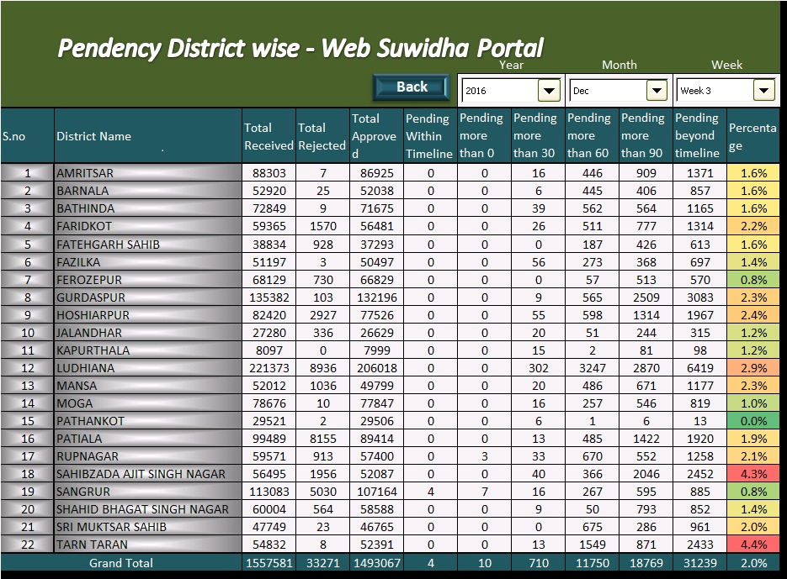
Service Delivery Pendency - Monitoring
Online Real Time Reprots
Efforts made by State
MIS Cell established in office of Chief Secretary Punjab for monitoring of e-Governance works and also pendency of service delivery.
Weekly Video Conference of Chief Secretary with DCs to monitor and review the pendency.

Slide 40
Thank You

