Slide 1
Rajasthan Sampark (CM Helpline 181) Government of Rajasthan

Slide 2
Rajasthan Sampark
Rajasthan Sampark (181) was implemented in the year 2014
An enhanced version of portal was launched in August 2017, Integrated with 400-seats
181 covers all Government Departments, Bureaus, Boards, Commissions, Corporations, Federations, Institutes, Academies & Universities.
Background
Objective
To disseminate awareness of various schemes, necessary information to citizens and dealing with public grievances
Centralized real time basis dashboard for higher authorities for proper monitoring
Mode of Communication
Call Center 181
RajSampark web portal and Mobile App
SMS & E-mail
E-Mitra Kioshak
Categories
Grievance
Demand

Slide 3
Rajasthan Sampark Modules
Reality Check Module
Feedback from Citizens about implementation of flagship programmes through IVR, Outbound calls, SMS etc
Tour module
Standardize the process of conducting and monitoring tours made by various government officers government officers
Service Request Module
Departmental users to report any technical issue or support required for any project

Slide 4
Functionalities for various Stakeholders
Citizen
Call Center Agent/ Kiosk Operator
Department Users
Higher Authorities
First Time User registration
Lodging of Grievance
Status tracking facilities (online/ SMS)
Feedback & Reopening
User Registration
Facilitate Lodging of grievance
Facilitate status tracking
Facilitate feedback and reopening process
Facilitate quality disposal
Complete workflow starting from grievance allocation process to grievance redressal.
Customized report generation as per the requirement
Admin facility for selected users
Dashboard facility to enable proper monitoring
Customized report generation as per the requirement

Slide 5
Grievance Workflow
1
2
3
4
5
Register Your
Grievance
Grievance Auto Allocation
Grievance
Disposal
Verification
Process By CCC
Feedback and Suggestion
Citizens register their grievance via short form or long form.
Grievance gets auto assigned to the lowest level officer for that subject and location.
The grievance gets disposed by the officials according to the steps mentioned later in this presentation.
The CCC verifies the status of the disposal and the satisfaction quotient of the citizen post the disposal.
The citizen may provide additional feedback and suggestions to assist the departments improve their disposal processes.

Slide 6
Grievance Workflow - Register Grievance
1
Complainant's Details
Grievance Area Details
Registration Details
Receive Mode Details
Grievance Details
Register Grievance
SMS to Assigned Level Officer
Grievance Auto Allocation
Citizen Raises Complain
Long Form
2
Call at 181
Sampark Portal
Citizen registers grievance
Mobile App
or
Short Form
SMS/ E-mail
Call centre executive registers the grievance on behalf of the citizen
Take a help from CCC
eMitra Kiosks
Complainant Name
Mobile Number
Grievance Description
Upload Document
SMS to Complainant

Slide 7
Grievance Workflow - Grievance Auto Allocation
Grievance
Disposal
3
2
Grievance Auto Allocation
Grievance Disposal Workflow (Escalation Process)
Grievance Types
1. General
2. Development
3. Employee
Go to the lowest level officer for further processing.
L1
L2
L3
L4
Monitoring
4. Enquiry
5. Corruption
6. Personnel
Supervisor (Collector)
Action Taken
Forward
Partial Closure (Relief)
Partial Special Closure (Reject)
Transfer
Request for Directions from Senior Level
Directions to Junior officer
Remark
Approved
Moderation
Action Taken
Approved
Disapproved
Moderation

Slide 8
Grievance Workflow - Grievance Disposal
3
Grievance Disposal Workflow (Escalation Process)
L1
L2
L3
L4
Grievance
Disposal
Monitoring
Partial Closure (Reject)
Partial Closure (Reject)
Partial Closure (Reject)
Partial Closure (Relief)
Partial Closure (Relief)
Partial Closure (Relief)
4
4
4
Verification
Process By CCC
Verification
Process By CCC
Verification
Process By CCC
In case of Dissatisfaction
In case of Dissatisfaction

Slide 9
Grievance Workflow - Verification process by Call Center
4
Verification
Process By CCC
L3
L4
Request for reopening
(valid up to two complete lifecycles)
CCC
Partial Closure (Relief)
Citizen
Satisfied
Not Satisfied
Call to Citizen after Disposal for verification
Partial Closure (Reject)
Final
Disposal
Upper level Officer
5
3
Feedback and Suggestion
(optional)
Grievance Disposal

Slide 10
Current Status
The Call Center CM Helpline 181 has been operational with 700 seats at Jaipur (450 seats), Jodhpur (50 seats) and Kota (200 seats) locations.
Registered and disposed grievances from 2014 to till date:
 | Grievances Status
Registered | Disposed | Disposal %
1.34+ Crores | 1.31+ Crores | 97.59 %

Slide 11
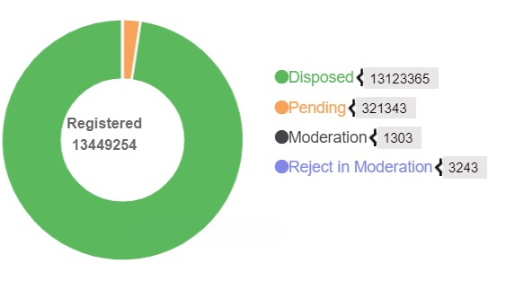
Summary of total Grievances

Slide 12
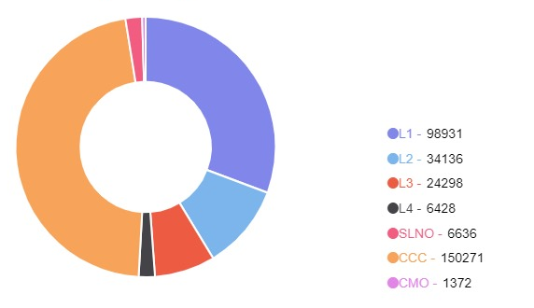
Summary of pending Grievances

Slide 13
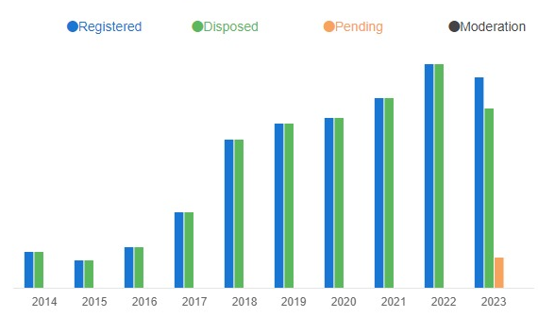
Year wise Grievances summary

Slide 14
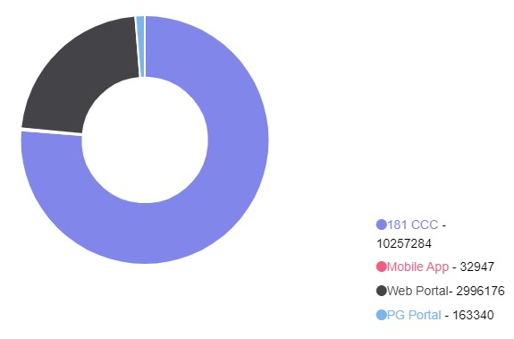
Source wise Grievances summary

Slide 15
Way Forward
To provide a platform to all citizens for various Services/ Schemes and delivery of Government
Auto Generations of Grievances for services which are not delivered in stipulated time frame.
To provide E-Jansunwai module to enable the government officials with facilities of video conferencing for easier way of connecting with the citizens.

Slide 16
Awards
Skoch Award of Merit 2015-16
Skoch Award of Merit and Platinum 2017-18

Slide 17
Thank You

