Slide 2
Agenda
Integrated eService Delivery in Rajasthan
Initiation of Jan Soochna Portal
Roll out of Jan Soochna Portal and Outreach
Case Studies
Recent Initiatives
Action for the future

Slide 3
Integrated eService Delivery in Rajasthan
Government of Rajasthan set up e-Mitra platform of eGovernance in the year 2002 for effective, efficient and transparent delivery of Government services to common man.
Sensitivity
Transparency
Ranked no. 1 Service Delivery Portal by
Department by Administrative Reforms & Public Grievances, Government of India
in National eService Delivery Assessment (NeSDA) 2021.
Accountability
Core principles in shaping the plans, policies and programs of the State Government

Slide 4
Integrated eService Delivery in Rajasthan
Application & Quality
of Service
e-Mitra Statistics…..
Citizen Empowerment
24X7 availability of services
Transparency in availing services (FIFO)
Dedicated helpdesk and support system.
Configurable, Service Oriented Application
Prepaid system.
Single Sign On / Unique ID Jan Aadhaar Sign In
80000+ Physical Kiosks
( Urban : 30000+; Rural: 50000+)
600+ Services (G2C & B2C)
Multi Modal
Service Delivery
Government
Commitment
Caters to 1 Crore+ citizens per month
Online Web Portal
Physical Kiosks
Mobile App
e-Mitra Self Service Kiosks (e-Mitra+ machines)
Delivery of all government services through e-Mitra platform at nominal service charges, near the doorstep of the residents of State.
15k e-Mitra+ Self Service ATMs
e-Mitra@Home

Slide 5
“INFORMATION” as part of eService Delivery
As the e-Mitra platform evolved into a robust eService Delivery platform, we realized:
Common man finds its difficult to know about the eligibility criteria, government business processes and related benefits provided by government under various schemes.
Most of the RTIs are filed because of unavailability of desired information in public domain.
Real-time access of public information related to Government Departments / Organizations helps in building trust of common man in Government System.
Government Schemes
- Formulated across sectors catering different beneficiaries following different processes
Govt. Business Process
Eligibility Criteria
Related benefits
Information as a “Service”

Slide 6
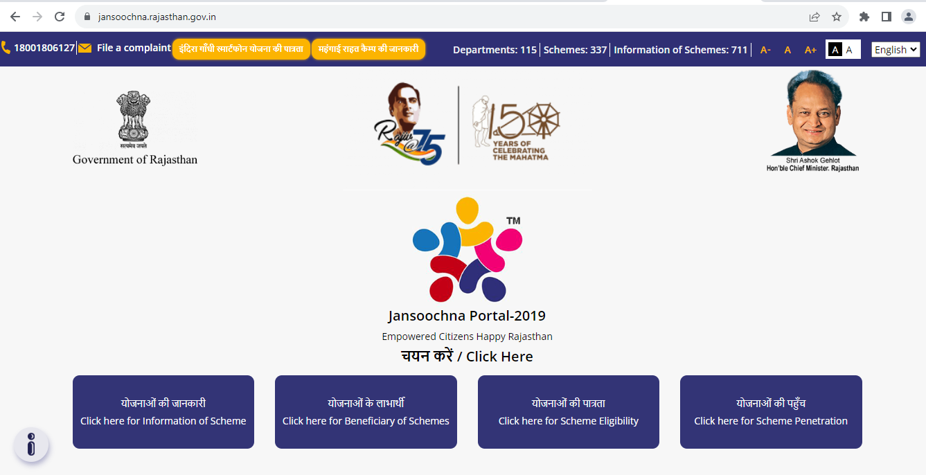
Initiation of Jan Soochna Portal
RTI Act, 2005
Real-time disclosure of public information
Jan Soochna Portal
Technology

Slide 7
Journey of Jan Soochna Portal
Sept 2019
Feb 2020
July 2019
Sept 2019
Jan 2019
Launch of Jan Soochna Portal on 13-09-2019
Formation of Digital Dialogue Team: Developed formats in which Departments were asked to disclose information in public domain
- What information needs to be disclosed ?
- At which level the information needs to be disclosed ?
- How should the information be disclosed ?
Circular Issued at the level of Chief Secretary: Formation of Jan Soochna Advisory Group
Meeting with 13 Departments to get the information in desired format on their schemes finalized for covering initially
Informal meetings, consultations and workshops of Civil Societies and Government Officials
- Agreement on formation of Digital Dialogue Team

Slide 8
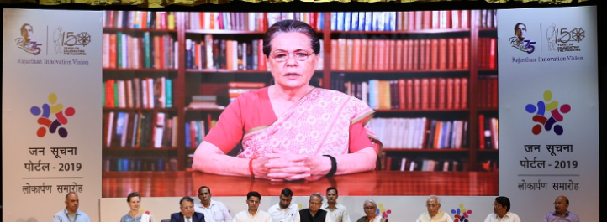
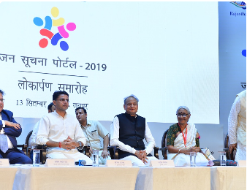
Roll out of Jan Soochna Portal
Launched By Hon'ble Chief Minister of Rajasthan on September 13th, 2019 with :
13 Departments,
23 schemes
and 44 Information of these schemes.

Slide 9
Outreach of Jan Soochna Portal
Hon'ble Chief Minister of Rajasthan mentioned in the Budget Announcement 2020-21 (Page 45, Point 165) to bring information related to all government schemes / services on Jansoochna Portal.
Departments, Schemes and Information's count on Jansoochna Portal
Information accessed by citizens
Departments Count | Scheme count | Information Count
115 | 337 | 711
S. No | Description | Count No’s.
1 | Web Portal Visitor Count | 15.05+ Cr.
2 | Web Portal Information Access Counter | 26.71+ Cr.
3 | Information Access Count through e-Mitra Plus Machine | 15.24+ Lac
4 | Mobile App download | 3.17+ Lac

Slide 10
Impact of Jan Soochna Portal during Pandemic
Covid-19 pandemic: No physical meetings Lockdown Social Distancing Norms
Jan Soochna portal played the instrumental role for those affected during the lockdown in accessing emergency benefits promised by the State Government.
Distribution of take home ration through the Anganwadis.
Financial assistance provided to BoCW registered workers
JAN SOOCHNA PORTAL
Distribution of enhanced entitlements under NFSA
Dry ration kit distribution, Status of grievances filed by people

Slide 11
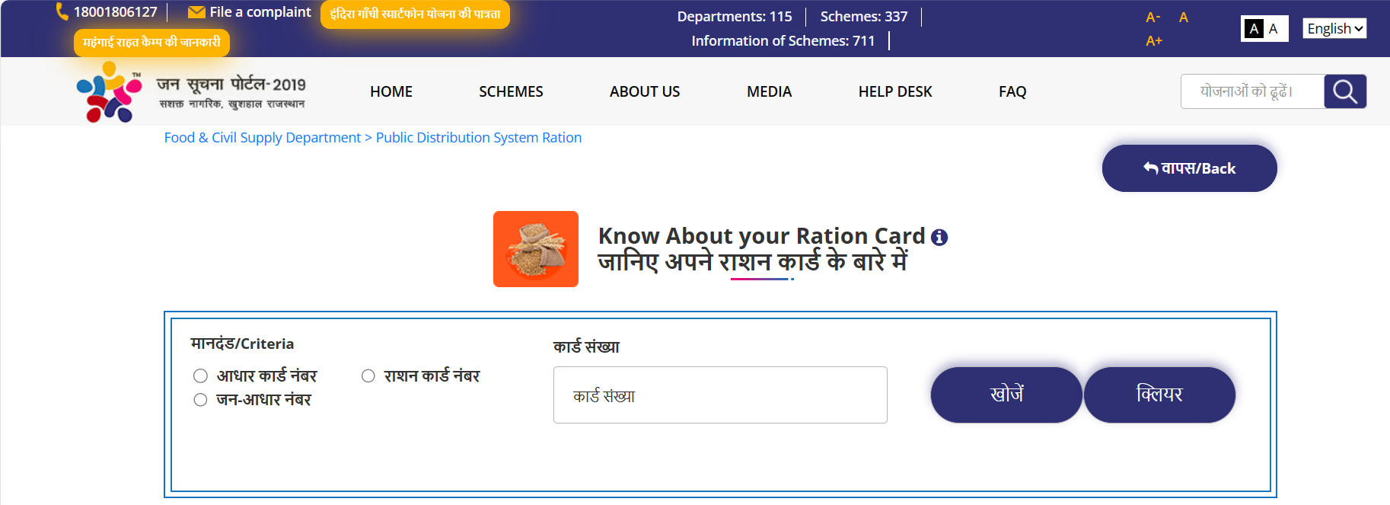
Case Studies : Ration
PDS Enrolment Workshop
In November 2020, Amba Bai and Ramba Bai discovered during an enrollment event at Panchayat Bhawan that the records indicated they were receiving a monthly sugar ration, although they were not actually receiving it, despite being eligible.
Use of Jan Soochna Portal
They produced the copy of Jan Soochna Portal information to dealer that showed how the sugar was being disbursed under their name while it was never given to them by the dealer.
The dealer also realized that the information was accurate after an initial hesitation and denial.

Slide 12
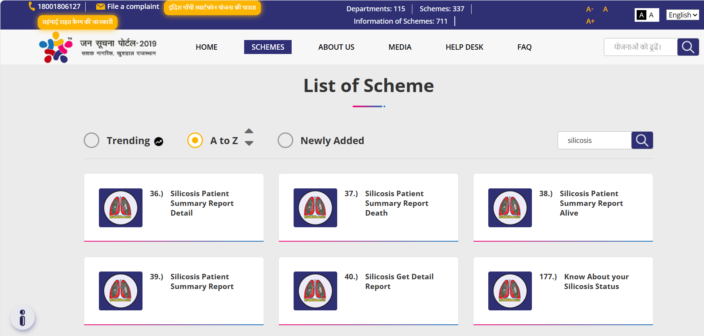
Case Studies : Silicosis
Offline Investigation Process
Potential beneficiary go to the hospital to get appointment
In some cases, the hospital management has provided a time period of a year for investigation
Online Investigation Process
Potential beneficiary go to e-Mitra kiosk and apply online
Monitoring of applications:
Administrative Secretary → District Collector → District Mining Officer or Sub-Divisional Magistrate → District Health Department → Concerned Medical Board → Potential Beneficiary/Patient
Jan Soochna Portal has empowered citizens by enabling them to easily monitor various levels of information

Slide 13
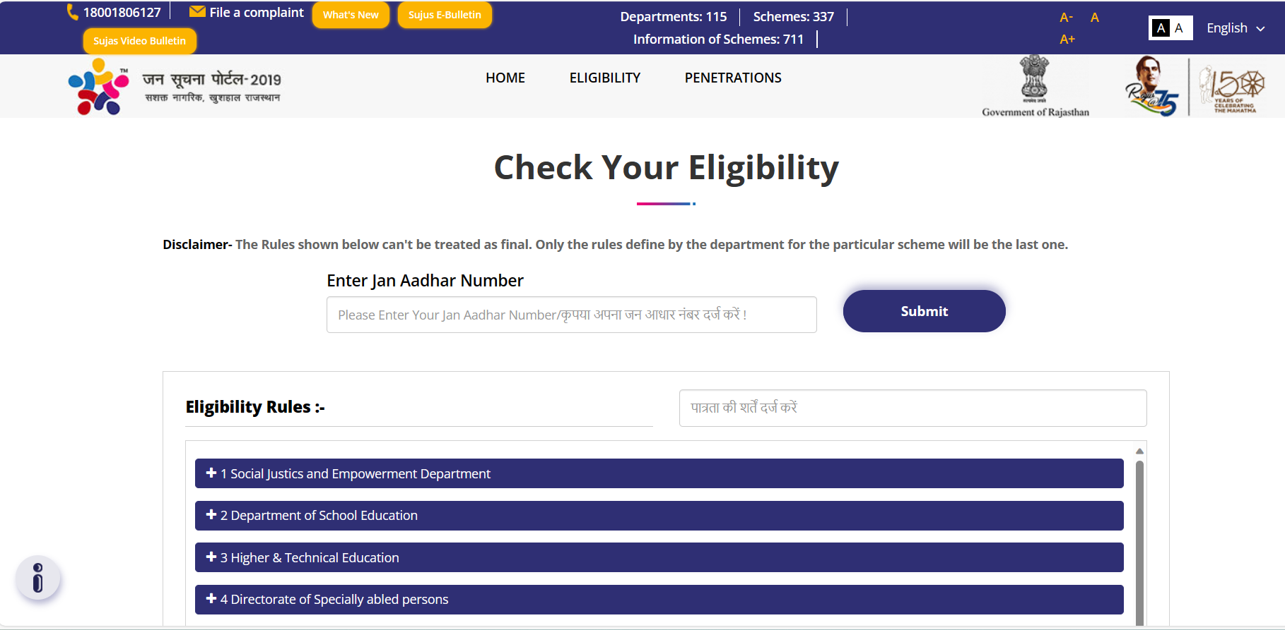
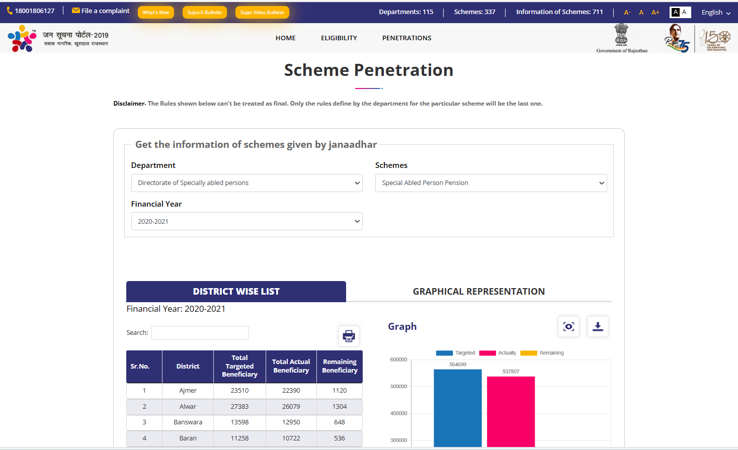
Recent Initiatives
Scheme Eligibility Module | Penetration Module
Empowers citizens wherein he/she can access his eligibility for various Government Schemes, process to avail the service and informs citizens about the benefits of particular scheme | Depicts the targeted number beneficiaries and achievements given so far for particular scheme

Slide 14
Action for the future
Issues relating to Law and Order
Tax and Excise
Working of the legislative assembly amongst other things
Functioning of the Judiciary
Functioning of Statutory Authorities
We will continue and efforts will be directed at making Jan Soochna Portal more rich, more participatory and more inclusive as we go along.

Slide 15
Thanks

