Slide 1
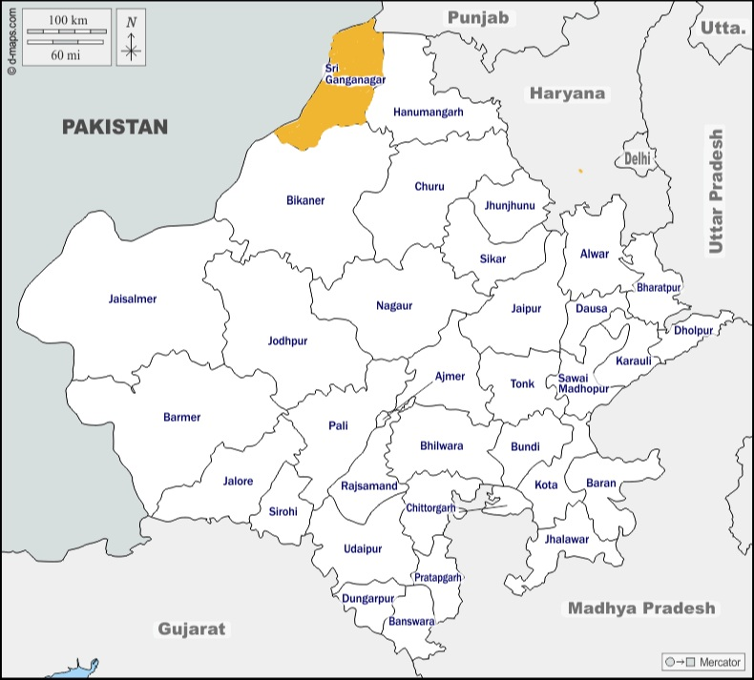
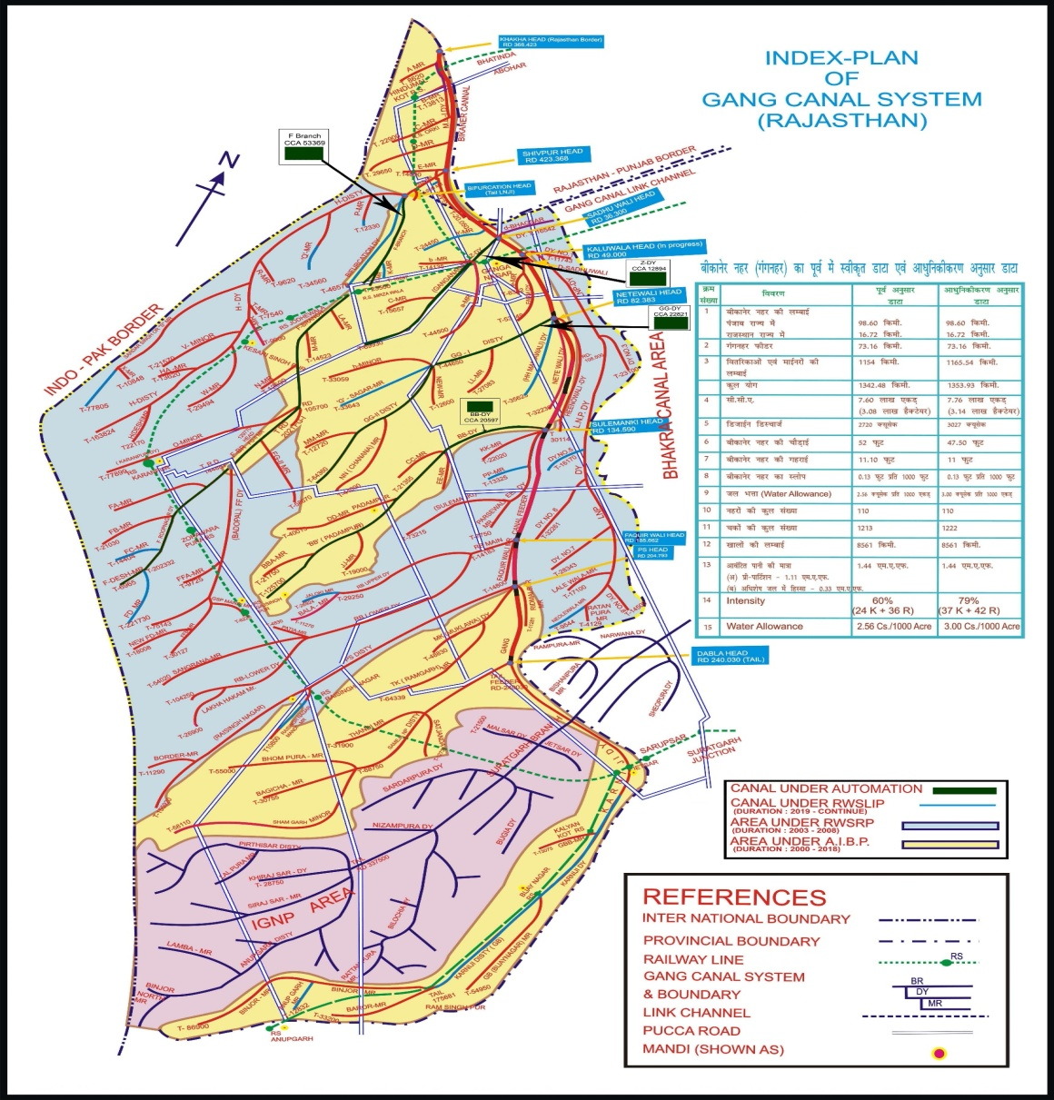
Gang Canal Regulation Computerization System
E-governance initiative for digitalization of Canal Irrigation
Gang Canal Map
Rajasthan Map

Slide 2
About the E-Gov initiative
Gang Canal Regulation Computerization System project provides farmers with up to date information of canal regulation system through a web portal/ mobile app, which is updated by irrigation department every 3 hours (24/7).
Benefits 1.50 lac farmers in gang canal area of the district.
Digital Portal/Mobile app provides real time data status of canal that how much cusec water is flowing in canal.
It illustrates date and time of canal opening and closing with full capacity of canal and present water level of canal head.
Free, transparent information sharing based on technology without any manual intervention
Convergence features
Basic knowledge of crops (cotton, wheat, mustard)
Knowledge on different types of diseases in crops.
Commodity price in Agriculture Markets.
Weather forecast of upcoming 5 days by Agriculture Research Station
Schemes related to agriculture department.

Slide 3
Situation before initiative
Situation After initiative
Gauge Reader
Reads Gauge Value every 3 Hours
Gauge value collected by LDC/dealing clerk
JEN/ AEN
Depending on availability of water (from gauge reader) Regulation chart of canal prepared in 12 hours.
Farmer
Send to office by post/mail/phone
Dealing Clerk
Recorded in Register
Regulation chart available to farmers by Newspaper 24 hours.
Water Level Source
Water Level measured by SCADA system.
Information Verification
Regulation chart prepared automatically.
End User
User gets real time data anytime, anywhere through Website and mobile application available for android and iOS platforms.

Slide 4
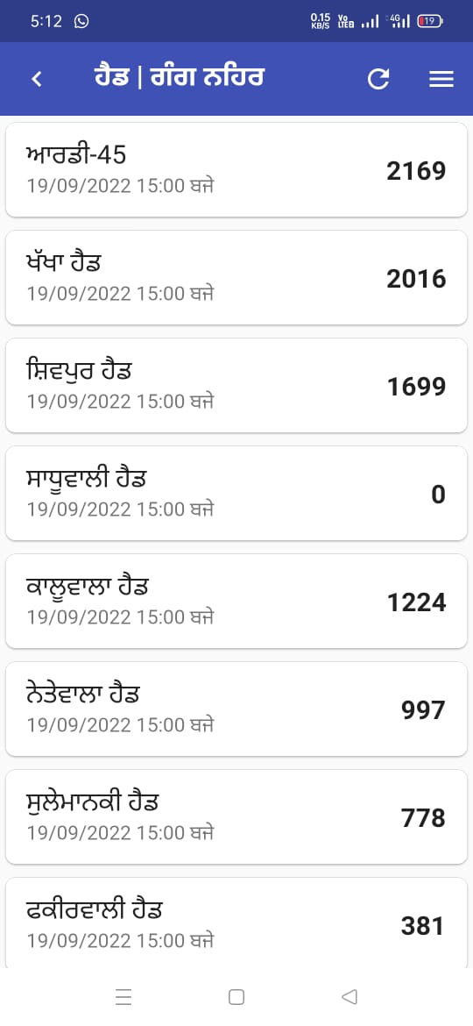
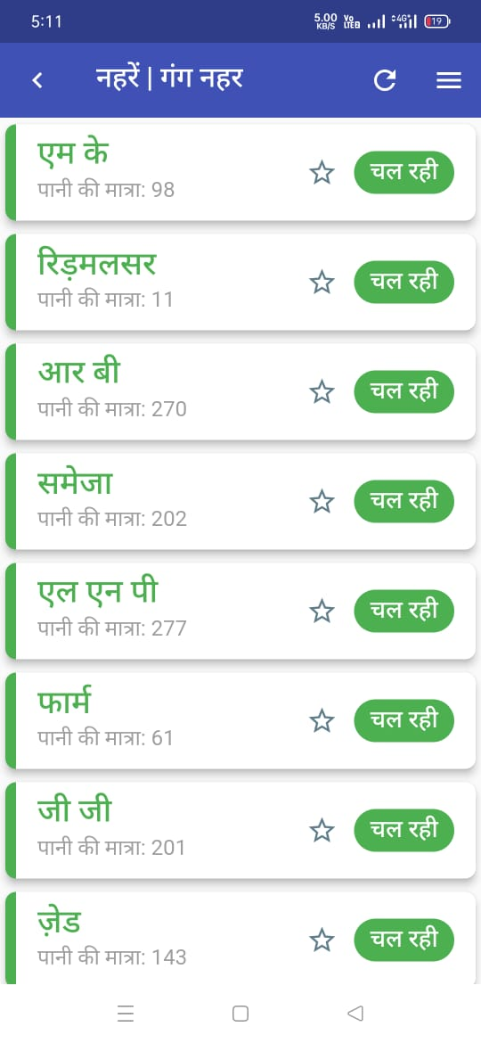
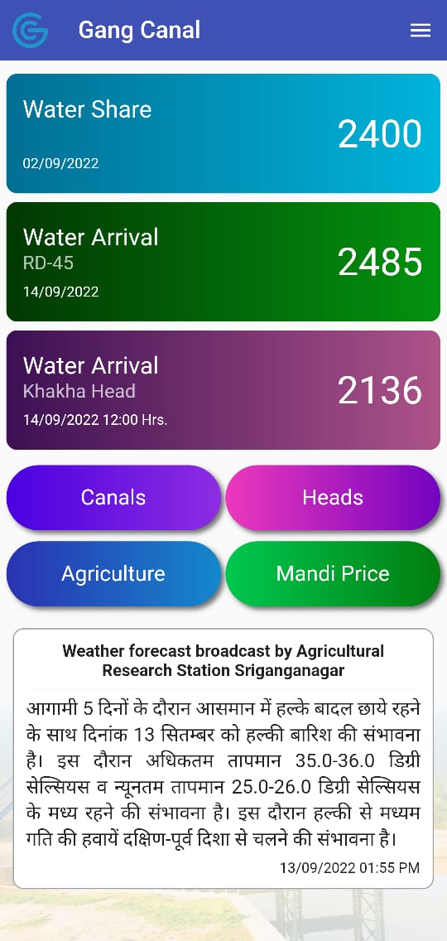
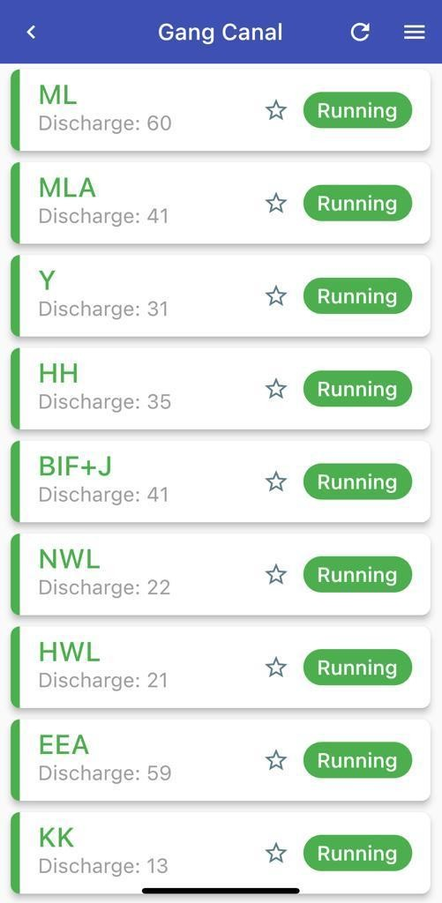
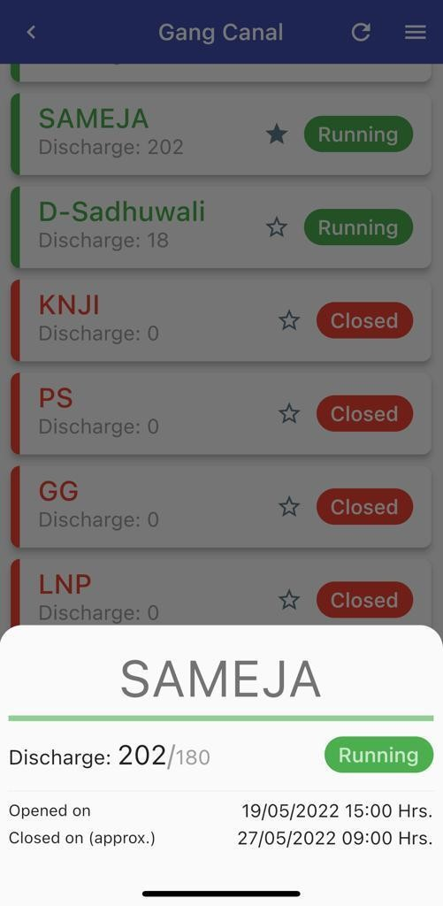

Slide 5
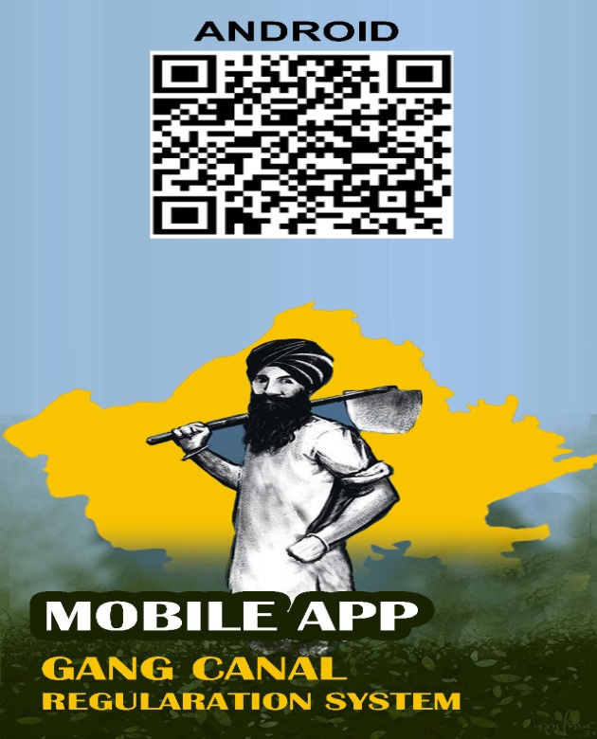
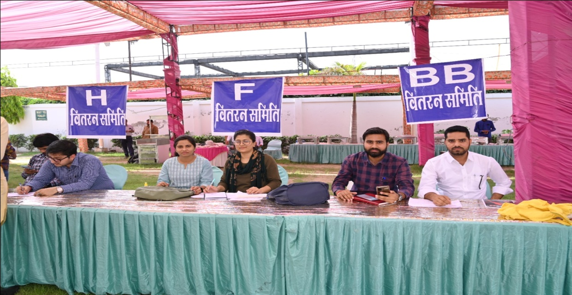
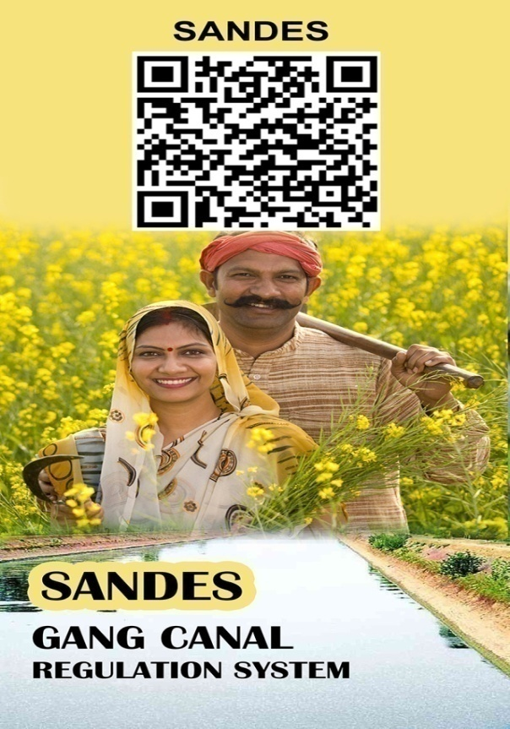
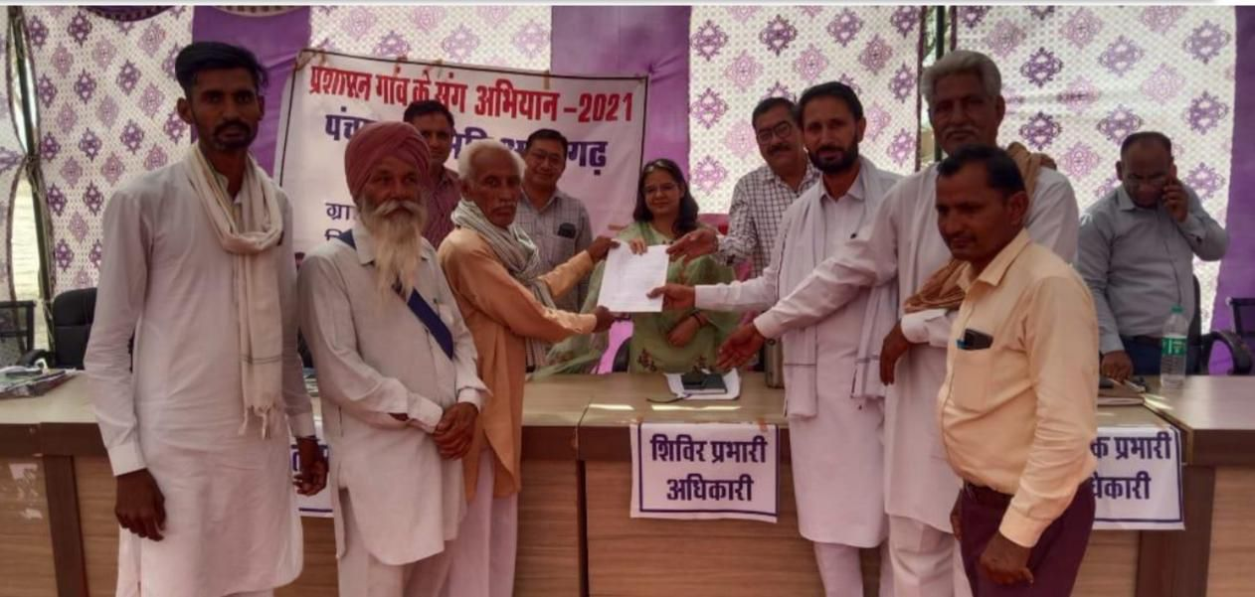
Efforts taken to popularize the initiative
Prashashan Gaon ke Sang Abhiyaan

Slide 6
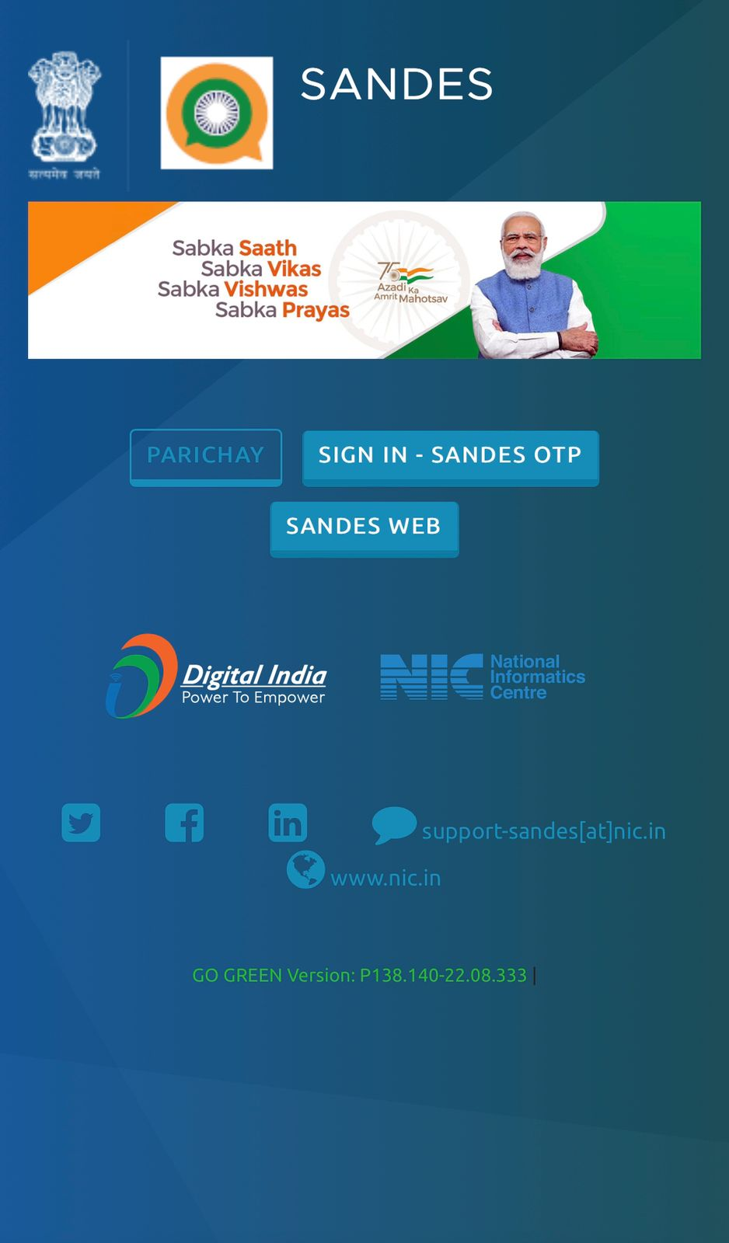
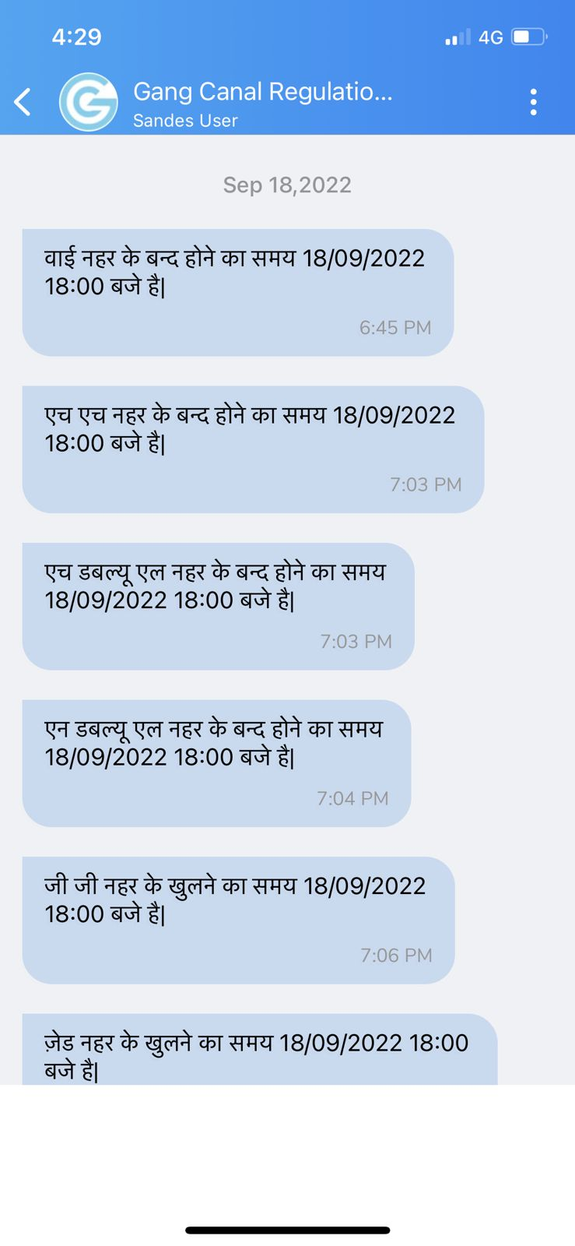
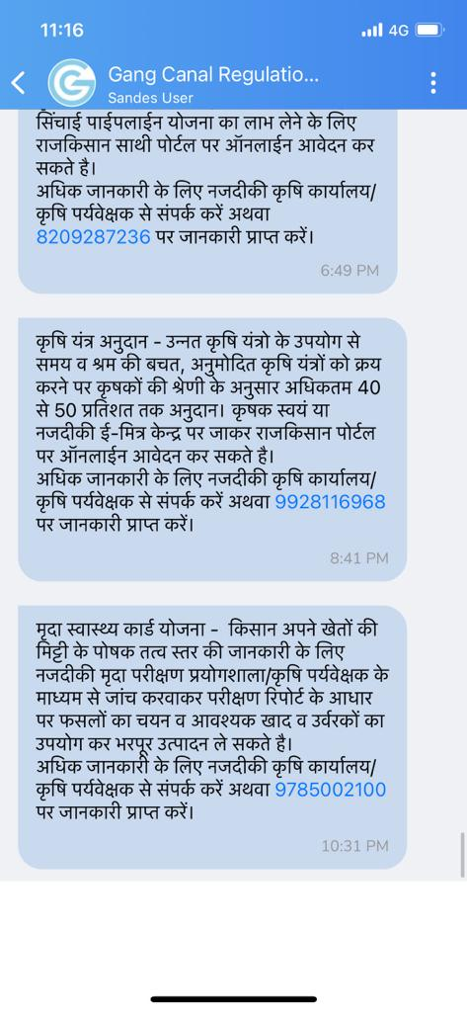
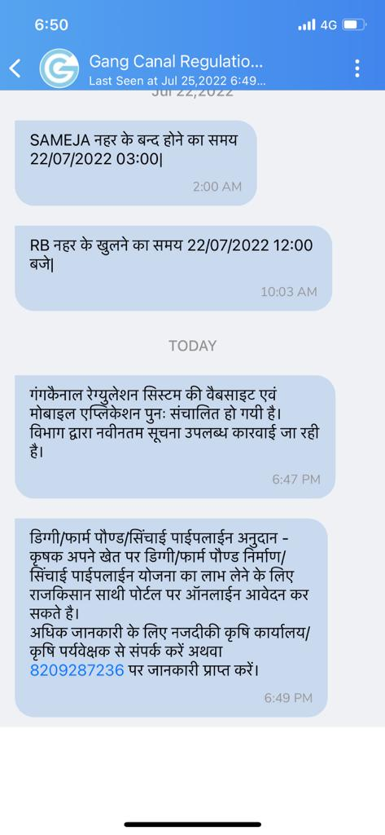
Sandesh app- free service delivery
State owned free instant messaging platform
Developed by NIC-GoI in 2020
Daily 5-6 messages sent per day per farmer
1 lakh messages per month
Sandesh app- Message screenshot

Slide 7
Impact on reduction of public Grievances

Slide 8
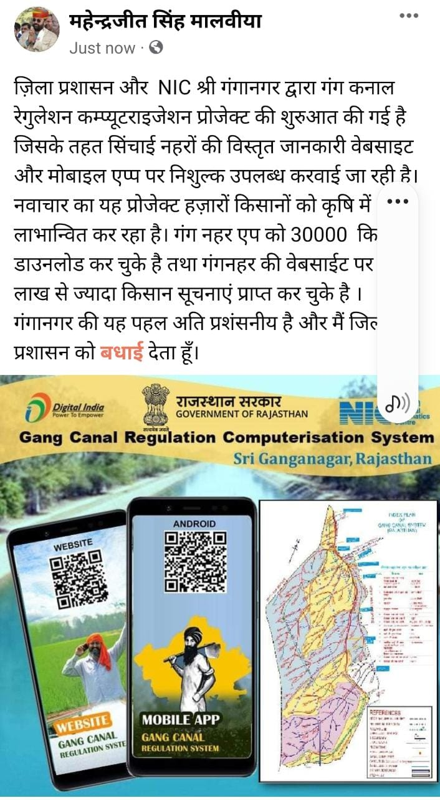
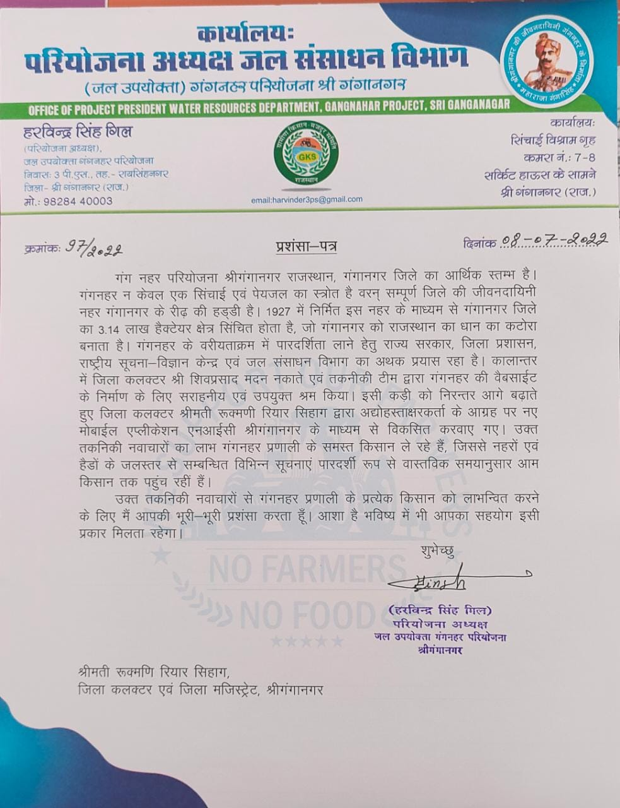
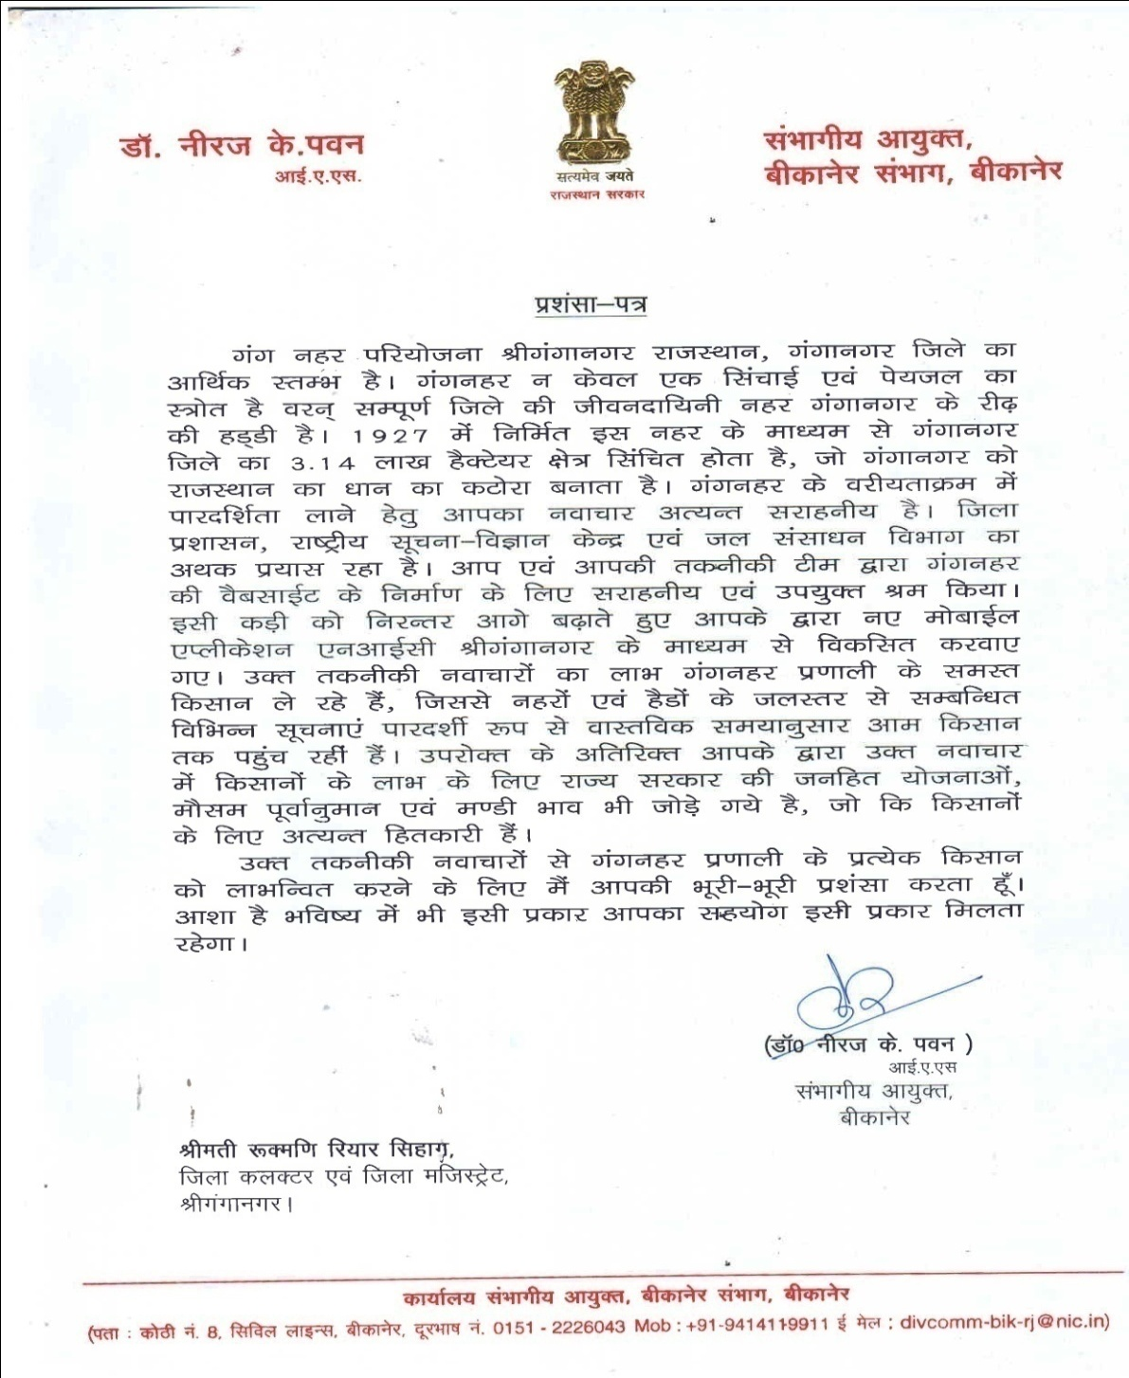
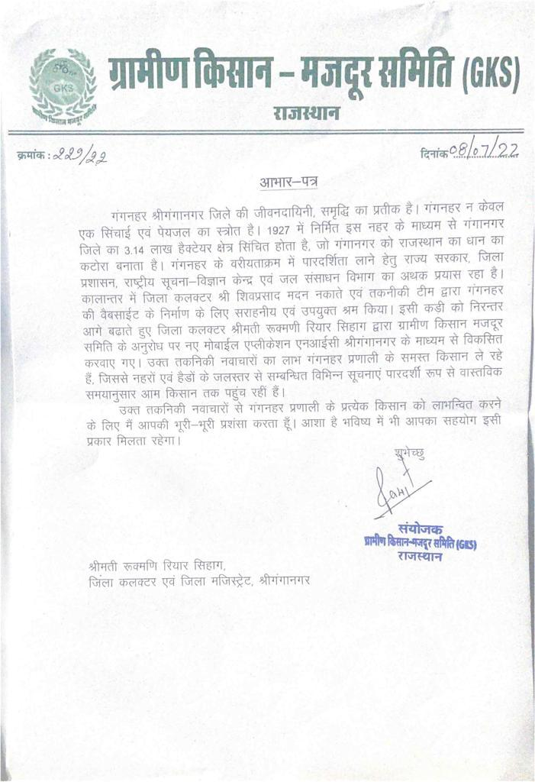
Appreciation Letters & Tweets
Tweet by Sh. Mahendrajeet Singh Malviya,
Hon. Irrigation minister, Govt. of Rajasthan

Slide 9
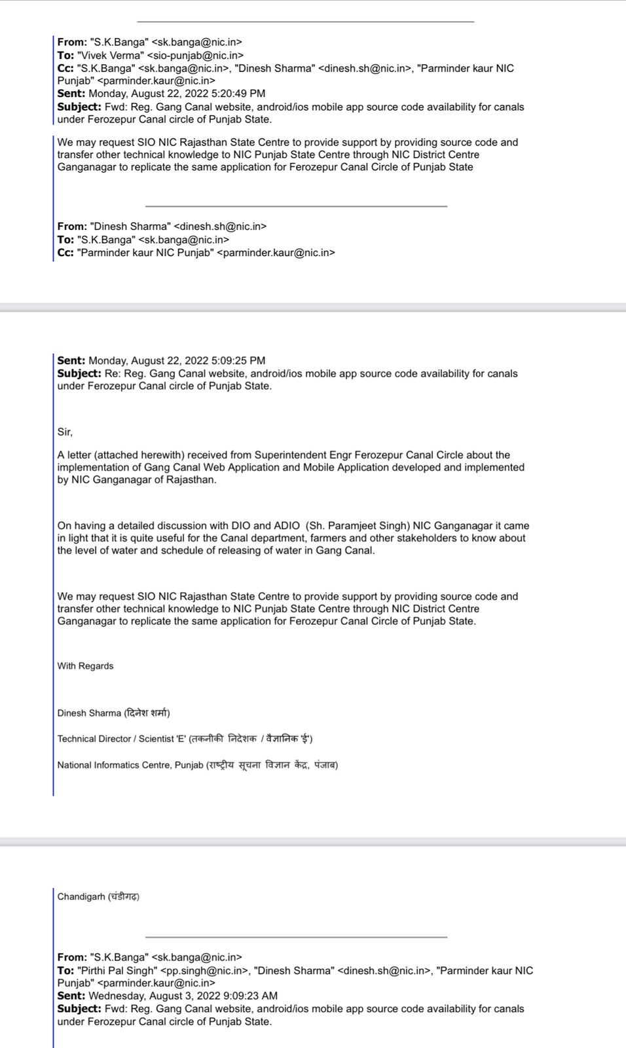
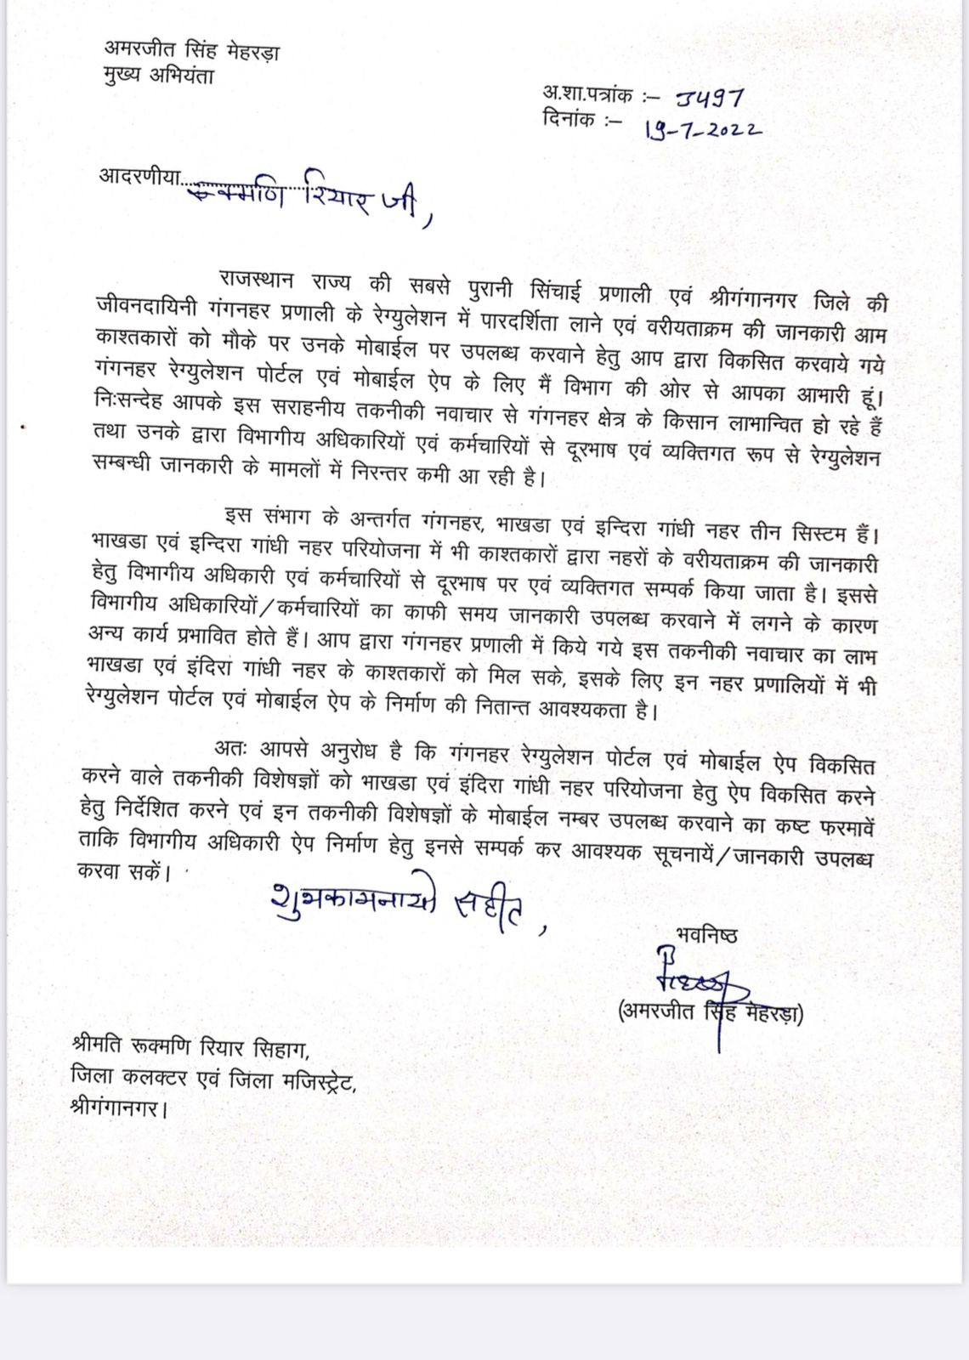
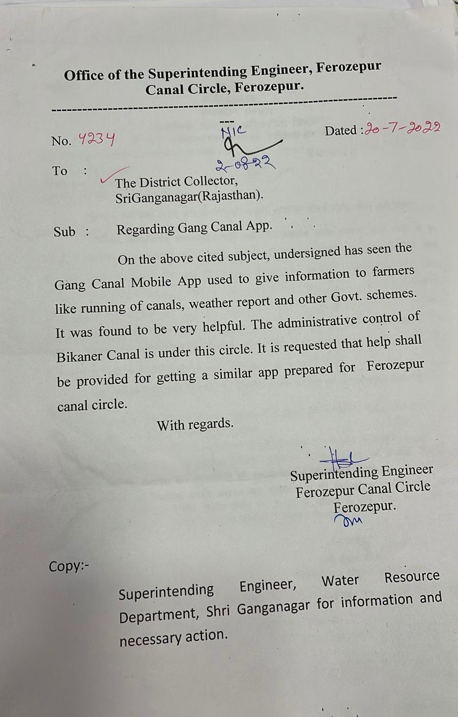
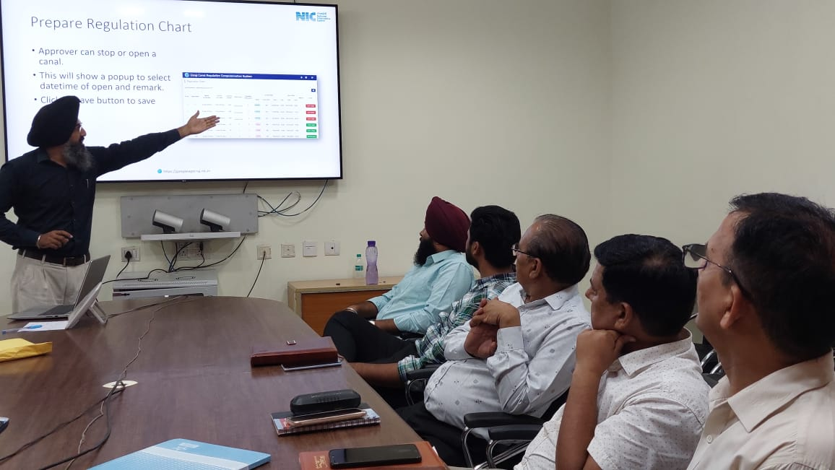
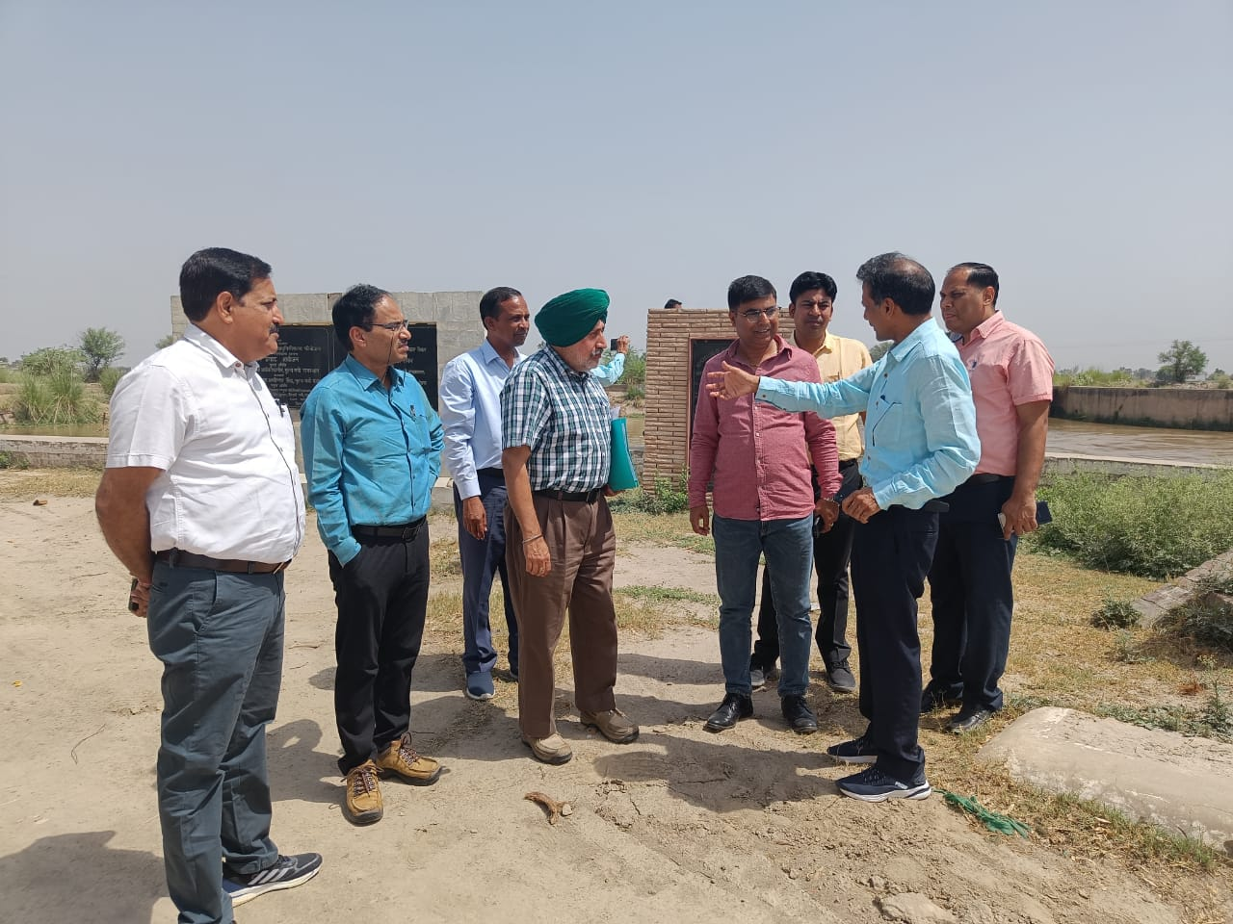
Scope for replication
Chief Engineer, Irrigition Department Rajasthan.
Letter from NIC punjab
Letter from S.E. Ferozpur Canal Circle, Ferozpur
Visit by Punjab and Hanumangarh irrigation officials to replicate the e-governance initiative

Slide 10
Thank you
Rukmani Riar Sihag, IAS
District Collector and Magistrate
Hanumangarh

