Slide 1
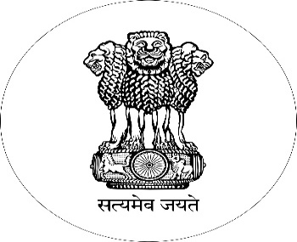
All Time Document Machine (ATDM)
Improving Public Service Delivery in Ahmednagar District
“One-click One-Stop Machine for getting documents by an automated machine”
Collector Office Ahmednagar

Slide 2
Formulating the RIGHT TO SERVICE and the RIGHT TO INFORMATION under the Article 19 and Article 21 of the Indian Constitution, the Ahmednagar District Administration has made a unique innovation in service to the Residents of the District.
The basic aim of the administration under this initiative is to delivery public service in a Transparent, Accountable, efficient and a Time Bound manner.
Transparency
Accountability
Time Bound
Efficiency
BETTER DELIVERY
OF SERVICES

Slide 3
7/12, 8A, FERFAR these most important common documents from the Collector's Office will now be available from an automated machine in a very simple process eliminating all the hastle to different tables in the office.
All Government documents are extremely important to every common citizen in the remote villages across the district, land-related documents like the 7/12, 8A, Kadaipatrak, along with other documents are even more important.
This innovative idea under the 'DIGITAL INDIA' blanket has brought a permanent solution to this seemingly neverending rounds to the office tables.

Slide 5
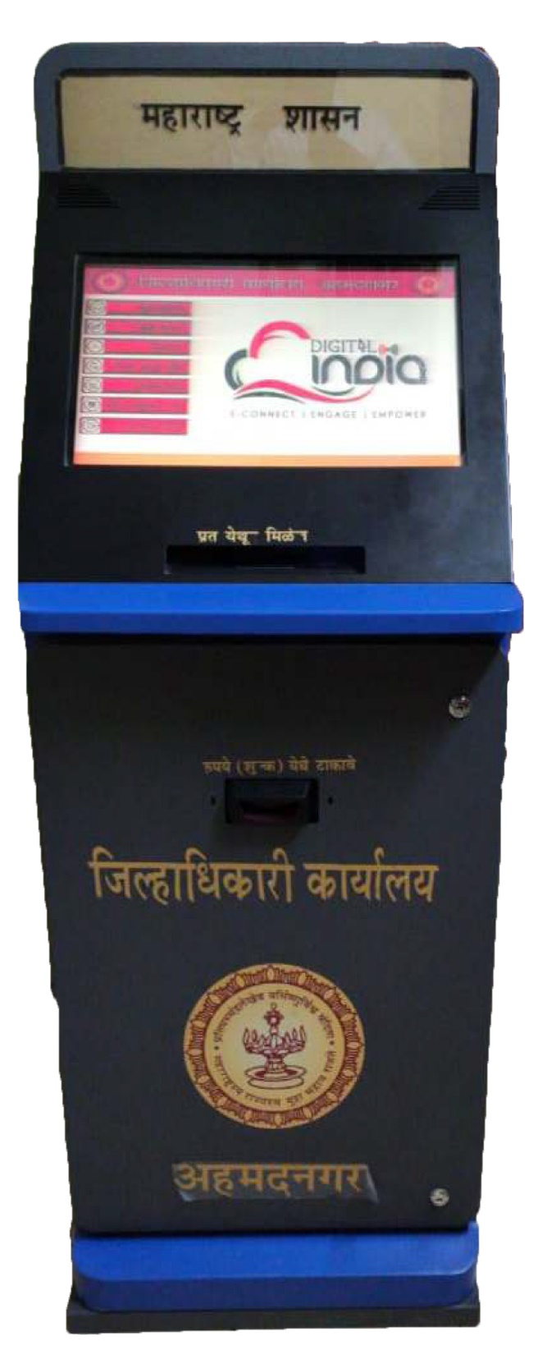
These Documents are required for various reasons in different government and personal proceedings, the lengthy process of procuring these documents will now be replaced by the automated 'All Time Document Machine (ATDM)'.

Slide 6
This unique innovation will now cater to thousands of visitors and also reduce the work stress of the office employees, making them more efficient in all other assigned tasks.
The ATDM was inaugurated on 15th June earlier this year has reduced the period of procuring the aforementioned documents from 15-30 to days to 60 seconds.

Slide 7
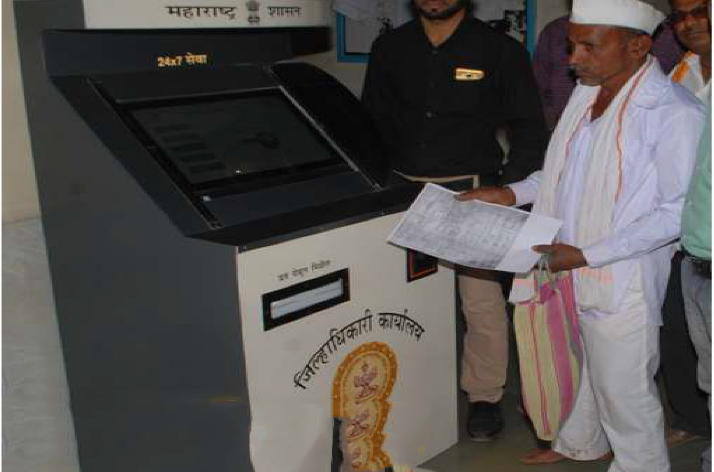

Slide 8
This 'get it in 60 seconds' initiative has in the past months helped more than 1000 citizens from the district to get a paper copy of their documents and has also helped more than 20,000 citizens to get legit information on their fingertips.
The ATDM has a database of more than 1.75 crore documents starting from the year 1930 to 2013. Documents ranging from a span of 80+ years is now available on the click of a button.

Slide 9
All the documents of the revenue department have been scanned and stored in the hard drives and saved for a lifetime now.
This innovative technological intervention aims to deliver public documents instantly.
The following Documents will be available by the KIOSK

Slide 10
OBJECTIVES
No need to physically approach the record rooms
Innovative and technological approach
Hassle free for the public especially to the poor farmers
Avail all the documents on one click
Avoiding delay in obtaining revenue documents conventionally

Slide 11
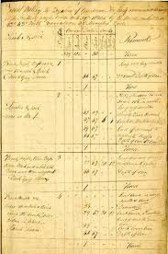
Problems faced earlier by the Citizens:
The documents regarding the land are quite old and fragile to handle.
Immediate procurement of these documents is quite difficult for the farmers in particular
The lengthy process of procurement of these document and a long time frame of 15-20 days
Apart from a regular fees the applicants paid more to get the documents on an urgent basis
The applicant needed to visit the concerned office twice before he gets hand on the documents

Slide 12
Benefits from the ATDM:
Seamless delivery of services
User friendly
Single Window Delivery
Security
Adaptability and scalability
Efficiency
Easily accessible
Sustainability
Cost effective
SINGLE WINDOW SOLUTION
SUSTAINABLE
ACCOUNTABLE
USER FRIENDLY

Slide 13
Touch Screen Display
Printer
Cash Receptor
Hard Disk Drive
COMPONENTS IN THE ATDM

Slide 14
Why? All Time document machine (ATDM):
All the documents of the 14 different Tehsil’s available at one single stop
Easy availability of documents at one click at one stop
60 seconds to get a document
A uniform fees of Rs 20 /- per page
One time visit ensures your work is completed

Slide 15
Project Summary:
Under the supervision of district administration all documents are scanned and processed by a scanning agency.
This machine is confined in a Fiber body cabinet similar to an ATM cabinet, integrated with an all in one computer and cash acceptor machine for accepting cash amount.
It is a customized offline application for scanned data-retrieval.
There is an integrated cash acceptance hardware attached to the ATDM which works in synchronization to the ATDM.
False notes are not accepted by this machine. A Payment receipt is also printed on demand and MIS is also generated.

Slide 16
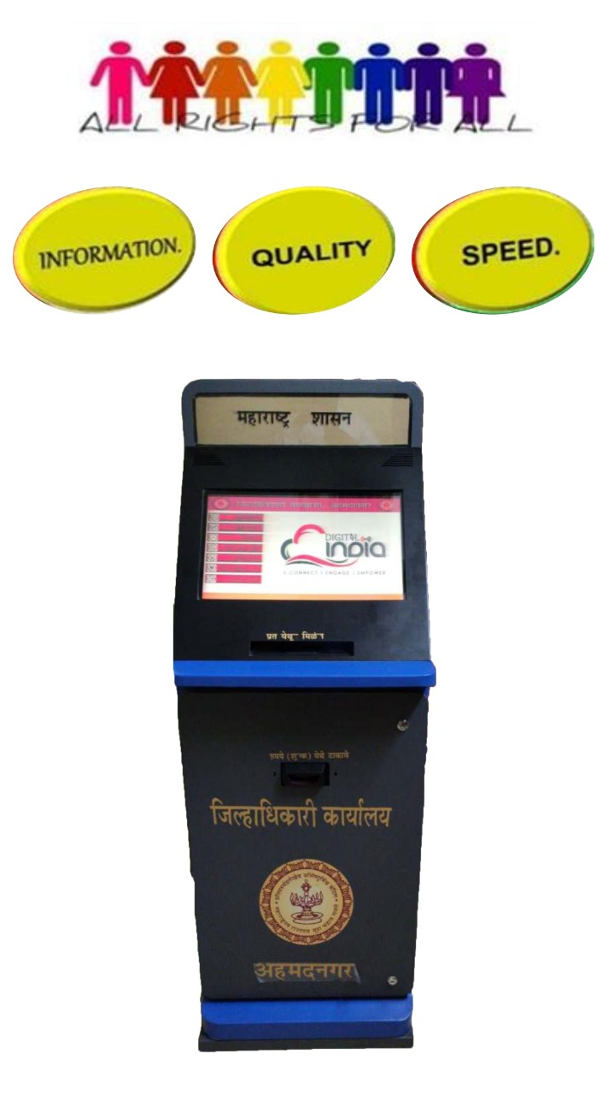
YOUR SERVICE IS OUR DUTY

