Slide 1
MaNTrA Maa Navjaat Tracking App Promoting e-Governace in Health in Uttar Pradesh

Slide 2
Rationale
Scale
Nearly 2.8 million deliveries annually at public healthcare facilities in Uttar Pradesh
Quality Care on the day of birth can prevent 46% maternal deaths, 40% newborn deaths and 40% stillbirths
Quality of care at and around childbirth difficult due to lack of critical relevant real time data in existing HMIS
Decision to create a simple online MIS capturing critical service delivery parameters in Labour room
Covers all 75 districts of UP
Rolled out across all 5,547 delivery points in UP in the public sector
4.2 million deliveries reported since launch
Launch by Hon’ble CM Uttar Pradesh
5 Dec 2021
Safe delivery app integration
CRS integration
Adhaar authentication
E kavach integration
Timelines

Slide 3
System Overview
CRS
Central Server
(NHM Cloud)
Birth registration
Facility Database
API / CSV
HR Portal
MaNTrA Dashboard
Delivery Point 1 .. n
Beneficiary Feedback
Health Messages
Mantra Application
Delivery Register
Referral-out Register

Slide 4
Digitization of Labor Room Delivery Register – Hindi/English
(as per GOI)
Open fields have been closed
E.g. Complications in previous pregnancy,
Causes of HRP,
Indications for C-Section

Slide 5
Features
Integrations
MaNTrA
Mobile-app and web versions
Integrated Decision Support System including interactive dashboard to monitor quality of care parameters at state, district and facility level
HR mapping to monitor provider performance
Automated mechanism for Robson’s criteria to monitor appropriateness of cesarean sections
Community Interface
- Client feedback
- Automated reminder/ communication messages
Hosted on NHM’s cloud server and incorporated in NHM PIP for sustainability
ABHA generation and authentication
(M1 completed)
For JSY authentication
GoI portal for birth certification
GoUP digital platform for antenatal and postnatal information capture
Educational content for delivery point staff
Manav Sampada-For service provider performance tracking
Health facility master of UP
FAMS for JSY payments
FBNC online MIS
RCH/ HMIS
eSushrut
In pipeline

Slide 6
MaNTrA- Process
Cloud Hosting - NHM
Facility Database
Integration with CRS Portal
eKavach
MaNTrA
HR Database
Admitted
Pregnant Women
Health Facility (Delivery Point)
Search/ Registration
Aadhaar Authentication for JSY
Delivery Outcome
Details entered in MaNTrA & submitted to CRS portal for Birth registration
&
Initiation of JSY Payment
PNC Services
RI Services
Referred
Feedback
Higher Facility (Delivery Point)

Slide 7
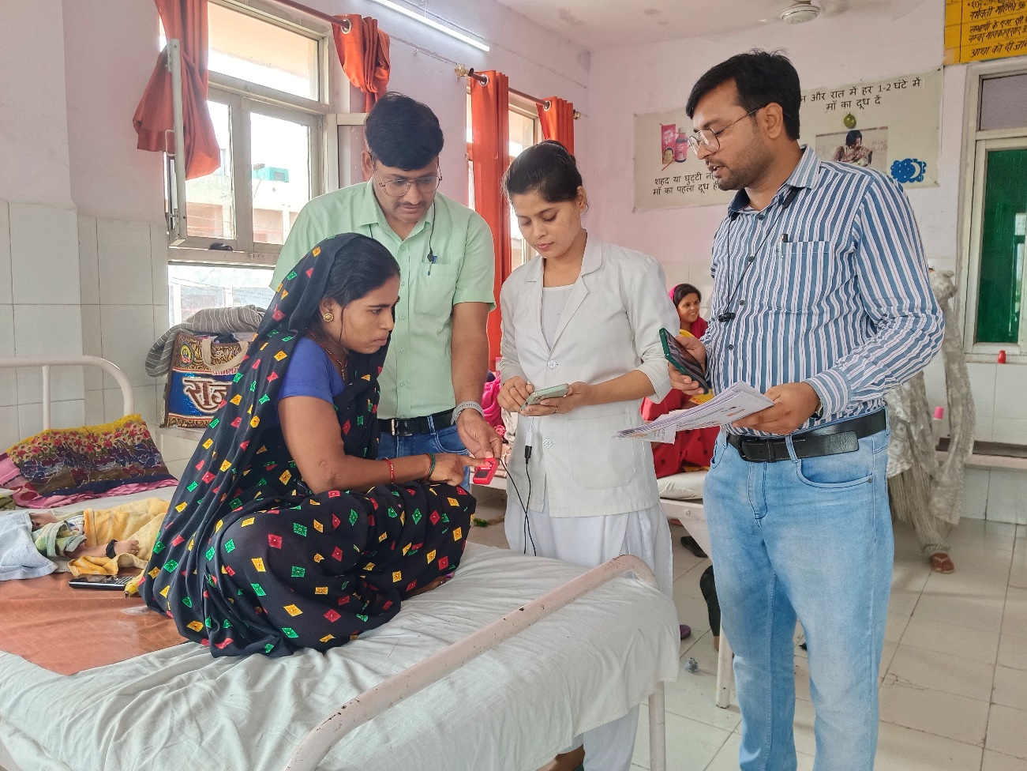
Uses
Patient care
Provisioning
Follow-up care- Tracking of High-risk Low Birth Weight newborns, Family planning
Administrative
Performance tracking of service providers
Facilitate DBTs
Beneficiary entitlement- Birth registration
Improve QoC through feedback
Functioning of First Referral Units
Monitoring patient outcomes- Deaths, complications, referrals
Auto generated reports
Monitoring service quality parameters- clinical practices, drug use and immunization
Experience of care
AADHAAR authentication of beneficiary

Slide 8
MaNTrA based Birth registration
Objective
Hassle free issueance of birth certificates before discharge addressing the issue of delayed birth registration
Process re-engineering
Target/ Achievement
100% birth registrations targeted before discharge
SMS based delivery of digital copy of birth certificates to beneficiaries*
Improved system efficiency in birth registration
API based two-way exchange of information on birth details and registration between MaNTrA and CRS portal
Benefits to beneficiary/ community
No additional documents required
System efficiency
Reduced turnaround time for birth registration process
Digital copy of birth certificate on Mother’s phone number
No follow-up visits for birth certificate- Travel expense and time saved
Consistency of records- CRS, JSY, Discharge form
Reduced workload of staff

Slide 9
Streamlining Direct Benefit Transfers (DBTs)
Objective
Reduce turnaround time for DBTs for over 2.8 million deliveries
Process reengineering
Auto generated digital prefilled JSY forms based on MaNTrA data
Target/ Achivement
Target- 100% JSY payments targeted before discharge
Ensure financial transparency
Real-time transfer of digital JSY forms to payment processing units mapped with delivery points
Aadhaar authentication of beneficiary
97,113 AADHAAR authentications till date
Benefits to beneficiary/ community
System transparency and efficiency
Reduced workload of staff
Paperless, real-time flow of beneficiary data to DBT processing centre
DBT before discharge eliminating the need for re-visits
Reduced paper-work
Reduced turnaround time
Digital process leading to complete transparency
Aadhaar authenticated DBTs

Slide 10
Longitudinal digital records- eKavach integration
Objective
Inform decision making of health service providers and FLWs through longitudinal data across pregnancy, delivery and afterwards
Process reengineering
API based two-way exchange of records across MaNTrA and eKavach
Target/ Achievement
Complete linkage of information of pregnancy, delivery and postnatal care including immunization for over 2.8 million public institutional births
Improve system efficiency by elimination duplication of processes and records
Benefits to beneficiary/ community
System Efficieny
Longitudinal integrated records across community and health facility for improved decision-making
Improved community and facility based care of clients needing special attention viz., High Risk Pregnancies (HRPs), low birth weight babies, babies with birth defects
Reduced workload by eliminating duplicate records
Prioritize beneficiaries for community-based care

Slide 11
Community interface for Health promotion and Client feedback
Objective
Community empowerment through institutionalized feedback mechanism
Process re-engineering
Community feedback on 5 quality of care parameters through online questionnaire sent through SMS
Target/ Achievement
Over 1.4 million mothers reached through health promotion messages
Information on care of newborn disseminated through SMS
Overall rating of 4.1/ 5 achieved for services delivered at delivery points
Health promotion for improved care of the newborn
Benefits to community
Benefits to service providers
Community inputs for improving QoC
Health system
Real-time monitoring of client feedback
Client-responsive health care services
Reduced need for physical interviews for feedback
Strengthen community-based care of newborn through promotion of exclusive breast-feeding and immunization
Complements outreach efforts of FLWs community-based care
Increase systems reach in community

Slide 12
Translational value
On the go monitoring and course correction.
Policy making decision on facility/ district and state level.
Fund allotment based on priority.
Training need assessment and refresher training.
Performance analysis of HR.
Continuous improvement in services provided based on patient feedback.

Slide 13
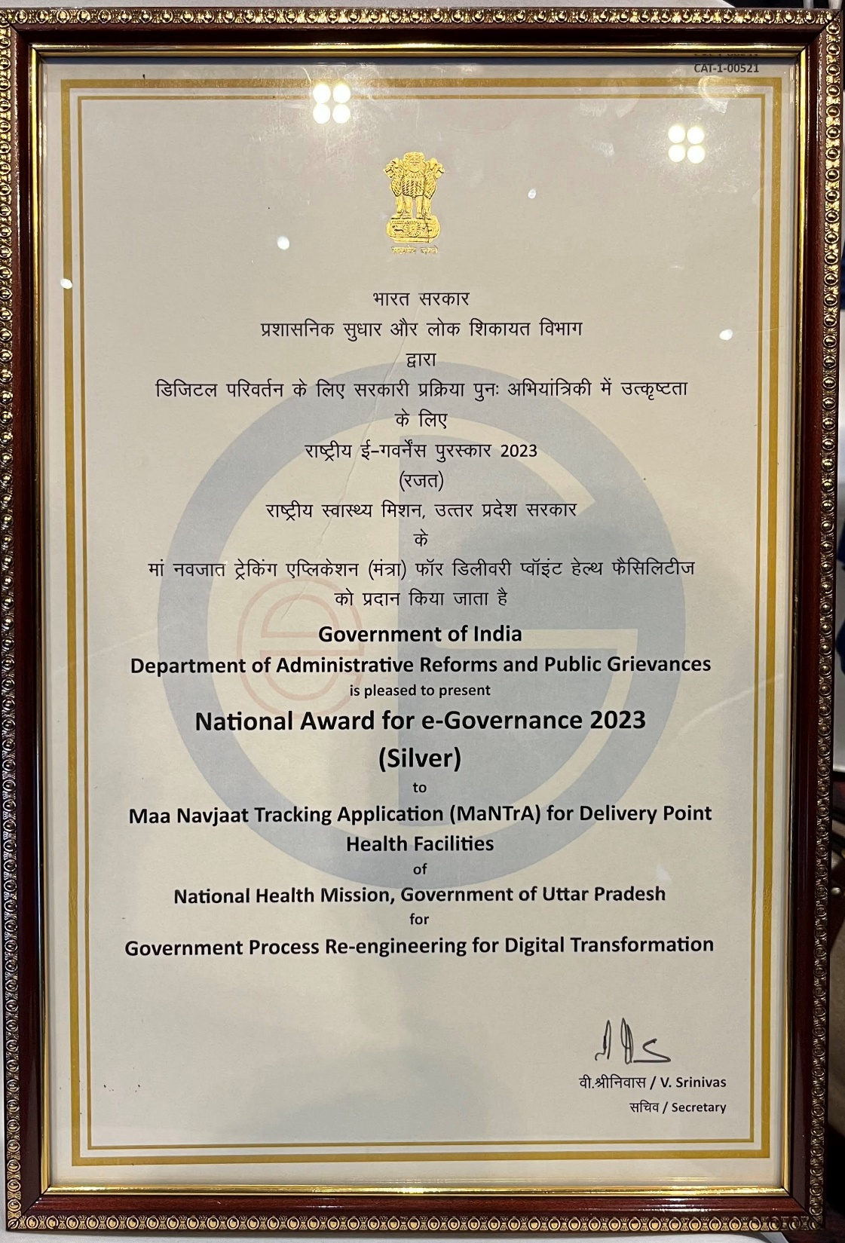
Thank You
Mantra app: https://play.google.com/store/apps/details?id=com.nhmup.frumis
Mantra dashboard:
http://mantradashboard.upnrhm.gov.in/

