Slide 1
Vision India@2047 on Governance
IIPA

Slide 2
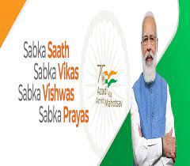
Vision
People First : bringing government and people “closure”
Identity -digital
Area-based RKM BSP now broadband
Services- Right to Public Services Delivery
Entitled
Desirable
Only “core” function –rule making and public good
Service delivery by private sector
Benchmarking and regulatory
Move from provider to facilitator to empowerment mindset
Digital first –cloud first mobile first remote serving
Justice , Social Security etc

Slide 3
Public Service
UN Public Service Day (23rd June) recognizes
the value and virtue of public service to the community;
highlights the contribution of public service in the development process;
recognizes the work of public servants, and
encourages young people to pursue careers in the public sector.
Building Back Better from COVID-19:
Enhancing innovative partnerships to meet the Sustainable Development Goals
Strengthen the means of implementation and revitalize the global partnership for sustainable development’

Slide 4
Civil Service Day
Civil service Day (21st April) recognizes
as an occasion for the civil servants to rededicate themselves to the cause of citizen and renew their commitments to public service and excellence in work
This date is chosen to commemorate the day when first Home Minister of Independent India, Sardar Vallabhbhai Patel addressed the probationers of Administrative Services Officers in 1947 at Metcalf House, Delhi, he referred to civil servants as the ‘steel frame of India’.

Slide 5
Prime Minister’s Awards for Excellence in Public Administration
Presented to Districts/Implementing Units for implementation of Priority programme and innovation categories
Bring together civil servants to connect with each other and learn the good practices being implemented across the nation in the field of public grievance.
India@100 should be watershed moment for country
People's participation and their strength behind where India is at today
Behavioural change has been brought through big initiatives RPT MGMG MK

Slide 6
e-Governance to Good Governance
Coordinating and supporting implementation of National e-Governance Plan through: National Conference on e-Governance
National Awards for e-Governance
Matters relating to e Governance Training Plan
National e-Governance Services Delivery Assessment (NeSDA)
Case Studies on Awarded e-Governance Projects

Slide 7
Administrative Reforms-AI ML NLP
Rule As Code ; Human and machine consumable . Information Technology led transformational impacts has been reshaping every walk of our lives. Digital India-a vision to transform India into a digitally empowered society and knowledge economy.
Benchmarking Government -Good Governance Index , District Good Governance Index
NeSDA framework (August 2018), conceptualized with an overall objective to measure the depth and effectiveness of existing e-Governance service delivery mechanisms.
Trusting Citizens ; e-participation and adoption of data-centric approaches through open government data, innovative use of new emerging technologies (artificial intelligence (AI) blockchain) addressing data privacy and cybersecurity concerns of citizens,
The whole-of-society engagement through alignment of digital government strategy with UN’s Sustainabe Development Goals (SDG), agile development of digital service supported by whole-of-government integration.
Aspirational to Inspirational District/Block and City initiative

Slide 8
Problem Framework
Expenditure component of GDP; gross fixed capital formation needs to be higher to fuel growth $5trliion now by 2035
Incremental capital output ration : needs to come down to <4 from >5 now
Weighted Average cost of borrowing Central govt - is going up 6.3% May go up further
General government outstanding liability ; very high >80% of GDP
Cost analysis of 1718 infrastructure project ; time delays are pushing cost up 18% up from original without including >4% cost overrun
Social sector expenditure of state ; resource guzzler >43% of GDP of states

Slide 9
Solution Framework
Infrastructure
Maximising PM GatiShakti Potential
Making Indian logistics competitive
Future readiness of Jal Jeevan Mission
Governance
Mission mode ,silo-busting at centre and state GST Council/Gati Shakti Model
Mission Mode Employment and hiring-eHRMS
Channelising Youth to Volunteerism- YouaShakti AgniPath
Technology
Tech adoption for infrastructure-BIM Geo-Spatial and Project Management
Getting future ready civil services ; MissionKarmaYogi
Emerging Tech adoption-AI ML Blockchain IoT and Analytics
Embracing Public Cloud Multi Cloud and subscription-based models
Finance
Improving incremental capital output ratio ICOR
Financial Inclusion : UPI Success ,Cutting time and cost delays
Reviving DISTCOM
Controlling competitive Welfarism

Slide 10
Mission KarmaYogi
Shift from Rule to Role ,Virtue is knowledge
Fluid Modernity : Toolset , Skillset and Mindset
Growth Mindset : Fixed-vs-growth , lifelong learning ,multi-stage life
Future Skills – Technical Human and Conceptual
New Age Tool Set- Dashboard , AI ML NLP Web3 Metaverse
Minimum Government but Maximum Governance
Reform : People Process and Technology
Perform : Input-Output to Outcome & Impact , Saturation
Transform : JanBhagidaari -Sabka Prayas
Citizen-centricity to people in the centre

Slide 11
Fostering innovation to deliver inclusive and equitable services
Drone technology in a district deployed for agriculture in a cost effective way
Impact is wonderful

Slide 12
BBB Government : must be creative again
BBB Build Back Better : Govt must be creative again
Governments loosing voice –cant reach citizens (social messaging ) though it can tax and crime Radio TV single channel
Decentralisation Content and Journalists –beg for attention in 1000 channel 1000 journalists 1000 times 1000 of small video ($1 to reach 1mn
Democratisation –Govt must fire half the staff , execution deficit despite believing –SM changing faster than Sarkaar Samaj and Bazaar
Day – Years-Months-Weeks are over, On The Day –as it happens

Slide 13
Enhancing the effectiveness of public institutions to reach SDG
Encouraging Virtual cluster –Force for Good with Govt-Entrepreneure-Academia (IIT M ,IIPA etc)
Aspirational to Inspirational
तृप्तिकरण – सर्वजन-हिताय, सर्वजन सुखाय से सर्व-मंगल मांग्ल्ये…
The advantage of a bad memory is that one enjoys several times the same good things for the first time.’ —Friedrich Nietzsche

Slide 14
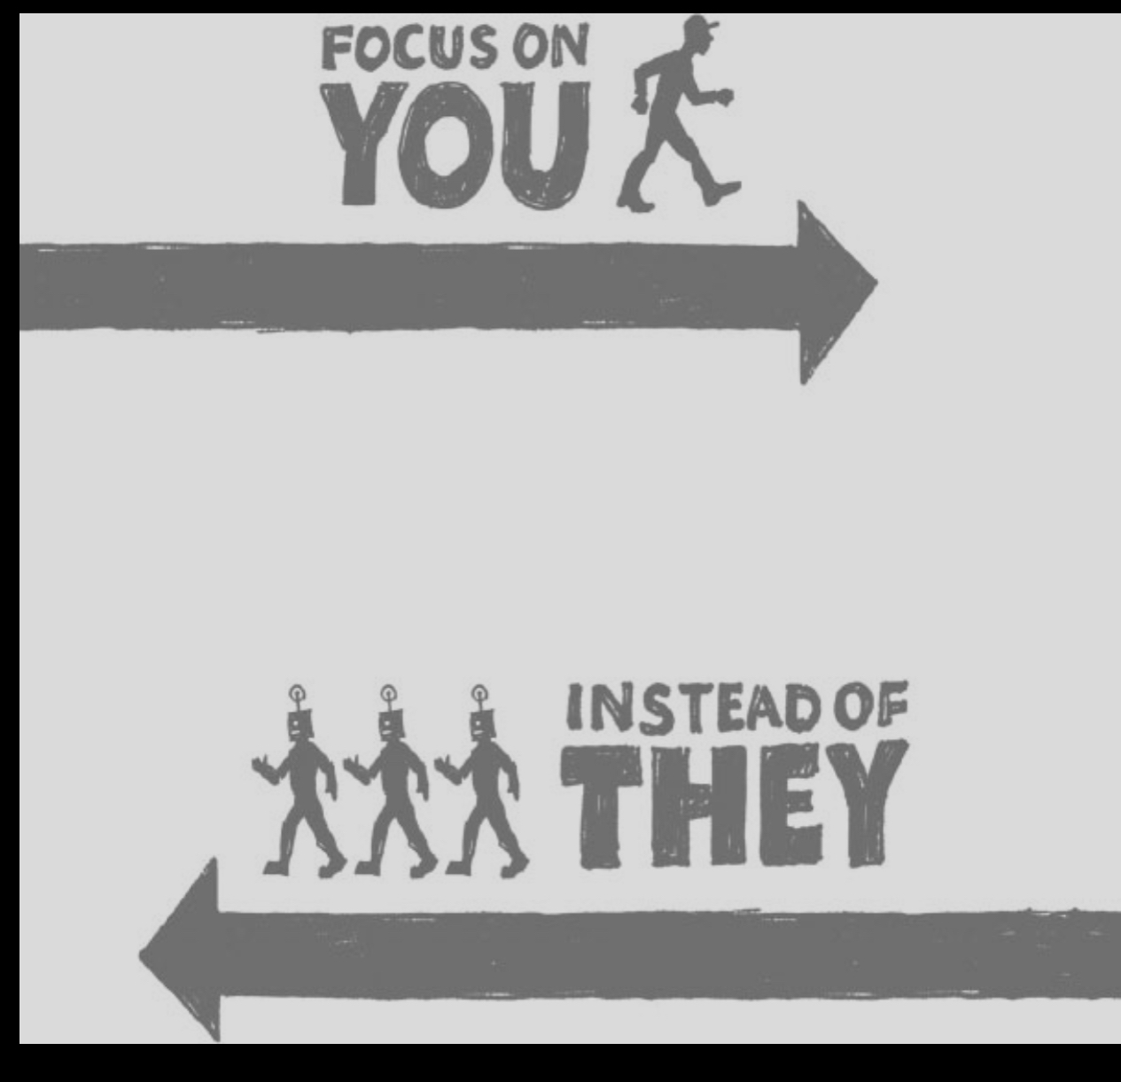
Thanks for your kind attention and time
For Good Governance
snt@gov.in
https://iipa.org.in

