Slide 1
National Award for E Governance
CATEGORY 2: Application of Emerging Technologies for Providing Citizen Centric Delivery
USE OF TELERADIOLOGY
AND
ARTIFICIAL INTELLIGENCE
FOR
DIAGNOSING SILICOSIS USING CHEST X- RAY
Dr. Samit Sharma, IAS Secretary to Government, Rajasthan

Slide 2
GOOD GOVERNANCE : CITIZEN CENTRIC SYSTEM
DESIRABLE ATTRIBUTES OF PUBLIC SERVICE DELIVERY
Accessible, available - anytime, anywhere
Principles of sensitivity, transparency and accountability
Assured and accurate.
Quick Benefit transfer.
User friendly.
Corruption and discretion free
Quality Services, provided with dignity.
Satisfaction of the beneficiary.
INFORMATION TECHNOLOGY (IT) IS AN ENABLING TOOL FOR ABOVE

Slide 3
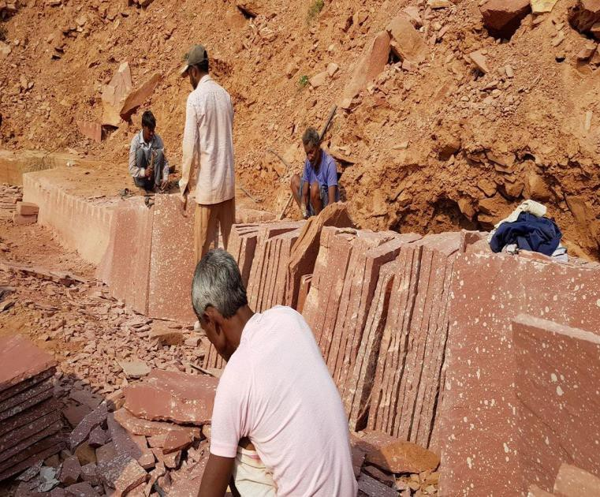
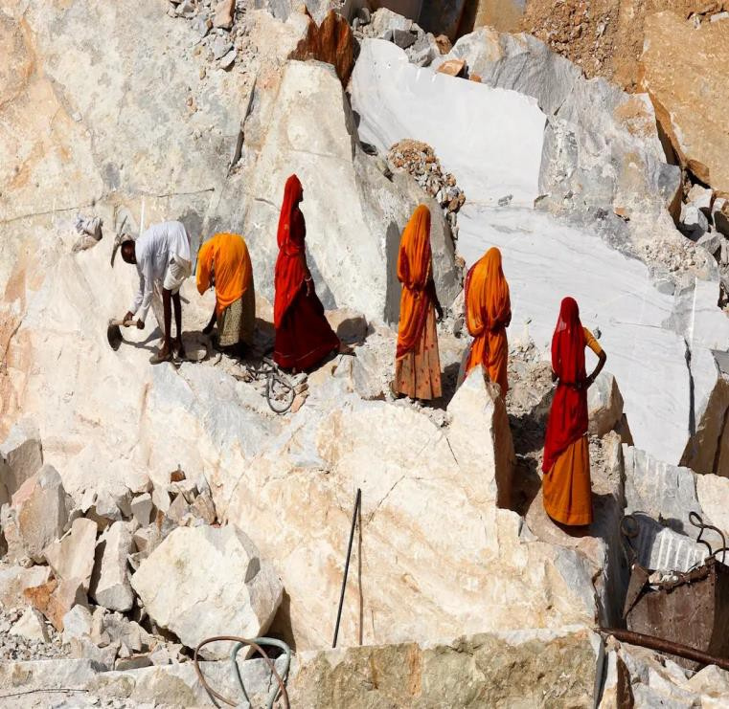
CHALLENGE OF SILICOSIS
1. Rajasthan has 33,000+ small and large mines
2. 3+ million workers in mining and related industries
3. 3+ million workers in building and construction industries
SILICOSIS WORKERS WELFARE POLICY : CHALLENGES IN IMPLEMENTATION
1. Long distances in Rajasthan
2. Shortage of radiologists
3. Delay and consequent corruption in payment
4. Prevention of silicosis by ensuring occupational safety and health

Slide 4
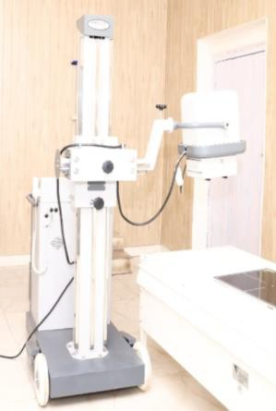
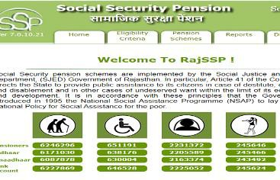
RAJ-SILICOSIS AUTO–APPROVAL PORTAL
It provides an integrated solution using digital radiography, teleradiology and AI algorithms for silicosis diagnosis and auto-approval
1
2 3 4
5
DIGITAL X-RAY FACILITY
AI BASED SILICOSIS CERTIFICATION
AUTO APPROVAL & DBT
AUTOMATIC OTHER BENEFITS TRANSFER
REGISTRATION
129 DH & CHCs
with Digital X-Ray facilities and teleradiology
AI analyses using Convolutional Neural Network(CNN)
Benefits of other welfare schemes SSP, NFSA etc.
85,000 + Existing e-Mitra/CSC
Transfer of relief assistance

Slide 5
KEY FEATURES OF THE RAJ SILICOSIS PORTAL
Digital Access to
Applicants
Public registration via 84,000 E-Mitra kiosks mapped on the portal for easy access.
Online Registration & Biometric authentication
Aadhaar-based biometric authentication linked with Jan Aadhaar database for secure verification and avoidance of duplicate payments.
Mapping of Health Centers
129 health centers and hospitals with digital X-ray facilities, 662 radiographers, 356 medical officers, and 87 radiologists mapped for medical examinations and certification.
Access for Departmental
Portal access for departmental users from health, labor, mines, social welfare sectors, and
_{Users & E-Sign Integration} others. Automated e-signing for quick processing of benefits without human intervention.
Automated Information
Sharing
Automatic relief to nominees on death of a beneficiary using online death certificate
integration from the Pehchaan Portal.
AI Assistance & Predictive Capability
AI model compares new X-ray images with confirmed cases, assisting radiologists in the accurate identification of potential silicosis cases.
Support to Radiologists
AI acts as a “first-line reader” to prioritize suspected cases, enhancing diagnostic efficiency
and aiding healthcare professionals.

Slide 6
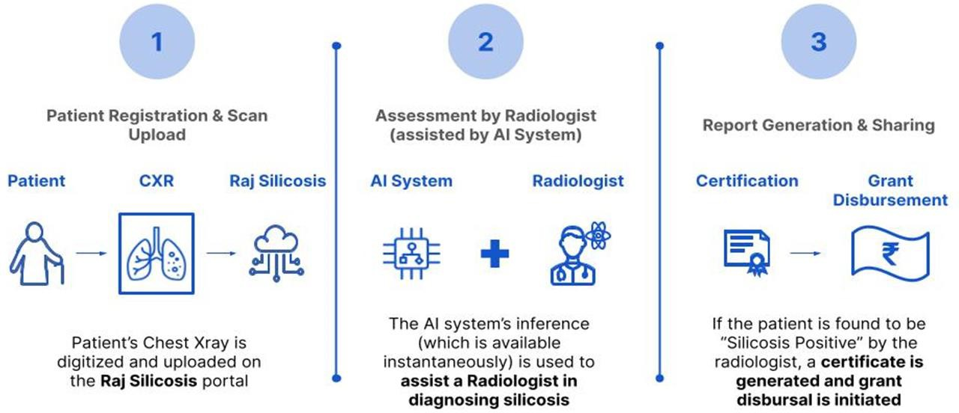
AI ASSISTANCE TO RADIOLOGIST FOR CERTIFICATION

Slide 7
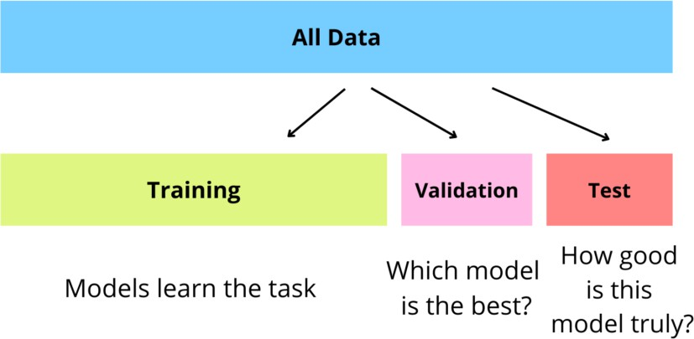
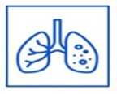
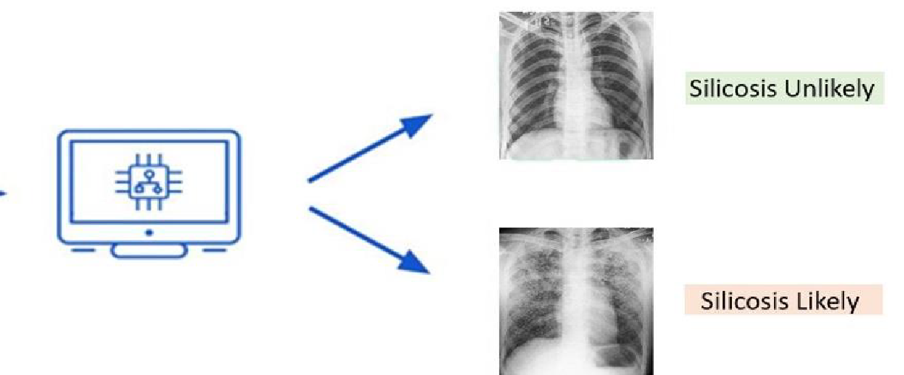
HOW AI SYSTEM FUNCTIONS : TRAINING AND PREDICTION
A:TRAINING
B: VALIDATION AND TESTING
TRAINING OF AI SOFTWARE USING CNN AND FEATURE EXTRACTION FOR PATTERN RECOGNITION
DEEP LEARNING
DATASETS OF 29160 LABELLED CHEST X-RAY IMAGES UPLOADED
C: PREDICTION
NEW PATIENT X-RAY DIGITIZED & UPLOADED
IMAGE TRANSFER
AI ANALYSES X-RAY USING CNN
AI PREDICTS X-RAY : SILICOSIS POSITIVE OR NEGATIVE

Slide 8
WHAT IS CONVOLUTIONAL NEURAL NETWORK(CNN)?
CNN IS A TYPE OF DEEP LEARNING ALGORITHM PRIMARILY USED FOR IMAGE RECOGNITION,
CLASSIFICATION AND VISUAL DATA PROCESSING.
1
SEEING PATTERNS
CONVOLUTIONAL LAYER
EXTRACT FEATURES E.G., SHAPES,
TEXTURES & EDGES
2
ZOOMING OUT TO GET THE BIG PICTURE
POOLING LAYER
REDUCE DIMENSIONALITY
3
MAKING SENSE OF IT ALL
FULLY CONNECTED LAYER
MAKE FINAL PREDICTIONS
4
FEEDBACK ADJUSTMENT
AND IMPPROVEMENT
LEARNING FROM MISTAKES
ACTIVATION FUNCTION

Slide 9
HOW AI IS CURRENTLY PERFORMING
Accuracy Sensitivity
Specificity
87.8 %
82.0%
86.9%
In an unparalleled effort within the public sector, Rajasthan has set a global precedent by training this AI
solution on an extensive dataset of 38,781 images.

Slide 10
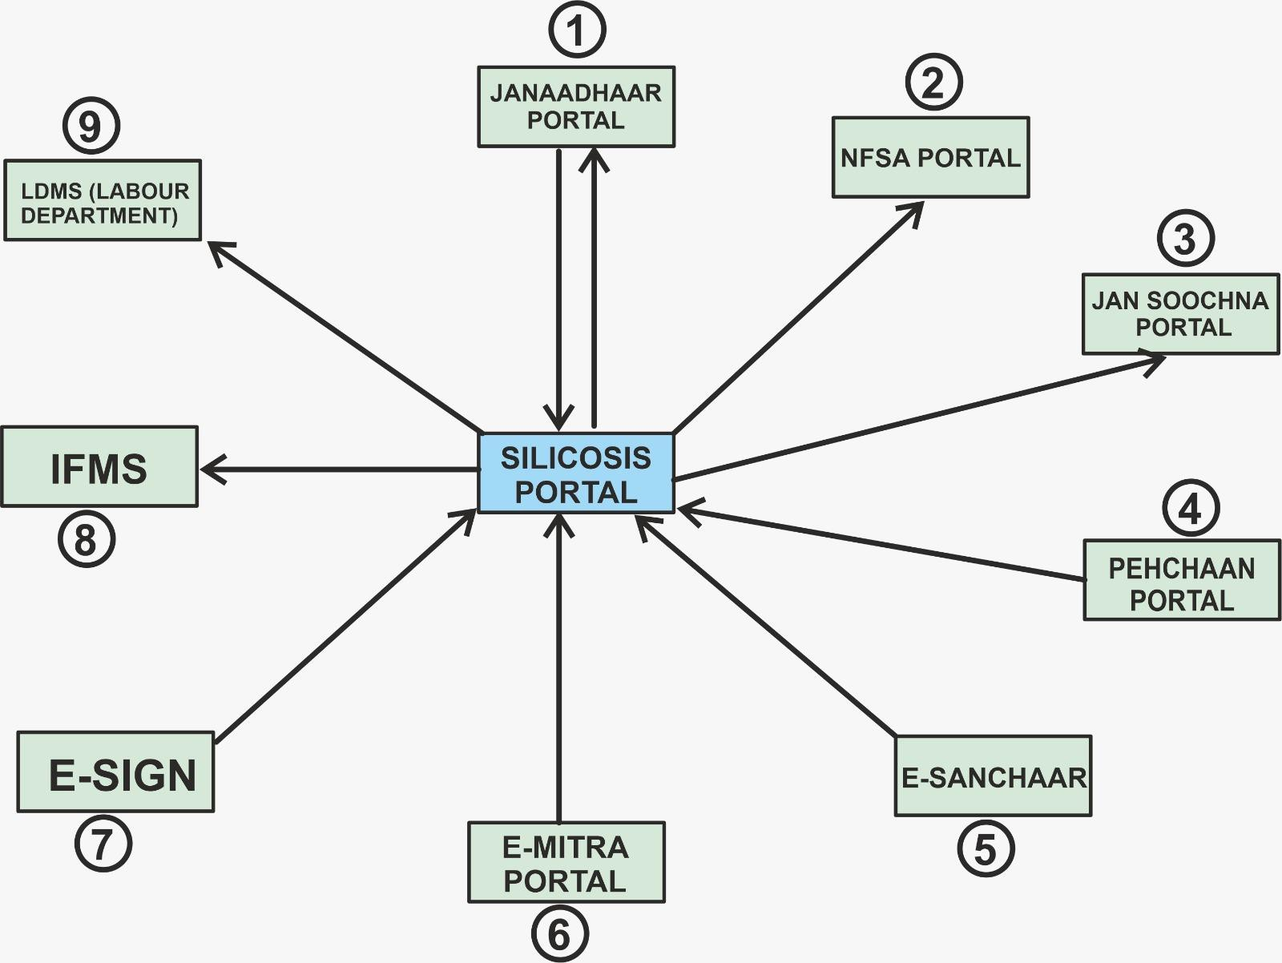
INTEGRATION WITH OTHER PORTALS
E-mitra
Jan Aadhar
Aadhar
Jan Suchna
Pehchaan
E-Sanchar
E-Sign
IFMS portals
Social Security Pension
LDMS
NFSA

Slide 11
SITUATION BEFORE AND AFTER THE DIGITAL SYSTEM: A COMPARISON
 | BEFORE RAJSILICOSIS |  | AFTER RAJSILICOSIS
01. | Long distance travel by the sick to DHQ for registration |  | Registration is online or through e-mitra centres
02. | Travel to DHQ for medical examination |  | Examination at any of the 129 mapped centres of choice
03. | X-ray diagnosis takes time as it is subject to radiologist’s availability |  | X-ray diagnosis is instant due to teleradiology, as an empanelled radiologist can diagnose anywhere anytime
04. | X-ray diagnosis is subject to radiologist’s subjective bias |  | AI tool prediction is objective and unbiased
05. | The radiologist’s report is physically sent to MO |  | Digital Certificate is generated instantly
06. | Patient has to apply for relief with certificate to the concerned department, which takes time |  | Physical presence is no longer required as the process is auto- approval based and through DBT
07. | Diagnosis, certification and benefit disbursal was time consuming and prone to corruption |  | Portal ensures quick, hassle-free, transparent and quality digital service delivery to the beneficiaries.
08. | Beneficiary has to apply separately for all other schemes – NFSA, Social security Pension and other BPL schemes |  | As the portal is integrated with other portals, beneficiary need not apply separately, thus time, energy and money is saved

Slide 12
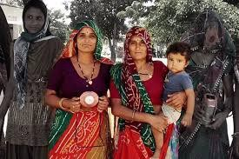
IMPACT
1,09, 930 persons have registered for silicosis screening
28,621 alive and 8,696 cases of death cases of silicosis
certified
17,309 persons and families given relief through centralised payment of Rs. 519.721 crores.
22,327 children given benefits under silicosis Palanhaar Scheme
30,661 beneficiaries have been given pension
11,084 cases of silicosis widows have been given
About 38,000 silicosis affected families benefitted under NFSA
It’s RAJASTHAN’s Contribution to DIGITAL INDIA PROGRAM

Slide 13
IMPACT OFTRANSFORMATIONFROMPHYSICAL TODIGITALGOVERNANCE
e-transformation
Physical Governance Digital Governance
Veil of Secrecy Opened door of Transparency
Dependence on thousands of oﬃcials
Without human intervention
Painful wait of months
Happiness within seconds
Studded with inevitable human errors
Error free high-ﬁdelity system with 100% accuracy
Many portals working in stand-alone mode
Synchronized working of multiple portals
with mutual data sharing
Discretion, delay and corruption
Software based ethical e-governance
Uncertainty and Unpredictable Outcome
Assured Service delivery
Crises of credibility
Pillars of trust

Slide 14
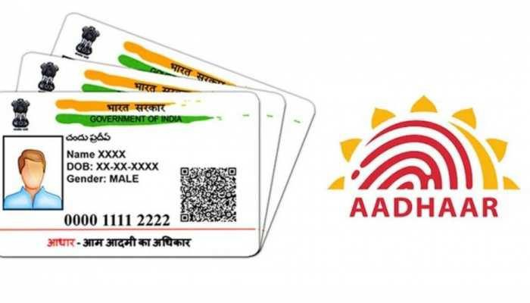
“Technology is an enabler to create a more equitable, digitally empowered and prosperous India”
THANK YOU!

