Slide 1
COMMERCIAL TAX (EXCISE) DEPARTMENT
GOVERNMENT OF CHHATTISGARH
R. SHANGEETHA
( I.A.S. )
Secretary &
Excise commissioner

Slide 2
reforms
Policy Reforms
Process Reforms
System Reforms

Slide 3
Policy reformS

Slide 4
Country Liquor
New license for country liquor manufacturing is opened for all country liquor/ foreign liquor manufacturers within the state along with franchisees.
Ends the monopoly of distillers in supply of country liquor, in specific supply areas, resulting in choices of brand/labels to the consumers and improvement in the quality of country liquor.
Online permit system for transportation of country liquor from manufacturing unit to storage warehouses.
02 new distilleries have shown interest in establishing distillery in the state and have applied for LOI.
02 existing foreign liquor bottling unit’s have applied for country liquor bottling under the new provisions.
Notes:
sis karna h, aur dalna h>iske bad 4th slide online permit CL

Slide 5
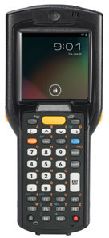
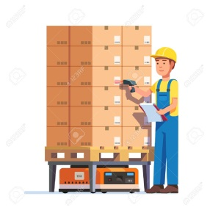
Online permit system of country liquor
Supplier creates online dispatch note & scan barcode of boxes, then requests for the online permit to distillery DEO
At Warehouse, consignment is received by scanning barcode of boxes & warehouse in-charge issues Excise Verification Certificate (EVC) online
Distillery DEO views & issues the permit online

Slide 6
Foreign Liquor
End of FL 10A / FL 10B ( wholesale ) licenses.
Direct procurement from manufacturers.
For better supply facilities to the retail foreign liquor shops, an additional godown has been opened at Arasnara ( Durg ).
The stock value of liquor stored at the godowns of CSBCL was 58.68 crores on 31st oct 2023 which has raised to 124.28 crores on 31st oct 2024, implying a better supply of foreign liquor.
Ensures availability of global brands at retail shops.
01 new application for foreign liquor bottling is under process.
The veritable supplier count has expanded from 40 to 54, ensuring greater diversity and reliability in our policy.
Significant growth: a total of 249 brands/labels supplied in FY 2024-2025, up from 176 in FY 2023-2024.

Slide 7
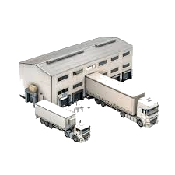
Logistics
Decentralization of transportation of liquor from godowns/ warehouses to retail liquor shops which is being done by CSMCL.
In the previous system, the supplier used to transport the liquor from the unit to the warehouse and from the warehouse to the shop, but to make the system transparent and time efficient, the transportation of liquor from the warehouse to the shop is now done by CSMCL itself.
Ensures security and tracing.
Ensures rational availability of liquor in retail liquor shops .

Slide 8
PROGRESSIVE REFORMS
Standalone restaurant bar license
Airport bar license
Reintroduction of hotel bar license
Provisioning of Excise Adhesive Label (EAL) From M/S India Security Press, Nashik (A Central Government PSU)
To avoid drinking at public places and for providing facility to the consumers for drinking, “Aahata” provision being introduced within the premises / adjoining place to the liquor shop.

Slide 9
PROCESS reformS

Slide 10
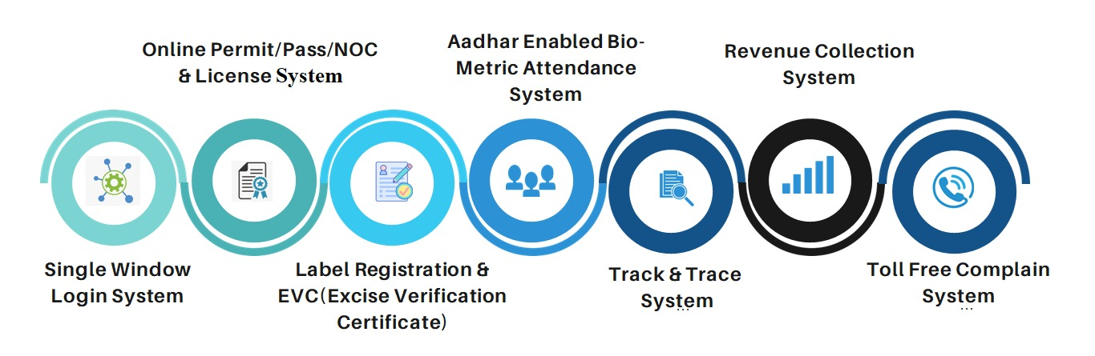
PARTICIPATION & CONSENSUS ORIENTED

Slide 11
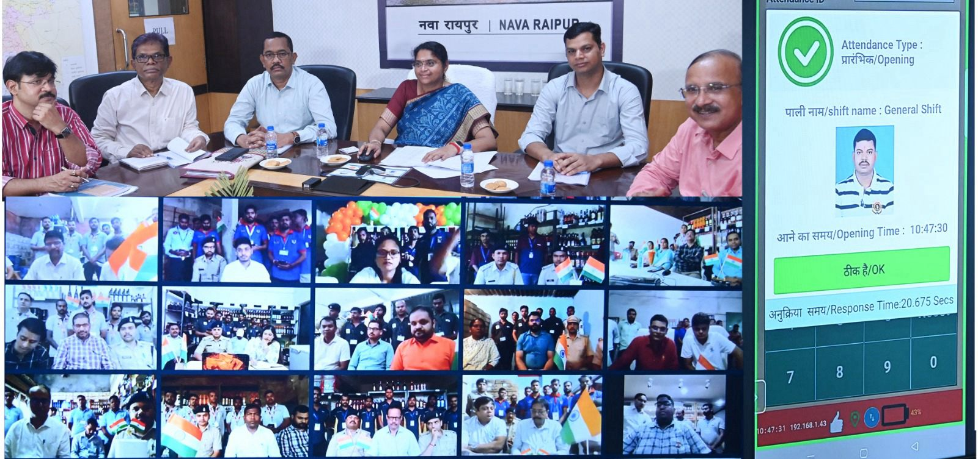
IT ENABLED SERVICES
Key Features Of AEBAS :-
Online employee attendance through face recognition authentication.
Security & privacy.
Enhancement in discipline of employees.
Ensures accurate timekeeping by precisely recording employees attendance and eliminating proxy entries, fostering accountability and fairness.
The system modernizes operations and strengthens overall efficiency and punctuality.
Real-time monitoring enables prompt management of absenteeism.
Aadhar Enabled Bio-metric Attendance System ( AEBAS )
Absentees %
Month | Jun | Jul | Aug | Sep | Oct
% | 0.17 | 0.55 | 20.03 | 13.27 | 14.7
Implementation of AEBAS on 14th August 2024

Slide 12
IT ENABLED SERVICES
Business Reforms Action Plan(BRAP) :-
To increase scalability, enhance security, improve flexibility & improve operational efficiency, shifting from physical server to cloud server of NIC.
There is provision in Excise Act to issue Excise Verification Certificate ( EVC) immediate on receipt of consignment:-
Issue of License & Label Registration | Issue of Shop/Bar Permit
Issue of Import & Export NOC/ Permit | Online NOC/Bar Verification
Notes:
EVC add karna hai|cloud infrastructure use kar rahe h | iske bad ONLINE ahata ka ppt dalna hai

Slide 13
e-TENDER FOR AAHATA
Aahata Online Portal
The portal streamlines the process of Aahata allotment and promoting transparency and fairness.
Accessible to all tenderer, ensuring a user-friendly and efficient application process.
E- Tender For Aahata
Digital submission: tenderers can submit tenders with integrated payment system online , eliminating the need of physical paperwork.
Transparent & secure bidding process: the e-tender system ensures a fair and competitive environment with real-time updates.
In e-tender bidding process bid price details are encrypted and OTP based login.
Ensures equitable access to all eligible participants
Reduces manual errors and delays.
Online Bidding
Online Payment Of EMD & Tender Fee
Scrutiny of Tenders
Top Bidder
Auto Selection

Slide 14
TENDERS USIng QCBS
The tender process was executed with utmost transparency, fostering participation from top-tier national service providers to ensure the highest standards of quality and reliability :
Manpower agency
Security agency
Cash Collection agency
Achieved high-quality services while ensuring significant cost savings.
The process led to significant financial savings of approximately 30 Crore rupees.

Slide 15
SYSTEm reformS

Slide 16
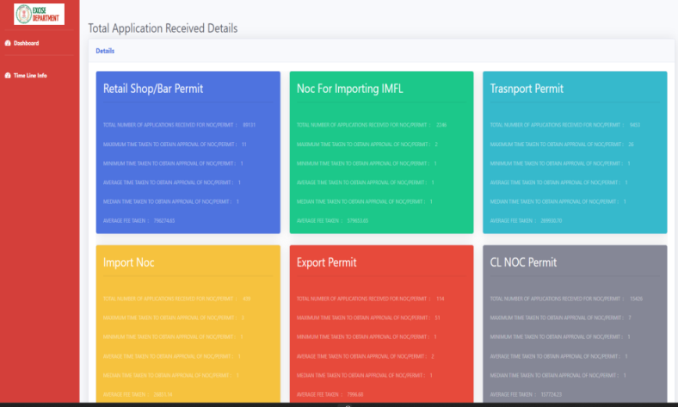
Responsiveness
An excise eDashboard is for enabling real-time monitoring of performance, efficient decision-making, and the consolidation of data from multiple sources into A single, accessible interface.
Notes:
Bar app photo dalna hai

Slide 17
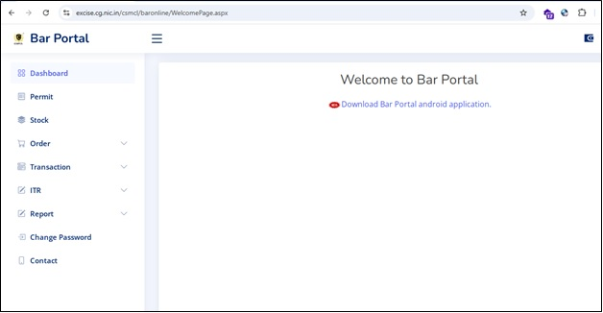
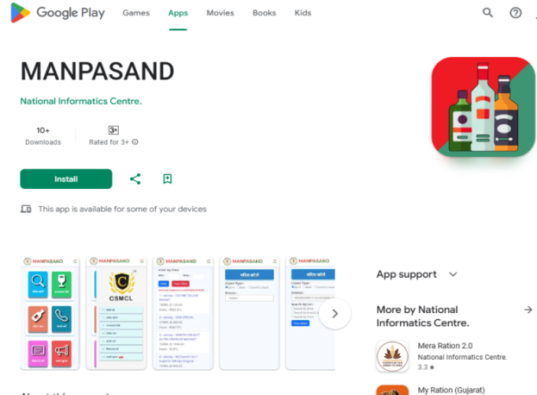
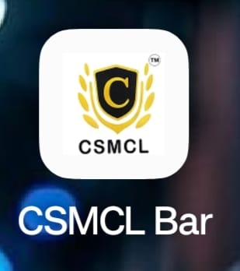
Equity & Inclusiveness
BAR Portal Mobile App For BAR Owners
Manpasand Mobile App for Public
Notes:
Bar app photo dalna hai

Slide 18
Effectiveness & efficiency
Revenue Collection
5425.22 Crore. [24-25]
(Till Oct 2024)
8430.49 Crore. [23-24]
6783.61 Crore. [22-23]
5110.16 Crore. [21-22]
4636.90 Crore. [20-21]
e-Challan
1178012 Paid Challan
EXCISE
DEPARTMENT
User
Registration
License Issuance
e-Services
6427 License Issued
13106 User
Registered
Liquor Inventory With Track & Trace
Cash Collection Management System
21.24 Crore Liquor Cases Received
20.94 Crore Liquor Cases Issued
450.25 Crore Hologram Processed
Real Time Cash Collection information at different stores
CVMS
92 Camera Under Surveillance
NOC Permit Issue System
4.64 Lakh NOC - Permit Issued
As on : 31 Mar2023

Slide 19
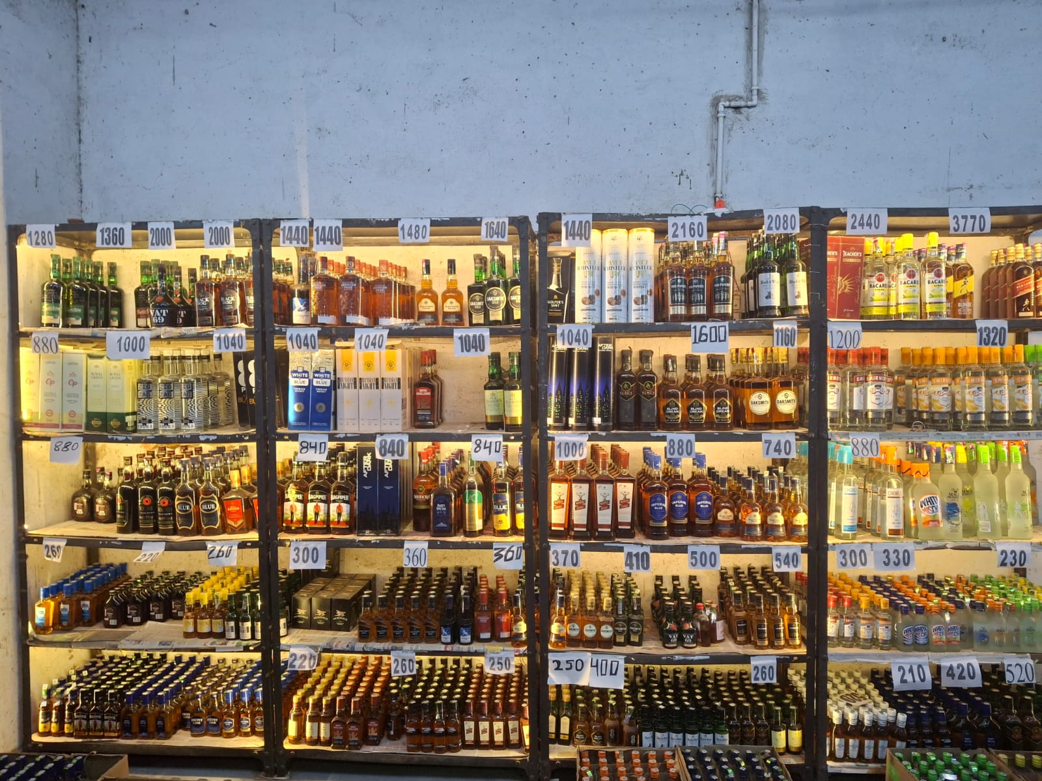
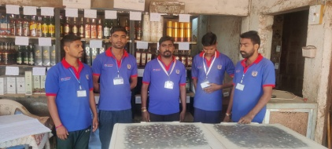
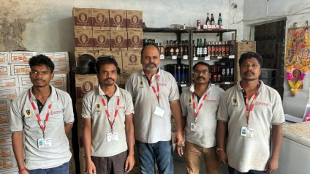
Improvements in retail outlets
Display of Brand/Labels at Retail Shop
Uniform & Employee ID at Retail Shop
Notes:
Bar app photo dalna hai

Slide 20
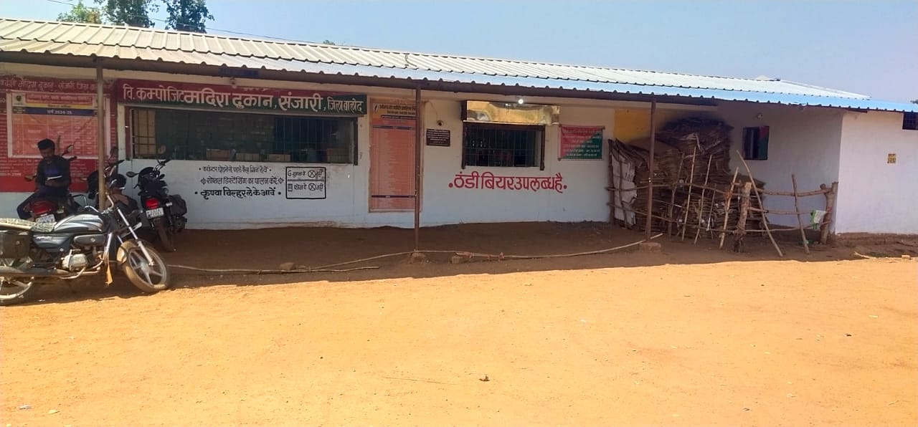
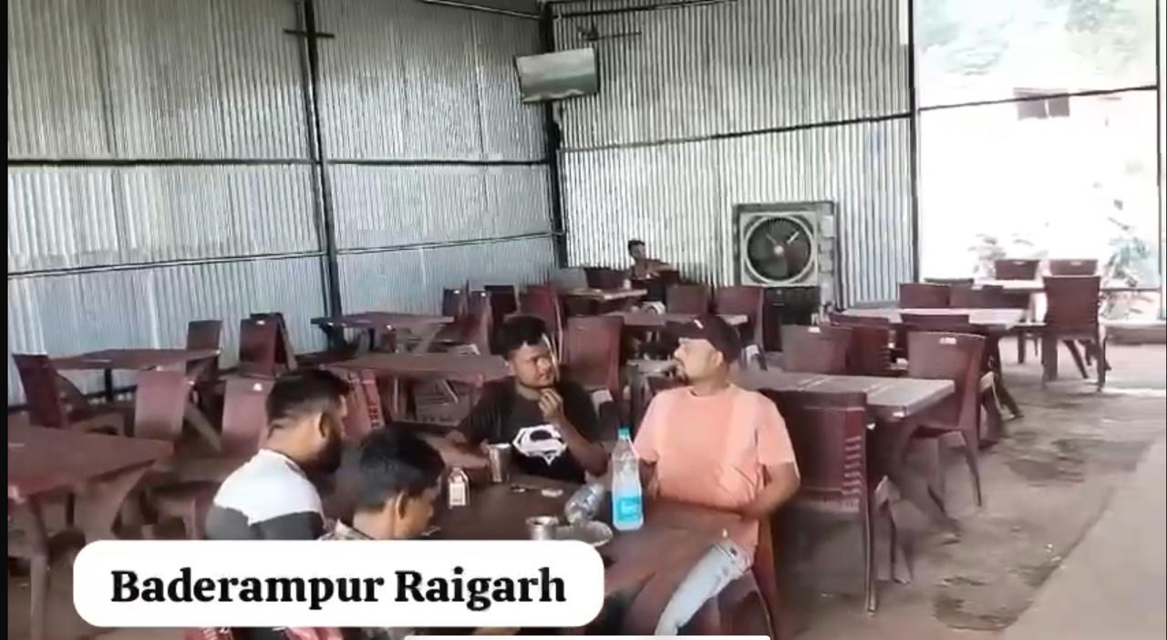
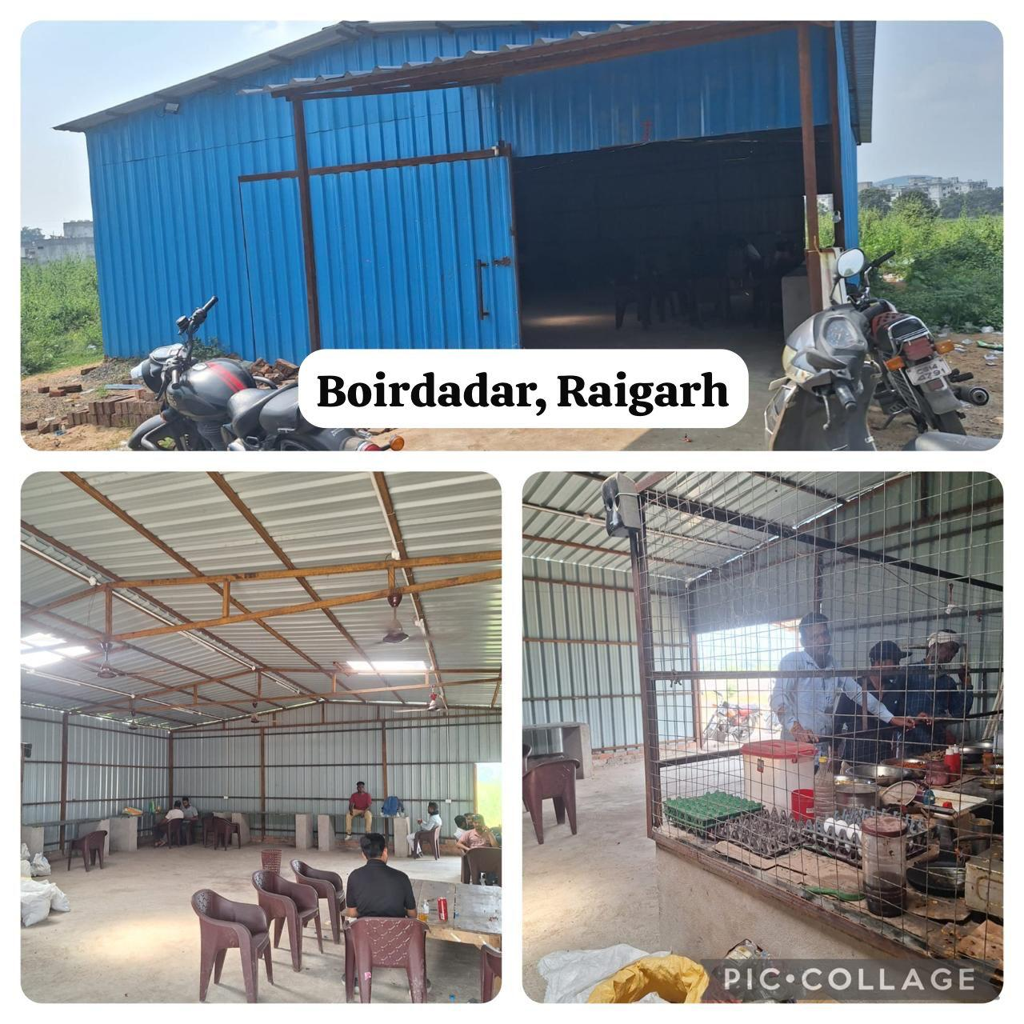
Improvements in retail outlets
Clean Shops
Clean Aahata
Notes:
Bar app photo dalna hai

Slide 21
Thank you

