Slide 1
A Flagship Programme of Govt. of Haryana Public Grievances Redressal & Monitoring System 21st December, 2019. Nagpur
CM WINDOW
Haryana

Slide 2
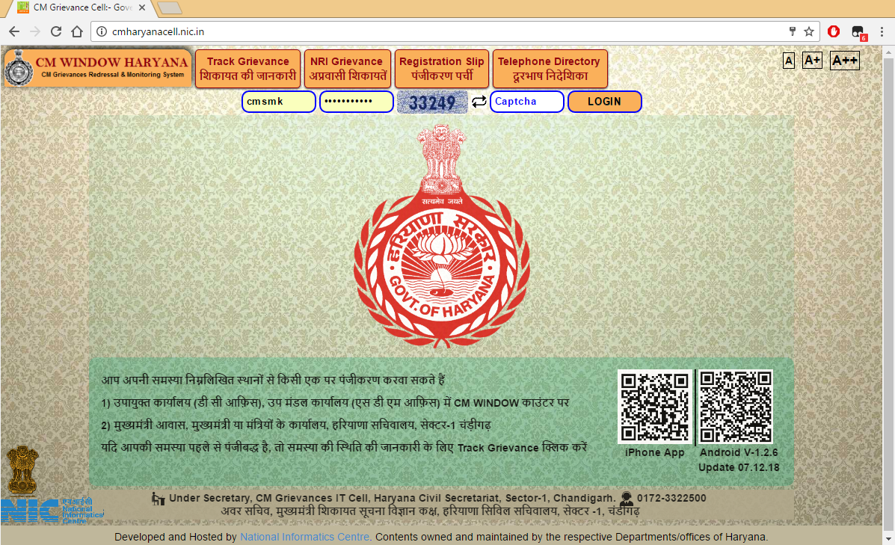

Slide 3
Salient Features
Customised Public Grievances Redressal and Monitoring System
Reduced Cost of Service delivery by eliminating multiplication of efforts by Departments/ Organisations
Time bound delivery of Redressal mechanism
Citizen friendly tracking of status of grievance redressal online (website and Mobile)
Strengthening back office operations for timely availability of information.
In house development by NIC Haryana State Unit Team. Solution implemented in all Departments/ Organisations of Haryana State.

Slide 4
Dashboard

Slide 5
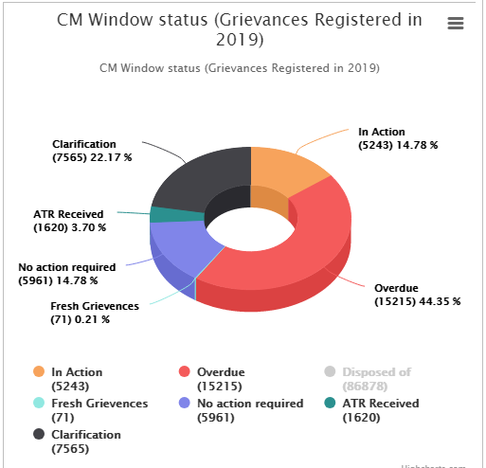
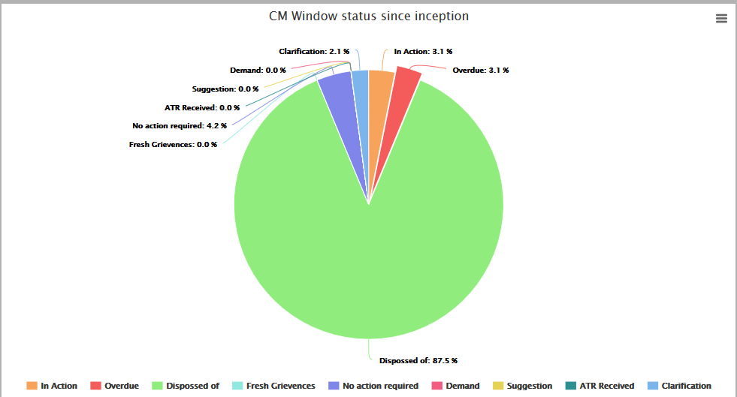
Status Charts

Slide 6
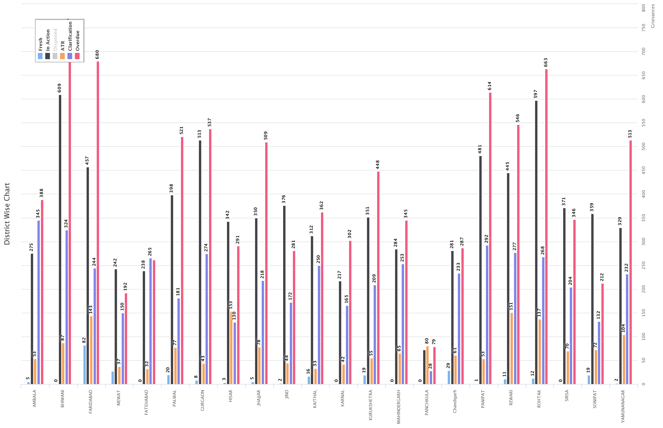

Slide 7
REPORTS
Department | Total Receipt | Overdue | In 10 Days | Marking pending | In-Action | Disposed | ATR Sent | Clarification
Director General of Police | 49546 | 520 | 1248 | 9 | 3195 | 45946 | 396 | 809
Administrative Secretary Development and Panchayats | 23027 | 2819 | 562 | 7 | 4188 | 18704 | 128 | 626
Administrative Secretary Power Department | 11380 | 751 | 214 | 2 | 1284 | 10015 | 79 | 254
Administrative Secretary Urban local Bodies | 10303 | 1231 | 213 | 3 | 1783 | 8334 | 183 | 274
Administrative Secretary Revenue & DIsaster Management | 10033 | 345 | 155 | 8 | 710 | 9257 | 58 | 173
Administrative Secretary School Education | 9935 | 504 | 152 | 0 | 812 | 9073 | 50 | 269
Administrative Secretary Town and Country planning HUDA and Urban estate | 7190 | 966 | 143 | 38 | 1281 | 5778 | 93 | 236
Administrative Secretary Social Justice and Empowerments | 5504 | 53 | 98 | 0 | 237 | 5240 | 27 | 105
Administrative Secretary Public Health Engineering | 5019 | 116 | 60 | 0 | 272 | 4685 | 62 | 48
Administrative Secretary Food and Supply | 4731 | 375 | 93 | 1 | 622 | 4077 | 31 | 80
Administrative Secretary Health | 4232 | 332 | 52 | 3 | 473 | 3727 | 29 | 75
Administrative Secretary Irrigation | 3993 | 269 | 104 | 4 | 480 | 3446 | 63 | 134
Administrative Secretary Transport | 3010 | 127 | 26 | 2 | 216 | 2775 | 17 | 28
Administrative Secretary Higher Education and languages | 2291 | 180 | 70 | 5 | 342 | 1917 | 27 | 152
Administrative Secretary Agriculture | 2279 | 124 | 68 | 15 | 247 | 1994 | 23 | 81
Administrative Secretary PWD B and R and Architecture | 2150 | 188 | 56 | 0 | 301 | 1795 | 54 | 95
Administrative Secretary Cooperation | 2019 | 195 | 66 | 0 | 329 | 1661 | 29 | 125

Slide 8
REPORTS
Department | Total Receipt | Overdue | In 10 Days | Marking pending | In-Action | Disposed | ATR Sent | Clarification
Administrative Secretary Labour | 1388 | 31 | 14 | 2 | 83 | 1299 | 4 | 18
Administrative Secretary Technical Education | 1340 | 34 | 23 | 1 | 77 | 1250 | 12 | 19
Administrative Secretary Excise and Taxation | 1242 | 150 | 21 | 2 | 200 | 1015 | 25 | 47
Administrative Secretary Women and Child Welfare | 1183 | 32 | 18 | 1 | 71 | 1105 | 6 | 22
Administrative Secretary Home, Jail and Administration of Justice, Home Guards | 1038 | 82 | 17 | 1 | 112 | 913 | 12 | 38
Administrative Secretary Forests and Wild life | 767 | 76 | 21 | 0 | 123 | 628 | 16 | 6
Administrative Secretary Industrial Training | 682 | 34 | 14 | 0 | 67 | 605 | 10 | 31
Administrative Secretary Medical Education & Research | 644 | 68 | 12 | 0 | 95 | 533 | 16 | 25
Administrative Secretary Animal Husbandry and Dairying | 638 | 48 | 22 | 6 | 85 | 539 | 8 | 31
Chief Secretary Office | 606 | 250 | 4 | 1 | 265 | 323 | 17 | 65
Administrative Secretary Industries And Commerce | 606 | 111 | 18 | 2 | 151 | 440 | 13 | 50
Administrative Secretary Welfare of Scheduled Castes and Backward Classes | 506 | 0 | 15 | 1 | 29 | 470 | 6 | 10
Administrative Secretary Housing | 459 | 23 | 10 | 0 | 42 | 395 | 22 | 23
Administrative Secretary Environment | 403 | 27 | 37 | 0 | 86 | 305 | 12 | 32
Administrative Secretary Sports and Youth Affairs | 391 | 2 | 9 | 0 | 22 | 356 | 13 | 12
Administrative Secretary Finance and Planning | 346 | 23 | 4 | 4 | 34 | 303 | 5 | 9
Administrative Secretary Mines and Geology | 231 | 42 | 2 | 0 | 49 | 179 | 3 | 3
Administrative Secretary information & Public Relations | 166 | 18 | 3 | 0 | 22 | 137 | 7 | 17
Administrative Secretary Tourism | 70 | 8 | 1 | 0 | 9 | 61 | 0 | 1
Administrative Secretary Fisheries | 66 | 2 | 1 | 0 | 7 | 59 | 0 | 4
Administrative Secretary Electronics and IT | 46 | 5 | 2 | 0 | 9 | 35 | 2 | 5
Administrative Secretary Renewable Energy Sources | 44 | 4 | 1 | 0 | 8 | 36 | 0 | 1
Administrative Secretary Archaeology and Museum | 24 | 2 | 0 | 0 | 5 | 18 | 1 | 1
Administrative Secretary Printing and Stationery | 20 | 0 | 0 | 0 | 1 | 19 | 0 | 1
Administrative Secretary Science and Technology | 7 | 0 | 0 | 0 | 0 | 7 | 0 | 0
Admin Sec Law and legislative department | 3 | 0 | 0 | 0 | 0 | 2 | 1 | 0
Administrative Secretary Archives | 2 | 0 | 0 | 0 | 0 | 2 | 0 | 0
Administrative Secretary to Govt of Haryana and Admn reforms | 2 | 0 | 0 | 2 | 0 | 0 | 0 | 0

Slide 9
Tools & Technologies Used :
Programming –PHP,JQuery
Web Server – Apache
Database – PostgreSql
Operating System – Linux
Other Tools and Pulg-ins – Apache Jmeter, HighCharts

Slide 10
Technical Features
CM Grievances Redress System -
An Integrated workflow system, based on web technology which primarily aims at lodging of grievances by the citizens from anywhere-anytime.
Open Source Technology Programming Language, Database and Linux web Hosting
Facilitates system generated unique registration number upon online lodging of grievances.
Online data transmission between department and its subordinate offices.
Online tracking of status of grievance by the citizen.
Mobile App based status tracking facility.

Slide 11
Other Features
Roll Based Application for various stake holders
Feedback Mechanism for maximum satisfaction of complainants through Call Centre.
Monitoring by APSCM, OSD, CMGGAs and Lok Sabha/ Vidhan Sabha Nigrani Samiti Members and Eminent Citizens nominated by Govt. of Haryana.

Slide 12
Coverage
CM Window Counters have been established at All district level e-Disha Centers, CM Office, CM Residence along with offices of all ministers, Haryana Bhawan New Delhi. NRIs can register grievance via sending e-mail to CM office.
Soon Services on counter going to be extended up to Sub-Divisional Level.
Online Module for establishment of Call Centre for feedback from complainants , graphical monitoring ,Nigrani samiti, CM Good Governance Associates

Slide 13
Work Flow
All Grievances received through all sources i.e. CM Windows at DC Offices/ CM Office/ CM Camp Office Received through Post, Received during public meetings of CM & Submitted by citizens on-line are to be entered in this system by respective offices, at the source itself.
Once the grievance is entered at the source, marking for action will be done centrally at CM Cell in Civil Secretariat.

Slide 14
Work Flow
Grievances are marked to concerned authority of the Department/ District/ Organisation e.g. Administrative Secretary, Deputy Commissioner, DGP etc.
Time for redressal of the grievance given by CM Grievance Cell.
Can be down marked by officers to their subordinates and instructions could be passed to them regarding redressal.
Action taken reports received at various levels and reach CM Grievance cell for final disposal/ clarifications to be sought etc.
Call Centre established for the purpose of getting feedback from citizens makes calls and takes feedback on parameters like satisfaction, whether contacted or not and any further comments.

Slide 15
Priority for Public Grievances Redressal by Govt. of Haryana
Haryana Government accords high priority to redress public grievances and is committed to meet the needs and aspirations of the people.
The Government moves forward for an efficient redress of public grievances through the launch of CM Grievance Redress and Monitoring System – Haryana,
A convenient and user friendly mechanism to meet public aspirations.

Slide 16
Monitoring and Feedback
The system facilitates generating various MIS reports and queries for effective monitoring of all grievances.
System facilitates monitoring through Dashboards (at the monitoring level i.e. Hon’ble CM/ APSCM/ OSDCM).
Pendency reports available online to respective DCs/Ads. SMS alerts sent by system.
The regular monitoring of the grievances redress status at CM Cell.
Call centre with 50 seats in operations for taking feedback from citizens.

Slide 17
Efficiency & Effectiveness
State Government has made 87.5% disposal till the date.
Increase in maximum satisfaction of citizen, even if citizen is not satisfied ,grievances are re-opened on their request for further action to be taken by redressing officer.
ATR sent by concerned officers is studied by CM Cell Officials and clarification is asked in cases , where CM Office feels that proper action has not been reported.

Slide 18
Resultant Gains
Easy, Hassle free access on the web and Mobiles as Improved quality of service
Effective feedback mechanism by calls to complainants through call center
Call center base inbound status enquiry and tracking of grievance
Transparent, efficient & effective, Reliable, real time service and reduced delivery and opportunity costs
Feeling of satisfaction amongst citizens by way of call center contacts
Satisfactory Responses by elimination of touts and exploitation

Slide 19
Current Redressal status
Out of total 6,76,900 grievances received till date, the 6,38,000 grievances have been disposed of.

Slide 20
Outcome
Timely and Effective Redress of Grievances
Leading to
Satisfaction and Credibility in
Public Delivery Systems of the Government.

Slide 21
Thanks

