Slide 1
WOKHA SAATHI
Smart AI Based Assistant for Timely Help & Interface
By Ajit Kumar Ranjan

Slide 2
What ails the Ecosystem of Public Service delivery?
Remote and hard to reach settlements
Poor quality of Citizen-Government Interface
Fragmented and Siloed Service Delivery
Poor Last Mile Service Delivery
Limited Access to Information
Inefficient Grievance Redressal

Slide 3
Key Tech Features
WhatsApp Based
Conversational AI
Active Engagement
Data Based Insights

Slide 4
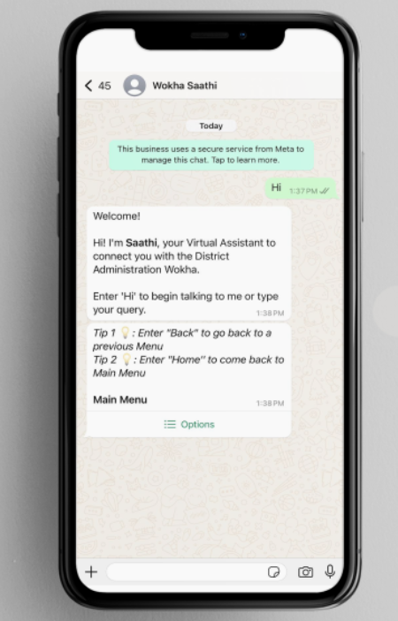
Objectives
User-Friendly Access
Timely Response
Increased Awareness
Two-Way Communication

Slide 5
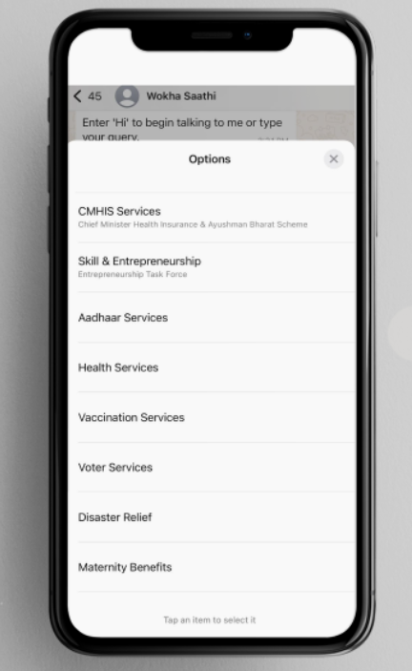
Salient features
WhatsApp-based Chatbot
Low Internet Bandwidth Required
40 Schemes & Services
Service Delivery
Monitoring
Campaigns

Slide 6
CITIZENS
INFORMATION CENTRE
SERVICE DELIVERY
GRIEVANCE REDRESSAL
PROACTIVE ENGAGEMENT
IEC CAMPAIGN
MONITORING INSIGHT
GOVERNMENT/ DEPARTMENTS/ AGENCIES
PRIORITY SCHEMES

Slide 7
Use Cases
Health
Vaccination
PMJAY & CMHIS
Skill & Entrepreneurship
Schemes information
Entrepreneurship Task Force
Grievance & Emergencies
Campaigns
Ayushman Card Drive
Outreach Activities
Ambulance
Filing Grivances

Slide 8
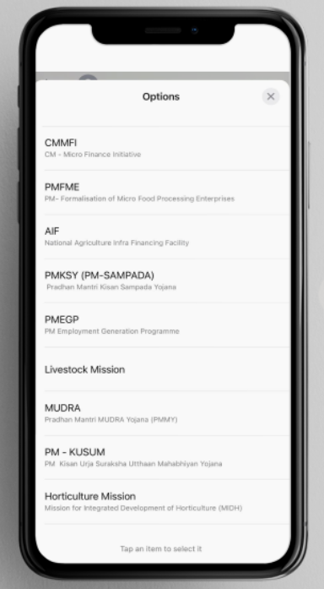
Quantifiable Achievements
Service Requests- 3024
User Engagement-With over 20,000 sessions
Information Dissemination-over 52,000 messages
User Reach- over 10% of population
Bot Performance-accuracy rate of 98.7%

Slide 9
Transforming Service Delivery-Impact
Cost Reduction-Over Rs. 2 Cr.
Time Savings-saving of over 80,000 hours
Improvement in Public Grievance Redressal
Efficient Feedback Mechanism

Slide 10
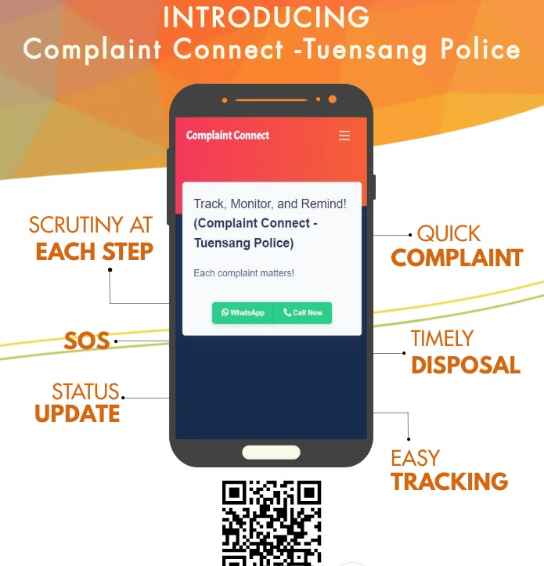
Replication of Wokha SAATHI
Tuensang police complaint connect App
https://nagalandtribune.in/tuensang-police-launches-complaint-connect-app-and-chatbot/
https://nagalandpost.com/index.php/2024/02/21/tuensang-police-launch-complaint-connect-app/

Slide 11
Enter "Hi" to 7005577231

Slide 12
Thank You

