Slide 1
Inclusive Development through Credit Flow to the Priority Sectors
Baseer-ul-Haq Choudhary, IAS

Slide 2
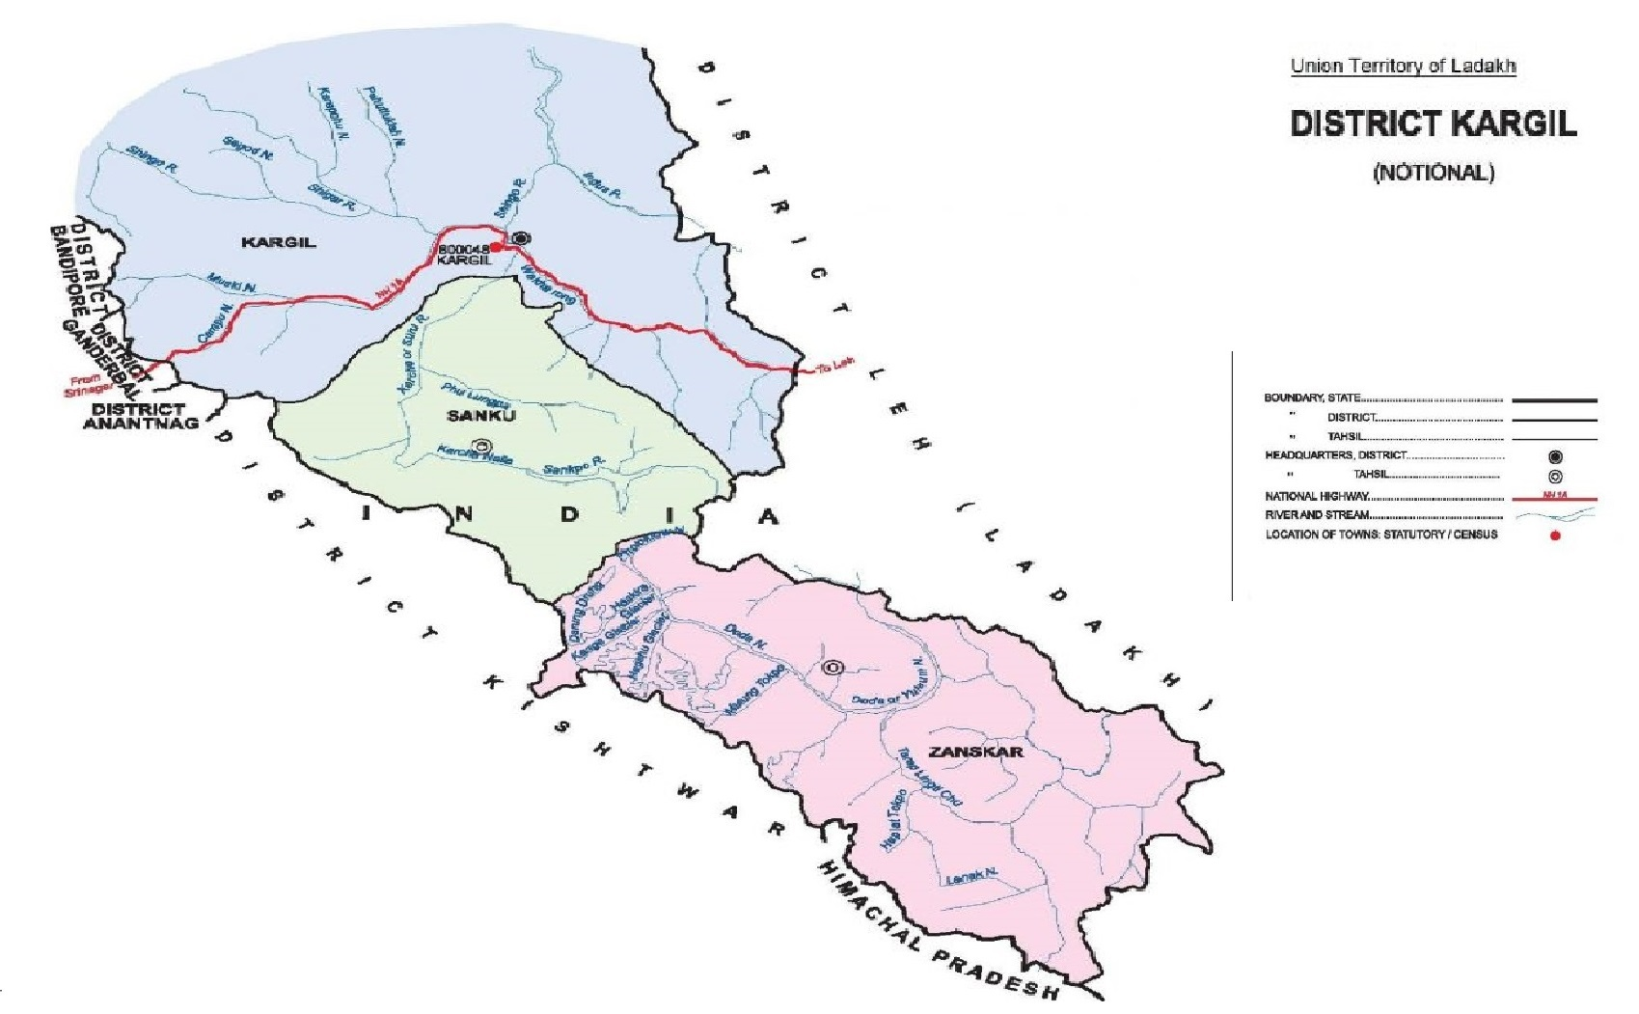
230 KM from Leh
203 KM from Srinagar

Slide 3
Profile of District
Kargil is one of the two Districts of Ladakh region and is the second largest town of Ladakh.
District Kargil is extended over an area of 14036 Sq. Kms and comprises of 129 villages.
As per Census-2011 population of the District was recorded as 1,40,802 souls.
The district has unique position in the country because of its high altitude which ranges from 8000 to 23000 ft. above the sea level.
The whole District comprises of high rocky mountains and cold arid desert.
60-70% of the total area of district remains covered with snow throughout the year and is devoid of any vegetation.
The temperature dip as low as -45° during winter.
The district remains cut-off from rest the country for 06 months
30%-40% of the total population migrates to other warmer parts of the country during winter.

Slide 4
Why our achievements are remarkable
Beside all the odds given above the district has following challenges to credit flow,
The district has shortest working season in the entire country.
District remains cutoff from rest of the country which disrupts its supply chain and access to markets.
No major industrial or business hub nearby.
All the activities, that is, production as well as consumption are confined to the town only.
The demand of priority sector lending is again exclusively indigenous to Kargil.

Slide 5
Annual Credit Plans
During the year 2018-19 district Kargil achieved 125% of the target.
And during the year 2019-20 district Kargil was able to achieve 107% * of the target set.
* The achievement of 107% of target during 19-20 is remarkable due to the fact that during the fag end of the year, district was faced by some unavoidable circumstances due to bi-furcation followed by COVID 19 pandemic.
Year | Target | Achievement
2018-19 | 203.19 | 280.78
2019-20 | 254.12 | 302.52

Slide 7
Agriculture
Kissan Credit Card under PM KISAN SAMMAN Scheme :
KCC is a comprehensive credit Scheme which provide financial support to farmers at a minimum interest rate of 4%.
In Kargil District out of 18120 farming families, 17955 (99%) farming families have submitted the application Forms.
15188 (83.81%) farming families have availed KCC since the inception of the scheme in the district.
A total of rupees 121.38 Crore were disbursed by various banks as KCC loans in the district.

Slide 8
Agriculture
How we achieved over and above the target:
By spreading awareness among the farmers.
By encouraging them to adopt the new CSS and technologies.
By conducting Loan melas in different blocks for documentation and sanctioning of Loans.
By augmentation from various schemes like PMKSY, Flood Management Program and AIBP.
From Artificial Glaciers in different panchayats.
By upgrading irrigation infrastructure and land development.
By regular monitoring and meetings with stakeholder departments and banks.

Slide 9
CASE STUDY
NAME: GULZAR HUSSAIN S/O MOHAMMAD ALI R/O TRESPONE
He availed KCC loan in 2018-19. Earlier he was a very financially distressed, due to low income of 01 Lacs per annum from his labor profession which was seasonal. After attending a local Loan mela he came to know about the KCC Scheme. After further detailed enquiry from Agriculture Officer on the spot, he applied for KCC Loan. He used the credit amount for purchasing high quality vegetable seeds, fencing materials to protect the vegetable garden from stray manilas and green house where he grow different vegetable seedling for general sale to public. He is now earning more from his farm and his annual income has increased to 04 lacs per annum. The KCC loan helped him to expend his farm enterprises and to market the produce for generating income from it.

Slide 10
CASE STUDY
NAME: HABIBULLAH S/O ALI HUSSAIN R/O TSG
Habibullah is a farmer and a beneficiary under KCC scheme. Before, availing loan he was working as laborer for annual income of 1.5 lacs. With this income he has facing difficulty to support a family of 07 members. He cultivated his farm field by the conventional way and hardly earns his living. After getting awareness of the scheme and availing the KCC he shifted to cultivate cash crops on his fields for selling the farm produce in the market for income generation. The credit system helped the small farmer to purchase all the required inputs for adopting new cultivation techniques available in the district. His income was increased three folds and is now much satisfied with his farming system and thanking the Govt’ for bring him under KCC scheme and providing the low interest credit in his favor.

Slide 11
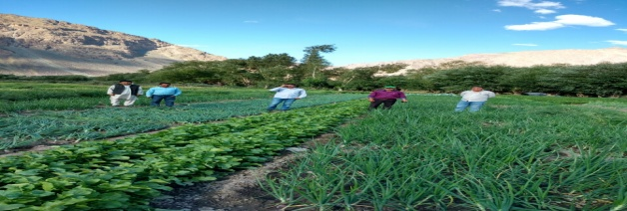
CASE STUDY
NAME: ZAHRA BATOOL D/O GHULAM MOHAMMAD R/O TSG
Zahra Batool has became supporting hand to her husband and a role model to women folk of the village. She belongs to a remote village with limited opportunity and encouragement to female entrepreneurs. She availed KCC loan in 2018 and the credit amount used to purchase different inputs like seeds, fertilizers, green house etc to grow and cultivate different kind of vegetable crops in her available field. She cultivates all types of vegetables of high yielding variety in organic way by avoiding use of chemical fertilizers and pesticides. She said that the credit amount helped her very much to adopt the organic farming system by means of purchasing basic inputs and labor engagement in her field. Now she fetched good income of her produce by vending the vegetables in the local market.

Slide 12
CASE STUDY
NAME: TRESING NAMGYAL S/O SONAM NURBOO R/O WAKHA
Tsering Namgyal belongs to a poor farming family forced to practice his ancestral traditional farming, but he was not satisfy with the returns from farming and is not able to run the family’s basic needs. So he got know in Agriculture awareness camp about KCC loan 2019, as he heard of it from another farmer. The Agriculture functionaries briefed about the scheme and also introduced him to modern technologies to increase his production and returns. Now he avail the loan for purchasing of good quality high yielding varieties of seeds, manures as per requirement of his soil and adopt modern machineries like tractors to plough his field to fine tilth, as before he is not able to do these because of his poverty. Now his production is increased and his produce is fetching good price as he is growing crops as per market demands. KCC loan became blessing for him, as many benefits associated with it.

Slide 13
CASE STUDY
NAME GULZAR AHMAD S/O GH. RASOOL R/O MUSHKOO DRASS
Gulzar Ahmed is a residence of Mushkoo Village of Drass zone which is of 65 km away from the district head quarter. He belongs to a poor & small farming family. He hardly earn his livelihood, but after knowing about the KCC scheme in the district he availed a credit of 01 lac under KCC scheme from the bank in the year 2018 and used it in agriculture purpose and shifted to cash crop from the conventional farming system. With the help of the credit amount, he was able to buy different farm inputs like hybrid seed and other modern technologies and introduced new innovations in his farming system and their by increased his agriculture production by manifolds. Now his socio economic status is much improved as besides cultivating cash crops in his farm he also rearing hybrid cow (jurcy cross breed) which gives an average of 8 liter milk daily. At the end he thanked the Government for support the poor farmers like him through financial assistance.

Slide 14
CASE STUDY
NAME: MOHD YOUNUS S/O MOHD IBRAHIM R/O FOKAR FOO
Mohd Younus of Fokar Foo being belong to farming family he continue his family farming , but he wanted to put some extra efforts to increase his production level, so that he can sold the surplus to the market to gain some monetary benefits from his farming. He got know in Agriculture awareness camp about the loan under the scheme of KCC for purchase of high yielding variety of different seeds, high quality manures, bio-pesticides as prophylactic measures, modern tools& implements to make his work easy and hire farm machinery like tractors, threshers to save labor & time. He shifts half portion of land to cash cropping to gain more returns by selling the produce in local market and in those areas where there is demand. Now he is in good condition and his livelihood is in much better than before where he hardly meet his own needs. All this is possible due low to loan on low interest rate and other benefits secure his farming, really thanks to the government.

Slide 15
MSMEs
Prime Minister’s Employment Generation Programme. (PMEGP) :
District Kargil achieved new heights in terms of achievements under PMEGP. This is evident from the fact that District Kargil, keeping into consideration its population compared to other districts, registered the highest percentage of achievement under PMEGP in the entire erstwhile State of J&K during FY 2019-20.
During FY 2019-2020, due to timely conduct of DLTFC meetings, 687 cases involving total project cost of 7618.3 lac with MM of 2666.32 lacs were sanctioned.

Slide 16
MSMEs
This has provided new impetus, vibrancy in the employment and business sector in the district.
Intensive/ widespread awareness campaign and remote outreach programs were conducted in the year 2018-19 and 2019-20.
Timely DLTFC meetings and further follow up meeting with Departments and banks paved way to achieving the targets.

Slide 17
Target and Achievements Under The Scheme PMEGP
Agency | Years | Target No. Of Project | Achievement No. Of Project
DIC | 2018-19 | 34 | 71
 | 2019-20 | 38 | 78
 | Total | 72 | 149
KVIB | 2018-19 | 36 | 72
 | 2019-20 | 96 | 57
 | Total | 132 | 129
KVIC | 2018-19 | 29 | 148
 | 2019-20 | 29 | 161
 | Total | 58 | 309
 | G.Total | 262 | 587

Slide 18
Activity wise details of pmegp beneficiaries
S.No | Type Of Activity | Number Of Beneficiaries
01 | Automobile works and service | 77
02 | Carpentry , wood carving and Cement Blocking | 195
03 | Fabrication Works | 69
04 | Repairing of Electronic Items | 28
05 | Readymade Garments | 87
06 | Food industries | 30
07 | Plumbing services | 02
08 | Electrical Services | 04
 | Total | 492

Slide 19
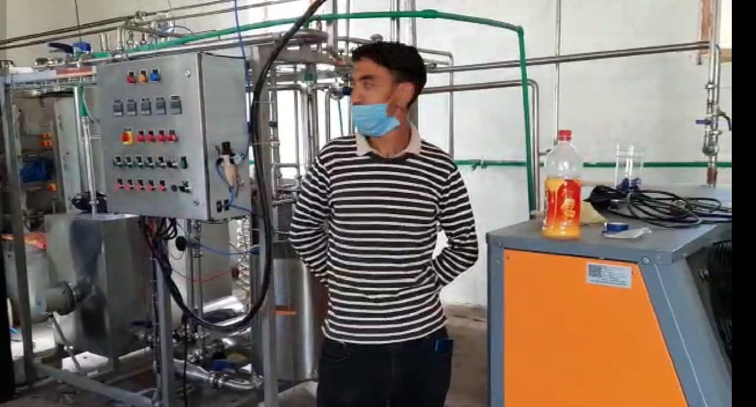
Loan Availed | 25.00 lacs
Annual Profit | 6 lacs
Employement provided | 20
Social Impact | Catering need of 3000 household for milk.
MILK PROCESSING UNIT
My name is Mohd Ali from village Minji of District Kargil ,I am just 12th pass and was highly disappointed to realise that with this much qualification I have very bleak chances of getting any Govt. Job .This issue was taking toll on my mental as well as Physical being. Then in 2018, during one awareness camp held in our village by DIC Kargil, I came to know about PMEGP Scheme. But even then, due to my limited exposure, I was unable to decide the activity for which I ought to avail the loan facility under PMEGP. I decided to go to DIC Kargil where the officials present briefed me about various business potentials available in the District.
This counselling on part of DIC official helped me to make up my mind to go for some business related to diary sector keeping in mind the highest milk production potential of my village in the entire District. After proper market survey regarding the difficulties faced by the people of the district to get fresh milk and milk products especially during the winter session, when the area remain cut off from rest of the World, I was encouraged to think bigger and I decided to go for a milk processing plant. This very novel initiative of mine was appreciated by the Worthy Chairman DLTFC himself keeping in view its viability and the benefits for the general public of the region. My case was processed on priority and I was sanctioned a loan of Rs. 25.00 lakhs to the full limit under PMEGP.

Slide 20
MILK PROCESSING UNIT
In the following three months I established the milk processing plant and brought it into production as well. This did not only bring me out of my sufferings on account economic distress but also inspired many other youths like me in the region to think of bigger projects, who where until know unable to think of anything above 5.00 to 10.00 Lakhs due to lack of exposure. With this novel business of its kind in the district , I am not only catering the demand of about 3,000 households for fresh milk and milk products but also earning handsome profit beside supporting 20 families of workers who are directly or indirectly earning their livelihood by engaging them self with various activities associated with production and supply.
Keeping in view of demand of Milk/milk products and the security of market available, especially during the winter season, I am planning to expand my activity in the next phase. On the basis of my achievements over last one year I can say with authority that PMEGP scheme and the implementing agency especially worthy chairman DLTFC (Deputy Commissioner Kargil) have proved as a blessing in saving me and my family of the suffering that we were facing. It may uplift many others like me in days to come.

Slide 21
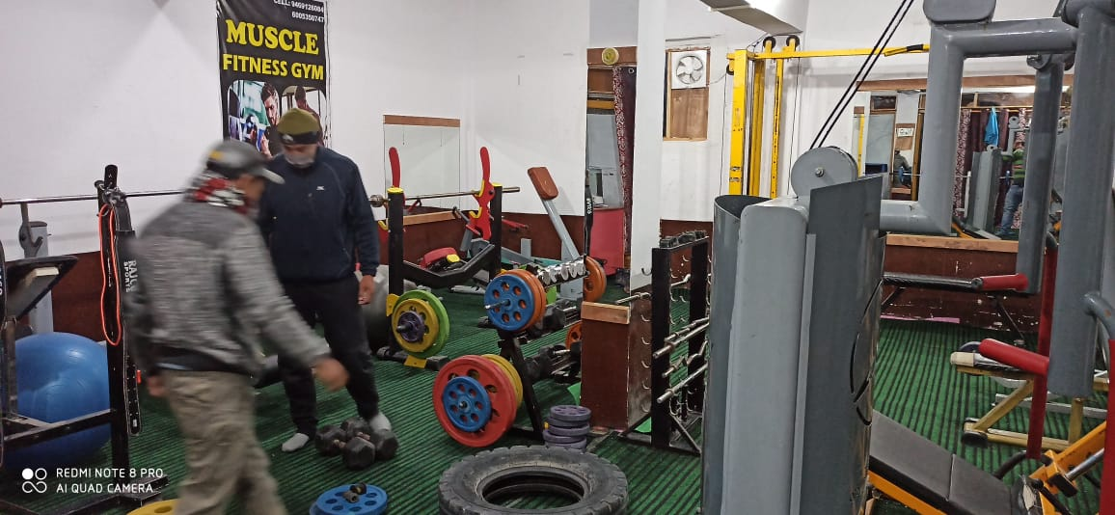
FITNESS CENTER / GYM
Loan Availed | 10.00 lacs
Annual Profit | 4.20 lacs
Employement provided | 02
Social Impact | Fulfilling Vision of Hon'ble Prime Minister for FIT India.
My name is Shahida Akhter, female, 26 years of age.
I am from Zaskar, Sub-division of District which is 250 Kms from the District Headquarter, i.e. Kargil and 500 Kms from Leh and Srinagar. The Zaskar subdivision remain cut off from the whole world itself for about 6 months. The region has few employment opportunities owing to its harsh climate and small population which comprises of only 15000 souls. This make any business based on production/Consumption less lucrative. So I decided to go for Fitness centre in the main town Padum itself where finding around 400-600 fitness enthusiasts was a difficult task. My idea did not get any support from the family. As this was something completely unimaginable in a society for even boys. And in my case it was nothing but a taboo. So I decided to look for the financing agencies. I approached DIC Kargil for getting detail of Loan under PMEGP where my project was discussed thread bear and I was able to convince the officials there about the success of my business. My idea was appreciated in the DLTFC meet by the chairman himself. I got a loan of 10 lacs in the year 2019 and started my gym centre despite all odds on account of social hindrances. Today, I am earning on average 35,000/month as profit besides providing employment to 2 local youths as trainers and fitness to 100 people in this remotest sub division of the country. This is remarkable in a sense that this fitness centre is being run in a region where life is still struggle for existence in typical biological sense. There is no internet. This centre is source of recreation and inspiration for the local youths besides keeping them fit and giving much needed earning.

Slide 22
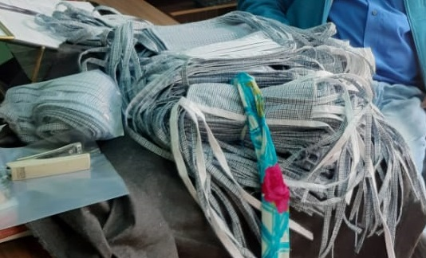
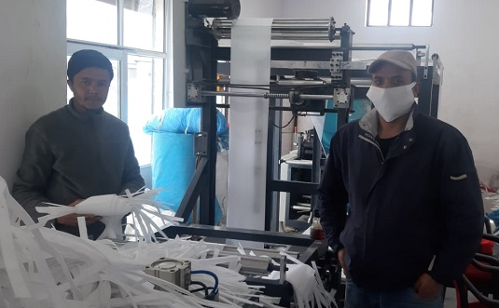
HIMALAYAN CARRY BAG
Loan availed | 24.00 lacs.
Annual profit | 6.00 lacs
Employment Generated | 12
Social impact | Saving Environment, Helping in fight against Covid
COVID 19 MASKS
My name is mohammed Riyaz, S/O Mohammed Taqi , R/o Pashkum.
Ladakh is a highly eco-fragile region in the entire country and owing to its fragile environment, the govt imposed complete ban on the use of plastic and plastic products few years back. I had no idea as to how this ban can help me make my livelihood. Once attending an awareness program of Department of I&C, conducted by DIC, Kargil, I got to know how I can capitalise on this opportunity with the help of financial assistance from the govt under PMEGP. At DIC, Kargil, I was briefed as to how an eco-friendly Carry bag Unit can prove highly profitable business venture in days to come. After completing all the preliminary surveys and enquiries, I decided to apply for the Loan with KVIB Kargil under PMEGP. A Loan to the tune of Rs 24 lacs was sanctioned in my favour in the year 2019 in a hassle free manner. As on date I am able to make a profit of 6.00 lacs/annum through sale of about 2.00 lacs Carry bags besides providing employment to 12 people
This venture of mine has not only saved me of my economic distress but has given me a purpose of life. I am playing my role in keeping my land free of scourge of plastic that many affluent societies in country are battling with. It is worthwhile to mention here that I too played my role in combating Covid-19 during initial phase of outbreak of the pandemic as I supplied about 24000 masks to the govt agencies fighting COVID 19.

Slide 23
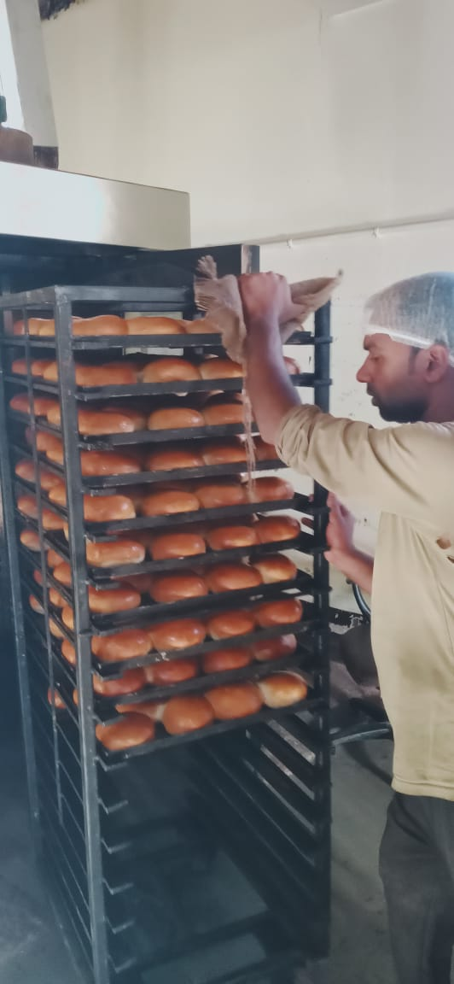
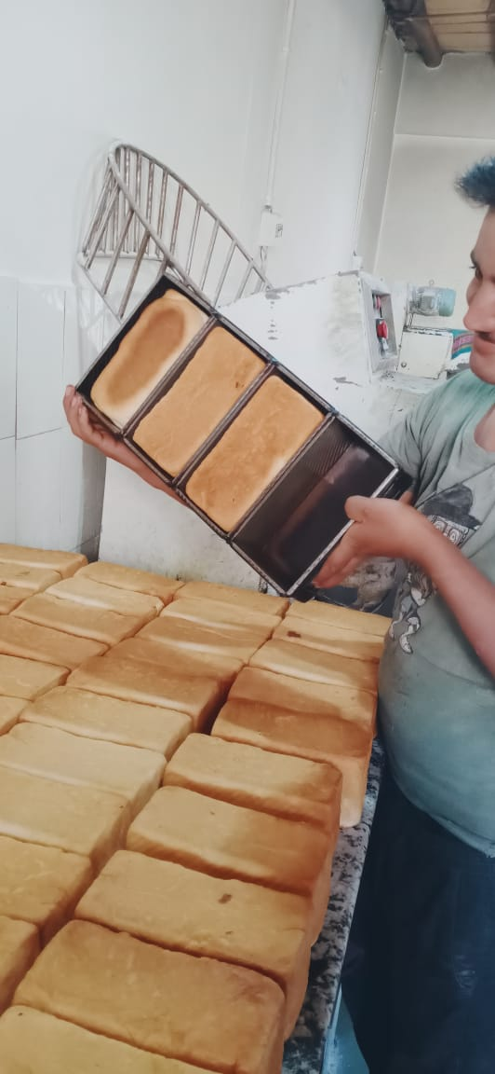
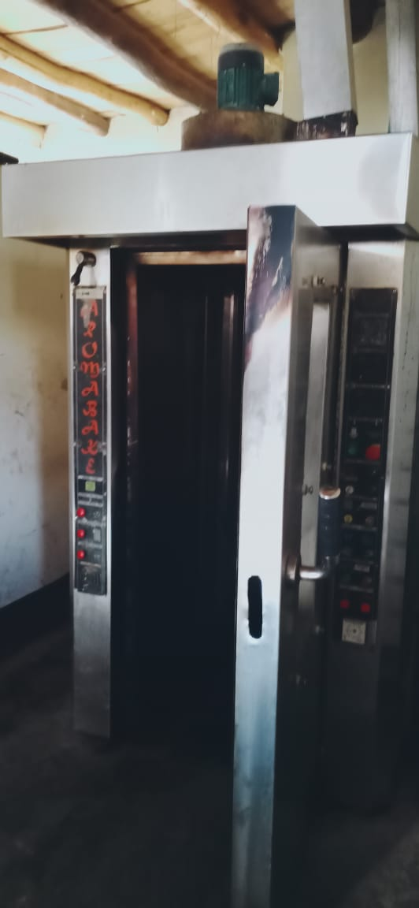
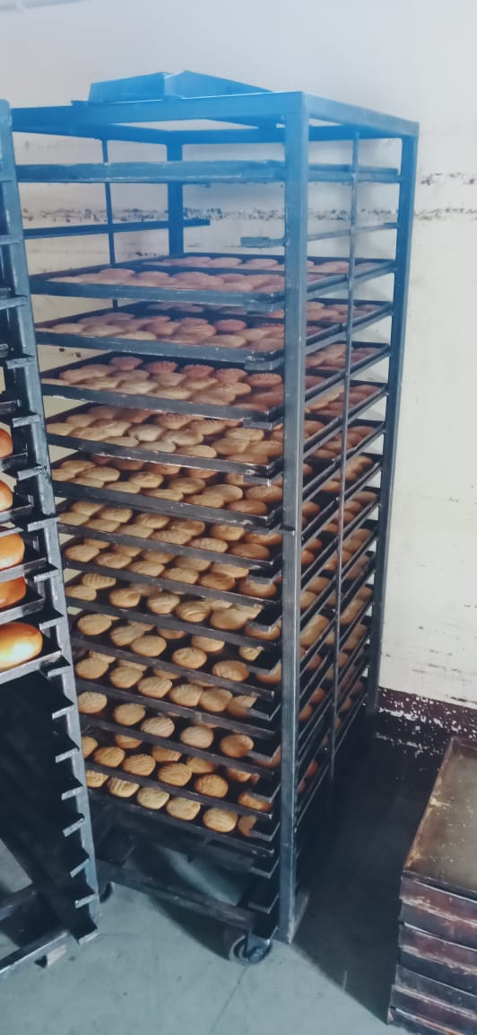
Ladakh Bakery
Loan Availed | 15.00 lacs
Annual Profit | 24 lacs
Employement provided | 08
Social Impact | Meeting Daily needs for fresh hygienic food of the people.
My Name is Zeeshan Ali from Minji Kargil, I have done my PG in Political Science in 2015. Thereafter I kept looking for the govt Job for few years. I was completely devoid of any idea of having any business venture of my own in life. In 2019, on the suggestion of one of my friend I attended one Lone Mela in the Town organised by the DIC Kargil where I came to know about the PMEGP Scheme. I was also given idea of various business opportunities available in the District by DIC official present there. This interaction encouraged me to start my own bakery unit. The idea of demand of Bakery product due to disruption of supply chain during winter was also given by the DIC official who also helped me to prepare my project Report for the PMEGP loan as well. My Bakery project for loan of 15 lacs was approved and Sanctioned within one month. My unit came into production in the month June 2019. And today on this date my average monthly turnover is 2 lacs rupees. Within one year I have started to think beyond my needs and am living a life with some purpose, i.e. providing employment to others who are struggling the way I was struggling a year before. It is worthwhile to mention here that today I am providing employment to 8 people who are working directly in the production unit itself beside about 100 those who are making their livelihood through sale outlets which are spread all across District Kargil. This helping hand of the govt in the form of PMEGP has not only enhanced my living standard but is also benefiting thousand locals by making fresh bakery products available throughout the year.

Slide 24
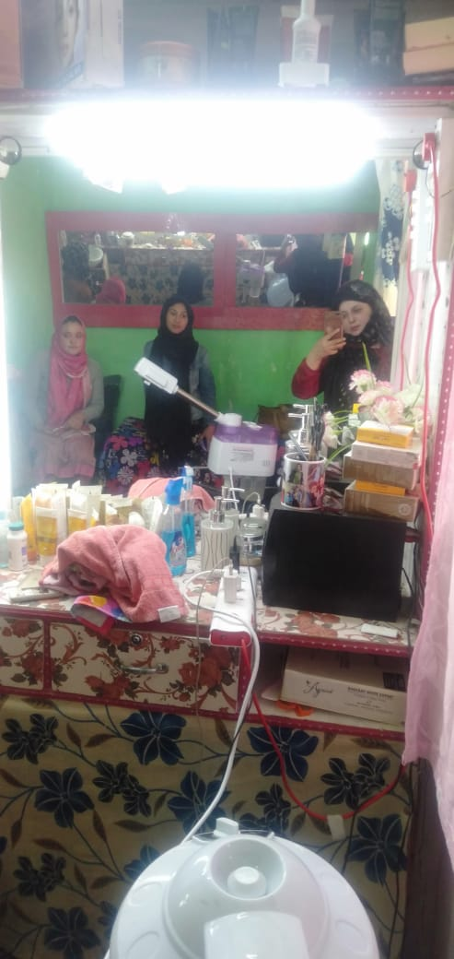
BEAUTY PARLOUR
STEEL FABRICATION
Shmt. Fatima Banoo D/o Mohd Ali R/o Trespone, an educated unemployed Youth with a entrepreneur sprit. After Getting a loan of 02 lacs in the year 2018 she established her own Beauty Parlor. And now she is earning 06 lacs per annum besides providing employment to 06 other female worker.
Mohd Sadiq from a remote area of Kargil. With the help of loan of 24.93 lacs under PMEGP he started his business in 2019 and is making a profit of 08lacs per annum besides providing employment to 12 persons.

Slide 25
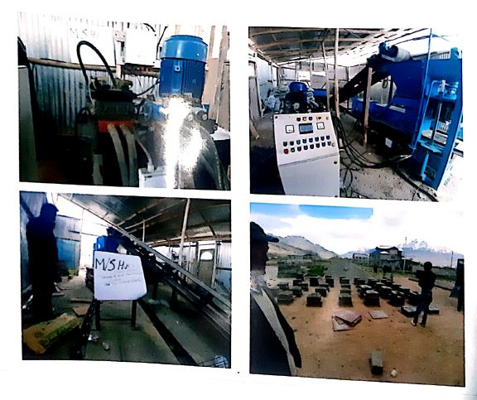
CASE STUDY PMEGP
Name of Unit | M/s Hussain Brick
Location | TV Station Kargil
Contact | 9419657909
Line of Activity | Cement Brick
Loan Disbursed | 15.00 Las
Bank | J&K Bank Main Kargil
No. of Persons Employed | 12
Year | 2018-19
Shri Mohd Hussain S/o Haji Ramin R/o Barchay Kargil, an unemployed youth with the help of loan under PMEGP set up a cement brick unit.
Now he is not only a successful businessman, but has engaged 10 more workers in Cement Brick Unit.

Slide 26
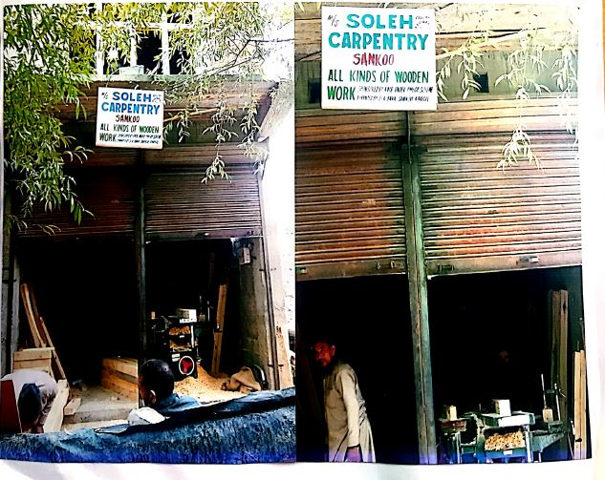
CASE STUDY PMEGP
Name of Unit | M/s Solah Carpentry
Location | Sankoo
Contact | 8491968707
Line of Activity | Manufacturing
Loan Disbursed | 10.00 Las
Bank | J&K Bank Sankoo Kargil
No. of Persons Employed | 4
Year | 2019-20
Shri Solah was working as a skilled manpower in a carpentry shop, with a dream to own his own manufacturing unit.
But due poor economic background, he was discouraged to take to the initiative. Alter learning about the scheme on
Local radio program, he visited the nearest office for further details.
He came to know about the financial assistance being provided under PMEGP. After getting detailed guidance he applied
for the Loan. From the sanctioned amount he purchased the required equipment and his dream business started.
Now he has engaged 02 more workers in his Carpentry shop.

Slide 27
CASE STUDY PMEGP
Name of Unit | M/s Twakkal RMG
Location | Baroo Complex Kargil
Contact | 6005795518
Line of Activity | Services
Loan Disbursed | 10.00 Las
Bank | J&K Bank lalchowk Kargil
No. of Persons Employed | 8
Year | 2019-20

Slide 28
Weaker Section
All the bank branches in Kargil district provided financial assistance to the weaker section of society under the welfare schemes launched by Govt. of India the women entrepreneurs of SC ST communities .
With Schedule Tribe Population of 1,22,336 with 86% of population, a significant opportunity was identified in the area.
The bank branches have sponsored 212.48 cr against the target of 182.87 c, thus achieving 116% of the target in the year 2018-19 and sponsored 251.70cr against the target of 25.60 cr in the year 2019-20.
Comprehensive awareness was done in the year 2019-20 for schemes giving assistance for the purpose of construction of houses exclusively for the benefit of SC/STs.

Slide 29
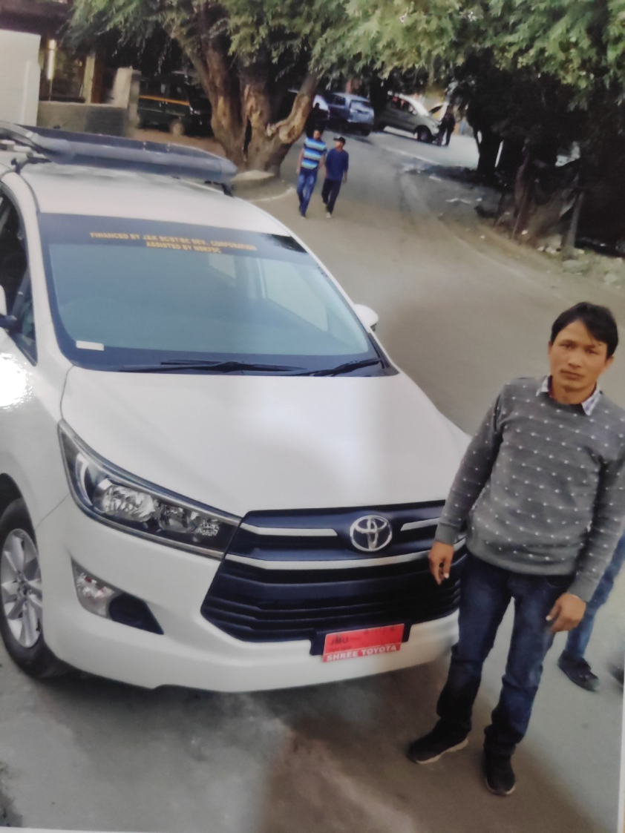
Name: Mohd Hussain
s/o Mohd Raza
Adress: kharul hardrass
I was working as a taxi driver, driving vehicles on commission basis. Due to restrictions of the owner, I was not able to drive on remote routes which promised higher commissions. I always dreamed of owning my own vehicle, and saw huge opportunity during the tourist seasons. Also the income was not meeting my daily requirement.
In the year 2019 I came to know about SC ST loans from local radio program I visited the office to get further details. I got immediately interested and applied for the loan, I was provided a loan of 15 Lacs with a minimum interest rate of only 6%.
Now I am driving my own taxi, and my income has increased 03 folds. I currently drive on Jammu- Srinagar to Leh Highway.

Slide 30
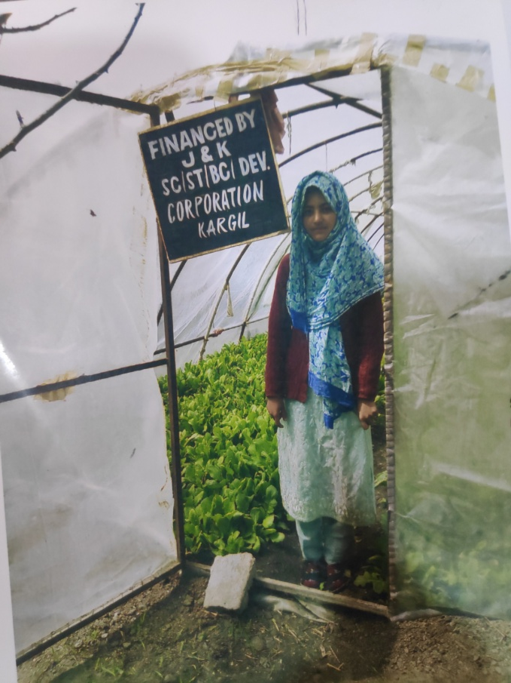
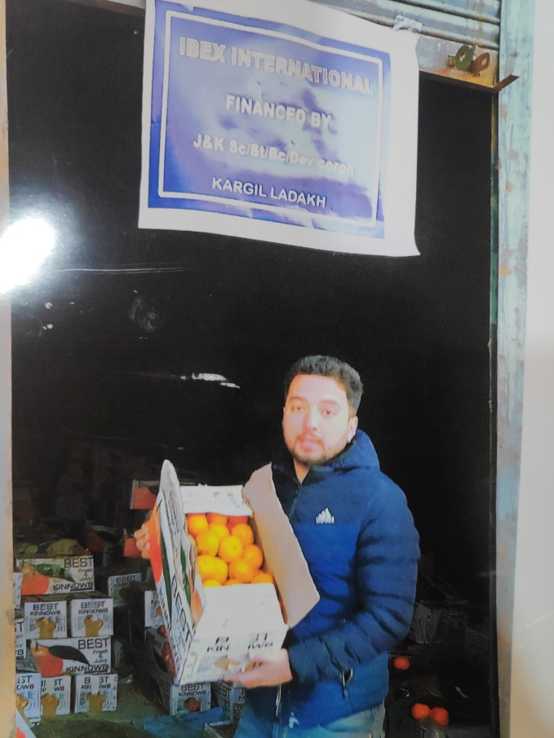
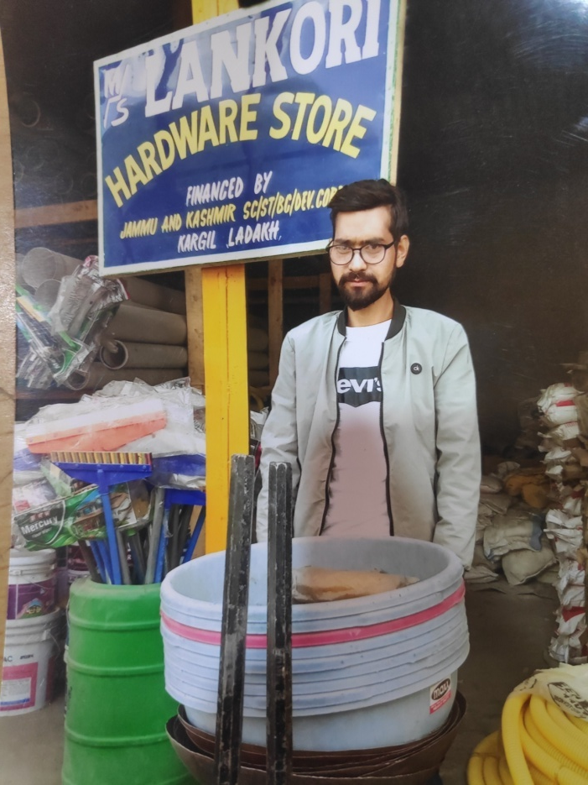
Shmt. Fatima banoo d/o mohd ali
R.o Trespone was an educated unemployed Youth with a entrepreneur sprit. After Getting a loan of 02 lacs in the year 2018 she established her own farming Setup. And now she is earning 02 lacs per annum and is working satisfactorily
Syed ali s/o Syed mohd r/o Trespone was in search of employment after getting his education. Belonging to low income ST background he was not able to start a business himself.
After knowing about the scheme in 2019 he opened his own Vegetable and Fruit shop by taking a credit of 05 lacs under the scheme.
Mohd Hussain R/o Lankore was experienced in business process, but was not able open his own shop. After getting familiar with SC ST Loan, He opened a hardware store by taking a credit of 05 lacs from the bank in the year 2018. Now he is running his successful business with annual turnover of 15 lacs

Slide 31
Socio-Cultural impact
Changed the behavior of the youth from employee to employers.
Standard of living have been upgraded day by day.
Availability of different products and opportunities in their own areas, providing nutritional helps in different areas of the district.
Decreased dependency on other areas like Kashmir Valley and Leh.
Increased stability and confidence among the youth.
Providing helping hand to think out of box.
Set a platform for other youths to avail the opportunity which results in employment for many mores.

Slide 32
THANK YOU

