Slide 1
Barpeta- Scaling New Heights
Aayush Garg

Slide 2
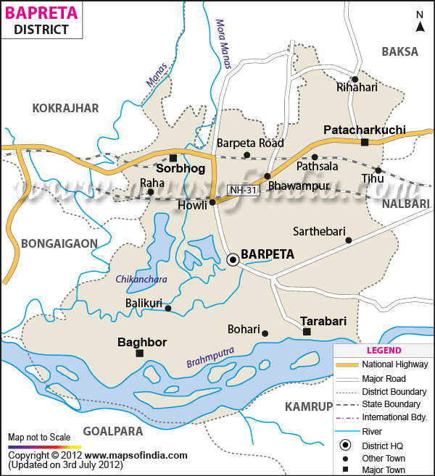
Barpeta: A brief overview
An Aspirational District situated in Western part of Assam.
Population =~16.93 Lacs.
9 development blocks
Distinct feature - 173 Riverine Islands called Char scattered over mighty Brahmaputra river.
Literacy rate = 51 % , Female literacy rate= 46%

Slide 3
A Quantitative Approach to Saturation
Key Themes in “Barpeta- Scaling new heights”
Scheme Saturation
Convergence
Target planning and Data Monitoring
Spatial Assessment Mapping and Project Development (SAMPADA)
Results
Grants of Rs 16 crores won in last 16 months.
All India leader in 6 KPIs out of 82 KPIs in ADP index.
Figured 4 times in top 10 country wide delta rankings.
Figured 7 times in top 5 sector wise performance (April 2022- Jan 24)
Increase in overall score by around 25% in one year on aggregate KPI score

Slide 4
Barpeta Experience: a look at composite scores
14th rank composite score wise up from 97th.
Increased composite score to 60.5 in Jan’24 from 42 in April’18
Theme | May‘18 | June’22 | Jan’24
Health and Nutrition | 57.6 | 67.5 | 75.9
Education | 62.9 | 77.3 | 80.8
Agriculture & water | 12.2 | 25.8 | 20.4
Financial Inclusion & Skill development | 28.2 | 22.9 | 30.2
Basic Infrastructure | 45.3 | 50.3 | 64.5

Slide 5
Health & Nutrition
Sectoral Highlights:
Mission Indradhanush: 98.88% saturation.
PMJAY (AB PMJAY): 91.82% saturation.
PMMVY: 104.5% saturation.
Initiatives
Pregnancy Tracker, Death and Referral audit (now being institutionalized in the state)
Infrastructural improvement- 19 new delivery points in Char areas.
Home Births dropped by 1563 in FY 2023-24.
Reducing home delivery pockets to 4 from 25
Linen Code policy
Boat referral coupons
RoP utilisation increased to 91% in 2024 from 62% in 2022

Slide 6
Education
Sectoral Highlights:
PM POSHAN: 100% saturation with 2,08,632 completion using app based monitoring via Shiksha Setu portal.
Infrastructure: 100% saturation in Electricity, Drinking water, Toilet and Electrical fittings across all 1892 schools.
Initiatives:
Fund Convergence for KGBV utilizing about Rs. 3cr of FFC grants
SAMPADA - tracks school visits by officials & GIS based field monitoring by the Magistrates.
Vidyanjali 2.0- 30 retired teachers giving services
Leveraging alumni associations

Slide 7
Basic Infrastructure
Sectoral Highlights:
Har Ghar Jal Yojana: Achieved 94.73% saturation
PMAY-G: Reached 1,20,045 of the 121,871 target (98.5% saturation).
PMAY-U: Met 6676 of the 7,412 target ( 90.08% saturation).
PM Ujjwala: Surpassed the target with 24,700 completions out of 23,000 (107.39% saturation)
Initiatives:
Reaching the last mile- Delivered 31,200 PMAY houses, 13,250 FHTCs, and 12,230 PMJAY cards in Char areas.
ODF+ : 634/634 villages certified ODF+ (constructed CMSC, MCF, CMCF, and soak pits), first in the state..
MGNREGS Convergence:
167 AWCs completed, Compound walls constructed in 53 schools; now being replicated in other districts.
Paver Block Roads: 7.967 km (FY22-23 to FY23-24), Godowns: 31 nos.
Sampoorn Ghar: 68,639 PMAY houses with all basic amenities i.e. Toilet, Gas, Electricity & water
*All data from April 2021 to January 2024.

Slide 8
Self Employment & Financial Inclusion
Sectoral Highlights:
PM SVANidhi: Enrolled 3,697 street vendors (100.27% of target (Apr’21 – Jan’24)).
PM Vishvakarma: Enrolled 50,000 craftsmen (100% of target), leveraging local jewelry and brass metal industrial guilds.
Financial Inclusion: Increase in Beneficiaries per lac population during 2022-23
APY : 3278 to 4555
PMSBY : 17490 to 25606
PMJJBY : 5590 to 8978
MSME: Disbursed ₹1,220 crore against a target of ₹935 crore (130% of the District Credit Plan target).
Initiatives:
Special enrolment camps for FI, Samadhan camps for scheme enrollment, door to door survey for beneficiary identification under SVANidhi.
Integrating social security with health and social welfare parameters by targeting MGNREGS workers for APY, JJBY, and JSBY schemes
Prioritizing MGNREGS jobs for HHs with poorer socio-economic indicators.

Slide 9
Agriculture
Sectoral Highlights:
Kisan Credit Card Scheme: Achieved 80,709 completions, with 100% target completion. (Apr’21 – Jan’24).
Paddy procurement Increased to 9,730 MT in FY24, up from 300 MT over the previous two years.
PM- KISAN : 95208 beneficiaries(96% of farmers as per Agri Census) ready for payment, highest in the state.
Initiatives:
Contract farming : MoU of potato farmers with ITC for cultivar replacement.
Jute retting tanks built using MGNREGS.

Slide 10
Governance Highlights
Janbhagidaari:
Collectivization- Formation of 76 health clubs, youth clubs in 98 GPs, 26 FPOs and 32 Cooperative Societies.
Leveraging SHGs- SHGs assist in scheme verification and serve as micro-vendors for government programs, increasing turnover from ₹405 Cr to ₹706 Cr, with expansions into catering and micro contracting.
Samadhan Camps:
Grievance Mechanism: Quarterly single-window grievance redressal in all 98 GPs.

Slide 11
Quality and Feedback :
Use of Technology:
GIS-Based Field Monitoring: Implemented via SAMPADA.
E-File and E-Billing: Systems introduced for administrative efficiency.
Budgetary and Institutional Reviews:
ROP Utilization: Health sector achieved 91%, and Education sector 83%, compared to 57% and 62% respectively in previous financial years.
Scheme Saturation and Convergence:
PMAY-G: Completed 120,045 houses in 2022-24, the highest in the state.
JJM: Provided 203,377 FHTC connections with 91% saturation.
PMUY: Reached 250,000 households with a 98.5% saturation rate.
Sampoorn Ghar: 68,639 PMAY houses with all basic amenities i.e. Toilet, Gas, Electricity & water
937 PMAY masons trained through ASDM using NITI Aayog funds.

Slide 12
Thank You

