Slide 1
Bikaner District
Category: Saturation approach in holistic development of districts
Presented by: District collector, Bikaner,
Rajasthan

Slide 2
Bikaner District Overview
Location: Thar Desert, Western Rajasthan
Area: 30,248 Sq Kms
Sex Ratio: 905 females per 1000 males (2011 census)
Female Literacy Rate: 52.12% (lower than the National Avg of 65.46%)
Focus on women-focused schemes due to demographic challenges
2011 census : 66.1 % rural population

Slide 3
Key Practices & Innovations
Transparency & Anti-Corruption:
Periodic inspections, employee performance monitoring
Beneficiary feedback and random data cross-checks
Grievance Redressal & Feedback Mechanism:
Sampark portal, 181 helpline, Jansunwai sessions
Priority on star-marked grievances

Slide 4
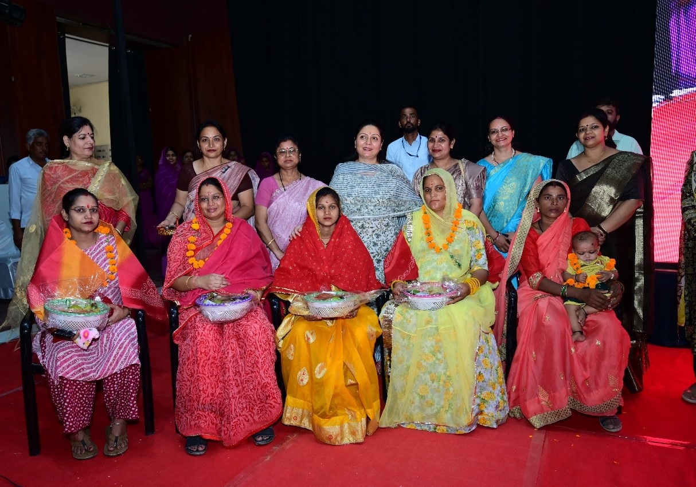
Key Practices & Innovations
Effective Administration:
Scheduled review meetings, ranking system for officials
Zero-tolerance policy for inefficiency and corruption
Human Resources and Capacity building:
Regular trainings for officials and community workers
Performance reviews to pinpoint improvement areas
Community Engagement :
Camps, Gramsabhas, and social audits for engagement
Awareness programs: street plays, school rallies, media outreach

Slide 5
Convergence of Schemes: 2 approaches
Integrated Planning:
Inter-departmental meetings to avoid duplication
Data integration for better beneficiary targeting
Saturation through Convergence:
Dovetailing of various aspects of different schemes for saturation
Complimentary use of fund sources (LAD funds, CSR, DMFT etc )

Slide 6
Saturation approach to schemes
Name of the Scheme | Target | Achievement | Percentage of Saturation
PM ujjwala Yojana | 30753 | 30753 | 100 %
PM Matru Vandana Yojana | 29,790 | 27,633 | 92.75 %
PM Awas Yojana (Gramin) | 16.224 | 15,668 | 96.57 %
PM Vishwakarma Yojana | 1210 | 1210 | 100 %
Kisan Credit Card scheme | 50,596 | 48,003 | 94.87 %

Slide 7
Illustrations of Saturation through convergence
Saturation of Benefits to Persons with disabilities (PwDs) under MGNERGA:
Extensive survey of PwD Job-card holders under NREGA with eligibility for “ Apna Khet -Apna Kaam “
Sanctioned works: 1197
School infrastructure:
>250 School boundary walls : Dovetailing of NREGA with other schemes
Given the extreme heat conditions of Bikaner, multi-purpose Tin Sheds are constructed in all school playgrounds for students, leveraging multiple sources like MLALAD, DMFT, CSR, NREGA

Slide 8
Illustrations of Saturation through convergence
Anganwadi centres:
All Anganwadi centres in Bikaner are provided with Smart TVs and Digital education content under Mission Nirman (Bikaner District initiative) leveraging CSR funds

Slide 9
THANK YOU

