Slide 1
bharatnet in Gujarat (state-led model)
Gujarat Fibre Grid Network Ltd
Jan-2025

Slide 2
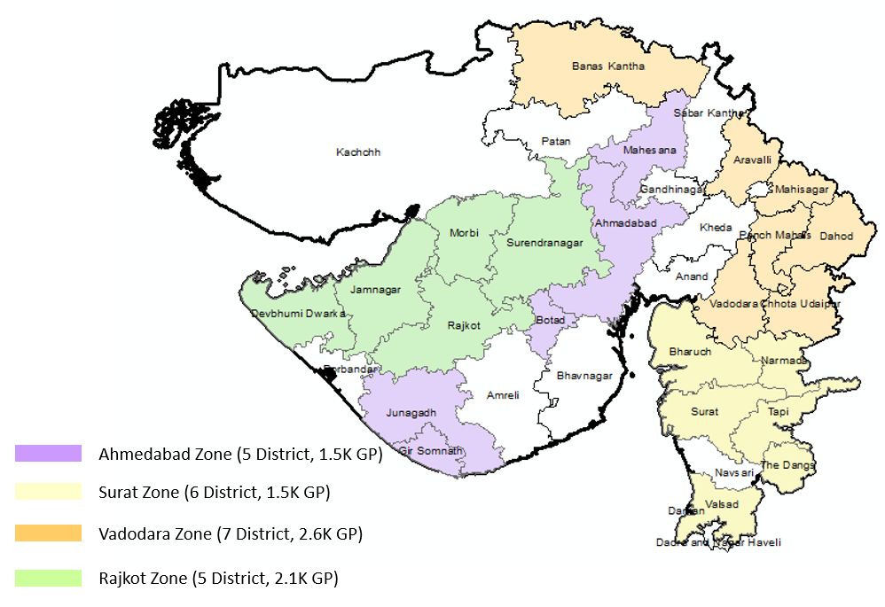
Existing BharatNet Phase-I and Phase-II Coverage
Phase-I Districts
Phase-II Districts

Slide 3
Phase-II : Gujarat Status on National Landscape
State-wide GP Uptime
>90%
<75%
<50%
<25%
Maharastra,
Chhatisgarh
Tamilnadu,
Andhrapradesh
Jharkhand,
Telangana,
Odisha
Gujarat

Slide 4
Best Practices > BharatNet Phase-II Project
Execution strategy
Key steps for Operation and Maintenance
Network Utilization
1
2
3
Design and Solution-Led RFP (EPC) with focus on outcome
Digital visibility of GP as first milestone of Payment
State RoW waiver
Zero dependency model : Network architecture from “State Capital to GP” Telecom Grade Infrastructure – Shelter
Technology led network governance with synergetic and seamless integration of RFMS, GIS, NMS and ERP
Provision of Partial Go-Live (50% O&M) before moving to 100% O&M
Technology-Led SLA based O&M Payments with 98.5% network uptime as baseline
Service provisioning in PIA scope
Provision of FRT & patroller (Fiber Restoration Team) at block level
Promoting use of “Call before u dig” under PM Gati-shakti Portal
Dark Fibre leasing to Telcos/ISPs
Shelter space monetization under Infrastructure sharing
Fiberization of Telecom tower for better mobile coverage to citizens
FTTH connections to rural households
Village LAN connectivity – Extended SWAN to Health centers, Schools and Police stations

Slide 5
Phase-II : 3-Dimensionals for making BharatNet relevant for citizens
For Connected Government
For Citizens
For Tower Fiberization
Serving to :
5

Slide 6
Best Practices (use) of BhartNet Phase –II for the State Government
A) Digital SewaSetu/e-Gram : Able to bring digital transformation to 7,749 Gram Panchayats with 321 services under one roof benefited around 1.57 crore rural residents in past two years. The notable improvements before and after the implementation of BharatNet-II.
B) State-wide Connected Government :
Alignment of Bhartnet network with GSWAN (District and Taluka HQ) : 300 Locations
Extending GSWAN vertically upto Gram Panchayats using Bhartnet : 8,036 Locations with free Wi-Fi
Rural public institutions
200+ government programs (PM,CM events) are telecast live through BharatNet Network.
50+ Iconic places like Mahatma Mandir,Dholera SIR,Science City,GIDCs, and the Statue of Unity
Urban public institutions: Connecting government institutions in Urban vicinity without capital outlay (Revenue sharing model).
C) FTTH-Home Wi-Fi and HAR GHAR EDUCATION :
Planning to leverage TV interface for providing educational contents with superior speed all and everywhere at Home
D) Enhancing Telecom Infrastructure for exponential increase in signal strength and expanded rural coverage :
Dark Fiber Leasing for high-speed internet connectivity, promoting digital inclusion and economic growth
Mobile Tower Fiberization to enhances network reliability and speeds
Parameters | Before Bharatnet | After Bharatnet
Network speed per GP | 100 Kbps | 100 Mbps (1000 Times)
State level Bandwidth | 31 Mbps | 20 Gbps (600 Times)
Govt Service | 20 | 321
Charges | VSAT | Free for GP
Wi-Fi | No | 7692 Gram Panchayats

Slide 7
Phase-II : Network Utilization Progressive report
3-Dimensional Utilization Strategy:
For Connected Government : Village LAN (FTTX) Connections
For Citizen : Leasing dark fiber to TSP/ISP
For Tower fiberization : Improving network strength in Rural

Slide 8
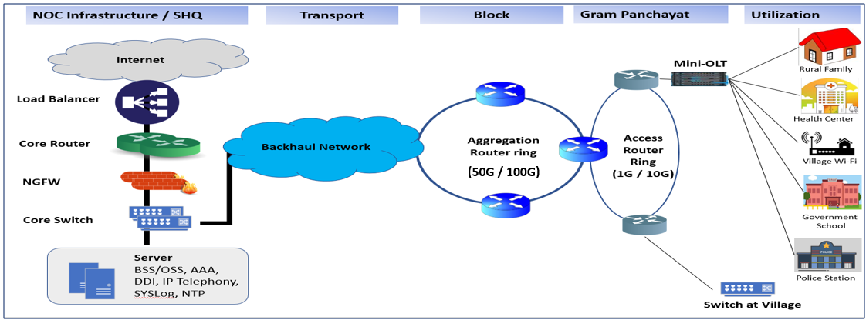
ABP (Phase-III) Network Infrastructure in Gujarat : At a glance
NOC RFP
Backhaul RFP
Phase-III RFP
LMCA/Urban/FTTH RFP
Sr No | Particulars | Scope | Equipment | Traffic Capacity | Design O&M Criteria
1 | Sub-Blocks / Shelter Location | 660 | Block Router, RFMS | 50G/100G Ring (3-Way protection) | > 99% availability
2 | Gram Panchayat | 14653 | Router, Mini-OLT, UPS | 1G/10G Ring (2-Way protection) | >98% availability
3 | Revenue Villages | 4387 | ONT | 1G capacity (Linear) | >95% availability

Slide 9
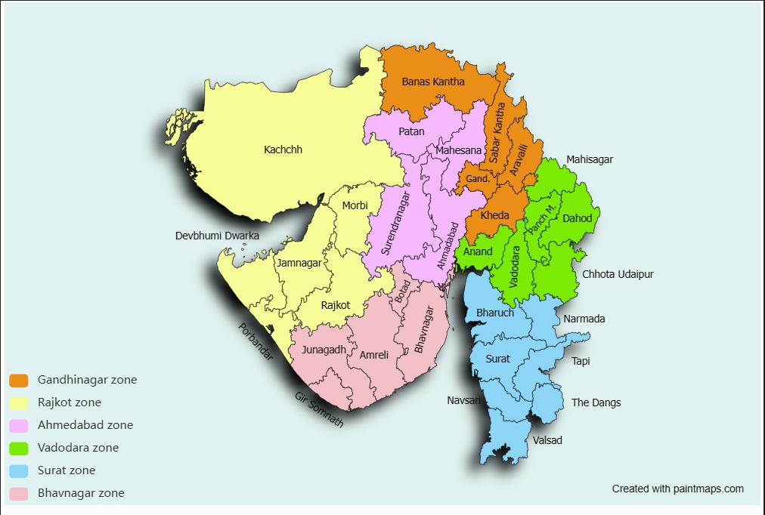
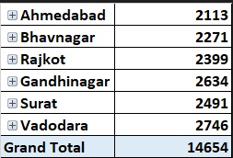
Proposed BharatNet Phase-III Coverage
Package-A : Gandhinagar, Vadodara, Surat Zones Package-B: Ahmedabad, Rajkot, Bhavnagar Zones
Sl. | Scope | Total Counts | Phase-I Counts | Phase-II Counts
1 | District HQ | 33 | 11 | 22
2 | Block HQ | 252 | 117 | 135
3 | Gram Panchayat | 14654 | 6617 | 8037
4 | Revenue Villages | 4387 | - | -
5 | No. of Exchange (Ring Block) | 660 | 259 | 401

Slide 10
Strategy for Amended BharatNet Program (ABP), State-led model GUJARAT
Equilibrium
Divided Gujarat Districts in two packages for effective execution and control unforeseen circumstance during project
Digital Payment
3D Model : Delivery, Draw and Discovery including Asset register for Lit GPs.
Industry Standard Network Infrastructure
Fiber and network with Internet breakout and inherent features for monetization
Virtual Inspection
Remote and Real time tracking of Project and Performance
Network Dashboard & Qualitative KPI monitoring
MTTR, No. of Fiber Cuts, Lossy Fiber, Latency, Jitter, Packet Loss etc.
Broad Service Portfolio
FTTH, MPLS, Digital Seva Setu etc.
Network Visibility in State NOC
Advanced Network Monitoring system and helpdesk at Central location including software
High Network Uptime
Boost Network Availability by establishing UPS with Solar energy at GP, Telecom shelter at Block

Slide 11
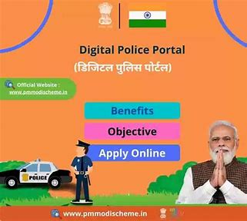
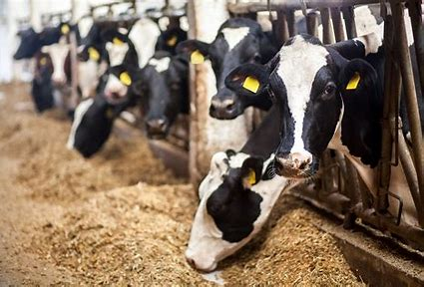
Outlook of Socio-Economic beneficiaries over BharatNet
Tele-Education (Schools connected-7394);
“Har Ghar Education”
E-Governance (Type of Services-321);
Grassroot level Governance up to Village
Presently served
Digital Police (Chowkies connected-372);
Online complain registration
Rural Health Center-600);
IoT in Agriculture;
Empower Farmers
Food and Civil Supplies;
Consumer Digital Rights – My Ration
Milk Co-operative Society;
Boost Dairy Network Economy
Asha Workers;
Empower Anganwadi operations
Targeted in near time
Rural Bank and ATM;
Secure Connectivity, matching industry standards
Open Network for Digital Commerce;
Connectivity to E-commerce

Slide 12
Thank You
From
Gujarat Fibre Grid Network Ltd.

