Slide 1
INNOVATION
in
GOVERNANCE
“Good governance is perhaps the single most important factor in eradicating poverty and promoting development”
- Kofi Annan

Slide 2
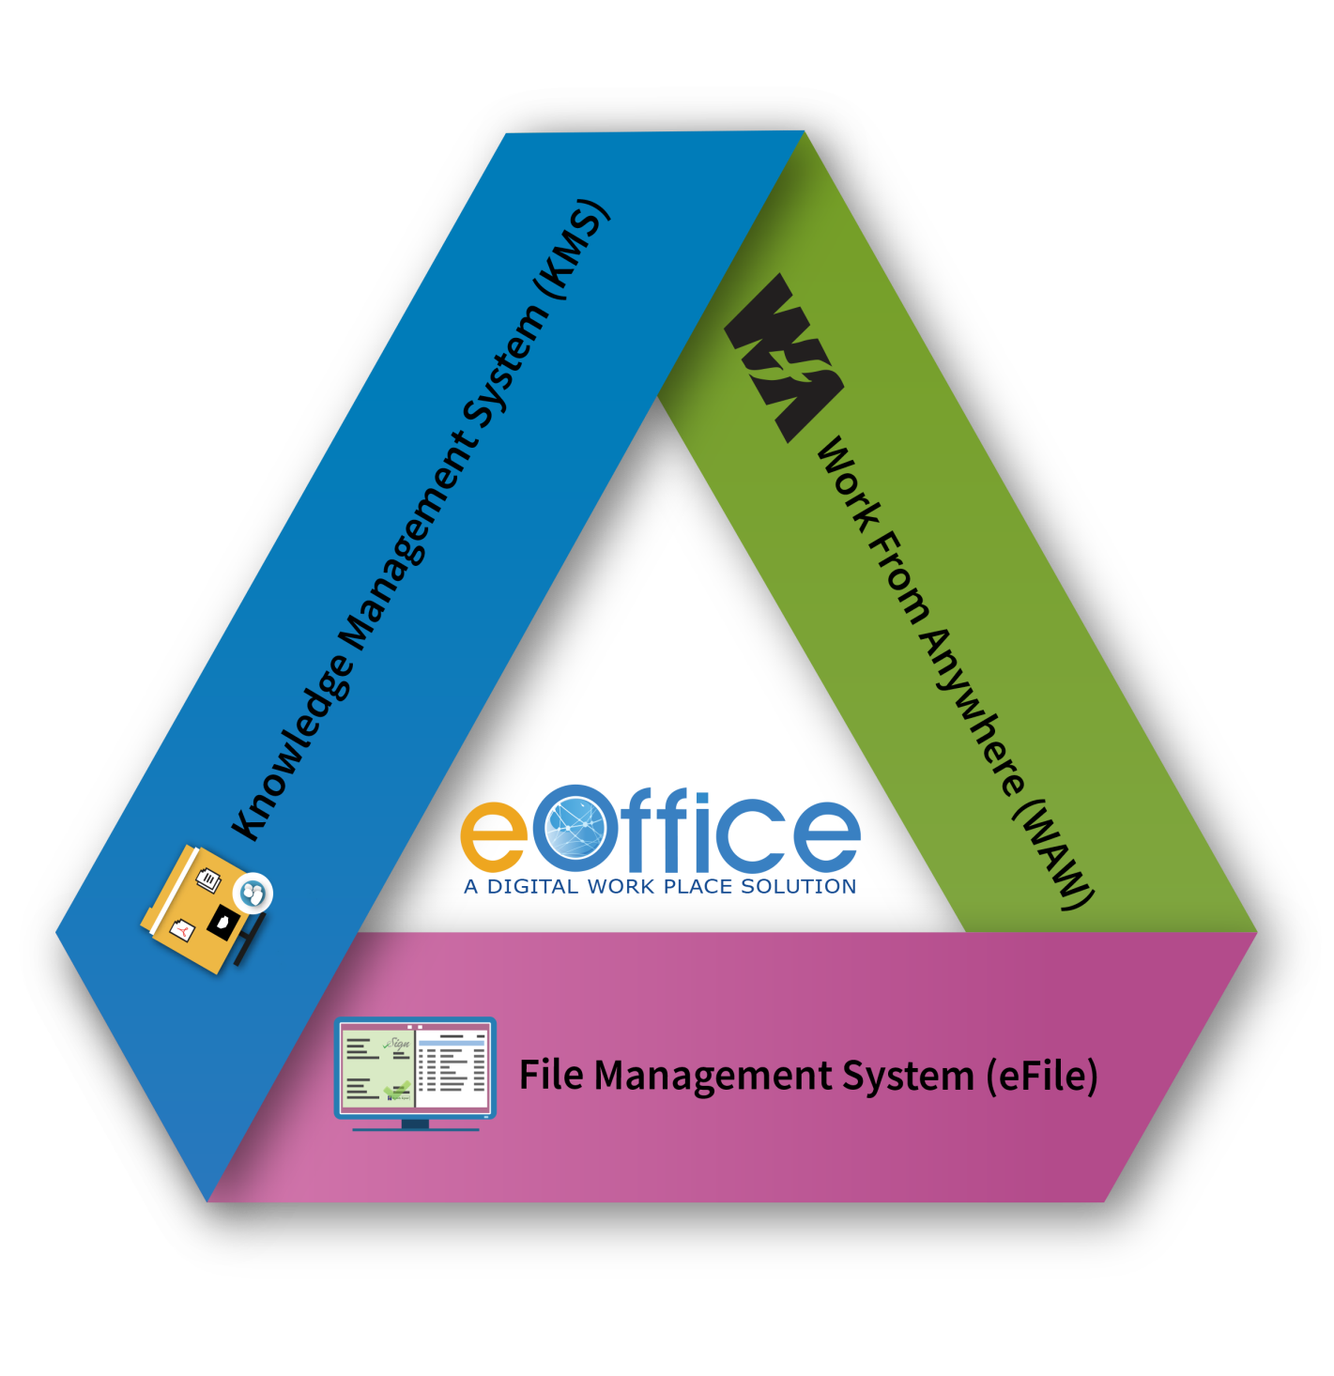
eOffice : A Digital Workplace Solution
Integral part of the Digital India Programme
Based on Central Secretariat Manual of eOffice Procedure (CSMeOP)
Strengthening the Government decision making machinery
Promotes less paper office with greater collaboration and knowledge sharing
Provides for transparency, efficiency, accountability and faster decision making
Single Product for reuse in the Government, replicable at the Central, State and Districts

Slide 3
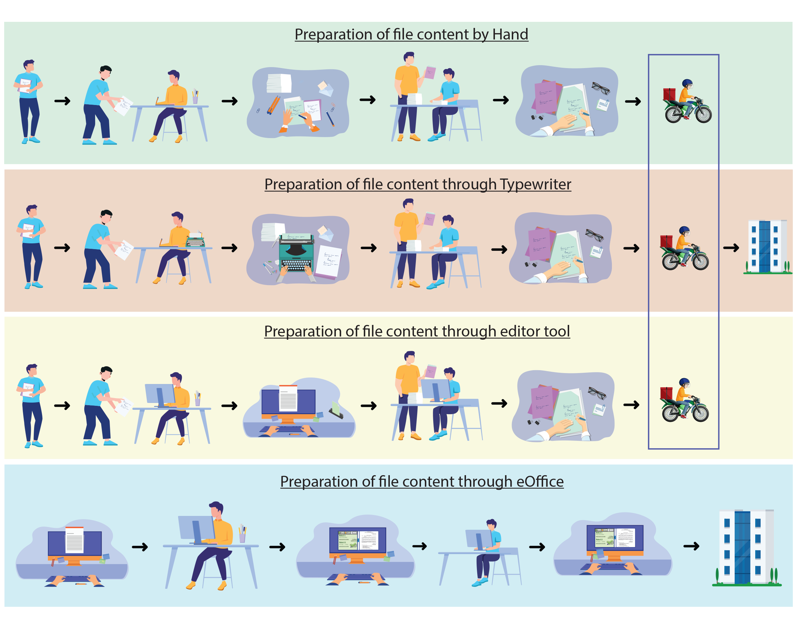
Transformational Journey

Slide 4
File Tracking(eOffice) Journey
Office Procedure Automation (OPA), File Tracking System and eOffice
S.No. | Year | Software Name | Application Type
1 | 1996-1999 | Office Procedure Automation (OPA) | Client- Server Based
2 | 2000-2001 | File Tracking System – OPA (Ver2.7) | Web Based
3 | 2004 | File Tracking System – OPA (Ver3.0)
4 | 2009 | eOffice (Beta Version)
5 | 2012-2019 | eOffice Product Suite (Deployed on Cloud)
6 | 2020- | eOffice Product suite 7.x (Work from Anywhere) with localization | Web based, Integration with legacy applications through web services

Slide 5
eFile v7.X
UX Redesign & Standardization
Responsive Design (iPad, desktop, tablet)
Seamless viewing of multiple documents (while noting/drafting)
Ease in navigating different Receipts/Issues in the Correspondence List
Consolidated file creation process
User Specific Customization (Setting of Landing page, View Preferences)
Inbox elegantly organized
Processes
Working on multiple Files/Receipts using Tabbed view
Multiple signing (Example: Minutes of meeting, committee members)
Flagging of important Files / Receipts / Dispatch
Quick Access Context menu
More area for Read-Write operations
Seamless working across multiple Posts
Para Referencing
Dispatch to Receipts
Processes Contd.
Localization – Menu in preferred Language
Provision of Department based Master data for Instances having multiple departments
Provision of Receipt no. Initialization
Receipt numbering based on Instance and Department
Address Book Management
Provision of Department based Templates for Drafts and Acknowledgements
Facility of uploading Ink Signed copy in draft
Address Book
Latest Technology Stack
Previous version based on old technology is being used since 2010
Complete revamp of existing structures, latest backend and front end in open source tools and technologies.
Scalable and SAAS based
Optimized for high transactions
Efficient storage of documents
Improved Signer service

Slide 6
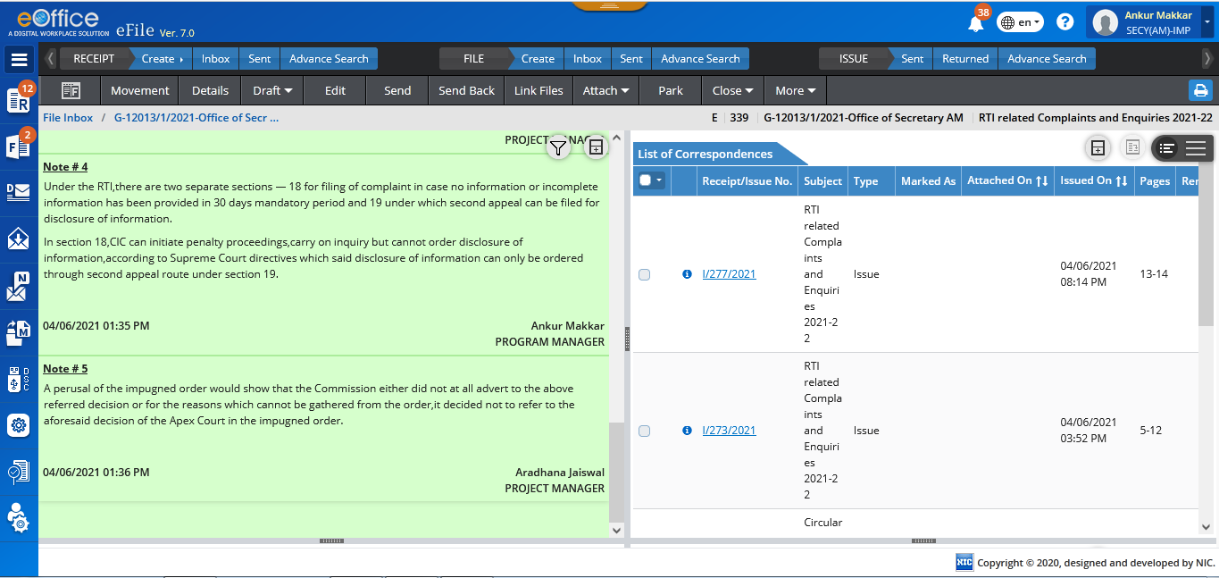
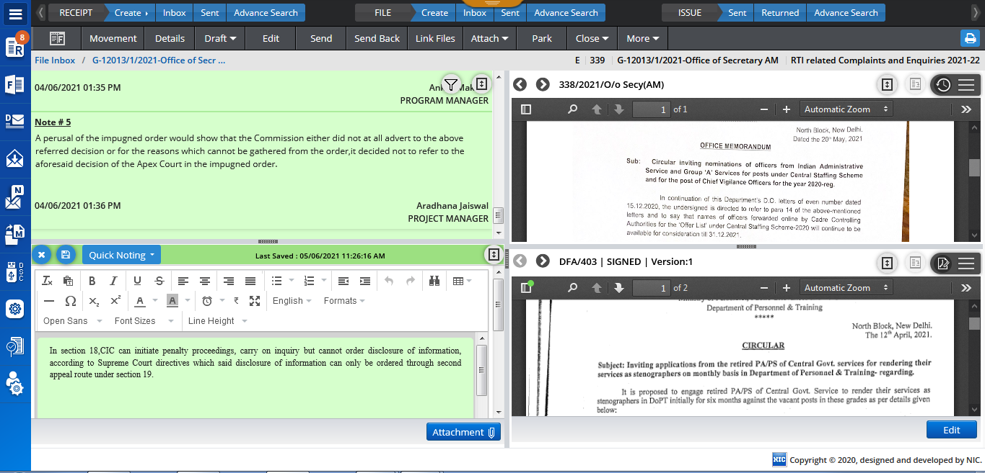
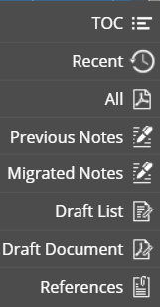
eFile – File Inner Look
Switch View : Screen Divided in 4 Windows
Add Noting
Hamburger Menu
Switch View

Slide 7
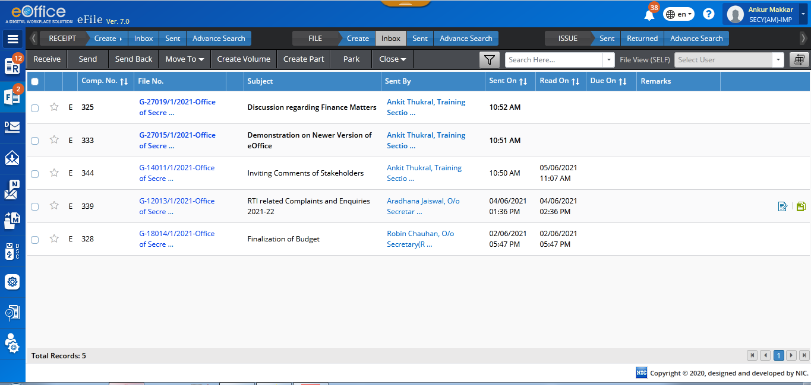
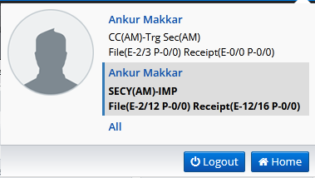
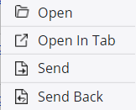
eFile – Enhanced Features
Quick Action Menu
Common Inbox
Quick Access: Context Menu

Slide 8
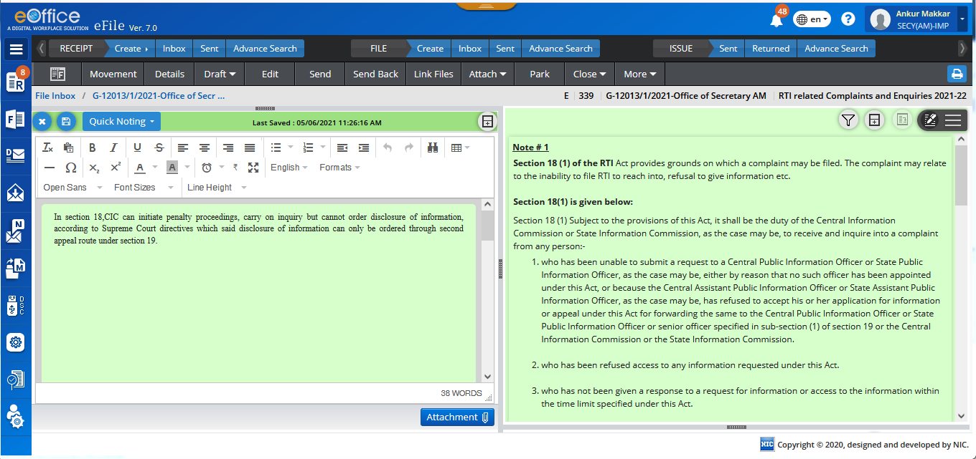
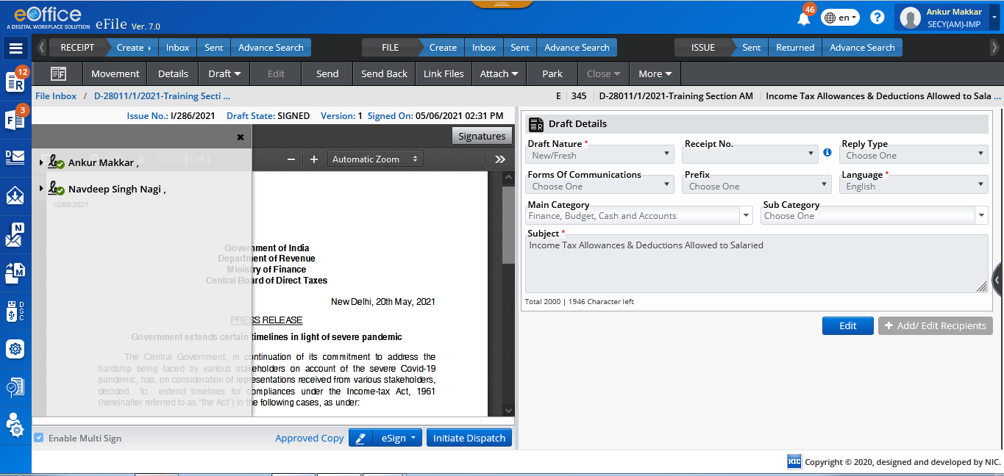
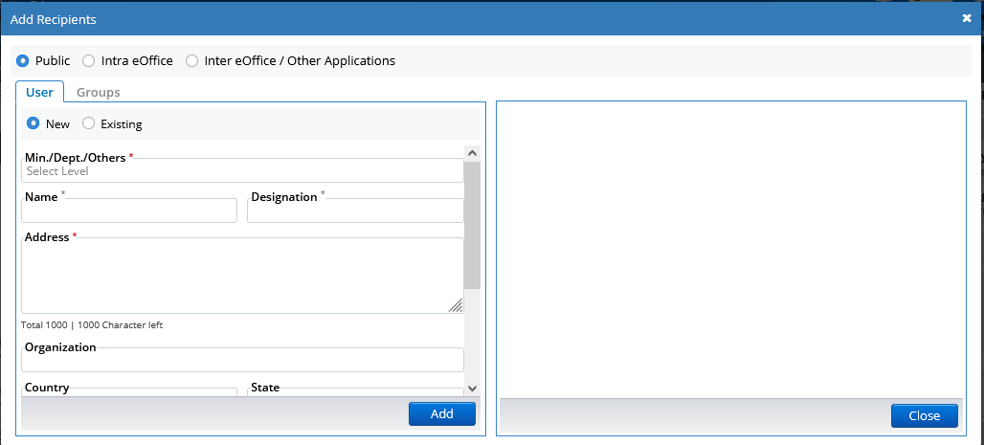
eFile – File Inner Look (Contd.)
Public, Inter eOffice and Intra eOffice Dispatch
Paragraph & Note Referencing
Multi Sign Feature in DFA

Slide 9
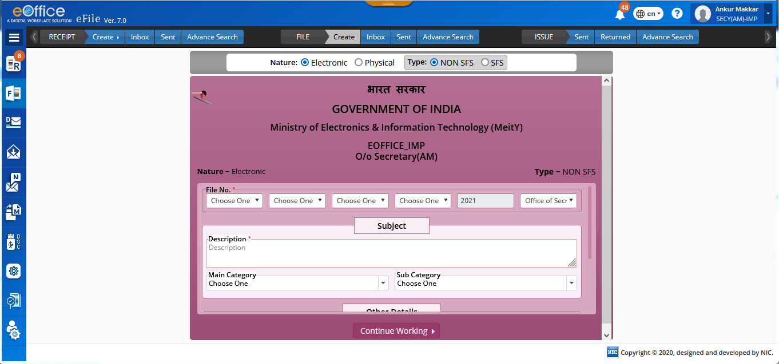
eFile – File Cover Page

Slide 10
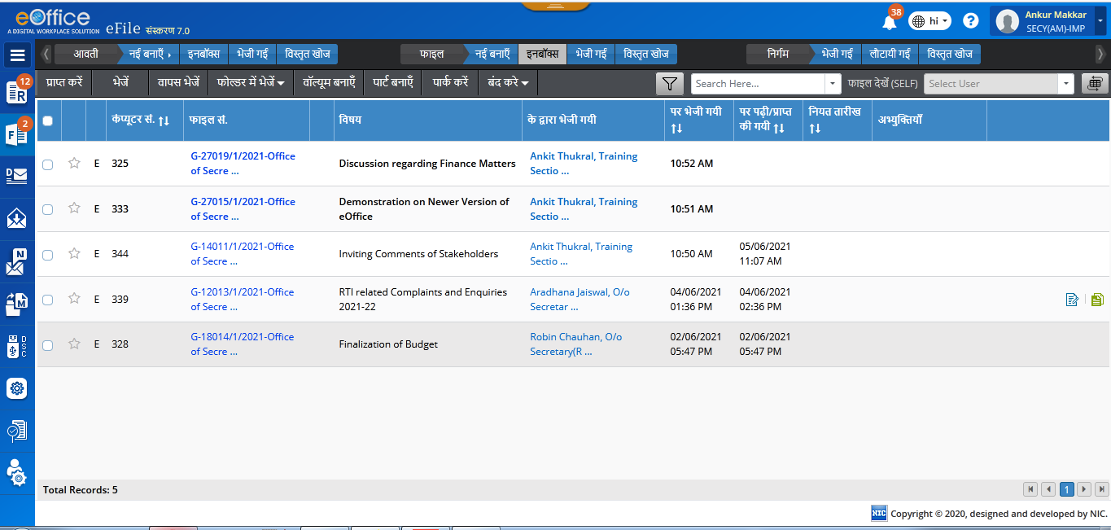
eFile – Localization
Bilingual
Language Labels

Slide 11
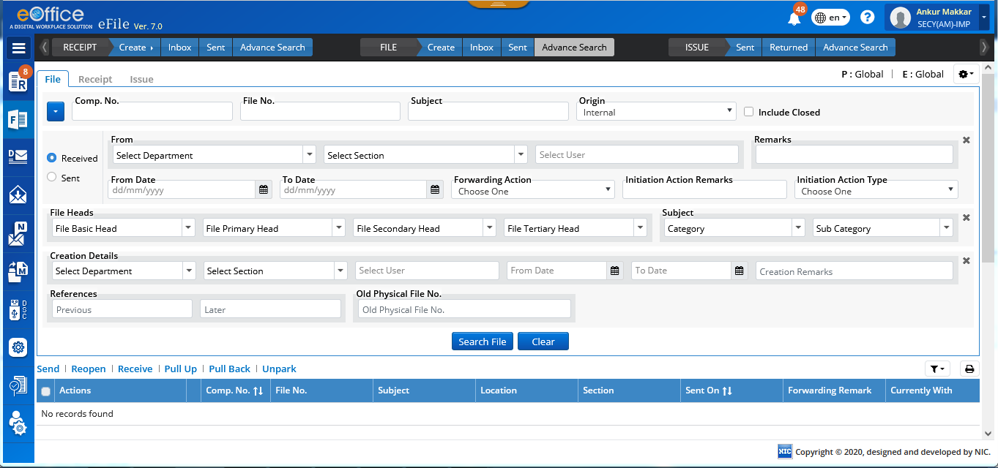
eFile – Advance Search

Slide 12
eFile MIS Reports
To optimize the usage of eFile and provide real-time monitoring; an explicit eFile MIS Reports application has been integrated in eOffice.
eFile MIS Reports application has been designed with role-based scope privilege for users to access different reports as per the requirement.
eFile MIS Reports has been broadly categorized into File, Receipt, Dispatch, VIP, Productivity and Miscellaneous modules to provide seamless monitoring of all the actions and entities involved in the decision making process.

Slide 13
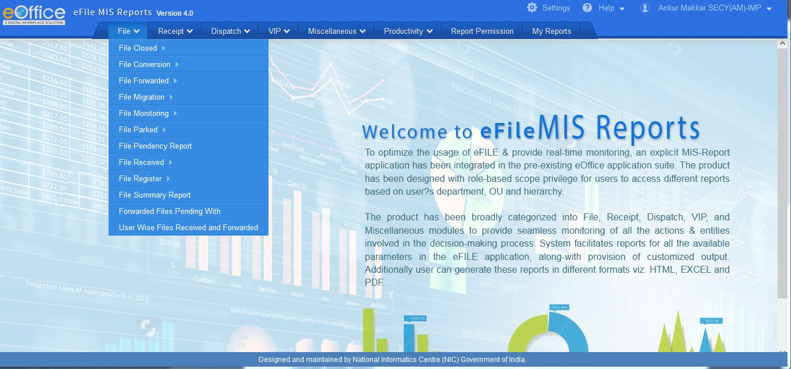
eFile MIS Reports

Slide 14
Work from Anywhere (WAW) Portal
WAW Portal is built upon core workplace experience and creates a highly extensible environment for users to dynamically adapt to changing needs.
The virtual work environment provisioned by WAW Portal, shall empower employees with all the key resources that will enable them to access organizations’ applications and data and communicate with fellow officials.

Slide 15
WAW Portal – Features
Flexible and Responsive Digital Workplace via smooth transition to Work from Home from Work from Office culture, by providing a realistic imitation of an office to an official.
Business and Service Continuity by facilitating unhindered work, unfettered and secured access to the departmental applications running in the organization, to the Government officials.
Confidentiality and Security via securing remote working arrangements through SSO.
Near Real-time information through access to Notices and Circulars published, Media Gallery and Social Media feeds etc.
Employee productivity via provisions of collaboration tools like, Calendar, eMail, eOffice, Tasks, To-Do List, Notes, KMS etc.

Slide 16
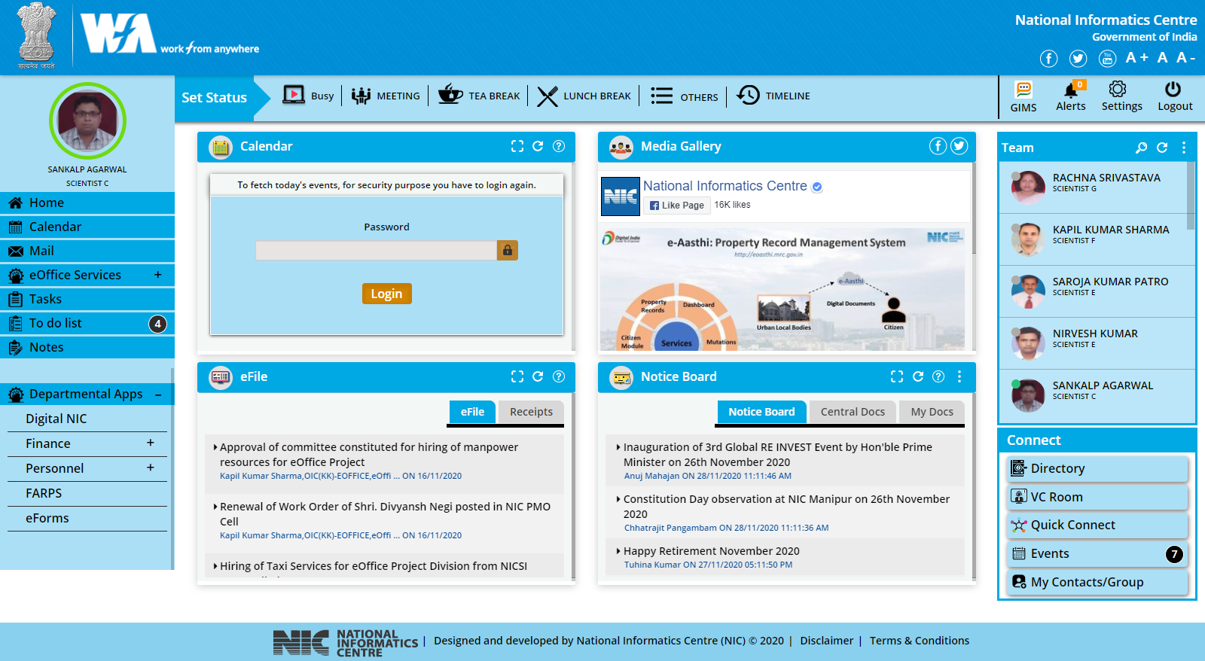
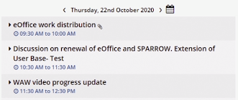
Work from Anywhere (WAW) Portal

Slide 17
Knowledge Management System (KMS)
KMS controls the life cycle of documents of an organization, enabling users to create and manage electronic documents that can be viewed, searched, shared and published.
Knowledge Management Portal for an organisation is developed with the objective of knowledge sharing and discovery among the users of an organisation to enable efficient utilization of knowledge.

Slide 18
KMS – Features
Authentication with Single Sign on with NIC Parichay.
Tagging of Document Based on Category, Organisation, Type, Collection.
Content Based OCR Search along with Metadata.
Document Workflow and Roles.
Knowledge Manager Layer.
Sharing among users.
Subscription and Alerts.
Web Services to Pull and Push data.
Customized Content and Metadata fields.

Slide 19
Interface with eGov Systems through API
Employee and Organization Unit (OU) Data Sharing APIs
External
Data Sources
(SAP/ERP/Other Applications)
eOffice-PIMS
Receipt Movements
Receipt Status
eFile Core APIs
Receipt No.
Approved Draft (Mail/Dispatch)
Decisions in eFile
Set Flag for Receipt
External
Application
Receipt Creation
External
Application
eOffice-eFile Application
External Dashboard and Reporting APIs
1. Organization Unit/Employee Pendency
2. OU/Employee Performance
3. CM Dashboard
many more……

Slide 20
eOffice Nation-wide Rollout
IMPLEMENTATION
SUPPORT MECHANISM
eOffice Instance Setup
Local NIC & Dept. System Admins
L0 Support
Onsite Rollout Team
Analysed, Accepted, Fixed/Developed
Issues & Bugs
NIC Service Desk
Training by NIC
Dept. EMD Mgrs. & Master Trainers
Released
as per release cycle
Change Requests / Feedbacks eOffice Support Portal
Deployment of upgrade/patch
By Dept. System Admins.
Training by Dept. Master Trainers
to Dept. users.
L1 Support
NIC Service Desk
Training by NIC
Dept. Master Trainers
Master Data Population
By Dept. EMD Mgrs.
L2 Support
Local NIC Cell
Trial Run & Go Live
Training by Dept. Master Trainer
to Dept. users.
L3 Support
NIC eOffice Project Division

Slide 21
Work done in eOffice during COVID-19
Central Government Ministries/Departments
from 23rd March to 29th December
Year 2019
Year 2020
Variance in %
Users
1,00,462
1,67,001
66.23
eFiles Created
3,55,074
12,15,250
242.25
eFiles Moved
72,70,835
1,45,60,408
100.26
eReceipts Created
22,06,261
65,03,949
194.80
eReceipts Moved
53,20,154
1,69,81,504
219.19

Slide 22
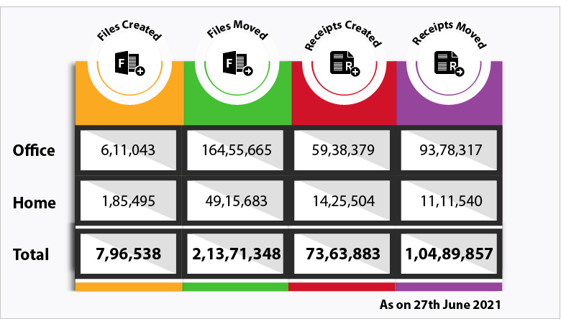
Work done in eOffice during COVID-19
Central Government Ministries/Departments from 23rd March 2020 till 27th June 2021

Slide 23
Current Status of eOffice Implementation
S.No.
Enterprises
Category
No. of Units where eOffice is implemented
Total
1.
Central Government
Ministries and Departments
83
296
Attached/Subordinate Offices/PSUs etc.
213
2.
State/UT Government
Secretariats
28
387
District Administrations
229
Other Departments/PSUs etc.
130
TOTAL
683
683
As on 27th JUNE 2021

Slide 24
Challenges
Data Migration and upgrading from previous eFile to eFile v7.x(eFile v6.x)
Absence of Onsite Rollout Team, EMD Managers, Master Trainers & System Admins (Local Deployments)
Keeping pace with the ever changing technologies, (Browsers, Java, OS, eSign, DSCs)
Device, Platform and Browser Neutrality
Conflicting Change Requests (CRs) from implementing organizations
Deployment of the Product and its maintenance

Slide 25
Way Forward
Archival of files and processes for archiving at National Archives
Single Knowledge Repository for the Government
Standardization of internal & external processes to bring in structured approval process
Unify eOffice into a platform with interfaces/linkages with other departmental applications
Efficiency enhancement by re-engineered processes & smart chatbots to assist in working

Slide 26
For more details on eOffice, visit
Website: https://eoffice.gov.in
24x7 NIC Service Desk
Website: https://servicedesk.nic.in
Toll Free Number: 1800-111-555

Slide 27
Thank you

