Slide 1
Presentation on e-Office Advanced Analytics Dashboard
(https://vishleshan.eoffice.gov.in/)
Regional Conference on ‘e-Governance’
Guwahati
10.01.2024
Department of Administrative Reforms and Public Grievances

Slide 2
Development of e-Office- A historical perspective
S. No. | Year | Software Name/ Milestone
1. | 1996-1999 | Office Procedure Automation (OPA)
2. | 2000-2001 | File Tracking System – OPA 2.7
3. | 2004 | File Tracking System – OPA (Ver3.0)
4. | 2009 | e-Office (Beta Version)
5. | 2014-2019 | e-Office Product Suite (Deployed on cloud) Version 5.x
6. | 2020- | Version 7.x - Inter-instance / APIs
7. | 2023- | Development and launch of e-Office Advanced Analytics Dashboard- Launched by MoS (PP) on 19th December, 2023 in the Inaugural ceremony of Good Governance Week 2023 (https://vishleshan.eoffice.gov.in)

Slide 3
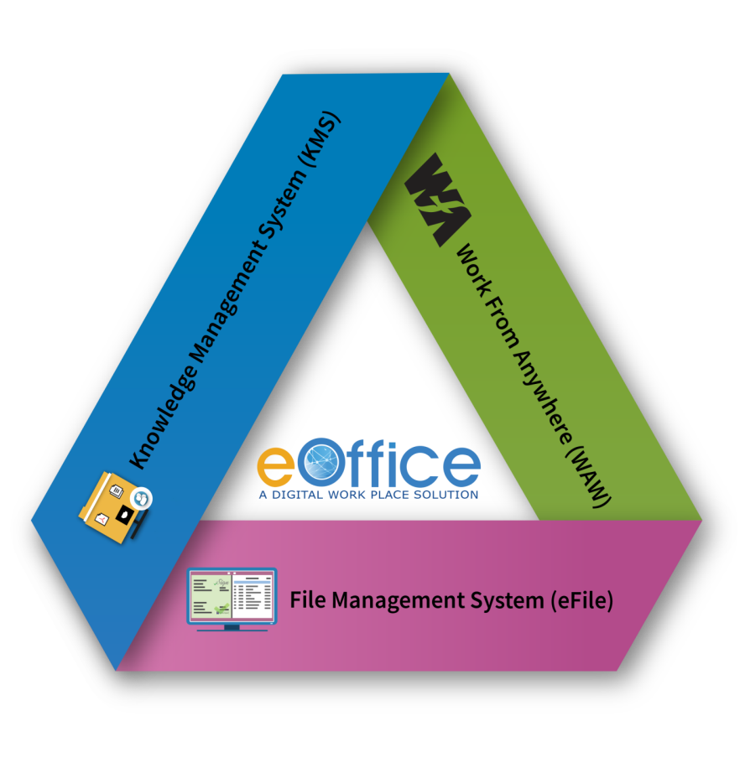
e-Office – A Digital Workplace Solution
Based on Central Secretariat Manual of eOffice Procedure (CSMeOP)
Built on Open Source Software Stack
Enhances Efficiency, Transparency, & Accountability
Generic Design :
Single Product for Government at all levels
Promotes less paper office with greater collaboration and knowledge sharing
Fast Tracking
Government Decision Making
Department of Administrative Reforms and Public Grievances

Slide 4
e-Office -a Support to Governance
1. The e-Office supports governance by
Enhancing effectiveness and transparency
Files can be tracked and their status is known to all at all times
Increases accountability
Quality and speed of decision making is easier to monitor.
Assure data security and data integrity
24*7 accessibility leading to enhanced productivity
2. e-Office has been implemented in
385 Central Government organizations including all Ministries/ Departments
607 State/ UT Govt. organization
Department of Administrative Reforms and Public Grievances

Slide 5
e-Office –Status in North-Eastern States
S.No. | State | Organization Name | eOffice Version | No. of Users as per project proposal issued by NICSI | No. of Districts where eOffice is implemented
1 | Arunachal Pradesh | Secretariat and Districts | Lite (eFile) | 25000 | 25
2 | Assam | Secretariat and Districts | Lite (eFile) | 50000 | 34
3 | Manipur | Secretariat and Districts | Premium | 10000 | 16
4 | Meghalaya | Secretariat | Lite (eFile) | 1000 | 0
5 | Mizoram | Secretariat | Lite (eFile) | 250 | 0
6 | Nagaland | Secretariat | Lite (eFile) | 100 | 0
7 | Sikkim | Secretariat | Lite (eFile) | 3000 | 1
8 | Tripura | Secretariat | Lite (eFile) | 5000 | 1
Source: e-Office PMU NIC
Department of Administrative Reforms and Public Grievances

Slide 6
Need for e-Office Advanced Analytics Dashboard
To maximize the potential of e-office by providing Real Time metrics to Facilitate in-depth data analysis & strengthen Decision Making
To provide inputs to senior management level on macro level Data and Trends in use of e-Office in an organization
Will facilitate a comprehensive implementation of IEDM
Data Analysis to identify bottlenecks and create scope for improvement by further streamlining e-Office
Identify the workload with Officers to help maintain an even distribution of work
Department of Administrative Reforms and Public Grievances

Slide 7
Journey So Far
Product Selection
Architecture Design
VA & Data Processing
Data & Visuals Design
Exploration of suitable tool for Analytics purpose.
Several Products were analyzed to meet business requirement.
E-Office Data Analysis Architecture was defined
Apache Super Set was customized and deployed, being OPEN Source
Selection, review and fine-tuning of Key Performance Indicators
Report Formats developed for Graphical Representation of Data
Vulnerability Assessment (VA) for all 74 Ministries/Departments’ servers
Data Processing and development of dashboard
Launched by MoS (PP) on 19th December, 2023 in the Inaugural ceremony of Good Governance Week 2023
Department of Administrative Reforms and Public Grievances

Slide 8
e-Office Advanced Analytics dashboard
The dashboard (https://vishleshan.eoffice.gov.in/) gives a macro view of 6 broad parameters:
eFiles and pFiles Statistics (Number and %)
e-File Movement Status (Levels)
Inter-Ministry/ Department File movement (Time)
Receipt Status (Total and Digitised numbers)
Signing Usage (eSign/DSC/None Number)
VPN usage (User number and usage numbers)
Department of Administrative Reforms and Public Grievances

Slide 9
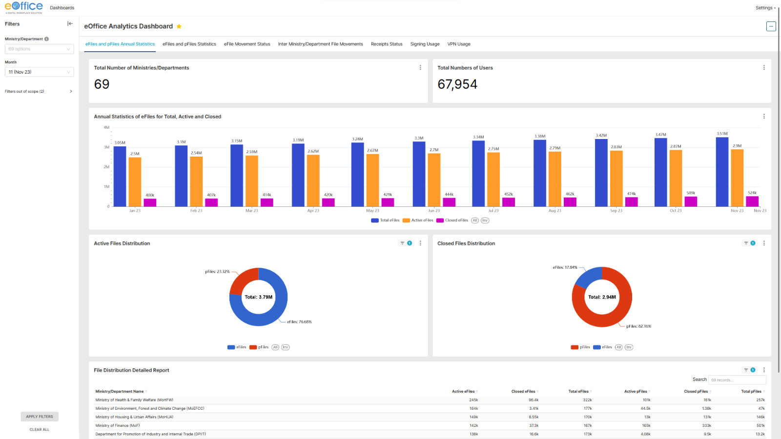
e-Office Analytics & Dashboard
(https://vishleshan.eoffice.gov.in/login/)

Slide 10
The Progress so far….. Successful Delayering
The distinct levels of file movement fell from an Average of 8.01 in 2020 to 4.11 in Nov 2023 for Ministries & Departments

Slide 11
Average Distinct level across Ministries/Departments

Slide 12
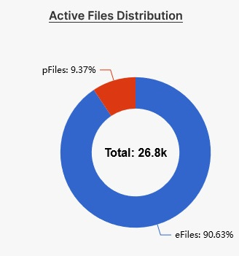
The Progress so far….. The growth of e-Files
More than 90% new files opened in Nov 2023 were e-Files For Ministries & Departments

Slide 13
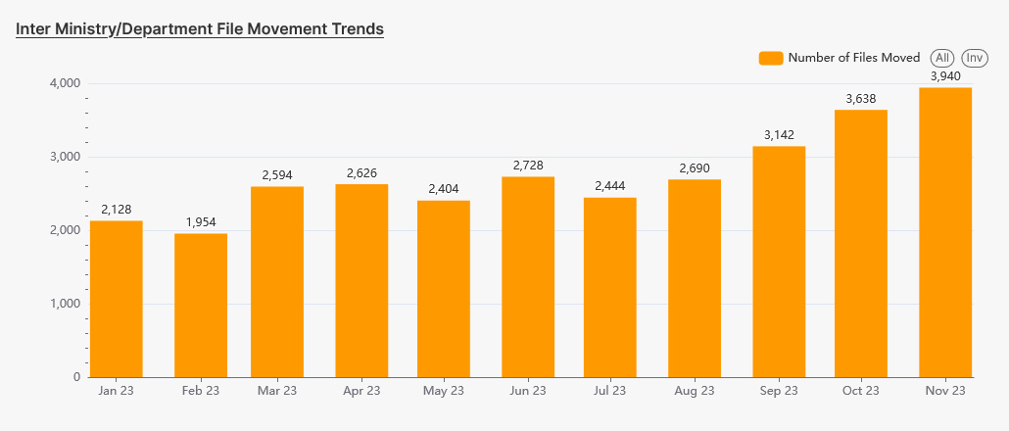
The Progress so far….. Inter-Ministerial File Movement
The Inter-Ministerial File movement is steadily increasing. The figures for Nov 23 (3940) only being more than total (3310) for Year 2020.

Slide 14
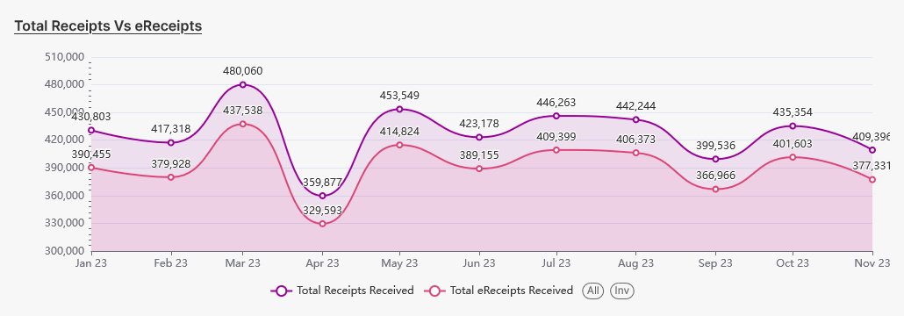
The Progress so far….. A shift to e-Receipts
Over 90% of Receipts are getting digitized as e-Receipts
% share of e-Receipts has gone from 87 % in 2021 to 91.55 % in Jan- Nov, 2023

Slide 15
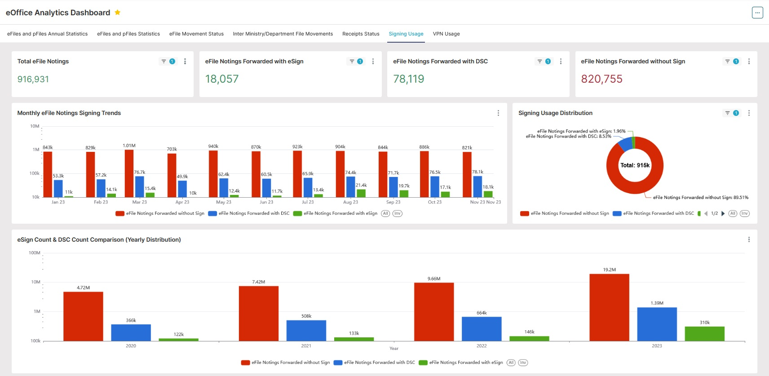
The Progress so far….. A gradual increase in DSC/ eSign Usage
There is a steady increase in DSC & eSign usage, specifically the usage has doubled in the Year 2023 over the Year 2022.

Slide 16
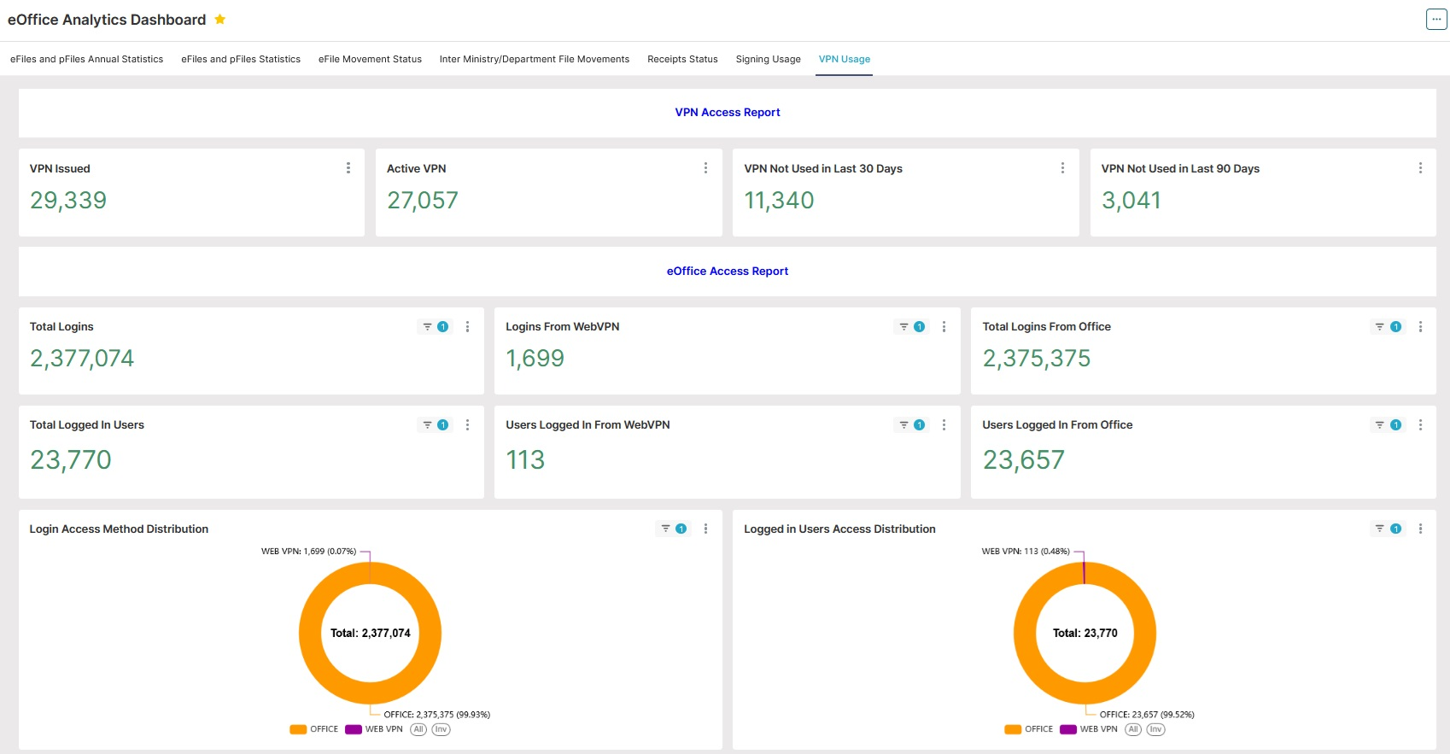
The Progress so far….. A view of VPN usage
The usage of VPN has not made sufficient progress. The VPN logins are less than 0.1% of total logins

Slide 17
Pre-conditions for optimum results by the dashboard
Timely Closing and Parking of Files
Deduplication of Receipts
Optimum utilization of VPNs
Sensitization on usage of Digital Signature & e-Sign
Department of Administrative Reforms and Public Grievances

Slide 18
E-Office Advanced Analytics Dashboard for States/UTs
Dashboard will provide real-time metrics on key digitization parameters to strengthen decision-making in States/UTs
Dashboard will enable optimization of levels/hierarchies for file movement to implement delayering reforms in States/UTs
Dashboard will enable real-time inputs to the State leadership on the performance of the Departments for key parameters
Dashboard will provide a comparative analysis of various departments and identify top performers and best practices.
Respective technology partners of the States/UTs can develop a customized dashboard for their e-Office applications similar to e-Office Analytics dashboard
Department of Administrative Reforms and Public Grievances

Slide 19
Thank you

