Slide 1
Data Driven Governance
January 2022
Presentation for Regional Conference on e-Governance

Slide 2
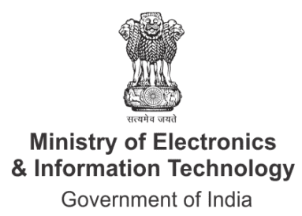
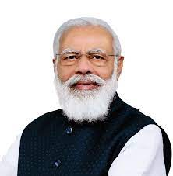
India’s Vision for Data Driven Governance
“I dream of a Digital India where 1.2 billion Connected Indians drive Innovation, Government Services are easily and efficiently available to citizens on Mobile devices, Netizen is an Empowered Citizen, and the World looks to India for the next Big Idea”
“With a digital-first approach we have been successful in building a robust network of citizen-centric services such as online payments. Digital India has given every citizen a market. Even the smallest street vendor is using the facility of UPI.”
Shri Narendra Modi
Prime Minister of India
(India Mobile Congress 2022)
“We are transforming people's lives by using digital technology for governance including empowerment, connectivity, delivery of benefits and welfare”
Shri Narendra Modi
Prime Minister of India
(Sydney Dialogues 2021)
Shri Narendra Modi
Prime Minister of India
(Launch of Digital India Week, 2015)

Slide 3
Potential of Data in Governance
Potential of Data-Based Technologies at Population Scale
 | Improving Public Service Delivery: Data-based technologies like AI have the potential to optimize digital welfare delivery and increase administrative efficiency, enabling citizen-centric services
 | Driving Inclusive Development: Data-based technologies can transcend traditional barriers to inclusive development and enable large-scale social transformation for all
 | Improving Policy Making & Programs Evaluation: Data enables evidence-based policy development, implementation and monitoring, bringing targeted social benefits to citizens
 | Empowering Digital Nagriks: Platforms developed on data enable improved citizen experiences and engagement with the government as Digital Nagriks
 | Enhancing Efficiency & Innovation: Technologies like AI provide innovative models of governance, catalyzing digital innovation for public good & creating new economic opportunities

Slide 4
Digital India: Leveraging Data to Transform Governance

Slide 5
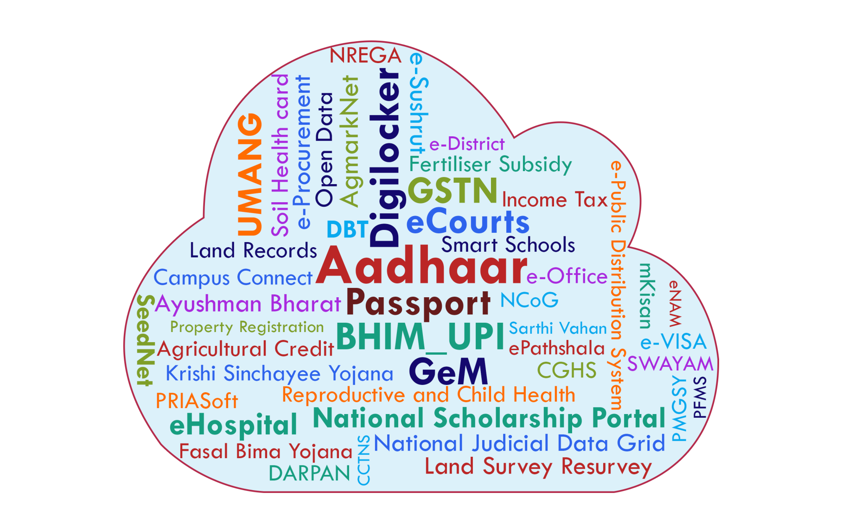
Digital India: Enabling Digital Transformation at Population Scale
200+
Major projects
Approach
Bridging the Digital Divide
Universal Coverage
Single Sign on
Enhanced Experience
End to end workflow
Architecture - InDEA
Whole of Government Approach
Open API as a Catalyst
Era of digital platforms
4030
Services
337 Mn
Average Daily Transactions
On Demand Services
From Central, State, Local Government

Slide 6
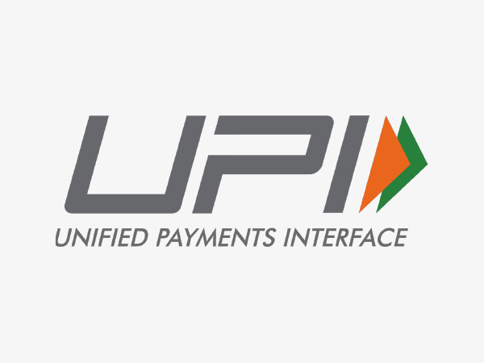
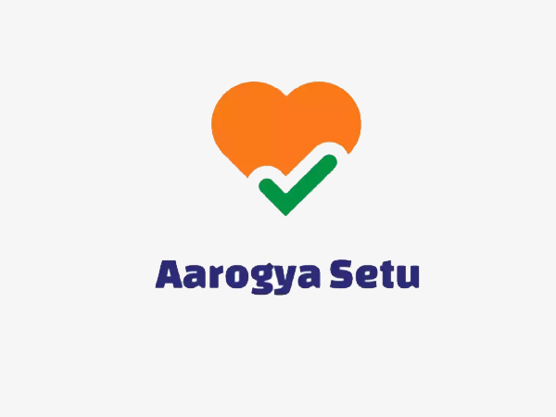
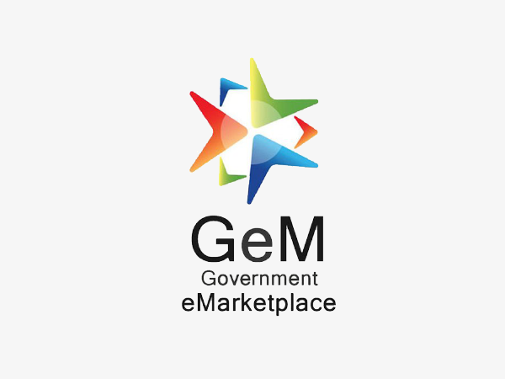
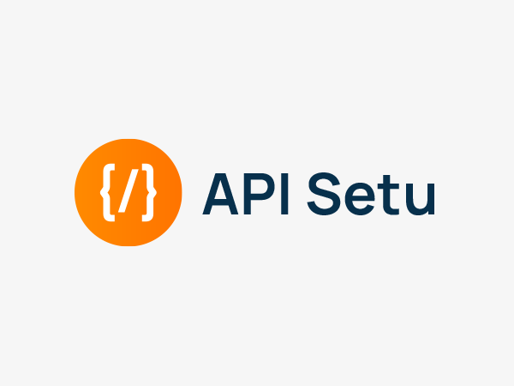
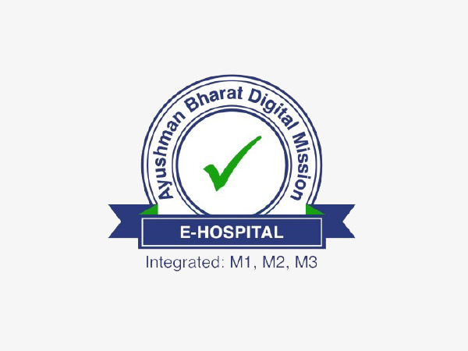
Indiastack: India’s Experience of Building Technology Platforms at Population Scale

Slide 7
Aadhaar – Empowering People
Key Features
Details Captured
Cradle to grave digital identity that is unique, lifelong, online, authenticable
Biometric
Best possible authentication & de- duplication mechanism in India
Demographic
Aadhar Service: Enabling Online Authorisation
Aadhar enabled ecosystem: eSign, DBT, AEPS etc
Electronic
1.3Bn
79 Bn
13 Bn
685
Mn
Aadhar
e-Authorisation
e-KYC
Update

Slide 8
API Setu
Platform enabling swift, transparent, safe And reliable information exchange
Features
12 Cr+
Monthly Transactions
Single platform to register and discover APIs
Only one connection for publishers and consumers
Common policy and governance structure
Industry standard protocols
Data standardization
15 Cr+
Transaction in FY 2021
1900+
No. of APIs published
Advantages
Faster deliveries of services
Open APIs driving Government Industry Citizen Linkage
Machine readable data exchange
900+
No. of Agencies On boarded

Slide 9
CO-WIN
A Scalable, Inclusive and Open Platform for Universal Vaccination
Features
1.1 Billion
Total Registrations
CoWIN is enabling countries worldwide to run Vaccination drives
Massive Open API based Scalable Architecture
Average 2 billion hits per day
Potential to be the largest vaccination database for the country`
2.2 Billion
Vaccine Doses given
Advantages
Blended Registration
Choice of Location
Instant Digital Certificate
Online Slot Booking
8326
Sites conducting vaccination

Slide 11
Unified Mobile App For New Age Governance
(UMANG)
1
One Mobile App for many Government Services
2
23 languages supported, saves mobile memory, more utility to users, customised branding for States
3
1658 Govt services operational from 308 Central & State Dept(s) & 21,000+ bill payment services
4
UMANG-India International app launched globally – for NRIs, Indian students & tourists
5
Voice and Text Bot launched for informational services

Slide 12
Data-Based Emerging Tech Initiatives for Governance

Slide 13
MYGOV, MEITY: INDIA’S AI-ENABLED CORONA HELPDESK - EMPOWERING CITIZENS
Problem
The onset of the global pandemic brought about a panic wave in the country, so the government took it upon itself to curb the spread of rumours and misinformation. The Government of India wanted a solution that would empower citizens with the right steps to take precautionary measures for staying safe during the COVID-19 pandemic. The key objective was to offer a 24/7 helpdesk that answered coronavirus queries in multiple languages and helped prevent the spread of false information.
Solution
Haptik is a Conversational AI company that built the MyGov Corona Helpdesk in record time. This Intelligent Virtual Assistant (IVA) is essentially an AI-powered WhatsApp chatbot that brings accurate information at the fingertips of the users. The chatbot has the following functionalities:
Help users check symptoms and get a diagnosis
Provide tips and precautionary measures to stay safe.
Bust myths around COVID-19.
MyGov Corona Helpdesk, world’s largest WhatsApp chatbot, has been handling millions of diverse queries in both English and Hindi. Since its launch in March 2020, the helpdesk has successfully catered to over 60.7 Million users and 240 Million user messages (as on November, 2021). Remarkably, the chatbot was deployed in a record time of only five days.
Impact

Slide 14
DRDO: USING CHEST X-RAYS & AI TO DETECT COVID-19 INDUCED LUNG DAMAGE
Problem
As the COVID-19 pandemic is steadily making its way into the rural pockets, it is presumed that access to CT scans and radiologists will be even tougher. Realizing the need for early and timely CT scans at an affordable rate, DRDO has developed ATMAN AI, an AI-based COVID detection application software using chest X-rays (CXR) to detect COVID induced lung abnormalities.
Solution
DRDO has developed an AI-based intelligent, secure, web based, COVID detection application software ATMAN using Chest X-rays which can classify the images into normal, COVID-19 and pneumonia classes using limited number of sample images.
Using Indian datasets from COVID-19 positive patients, the dataset comprised of 1,324 COVID-19, 1,108 Normal, and 1,344 Pneumonia CXR images. The model was retrospectively used to test CXRs from RT-PCR proven COVID-19 patients to test positive predictive value and accuracy.
Based on the initial screening results, the solution is recommended for mass testing by the doctors. To help scale up this project, 5G Network enabled access to radiologists anywhere through its public cloud and AI-based infrastructure. The turnaround time for the deployment of the solution is a matter of days and the reach can be increased many folds due to the remote, accessible nature of the 5G Network Platform.
Impact

Slide 15
Challenges in using Data for Governance

Slide 16
Challenges in using Data for Digital Governance
Lack of Institutional Framework for Data Sharing
Poor Data Discoverability & Inter-Government Data Sharing
Lack of Dedicated Data Management Teams
Absence & Non-compliance to Meta-Data Standards – Poor data quality
Siloed Data Portals/Initiatives
Absence of Data Anonymization & Privacy Preservation Tools
Lack of Mechanism for Integrated High Value Datasets
Absence of standard end-user agreements for Unlocking Value of Data
Key Stakeholders don’t get the data that they need

Slide 17
Way Forward – National Data Governance Policy

Slide 18
Upcoming Initiatives for enabling Emerging Technologies
Salient Features
Role of Data Management Office
Institutionalizing data governance & sharing through India Data Management Office
Guidelines for Identification & Classification of Datasets
Data Quality and Metadata Standards
Usage Rights
India Datasets Program
Streamlined G2G and G2B data sharing
Data Access & Availability Rules
Data Anonymization & Privacy Preservation
Disclosure Norms
Data and digital capacity building of line ministries/departments
Data Storage & Retention Guidelines
Data Sharing Toolkit
Limits to Data Requests
India Datasets Program & Platform for transforming non-personal data ecosystem
Principles for Ethical & Fair Use of Data
Redressal Mechanism
User Charges
Ensure privacy, security & trust

Slide 19
Thank You

