Slide 1
‘Digital data to Good Governance’ Data Analysis and Quality Issues
S B Agnihotri
Emeritus Fellow, CTARA IIT Bombay
January 2023

Slide 2
Governance has been data driven – whether in Todarmal’s time or today
But has good governance been data driven?
in fits and starts yes. Systematically, NO
Today Good Governance can be scaled up through better utilisation with IT support
Hence the importance of the Digital data
However, we need to discuss some quality issues and new ways of analysis

Slide 3
Of these new ways of analysis
Geo-spatial analysis is important. It tell you where does the shoe pinch
Then there is the buzz-word AI/ML. It is quite vulnerable to GIGO
We need considerable pre AI/ML analysis which can be insightful
Hence the importance of the quality of the Digitalized data
This data needs i) Quality Checks (Concurrent) and ground truthing
Dash-Boards for decision support can help build in – house capacity

Slide 4
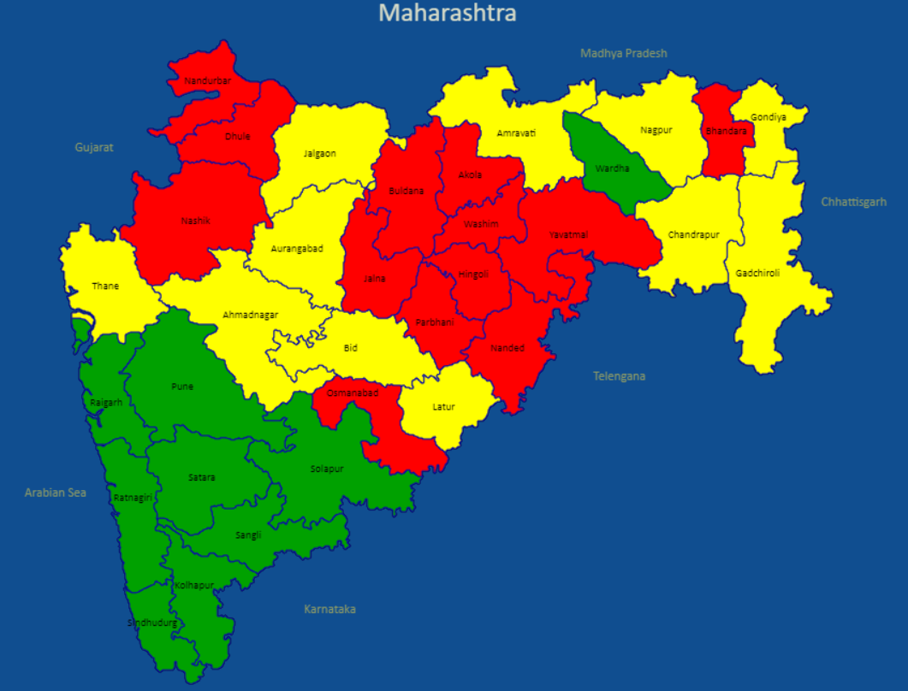
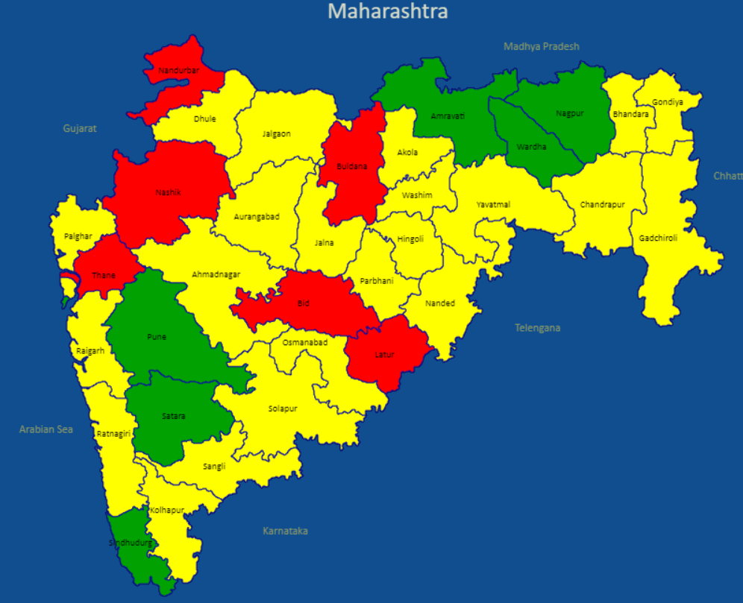
Some examples: Good quality data nudges policy
Maharashtra: Children under 5 years: Comparing Stunting NFHS-4 vis a vis NFHS-5
NFHS - 4 (2015-16)
NFHS - 5 (2019-21)

Slide 5
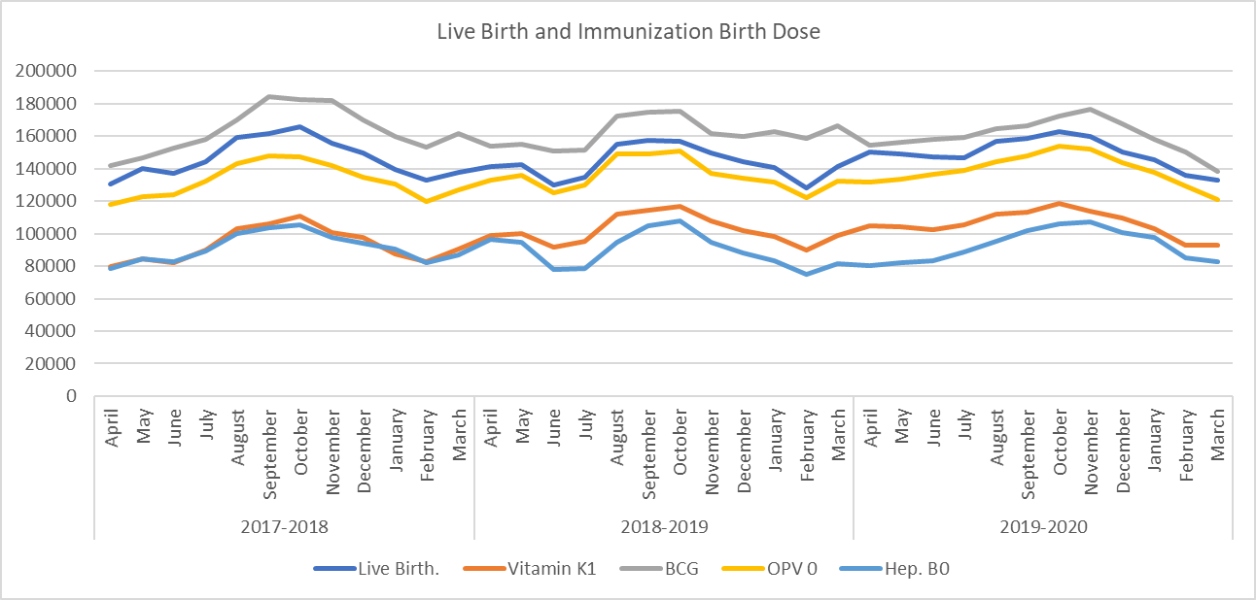
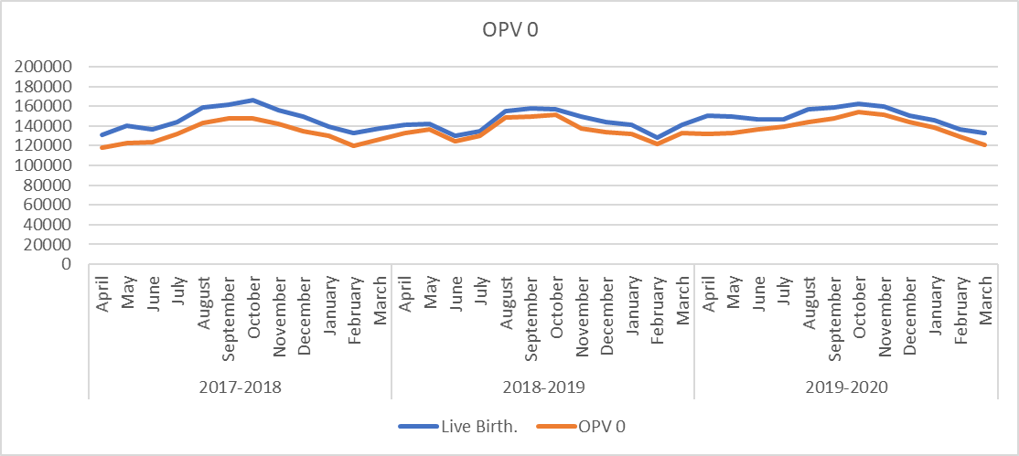
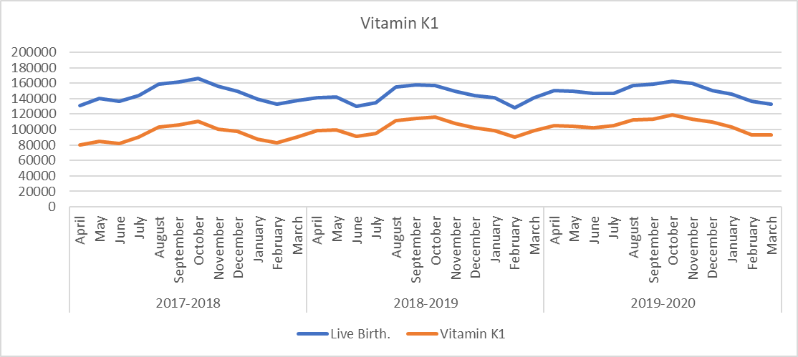
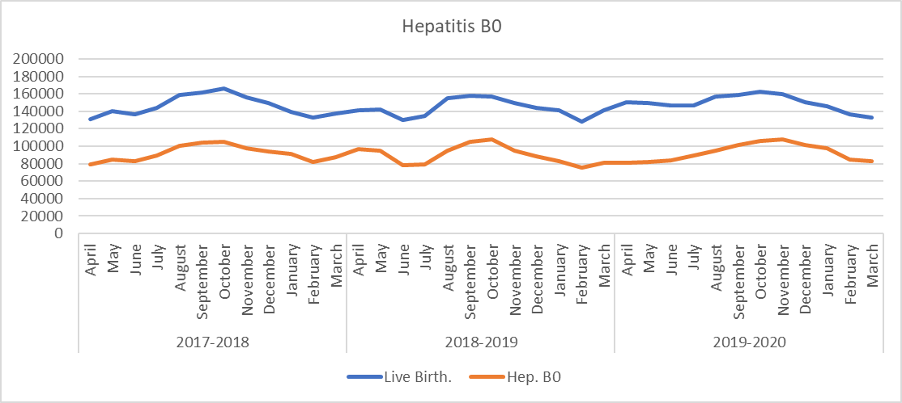
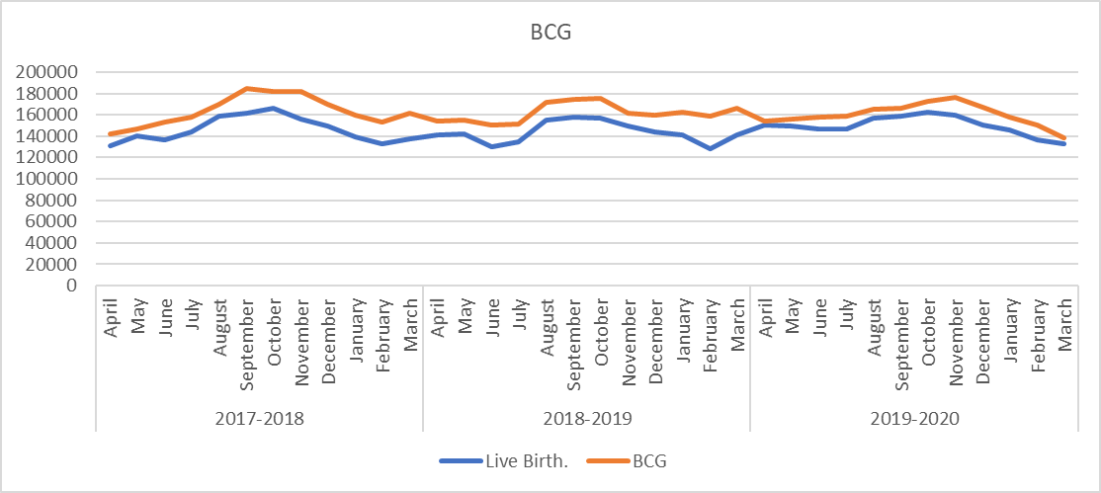
Child Immunization
(Zero) BIRTH DOSES – Rhetoric and the reality

Slide 6
Analysis and Policy Briefs.
We have done some insightful analysis
Birth seasonality
ANC Coverage – albendazole as the step child
Pre-term birth patterns
Still birth
Sepsis
Snake bites!
For overall analysis we have developed a user friendly dash-board
Quality issues: Nil report, Zero report, Outliers, implausible data
Case of no childhood disease!
Concurrent detection or post – mortem
Location shift of mothers and children – Delhi State, Mumbai Ahmednagar
and automation (at least in urban areas)

Slide 7
Birth seasonality
Birth seasonality in Punjab (2017-2020) Numbers and % of the annual births

Slide 8
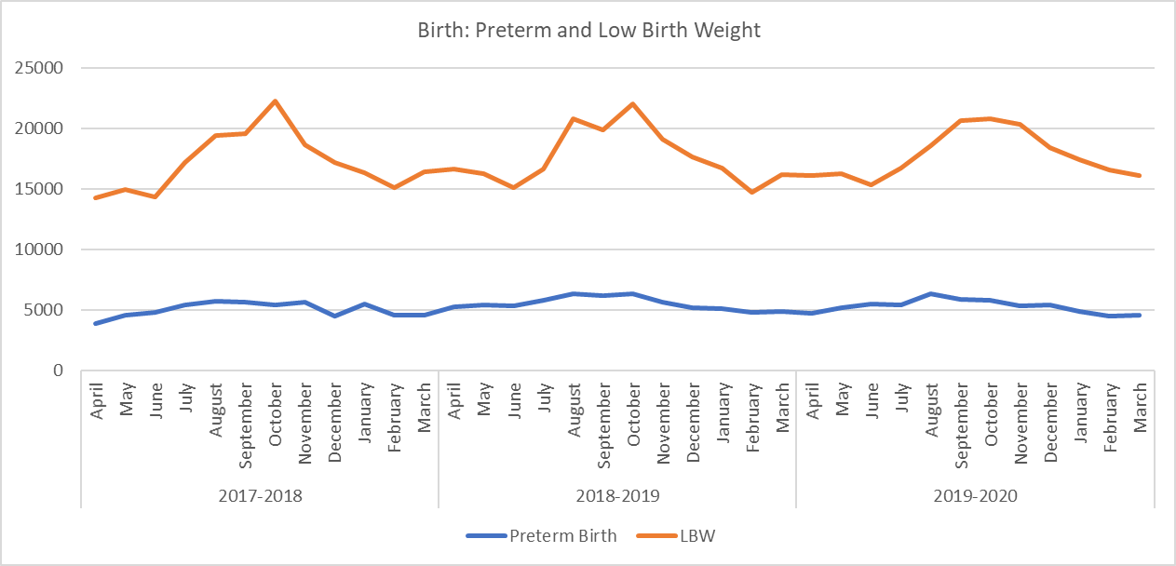
Preterm Birth and Low Birthweight
Low birth weight and live birth peaks at the same time period

Slide 9
Importance of concurrent quality check

Slide 10
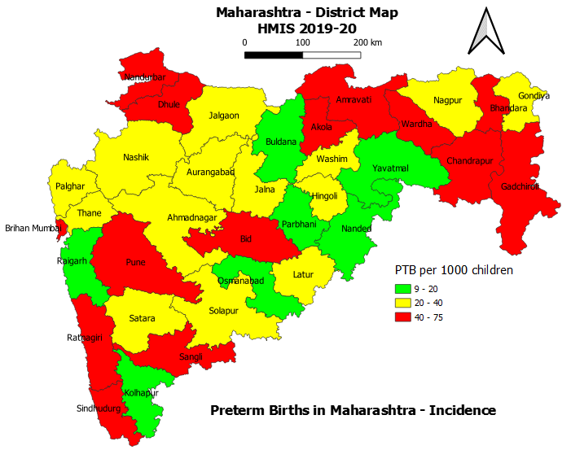
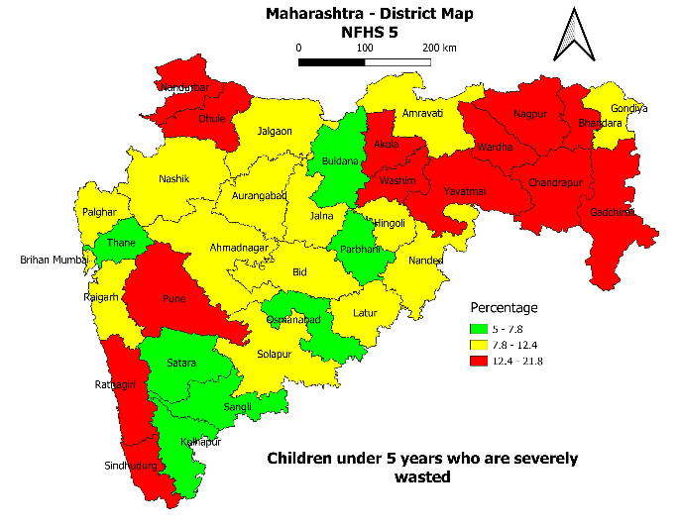
Connecting the patterns: pre term birth and wasting
Spatial map of Preterm Birth Rate (or Incidence) as per HMIS 2019-20
Spatial map of Severely Wasted Children (NFHS-5)

Slide 11
Simple visualisation helps Childhood Disease Burden (19-20) for Maharashtra (Pneumonia)

Slide 12
Concurrent quality check helps
Missing values
For district of XXX, data on childhood burden is missing for 3 years!
Pneumonia,
Asthma, Sepsis,
Tuberculosis (TB),
Acute Flaccid Paralysis(AFP),
Measles and Malaria
Hence we need CONCURRENT quality control not POAT-MORTEM !

Slide 15
Thank You

