Slide 1




  Manual of Office Procedure
  General Administration Department
  (Administrative Reforms & Organization Methods),
  Government of Maharashtra
Regional Conference on
“e-Governance”
23rd – 24th January 2023
Mumbai, Maharashtra

Slide 2

e-Governance in Maharashtra
e-Governance being the prime focus area, Government of Maharashtra has been at the forefront in implementing initiatives under e-Governance, with key objectives to:
Improve accessibility & delivery of government services for citizens | Increase transparency in government processes
Provide information on government programs | Ensure quick redressal of citizens grievances
Portal facilitates dissemination of government services in Maharashtra with 95% service request disposal rate
Status of Aaple Sarkar Portal till date:
38
Total
Departments
387
Total Online Services
13.31+ Crore
Applications Received
12.65+ Crore Applications Disposed

Slide 3
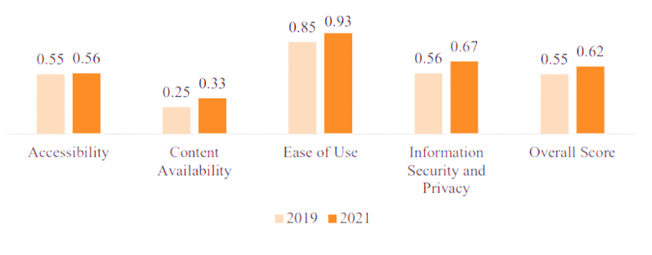
National e-Governance Service Delivery Assessment (NeSDA)
National e-Governance Service Delivery Assessment (NeSDA) study assesses and benchmarks e-governance initiatives at a national level
In NeSDA 2021 Framework, 56 G2C and G2B services were covered across following 7 sectors:
The framework assessed state ministry portals based on following parameters:
Maharashtra has achieved 13% increase in NeSDA compliance score for its e-governance portal from 2019 to 2021
Finance | Environment | Education | Labour & Employment
Social Welfare | Local Governance & Utility Services |  | Tourism
Accessibility | Content Availability | Ease of Use | Information Security & Privacy

Slide 4



Seva Pandharwada
For ensuring quick response to citizen service requests and grievance redressal, Maharashtra launched the ‘Seva Pandharwada’
The initiatives identified pending matters from 14 services across 11 departments and portals, viz.
Status of the initiative:
  STAGE I: 17th September 2022 - 02nd October 2022
  [
  STAGE II: 03rd October 2022 – 05th November 2022
Aaple Sarkar | Mahavitaran | MahaDBT | Nagari Seva Kendra | Department Portals
 | Service Requests Received | Service Requests Disposed | Service Request Disposal Percentage
Services | 79.63 Lakh | 59.99 Lakh | 75%
Portals | 23.76 Lakh | 14.86 Lakh | 63%
 | Service Requests Received | Service Requests Disposed | Service Request Disposal Percentage
Services | 49.18 Lakh | 46.52 Lakh | 95%
Portals | 34.39 Lakh | 32.92 Lakh | 96%

Slide 5
Committee for Good Governance
Government of Maharashtra has established a Senior Committee for Good Governance on 27th May 2022.
  Shri. Suresh Kumar (Chairman) , IAS (retd.), Ex. Uplokayukta & Incharge Lokayukta, Maharashtra, GoM
  Shri. Jayantkumar Banthia, IAS (retd.), Ex. Chief Secretary, GoM
  Shri. Swadheen Kshatriya, IAS (retd.), Ex. Chief Secretary & Chief Comm., Maharashtra State Commission for Right to Public Services
  Shri. Ajitkumar Jain, IAS (retd.), Ex. Commissioner, State Information Commission, Brihanmumbai
  Shri. K. P Bakshi, IAS (retd.), Ex. Chairman, MWRA, GoM
  Shri Somnath Bagul, Joint Secretary , GAD (A.R. & O.M.), GoM
Scope of Work of the Committee:
Committee has conducted 27 meetings till date and has consulted with state Departments, field offices and various stakeholders.
1. Study the present situation in terms of e- governance in Departments | 3. Understand the areas of improvements
2. Document the best practices | 4. Draft Manual on Good Governance to bring:
Transparency | Citizen Centric Government
Digital Transformation | Data Driven Administration

Slide 6
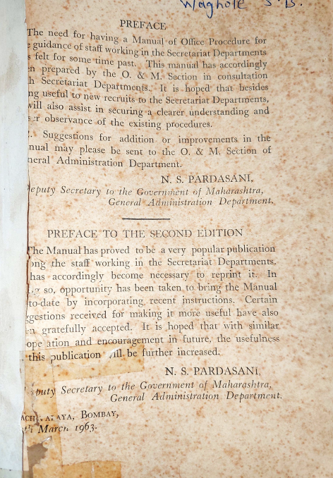
Initiatives under Good Governance
6 member DARPG delegation led by Secretary DARPG, GoI visited Mumbai on 1st December 2022 which enabled collaboration between DARPG and GoM for Administrative Reforms and Good Governance
In view of the same, Maharashtra has undertaken below initiative:
  Updated edition of State's Manual of Office Procedure in cooperation with DARPG, GoI
Manual for Good Governance in association with Committee for Good Governance
e-Office: Implementation & Analytics at Department / District level in association with National Informatics Centre
District Good Governance Index in association with Centre for Good Governance, Hyderabad
​
Impact Evaluation Report Of Initiatives For Increasing Efficiency In Decision-making along with Quality Council of India
Revision of Rules of Business, GoM
Manual Of Office Procedure, 1963

Slide 7

State Manual of Office Procedure
1st edition of State Manual of Office Procedure was published in 1963 and reprinted in 1994
Updated edition will focus on the 4-pronged approach:
      Delayering: Review of levels of disposal and channels of submission
    Delegation: Assignment of powers in departments
      Desk Officer System: Organization of departmental work into distinct functional desks manned by two desk functionaries of appropriate ranks (e.g., Under Secretary/ Section Officer)
      Digitisation: Of State Registration Units and adoption of e-office 7.0
Expected Outcomes in Administration:
    Streamlined reforms & policy framework
    Sensitized new officers inducted at various levels in the administration
    Increased efficiency in:
    Decision Making
    Information & File Management
    Paperless State Secretariat
    Flexibility for administration & continuity of work during crisis
    Quick Disposal of Pending Matters
    Revised timelines for grievance redressal
Notes:
Multiple office procedures have been evolved according to requirement of departments which need standardization
Absence of delayering affects administrative efficiency and increases delays
Lack of digitization in decision making hinders speed, efficiency, and utilization of resources

Slide 8
Cost Effectiveness of e-Office
Revised edition of State MOP emphasizes on:
  Transition from manual movement of a file/document to an “electronic” movement
  Implementation and use of e-Office Version 7.0
The table demonstrates the time, resource and cost efficiency that will be achieved after implementation of e-Office:
(* Figures mention are a ballpark estimation)
Parameters | Measurement | Avg. Cost Per Annum | % Saving after e-Office implementation
Infrastructure & Real Estate
Cupboard | 1200 Nos. for 40 departments | ₹ 96 Lakhs | 100%
Office Space (Released) | 10000 sq. ft. in Mantralaya and allied offices in Mumbai | ₹ 25 Crores | 100%
Physical Security (Custodian) | 50 Nos. | ₹ 1.05 Crores | 100%
Man Power Resources for file handling
Existing Man Power Available for the handling | Actual (Nos.) | - | Multitasking & Saving of Man Power
Peon for movement files in inter-region | ₹ 2,000 TA per day | ₹ 1.72 Crores | Multitasking & Saving of Man Power
Saving in use of Paper
Notes | 4,000 Pages for 40 departments | ₹ 1 Crore | 100%
Correspondances Pages | 12,000 Pages for 40 departments | ₹ 3 Crores | 100%
Total | - | ₹ 32.73+ Crores | 100%

Slide 9
Way Ahead
Initiatives undertaken which are expected to be completed by February 2023:
Revised State Manual of Office Procedure by GAD (A.R. & O.M.), Government of Maharashtra
Good Governance Manual comprising of recommendations from Committee for Good Governance
Initiatives undertaken which are expected to be completed by March 2023:
Upgradation of underlying IT infrastructure and migration to e-Office V7.0 | e-Office: Implementation and Analytics Report at Department/District level with NIC
Impact Evaluation Report to reduce delays and increase efficiency in decision-making with Quality Council of India | District / Department Good Governance Index with Department of Planning, Directorate of Statistics and Economics and Centre for Good Governance Hyderabad
Rules of Business | Archiving Policy

Slide 10
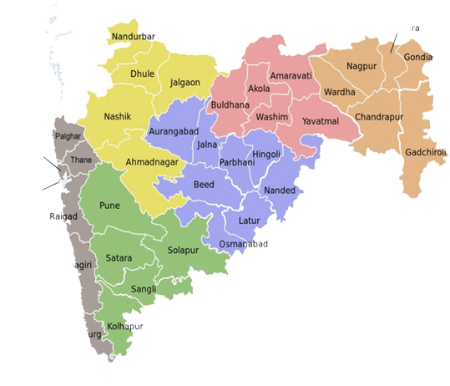
  Thank You!

