Slide 1
National Automated Fingerprint Identification System (NAFIS)
Dr. Prashun Gupta
prashun@ncrb.gov.in

Slide 2
NCRB-Vision and Mission
To empower Police with Information Technology Tools to aid in investigation
To help Police Forces across the Country to use these tools to meet their technical imperatives

Slide 3
NCRB-Mandate
To function as a clearing house of information on crime & criminals so as to assist in linking crimes to their perpetrators
To collect and publish crime statistics at the National level
Empower Police with Information Technology
Guide, modernize and capacity building of SCRBx, DCRBx and State FPBx.
Implement and monitor CCTNS | ICJS | NAFIS
Implementation of Criminal Procedure (Identification) Act-2022 Act

Slide 4
Data Repository
8.51 Cr
FIRs in CCTNS
15.49 Cr
Lower Court data from CIS
1.88 Cr
Prisoners data from e-Prisons
1.31 Cr
Legal advices from e-Prosecution
18.87 lakh
Exhibits/samples from e-Forensics
12 lakh
Arms licenses data from ALIS
3.46 lakh
FIR data from RPF
31.45 Thousand
FIR data from CBI
310
FIR data from NIA
1.1 lakh
FIR data from NCB
90.77 Lakh
Fingerprint data from NAFIS

Slide 5
Publications by NCRB
1995 1967 1953 1997

Slide 6
NAFIS
Objective
To Establish a National Repository of Criminal Fingerprints in India
Enabling Uniform Access to this National Repository by users of States/UTs/Central Agencies across the Country
Salient Points
Workstations: Covering all the Central and State Finger Print Bureaus, Districts, Commissionarates and Central Agencies
Database Size: 1 Crore approx.
User Concurrency: 500
Modular and Scalable

Slide 7
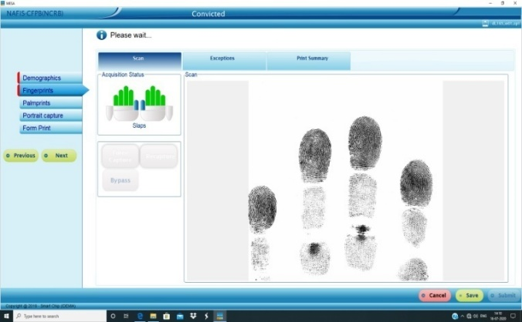
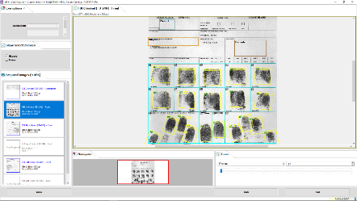
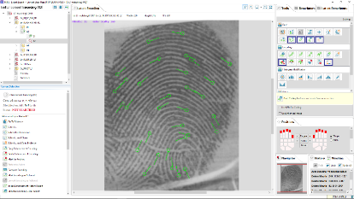
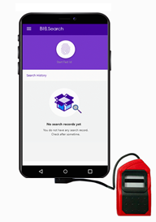
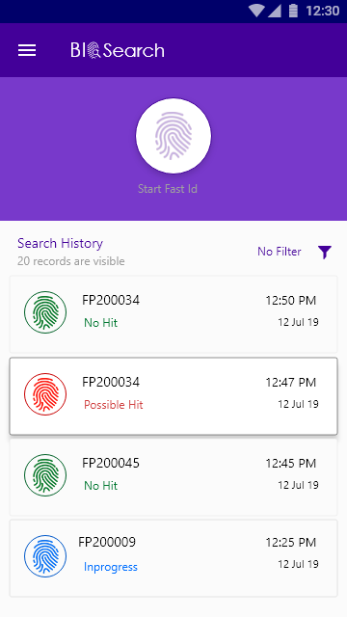
NAFIS- Capabilities
Live enrolment
Ten-print Slip Capture
Live Enrolment using Fingerprint Enrolment Devices (FEDs)
Online & offline availability
Enrolment of Physical Slips using Flatbed Scanners
Chance print
Field level Identification
Scene of Crime Prints
Quality enhancement
Search
Expert Verification
Single Digit Scanner attached to dedicated device
Fast Suspect Identification
No FP- Expert required

Slide 8
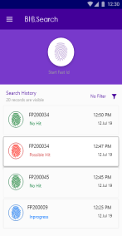
NAFIS Framework
NAFIS
DC - Delhi
SFPBx & CLEAs
AT THE DISTRICT SITES
DR - Bhubaneshwar
AT NCRB HEADQUARTERS
DR –Disaster Recovery
IN THE FIELD

Slide 9
Criminal Registration in NAFIS
NAFIS Database
Virtual State Partitions
JK | DL | HP | PB
HR | UP | RJ | .....
..... | ..... | ..... | .....
..... | ..... | ..... | .....
..... | ..... | ..... | .....
..... | ..... | ..... | .....
KR | KT | TN | AP
HR
RJ

Slide 10
NFN- National Fingerprint Number
Unique ID
Unique 10 digit alphanumeric NFN
Multiple Crimes
Crimes registered against one criminal, even in multiple States/UTs, are stacked with same Unique NFN
State Identifier
Each NFN has -
First 2 Alphabets as State/UT Code
Followed by eight digit numerical sequence
For e.g. GJ00000001, UP00000002, HR00000001 etc.

Slide 11
NAFIS- Features
One Nation, One Data, One Entry
One Criminal, One Number, One Identity
One Nation, One Standard
Algorithm is one of the best in the world, same as used by FBI and Interpol
Declared as Critical Infrastructure and notified as Protected System

Slide 12
NAFIS- A Game Changer
Before | After | Impact
Manual Offline System | Complete Automation | 100%
Recording on Paper (Inking Method) | Paperless Working (Live Scanner) | 100%
Standalone Districts/States | Real-time Connectivity | 100%
Different Fingerprint Standards adopted in Country | One International Standard for entire Country (NIST/ISO) | 100%
No Interface with other databases | Seamless Interoperability with other large databases as per requirement | 100%
Central Database of 12 Lakh only available for matching | Central Database size of approx. One Crore (daily increments) | 100%

Slide 13
NAFIS- A Game Changer
Before | After | Impact
Average time for Results- Weeks to Month | Maximum 10 seconds | Near real-time identification
Scene of Crime Chance Prints rarely matched | More than 4400 Chance Prints matched in last few months | Detection of cases with scientific forensic evidence
No. of users 35-40 | Approx. 3000 Active Users | Exponential Increase
Availability of National search at only one location | At all districts in 36 States/UTs | Pan India Coverage
Absence of single Identity of criminal | Unique NFN for each criminal | Higher conviction rate with enhanced sentence

Slide 14
NAFIS- Significant Success Stories
Heinous Crimes
Helped to crack a 17 years old dacoity and murder case in Delhi
Real-time identification of double blind murder case using NAFIS within two hours in MP
Real-time identification capability of NAFIS unraveled a murder mystery on the same day in Tamil Nadu
Unknown Dead Body
Identification of deceased through NAFIS lead to nabbing the killers in MP
Burglary
NAFIS palm print tracked an inter-state criminal in Haryana
Cases of Impersonation
Many cases of impersonation have been solved with the help of NAFIS

Slide 15
NAFIS- Agent of Change
Faster detection of cases.
Higher Conviction Rate.
Metamorphosis of the criminal fingerprint landscape.
Improving policing and safety of citizens.
At par with the Best in the World

Slide 16
The Criminal Procedure (Identification) Act, 2022 and its Implementation
Collect
Preserve
Process
Share
Destroy
4

Slide 17
Criminal Procedure (Identification) System
Criminal Procedure (Identification) Act, 2022 notified on 18th April 2022
Objective is to use technology to aid investigation and enhance the conviction rate
Standard Operating Procedure (SOP) prepared by NCRB and shared with States/UTs
Specifications of National Standards for fingerprint, facial, iris and biometric exchange adopted
C-DAC Kolkata onboarded as Total Service Provider (TSP)
Initial phase focus on capturing of four biometrics – fingerprint (NAFIS), face, iris and DNA
Advanced technologies including Machine Learning & AI to be used for secure collection, storage, processing, matching, sharing and deletion of these measurements
Rollout at 2649 locations (Police Districts – 1331, Prisons – 1224 and Central LEAs (CBI, NIA and NCB) – 94); Rollout in most locations by next year

Slide 18
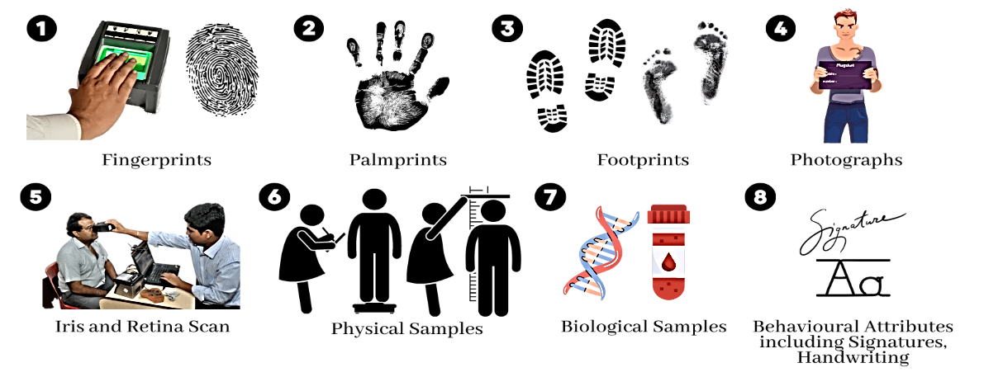
Definition of Measurements
An inclusive definition of the term ‘Measurements’ has been provided under Section 2(b) of the Act which includes:
Finger-impressions
Palm-print impressions
Foot-print impressions
Photographs
Iris and retina scans
Physical & biological samples and their analysis
Behavioral attributes including signature and handwriting
Any other examination referred to in section 53 or section 53A of CrPC
18

Slide 19
Officers Authorized to Take Measurements
Who can take ‘Measurements’?
Police officer — Officer-in-charge of a police station or an officer not below the rank of Head Constable
Prison officer — The officer of prison not below the rank of Head Warder
19

Slide 20
CrPI Act: Achieving Multiple Objectives
Enhance conviction rates and empower law enforcement officers
Aligns with global advancements in criminal investigation techniques
Strengthens the quality and reliability of scientific evidence

Slide 21
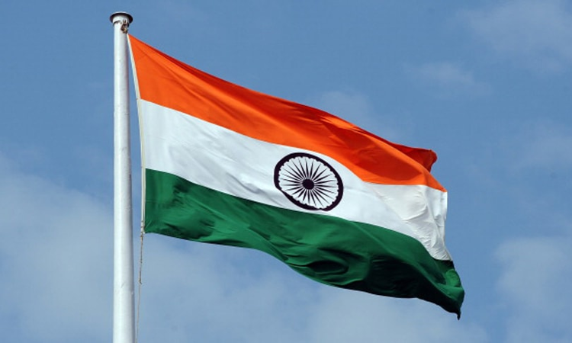
Thank You

