Slide 1
TECHNOLOGY IN AID TO ADMINISTRATION
K THAVASEELAN, IAS
PRINCIPAL DIRECTOR, SCHOOL EDUCATION &
CEO, STATE HEALTH AUTHORITY
(Ex DC, Mon District, Nagaland)

Slide 2
CHALLENGES
Large number of returnees from different parts of the country
Behavioural change required to fight COVID
Only one Hospital in the district with inadequate facilities
Highly mobile population
Lying at the International border and sharing Inter State border with two States
Complete dependency on Assam for essential commodities
Other geographical constraints, communication issues and lack of resources compounding the problem
RESPONSE
A multi pronged approach with the help of Technology to
Reduce the hardship of people
Keep the district safe
Improve the effectiveness of the Administrative Machinery
For Long term changes, CARE model was launched which is a behaviour change model

Slide 3
Result
There were only 8 COVID deaths in the district (1 in 2020 & 7 in 2021) (Mortality Rate - 0.78%)
Continuous supply of essential items reducing the hardship with total enforcement of lockdown
RECOGNITION
National eGovernance Award 2020 - 21 (Use of ICT in Management of COVID 19)
Skoch Award to the District for COVID Response
2021 - Silver Award (No Gold in the Category)
2020 - SKOCH Order of Merit

Slide 4
Reduce the hardship of people
Food bank to provide food to needy
Door step delivery of essential commodities
Online e-pass for people to travel
Keep the district safe from COVID
Mobile Sample Collection Van
Advance Life Support Ambulance
Enforcement of Lockdown with involvement of the Community
Improve the effectiveness of the Administrative Machinery
NL SOJO COVID App to monitor returnees
Geofencing - Intugine Tech + Oblivious AI
Contact Tracing - Infinite Analytics
OBJECTIVES AND TOOLS

Slide 5
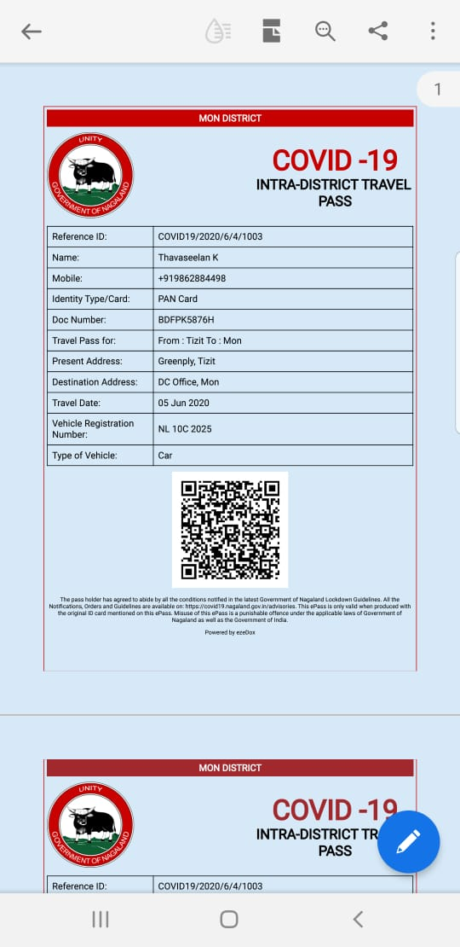
Online ePass for Intra & Inter District
Movement
Launched on 6th June 2020
In collaboration with ezeDox, Bangalore
ePass issued only for a specific purpose &
limited period validity
Negates the need of people coming to the Office
to avail movement permit
More than 300 passes were issued to people in need

Slide 6
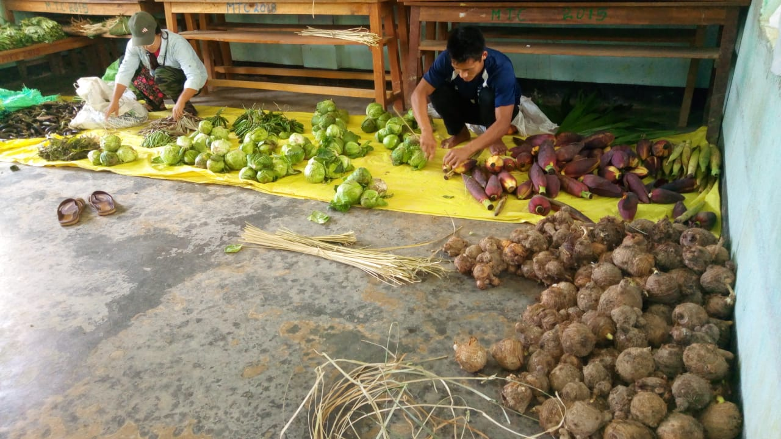
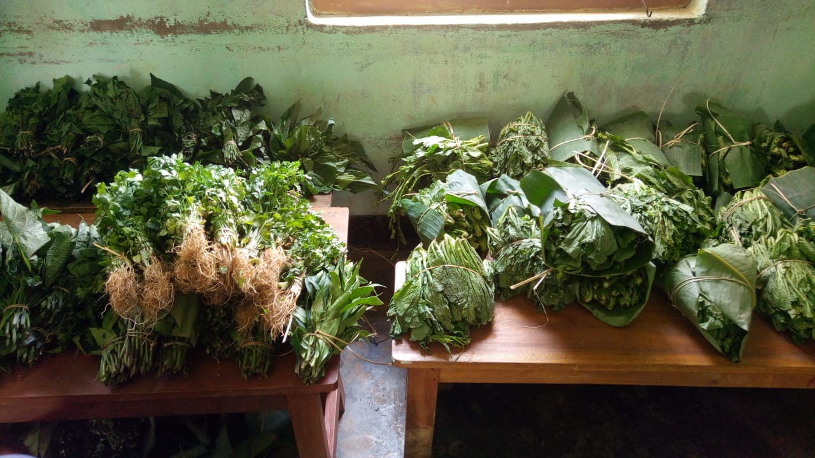

Slide 7
Delivery of Banking Services
Visit of representatives from Indian Post Payment Banks (IPPB), Banking Correspondents (BC) and Customer Service Point (CSP) Representatives - Villages for withdrawal and deposit of cash
Business Correspondents (BC) of IndusInd Bank and SBI – Urban Mobile ATMs
Bulk withdrawals by Village Authorities - Nagaland State Cooperative Bank (NSCB) with prior authorization from the individual
Home delivery of Water, Gas, Grocery and Medicines
Water Supply at the doorsteps – 500 Rs for 1000 litres – Fuel sponsor
Tie up with Naga Logistics for home delivery of Grocery and Medicines at a delivery rate of Rs. 10 in Mon Town. Fuel was sponsored
LPG Gas Cylinders were delivered at the doorsteps of the customers in Mon Town

Slide 8
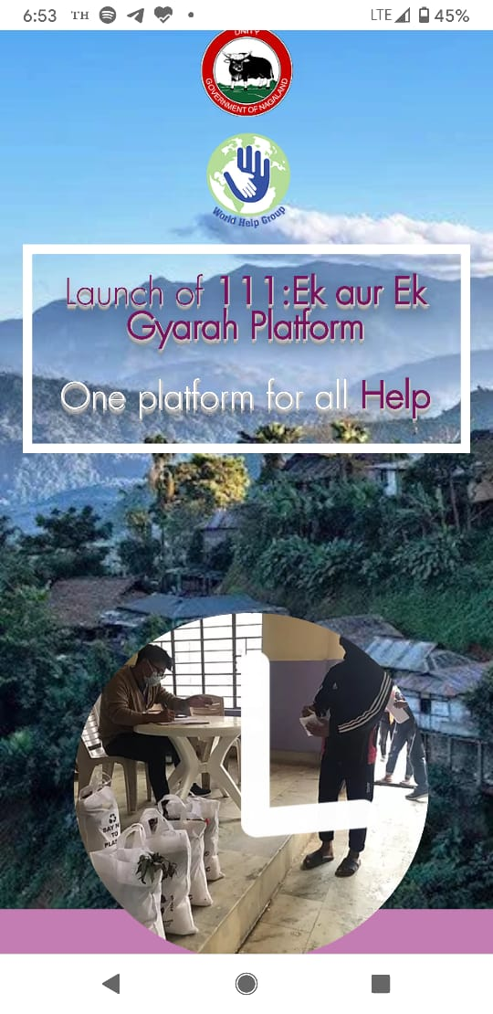
World Help Group
Launched on 22nd May 2020
Online platform to cater to the ration, food & medicines of the people affected by COVID -19 pandemic
Call Centre set up in the Office of the Deputy Commissioner, Mon for any assistance
Enables local authorities, NGOs, Civil Societies to distribute ration, food and basic medicines in a prompt manner
More than 900 families were delivered essential items

Slide 9
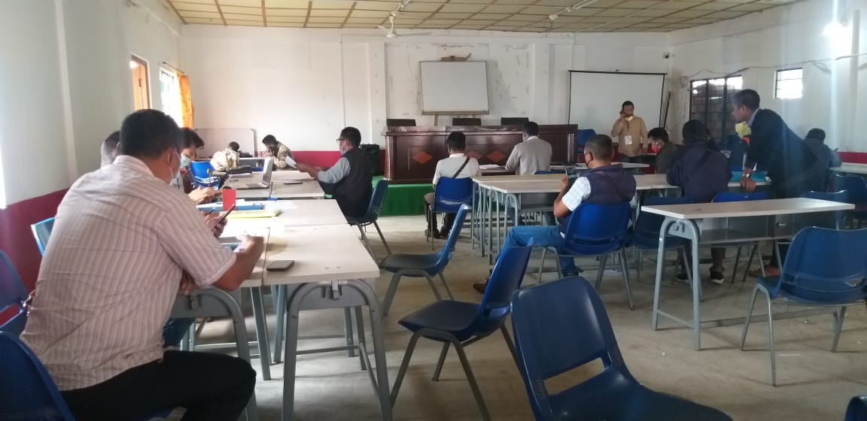
War Rooms
Set up at District HQ and four ADC Sub – Divisions
Daily monitoring of the health and basic necessities of quarantined persons in the district
Contact Listing / Tracing and Cluster Containment Strategies
Active Case Search Strategy and Contact Listing / Tracing
Door to door survey in the district to identify people who have chronic illness, pregnant women, people above 60 years & those with travel history
891 teams comprising of Village/Ward Level Task Force members, ASHAs, ANMs, Anganwadi Workers and teachers. A team comprising of 2 (Two) members each is allotted 50 Households

Slide 10
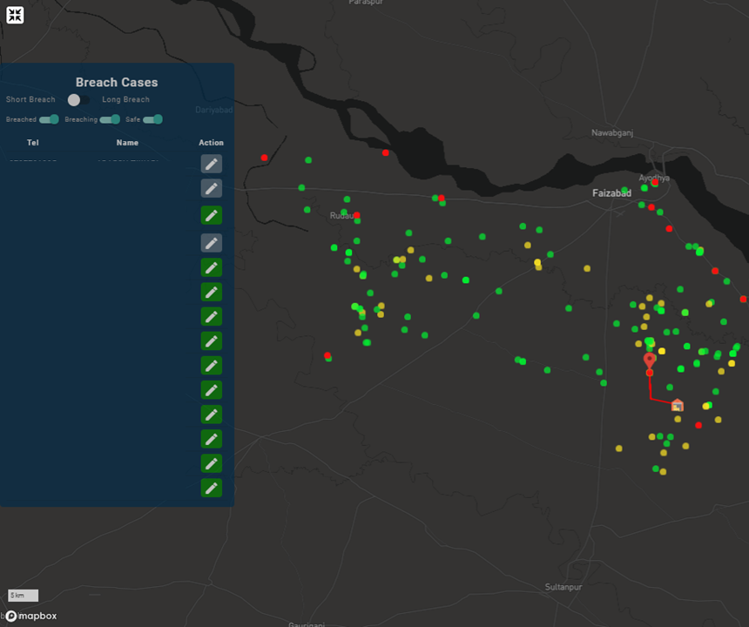
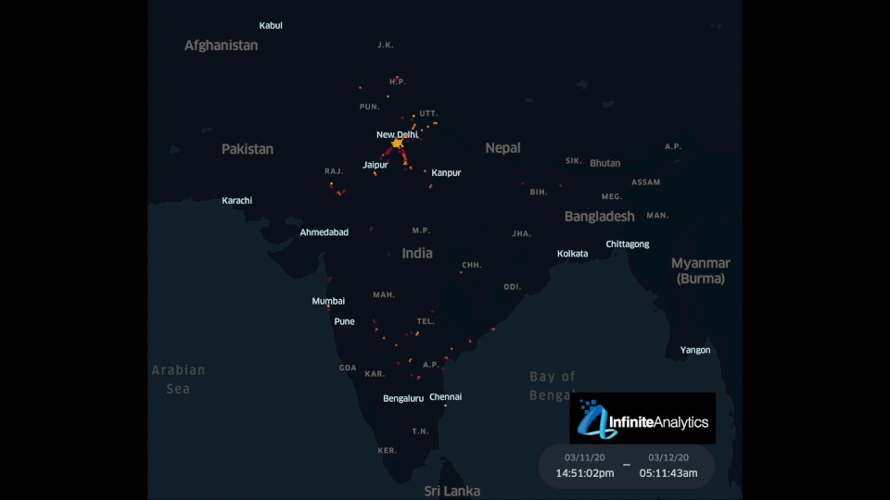
Geofencing and Contact Tracing
Collaboration with Intugine Technologies & Oblivious AI for location based tracking of people under Quarantine
Uses SMS based user consent to initiate the tracking
Tool for better monitoring by the District War Room
Collaboration with Infinite Analytics for rapid contact tracing of those people who were in close proximity with a COVID-19 positive person
Capable of classification of contacts into high/ medium/ low risk based on close proximity and exposure time parameters

Slide 11
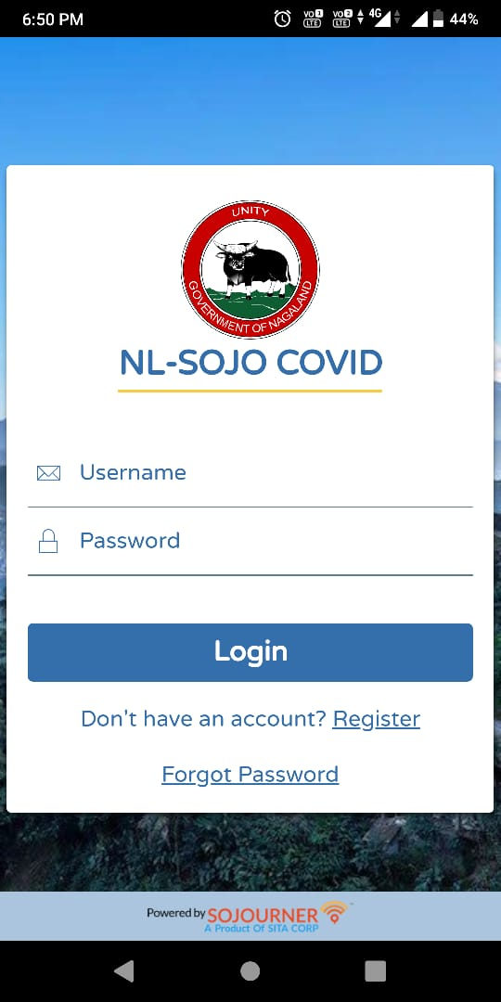
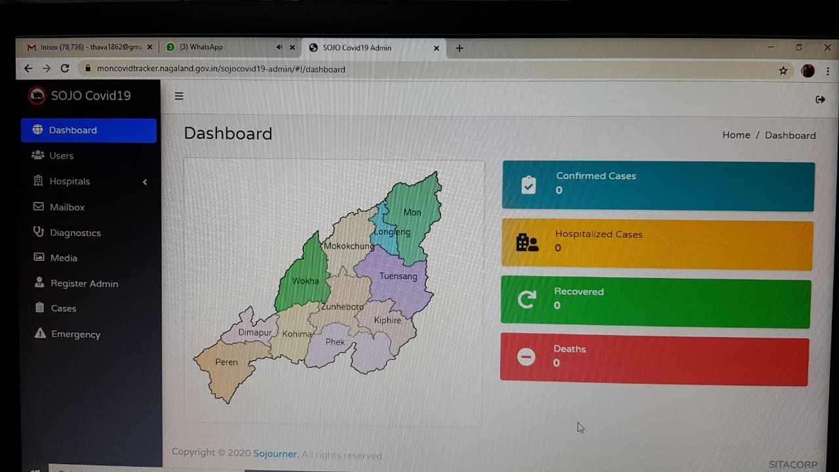
NL-SOJO COVID App
Developed in collaboration with Sita Corp, New Jersey, USA
Monitors the movements of people under observation
Instant alert when the users go outside the defined boundaries
Daily health status updates
Users get alerts about the locations of Test Centres, nearby hospitals and educational COVID-19 resources
Last visited locations of infected individual can be tracked

Slide 12
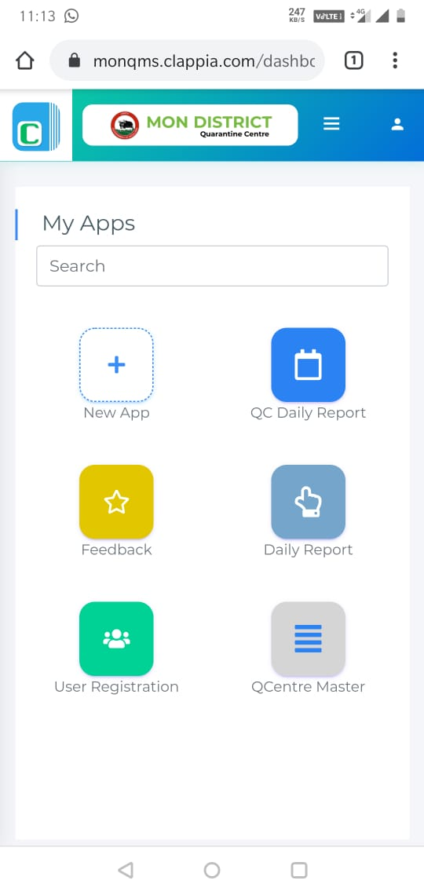
Clappia - App + Web Portal
In collaboration with Clappia Platform / Way2Cloud for Quarantine Centre Management
Features of the App / Web Portal :
Registration of returnees and maintenance of records
Details of Quarantine Centre
Daily updation of report on Quarantine Centres
Daily submission of selfie and positional co – ordinates by the returnees
Feedback from returnees
Reminder to returnees

Slide 13
DocOn - free video consulation facility

Slide 14
