Slide 1
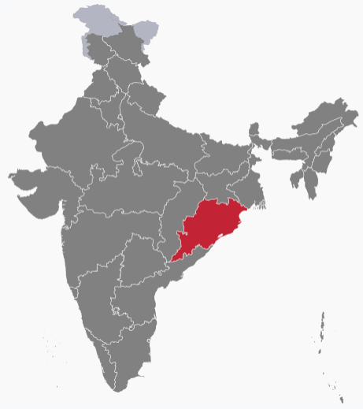
Odisha One
Unified Citizen Portal
Department of E&IT, Govt. of Odisha

Slide 2
Unified Service Delivery Portal: Introduction
It is a single window platform which provides the following diverse solutions
1
2
3
4
5
Single Access Point
Diverse Service Integration
Transparency (Public Dashboards & MIS)
Feedback Mechanism
User-Friendly Interface (Web & Mobile)
6
7
8
9
10
Active Civic Engagement
Centralized User Accounts
Multi-Channel Delivery (Citizen & MSK)
Streamlined Processes
Citizen Empowerment

Slide 3
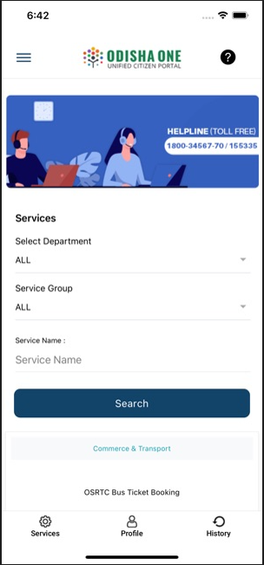
Odisha One: Overview
A unified integrated service delivery portal created by Government of Odisha providing citizens with a single point of access.
Delivers G2C and G2B services through self and assisted mode with integration of e-governance applications of various departments
Portal framework is designed in such a way that various applications can utilize this framework irrespective of their level of automation
System is Successfully Running with more than 99.95% uptime at own Odisha State Data Centre
Open-Source technology used; no proprietary tool, hence no recurring cost.

Slide 4
Need for Odisha One
Odisha Online, the first service portal of the state, was limited to few services and was not integrated with the services of all departments. This led to the following problems in accessing government services:
Multiple Points of Access: Citizens had to visit multiple government offices or websites to access different services, resulting in additional time and effort.
Paper-Based Processes: Many government services were processed using paper-based forms and documents, which was time-consuming and inconvenient for citizens.
Lack of Transparency: Citizens had no easy access to information, the status of their applications, or the progress of their requests, leading to frustration and uncertainty.
Limited Availability: Government offices had limited working hours or were not easily accessible to all citizens, making it difficult for some individuals to access government services.
Manual Processes: Some government services were processed manually, resulting in delays and errors.

Slide 5
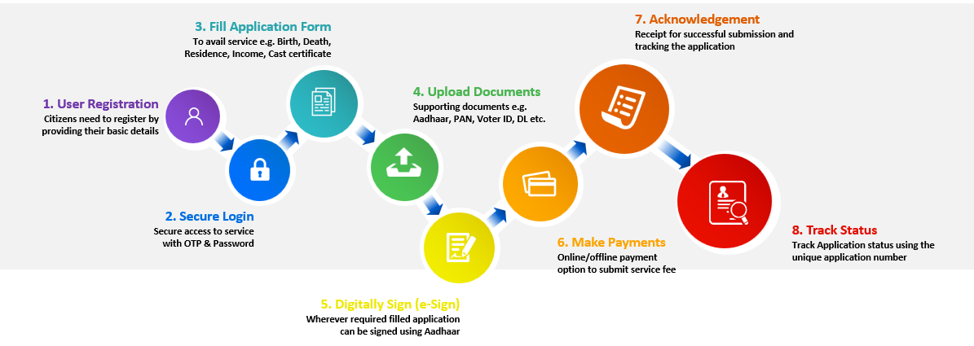
Workflow:

Slide 6
Service Delivery Architecture
Apply for Service
Service Delivered
Payment Through Payment Gateway
Citizen
Service
Delivered
Yes
No
Is Charges Applicable?
Govt. Services
Electricity Bill
Water Bill
Trade License
Holding Tax
Birth Certificate
Death Certificate
Service Delivered
No
Is Mo Seba Kendra User?
Yes
Payment Through e-Wallet
Service Delivered
Apply for Service on behalf of Citizen

Slide 7
Salient features of Odisha One
Citizens can apply for the service, make payment of statutory Govt. fees, track application status and download certificate upon approval.
Support system to provide services during primary business hours (9AM-5PM).
Delivery of services through Mo Seba Kendra (MSK) by leveraging the common infrastructure
Integrated with payment gateways i.e. CC Avenue, RazorPay, PayTm and IFMS. Also, various central govt. platforms like Digi-Locker and e-Taal etc. are integrated.
Integrated Feedback Mechanism to collect feedback, post service delivery.
Dashboards for all the stakeholders.
SMS & Mail have been Integrated for notifications.

Slide 8
Impact/Outcome
Transformational Public Service Delivery
Odisha One Portal
Achievements
Impact
Convenient, transparent, fast, anywhere, and 24/7 access to public services for citizens
Responsive governance for enriched citizen experience
Increased digital interaction between citizens and the Government
Improvement in digital infrastructure and connectivity in remote areas for better access
Employment for skilled and educated youth across the state
Quick data availability for formulation of policies for citizen welfare
640 Services
Available on the portal, spanning 37 departments
191 Services
INTEGRATED
66,77,364
Transactions have been made through the portal since launch
7647
Number of Registered Mo Seba Kendras

Slide 9
Upcoming Focus Areas (1/3)
xx
xx
Reducing the response time from the government department responsible for the service.
Enhancing the ease of usage and providing better user experience.
Providing regular updates to improve features of the mobile application.
Fixing accountability of officials to enable more timely response.

Slide 10
Upcoming Focus Areas (2/3)
Installation of KIOSK machines
Integration of AI
Feedback Analysis by IVRS and WhatsApp Business
This will significantly enhance overall efficiency by providing:
AI Chatbot for help desk management.
Chatbot for providing automated assistance to users in accessing services
User-Specific Service Recommendations
Personalized User Dashboards.
User feedback analysis to identify areas for improvement
A Feedback mechanism through Interactive Voice Response System (IVRS) and WhatsApp Business in the Unified Service Delivery Portal to provide following benefits for end users and administrators.
Voice Menu Navigation
Automated Information Retrieval
Surveys and Feedback
Emergency Notifications
Outbound Calling
Broadcasting through WhatsApp
To increase footfall on the Service Delivery Portal, a strategy has been proposed involving the installation of KIOSK machines at high-traffic public locations. These include airports, railway stations, bus terminals, and community centres
This strategic placement of KIOSK machines at these diverse public locations aims to enhance visibility, accessibility, and user engagement with the Service Delivery Portal

Slide 11
Upcoming Focus Areas (3/3)
Implementation of Advanced BI and Analytics
SLA Monitoring Dashboard
Integrating Blockchain
To guarantee the delivery of public services to the citizens in a time bound manner, it is proposed to develop an SLA Monitoring Dashboard. The envisioned modules are as follows:
SLA Performance Metrics
SLA Violation Details
User Accountability Metrics
Integration with e-Appeal and e-Revision
Threshold Alerts
This will enhance security of the portal by:
Preventing unauthorized tampering of data
Reducing the risk of identity theft and unauthorized access
Ensuring secure and transparent interactions
Strengthening user authentication processes
Safeguarding sensitive citizen information
Improving system resilience against denial-of-service attacks
Facilitating secure and efficient interdepartmental data sharing
This will enhance efficiency by enabling:
Geographic Analysis
Predictive Analytics
Forecasting of footfall or usage of a service
User Behavior analysis

Slide 12
THANK YOU
I
O
H
A
D
S

