Slide 2
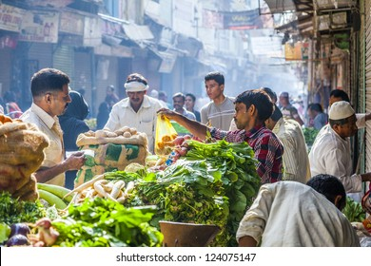
PM SVANidhi: Features
Loan up to ₹10,000; ₹20,000 & ₹50,000
Open the doors of formal banking channels & Holistic Socio-economic upliftment
7
1
Enhanced Loan
Vision
6
2
To impart sense of identity and reduce harassment
Safety net
for self
& family
Parichay Board
Interest
Subsidy
Interest subsidy to encourage timely repayment.
5
3
Digital
SVAD
SVANidhi
Se
Samriddhi (SSS)
Cashback to encourage adoption of digital transactions - transaction history
Onboarding and training of Street Food Vendors on e-commerce platforms
Micro-credit
4
Safety net for Street Vendors and Family, through access to 8 Central welfare schemes

Slide 3
Partners in the Journey
1
2
3
4
5
6
7
8
9
10
Lending Institution – NBFCs, MFIs, RRBs, Coop Banks
6 Central Ministry / Department - DFS, MoLE, MoWCD, MoCAFPD, MoHFW
SVs* & their Families
States / UTs / Urban Local Bodies**
Digital Payment Aggregators
Stakeholders
Bank
Implementation Partners
CSC e-Services Limited
SIDBI / QCI
NPCI
Indian Bank
CGTMSE
*Street Vendors living in Rural areas but vending in Urban Areas are covered.
**ULBs include Industrial Development Areas, Cantonment Boards, Notified Area Councils, Town Council, Hill District Headquarters etc

Slide 4
Salient e-Governance features:
End to end digitally integrated loan application process for Street Vendors (SVs) & Mobile App – Ease of Access
Real time status of loan application to SVs via SMS at every stage – Increased transparency
Interactive dashboard for all stakeholders - Effective implementation and monitoring
On-boarding & training on Digital Payment Platforms – Empowering SVs
Comprehensive database for SV’s families – Tool for identifying eligibility and linking to Welfare Schemes
API integration - UIDAI, Credit Bureaus, Banks, PAiSA Portal, CGTMSE etc – Process Streamlining.
DBT based payment of Interest Subsidy and Cashback – Simple and Transparent

Slide 5
PM SVANidhi: Government Process Re-engineering (GPR)
Before SVANidhi
Dependence on the ULBs for formal recognition
No Central Database of Street Vendors
No access to credit facilities for SVs
No formal training in use of Digital Payment platforms
Lack of holistic approach to Socio – economic upliftment
Absence of Sense of Identity and security of business
After SVANidhi
Introduction of ‘Letter of Recommendation’ (LoR) from the ULBs. Identified SVs almost triples since implementation of Scheme.
Comprehensive database of Street Vendors in India that can be leveraged to extend other benefits
Opened the doors of formal Banking channels
Mandatory Issue of UPI ID/ QR Code free of cost to SVs
Socio-economic upliftment of SVs’ families through ‘SVANidhi se Samriddhi’
Issue of Parichay Board

Slide 6
PM SVANidhi: GPR (contd..)
Before GPR
Lack of visibility of processing of applications. Required to undertake multiple visits to banks
Undue dependence on ULBs for recognition
Database of street vendors maintained at State/UT level
No formal micro loan product for the urban SVs
Complex process of loan application
G
After GPR
LoR applications processing Status is reflected on the PM SVANidhi Portal
Details auto populated through Aadhaar based E-KYC
Loan applications processing status is reflected on the PM SVANidhi Portal
The street vendor not in possession of any Identiy Card / CoV may apply for LoR using simple online application
Simplified the Loan Application from 3 pages to 2 page application
The street vendor has communicated the status via SMS at each stage.

Slide 7
Government to Citizens (Street Vendors)
1
Letter of Recommendation to overcome the dependence on formal recognition by the ULB
Government to Business
Government to Business
Execution Speed
Transparency
Online applications, live
Tracking status and notification through SMS
Status update via SMS at each level
2
Simple Online Loan application form.
Ease of application – ULB / CSC / Mobile App
.
1
.
2
3
Applications move directly to the Bank branches Online after the Credit Score is arranged from the Credit Bureaus.
Increased access to information
Direct benefit transfer of interest subsidy and cashback
Easy access to other Welfare Schemes
3
Improved Customer Service
4
Socio-economic profiling using an online App based software; Rules engine developed for identifying eligibility of various welfare schemes
LoR, CoV, SRN and Status of LoR and Loan application
4
5
Portal provides the status of loan processing
1- PM Shram Yogi Mandhan Yojana
2- PM Suraksha Bima Yojana
3- PM Jeevan Jyoti Bima Yojana
4- PM Jan Dhan Yojana
5- PM Matru Vandana Yojana
6- Janani Suraksha Yojana
7- One Nation One Ration Card
8- Registration under BoCW
.
6
Direct Benefit transfer of interest subsidy and cashback
On-boarding on e-Commerce platforms

Slide 8
Government to Business
1
Flexibility to LIs to allocate/move applications from one branch to another (internally) via online portal
Government to Business
Government to Business
Convenience
Accountability
2
Flexibility to LIs to allocate/move applications from one branch to another (internally) via online portal
.
IT solution for submission and verification of subsidy claims
User friendly and simple mobile app for lending institutions
1
.
2
3
Real time Dashboard; Daily updated reports available to LI users for monitoring pendency and performance
Real Time Monitoring
4
IT solution for submission and verification of subsidy claims
Improved Customer Service
3
Post applying, SV needs to visit branch only once (for disbursement)
Daily updated reports available to LI users for monitoring pendency and performance
4
5
Simplified online credit guarantee process to increase lender confidence
6
API integration with various Banks/ RRBs/ NBFC, MFIs, Credit Bureaus etc
.
.

Slide 9
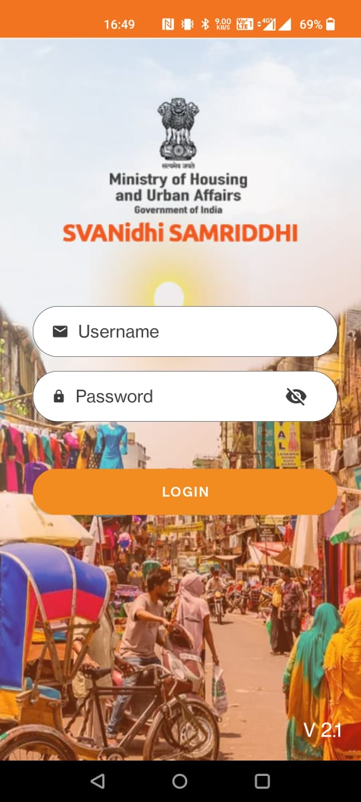
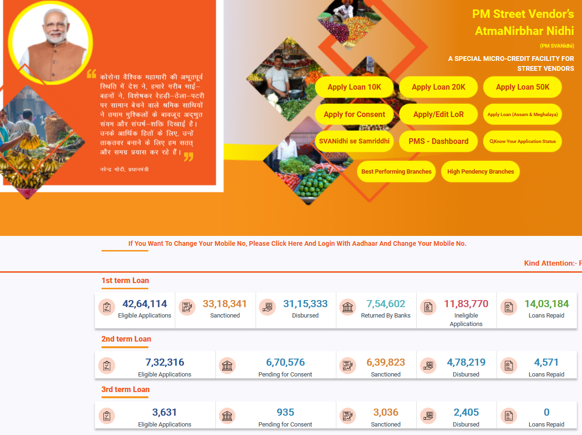
Government to Government
1
Integration of services and platforms: Aadhaar platform, DFS, MoLE, MoWCD, MoCAFPD, MoHFW, State / ULBs
2
Data Integration across platforms provides analytical depth and helps in monitoring
.
Increased Access to Information
Government to Business
3
Automated platform to capture beneficiary & family profile and auto populate scheme eligibility across various central schemes
Accountability
Data Integration across various platforms to provide analytical depth and help in monitoring
Line Ministries/ Departments can access beneficiary eligibility and real time update the status
.
1
4
State/ULB are provided tailor-made access to dashboard to view, assess, analyze and monitor progress
2
Transparency
Technology intervention led to single time beneficiary visit.
Convergence at National / State and ULB Level
3
Real time data is available to all stakeholders including general public
Convergence & High Speed Delivery
5
Line Ministries/ Departments can access beneficiary eligibility and real time update the status
.
4
6
User-friendly Mobile Apps developed for PM SVANidhi and SSS.
.
URL: www.pmsvanidhi.mohua.gov.in;
Dashboard: https://pmsvanidhi.mohua.gov.in/Home/PMSDashboard;
SSS URL: https://pmsvanidhi.qcin.org/account/landing-page;

Slide 10
Outcomes & Way forward
Equitable access: Simplified demand-based registration-36.04 lakh new SVs identified
10,000 SFoodVs onboarded on E-Commerce platforms generating business of ₹20 crores
E-Commerce
LoR
Image enhancement technology for Parichay Board, aiming reduction in SV harassment - 17 lakh Parichay Boards distributed across 34 states
Use of ICT & BPR: Simplified loan application forms & Automatic 2nd & 3rd Loan application
Efficiency: 60.8 lakh applications; 39.5 lakh loans worth ₹4,663 crore disbursed in 31 months
Loan Disbursed
Parichay
Board
Generation of a Comprehensive database; Automated eligibility assessment of SVs and family across 8 GoI welfare schemes; Identified Eligibility: 52.31 lakh; Successful Sanctions: 34.59 lakh
Safety Net to SV’s Family
Interest
Subsidy
Integration of LIs & PAiSA Portal for DBT based payment - ₹58.84 crore released to beneficiaries
Cashback
Integrated data flow among Scheme Portal, NPCI & PAiSA Portal for DBT based payment - ₹23.02 crore paid to 12.47 lakh SVs
Way forward:
Integration with States to extend the benefits of State specific Welfare Schemes

Slide 11
PM SVANidhi: Overall Performance Summary (1/2)
Overall
Loan applications received
Loans sanctioned
Loans disbursed
60.9 lakh
45.9 lakh
39.5 lakh
Total amount disbursed
₹ 4,663 crore
Total loans closed
15.02 lakh
Digital and other details
Letters of Recommendation issued
Interest subsidy paid
Cashback paid
36.0 lakh
₹ 58.84 crore
₹ 23.02 crore
Digitally enabled Street vendors
Digitally active Street vendors
Digital transactions conducted
26.5 lakh
16.14 lakh
42.87 crore
PM SVANidhi Homepage

Slide 12
PM SVANidhi: Overall Performance Summary (2/2)
Eligible Applications
Sanctioned
Disbursed
1st Loan
46.3 lakh
36.2 lakh
32.6 lakh
Repaid
Sanction Amount
Disbursed Amount
14.8 lakh
₹ 3,617 Cr
₹ 3,235 Cr
Eligible Applications
Sanctioned
Disbursed
2nd Loan
14.3 lakh
9.5 lakh
6.8 lakh
Repaid
Sanction Amount
Disbursed Amount
21,102
₹ 1,906 Cr
₹ 1,357 Cr
Eligible Applications
Sanctioned
Disbursed
3rd Loan
20,693
17,300
14,139
Repaid
Sanction Amount
Disbursed Amount
-
₹ 85.8 Cr
₹ 70 Cr
PM SVANidhi Dashboard

Slide 13
SVANidhi se Samriddhi Performance Summary
Launched on January 4, 2021.
Socio-economic profiling completed for 11.76 lakh beneficiaries along with 27.37 lakh family members.
34.59 lakh scheme benefits extended through monthly camps.
S. No | Ministry / Department | Scheme Name | Number of Applications | Number of Benefits Sanctioned
1 | Department of Financial Services | PM Suraksha Bima Yojana | 15,78,407 | 15,05,147
2 |  | PM Jeevan Jyoti Yojana | 11,42,935 | 10,74,588
3 |  | PM Jan Dhan Yojana | 2,67,565 | 2,53,529
4 | Ministry of Consumer Affairs & Food Distribution | One Nation One Ration Card | 2,39,541 | 2,31,016
5 | Ministry of Labour and Employment | PM Shram Yogi Maandhan Yojana | 4,44,988 | 3,76,563
6 |  | Registration under Building and other Construction Workers (BoCW) | 19,956 | 12,950
7 | Ministry of Health and Family Welfare | Janani Suraksha Yojana | 8,033 | 5,072
8 | Ministry of Women and Child Development | PM Matru Vandana Yojana | 1,157 | 715
Grand Total |  |  | 37,02,582 | 34,59,580
SVANidhi se Samriddhi Homepage

Slide 14
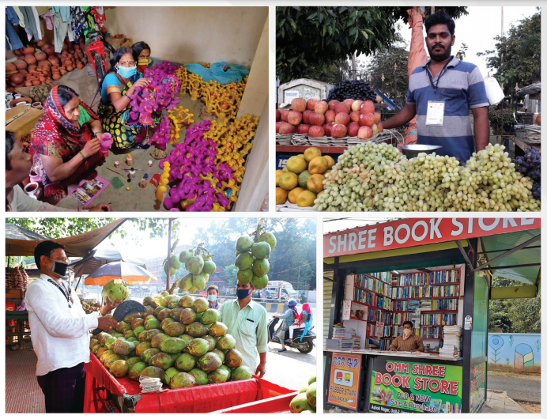
Thank You...

