Slide 1
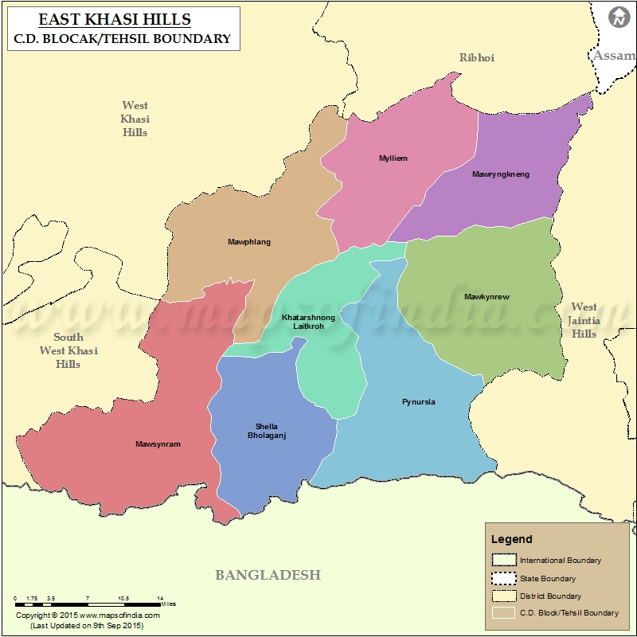
PRADHAN MANTRI JAN DHAN YOJNA east khasi hills district

Slide 2
DISTRICT PROFILE
Population (Census 2011): 8,24,059
HouseHolds (Census 2011): 1,60,832 (Excluding Institutional Households)
Density (Census 2011): 292 Per Sq. Kms.
Literacy Rate (Census 2011): Total Literacy* 84.70 % (Male : 85.26 % & Female 84.15 %) *Literacy rate is the percentage of literates to population aged 7 years and above
Civil Sub Division: Sohra Civil Sub Division
Community & Rural Development Blocks: Khadarshnong Laitkroh, Mawkynrew, Mawphlang, Mawryngkneng, Mawsynram, Mylliem, Pynursla, Shella Bholaganj

Slide 3
LAUNCH OF PMJDY IN MEGHALAYA

Slide 4
PROMOTING AWARENESS FOR ACCIDENT INSURANCE COVER
137 FLCs conducted by banks in different villages and schools for creating awareness (2014-2015)
Displaying banners, posters, etc. with detailed features of the scheme in markets and more prominent areas
Displaying banners and posters in the banks with scheme related features
Familiarizing bank staff with the scheme to enable them to assist customers during the enrolment process

Slide 5
PROMOTING AWARENESS FOR ACCIDENT INSURANCE COVER
Special drives in government offices, educational institutions, markets and other prominent places.
Wide publicity through electronic media, local print media and also by AIR in local language
Press Information Bureau, Shillong has conducted a three day public information campaign and exhibition from 28.01.2016 to 30.01.2016 at Smit village wherein stalls have been set up displaying posters, banners promoting the scheme
So far 13396 numbers of PMSSBY were registered

Slide 6
RUPAY CARD ACTIVATION INITIATIVES
Banks have been explaining/discussing issue in all FLCs and Bank branches for activation of Rupay cards
Bank branches have been maintaining close liaison with respective post offices for prompt delivery of Rupay PIN mailers
Bank staff have been sensitized for creating awareness about usage of Rupay cards,
Focus on delivery and activation of cards to get the benefits of accidental insurance cover of Rs. 1lakh to the nominee
So far 42% of Rupay cards have been activated

Slide 7
BANK MITRAS SERVICES FEEDBACK
Active Bank Mitras are available in the respective Customer Service Points (CSP)
Rendering the banking services through proper devices – Kiosk Banking and doing daily transactions like deposits, withdrawal, remittances etc.
53 CSPs have been registered and made operational

Slide 8
STATUS OF ZERO BALANCE ACCOUNTS
All bank branches and CSPs are making contacts with the account holders by personal visits, phone calls, sending letters to the account holders for deposits in their zero balance accounts and activation of Rupay cards
So far 1562 zero balance accounts have been upgraded into deposit accounts out of approximately 5521 zero balance accounts

Slide 9
STATUS OF ZERO BALANCE ACCOUNTS FOR WOMEN
Likewise similar steps have been adopted for women account holders - 88.4%

Slide 10
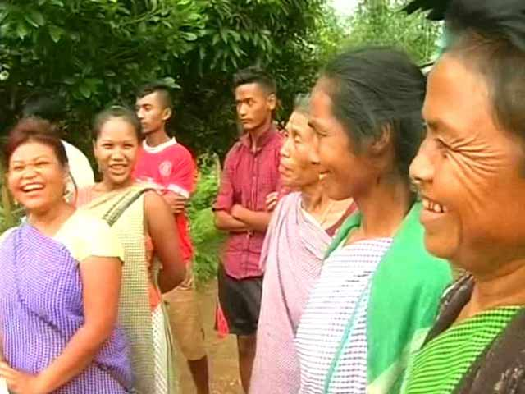
EFFORTS IN IMPLEMENTING IN DIFFICULT GEOGRAPHICAL TERRAIN AND OTHER SOCIAL CRITERIA
LFCs are being conducted by local NGOs & Banks
Wide publicity – Display of banners, posters etc.
Promotion of the scheme in market and prominent areas

Slide 11
STATUS OF AADHAR
Enrolment has been started and biometrics captured in many rural areas
24% has been achieved
Local issues involved

Slide 12
SCOPE AND SUGGESTIONS
Net connectivity to be improved
Training of CSPs
More avenues for income generation for CSPs
Infrastructure development like roads, transport, etc.
Intensive awareness and sensitization programmes
Involvement of stakeholders eg. School teachers, social workers including civil societies, youth clubs and mahila samitis

Slide 13
INNOVATIONS INTRODUCED FOR SUCCESSFUL IMPLEMENTATION
20 numbers of mini ATMs have been given to Bank Mitras to facilitate easy swipe of Rupay cards
Use of social media
Government insistence

Slide 14
IMPROVEMENTS IN ACHIEVING SCHEME GOALS
Visit to Bank Mitras by bank officials at regular intervals have been intensified to motivate them to bring more customers
Conversion of zero balance accounts to deposit accounts has helped to increase business
Improved savings and better livelihood
With the successful introduction of Bank Mitras banks are encouraged to engage more Bank Mitras

Slide 15
ENSURING EFFICIENT AND CORRUPTION FREE PUBLIC DELIVERY SYSTEMS
Regular visits to Bank Mitras by bank officials maintaining transparency, control and good customer service
Verification of bank accounts maintained by Bank Mitras
Declaration of number of accounts held and deposits
Upgradation of skills of Bank Mitras through capacity building

Slide 16
INNOVATION & ADAPTATION TO MEET CITIZEN’S REQUIREMENTS
Concept of CSPs
Client feedback taken by CSPs during sensitization programmes for better implementation
Business correspondents by banks

Slide 17
EXTRAORDINARY PERFORMANCE RELATING TO PROGRAMME IMPLEMENTATION
Town Hall meetings were conducted by the Lead Bank Manager to educate the participants about the various flagship programmes of the Government of India

Slide 18
SETTING HIGH STANDARDS OF SERVICE AND CONTINUED IMPROVEMENT FOR IMPLEMENTATION
Regular visits by Bank officials to CSP outlets to ensure quality delivery of services to the customers, training of Bank Mitras for better delivery of services
Personal attention to individual account holders for better customer service
Ownership

Slide 19
SYSTEMATIC CHANGES TO ENSURE SUSTAINABILITY
Convenience
Accuracy and Efficiency
No third party involvement
Easy accessibility to one’s own account
One umbrella concept

Slide 20
EFFECTS AND BENEFITS ON ALLIED AREAS
FLCs conducted in different villages in East Khasi Hills District gradually transforming the mindset of the people resulting in increased number of enrolments in concerned areas
Direct transfer benefits of various flagship programmes under MGNREGA, IAY, Housing Loan etc. have helped to ensure transparency and prompt benefits to the public

Slide 21
THANK YOU
P. S. DKHAR
DEPUTY COMMISSIONER,
EAST KHASI HILLS DISTRIICT, MEGHALAYA

