Slide 1
Priority Programme *Pradhan Mantri Jan Dhan Yojana*
Presentation From District Murshidabad West Bengal
Date--01.03.2016
Time slot. 11 AM.

Slide 2
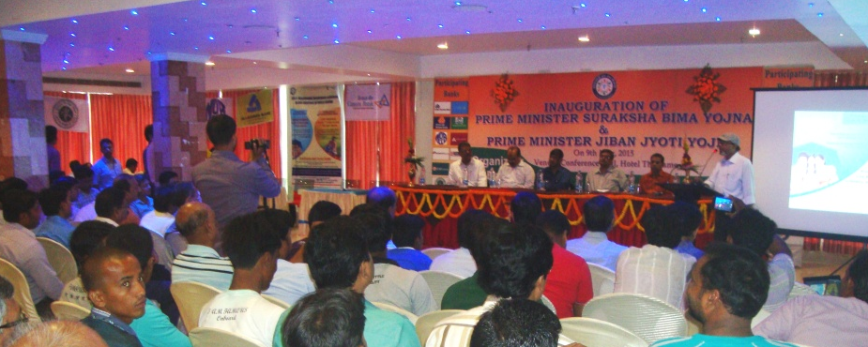
Efforts Done to promote awareness for accident insurance cover:
Extensive publicity was given through Flex-banners,Miking and Leaflet throughout the district.
Awareness camps were organized by the branches in the SSA(Sub Service Area)
Bankers’ participated in different Melas for publicity of the accidental insurance coverage.
Financial literacy camps were organised by the FLCC and LDM throughout all the Blocks.

Slide 3
District Profile at a Glance:
1. Demographic Features (as per Census, 2011)
Total population Urban 14.06 lac Rural 57.31 lac | 71.37 lac
Sex Ratio (M:F) | 1000:957
Population Density | 1134 per Sq. km
Percentage of literacy | 66.59%
2. (i) Administrative Units (District Head Quarter at Berhampore)
Sub-Division | 05 (Berhampore, Lalbagh, Jangipur, Kandi & Domkal)
Blocks | 26
Police Station | 26
Municipality | 07 (Berhampore, Beldanga, Dhulian, Jangipur, Msd-Jiaganj, Azimganj and Kandi)
(ii) Zilla Parishad (Head Quarter at Berhampore)
Panchayat Samity | 26
Gram Panchayat | 255
No. of Mouzas | 2200

Slide 4
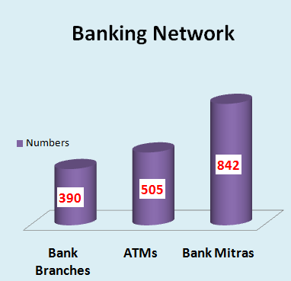
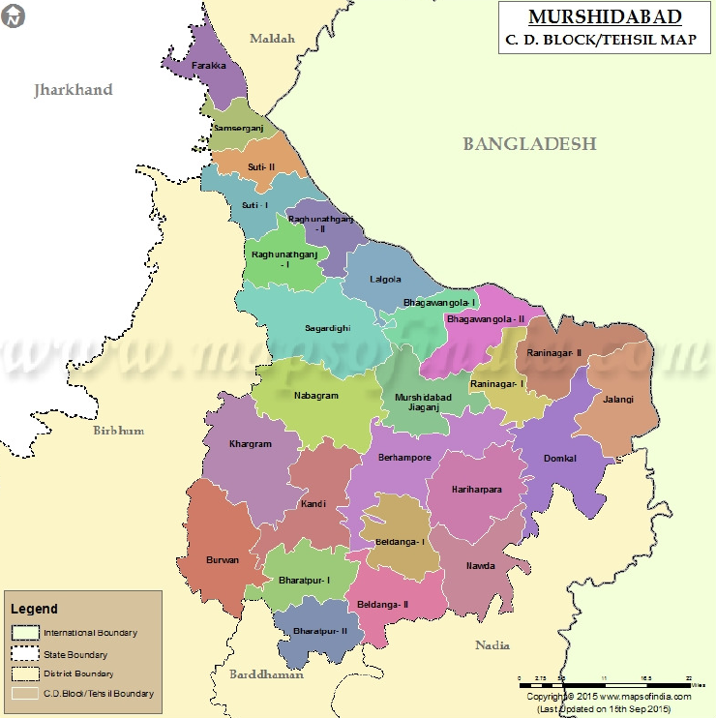
Per Bank Branch Population: 18300

Slide 5
Efforts done for RuPay Card activation:
RuPay Card Issued:- 929079 Nos
Village Wise awareness camps were organised by the Bank branches with the involvement of Gram Panchayat about the benefits of Card Activation.
Extensive miking done in the villages to contact the Bank Branches after receiving of the RuPay card for its activation.
Bank Mitras are being deployed for expediting the RuPay Card Activation.

Slide 6
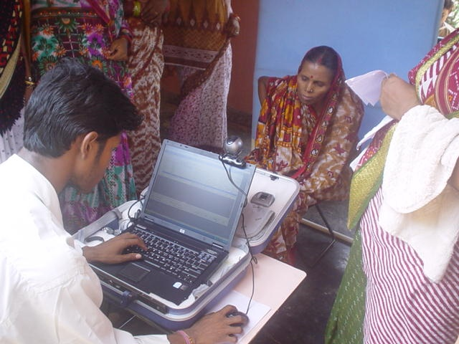
How are the services of Bank Mitras in terms of availability, proper device use and daily transactions :
Cont..

Slide 7
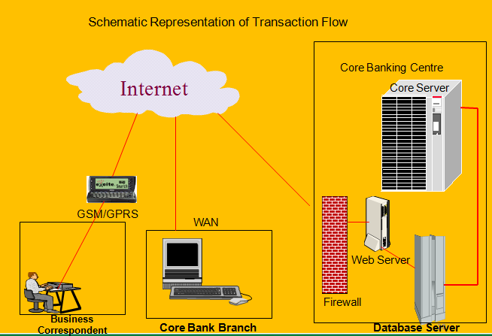
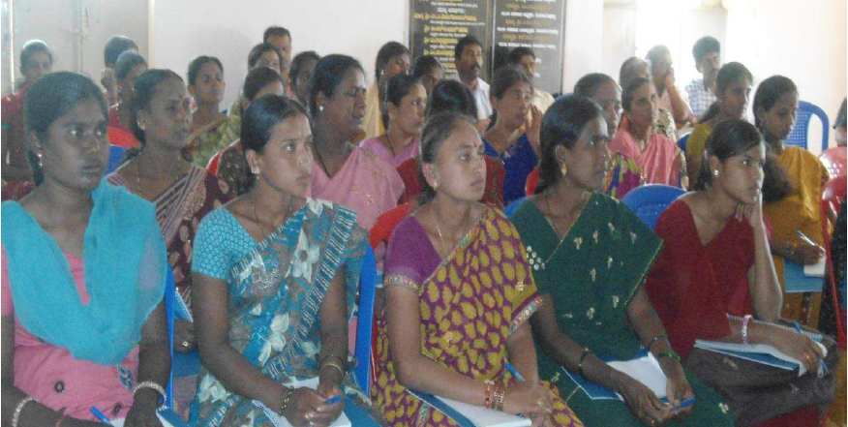
Regular meeting with the Bank Mitras are being conducted by all the banks, to appraise them about their role to serve the customers at their door steps .
Visit at the BC point is being done by the bank officials on regular basis to ensure their availability.
Training of the Bank Mitras are being imparted by the Banks for the proper use of device to provide hassle free service.
Bank Mitras has been directed to communicate with the villagers for inculcating banking habit through regular transaction in their accounts.

Slide 8
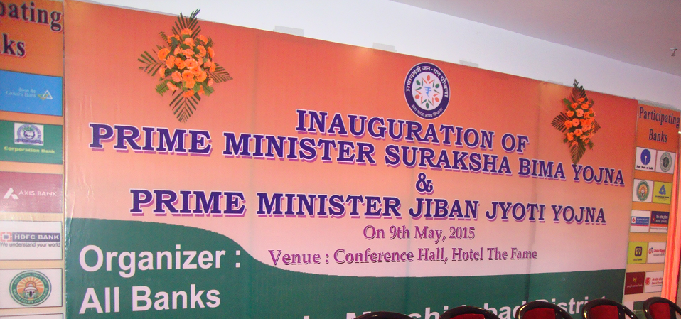
Reduction of Zero Balance Accounts:
As the sex ratio of the district is 1000:957(M:F), there are huge number of individual account of women. There are lesser percentage of Women account with zero balance in comparison to Male account.
Steps taken for reduction:
Help of the women SHGs
Awareness program regarding DBT(Direct Benefit Transfer).
Awareness about benefit of savings.
Awareness about benefit of Insurance(Accidental/Life).

Slide 9
Reduction of zero balance accounts:
Bank Mitras have been directed by all the banks to approach to the account holders having zero balance and motivate them for transaction in their accounts.
Awareness programmes are being organised by banks for building up of confidence amongst the account holders.
Financial literacy programmes are being conducted by the bank branches to inculcate the habit of savings.

Slide 10
Efforts in implementing in difficult geographical terrain and BPL no( Social Criteria):
Some part of the district, particularly the embankment of Bhagirathi River are still having some difficult area. Banking facilities has been provided through Bank Mitras in those areas.

Slide 11
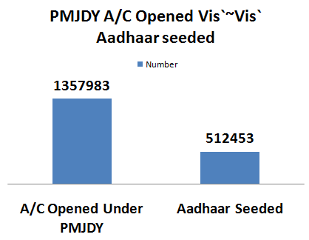
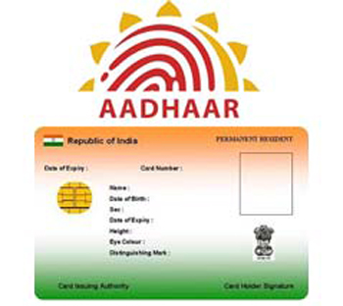
No of Aadhaar seeding done and efforts made for the same:
Wide publicity made in the Public Places,Govt. Offices, Gram Panchayats as well as in the BC points, ATMs,and Bank Branch premises.
Continuous awareness programme undertaken by the banks for seeding the Aadhaar numbers and the benefits thereon.

Slide 12
Suggestion for improvement :
Financial Literacy camp to be organised on regular basis by the Banks with the help of local administration and NGOs.
Proper Network connectivity in rural areas to be ensured.
Provision of Pass sheet/Pass book printer machine for confidence and satisfaction of the account holders at the BC points.
It is to be ensured that a conducive environment is created when a person who is totally new to the banking environment approaches the Camp or branch or Bank Mitra for opening the account.
Publishing of comics book on “Money and Savings” in local languages and distribute among people through the rural and semi urban branches to reach the rural students and the farming community.
Interview based programme on Financial Literacy programme on DBTL and Aadhaar seeding to be telecast through DD to educate the people on the need and importance of DBTL and Aadhaar Seeding.

Slide 13
Special Initiative taken in District towards financial inclusion and bank linkage :
Massive programme organised on 29th February across the district for credit linkage to the SHGs for empowerment of the women with the objective of “Funding the Unfunded”
Total Rs 50 Cr credit was given to 5300 No of SHGs

Slide 14
OUR MISSION
“Banking for the Unbanked”

Slide 15
Thank You

