Slide 1

PRESENTATION ON PMJDY IN HYDERABAD DISTRICT

Slide 2
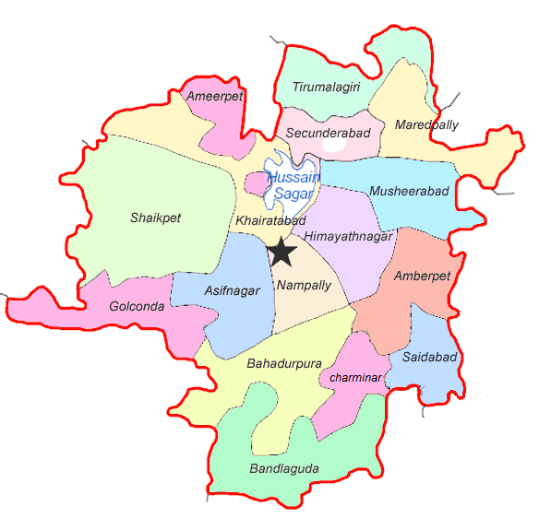
Hyderabad District demographics
Sl. No | ITEM | No.s
1 | Geographical Area in Sq. Kms | 217
2 | No. of Revenue Divisions | 2
3 | No. of Mandals | 16
4 | Total Population as per population census of 2011 | 39,43,323
 | Male | 18,24,748
 | Female | 21,18,575
5 | Percentage Growth | 2.97
6 | Density of Population | 18,172
7 | Sex Ration (Males for 1000 Females) | 954
8 | Literacy Percentage | 75 %
9 | No. of Constituencies | 15

Slide 3
Certain Important Statics
Total Number of House Holds as per census 2011 : 8,37,927
Urban population as per Census 2011: 39,43,323
Approximate number of bank accounts under PMJDY : 9,31,170
RuPay Cards Issued : 8,94,229
RuPay Cards Active : 7,43,900
Insurances Involved : 26 cases ( source LIC )

Slide 4
Brief Background
Financial Empowerment and Financial Inclusion are the only ways to ensure equitable and inclusive growth .

Slide 5
Brief Background
Financial Inclusion and institutional finance have been the strategy backdrop in the state since the early 2000
Very strong network of SHGs both in rural and urban sectors(SLFs and TLFs)

Slide 6
Some important statistics
Number of SHGs in Hyderabad : 16,191
Number of SLFs : 390
Number of TLFs : 9
Approximate Bank Linkage to : 35 Cr
the SHGs per annum
Cumulative linkage till date : 210 Cr

Slide 7
Post PMJDY Mission
Community in a state of readiness for taking up the PMJDY
The environment of private money lenders, micro finance companies, farmer suicides etc;
The success/benefits seen by the SLFs and TLFs

Slide 8
Post PMJDY Mission
Number of accounts : 9,31,570
Steps taken by the District Administration
Extensive awareness campaign taken up, especially in vulnerable areas
Involvement of Public Representatives, civil society organizations, community groups, students, youth organizations, TLFs and SLFs etc;
Engaging with Banks to sort out operational issues

Slide 9
Post PMJDY
Certain strategies
Bring various popular welfare schemes into the banks fold with PMJDY accounts
Linking various non financial activities to Aadhar, like Voter list, civil supplies list, housing list, etc
Holding kala jathas on criticality of the insurance scheme
Close liaison with banks and insurance agencies in promoting the concept of insurance

Slide 10
Some statistics
Social security pensions given : 1,61,163 - 98.3% of which are paid into the beneficiaries bank accounts
- 99.6% of which are Aadhar seeded accounts
Student scholarships under : 1,24,733
various schemes

Slide 11
Post PMJDY Mission
Certain Strategies
Promoting electronic/mobile banking in various non governmental activities also
Women and youth encouraged to increase their participation in financial activities through mobile banking
Targeted literacy campaign taken up to promote
Funds transfer
Immediate payment services
Mobile Money

Slide 12
Post PMJDY Mission
Certain Strategies
Awareness regarding financial services like pensions and insurance among women groups and unorganised workers
Technical literacy campaign on operating the RuPay card and accessing other services
E-seva and Meeseva centers doubling up as CSPs(Customer Service Points) and FLCs (Financial Literacy Centers)
Linking with active state schemes and central schemes to keep the accounts live

Slide 13
Post PMJDY Mission
Plans for the future
Bringing in more central and state initiatives into the institutional finance fold
Provide easy and low cost products/solutions to enable Citizen-Government transactions through mobile banking
Strengthen E-seva and Meeseva centers as complete CSPs
Engage aggressively with the private sector and the booming IT and ITES sector in the city

Slide 14
Post PMJDY Mission
SUCCESS STORY PMJDY
HYDERABAD DISTRICT
Shri. D Pandarji, aged 51 years got an account opened under PMJDY with Andhra Bank, Amberpet Branch. D Pandarji was a flower vendor selling followers at RTC cross roads on a pushcart. He died due to a massive heart attack on 01 Jan 2015 after coming back to home after a long day of work. He is survived by his wife and three children. He was the sole bread earner of his family. The family members were not aware of the PMJDY scheme for claiming the benefits linked with PMJDY.
The awareness program conducted by the FLCs and camps conducted by the branches to educate the people on the scheme helped them to approach the Andhra Bank branch and submit the required papers to get the claim. The wife of the deceased Smt. Sujatha and her eldest son utilized the claim amount to start a tailoring shop which is now their livelihood .

Slide 15
Thank you…

