Slide 1
Pradhan Mantri Jan-Dhan Yojana in Ranga Reddy District
Telangana State

Slide 2
Contents
District Overview
Financial Indicators
Strategy Used for 100% Inclusion
Last Mile Connectivity
Rupay Cards and Accident Insurance Cover
JAM in RR- The Flavor
Last Mile Issues to ensure JAM
The Way Forward

Slide 3
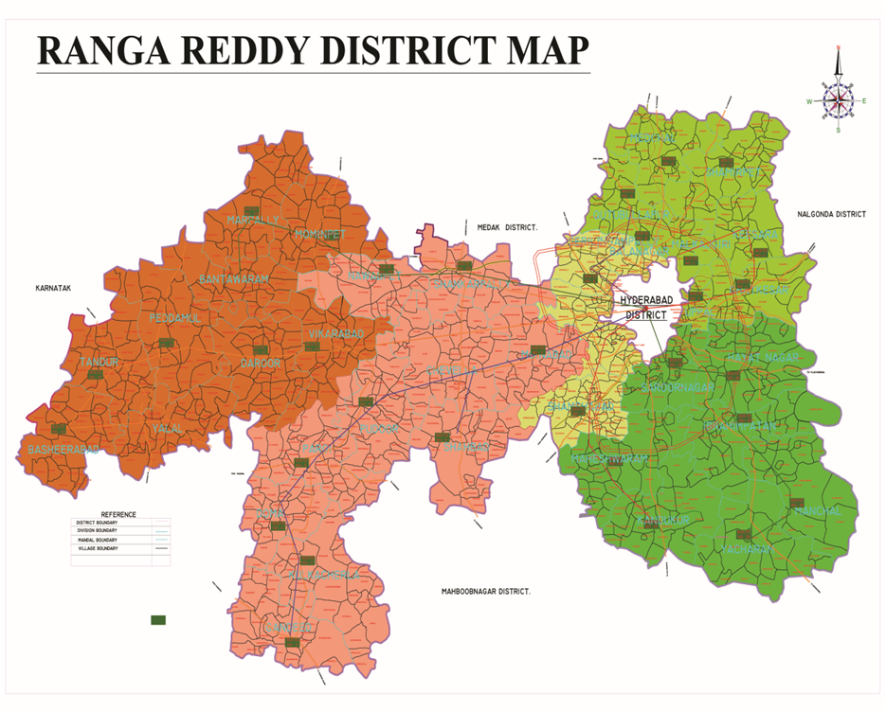
Overview of District
Geographic Area 7493 sq Kms
About 5 times the size of Delhi
10% of the area falls in GHMC
Urban Population Approx 2.5 times Rural Population
1254 Bank Branches
1 Branch per 6 sq km
As Opposed to India’s 1 in 70 sq km (approx)*
*Source: India in Figures 2015, Ministry of Statistics & Programme Implementation
Total House Holds 12.35 Lakhs

Slide 4
Financial Inclusion in Ranga Reddy
Target: 4,71, 900 House Holds
Achieved: 7,25,988 Accounts
100% Households Included

Slide 5
PMJDY Status
Target: 4,71, 900 House Holds
Over 7,25,988 Accounts Opened
Maintaining a Balance of Rs 114.84 Crores

Slide 6
How We Did It

Slide 7
The Strategy
Round 1
Meetings with SHGs by Bankers for dissemination of knowledge and account opening forms
Pre Scheduled Camps at local levels for opening of accounts
Round II
Survey by Bank Correspondents and SHG Group Leaders
Account Opening Forms distributed and camp details disseminated
Round III
Public Challenge
Certification by Sarpanches/Commissioners
Account Opening camps for opening accounts
Call for any known case of non inclusions
Opening of accounts
FP Shops Used in Urban Areas
Last Mile Inclusion Issues

Slide 8
The SHGs in Telangana
Zilla Samakya
Mandal Samakya
Mandal Samakya

Slide 9
SHG Network
6,23,527 financially literate women in SHG network
Credit Worthy Women
Rs 250 Crores disbursed so far as loans
Existing working relationship between Groups and Bankers
PMJD Camps by Bankers with Village Organizations
Public Representatives involved for sensitization
Information from VO to Group Leaders to Individuals

Slide 10
Bankers
Mapping of Branches and Vos
Organizing meetings and camps
Publicity material distributed
Account opening forms distributed through VOs
Account Opening Camps
Camps held 2 weeks after distribution
Counters to open accounts on the spot
Counters for awareness on Rupay
Pass Book and Rupay cards in 2-3 weeks
Banks relaxed KYC Requirements
KYC of VO Office Bearers sufficient
E- KYC :100% of the district covered by Aadhar
Aadhar enabled KYC
Simplified account opening process
Only one document for identity and address proof

Slide 11
Round II
Final Survey Conducted to Identify Missing Households by
Village/Ward Organizations
Business Correspondents (1260 available in district)
Incentivised by households identified
Fair Price Shops 1846 shops
685 in Urban Area focussed on
Account Opening forms provided through all the above
Account Opening Camps Organized
Identified beneficiaries came with account opening forms
Date and Location communicated at the time of Survey

Slide 12
Round III
Public challenge
Announcement of 100% coverage done
Call for un-included House Holds
Autos and Public Announcement Systems in Urban Areas
Details of contact persons, time to contact published
Involved local sarpanch and public representative

Slide 13
Last Mile Connectivity
Brick Kilns/ Migrant Construction Workers (1900 HH)
Labour Department had surveyed
Already covered for PDS Rice
Small Accounts
Camps
Chenchus (799 HH)
Primitive Tribal Group found in pockets of the district
Targeted Camps held
Account forms distributed through SHGs
Foreign/Non Local Students
2.84 lakh students (Number is over half of un-included HH)
Camps at all Major Institutions
Involved NSS wings of Colleges
One month to get local id proof
Transferred/ migrant workers
Self declaration about current address
Small Account

Slide 14
Rupay
Rupay to all
Education/Sensitization
Designated areas in Account Opening camps
Designated staff at banks
174 Bank Mitras in the district
Contacted all Rupay card holders through SHGs
Tied up post offices and banks to ensure speedy delivery of Rupay Cards
Government Schemes tied in with Rupay Cards
Student scholarships: Staff segregated and distributed cards
Banks took care to ensure ATMs are stocked

Slide 15
Reduction of Zero Balance Accounts
Sensitization
Bankers contacted zero balance account holders through SHGs
Publicity of the OD facility
Banker’s target to aim for a deposit of at least 200
Zero balance account holders incentivised to join PMSBY
Bank paid first Rs 12 if min balance of Rs 500 is maintained
Appreciation Certificates to Branches with significant reductions
All Government DBT transactions routed through these accounts
Accounted for 25,06,890 of accounts
Amount Rs 1530.52 Crores

Slide 16
Accident Insurance
Sensitization and Information Dissemination
Wide publicity in account opening camps
Information to all SHGs through Vos, MS and ZS
Pamphlets distributed extensively
Information dissemination through
Financial literacy & credit counseling centre, business correspondents and bank mitras
Village Level Enrollment Teams used to enroll the individuals into the schemes.
SHGs
Group resolutions taken to sign the whole group for insurance program
Premium from Group Savings
Amount goes to individual accounts
Banker auto debits
To ensure ease of claims
VOs and Group Leaders trained to apply
Minimal documentation required :death certificate and aadhar card
Group Leader tied in with banker
Awareness on claim settlement process
Confidence Building by speedy disposal of claims
Lakshmi Vilas Bank processed a claim in 1 week

Slide 17
The Way Forward

Slide 18
JAM

Slide 19
Amount of JAM-DBT in RR District in 2015-16 (to date)
Sl No | Name of Scheme | Total Amount Disbursed( Rupees Crores) | Total Beneficiaries | Beneficiaries seeded with Aadhar
1 | DRDA (Microfinance to SHG) | 342 | 20,000 Groups 2,00,000 Individuals | 94.5%
2 | MEPMA (Semi Urban SHG) | 35.62 | 3,878 Groups 39,515 Individuals | 70%
3 | MGNREGS | 147 | 2,89,467 | 84%
4 | Agriculture Loan Waiver | 251.207 | 1,99,653 | 90%
5 | Cotton Procurement | 35.57 | 1,600 | 100%
6 | Paddy Procurement | 26.99 | 3,674 | 100%
7 | PAHAL (LPG Subsidy) | 124.76 | 13,86,270 | 86.47%
8 | Scholarship Schemes Nmber of Schemes= 5(SC,BC,ST, EBC, Minority) | 438.73 | 2,84,845 | 100%
9 | Pension Number of Schemes = 3 (Disabled, Old Age, Widow) | 128.65 | Old Age – 33,713 Disabled – 17, 114 Widow – 50, 550 Other – 489 Total – 1, 01, 866 | 99.38
 | TOTAL | 1530.52 | 25,06,890

Slide 20
Spread of JAM Across the RR Economy
 |  | LPG | SHG | MGNREGS | Scholarships | Procurement | Pension
First Mile | Eligibility | Household |  |  | Individual | Individual | Household
 | Targetting | Universal | Targeted (BPL) | Targeted (BPL) | Targeted (BPL) | Targeted (BPL) | Targeted (BPL)
 | Beneficiary Database | Digitized | Digitized | Digitized | Digitized | Digitized | Digitized
Middle-Mile | Within-Government Coordination
 | Supply Chain Interest Groups
Last- Mile | Beneficiary Vulnerability | Reduced through issual of Deepam Connections | Universalized access to credit | Self Targeting | Minimized by ease of application, monitored grievance redressals and SLA based deliveries | Self Targeting | Minimized by ease of application, monitored grievance redressals and SLA based deliveries
 | Beneficiary Financial Inclusion | 100% | 100% | 100% | 100% | 100% | 100%
To be examined at a state and national level

Slide 21
JAM Preparedness Index
 | Urban DBT | Rural DBT
Can Government Identify Beneficiaries? | Aadhar Penetration (100%) | Aadhar Penetration (100%)
Paying Beneficiaries | Basic Bank Account Penetration (100%) | Basic Bank Account Penetration (100%)
Beneficiaries Accessing Money | 925 Branches 1649 ATMs 1 per 537 Urban Households 1 per 2255 Urban Population India Average: 1 in 6630 Kenya Average: 1 in 172 | 1260 Business Correspondents + 386 Postal POS devices 1 per 290 Rural House hold 1 per 848 Population India Average: 1 in 6630 Kenya Average: 1 in 172

Slide 22
Last Mile Issues: Aadhar Seeding issues
EID available but no UID
Careless enrollment agencies
Data not yet transferred to UIDAI
Aadhar data base
Access through SRDH
Not instantaneously updated
Non consent
Solutions
At the Account Opening camps- aadhar enrollment facility provided
Mee seva centers enabled 85 permanent enrollment centers in the district
625 permanent centers to correct and update information

Slide 23
Last Mile Issues: Beneficiaries Access to Accounts
Current Business Correspondents : 1260
1 Per 290 HH (Rural)
1 per 848 Population (Rural)
Current Branch : 925
1 Per 1335 HH
1 per 5697 Population
ATMs : 1649
1 per 537 Urban HH
1 per 2255 Urban Population
Postal Network
Over 1 lakh social security pensioners served
Biometric aadhar enabled distribution
Use of POS – Point Of Transaction Device POTD
About of 1-3 villages per instrument
386 POTDs per 686 Gram Panchayats

Slide 24
Biometrically Authenticated Physical Uptake (BAPU) in PDS
Number of Households : 11.77 lakh
102% of BPL HH
Number of Beneficiaries : 39.15 lakh
Aadhar Seeding % : 100%
Number of FP Shops :1847
In Urban Area (GHMC) : 685
In Rural Area :1162
POS Machines Distributed :685
BAPU Preparedness Index :37.08%
Telangana State’s BAPU Index :2.6%

Slide 25
The Next Step
Opening of bank accounts is Ground Zero: We don’t re
Poverty alleviation through gamut of financial solutions
Regularity : As per needs vis-à-vis as per seasons
Reliability: Strong relationship guaranteed to enable access to opportunity
Responsiveness: Protection against Unpredictable vulnerabilities
Last Mile Connectivity – The BC
Limited credibility of BC both ways
One way flow of money
Restricted quantum of transactions
Safety and transit Insurance
Poverty Alleviation
Reducing Vulnerability
Enhancing Opportunity
Financial Inclusion
Responsiveness
Reliability
Regularity
Empowerment

Slide 26
Thank You

