Slide 1
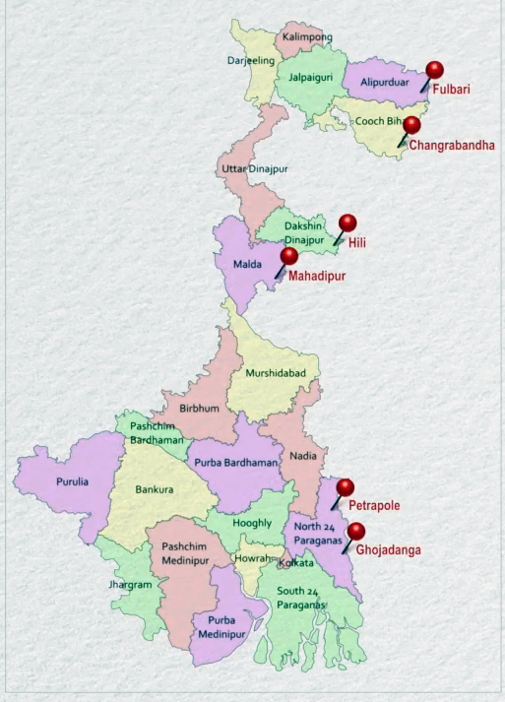
Suvidha Vehicles Facilitation System
Integrated Check Posts (ICPs) on Indo-Bangladesh border :
ICP Petrapole
ICP Ghojadanga
ICP Mahadipur
ICP Hili
ICP Changrabandha
ICP Fulbari
Countries Involved
India
Bhutan
Bangladesh

Slide 2
Issues Identified
Detentions Up to 40/45 days
No certainty of date of export
Queue Controlled by Local Groups/Cartels
No Inter communication between agencies
A complete chaos at land Ports

Slide 3
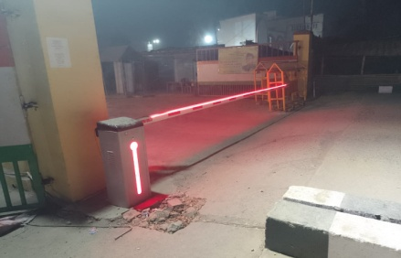
Journey of Suvidha…
Private Agencies Involved
Exporters Association
Custom House Agents (CHAs) Association
Transporters Association
Parking Association
Vehicle owners & Drivers
Individual Exporter, Transporter, etc.
Local Residents
Government Agencies Involved
Land Ports Authority of India (LPAI)
Indian Customs (CBIC)
Border Security Force (BSF)
Central Warehousing Corporation (CWC)
Police
Transport Department
Understanding the Process of Different Agencies and providing dashboards to all linking all stakeholders
Online allocation of Slots
Round the Clock Call Centre facility placed to support and guide
Technology used for automation of ICPs
Automatic Number Plate Recognition (ANPR) Cameras
Using of Boom Barriers for Access Control of Trucks

Slide 4
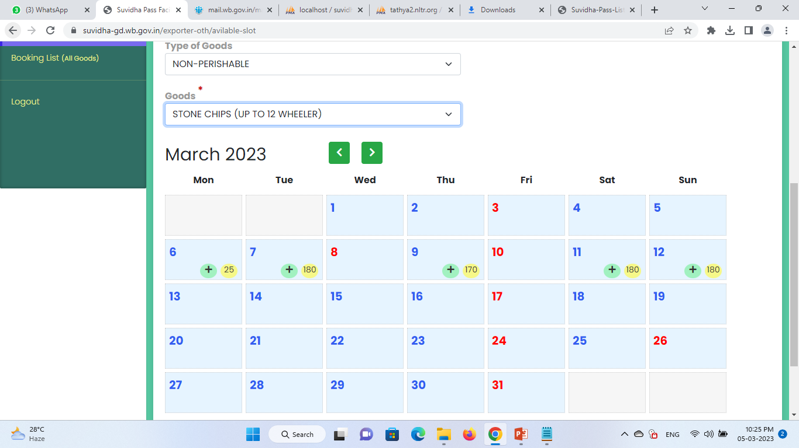
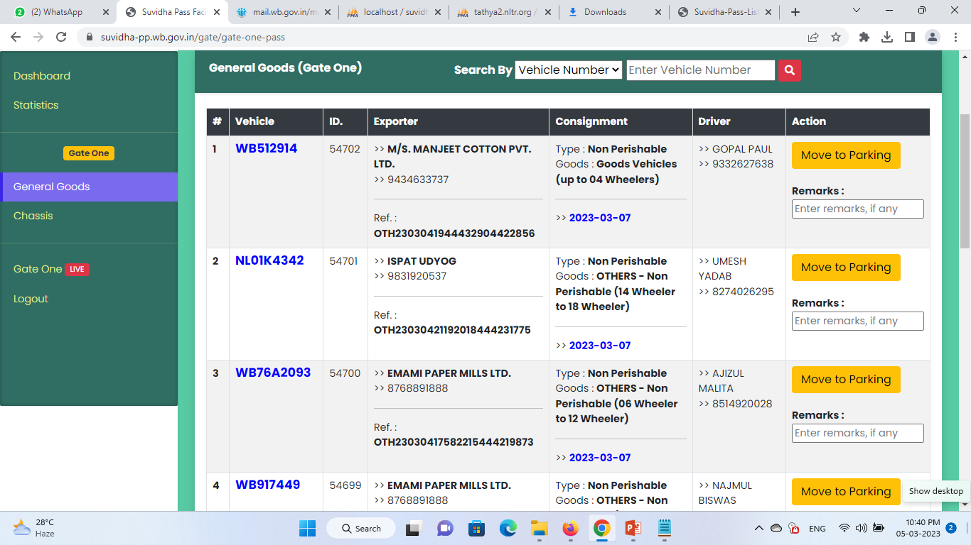
Journey of Suvidha….contd.
Slot Booking facility inside Exporter Dashboard
Dashboard of BSF Official/LPAI Official

Slide 5
Results Achieved…
 | Post-SUVIDHA |  | Pre-SUVIDHA
ICP | Per Day Export | Waiting Period | Per Day Export | Waiting Period
Petrapole | 400-450 | 0-1 Day | 300-350 | 40-50 Day
Ghojadanga | 350-400 | 0-1 Day | 250-300 | 60-70 Day
Mahadipur | 400-450 | 0-1 Day | 300-350 | 40-50 Day
Hili | 150-200 | 0-1 Day | 120-150 | 30-40 Day
Changrabandha | 350-400 | 0-1 Day | 300-350 | 40-50 Day
Fulbari | 150-250 | 0-1 Day | 075-125 | 30-40 Day
Rs 400 Cr (approx.) revenue generated as Suvidha facilitation fee
Government spent Rs 40 Cr (approx.) for infrastructural development of the local area and people in and around ICPs
Average cost at all ICPs for one transaction reduced from Rs 70k-100k (approx.) to 3k-10k.
Till now 5.5 Lakh (approx.) Vehicles exported through Suvidha

Slide 6
Feedback and Appreciation Received from different Agencies…
World Bank
Land Port Authority of India (LPAI)
Government of Tamil Nadu
Exporters, Custom House Agents (CHAs) and Drivers
Points for further Improvement
Stakeholders of other side of the ICPs (Bangladesh Land Port Authority (BLPA), Border Guard Bangladesh (BGB), Bangladesh Customs, etc.) not yet included
Exchange of information with Customs EDI portal is required to facilitate more single-window activities which will help reduce the time taken for submission of EGM.
Online Car pass facility is not yet integrated
Parking and Goods unloading Capacity of other side of the ICPs are required to be increased
Thank You! Any Questions?

