Slide 1
National ID Card for Peruvian children: Impact on human rights and development
Lecturer: Carlos Reyna Izaguirre
Representative of the National Registry of Identification and Civil Status
RENIEC - PERU
International Symposium
On Excellence in Public Service/Public Administration

Slide 2
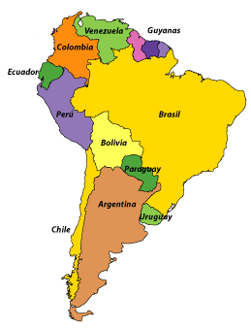
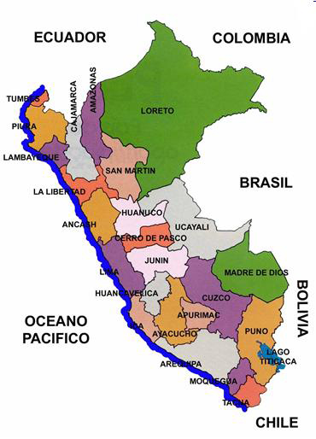
Children Identification Program through DNI
Geographical location
Basic data
Area
1´285,220 km²
Waterfront
3,079.5 km
Coastal area
136,233 km² - 10.6%
Mountain area
404,844 km² - 31.5%
Jungle area
744,142 km² - 57.9%
Population
30´814,175
Pop. Density
24 /km²
Languages
Spanish / Quechua
Capital City
Lima
Political div.
25 regions
195 provinces
1846 districts

Slide 3
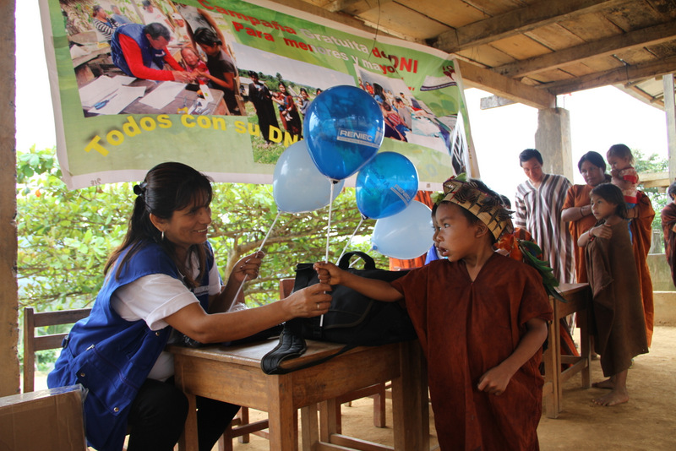
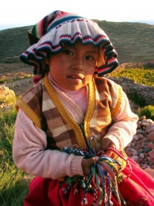
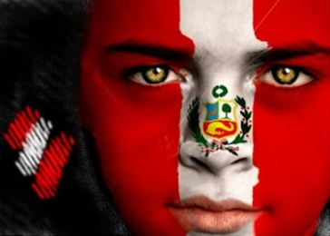
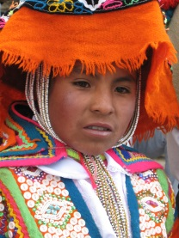
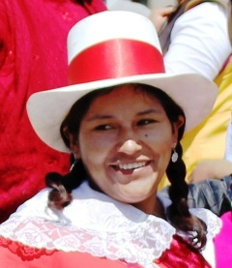
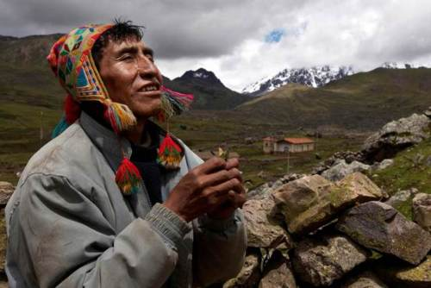
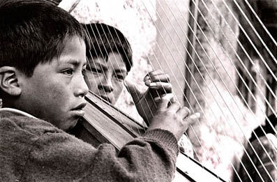
Children Identification Program through DNI
Peru is a melting pot of cultures

Slide 4
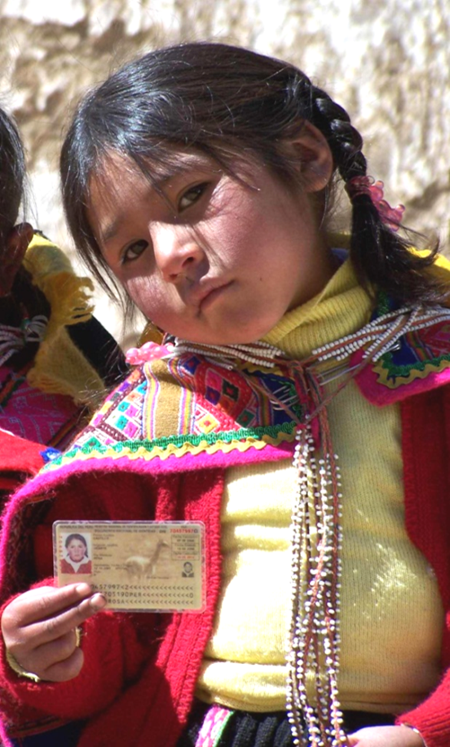
What is the reform initiative / best practice about?
Definition
Identifying peruvian children.
Data
Began in 2002.
Responsibility of RENIEC.
National coverage
Task was to document more than 10 million children.
Triggers of initiative
Consensus on the social impact of the children’s identification.
Will increase safety, and effectiveness of social prog.
Goal
To achieve universal coverage in the identification of children.

Slide 5
Children Identification in operation
Development process of the initiative
Peruvian identification cycle
Certificate of Live Birth
Birth certificate
DNI National ID Card
Health Services
Civil Register Offices
RENIEC Offices
Ministry of Health
Municipalities
RENIEC
Issued by health staff that assist with deliveries.
Live birth certification.
Done by parents carrying their DNI (Both or one of them).
Birth certificate.
Parents or direct relative carrying their DNI.
Any domiciliary certificate.

Slide 6
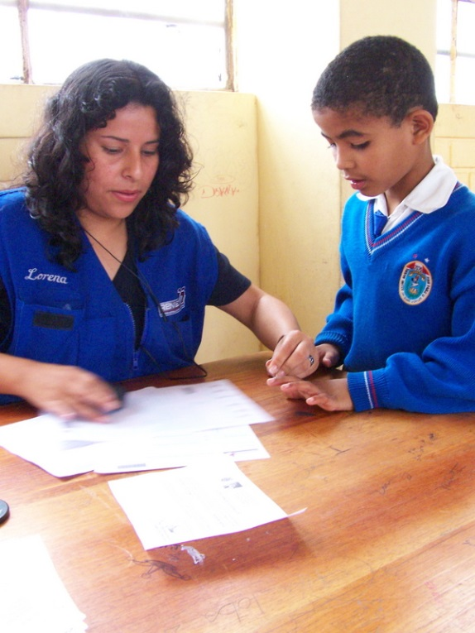
Children Identification in operation
Development process of the initiative
Some changes in the process
Regulatory simplification.
New set of people that can declare to children for DNI paperwork
Certificate of live birth number will be the same for birth certificates and DNI.
Team work with social ministries to associate the DNI to social programs.
2006 Identifying children at schools.
Delicias de Villa. Chorrillos. Lima.

Slide 7
Management of the process
Keys to start
Main trigger
Persuade the governments about the importance of the initiative and the need for funds
Change of management: Key strategies
Managenment
Administratives
Synergies
Advocacy
Mass campaigns in urban / rural areas
Simplification of procedures
Strategic alliances with public/private organizations
Strong promotion with decision makers
Free DNI
Deployment
of Itinerant Registration Teams
Massive information and awareness campaigns
Renewing destroyed birth registers
Strong support from international cooperation

Slide 8
Constraints and solutions
Poverty and extreme poverty
Free DNI
Remoteness of rural populations
Itinerant Registration Teams
Legal constraints
Regulatory simplification.
Political constraints
Alliances, Networking.
Cultural constraints
Bilingual Registration Teams
Institutional constraints
Increased RENIEC offices
Civil Register constraints
Strengthening civil registries.

Slide 9
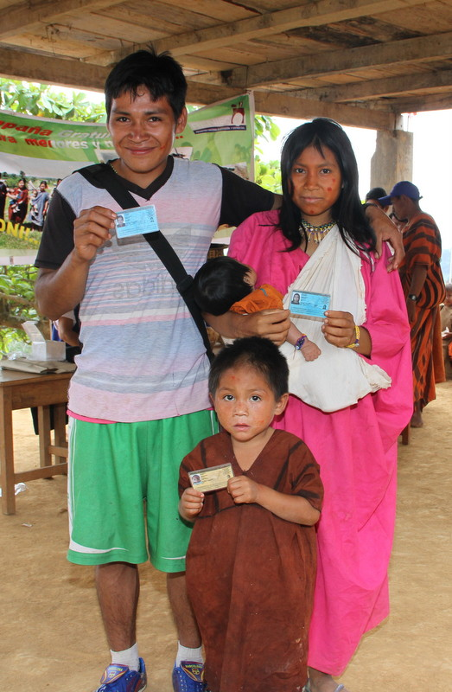
Enabling factors
What worked and what did not work
RENIEC is an administratively and legally autonomous institution
Partnership with local governments and social programs
Itinerant Registration and free DNI
Technological innovations
Restrictions:
Insufficient RENIEC offices nationwide.
2014 Gran Shinungari Native Community
La Convención, Cusco
Weaknesses remain in Registry Offices.

Slide 10
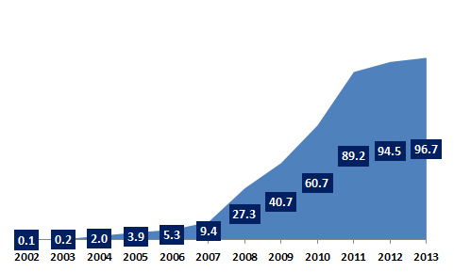
The impact in figures
Identified children with DNI
2002 / 2013
96.7% of children with DNI.
Increased security for children and their families.
More efficient social programs
Continued governmental support for the campaigns
Sources: INEI National Institute of Statistics and Informatics. Population Projections 2000 – 2015. National Survey of Strategic Programs ENAPRES. RENIEC National Register of Natural People RUIPN 2002-2013. Population identified by age group. Statistical Reports.

Slide 11
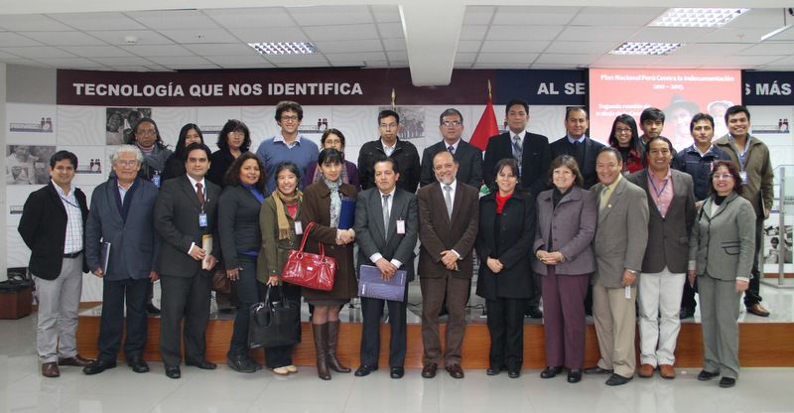
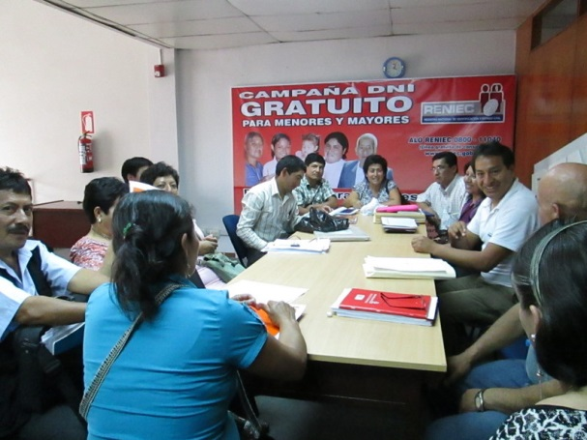
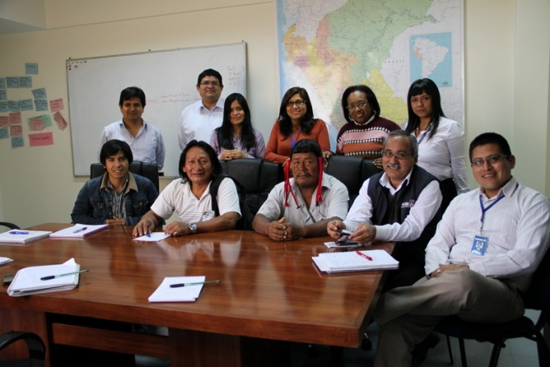
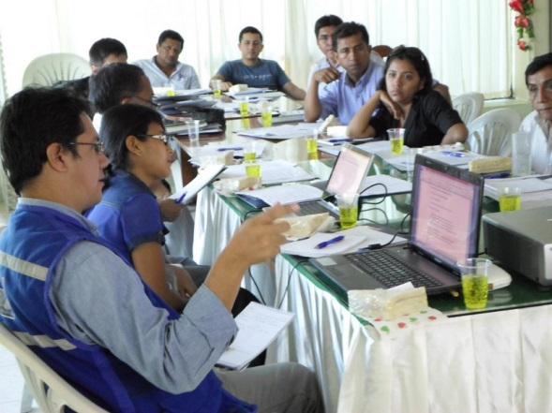
Sustainability
Institutional strength of RENIEC
Strategic alliances
Legal frame improved equals accessibility for vulnerable population
Coordination with strategic partners
2012 Coordination with allies in Piura.
2013 Coordination with Achuar representatives.
2014 Promotion group at Ucayali.

Slide 12
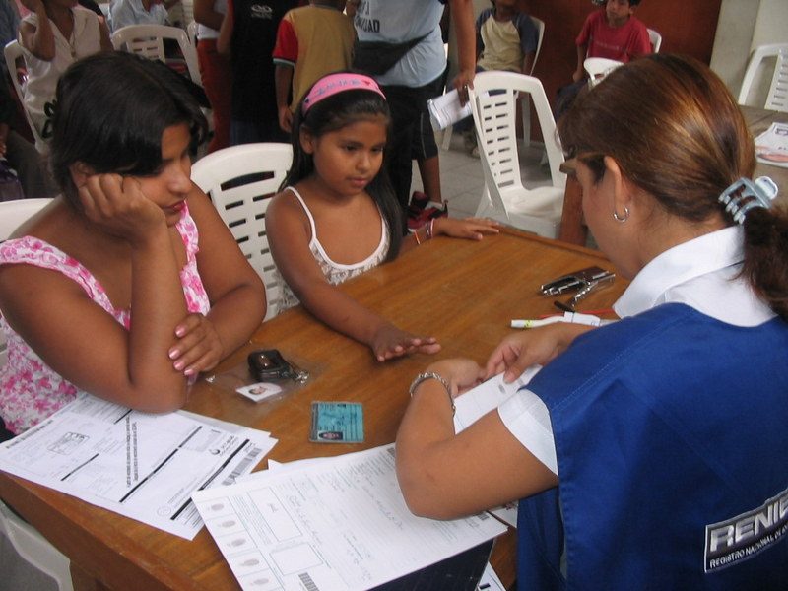
Lessons learned
The importance of consensus around the initiative.
The significance of institutional strength of RENIEC.
Good combination through offices and Itinerant Registration.
Regulation must balance data security and easy access to registration.
2005 Identifying children at schools
Ventanilla, Callao.
Technological innovations should be appropriate to the contexts.
Need for intercultural perspective to attain universal registration

Slide 13
National ID Card for Peruvian children: Impact on human rights and development
Thank You very much

