Slide 1
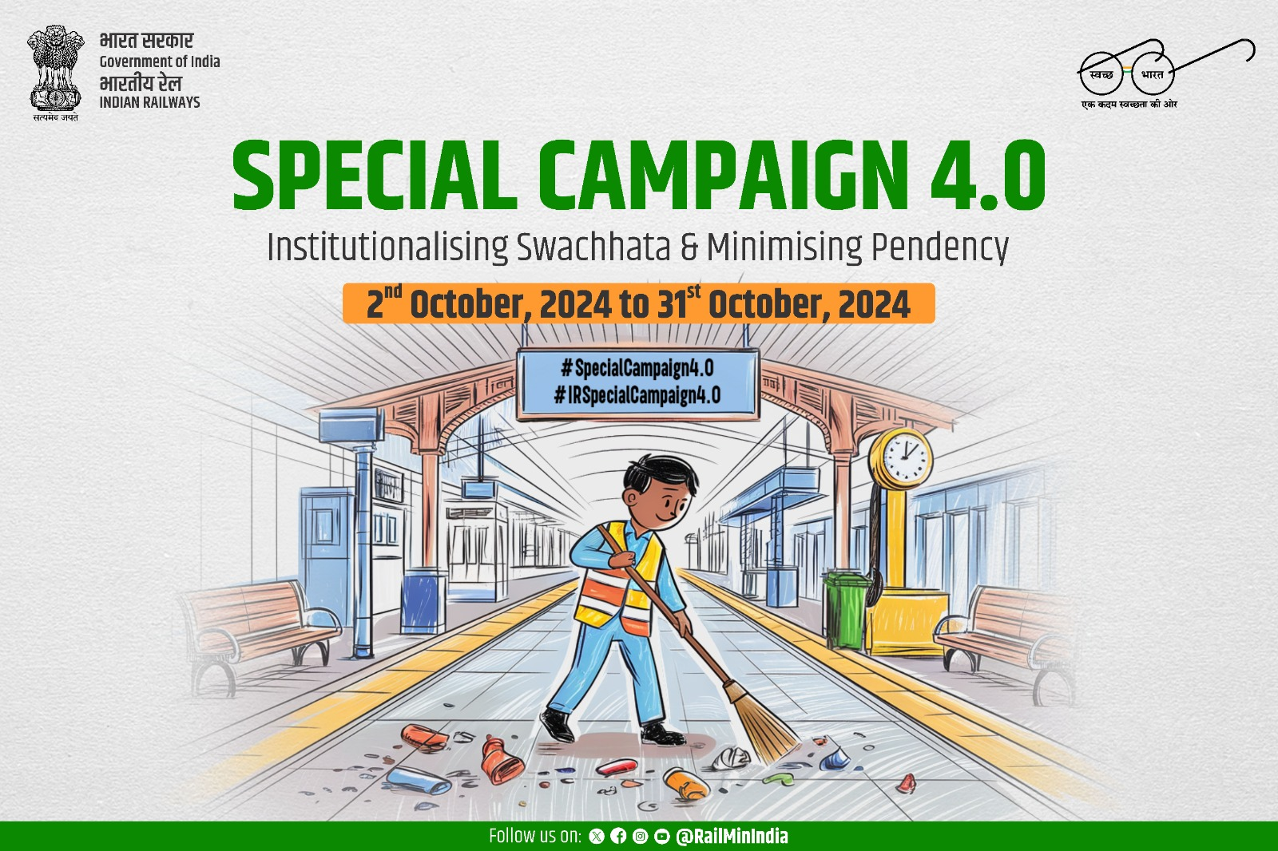

Slide 2
Special Campaign 4.0 – Key points
Special Campaign 4.0 focused on promoting efficiency, reducing pendency and improving swachhata at work places.
Covered all Zonal Railways/Divisional offices /PSUs /PUs /Attached Subordinate /Field offices/Workshops/Stations.
Focus was on implementation of the Campaign in Public Centric offices involving public interface.
Saturation approach was adopted to cover all the field offices of Railways.
Supervision of the campaign was done by senior officials on a regular basis.

Slide 3
Special Campaign 4.0 – Preparatory Phase
Targets were set during preparatory phase of the campaign (16th Sep to 30th Sep’24).
Nomination of more than 150 Nodal officers over entire Railways.
Creation of WhatsApp group of all Nodal officers for better coordination.
Targets fixed and uploaded on the portal of DARPG during the preparatory phase .
Launch of Achievement Phase of the campaign was from 02.10.2024.

Slide 4
Special Focus
Digitization
Inclusivity
Scrap Disposal
Enhancement of Office Spaces/Work Place
Waste to Wealth
“Rail Chaupal” at Railway Stations
In focus Offices
Divisional offices
Attached Offices
Subordinate Offices
Field Offices
Workshops/Stations
PSUs & PUs

Slide 5
Digitization
RailMadad, an innovative digital platform developed by Indian Railways to
Streamline passenger grievance redressal and feedback
Enhance efficiency and transparency integrating real-time tracking
Resolution of complaints through digitization
HRMS (Human Resource Management System), A digital platform to manage
Employee records, payroll, administrative functions,
Streamlining operations enhancing transparency
E-office, A digital platform aimed at streamlining administrative processes, ensuring paperless communication, and improving efficiency in office work.
App developed at Divisional level, In Vijayawada and Secunderabad divisions, an App developed for allotment of beds in Running Room and issue of Meal Tokens.

Slide 6
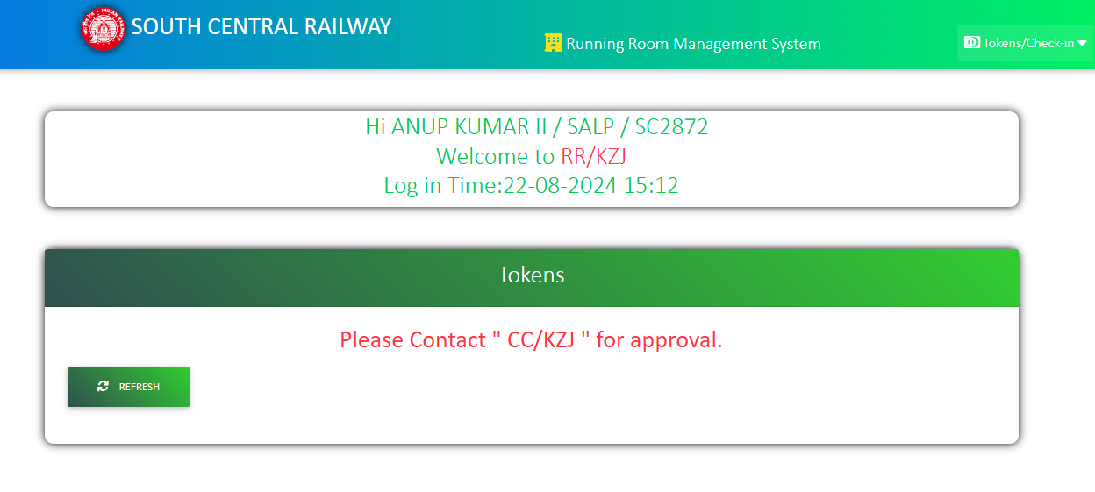
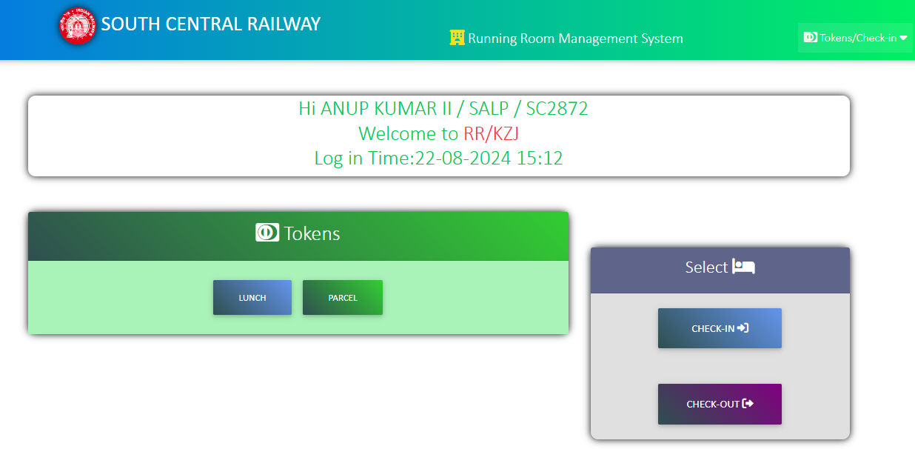
App developed for Running room staff by SCR
CREW, CC & RRI Log in page
Crew log in and awaits for sign off approval at CC
Crew has access to time based food tokens & accommodation

Slide 7
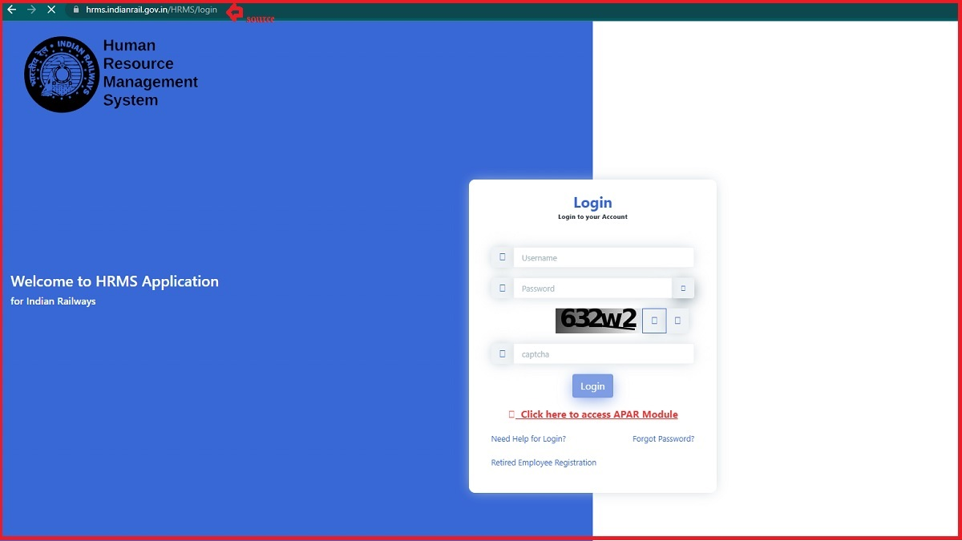
HRMS

Slide 8
Inclusivity
Accessibility for Divyang Jan: Improved station and coach infrastructure with ramps, lifts, Braille signage, and dedicated seating for persons with disabilities – an integral part of IR
Women centric initiative: Introduction of women-only coaches, improved safety measures, and introduced all-women gangs at work
Real-Time Assistance: Providing assistance through RailMadad in a short time - promoting a more inclusive travel experience for passengers

Slide 9
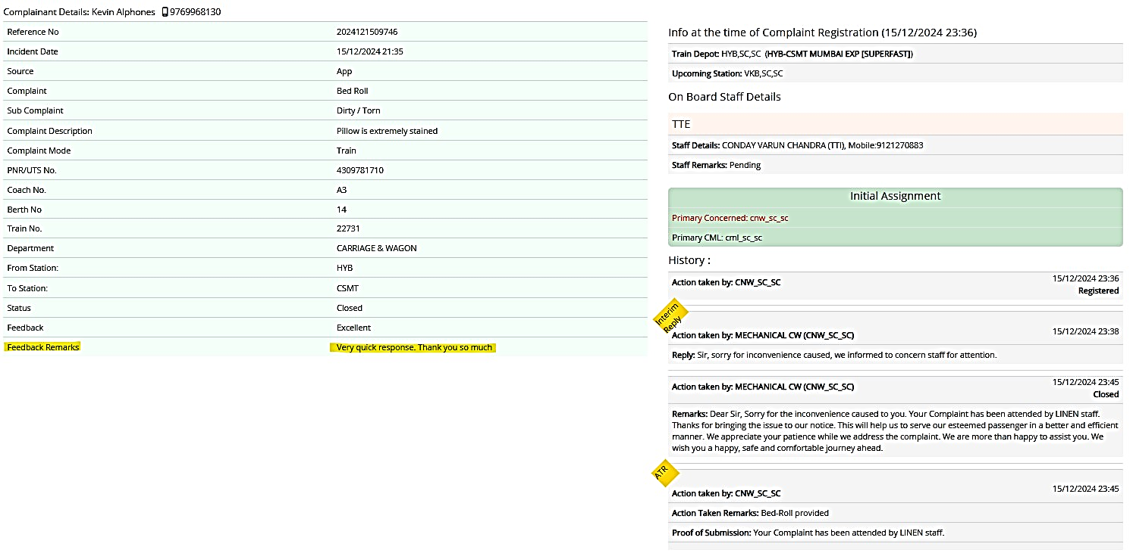
Rail Madad app

Slide 10
Scrap Disposal
Particulars | Special Campaign 3.0 | Special Campaign 4.0
Total waste removed (in tonnes) | 61092 | 75558
Revenue generated from Office scrap disposal till date (In Rs.) | 224.9 Cr. | 452.40 Cr.

Slide 11
Enhancement of Office Spaces/work Place
A complete renovation of Rail Bhawan focuses on modernizing infrastructure, energy-efficient designs, and creating a more functional workspace.
Office of South Eastern Railway re-modelled and retrofitted for enhancement of office space and better aesthetics.
Record Room/Old store room located at HQ office, Central Railway was transformed into ‘Gym”.

Slide 12
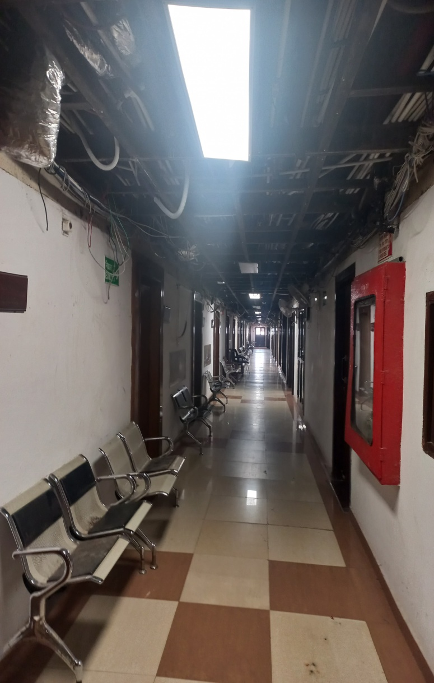
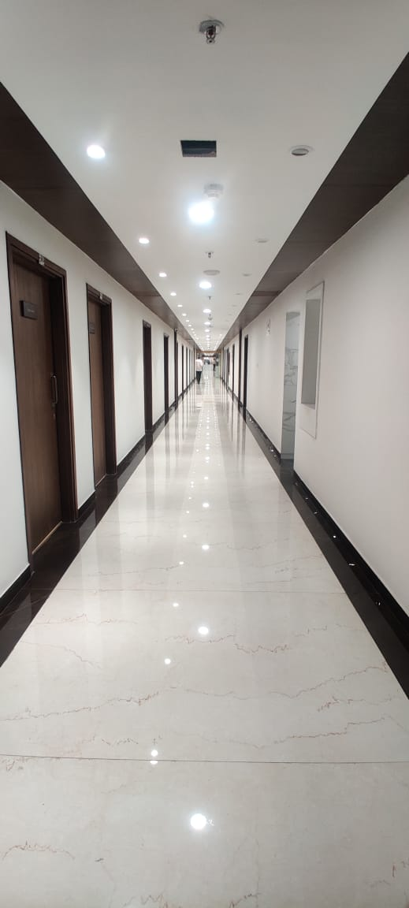
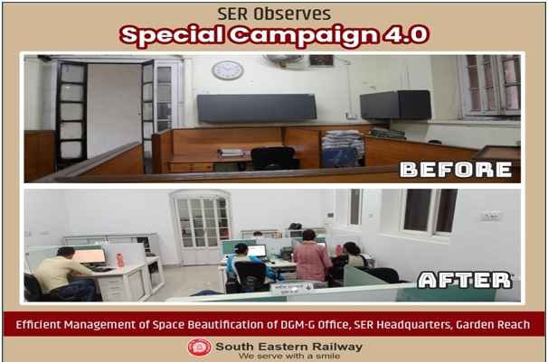
Before & After image of Corridors in Rail Bhawan

Slide 13
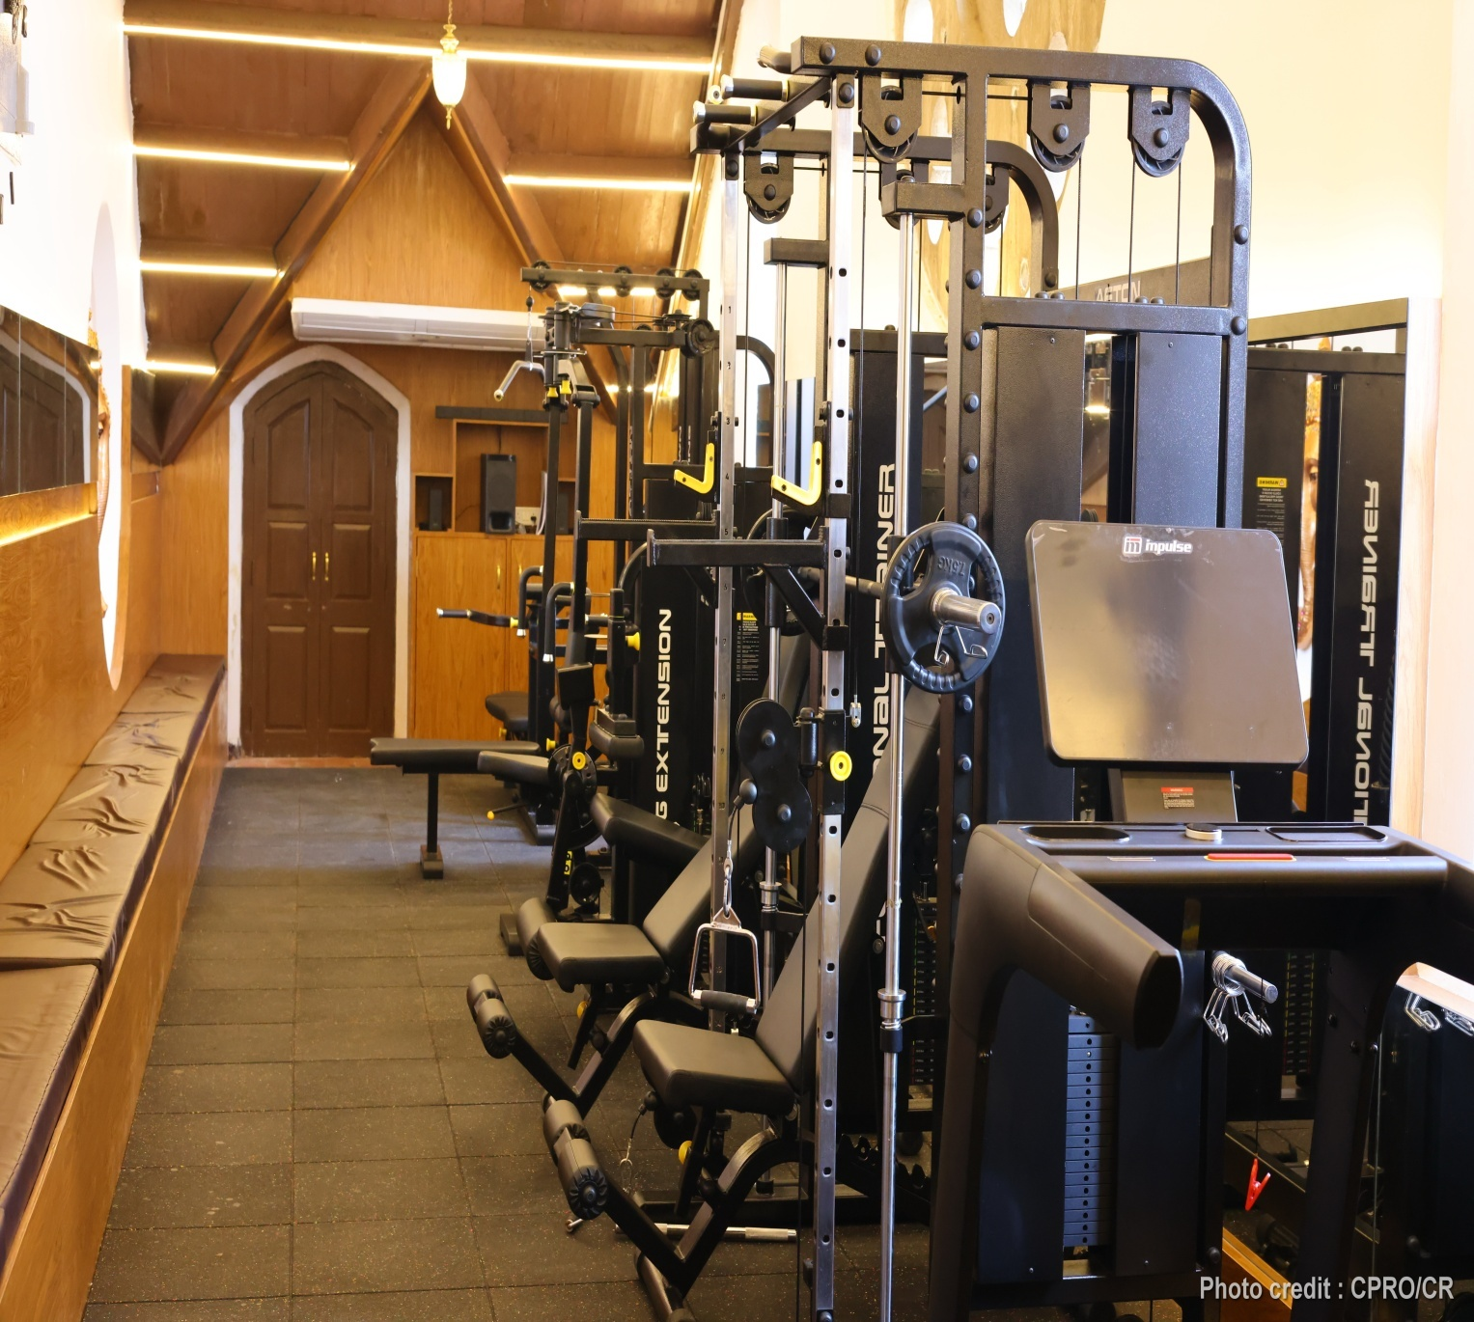
Record room to Gym at HQ, Central Railway

Slide 14
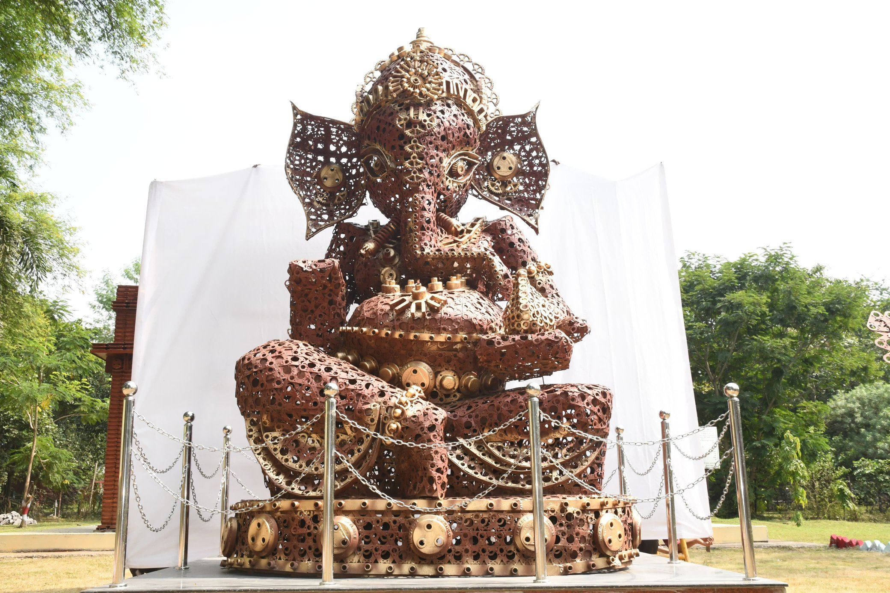
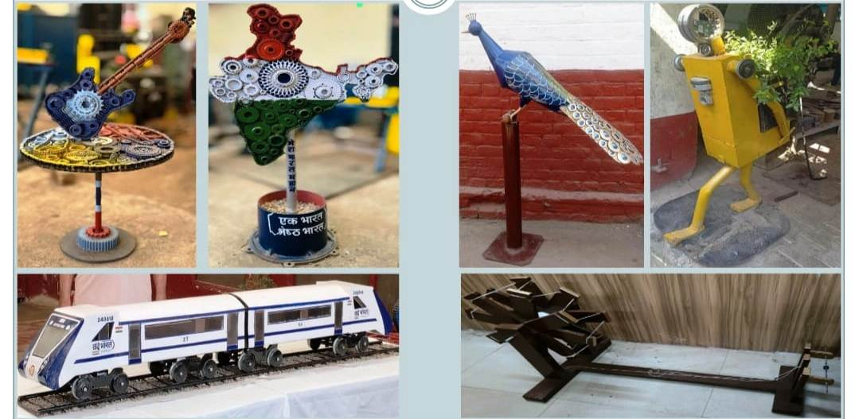
Waste to wealth
An Idol of Lord Ganesh is made by using the scrap material at Raipur, South East Central Railway.
Waste to Art made by Northern Railways

Slide 15
Rail Chaupal at Railway Stations
Community Interaction: Provided a platform for passengers to share feedback, suggestions, and grievances directly with railway officials.
Awareness Programs: Educated passengers on safety, hygiene, and railway services through workshops and discussions.
Problem Solving: Facilitated prompt resolution of passenger issues, enhancing customer service.
Networking Opportunities: Encouraged connections among travelers, local businesses, and stakeholders.
Sustainability Initiatives: Promoted eco-friendly practices and awareness among passengers.

Slide 17
Special Campaign 4.0-Achievements
Campaign implemented at 56,168 sites
Scrap Disposal - generated revenue of Rs. 452.40 crores
12.14 lakhs square feet space freed
2.53 lakhs public grievances and appeals resolved
1.62 lakhs files reviewed
3713 tweets posted and PIB Statements issued
Adequate media outreach through print/social/visual media/press conference
Local channels/AIR used to propagate campaign highlights.

Slide 18
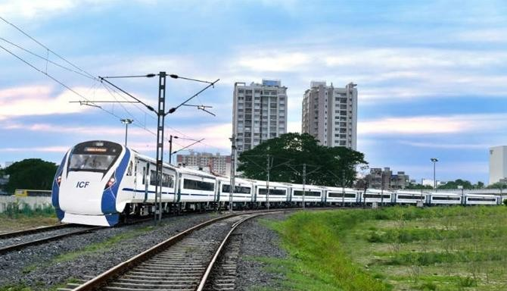
धन्यवाद
Ministry of Railways

