Slide 1
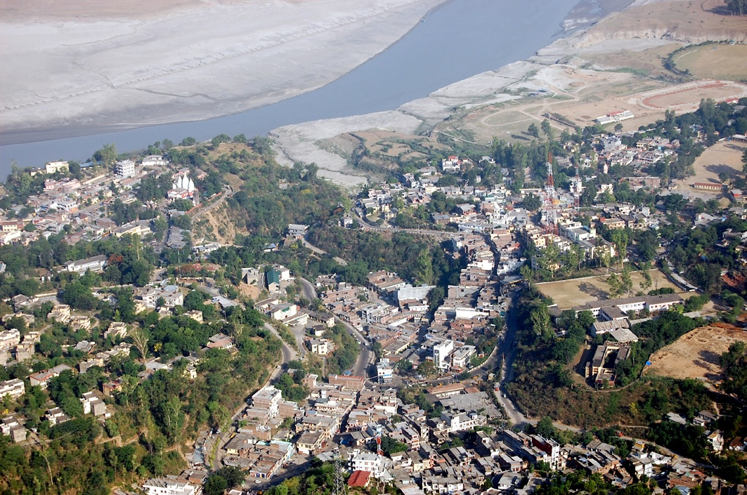
Welcome to the Presentation on Soil Health Card
District Administration Bilaspur, HP

Slide 2
DISTRICT BILASPUR (HP) AT A GLANCE
Agro-climatic zone and situation | Sub Mountain and low hills sub tropical (31⁰ 12’30” to 31º35’45” N latitude and 76º23’45” to 76º55’45” E longitude)
Altitude | 290-1980 m amsl. A large portion of the area falls below 650 m amsl.
Total geographical area (ha) | 112135
No. of Blocks | 4
No. of Villages | 752
No. of Holdings | 57422 ( Av. Size 0.5 ha)
Average rainfall | 110cm (80% in monsoon season)
Soil Types | Shallow, light texture, low in fertility and neutral pH
Major crops | Maize , Wheat (90%) and Vegetables

Slide 3
1. MEASURES TAKEN TO POOL RESOURCES FOR EXECUTION OF SCHEME
Assistance of State Agriculture University Palampur and Krishi Vigyan Kendra Berthin was taken for capacity building and training of staff.
Additional man power was deployed from
ATMA
JICA Project
Soil Conservation Staff

Slide 4
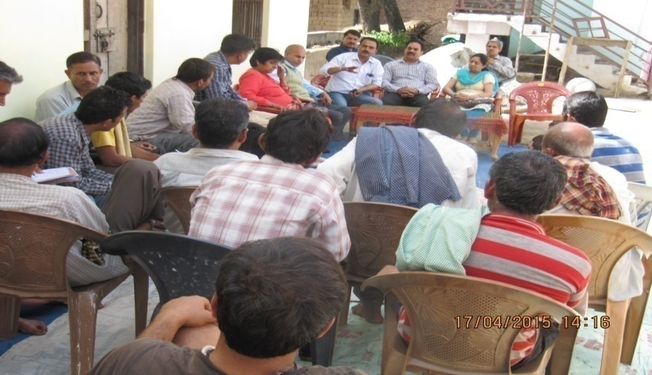
Training programme on Soil Health Management for farmers at village Rajpura by DOA and KVK Bilaspur

Slide 5
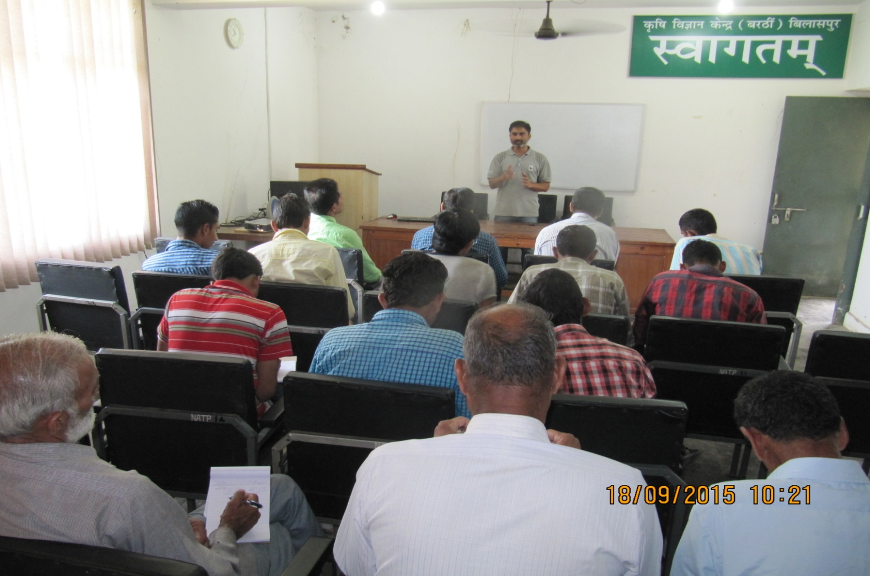
Training programme on Soil Health Management for farmers at KVK Berthin by DOA Bilaspur

Slide 6
2. STRENGTHENING LAB EQUIPMENT TO TEST MICRO NUTRIENTS
District soil testing laboratory is situated at District Headquarter Bilaspur.
Lab is well equipped with Atomic Absorption Spectrophotometer to analyze micronutrients.
Cu, Fe, Zn, and Mn are being analyzed along with other nutrients.
Soil samples are also being analyzed through Mobile Soil testing van at farmers’ fields.
Additional equipments/ glassware were also added.
Coloured printers were also procured.

Slide 7
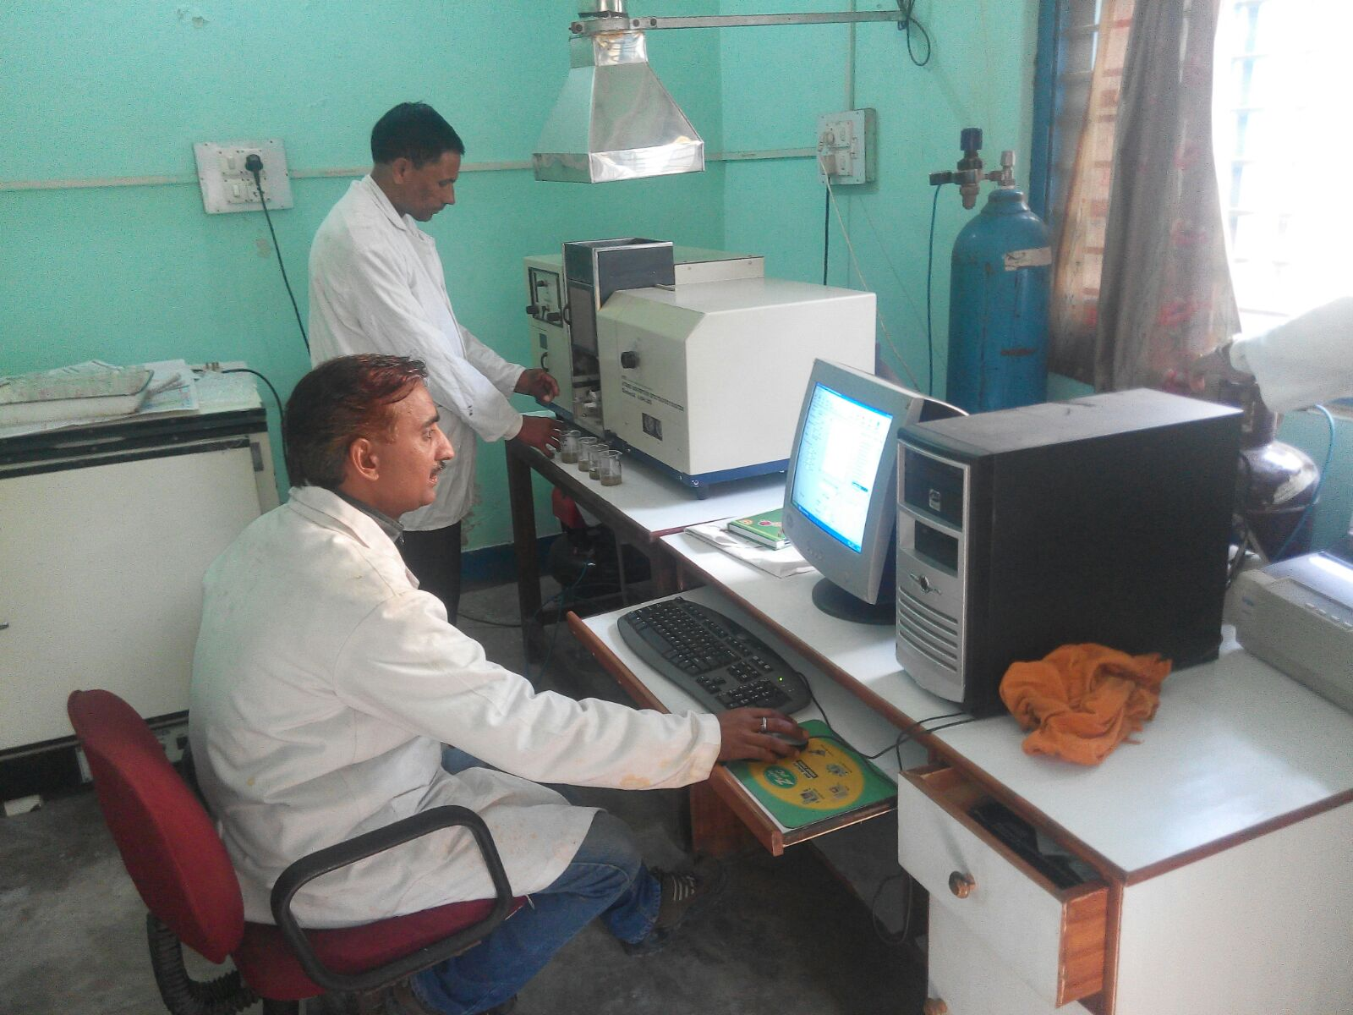
Micro- nutrient analysis at Soil Testing Lab Bilaspur

Slide 8
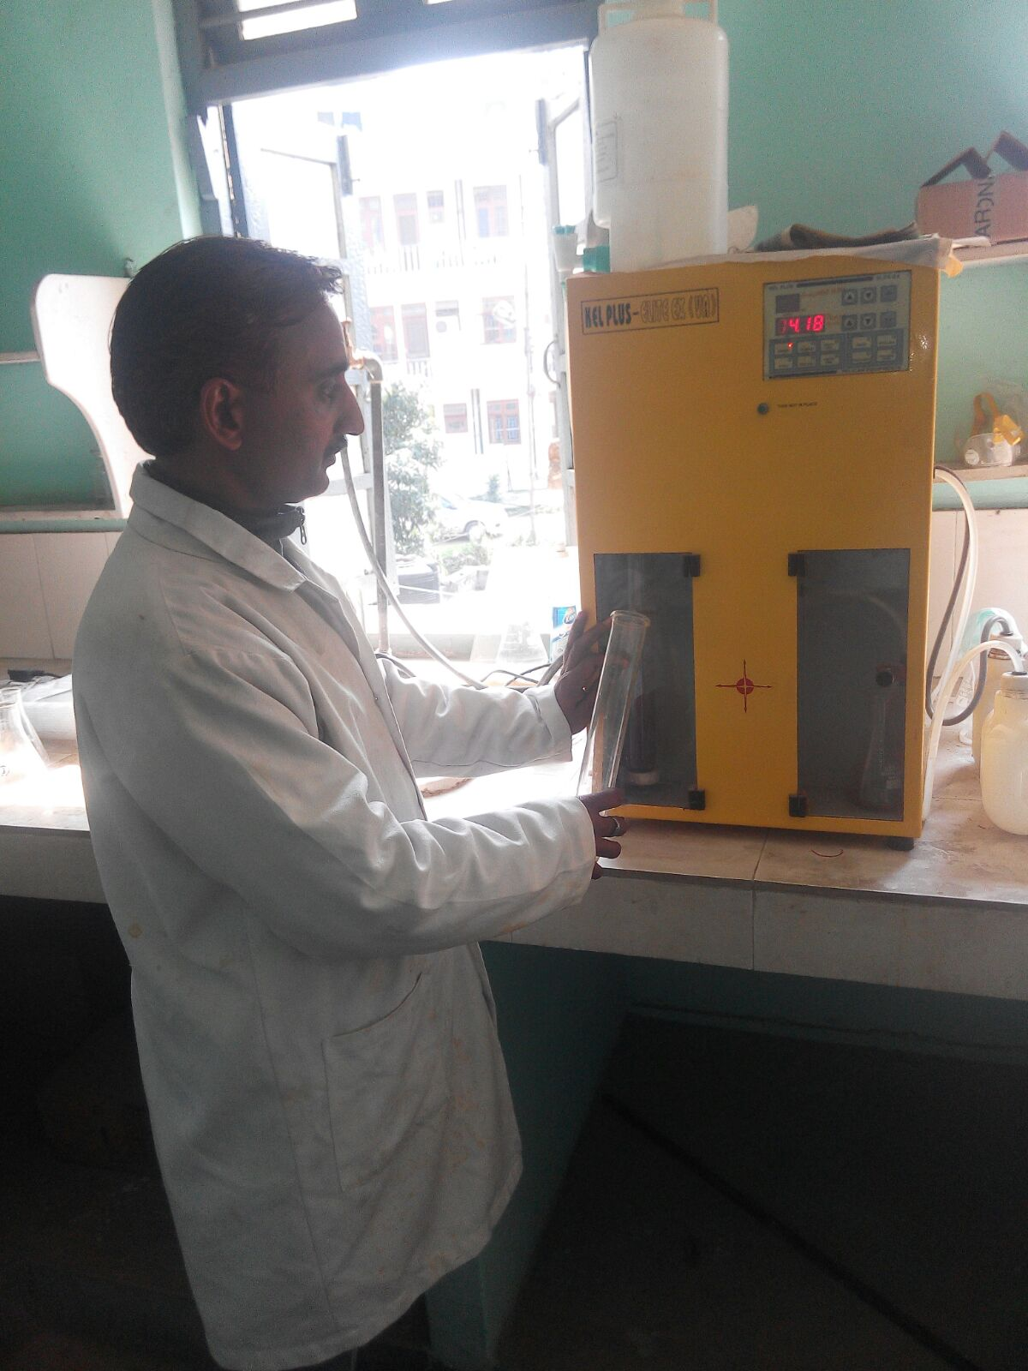
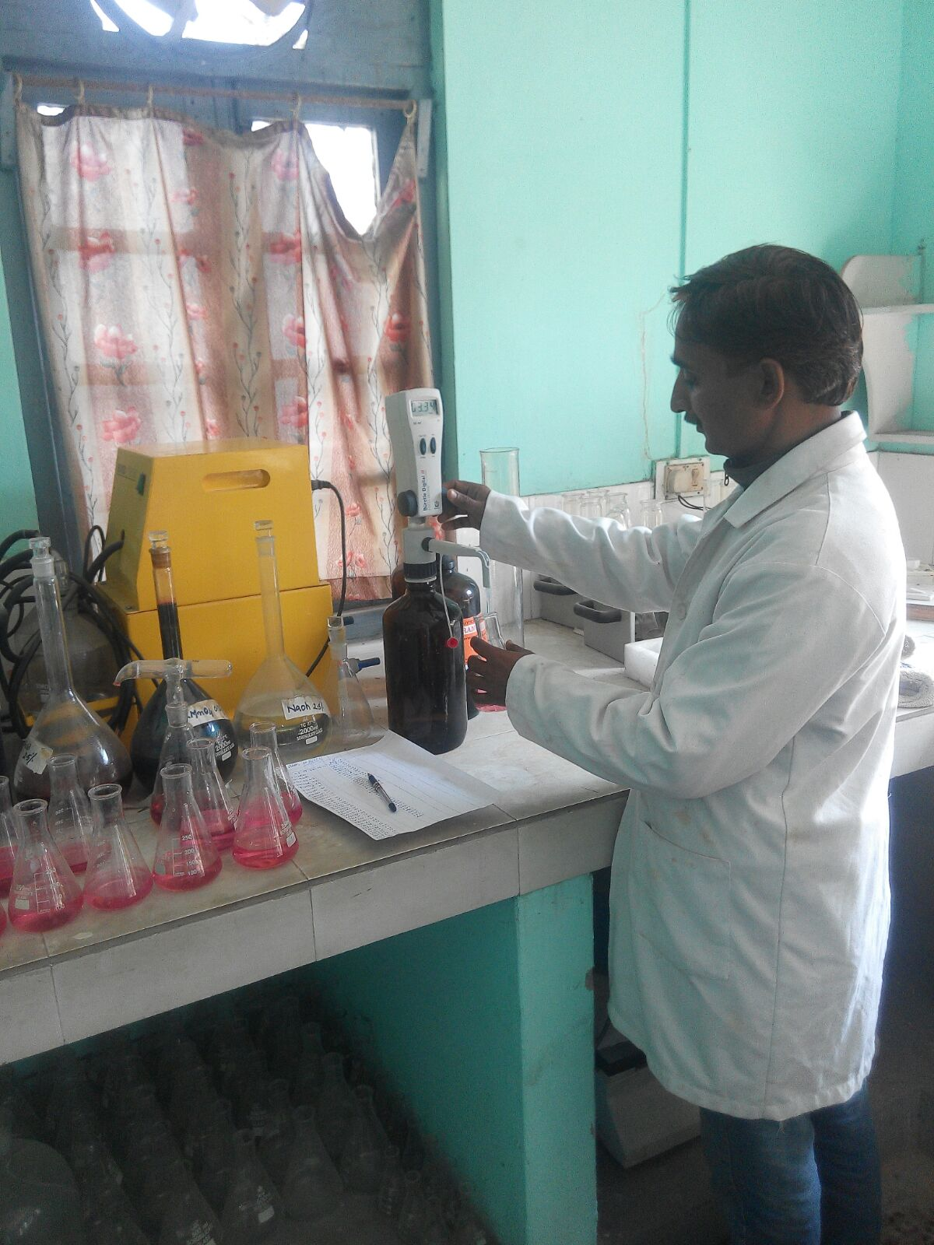
Analysis process of Nitrogen Soil Testing Lab Bilaspur

Slide 9
3 : STEPS TO DEPLOY TRAINED SOIL SCIENTISTS AND TO FILL UP VACANT LAB POSTS
Department of Agriculture deployed additional officers/staff in the soil testing laboratory from other labs like Seed Testing labs.
Deputed officers/ staff were provided proper training on latest technique of soil testing in the State Agriculture University, SAMETI Shimla, and Farmers/Regional Training Centre Sunder Nagar.
20 officers/ officials in all have been trained till date.
Additional Lab attendants were also deployed from other seed testing labs of Department.
KVK Scientists visited the lab frequently to ensure the quality of soil testing.

Slide 10
4 : MEASURES TAKEN TO COMPLETE SAMPLE ANALYSIS IN TIME.
After launching of scheme by GOI on 19th February, 2015 District Level awareness campaign was started.
Organized workshop for officers of soil testing lab and field functionaries of Department of Agriculture.
Circle wise teams (7) were constituted under the ADOs.
Training of officers The officers /staff was provided at SAU/KVK regarding use of GPS sampling, grid formation.
Lab staff was provided training regarding sample analysis
On the basis of grids total 3245 number of GPS based soil samples (1629 in Kharif and 1616 in Rabi season) were collected and analyzed.
Weekly monitoring of progress.
So far, 5998 health cards have been distributed so far and 700 health cards are ready for distribution.

Slide 11
TEAM Composition
Deputy Director Agriculture
Subject Matter Specialist(Agri.) Sadar Block
ADO, AEO & Beldar
ADO & AEO
ADO, Swarghat Block, AEO & Beldar
Subject Matter Specialist(Agri.) Ghumarwin Block
Subject Matter Specialist(Agri.) Jhandutta Block
ADO, AEO & Beldar
ADO & AEO
ADO, AEO & Beldar
ADO & AEO
Soil Testing Lab
STO, ADOs, AEOs, LAs & Beldars
(Data uploading on portal by ATMA)

Slide 12
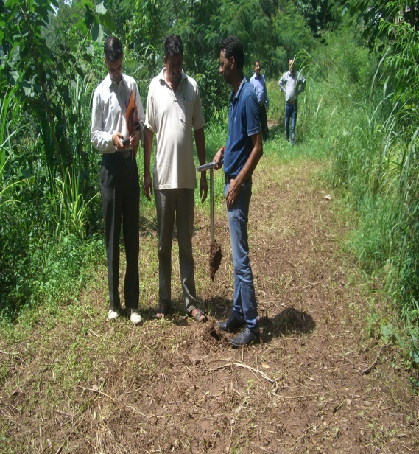
Collection of soil samples

Slide 13
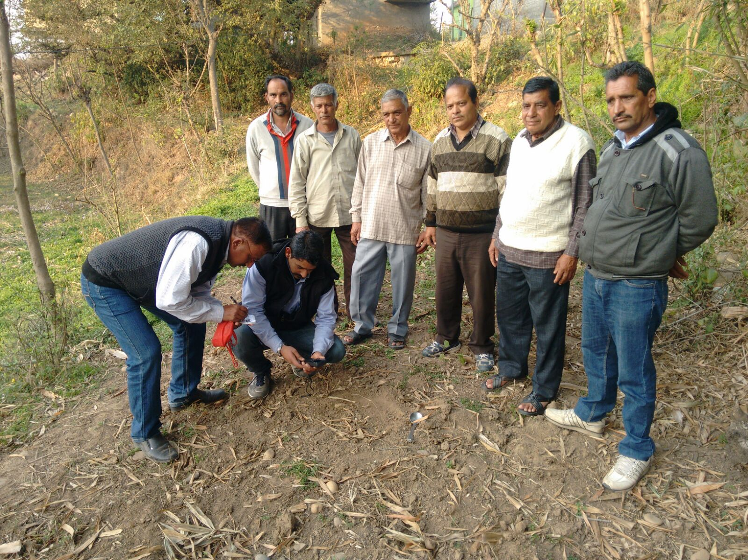
GPS location of farmer’s field i.e. longitude, latitude and elevation before soil samples

Slide 14
5 : INVOLVEMENT OF FARMERS BY INFORMING THE SCHEDULE OF SAMPLE COLLECTION
Group meetings of farmers at AEO circle levels were conducted.
Farmers were made aware of the importance of soil testing for crop production.
Selection of grid of 10 hectare (for unirrigated areas) and 2.5 hectare(for irrigated areas) was finalized with the participation of farmers.
The information regarding details for soil health card (Khasra number, number of farming families falling in grid, etc). was provided by the farmers.
Teams were constituted and village/grid wise programme was finalized in advance and intimated to farmers.
NGOs/ farmers clubs/ Mahila Mandals/SHGs/ FIGs were involved in the campaign.

Slide 15
6 : CAMPAIGN FOR SAMPLE COLLECTION/ CARD DISTRIBUTION AND EDUCATING FARMERS
  Department formed Two Teams at ADO circle level for collection of soil sample. Teams made wide publicity:
  Educating farmers through Youth clubs/ mahila mandals/SHGs/NGOs.
  Educating farmers in training programmes/kisan gosthis/melas.

Slide 16
  7:AWARENESS ON SOIL HEALTH MANAGEMENT & CELEBRATION OF WORLD SOIL DAY
  Awareness on Soil Health Management of the farmers is being done by DOA, KVK/SAU/ SHG/ Kisan Clubs/ Women groups by
  Organizing Kisan Melas, Camps, Field Days, youth leadership training camps, training of Public representative of PRIs.
  World soil day has been Celebrated on 5th December, 2015 at block level and District Level and 5000 Cards were distributed.
  World Soil Day was also celebrated at KVK campus.
  Print and electronic media was used to publicize and create awareness among farmers.

Slide 17
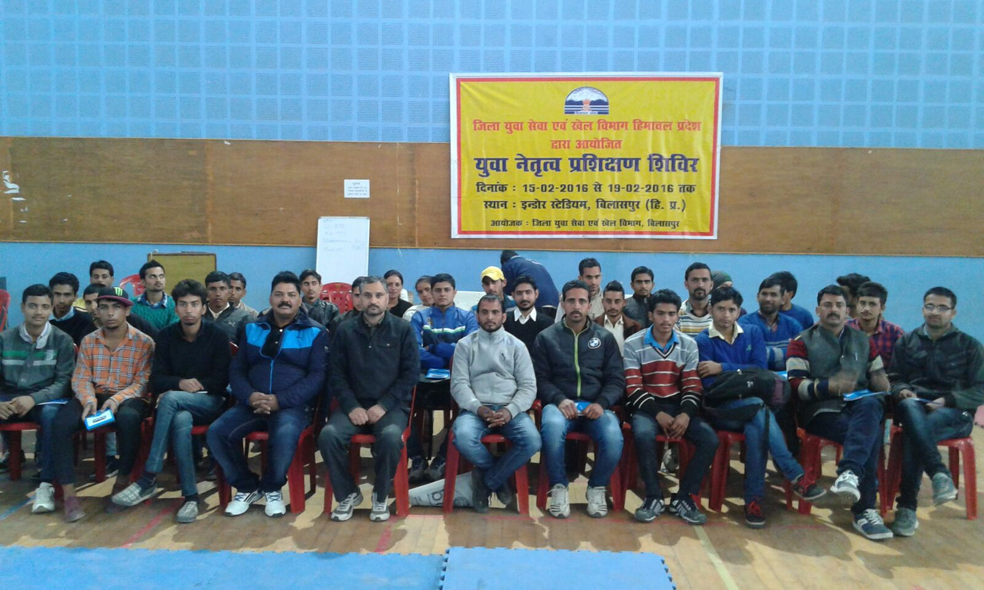
Awareness among rural youth in rural leadership training camps by the departmental officer.

Slide 18
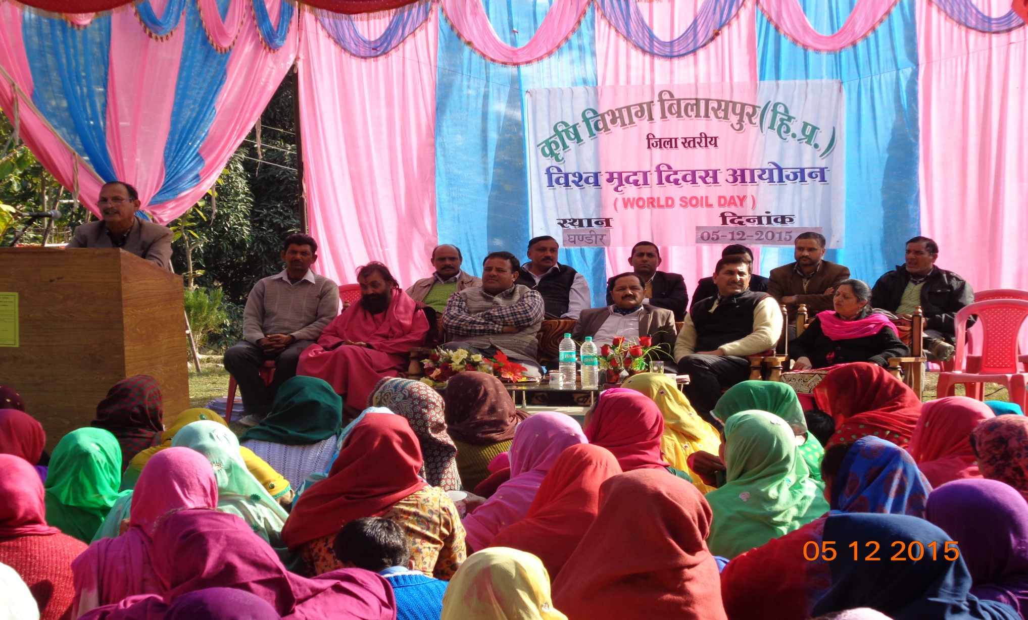
Celebration of World Soil Day at District level, Deputy Director of Agriculture Bilaspur delivering the lecture on soil health managment

Slide 19
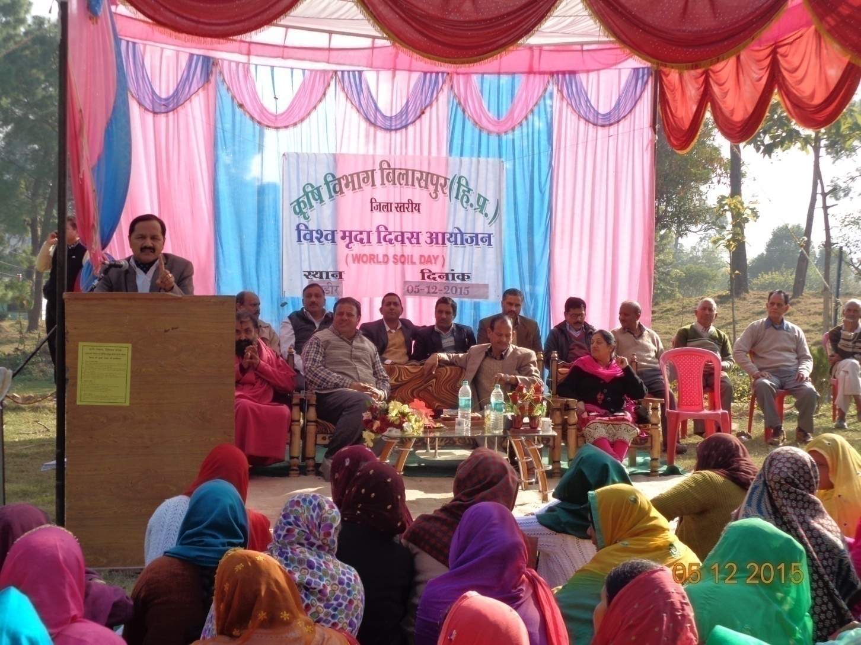
Celebration of World Soil Day at District level ,learned ADM cum Additional Collector delivering the lecture on importance of soil health

Slide 20
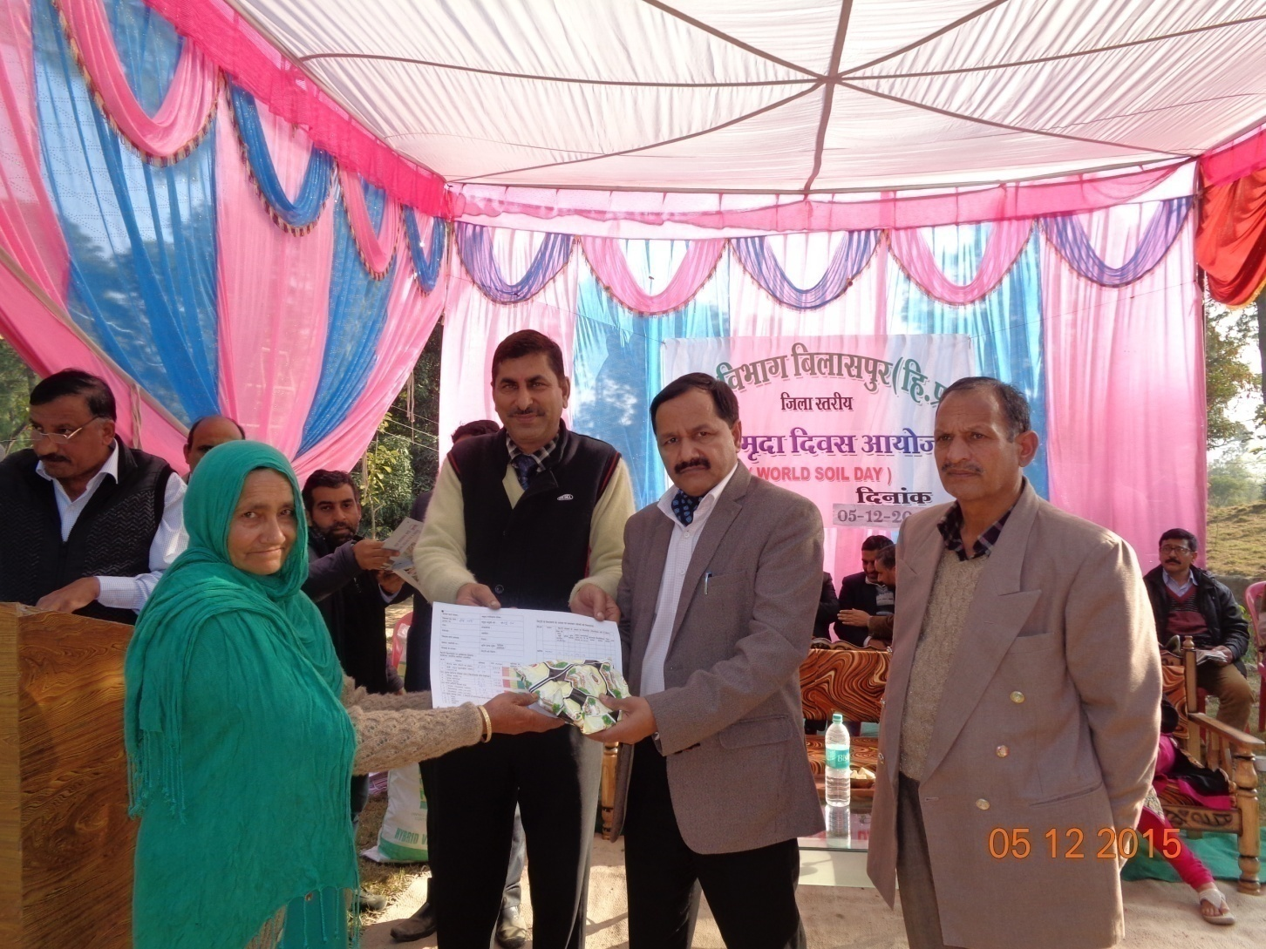
Celebration of World Soil Day at District level - ADM cum Additional Collector distributing SHC to the farmers.

Slide 21
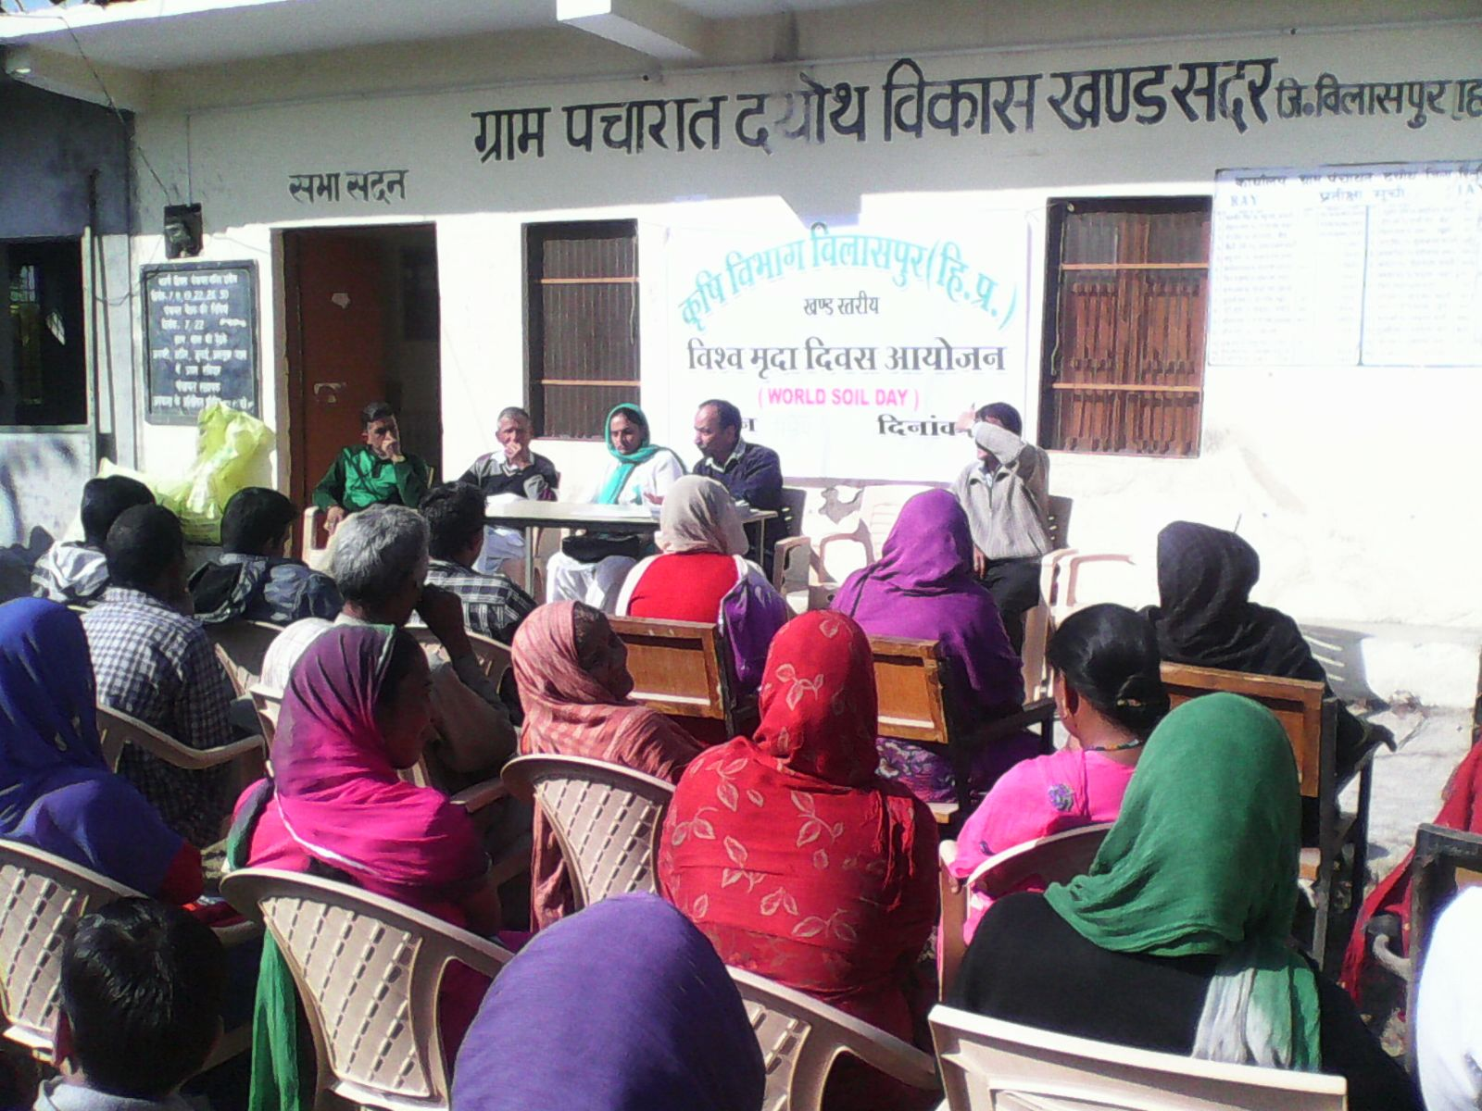
Celebration of World Soil Day at Sadar Block

Slide 22
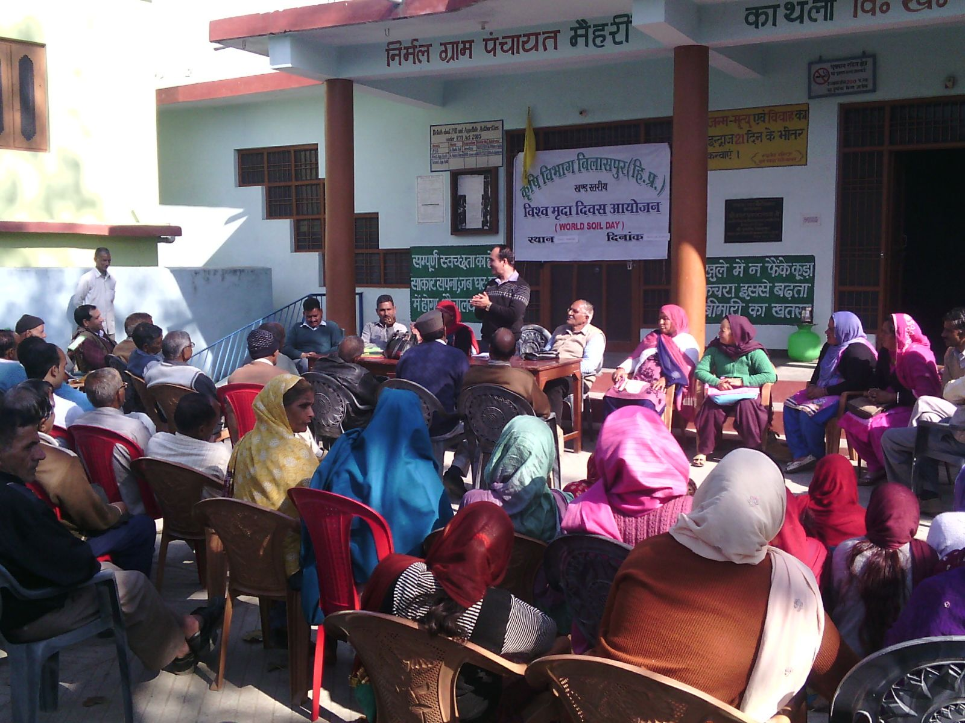
Celebration of World Soil Day at Ghumarwin Block

Slide 23
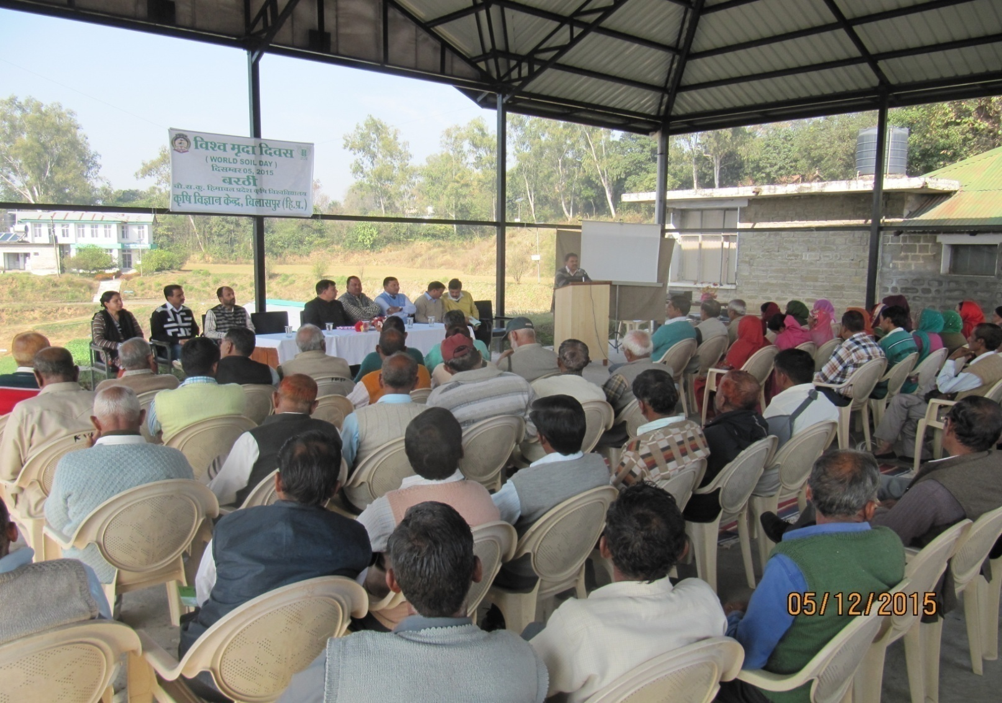
Celebration of Soil world Day at KVK Bilaspur campus

Slide 24
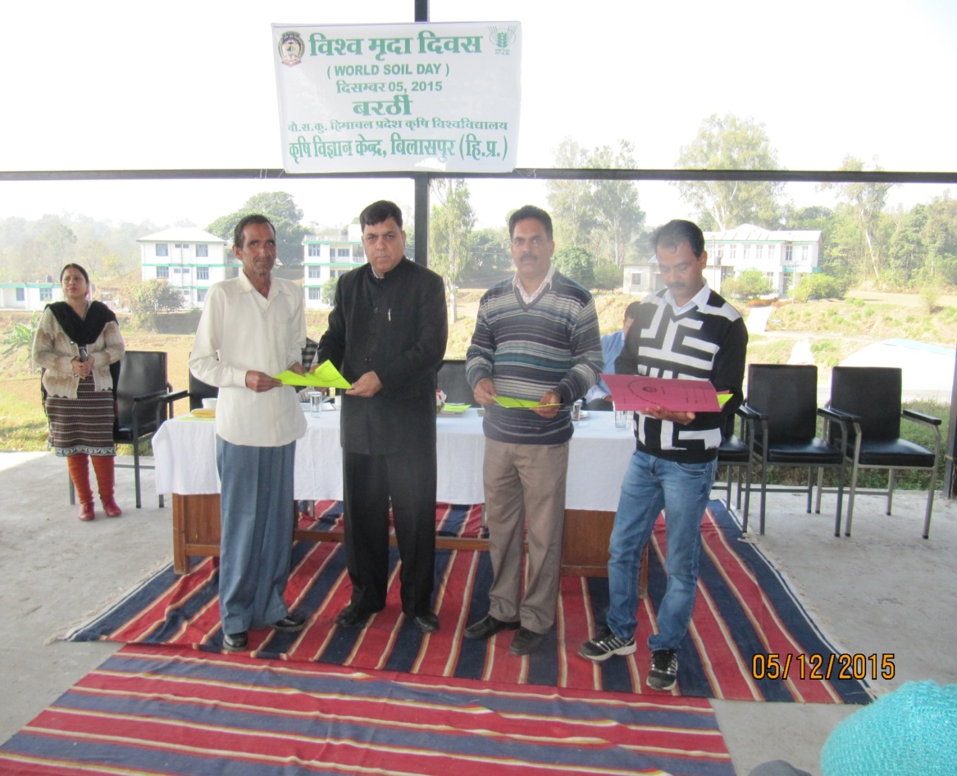
Celebration of World Soil Day at KVK Bilaspur campus

Slide 25
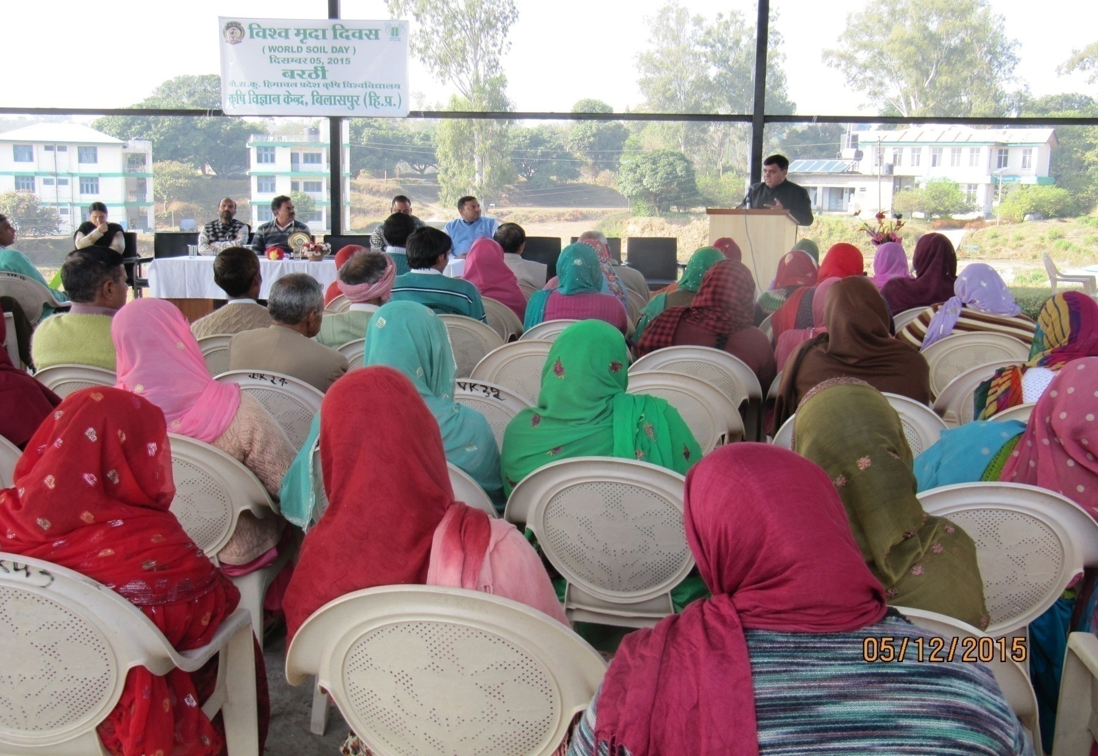
Celebration of World Soil Day at KVK Bilaspur campus

Slide 26
  8 : INNOVATIVE MEASURES TAKEN
GPS( 2 in each block) were provided to the departmental officers to find out the Longitude, Latitude and Elevation of the area where soil sample was taken.
20 Nos android phones with latest application have also been provided to DDA, SMSs and ADOs for communication with farmers for providing the technical guidance i.e. use of balance fertilizers in order to sustain the soil health and remedial measures for control of diseases and insect-pests.
Coloured printer was procured by the Department for each Soil Testing Lab

Slide 27
9 : OUTCOME OF THE SCHEME- HOW DID THE SCHEME HELP FARMERS.
It will promote balanced and judicious use of plant nutrients.
Promotion of integrated nutrient system is expected to reduce the consumption of chemical fertilizers by 20%.
The productivity of selected crops is expected to increase significantly.
The demand for organic sources of plant nutrient like bio-fertilizers, organic manure, vermi-compost, slow release nitrogenous fertilizer like Neem/sulphur coated urea will increase, which in turn improve the soil fertility as well nutrient.

Slide 28
10: suggestions for improvement in the scheme
Strengthening of soil testing laboratory.
Establishment of soil labs at block levels.
Increase in mobile soil testing labs.
Improvement of Soil health portal functioning.

Slide 29
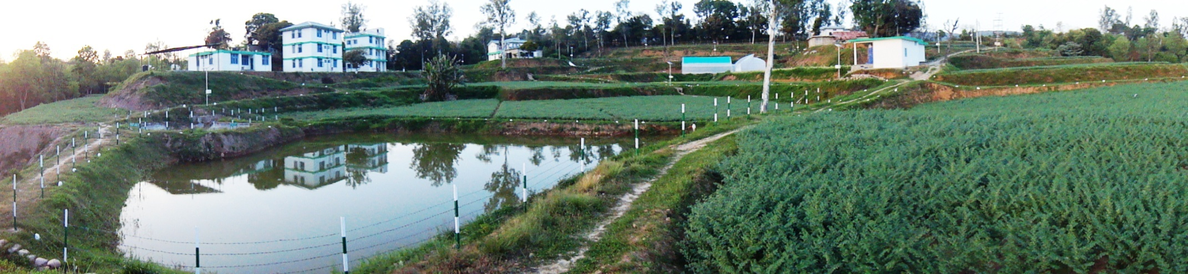
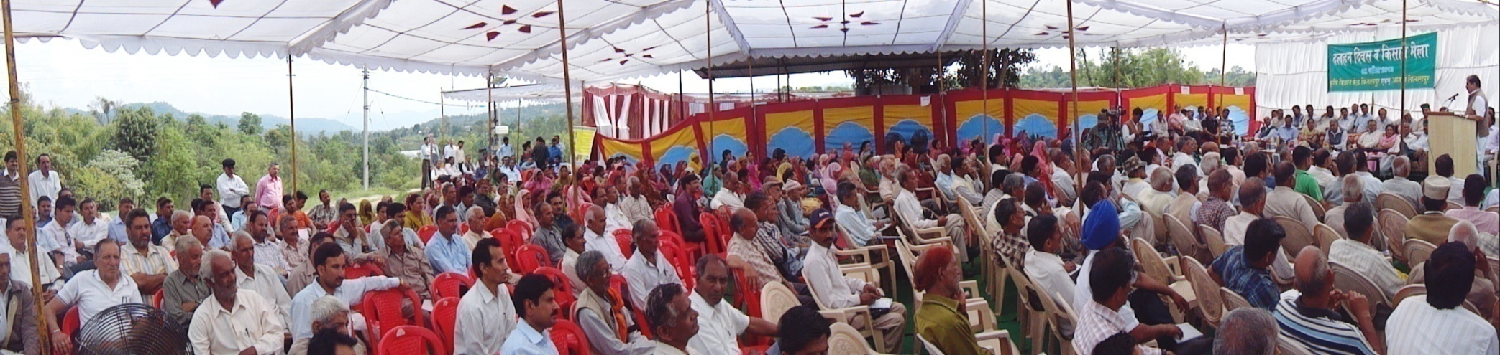
THANK YOU

