Slide 1

Implementation of Soil Health Card
Team Chhotaudepur
District Panchayat,
Chhotaudepur,
Gujarat State
Presented By:
Dr. Sourabh Pardhi (IAS)
District Development Officer,
Chhotaudepur district, Gujarat

Slide 2
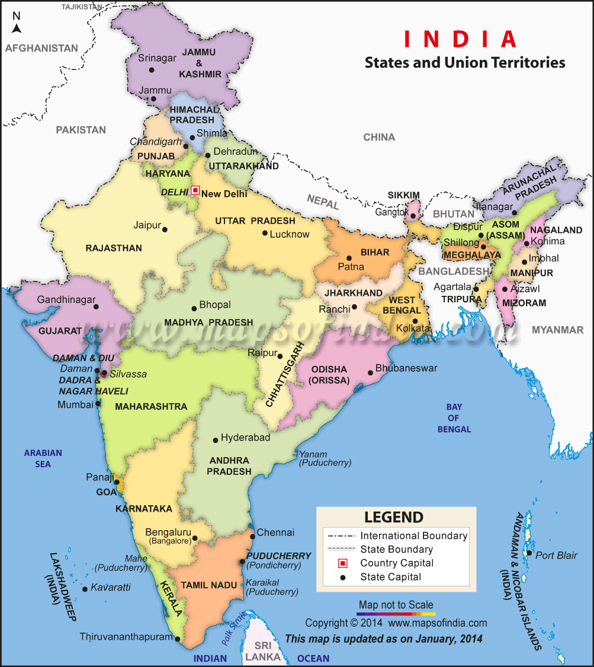
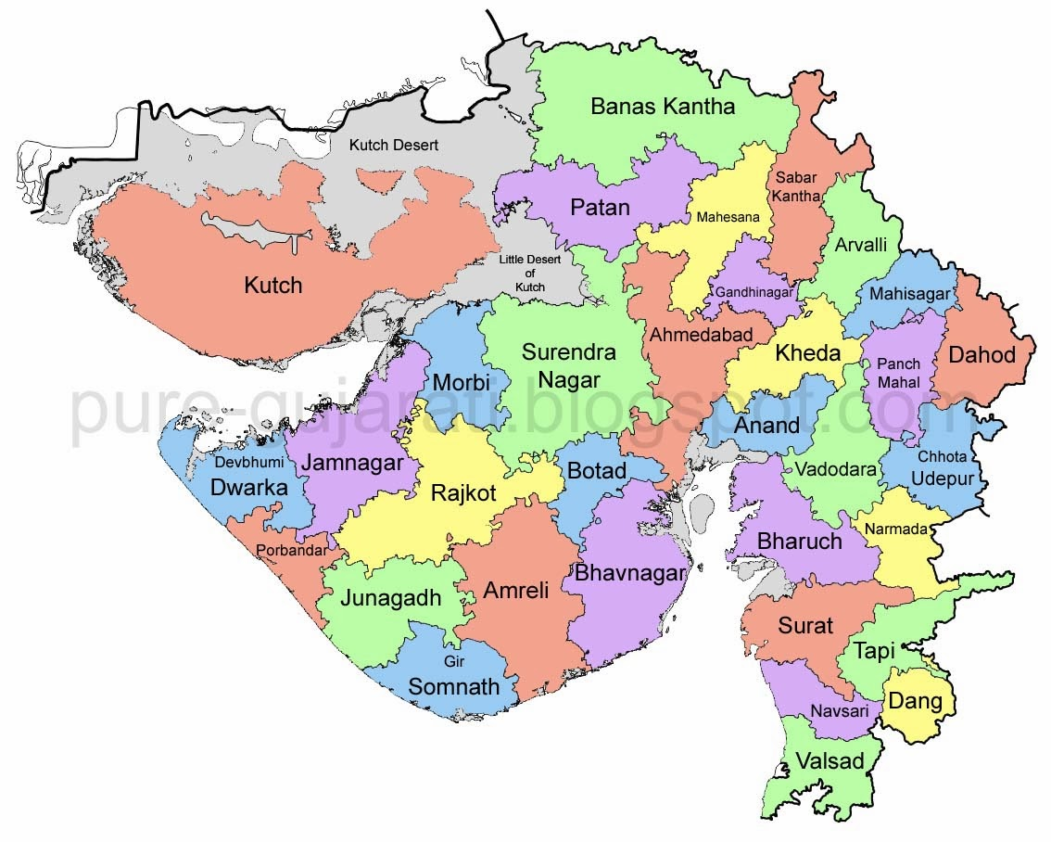
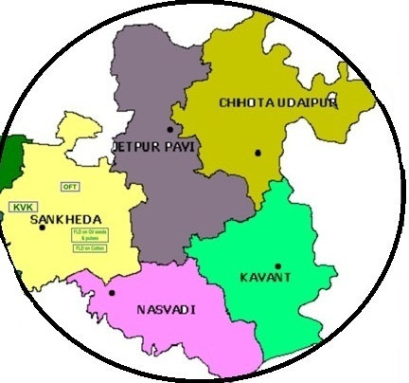
Chhotaudepur District

Slide 3
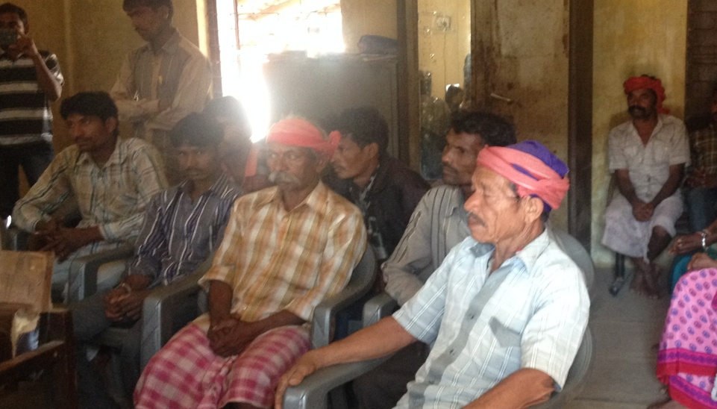
District- At A Glance
Newly formed district, separated from Vadodara.
It is tribal-dominated (89.4%) district based on 100 % Agriculture.
Comprises Six talukas including two with hilly terrain.
More than 64% area rain fed.
Relatively low consumption of fertilizer & pesticides.

Slide 4
District- At A Glance
Geographical Area: 3,34,606 Hac.
Cultivated Area: 2,08,866 Hac.
Barren Land Area: 5,298 Hac.
Irrigated Area: 74,499 Hac.
Un-Irrigated Area: 1,34,367 Hac.
No. of Taluka: 6
No. of Total Villages: 891
Main Crops: Cotton, Pigeon Pea, Maize, Paddy, Sorghum

Slide 5
Categories of Farmers

Slide 7
OPPORTUNITIES
Large area (125740h) available to be brought under cultivation
Tremendous irrigation potential
Availability of organic manures
Crop rotation with leguminous plants to improve nutrient content
STRENGTH
Conditions favorable to Kharif and Rabi crops
Agriculture college at Jabugam
Irrigation Projects eg Rami, Sukhi, Dev, Orsang as well as Sardar sarovar command area
Good soil with 7.5-8.5 pH, High P and K, Low EC
Situation Analysis
WEAKNESS
Large area still rainfed (64%)
Over exploitation, waterlogging and excessive chemical fertilizers depleting soil
Low carbon content in soil
Low water table and poor quality

Slide 8
Soil Health Card
Government of Gujarat Launched Soil Health card Programme in 2003-04.
Provision of readymade information on soil fertility in SHC.
Analysis of available macro and micronutrients as well as trace elements
Fertilizer recommendation & crop planning in succeeding year on the basis of soil test .
Free of cost distribution of soil health card.

Slide 9
Status Before programme
Single Cropping pattern in district.
Haphazard use of fertilizers.
Less awareness of soil health.
Productivity of crop was low.
Uneven cultivation practices.
Low use of Micronutrients.

Slide 10
Benefits of Soil Health Card
Soil Fertility information- Macro & Micro-nutrients
Information regarding fertilizer application in crops.
Information regarding salinity & alkalinity of soil
New Concept of Integrated nutrient management to enhance productivity of crops.
Reduction of fertilizer cost.
More Productivity

Slide 11
Pooling of Resources
Samples sent to various allotted soil testing laboratories with details.
In chhotaudepur four various agencies are testing soil samples.
APMC, Pavi Jetpur – 10,000 samples.
APMC, Bodeli – 10,000 Samples.
Science college, Chhotaudepur – 10,000 samples.
Soil Testing Laboratory, Chhotaudepur – 10,000.
Science college is well equipped with soil testing facilities.
Agriculture Produce Marketing Committee are working on the PPP mode in district.

Slide 12
Strengthening Lab Facilities
Before Programme there was only one STL in district.
After programme updation of STL with micro nutrient facility in 2013-14.
With the vision of our Hon. CM outsourced agencies fixed in district.
For Capacity Building of the students, remuneration fixed by Government to science college students.
APMC strengthened with lab facility under RKVY scheme.
Special Training to the chemist in Agriculture University.
Equipment Bank established at Vadodara Divison.

Slide 13
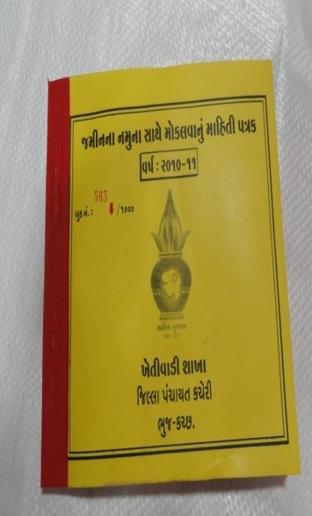
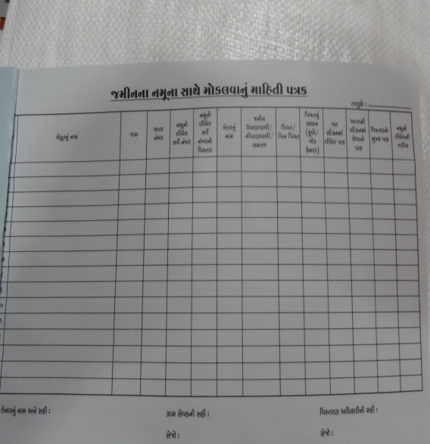
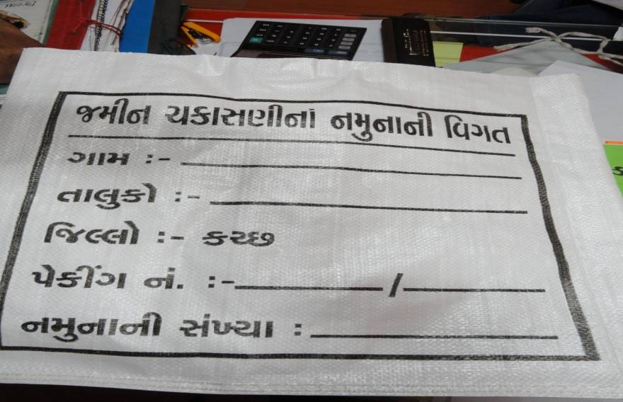
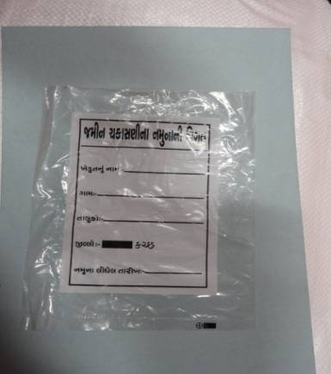

Sample Analysis
Technical know how provided by District Agriculture Officer and Taluka Level
Officers
Use of extension functionaries, VLWs & Farmer Friends for collection of soil samples
Outsourcing & PPP mode for analysis of soil samples
Soil samples Sent to allocated soil testing laboratories for analysis.

Slide 14
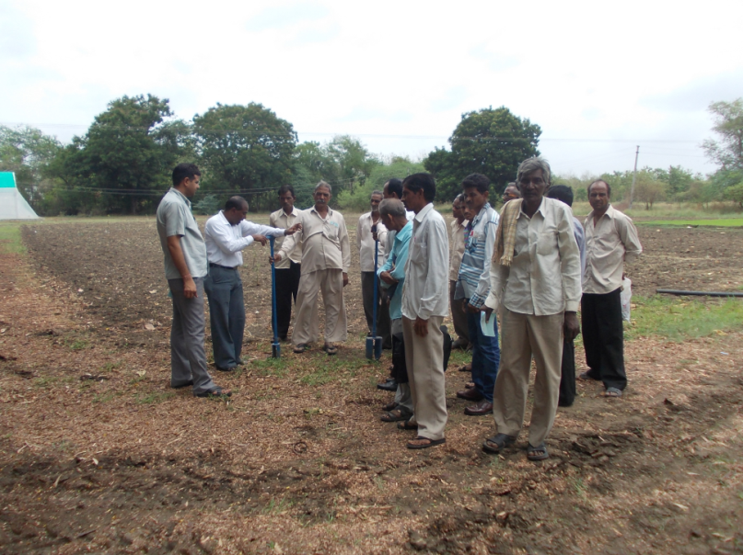
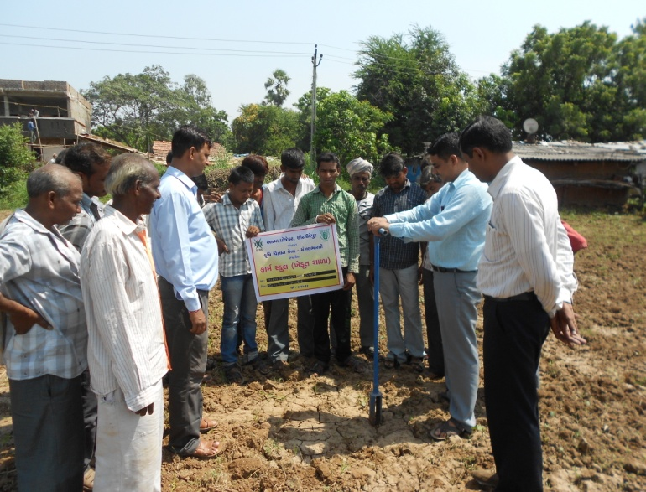
Demonstration of Soil Sample Collection

Slide 15
Third Party Verification
5% random checking of samples for quality analysis.
A team of senior officers jointly monitor outsourced agencies.
Coding of each soil samples for avoiding fake analysis.
Organization of training for soil analysis.
Mandatory certificate required from Talati, Sarpanch and Gram sevak regarding satisfactory sample collection work
Publication of the list of farmers at gram panchayat office.

Slide 16
Sr. No | Taluka | No. Of Villages | No. Of Farmers | Samples collected and Cards Distributed
1) | Sankheda | 29 | 16091 | 7032
2) | Bodeli | 51 | 14153 | 10233
3) | Jetpur-Pavi | 58 | 20749 | 12237
4) | Chhotaudepur | 35 | 16079 | 6720
5) | Kawant | 31 | 18749 | 6275
6) | Naswadi | 60 | 13487 | 5153
 | Total | 264 | 99308 | 47650

Slide 17

Progress Under Soil Health Card Programme for 2015-16

Slide 18
Action plan Achieved For SHC Programme Yr: 2015-16
Collection of Samples
Testing of Samples
Allocation of Targets
Preparation of Soil Health Card
5% Random checking
Distribution

Slide 19
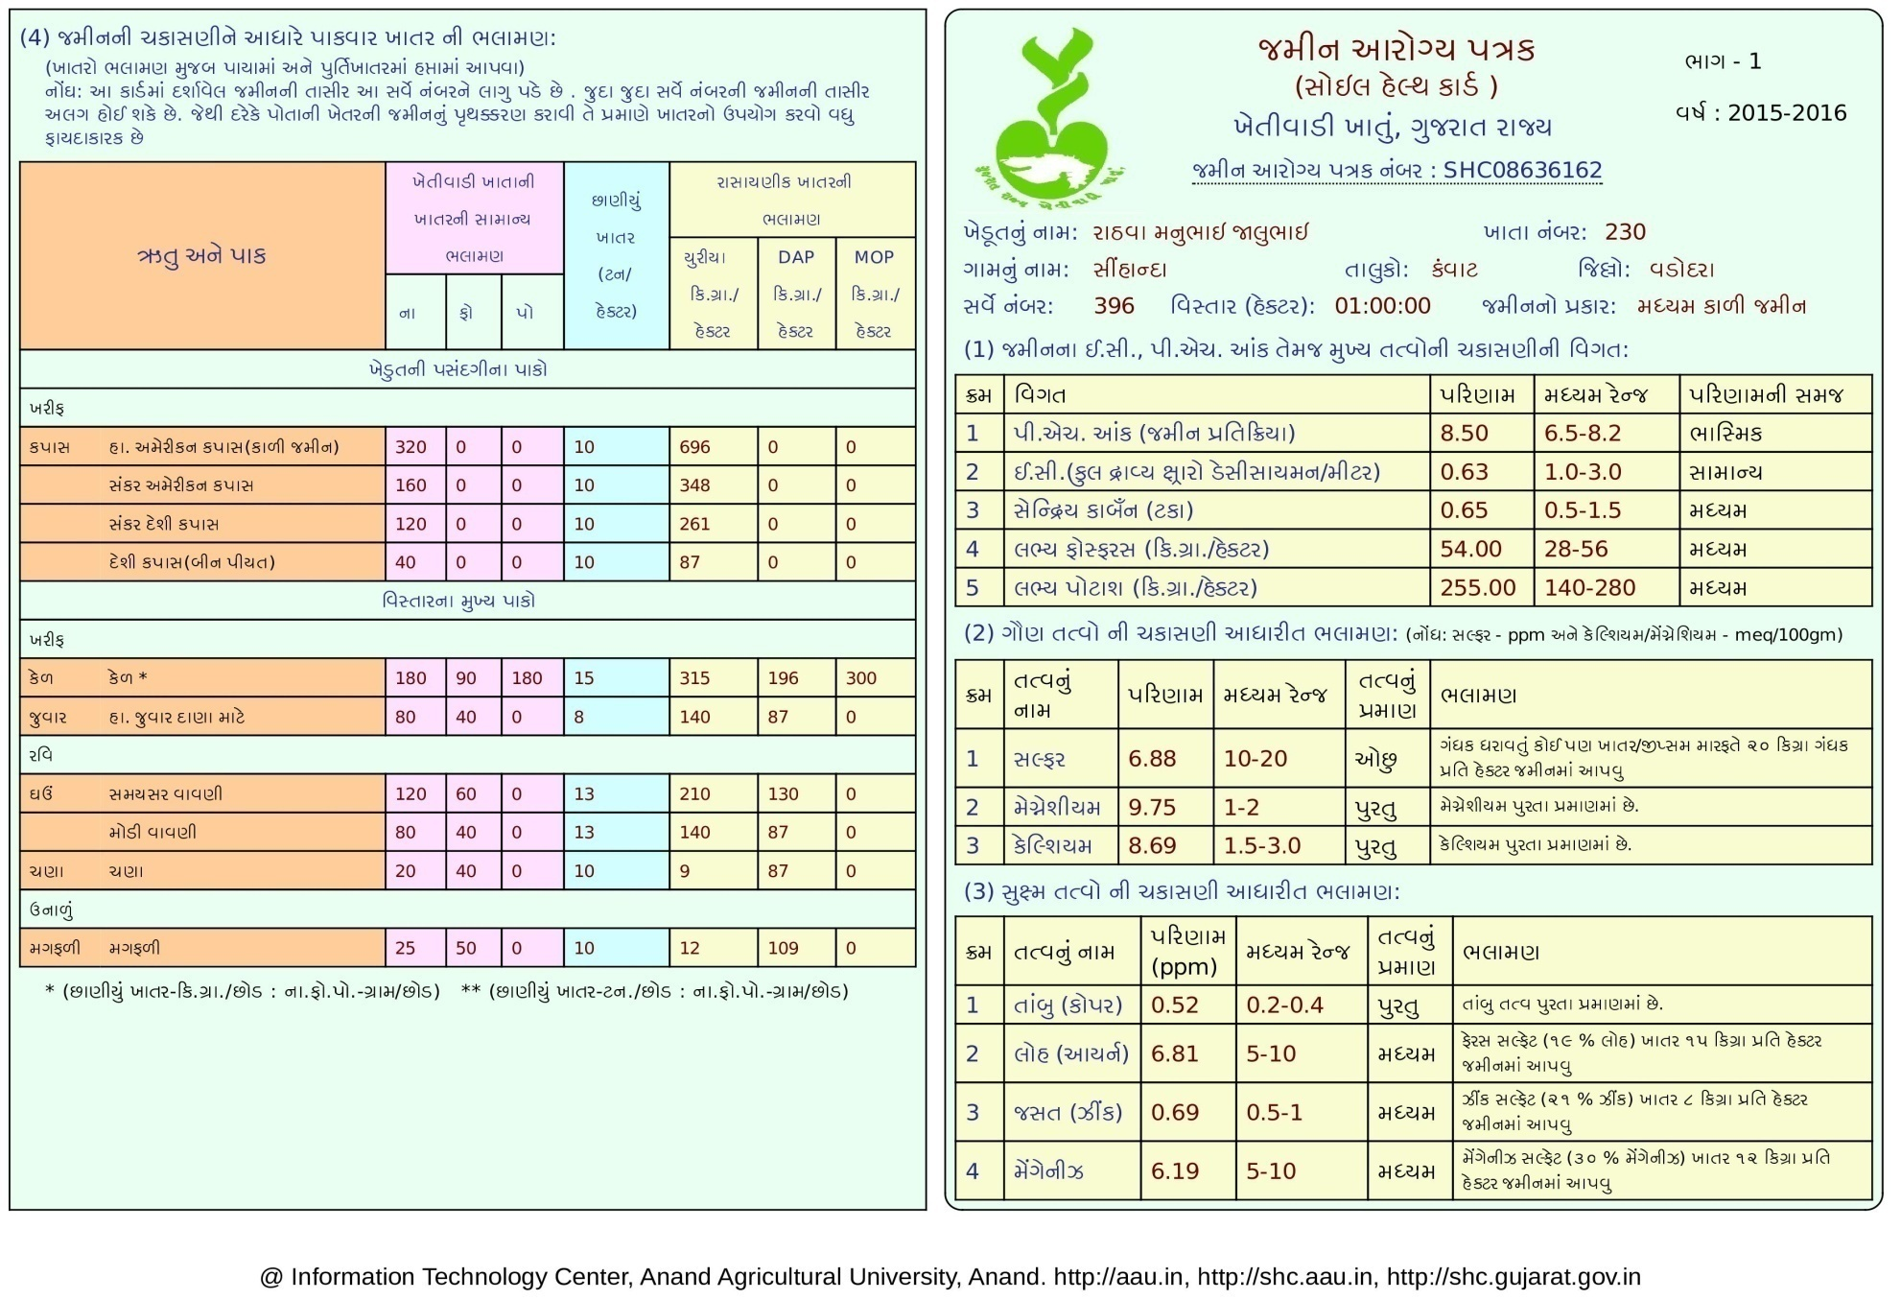

Slide 20
Awareness of Soil Health Management
Celebrated the World Soil Day on 5th Dec. 2015.
1000 farmers has participated in Programme.
Organized 20 Stalls in programme for new Agriculture Technology.
Demonstration given to the farmers for collection of soil sample.
Success stories regarding benefits of soil health card have been displayed in programme.
Distributed Micronutrients in prog.

Slide 21
Involvement of Farmers for the Schedule of Sample
During kharif krushi mahotsav special campaign was done for soil sample collection benefiting more than 7000 farmers.
Importance of soil health shared by Progressive Farmers on 15th september 2015.
Educating farmers on Soil Health Card in Rabi Krushi Mahotsav in December in campaign mode.
Special campaign carried out in mid of December for soil health card distribution.
Resources of Anand Agriculture University & KVK used for technical guidance.
Soil testing lab strengthened in RKVY scheme.
With the support of ATMA farmer friend, farmer’s involvement in SHC has been increased.

Slide 22
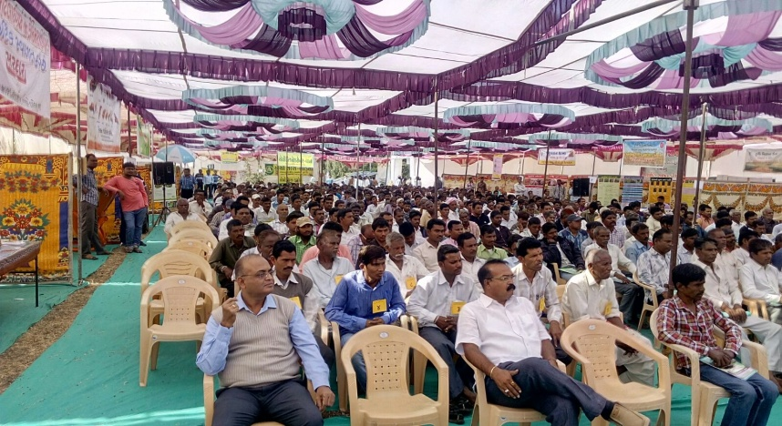
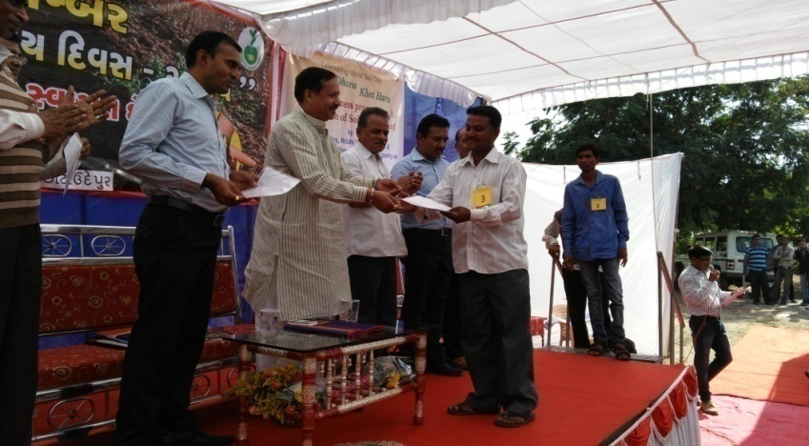
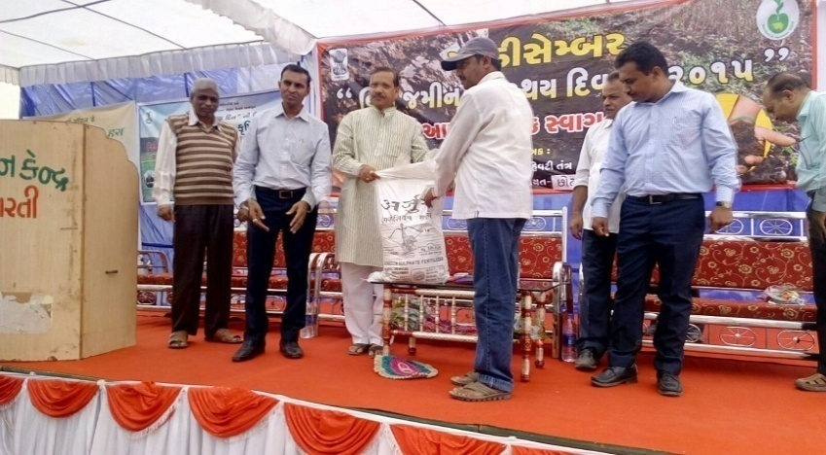
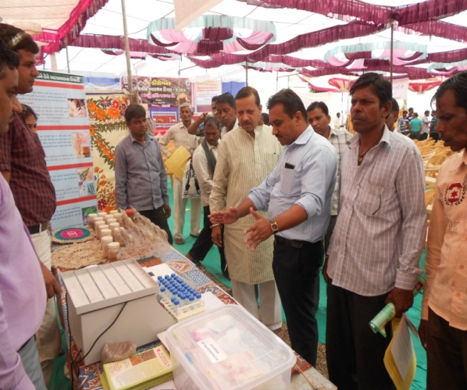
Glimpses of Celebration of World Soil Day

Slide 23
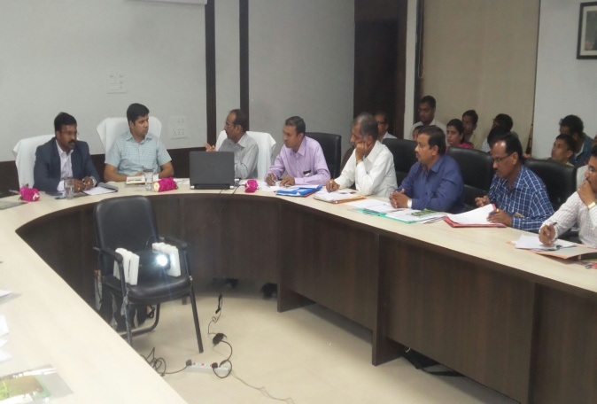
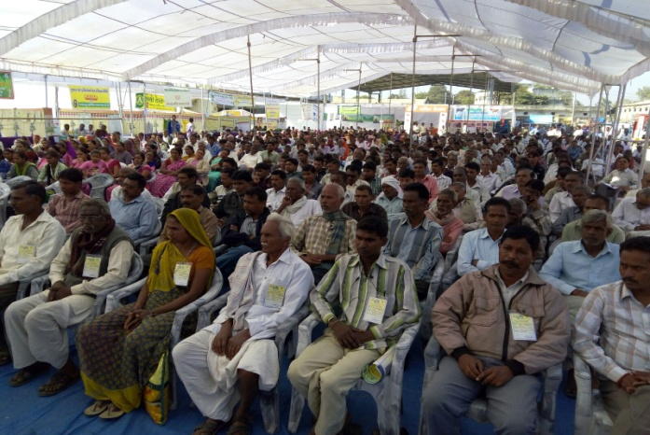
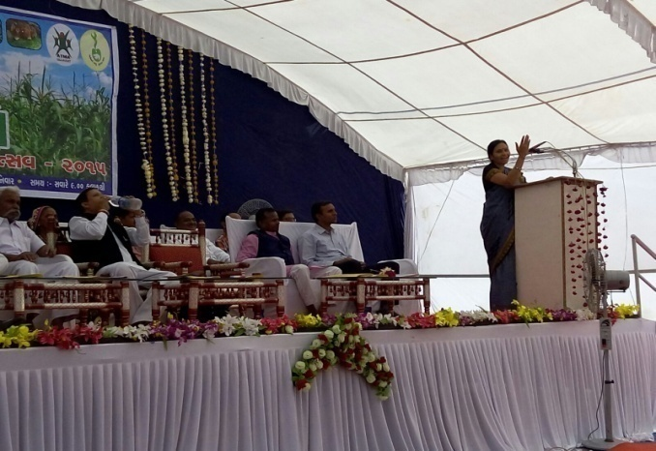
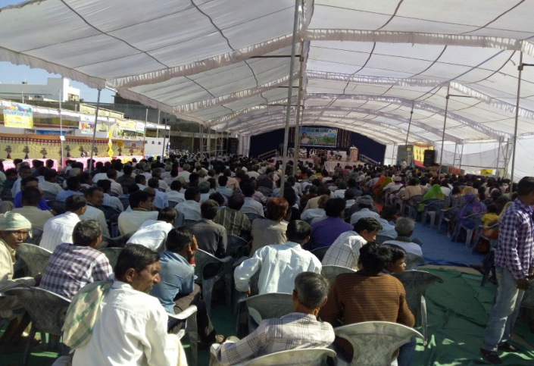
Support From Team Chhotaudepur for the programme

Slide 24
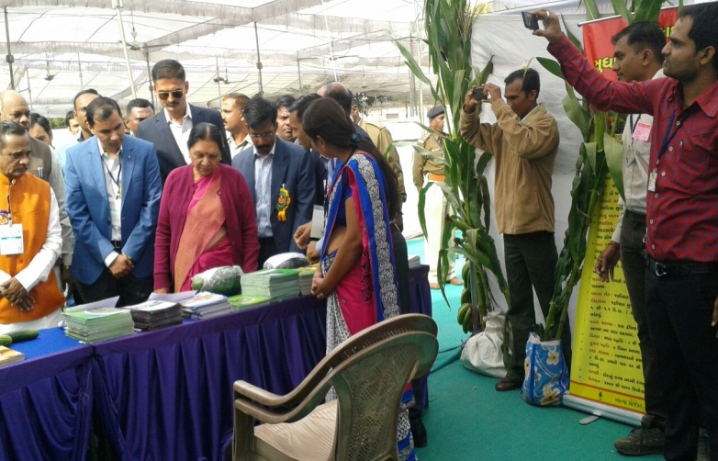
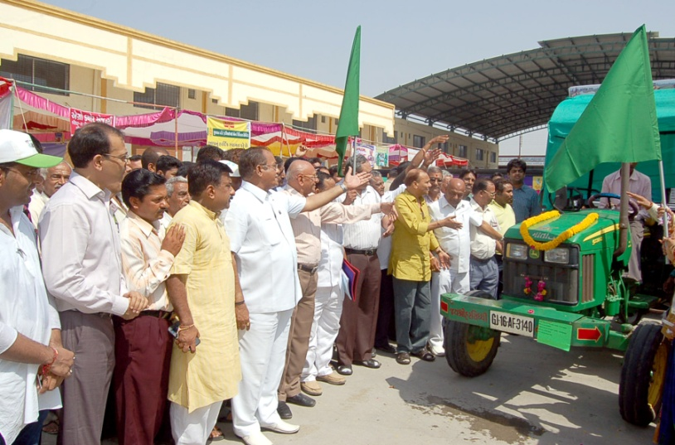
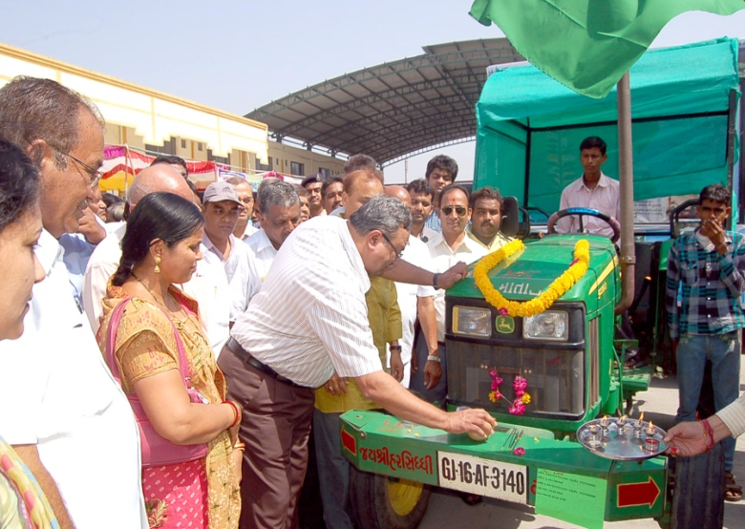
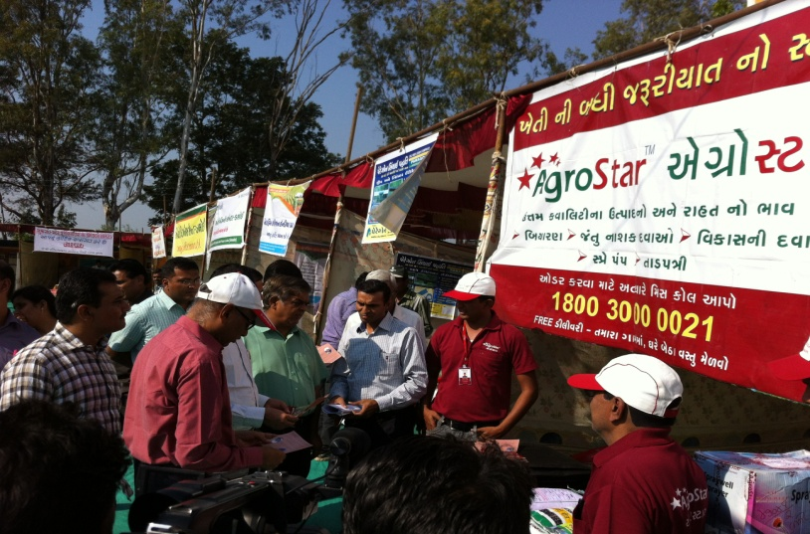
Support From Team Chhotaudepur for the programme

Slide 25
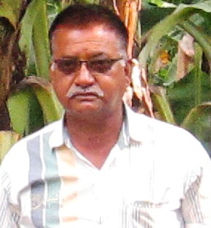
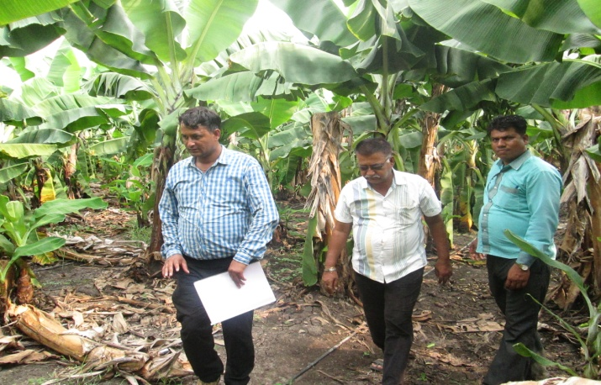
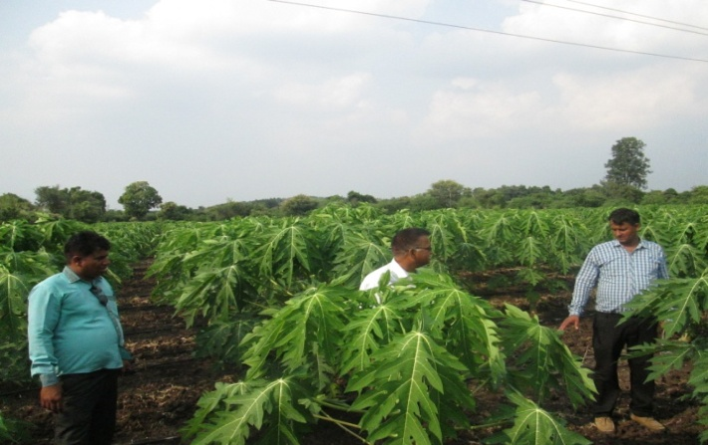
Success Story of Soil Health Card - 1
Name: Panchal Vijaykumar Ramanbhai Address: At & Po: Naswadi, Ta.: Naswadi, Dist. Chhotaudepur Mobં: 9427351110 Business: Cultivation of Horticulture Crops
My Name is Panchal Vijaykumar Ramanbhai. I am living at Naswadi Village. I am a member of ATMA FIG and studied up to SSC (10th) level.
I am cultivating total 3-07-88 Hac Land.
Under ATMA project, guidance was given by the scientist for soil health card. I have started to use Modern cultivation techniques.
I have adopted drip irrigation in my field and through it I got more yield.

Slide 26
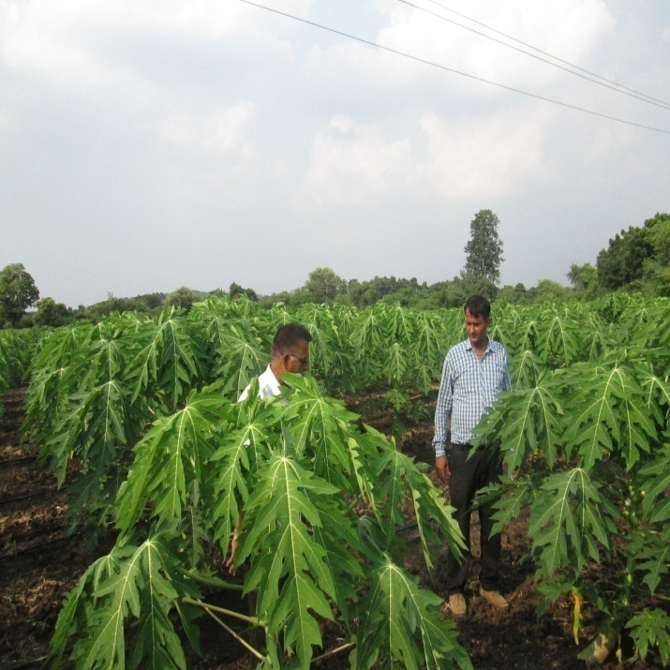
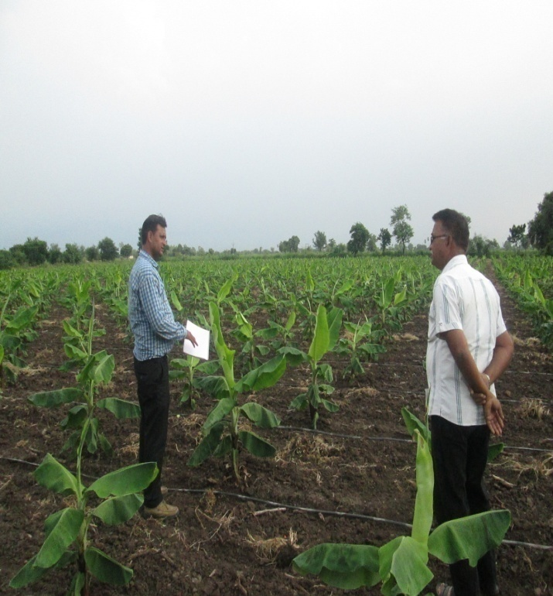
Earlier I was cultivating Cotton and Castor crop. Now I am cultivating tissue cultured banana & papaya.
Due to Soil Health Card Information I could move towards efficient use of fertilizers.
My Three Years data are as Below.
Details | 2013-14 | 2014-15 | 2015-16
Area (Hac.) | 3-0-88 | 3-0-88 | 3-0-88
Crop | Cotton | Papaiya | Banana
Cost (Rs.) | 4625 | 107000/- | 96000/-
Production (Kg/Hac) | 12200/- | 120000/- | 90000/-
Income (Rs.) | 63000/- | 600000/- | 630000/-
Net Profit (Rs.) | 50800/- | 493000/- | 534000/-

Slide 27
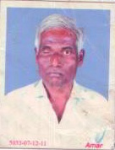
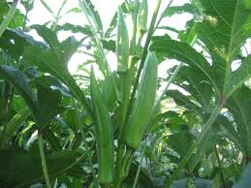
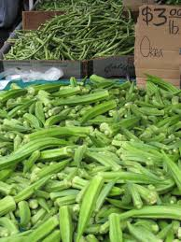
Success Story of Soil Health Card - 2
Name: Rathava Jayantibhai Dhanabhai Address: At & Po.: Tithor, Ta.: Jetpur Pavi Dist.: Chhotaudepur Mob. No.: 7567351544 Business: Agriculture
My Name is Rathava Jayantibhai Dhanabhai, I
am Living at Tihor village Ta.Jetpurpavi and I have passed 12th Standard.
I have benefited from the exposure visits of various Agriculture universities.
Through soil health card programme I am applying recommended dose of Organic matter and Fertiliser in my field.

Slide 28
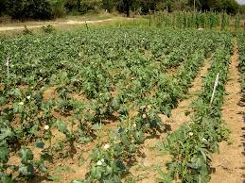
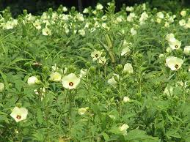
Earlier I was cultivating lady finger haphazardly but after training I am cultivating lady finger with new technology.
I am also applying organic matter and bio- pesticides in my field
Through all this technology I am earning good profit.
Details | 2013-14 | 2014-15 | 2015-16
Area (Hac.) | 1 | 1 | 0.5
Crop | Paddy | Cotton | Lady Finger
Cost (Rs.) | 7000 | 9200 | 14310
Production (Kg/Hac.) | 1000 | 1200 | 3000
Income (Rs.) | 16800 | 70000 | 75000
Net Income (Rs.) | 9800 | 60800 | 66000

Slide 29

Farmers opinion about SHC

Slide 30
Farmers opinion about SHC

Slide 31
Impact of the programme
SN | Crop | Area | Prod. (Kg/Hac.) |  | % Increase
 |  |  | Before Prog. (2010-11) | After Prog. (2015-16)
1 | Rice | 15020 | 1957 | 2200 | 12.42
2 | Maize | 33600 | 2063 | 2530 | 22.64
3 | Tur | 22550 | 1062 | 1260 | 18.64
4 | Black Gram | 11690 | 938 | 1060 | 13.01
5 | Cotton | 80380 | 745 | 840 | 12.75
6 | Soyabean | 5725 | 796 | 890 | 11.81

Slide 32
Outcome of the scheme
Efficient use of fertilizers.
20% Reduction in phosphetic fertilizer.
Efficiency of farmers increased.
Change in cropping pattern.
Increased productivity in maize & pulse crops.
20% Reduction in cost of cultivation.
Increased interest of farmers on horticulture crops.
Changing in standard of living of the tribal farmers.

Slide 33
Successful Implementation of the programme
Scheme goal achieved through public private partnership.
Extension functionaries directly connected with stake holders & farmers through non-officials & various organizations.
More than 48% soil health cards distributed this year.
Participatory approach used in the programme.

Slide 34
Way Forward…
Involvement of Farmers by ICT activity.
Soil Sampling Van facility at Block level.
Involvement of Agri-clinics of NABARD scheme
Mobile friendly software for farmers.
Panchayati Raj system should be involved.
Geo-spatial mapping for soil nutrients. (BISAG)

Slide 35
Thank you

