Slide 1


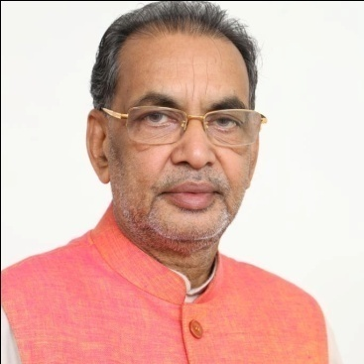
SOIL HEALTH CARD SCHEME
(Swasth Dharaa Khet Haraa)
Kantilal Dande, I.A.S.,
Collector & District Magistrate,
Guntur District, A.P,

Slide 2
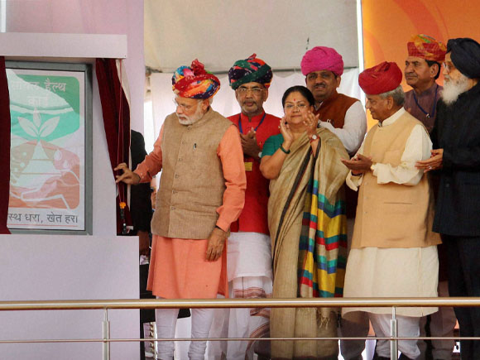

Hon’ble PM, India Launching the Programme at Suratgarh, Rajasthan
Agriculture as a key to poverty eradication.
It is necessary to nurture the soil
Sri Narendra Modi,
Hon’ble Prime Minister of India

Slide 3
PRE HISTORY
The world’s worst recorded food disaster happened in 1943 in British ruled India known as the Bengal Famine. An estimated four million people died of hunger that year alone in Eastern India due to acute shortfall in food production.
Nevertheless when the British left India four years later in 1947, India continued to be haunted by memories of the Bengal Famine which led to the Green Revolution in India.
However, the term “Green Revolution” synchronises to the period from 1967 to 1978. Between 1947 and 1967, efforts at achieving food self sufficiency were not entirely successful.

Slide 4
RECOMMENDED BALANCED DIET AS PER INDIAN STANDARDS
(gms/day)
Food Items | Adult Man |  |  | Adult Woman
 | Sedentary | Moderate at work | Heavy work | Sedentary | Moderate work | Heavy work
Cereals | 460 | 520 | 670 | 410 | 440 | 575
Pulses | 40 | 50 | 60 | 40 | 45 | 50
Leafy Vegetables | 40 | 40 | 40 | 100 | 100 | 100
Other Vegetables | 60 | 70 | 80 | 40 | 40 | 100
Roots & Tubers | 50 | 60 | 80 | 50 | 50 | 60
Milk | 150 | 200 | 250 | 100 | 150 | 200
Oils & fats | 40 | 45 | 65 | 20 | 25 | 40
Sugar & Jaggery | 30 | 35 | 55 | 20 | 20 | 40
Source : http://www.fao.org/docrep/x0172e/x0172e02.htm

Slide 5
Per capita availability of food grains in India
S No | Year | Population (in Crores) | Food grain production (in MTs) | Per capita availability of food grains (in grams / day)
1 | 1951 | 36.10 | 50.8 | 124
2 | 1961 | 43.92 | 82.0 | 124
3 | 1971 | 54.81 | 108.4 | 112
4 | 1981 | 68.33 | 128.96 | 128
5 | 1991 | 84.63 | 176.4 | 176
6 | 2001 | 102.70 | 196.8 | 220
7 | 2011 | 121.3 | 250 | 281
8 | 2014 # | 125.0 | 257 | 324
# Projected Values
Population increased in Geometrical ratio where as the food production in
Arithmetic ratio

Slide 6

The discovery of agriculture was the first big step toward a civilized life.
Arthur Keith

Slide 7


Slide 8

Father of Green Revolution

Slide 9
Strategies adopted for Green Revolution
Use of High yielding varieties
Use of chemical fertilizers and pesticides
New projects were built, irrigation potential generated
Use of tractors, motor pumps & farm machinery increased
Banks lent Agricultural loans to farmers
(the GOI Nationalized 14 largest commercial banks having 85% of deposits in the country during 1969)

Slide 10
Impact of Green Revolution
The Green revolution in Agriculture increased the yields of food crops ie., Rice, Wheat.
Nation attained self sufficiency in food production.
GOI started maintaining Buffer stocks (started FCI during 1964) of food, fertilizers and seeds.
Government able to curb inflationary trend of food products.

Slide 11
Aftermath
Fertiliser responsive, Photo insensitive HYVs highly prone to Pests and diseases
Indiscriminate use of chemical fertilizers & pesticides caused pollution.
Mechanization triggered Agricultural labour unemployment
Increased disparity between large and small farmers

Slide 12
Trends in fertiliser consumption (N, P and K) in India
Nitrogen
Phosphorus
Potash
Source: Fertiliser Association of India (2010)

Slide 13
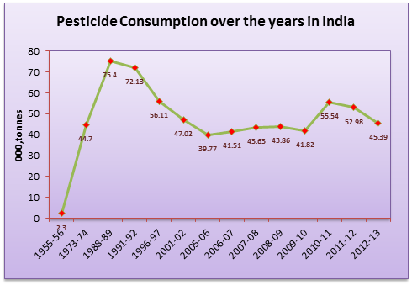
Pesticide Consumption over the years in India

Slide 14
Per hectare fertiliser use by states in India
(kg/ha)
Source : Fertilizer Association of India (2010)

Slide 15
Low Production (Food Scarcity)
Green revolution (Cultivation of Fertilizer responsive HYVs)
Enhanced use of Fertilizer
Succulent and Luxurious Crop Plants
High incidence of Pests and Diseases
Indiscriminate use of Pesticides
Alarming levels of Chemical Residues in Food and Soil
Health Hazards to Human, Animals Birds & Nature as a whole
Soil Health Degradation
ONLY ANSWER IS TO SUSTAIN SOIL HEALTH

Slide 16
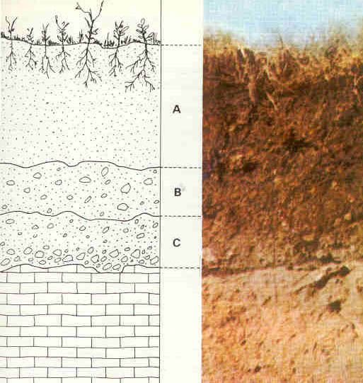
WHAT IS SOIL ?
Soil can be defined as the organic and inorganic materials on the surface of the Earth that provides the medium for plant growth.
Soil is the mixture of minerals, organic matter, gases, liquids, and the countless organisms that together support life on Earth.
SOIL HEALTH
Condition or status where optimal condition for crop growth exists i.e. sufficient moisture, availability of nutrients and good soil texture and structure.
SOIL HEALTH CARD (SHC)
Evaluates health or quality of soil as a function of its characteristics with particular reference to availability of macro and micronutrients in the soil.
SHC is a tool to help the farmer to monitor and improve soil health based on recommendations and enables the farmer to use the soil and crop specific fertilizers.
It provides a qualitative assessment of soil health and reclamation measures to the problematic soil.

Slide 17
SOIL HEALTH DEGRADATION
Excessive use of Chemical Fertilizers lead to
  Reduced Microbial activity due to low Humus Content
  Excessive usage of Macronutrients like
  # Nitrogen - Increased succulency lead the crops to more susceptible to pests & diseases.
  # Phosphorus - Affects the uptake of available
  Micronutrients.
  Development of - Acidic and Alkaline Soils
  Problematic soils
  To optimize the Integrated use of manures and fertilizers and to reduce cost of cultivation it is necessary to test the soil and issue Soil Health Cards to farmers, with the ultimate objective of achieving Fertile Soils and Healthy Crops

Slide 18
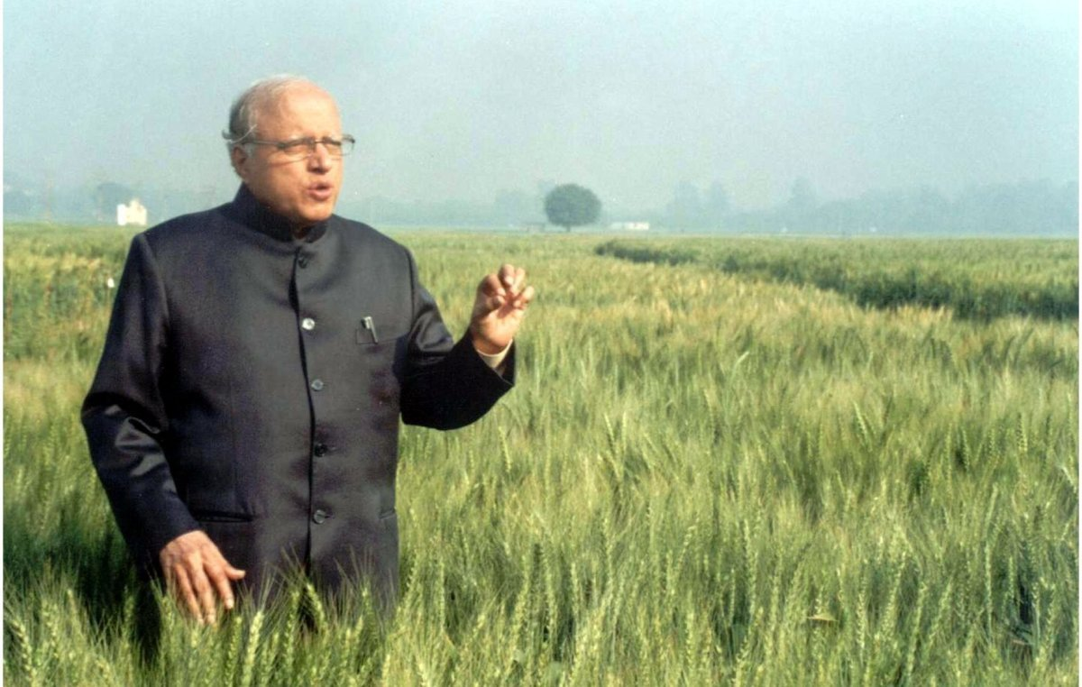
Father of Green Revolution in India
M.S SWAMINATHAN
“The Green Revolution was criticised by social activists on the ground that the high-yield technology involving the use of mineral fertilizers and chemical pesticides is environmentally harmful. Similarly, some economists felt that the new technologies would bypass small and marginal farmers, for although the technologies are scale-neutral, they are not resource-neutral. This led to my coining the term “ever-green revolution,” to emphasise the need to enhance productivity in perpetuity without ecological harm”.

Slide 19
RELEVANCE OF SOIL HEALTH CARD FOR GUNTUR DISTRICT
Guntur Tops in consumption of pesticides and 5th in respect of fertilizers at National level.
Indiscriminate fertilizer consumption made the crops more vulnerable to pests and diseases.
Excessive dependence on pesticides lead to more cost of cultivation.
Environmental pollution ie., Soil, Air and Water.
Hazards to Humans and Animals.
There is dire need to optimize the fertilizer usage by adopting balanced nutrient management through SHC.

Slide 20
COMPARITIVE PRODUCTIVITY
Kgs/ha.
S. No | Crop | Guntur | AP | India | World
1. | Paddy (Rice) | 3158 | 3152 (Nellore 3709) | 3721 (Punjab) | 6775 (China )
2. | Cotton (Kapas) | 1095 | 796 (Prakasam 1324) | 1542 (Rajastan 2151) | 2298 (China)
3. | Blackgram | 1099 | 681 | 735 | 890
4. | Greengram | 872 | 573 | 735 | 890
5. | Maize | 9144 | 4475 | 2583 | 4930
6. | Jowar | 5987 | 2411 | 962 | 1440

Slide 21
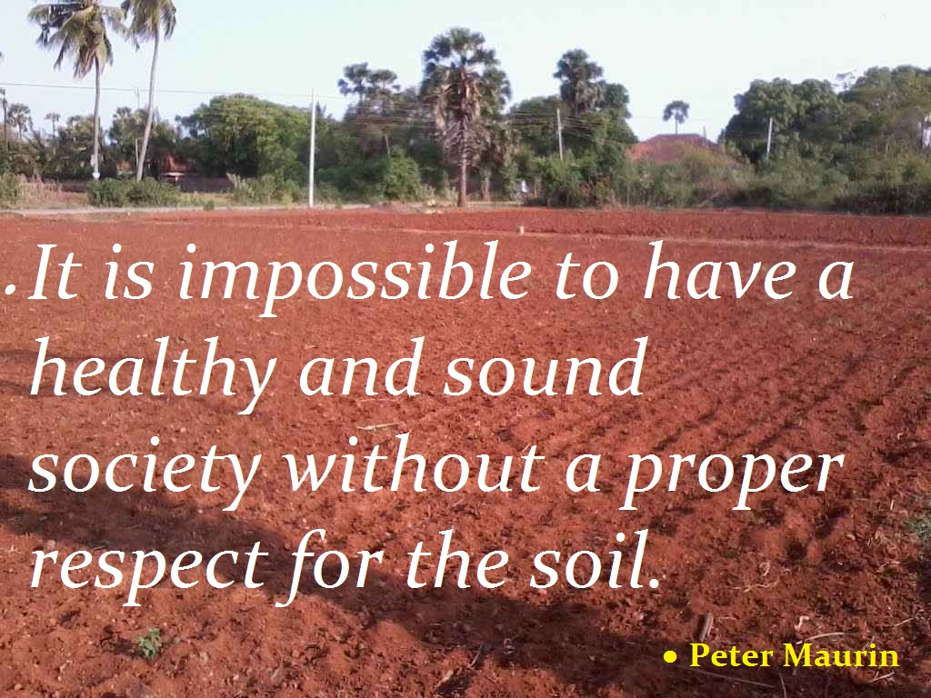

Slide 22


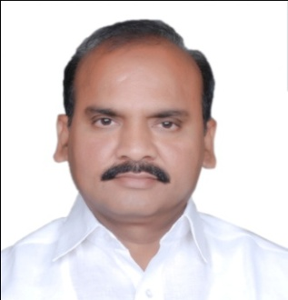
INTENSIVE SOIL TESTING PROGRAMME
GUNTUR DISTRICT

Slide 23
INTENSIVE SOIL SAMPLING
AIM :
Soil samples were collected by using 171 GPS (Global Positioning System) which facilitates accuracy in preparation of soil fertility maps.
Farmers are advised to use balanced fertilizers as per the soil analysis data by issuing Soil Health Cards well before commencement of season.
Reclamation of problematic soils as per the recommendations of the soil health cards.
To facilitate Double Digit Growth in Agriculture by correcting the micro nutrient deficiencies.

Slide 24
Target and Achievement – 2015-16
Name of the Institution | Macro Nutrients |  | Micro Nutrients (Target -16000)
 | Target | Achievement
Department of Agriculture
STL, Guntur | 16,520 | 17,133 | 7,340
AMC – STL, Narasaraopet | 5,490 | 5900 | 1344
RSTL – Bapatla | 6,990 | 7154 | 3530
MSTL – Bapatla | 3,000 | 3049 | --
ANGRAU Institutions
RARS – Lam, Guntur | -- | -- | 2191
AG College, Bapatla | -- | -- | 1505
International Institutions
ICRISAT | -- | -- | 692
Total | 32,000 | 33,236 | 16,636
No. of Soil Health Cards distributed including grid farmers – 1,40,000
No. of Water Samples analyzed and cards distributed – 1,140

Slide 25
Target for 2016-17
No. of Soil Samples : 81, 560(Guntur dt.) STL, Guntur - 30, 537
AMC, NRT - 11, 206
MSTL, BPT - 22, 349
RSTL, BPT - 17, 468
Soil Health Cards Target : 3, 01, 263
(including grid farmers)
Planned to analyse Targetted samples by the end of June @ 16300/month

Slide 26
MEASURES TAKEN TO POOL RESOURCES FOR EXECUTION OF SCHEME
Human Resources :
Involved : ICRISAT, ANGRAU in addition to Govt. of AP Soil Testing Labs.
Additional Staff : Staff of PTL, FCO, FTC and Field functionaries, ATMA staff drafted for the purpose.
Daily wage workers : Sample preparation and Cleaning of glass ware.
Data entry operators : Online Data entry of Soil Analysis report in Soil Health Cards in E- Rythu Sevalu Portal of AP.

Slide 27
OTHER LOGISTICS
Distilled Water : Collected from Govt., Private, ANGRAU Laboratories.
Power : 5 KV Solar System, Generator along with UPS.
Chemicals, Glassware & Equipment : Provided with Chemicals, Glassware and all equipment (along with standby).

Slide 28
Strengthening Lab to test Micro Nutrients
ATOMIC ABSOROPTION SPECTRO PHOTO METERS
AVAVILABLE STATUS
Sl. No | Name of the Lab | Existing No | Addl. No Provided | Total
1 | STL, Guntur | 1 | 1 | 2
2 | RSTL ,Bapatla | 2 | -- | 2
3 | AMC, Narasaraopet | 1 | -- | 1
TOTAL : |  | 4 | 1 | 5
Also utilized the Services of Soil Science Dept of RARS – Lam,Guntur. College of Agriculture, Bapatla and ICRISAT, Hyderabad for analysis of Micro Nutrients.

Slide 29
STEPS TO DEPLOY TRAINED SOIL SCIENTISTS TO FILL UP VACANCIES INTO LABS
Technical Staff Positioned during 2015-16.
Sl.No | Name of the Soil Testing Lab. | Existing Staff |  |  |  | Additional Staff Positioned
 |  | ADA | AO | AEO | Lab Assistants | Persons with B.Sc (Ag)/ M.Sc (Ag) Soil science as “Analysts” | Persons with BSc./Agri Diploma “to assist the Analysts” | Persons with good computer knowledge “as data entry operators” | Daily wage workers
1 | STL, Guntur | 1 | 3 | 1 | 1 | 8 | 8 | 5 | 6
2 | STL, AMC Narsaraopet | - | 1 | 1 | - | 4 | 4 | 2 | 2
3 | RSTL, Bapatla | 1 | 3 | 1 | 1 | 6 | 6 | 4 | 4
4 | MSTL, Bapatla | 1 | 1 | 1 | 2 | 7 | 8 | 4 | 5
Total |  | 3 | 8 | 4 | 4 | 24 | 26 | 15 | 17

Slide 30
STEPS TO DEPLOY TRAINED SOIL SCIENTISTS TO FILL UP VACANCIES INTO LABS
Technical Staff Planned during 2016-17.
Sl.No | Name of the Soil Testing Lab. | Existing Staff |  |  |  | Additional Staff Positioned
 |  | ADA | AO | AEO | Lab Assistants | Persons with B.Sc (Ag)/ M.Sc (Ag) Soil science as “Analysts” | Persons with BSc./Agri. Diploma “to assist the Analysts” | Persons with good computer knowledge “as data entry operators” | Daily wage workers
1 | STL, Guntur | 1 | 3 | 1 | 1 | 20 | 20 | 5 | 10
2 | STL, AMC Narsaraopet | - | 1 | 1 | - | 20 | 20 | 5 | 10
3 | RSTL, Bapatla | - | 3 | 1 | 1 | 20 | 20 | 5 | 10
4 | MSTL, Bapatla | 1 | 1 | 1 | 2 | 20 | 20 | 5 | 10
Total |  | 2 | 8 | 4 | 4 | 80 | 80 | 20 | 40

Slide 31
TRAININGS AND WORK SHOPS
Training / Work Shop | Subject | 2015-16 | 2016-17
State level | Planning | January | January
District level | Planning | February | February
Revenue Division level | Grid formation, GPS & Android App, Agrisnet/ NIC portal, Sample collection & sending to labs | February | January
Mandal level |  | February | January
Village level |  | January | January
Soil Analysts | Analytical Procedures & Agrisnet/ NIC portal | January | January

Slide 32
MEASURES TAKEN TO COMPLETE SAMPLE ANALYSIS IN TIME
Sampling : Division of targets – Week wise; officer wise starting from December to May.
Analysis : Division of targets – Lab wise; week wise; team wise starting from December to June.
Printing of SHC : Simultaneously from January to June.
Distribution of SHC: May to July
Awareness campaign on SHC : April to July
Monitoring Cell : Ensures all above activities done as per schedule.

Slide 33
PLANNING
Details | 2015-16 | 2016-17
Target | 32000 | 81560
Prorata Target / month | 8000 | 16300
No. of Shifts | 2 | 2
No. of Teams | 4 | 8
Sets for Analysis | 2 | 2
Officers engaged for analysis | 50 | 160*
* AEOs/MPEOs/ATMA staff are engaged apart from Agricultural Officers

Slide 34
Farmers Involvement and Campaign for Soil Sample Collection / Card distribution and educating farmers
Soil Sample Collection
Preparation of village wise schedule
Communication of Schedule :
Print and electronic media, FM Radio, Tom-tom, Blackboard writings, SMS through Reliance foundation, Local Cable Network, Meetings, Farmer Facilitators, Personal Contacts etc.,
Involving RMGs, JLGs, SHGs, PACS, Local bodies etc.,
Involving peoples representatives.
Organizing Village level Demonstrations for Sample Collection
Distribution and understanding of SHC
Village level meetings involving all above.
Follow up for SOIL TEST BASED FERT. USAGE
Innovators, Early adopters, contact farmers, RMGs, JLGs, SHGs, PACS, Farmer facilitators etc.,

Slide 35
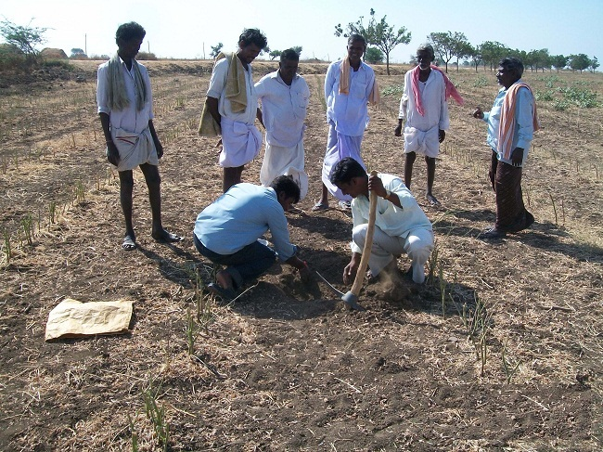
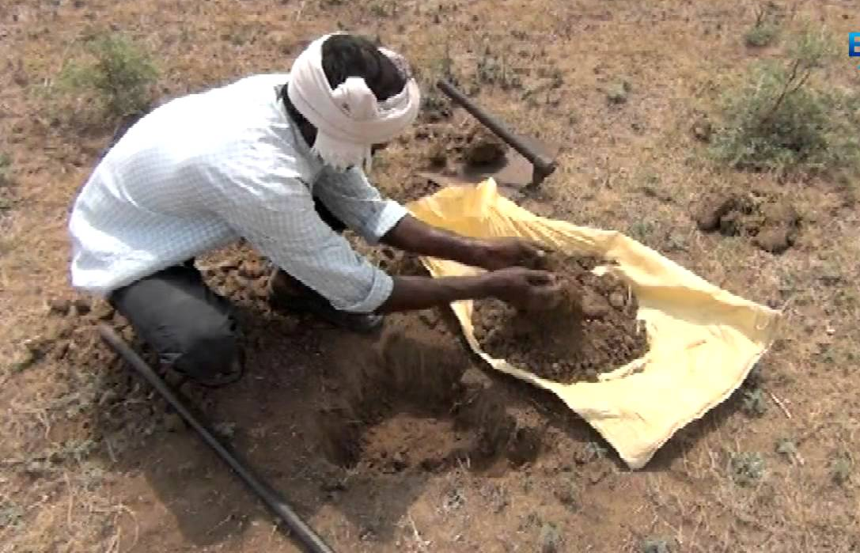
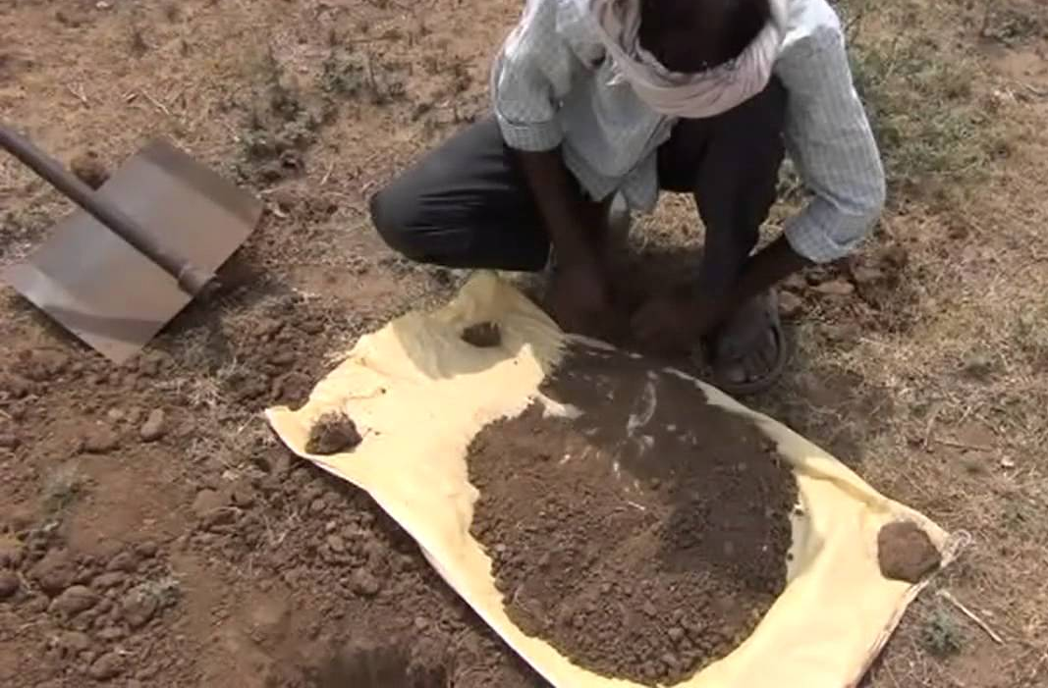
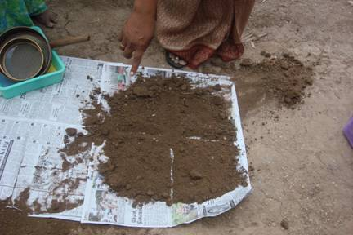
Method of soil sample collection
Awareness creation on sampling
Collection of soil from pit
Preparation of composite sample
Preparation of representative sample (Quartering)

Slide 36
Awareness on Soil Health Management.
Awareness on SHC by conducting Meeting / Trainings/ Exhibitions and Demos at Village level.
Utilising Departmental Programmes like Polampilushondi, Janmabhumi - Maa Vooru and other demonstrations for popularizing importance of Soil Health management.
Popularizing Soil Test based Fertilizer usage.
Soil ameliorating measures for problematic Soils.
Growing and incorporation of Green manure crop at 50% flowering to improve the organic matter content.

Slide 37
Innovative measures adopted
Technology | 2015-16 | 2016-17
GPS Instrument | 171 | 171
Android App | 0 | 500
Online Data Entry | Agrisnet | NIC
Communication of recommendations | SMS, Internet, Health Cards | SMS, Internet, Health Cards
Village Fertility maps | Yes | Yes
Innovative measures contd…

Slide 38
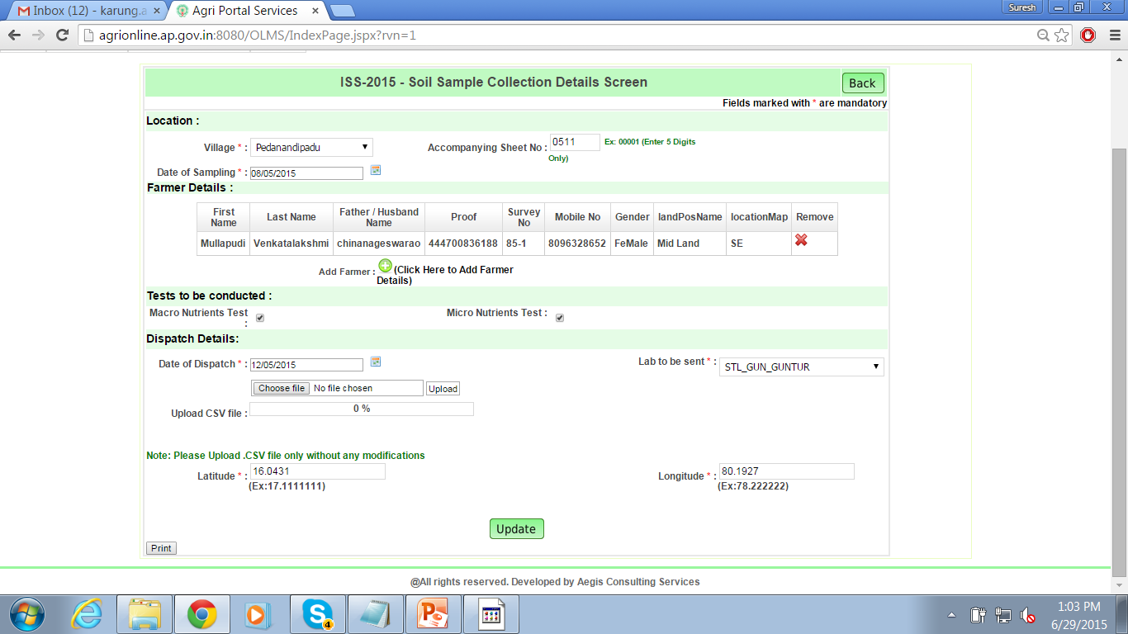
Sample Collection Details Screen

Slide 39
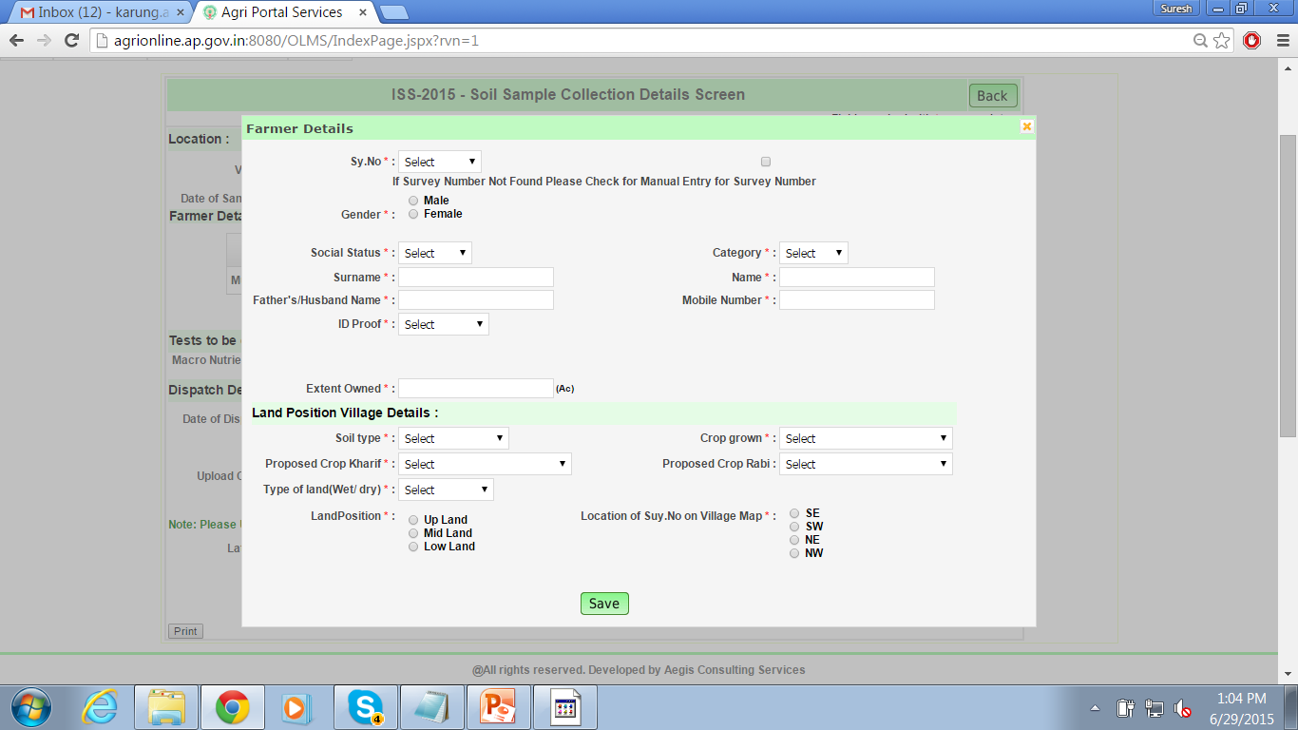
Farmer Details Entry

Slide 40
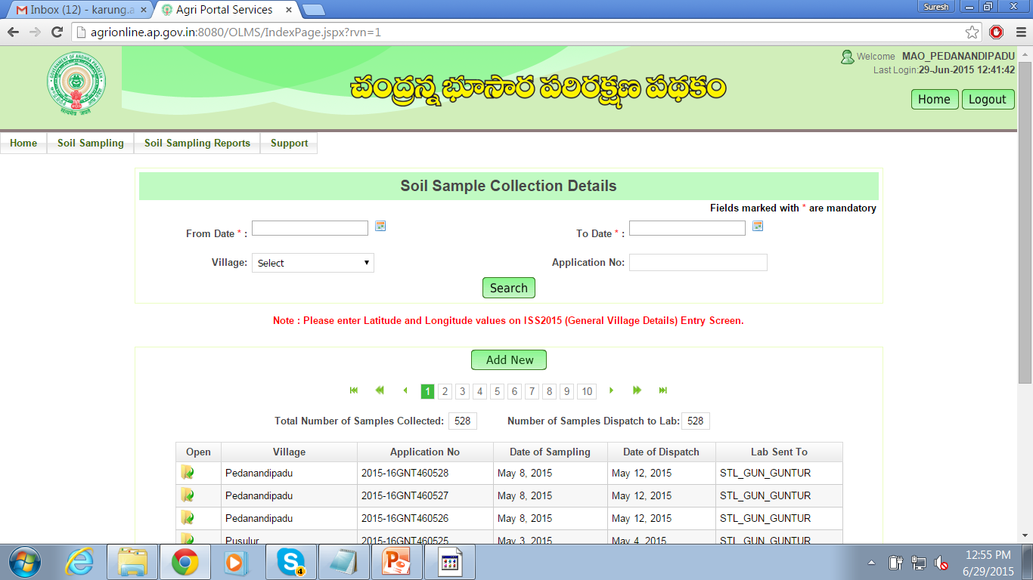
Sample Collection Details

Slide 41
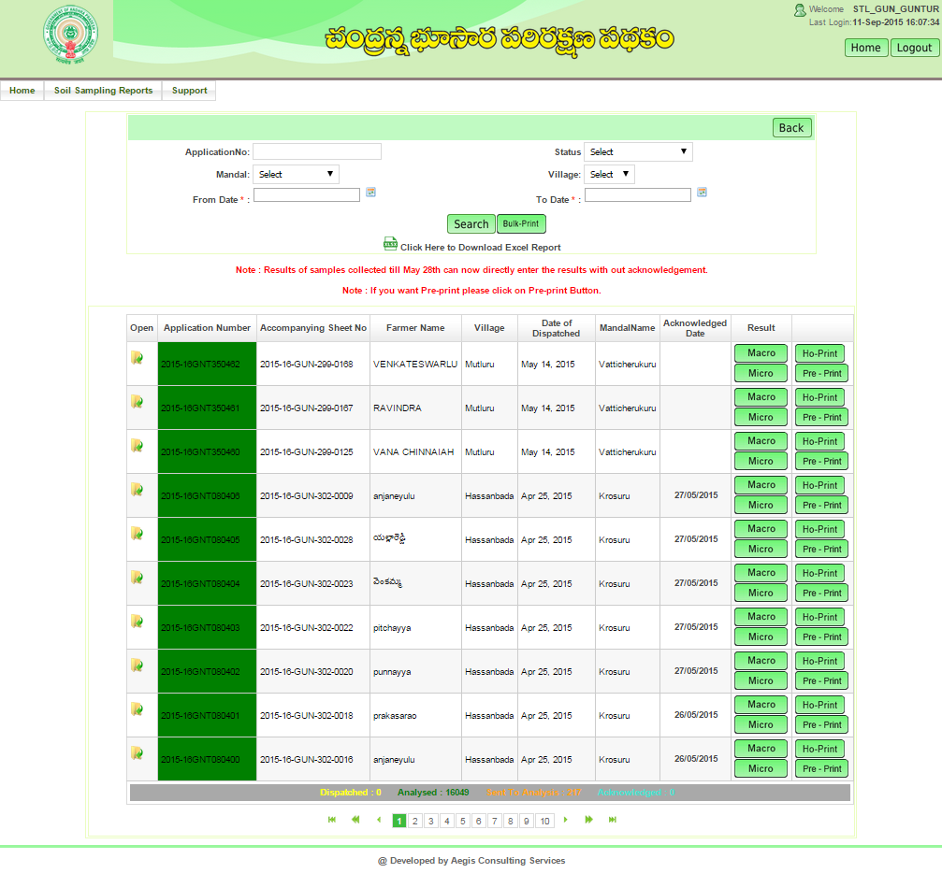
STL Login

Slide 42
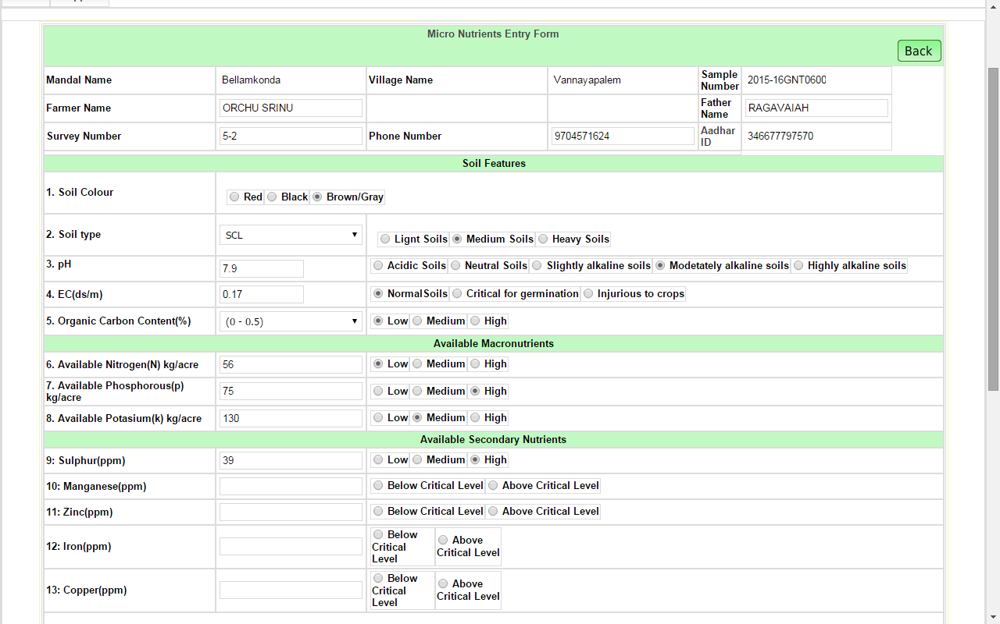
Micro Nutrients entry screen

Slide 43
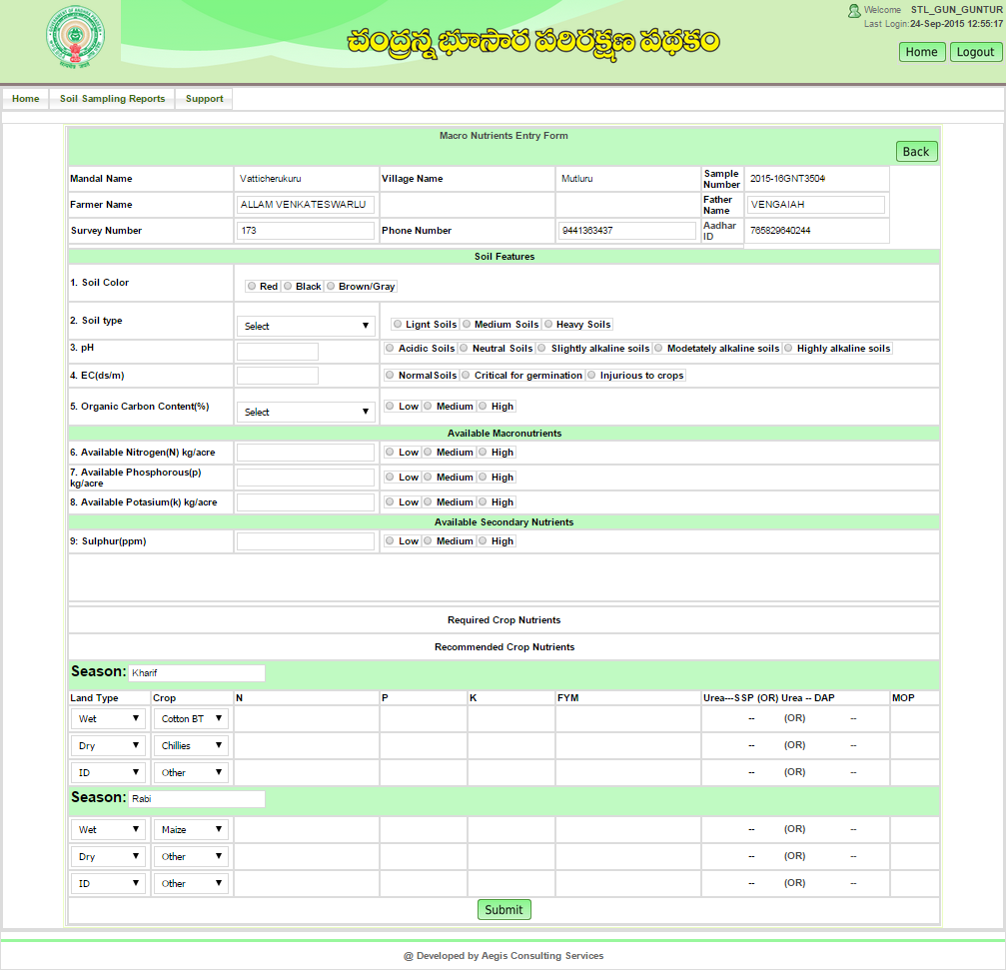
Macro Nutrients entry screen at STL level

Slide 44
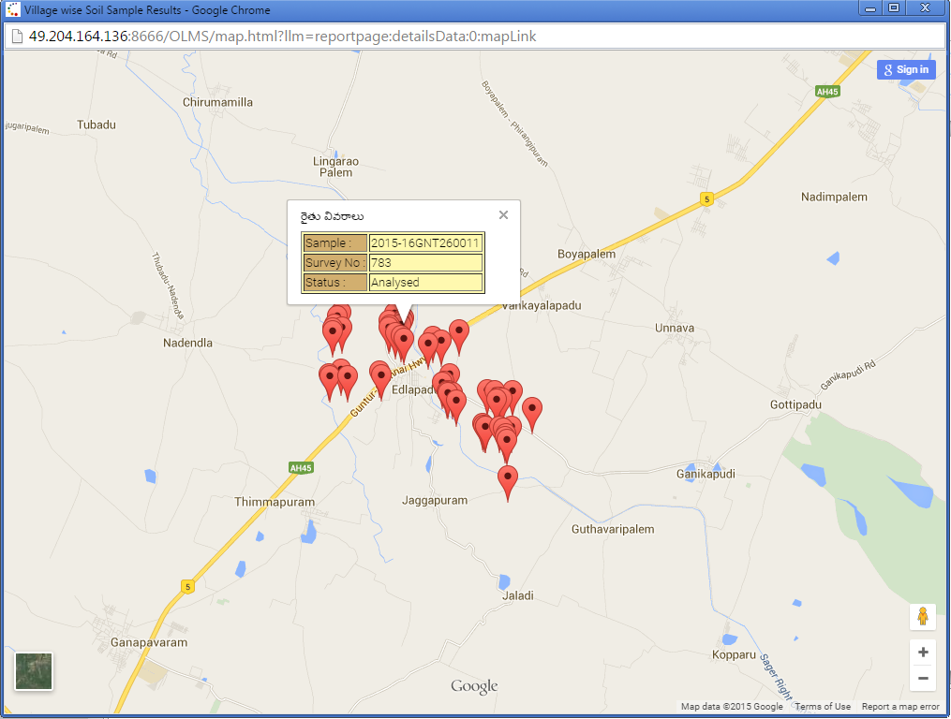
Exact Location of Zoom View

Slide 45
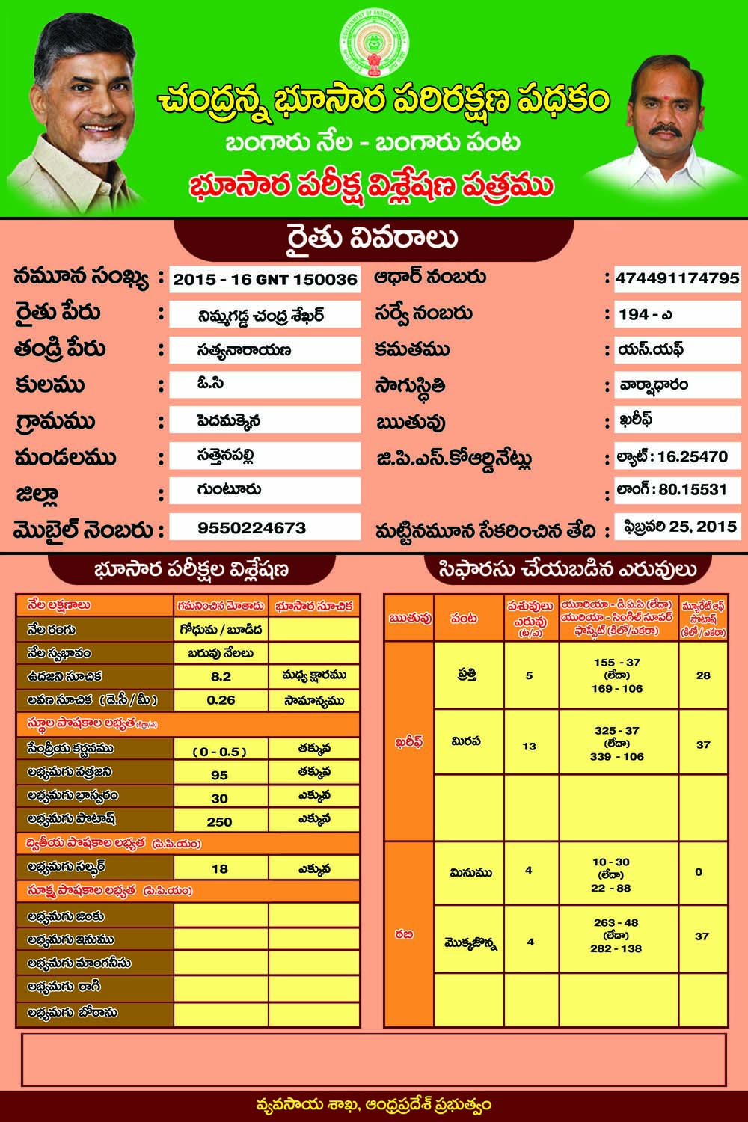
Soil Health Card distributed to farmers of Andhra Pradesh

Slide 46
Outcome of the Scheme – 2015-16
74% of the Soils are low in Organic carbon Content.
84% Soils high in Potash & 62% high in P2O5.
Sulphur Deficiency is very low i.e, 3% and 39% Zinc deficiency.
1791MTs of Zinc sulphate, 3400 MTs of Gypsum and 21MTs of Boron were supplied to the farmers on 50% subsidy for correcting micronutrient deficiency covering 2,15,000 Ha.
22% of Iron deficiency was identified in rain fed areas which was corrected by application of Ferrous Sulphate as Soil application.
Inspite of drought situation - Paddy, Blackgram, Greengram, Bengalgram, Redgram, Maize recorded better yields as Micronutrient deficiency correction was done in time.

Slide 47
Suggestions for improvement in the Scheme
Designing mechanical equipment to draw soil samples at different depths, viz, 0-15, 15-30 cm etc.
MPAES for each lab is provided for analysing targeted soil samples in time accurately.
Strengthening of existing Soil testing laboratories at Agril. Market yards which facilitate easy approach to farmers for getting soil analysis in time.

Slide 48
ORGANIZATION OF THE WORLD SOIL DAY
On 5th December, 2015 “World Soil Day” was organized at large in RARS, LAM, Guntur.
Hon’ble Minister for Social welfare & Tribal Welfare empowerment & other People’s Representatives, Collector & District Magistrate, Guntur, State Agricultural University Officials & Department Officials participated.
About 5000 farmers participated.
30000 pamphlets on success stories of organic farming, soil test based fertilizer application, micronutrient deficiency correction and reclamation of problematic soils were distributed among the farmers.
The soil health cards were distributed to the farmers and educated them regarding the importance of soil health cards.
Hon’ble Minister for Social Welfare inaugurated five mobile soil testing laboratories.

Slide 49
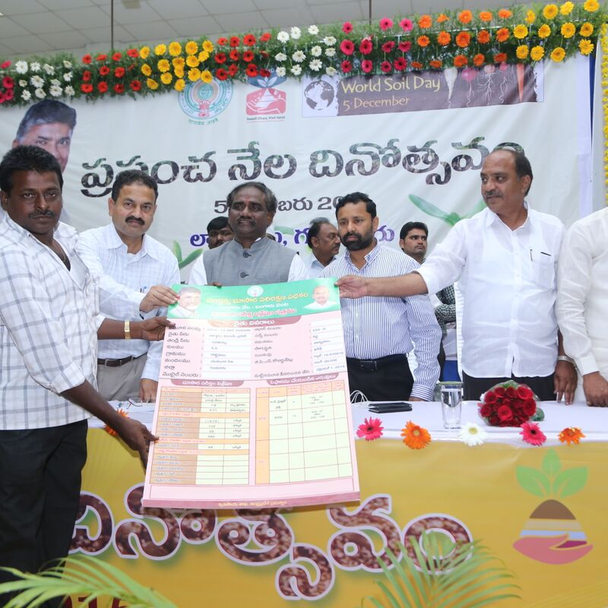
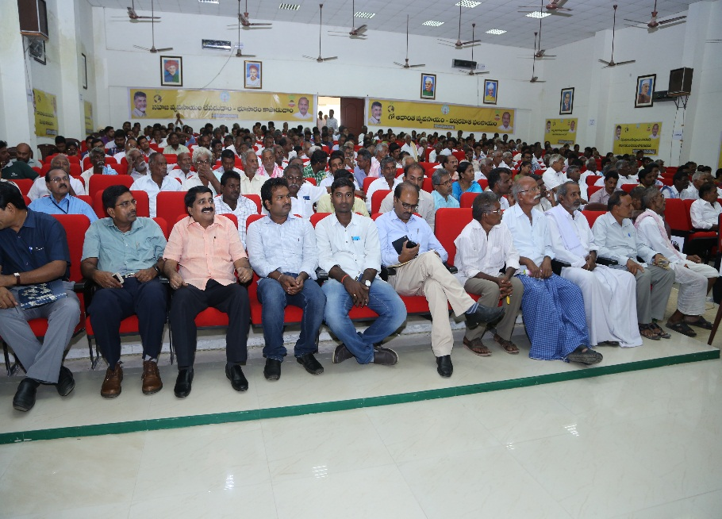
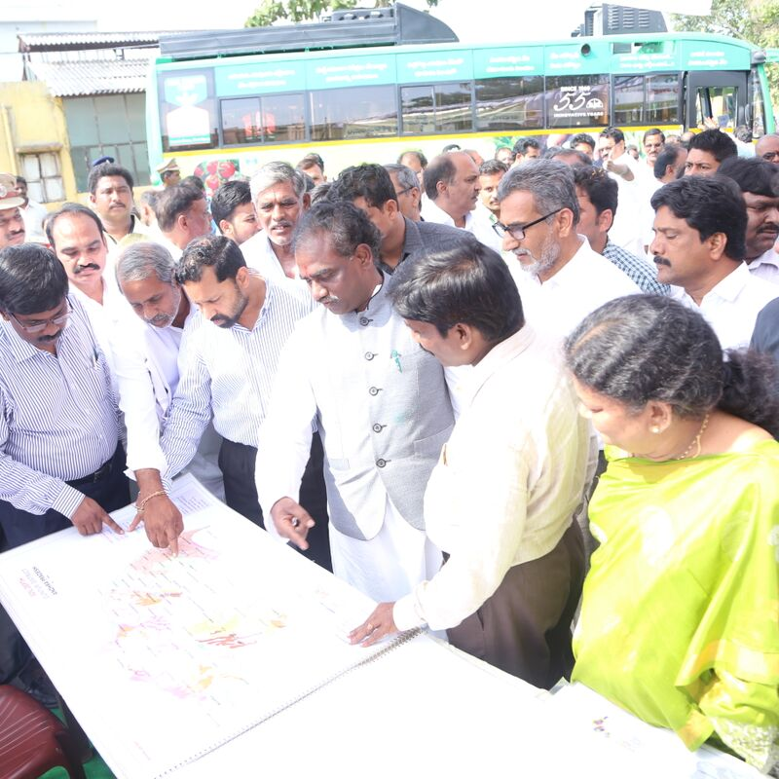
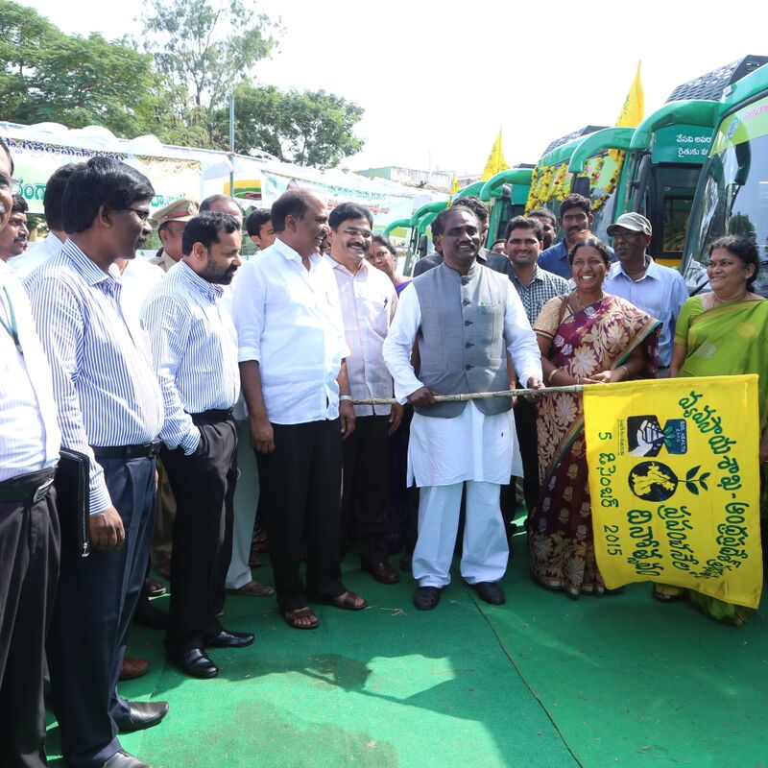
World Soil Day Celebrations
Distribution of SHC on World Soil Day by Hon’ble Minsiter of Social Welfare Andhra Pradesh
Farmers, Scientists, who have attended World Soil Day Programme on 05.12.2015
Soil Fertility Status Map of Guntur district
Flag Off for Mobile Soil Testing Laboratories by Hon’ble Minsiter for Social Welfare

Slide 50
Guntur District
Stepping towards Chemical free Agriculture
High Input Agriculture
Indiscriminate use of Fertilizers and Pesticides
Farmer Field Schools (Polambadi)
ICM (INM + IPM)
NPM
Bio-fertilisers and Bio-pesticides
Natural Farming
Healthy Soil -> Healthy Food -> Healthy Nation
Organic Farming

Slide 51
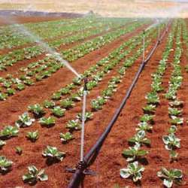
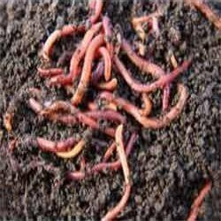
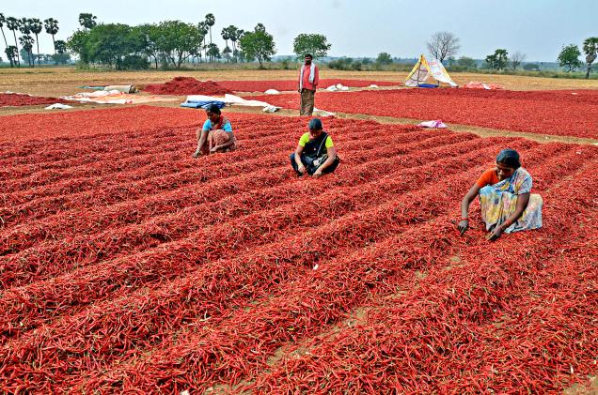
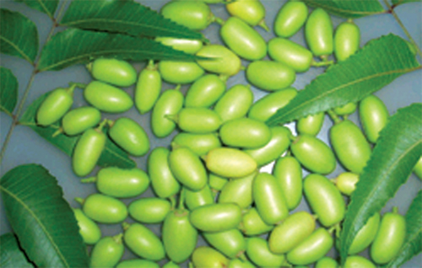
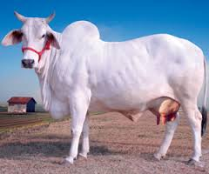
Micro Irrigation
Organic Farming
Healthy Crop
Non Pesticide Management
Natural Farming

Slide 52

Thank You
The future belongs to Nations who have grains not guns.
MS Swaminathan

