Slide 1
District Hamirpur, HP

Slide 2
District Profile – Hamirpur, HP
Situated between 31°52′N to 31°58′N and between 76°18′E to 76°44′E.
Altitude ranges between 450-785 meters AMSL.
Geographical Area of District: 1,10,070 Ha
Number of Development Blocks: 6
Number of Gram Panchayats: 229
Number of Villages: 1697

Slide 3
At a Glance – Hamirpur, HP
Gross Cropped Area: 66,848 Ha
Net Area Sown: 35,295 Ha
Net Irrigated Area: 1,789 Ha
Rainfed Area: 33,506 Ha
Number of Operational Holdings: 76,140 No.
Market Yards: 3
Krishi Vigyan Kendras: 1
Soil Testing Laboratories: 2
( 1 Static Lab, 1Mobile Lab)
Important Crops: Maize, Wheat, Paddy, Black Gram, Rape Seed & Mustard and Vegetables

Slide 4
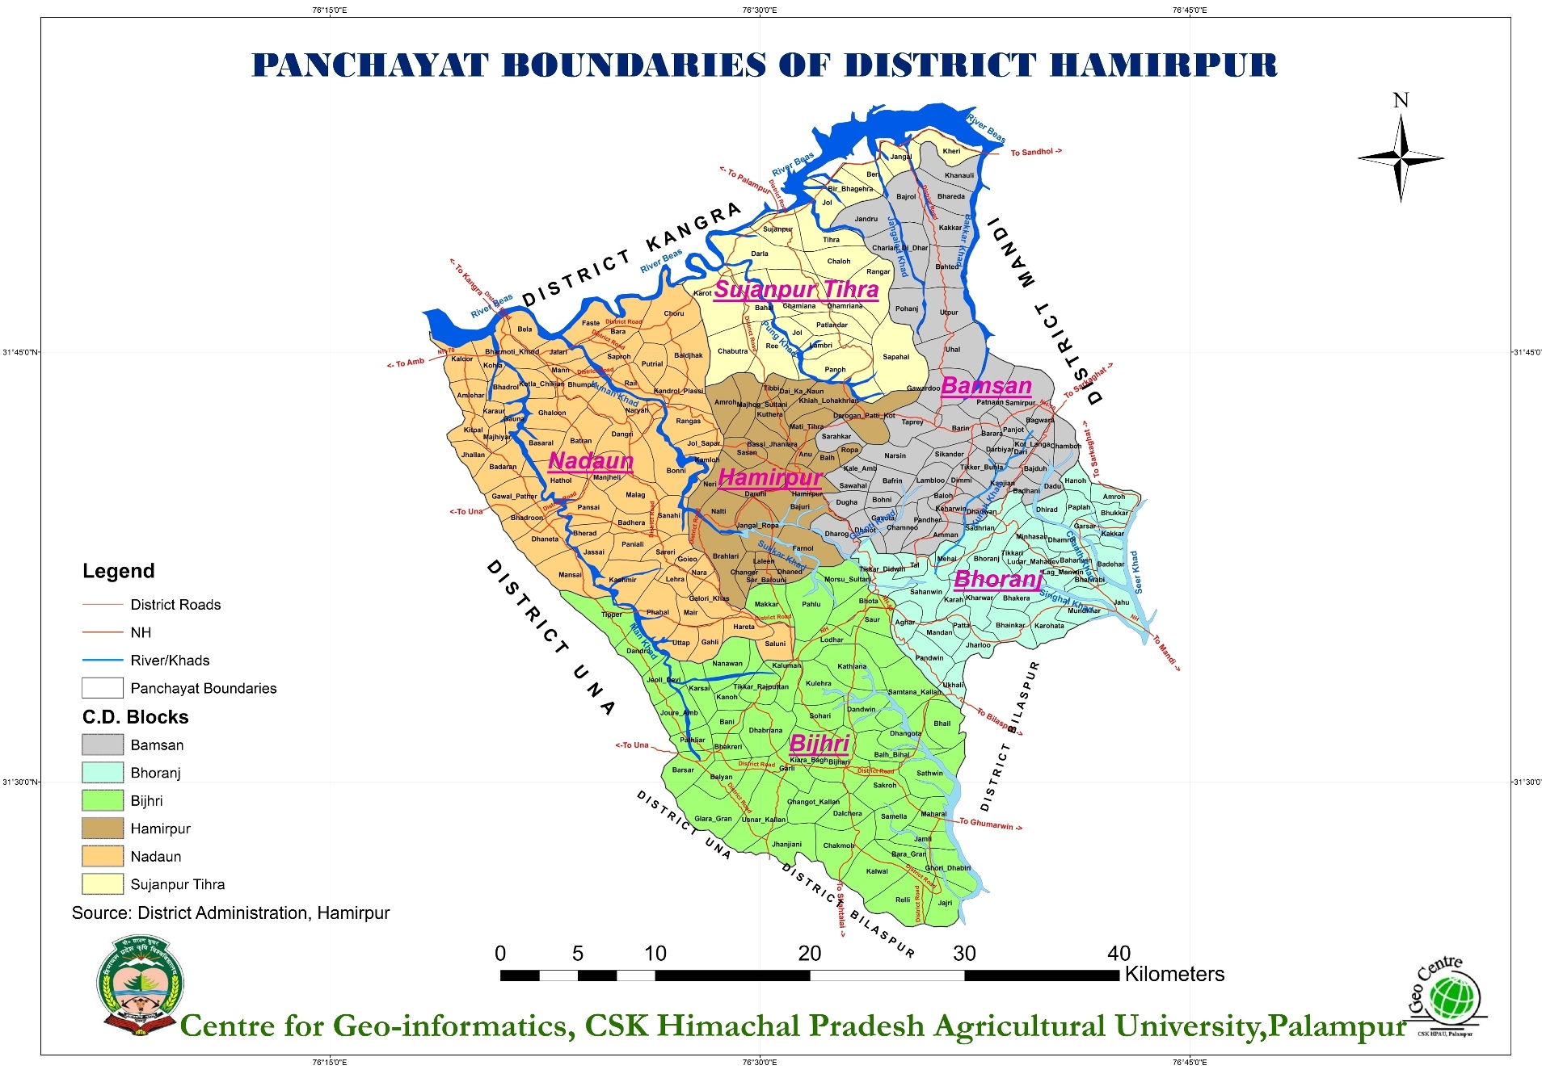
Block Map – Hamirpur, HP

Slide 5
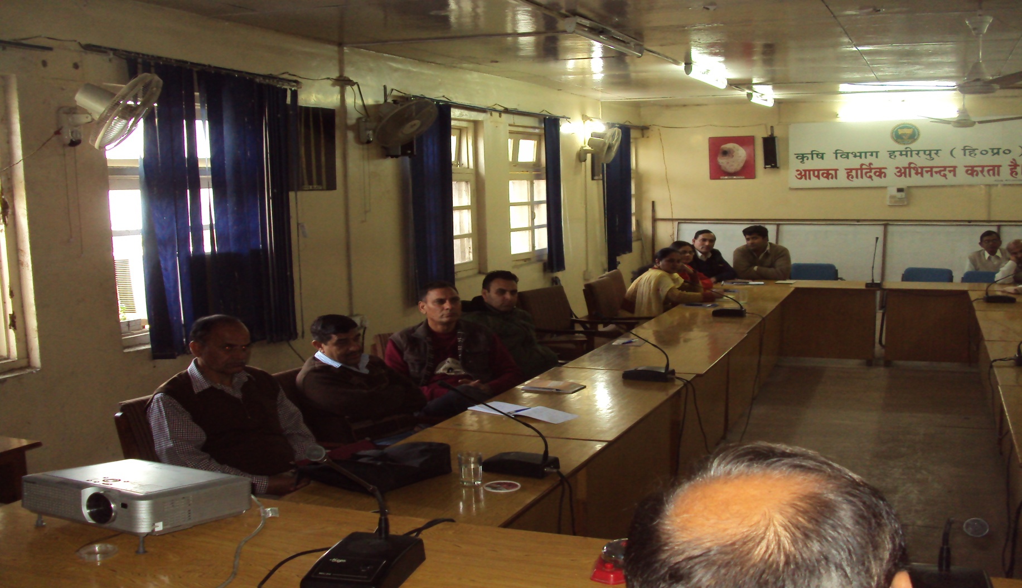
Staff Meeting for the Implementation of SHC Scheme

Slide 6
Awareness Camps on the Scheme at Village level

Slide 7
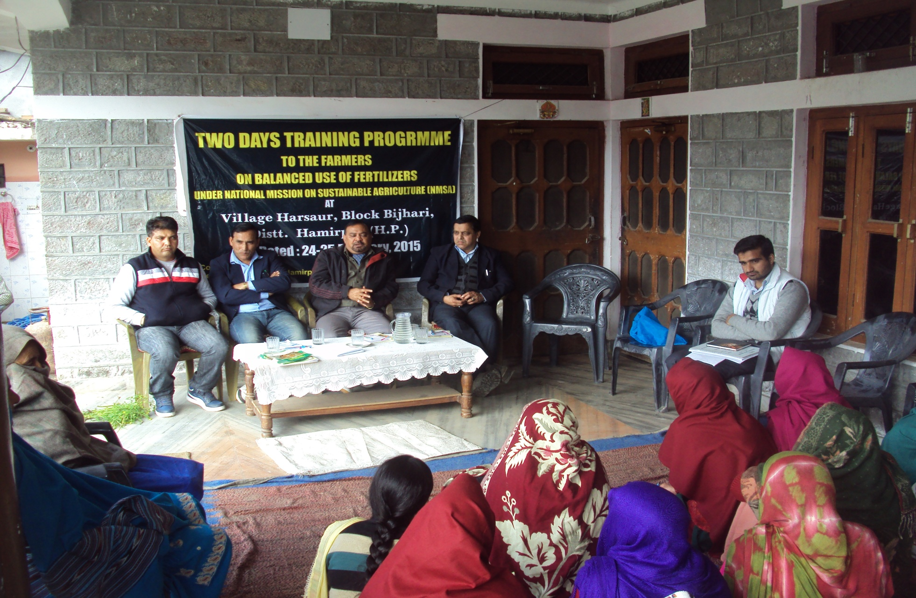
Farmer Awareness Camp

Slide 8
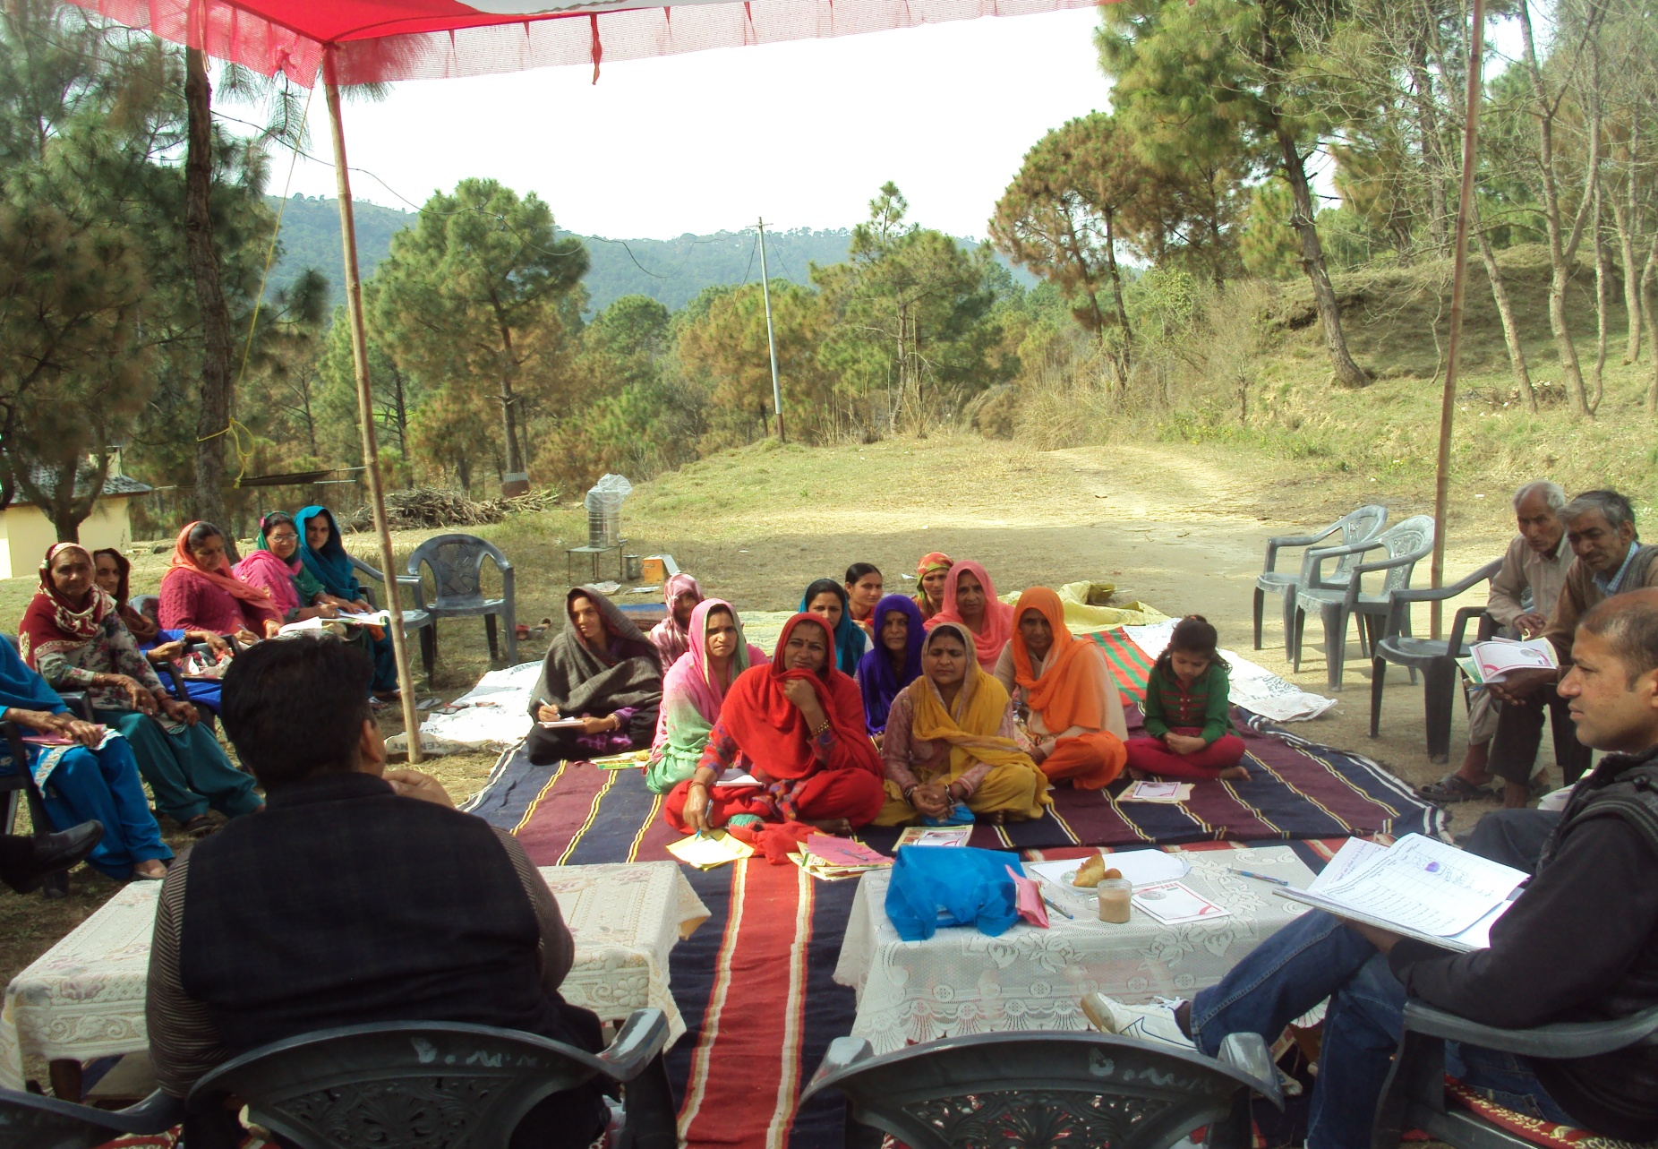
Farmer Awareness Camp

Slide 9
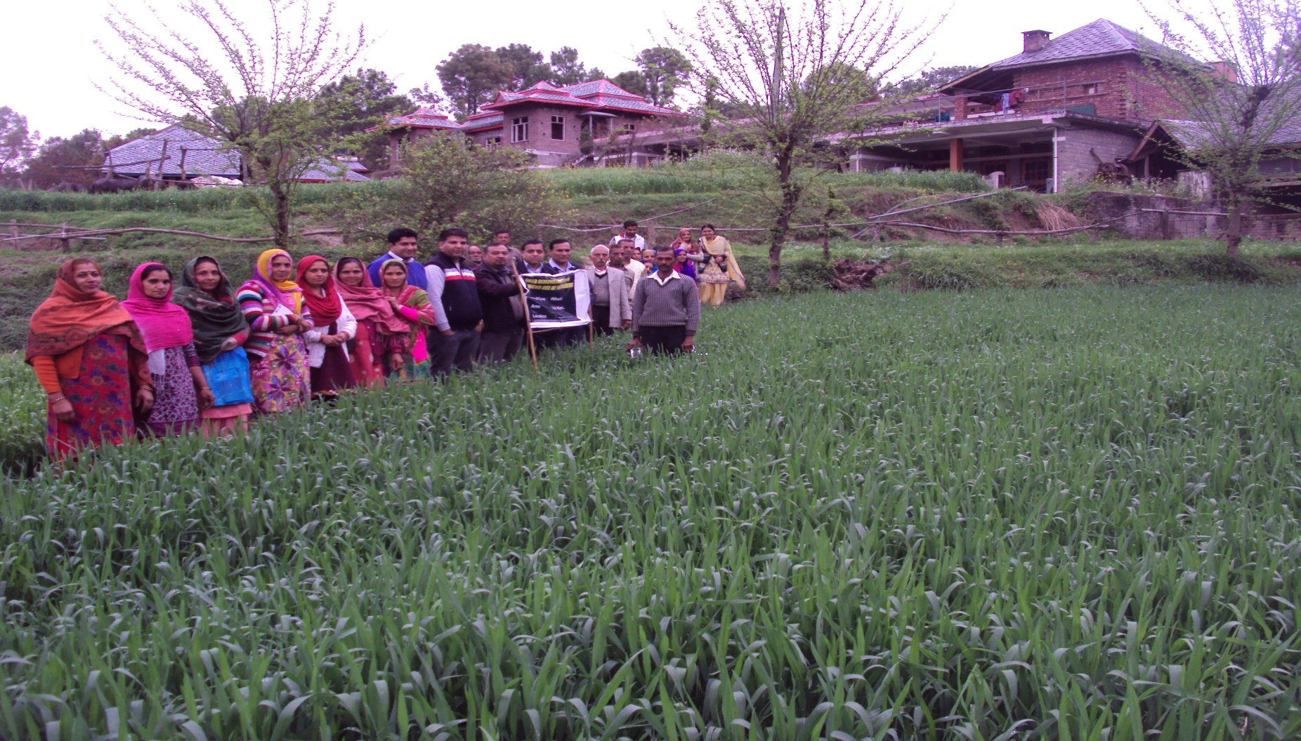
Demo Visit on Balanced Fertilization

Slide 10
District Target & Achievements [Collection of Soil Samples] (Till 31st January, 2016)
Target Kharif, 2015 | Achievement Kharif, 2015 | Target Rabi, 2015-16 | Achievement Rabi, 2015-16
1,456 | 1,456 (100 %) | 1,871 | 1,871 (100%)

Slide 11
District Target & Achievements [Distribution of Soil Health Cards] (Till 20th February, 2016)
Target | Achievement | % age Achievement
16,635 | 10,299 | 61.91

Slide 12
Soil Health Card Scheme
Scheme launched by Hon’ble Prime Minister of India Sh. Narender Modi on 19th February, 2015.
Scheme Objectives:-
To provide Soil Health Cards every three years to each and every farming family of the country, so as to provide a basis to address nutrient deficiencies in fertilization practices.
To strengthen functioning of Soil Testing Laboratories (STLs) through capacity building and effective linkage with ICAR/SAUs.
To diagnose soil fertility related constraints with standardized procedures, uniformly sampling and analysis across states.

Slide 13
Resource Utilization
Technical manpower available in the Department was pooled for this National Programme.
Additional manpower engaged during programme from ATMA and Soil Conservation: 17
Scientists of KVKs/SAUs were involved for technical advise on Soil Testing.
Additional 8 GPS were arranged from other departments.
Retained the analyst in the lab. who was under transfer.
Staffs were engaged for sample analysis till late hours and even in holidays.
Shift duties were assigned to maximize the utilization lab resources

Slide 14
Sampling and Analysis
Each Block was provided with 2 GPS for soil sampling.
Grids were delineated for taking composite samples with the involvement of farmers.
Data of all the farmers in a Grid was recorded for which teams of officers were constituted at Block level.
Soil Samples along with all details were handed over in the Soil Testing Laboratory for analysis.
Ensured in time Submission of Soil Samples to Lab.
Regular monitoring & redressal of day-to-day problems.
Utilized the services of Panchayat Secretaries and Patwaries.

Slide 15
Strengthening Lab & Equipments
Soil Testing Laboratory was strengthened for Micro-Nutrients testing facilities as well as other parameters.
Purchased New Centrifuge Machine
Purchased Electrical Conductivity Meter
In time procurement of lab chemicals, filter papers, glassware and cathode lamps etc.
Arranged additional Internet connectivity link for speedier data entry and generation of SHCs.
Capacity Building – Imparted Staff Training for analysis & fertilizer recommendations in KVKs/SAUs.

Slide 16
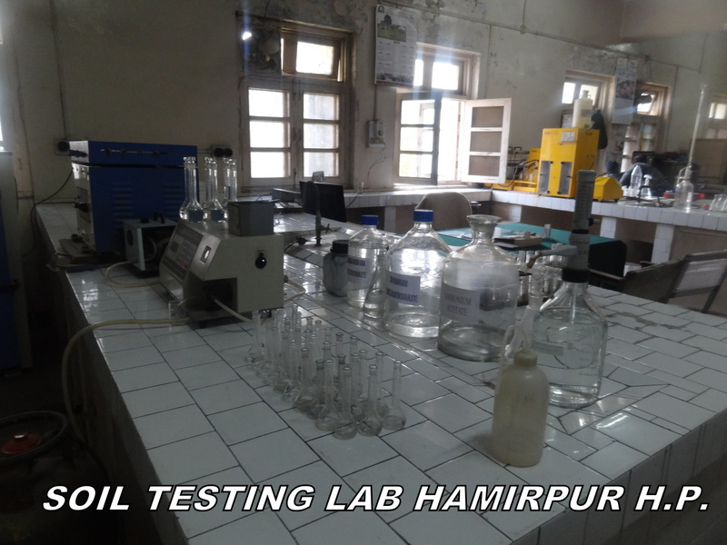
District Soil Testing Lab

Slide 17
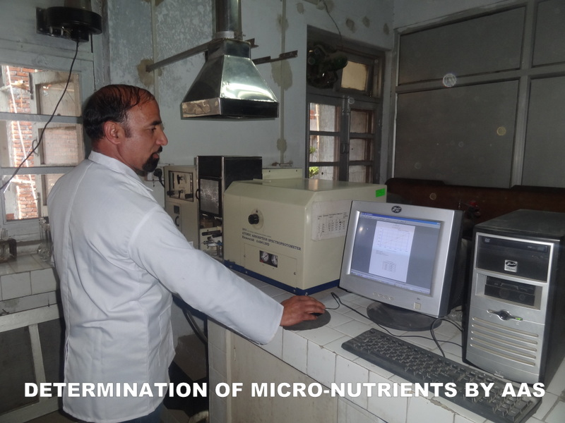
Determination of Micro-Nutrients

Slide 18
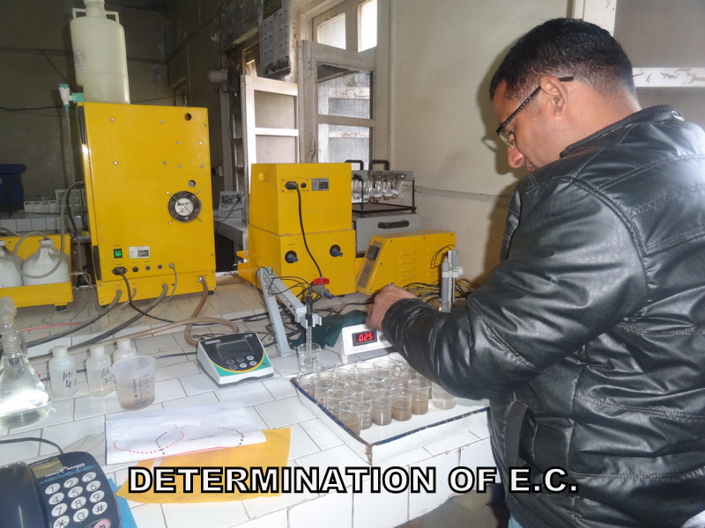
Determination of E. C.

Slide 19
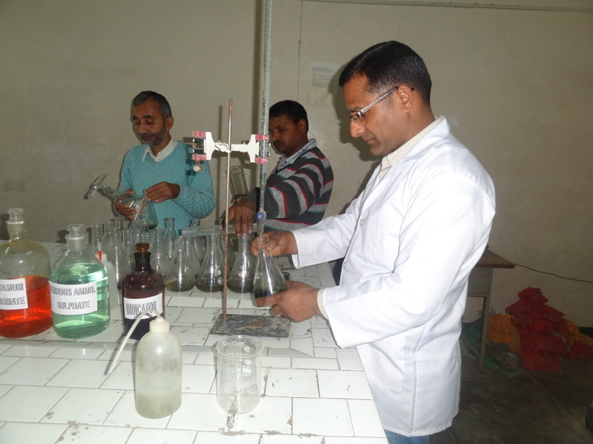
Determination of Organic Carbon

Slide 20
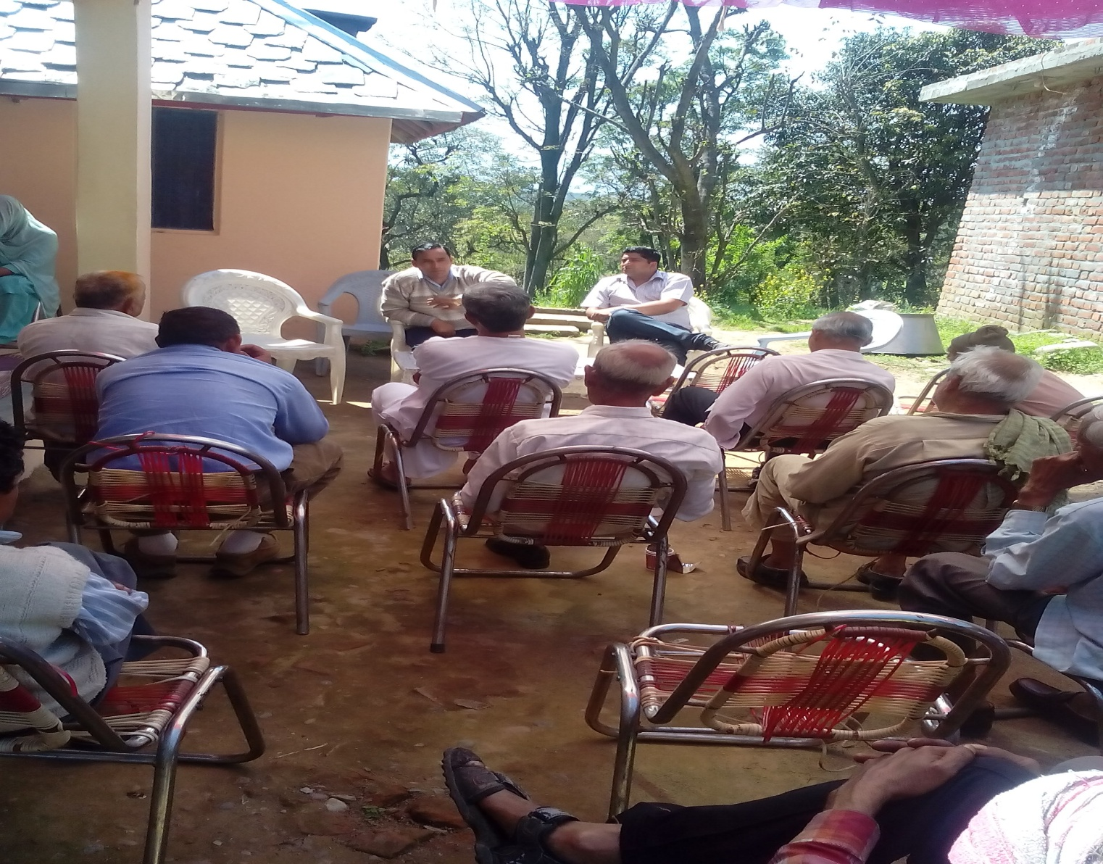
SHC – Farmer Awareness Camp

Slide 21
World Soil Day Celebration
Organized District level World Soil Day on 5th Dec., 2015 at Hamirpur.
The programme was inaugurated by Hon’ble Chief Parliamentary Secretary.
More than 500 farmers from all the 6 Blocks of the district participated.
The farmers were got acquainted with the scheme through lectures, presentations.
Farmer queries were addressed by the Soil Scientists and other Subject Matter Specialists.
Distributed 500 Soil Health Cards to the Farmers on occasion.

Slide 22
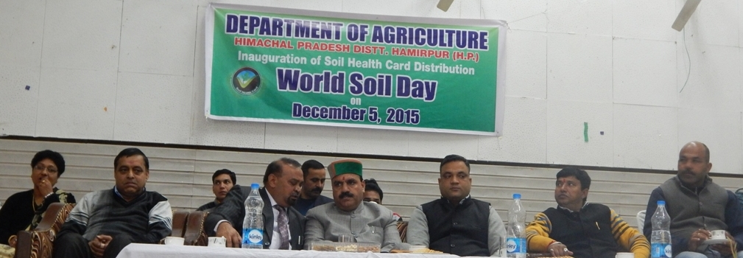
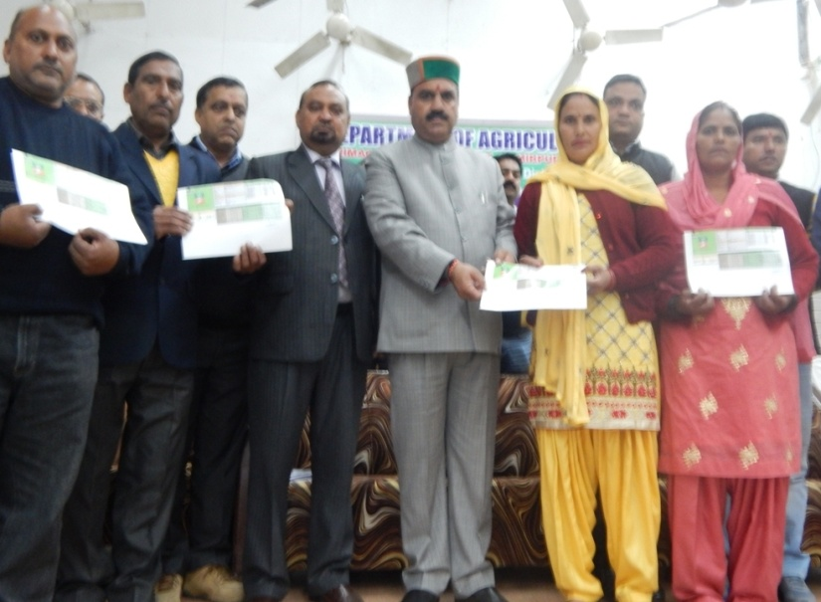
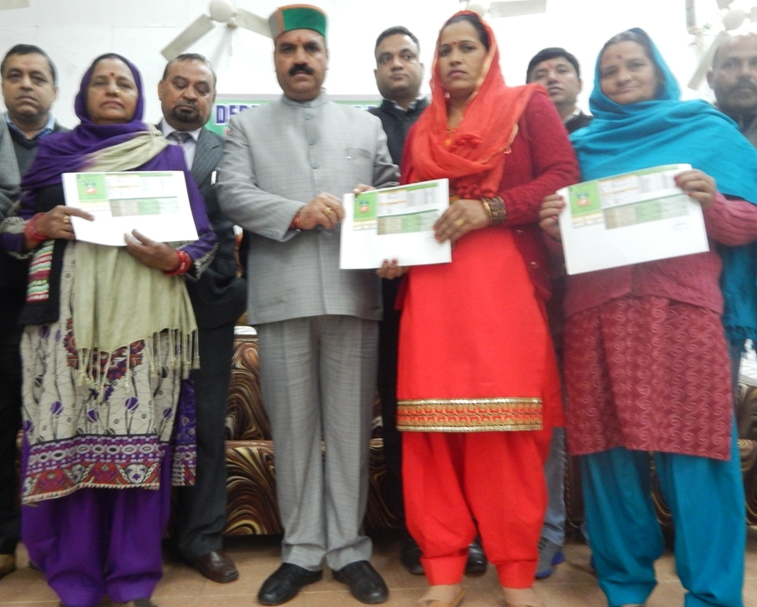
Distribution of SHCs

Slide 23
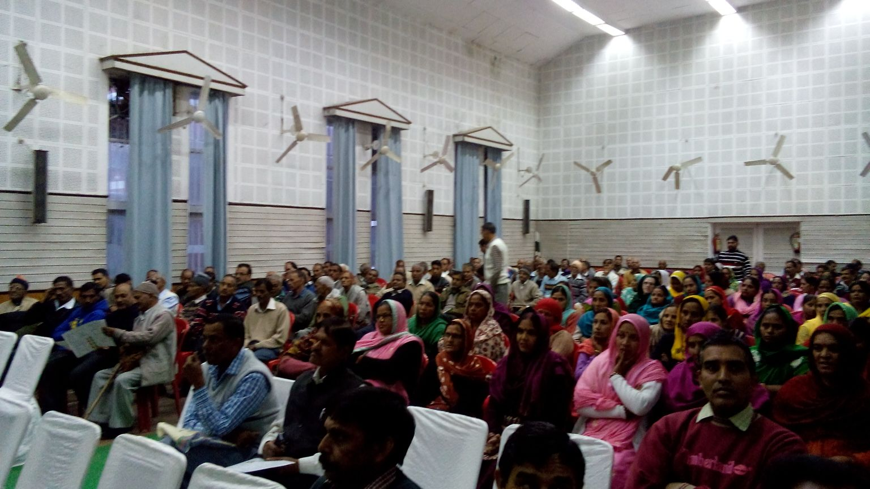

Farmer’s Participation on World Soil Day

Slide 24
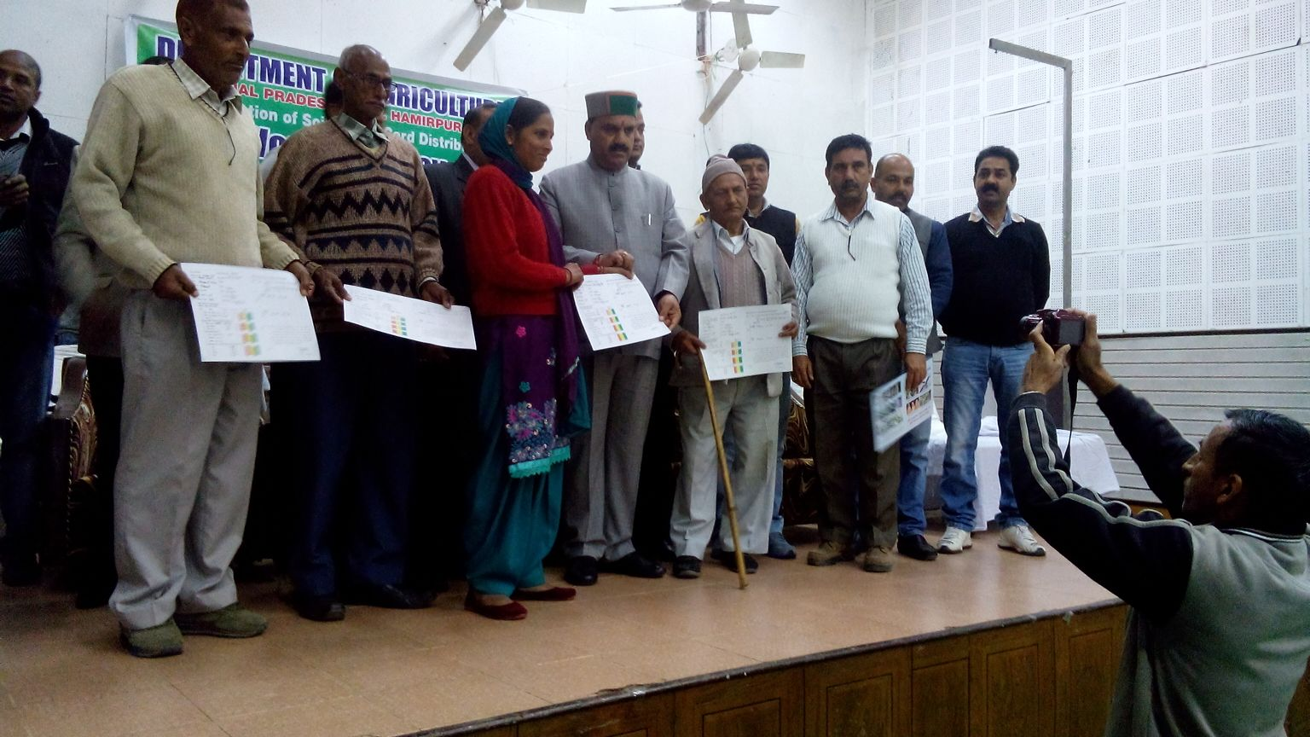
World Soil Day Celebration [Distribution of SHCs]

Slide 25
Innovative Measures for Identification of Grids & SHC Printing
The District is trying to achieve full target in the current year instead of three years.
Arranged 13 No’s GPS (2GPS/Block) for soil sample collection in entire district.
100% sample collection using GPS devices.
Procured colored printing machine along with Glossy sheets well in time.
Sensitized all the stakeholders as well as farmers through workshops and trainings.

Slide 26
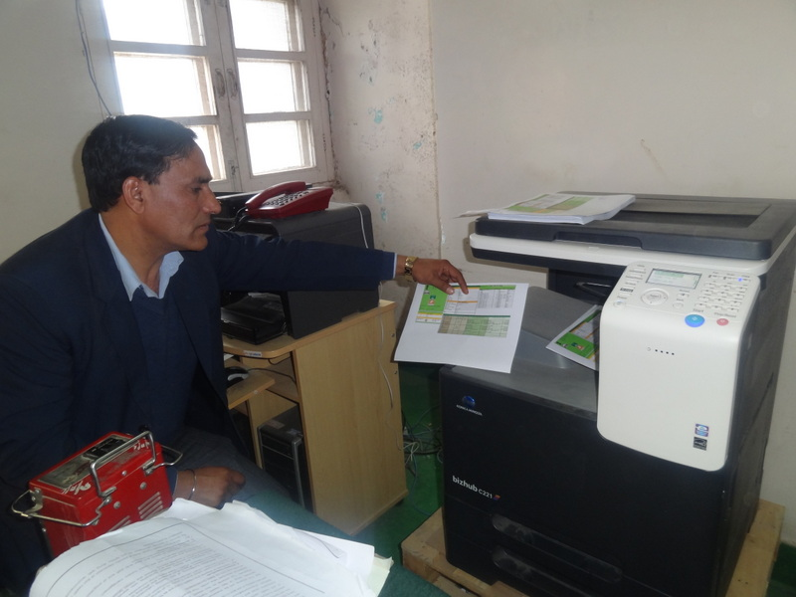
Soil Health Card - Printing

Slide 27
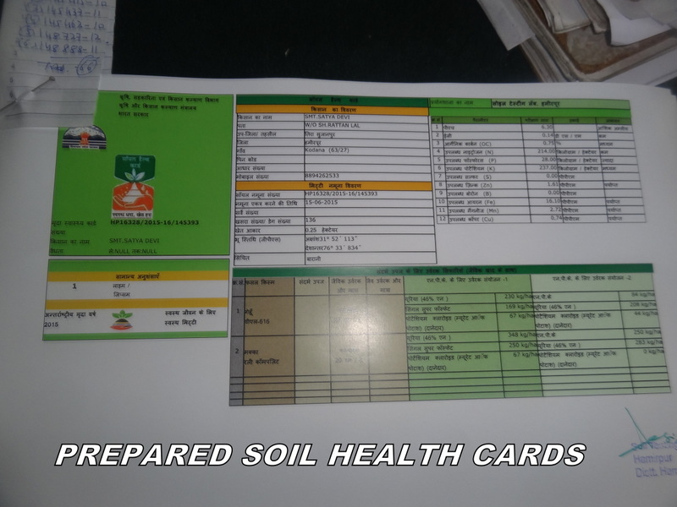
Soil Health Card

Slide 28
Scheme Outcome
Farmers are now aware about Soil Testing programme and getting reports for micro-nutrients along with major and secondary nutrients.
Farmers are aware about their soil fertility status and soil amendments if needed.
Farmers are showing interest regarding balanced fertilizations as per recommendations.
Sampling is completed in one year and district is trying to distribute SHCs by next Kharif season.
Increase in awareness among the farming community regarding importance of Soil Testing in Soil Health Management.

Slide 29
Suggestions for Improvement
Horticultural Crops (Fruit Crops) must be included for fertilizer recommendations.
For determination of Boron, the chemical carmine is not easily available, parameter should be optional.
For hilly terrain / remotest area special soil testing kits be promoted for testing major nutrients.
Units for recommendation should also be on Kanal and Bigha basis for better understanding of the farmers.
The soil testing has to be continued and after every three years fresh sampling has to be done and new SHCs to be issued so the Govt. of India support would be required.

Slide 30
Thanks….

