Slide 1
Implementation of Soil Health Card Scheme in West Tripura District for Soil test-based fertilization & farming (2015-16)
1

Slide 2
Collection of soil samples in West District
Norms :
One sample each for 2.5 ha irrigated area & 10 ha rain-fed area.
West District :
Irrigated area – 8170 ha
Rain fed area – 29,220 ha
2

Slide 3
Collection of soil samples in West Tripura District.
Contd..
Sample collection target | 1st yr. (14-15) | 2nd Yr. (15-16) | 3rd Yr. (16-17) | Total
Irrigated area (Nos.) | 900 | 1240 | 1128 | 3268
Rain fed area (Nos.) | 890 | 560 | 1472 | 2922
Total | 1790 | 1800 | 2600 | 6190
3

Slide 4
Collection of soil samples in West Tripura District
Sample collection | 1st yr. (14-15) | 2nd Yr. (15-16) | 3rd Yr. (16-17) | Total
Total target | 1790 | 1800 | 2600 | 6190
Samples actually collected (Nos.) | 2322 | 2060 | Irrigated : 1315 Rain fed :745 Total: 2060
Samples analyzed (Nos.) | 2322 | 2060
Soil Health Card distributed (Nos.) | 2322 | 2060
% against target | 130% | 114%
4

Slide 5
Resources Utilized
Physical Resources :
Static Lab : 1 ( Capacity – 10,000 samples per annum)
Mobile Lab : 1 ( Capacity – 5,000 samples per annum)
Man power :
Agri. Sub – Division Level officers – 4
Agri. Sector Officer - 12
Village Level Worker-110
KVK Scientist – 1 Total: 139 Nos.
ICAR Scientist – 1
Analyst : 4
Lab Assistant & Others : 7
5

Slide 6
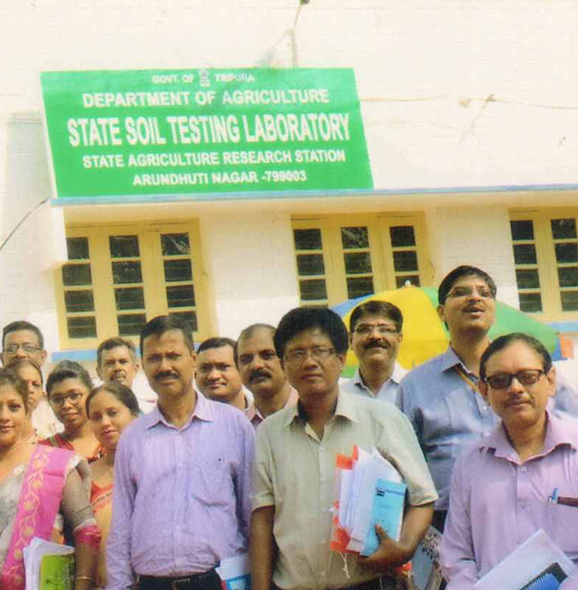
Strengthening lab equipments
Contd..
Till 2014-15, only major nutrients (NPK) were analyzed through –
OC(N) – Walkley & Black method
P – Bray & Krutz method
K – Normal Ammonium Acetate method
Flame photometer
State Soil Testing Lab
6

Slide 7
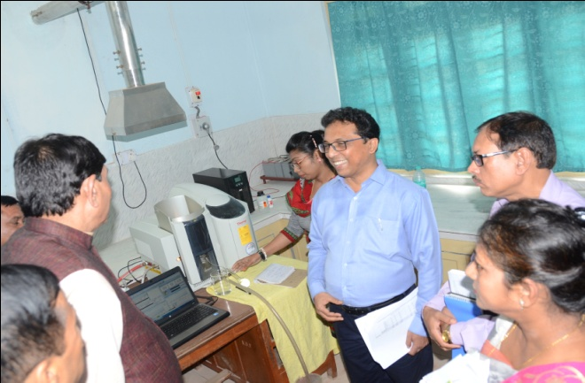
Strengthening lab equipments
Facilities (Atomic Absorption Spectro-photometer) added during 2015-16 for estimating of Micro nutrients ( B, Zn, Cu, Fe & Mn ).
Facilities for estimation of S through Inductive Couple Plasma & AAS is under process.
Atomic Absorption Spectrophotometer
7

Slide 8
Present Laboratory staff
Three qualified scientists.
One more analyst is appointed.
Seven Lab Assistants.
Further requirement :
More Farmer Friends (110 nos.) under ATMA programme are necessary for facilitating collection and distribution of SHC.
8

Slide 9
Steps taken for timely accomplishment
Time – targets
- Collection of samples :
For Kharif Crops : April – June
For Rabi Crops : Oct - Dec
Average time taken for soil sample collection, testing & handing over soil test report : maximum 14 days.
Mobile Soil Testing Van for on the spot analysis and distribution of SHC to farmers.
Necessary backstopping by the Agricultural Officers & VLWs’ at identified locations.
9

Slide 10
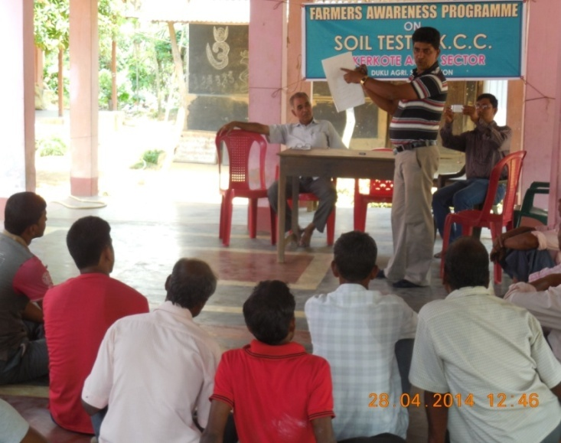
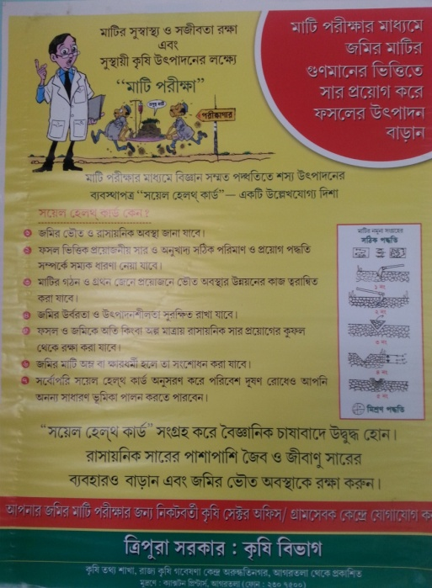

Awareness on Soil Health Management
Training and awareness camps at G.P., Agri. Sector & Block level for filed functionaries, PRI bodies and the growers.
Postering, leaflet distribution etc. to launch the programme in mission mode.
Involved Electronic & Print Media for mass communication & popularization.
10

Slide 11
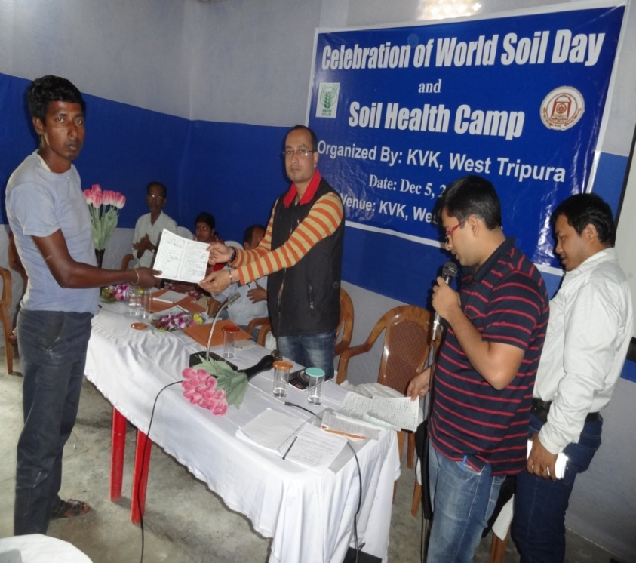
Celebration of World Soil Health Day
“World Soil Health Day” was Observed on 5th Dec. in each Agri. Sub-Division of the District to popularize the concept.
And for mass communication,
T.V Programme telecasted.
Radio Programme broadcasted.
Postering was made.
Soil Health Cards distributed
11

Slide 12
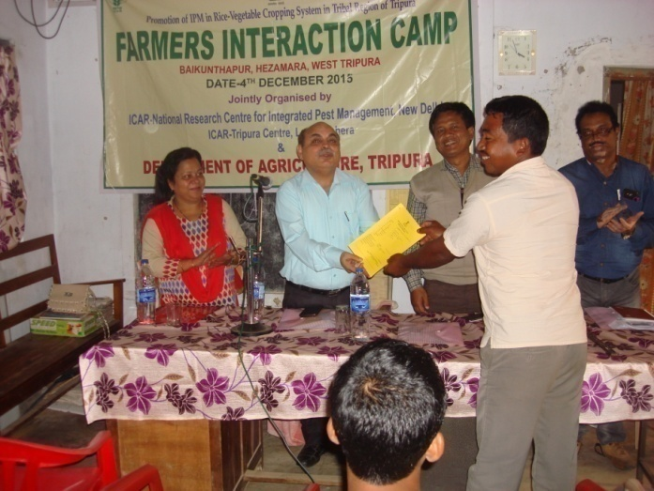
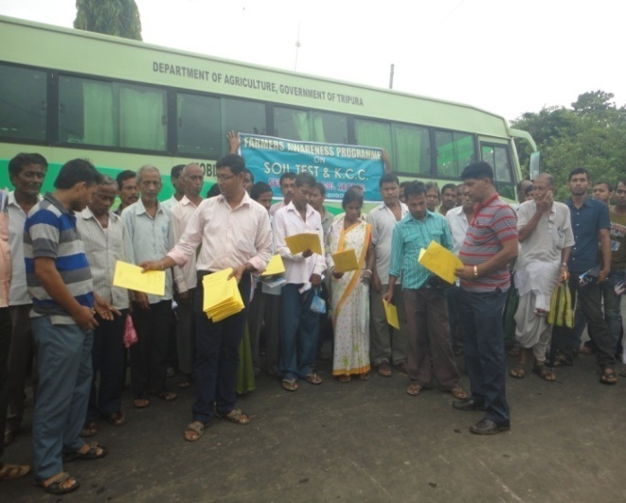
Campaign for Card distribution & educating farmers
Soil Health Cards were distributed to farmers in programmes like Krishi Mela, Vegetable Show, Farmers Forum etc.
Issuance of online Soil Health Card through Departmental Website (www. agri.tripura.gov.in).
MIS entry of soil samples, testing & distribution of Soil Health Cards in GOI portal (http://soilhealth.dac.gov.in/)
12

Slide 13
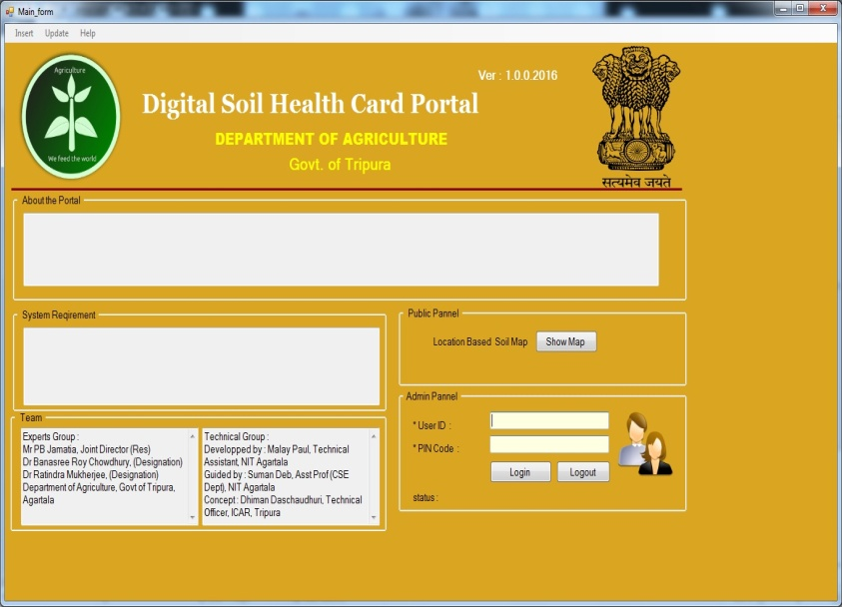
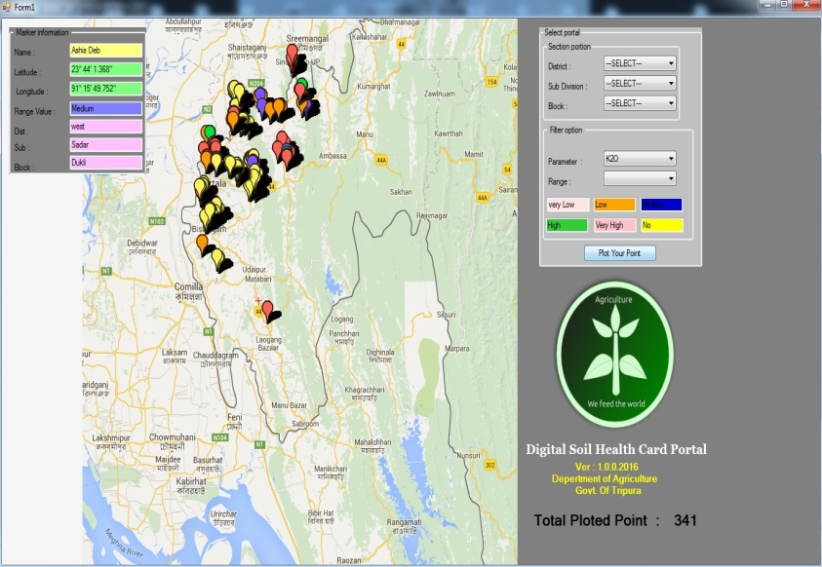
Innovative Measures
Soil Samples are collected from GPS- referred locations.
The location-wise & nutrient-wise test reports are collated in the digital map of the district.
Application of “Nutrient Manager” software is in the process for quick circulation of advisories on enhancement of the productivity.
13

Slide 14

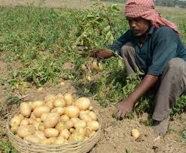
Outcome
Test based fertilization & farming :
Productivity of Kharif Rice
2013-14 | 3005 kg/ ha
2015-16 | 3120 kg / ha
Productivity of Potato
2013-14 | 16.93 MT/ ha
2015-16 | 18.20 MT/ ha
14

Slide 15
Suggestions for further Improvement
Provision for strengthening of the existing static laboratory.
Provision for procurement of GPS device may be increased.
Provision for android devices for identification of grids for sample collection, locate latitude / longitude of holdings.
Schematic fertilizer distribution may be linked with the SHC.
Training of the technical officers/ field staff on use of ICT component.
Since analyzing capacity of the district is more, target may be increased.
15

Slide 16
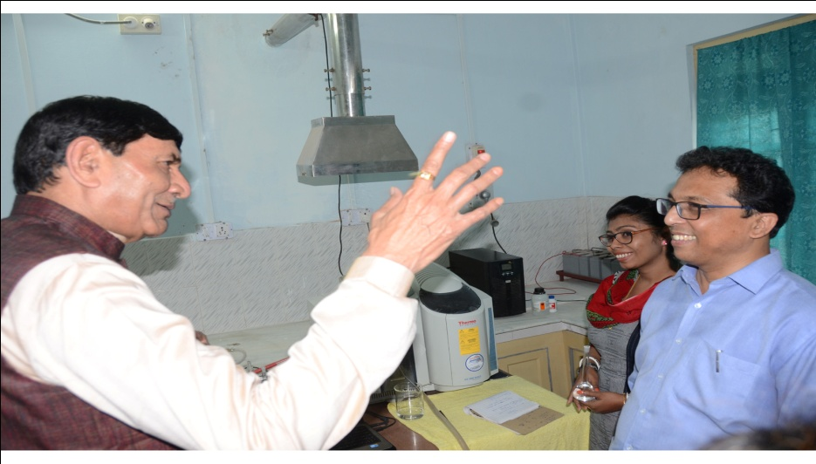
Visits of Hon’ble Union State Minister
Visit of Hon’ble Union Minister of State for Agriculture to the State Soil Testing Lab, Agartala, West District on Oct. 16, 2015.
16

Slide 17
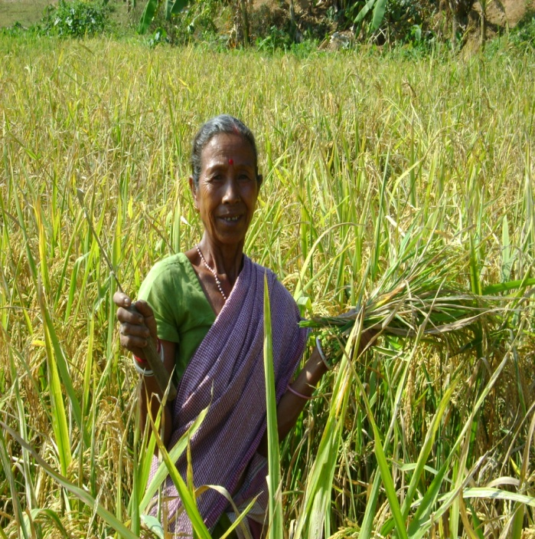
THANKS
17

