Slide 1
PERFORMANCE REPORT OF
IMPLEMENTATION OF SWACHH VIDYALAYA ABHIYAN IN LAKHIMPUR DISTRICT.
DISTRICT - LAKHIMPUR, ASSAM.
PREPARED BY
Inspector of Schools,
Lakhimpur District Circle, Lakhimpur
Cum
DPC, RMSA, Lakhimpur.
And
District Elementary Education Officer
Cum
DMC,SSA, Lakhimpur.

Slide 2
Lakhimpur district at a glance:
Lakhimpur District is situated in the North Eastern corner part of Assam., The total population of the district as per census report- 2011,is 10,42,137 and the literacy rate is about 77.20%. There are 6 Nos. Educational Block and 2 nos. sub-division. In the mean time, no educational block is identified as Educationally Backward Block (EBB). There are four types of School in the stage from Elementary to Secondary level in Lakhimpur District, they are Govt. Provincialised, Recognised and Private aided / unaided schools. There are 302 nos. Govt./ Provincialised secondary schools and 3 nos. High Madrassa and 1 (one) Sr. Madrassa School and 177 nos. class X recognized sec. There are 1825 nos. of LP School and 507 nos. of Middle Schools.

Slide 3
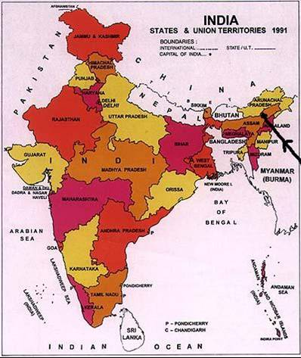
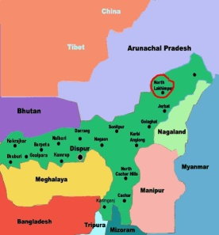
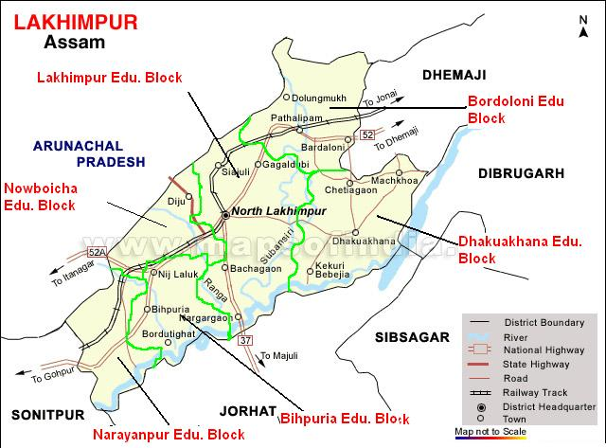
Map of Lakhimpur District
The Education Blocks (i.e. Bihpuria, Narayanpur, Nowboicha, Lakhimpur, Dhakuakhana & Bordoloni) are being separated by light green line in the map

Slide 4
GEOGRAPHY
Location | Northern Assam in Northeast India.
Distance from the state capital | 396 Km.
Total Area | 2957 Sq. km.
Rural Area | 2937 Sq. Km.
Urban Area | 20 sq. Km.
Total Forest cover | 84321.26 Hect.
Boundaries | To the North- Arunachal Pradesh. To the South-Majuli sub-division under Jorhat district. To the East -Dhemaji district and the Brahmaputra river. To the West-Sonitpur district.
Major rivers | Boginadi,Subansiri, Ranganodi, Korha, Charikoria, Champara, Dikrong,Ghagar,Singara, Kakoi, Dhal, Sumduri
Major hills | Pathali Pahar, North Arunachal Pradesh hills, Dofala Pahar, Bhanga Pahar.

Slide 5
Demographic Scenario: -
The present population of the district is 10.42 lakh as per 2011 census. Out of which the female population is 5.12 lakh and 5.29 lakh male. It means 49.17% female and 50.82% are male respectively. The growth rate of population on 2001-2011 is 17.22 %.
Name of District | Population: 2011 |  |  | Sex Ratio (per 1000) | Population Density per Sq. KM
 | Total | Male | Female
Lakhimpur | 10,42,137 | 5,29,674 | 5,12,463 | 968 | 458
Source: Census Report’ 2011.

Slide 6
Literacy rate: -
Total literacy rate of the district is 77.20% as per 2011 census out of which the female literacy is 70.67% and 83.52% male.
Table:
Name of District/ State` | Persons (%) | Male (%) | Female (%)
Lakhimpur | 77.20 | 83.52 | 70.67
Assam | 72.19 | 77.85 | 66.27
India | 74.04 | 82.10 | 65.50
Source: Census Report’ 2011.

Slide 7
Comparison of Literacy Rate of Lakhimpur with respect to State and Nation
The above table shows that the Literacy rate of Lakhimpur District 77.20% is higher than the literacy rate of the State (72.19%) as well as Nation 74.04%).

Slide 8
General Information | Numbers
LACs | 4
Member of Assembly Constituencies | 4
Sub Division | 2
Circle | 7
Anchalik Parishad | 9
Educational Block | 6
Rural Blocks | 6
Urban Blocks | 0
Community Development Blocks | 9
Town | 4
Gaon Panchayat | 81
Ward | 26
Cluster | 165
Tea Garden | 11
Tea Garden Division | 15
Village | 1009
Habitation | 3514

Slide 9
Educational Institutions
1 | Universities | Nil
2 | Medical College | Nil
3 | Engineering college | Nil
4 | Degree College(having XI & XII) | 11
5 | Provincialised Junior College | 6
6 | Permitted Junior College | 15
7 | Govt. HSS School | 1
8 | Provincialised HSS School | 33
9 | Provincialised Sr. Madrassa | 2
10 | Provincialised Sanskrit Tol | 3
11 | Provincialised High School | 263
12 | Recognized High school | 44
13 | J.N.V School | 1
14 | Central School | 1
15 | Polytechnic | Nil
16 | ITI | 1
17 | B. Ed College | 1 (Private)
18 | Law College | 1

Slide 10
19 | DIET | 1
20 | BTC | 1
21 | Normal school | 1
22 | Middle School | 507
23 | Primary School | 1825
24 | ICDS centre | 9
25 | Any other Institutions | NA
Other Institution
1 | Police Station | 6
2 | Police Out post | 4
3 | Civil Hospital | 1
4 | 30 beded Hospitals | 5
5 | State Dispensaries | 5
6 | Primary Health Centre | 23
7 | Community Health Centre | 5
8 | Health sub Centre | 183
9 | Fire Brigade | 2 (One Adhoc)

Slide 11
Scenario of Lakhimpur District before Swachh Vidyalaya Abhiyan in respect of Toilet.
(A) In Secondary level
(as per U-DISE data 2014-15. before Swachh Vidyalaya Abhiyan)
Sl no. | Description.
1 | Total No of School. | 302
2 | Total No of School having Permanent Boys Toilet. | 58
3 | Total No of School having Permanent Girls Toilet. | 48
4 | Total No of School having no Boys Toilet. | 244
5 | Total No of School having no Girls Toilet. | 254

Slide 12
(B) In Elementary level.
(As per U-DISE data 2014-15. before Swachh Vidyalaya Abhiyan)
Sl no. | Description.
1 | Total No of School. | 2332
2 | Total No of School having Permanent Boys Toilet. | 865
3 | Total No of School having Permanent Girls Toilet. | 1816
4 | Total No of School having no Boys Toilet. | 1467
5 | Total No of School having no Girls Toilet. | 516

Slide 13
Allocation of Toilets under Swachh Vidyalaya: SSA,RMSA and PSU.
SL. NO | NAME | CATEGORY | School/college cover | TARGET |  |  | TARGET COMPLETE |  |  | % of Complete
 |  |  |  | Boys | Girls | Total | Boys | Girls | Total
1 | RMSA | HS/HSS | 116 | 102 | 42 | 144 | 102 | 42 | 144 | 100%
2 | SSA | LP/UP | 608 | 102 | 491 | 593 | 102 | 491 | 593 | 100%
3 | NHPC | LP/UP/HS/ HSS | 1415 | 1393 | 94 | 1487 | 1393 | 94 | 1487 | 100%
4 | NEEPCO | LP/UP/HS/ HSS | 33 | 30 | 13 | 43 | 30 | 13 | 43 | 100%
5 | AAI | LP/UP/HS/HSS | 44 | 43 | 6 | 49 | 43 | 6 | 49 | 100%
6 | EIL | Jr./Sr. College | 10 | 10 | 10 | 20 | 10 | 10 | 20 | 100%
7 | Petronet LNG Ltd. | HS | 1 |  | 1 | 1 |  | 1 | 1 | 100%

Slide 14
Status Secondary level. after implementation of Swachh Vidylaya Abhiyan
Sl no. | Description.
1 | Total No of School. | 302
2 | Total No of School having Temporary Toilet (Boys & Girls) | 91
3 | Total No of School having Permanent Toilet(Boys & Girls) | 211
Status Elementary level after implementation of Swachh Vidyalaya Abhiyan
Sl no. | Description.
1 | Total No of School. | 2332
2 | Total No of School having Permanent Toilet. (Boys & Girls) | 2310
3 | Total No of School having Temporary Toilet (Boys & Girls) | 22

Slide 15
1.1. Innovative monitoring mechanism to ensure timely completion and quality of construction.
☞ For 100% completion of the programme following steps are taken in strict manner.
 Continuous Supervision and Monitoring of Inspector of Schools, District Elementary Education Officers, RMSA and SSA officials along with the officials of Inspector of schools L.D.C., North Lakhimpur.
 The NHPC officials had been monitoring the construction where constructed by self.
 One Day orientation programme was held of RMSA officials and officials of Inspector of Schools about the programme, Budget, Drawing and Estimate for monitor in better way.

Slide 16
1.2. Who actually constructed the toilets ?
All are constructed by the School Management and Development Committees (SMDC) in Secondary level and by the School Management Committees (SMC) in Elementary level with the participation of Community.
1.3. Timely / before time construction.
Construction completed on time.
1.4. System Improvements for maintenance and cleanliness.
☞ Maintenance of Toilets (Cleanliness Drive)
Running water and cleanliness materials are provided and one Nodal Teacher is engaged for improvement of maintenance and cleanliness drive.
All Head of the institutions are instructed to aware the students for Cleanliness Drive.

Slide 17
An Innovative programme also implemented simultaneously as per instruction of the Sri Debeswar Malakar, Deputy Commissioner, Lakhimpur and Sri Naba Kr. Dutta, Planning and Statistical Officer of office of the Inspector of Schools, L.D.C.,North-Lakhimpur in the name of “PARICHANNA PARIBESH ACHANI”.
1.5. Community participation in construction and maintenance.
SMDCs and SMCs are aware about the construction of toilet and requested to involve for monitoring and decisions are taken with the participation of same.
1.6. Efforts for behavioural change through cleanliness and awareness campaigns in schools/ community.
In the Morning assembly all students are aware by the Head of the Institutions and teachers.

Slide 18
7. Impact on attendance of students, specially girls.
☞ All students are attended in cleanliness drive.
8. Local policy interventions/ use of flexibility to facilitate implementation innovations in implementation.
☞ The plinth height of newly constructed toilets are raised upto 0.90 meter specially in flood porn area.
1.9. Innovations in implementation.
☞ Though the tiles was not included in Plan and Estimate, Tiles are provided in all Toilets as per instruction of the Inspector of Schools cum DPC, RMSA, Lakhimpur.

Slide 19
10. Three significant positive things that helped the district achieve out outcomes.
The Significant positive things which help to complete the work in time is stated follows.-
a) SMDCs and SMCs.
b) Timely release of fund.
c) Continuous monitoring of officials.
11. What improvements would you suggest ?
Works should be done in proper way and in group order and in mission mode..

Slide 20
2.2. Brining participation improvements in system/ institutions for achieving the Scheme goals.
The Head of the Institutions have taken responsibilities for improvement the system/ institution for achievement of the goals.
2.3. Making public delivery system efficient and corruption free.
The SMDCs and SMCs have submitted the utilization certificate with the approval of same and verified by the concerned authority.
2.4.Innovation & adaption
The fund is released in installment basis one as advance and another after submission of Utilisation Certificate.

Slide 21
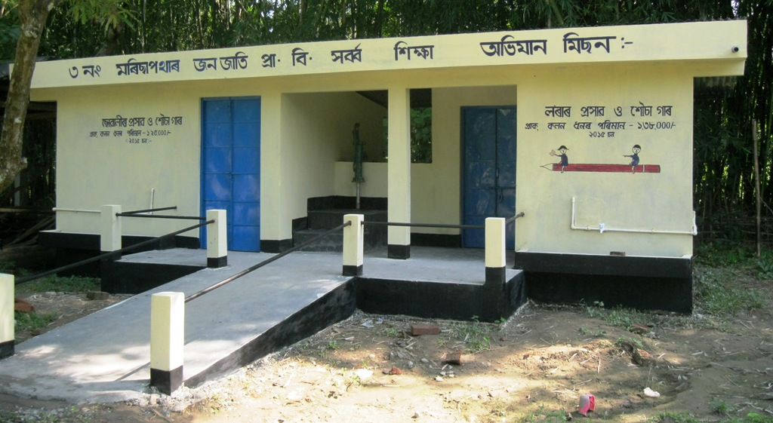
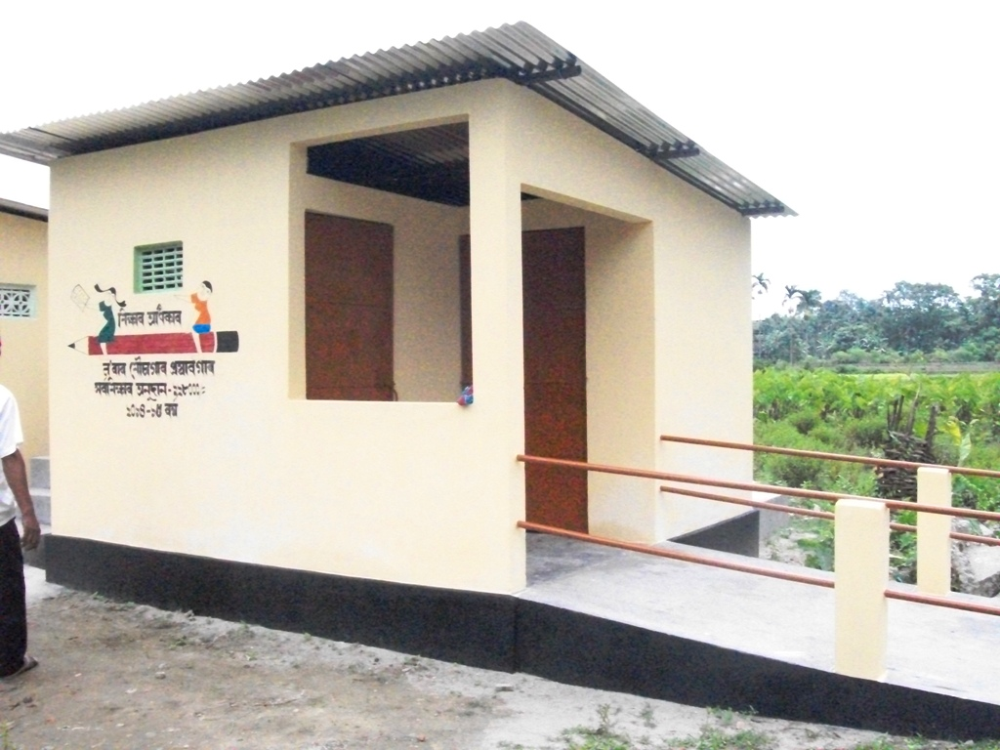
Photographs of Toilets
3 No Moricha Pather Janajati LPS
Bihpuria
DISE Code 18120103901
Pub-Phulbari Girls MES
Nowboicha Block
DISE Code 18120613704

Slide 22
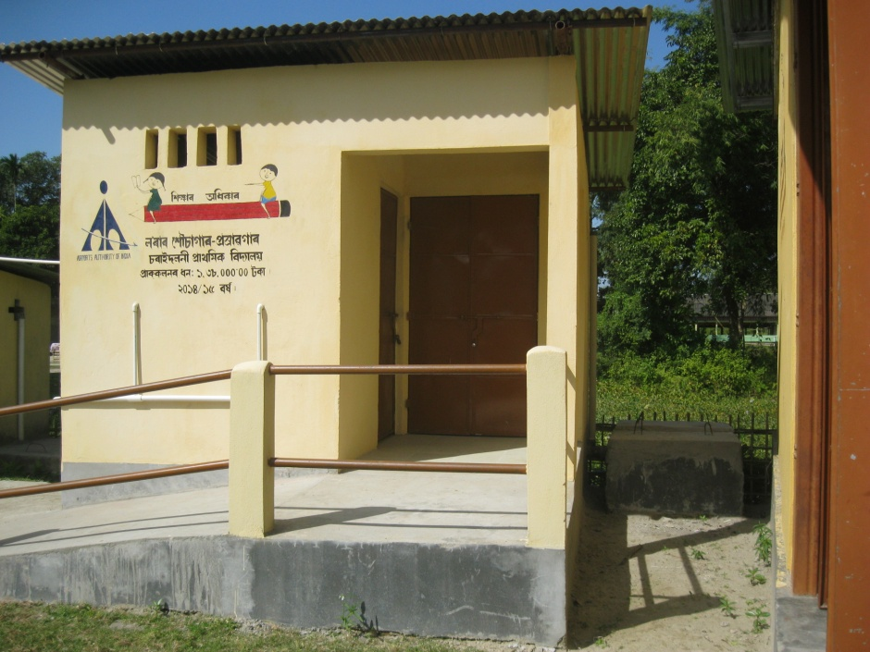
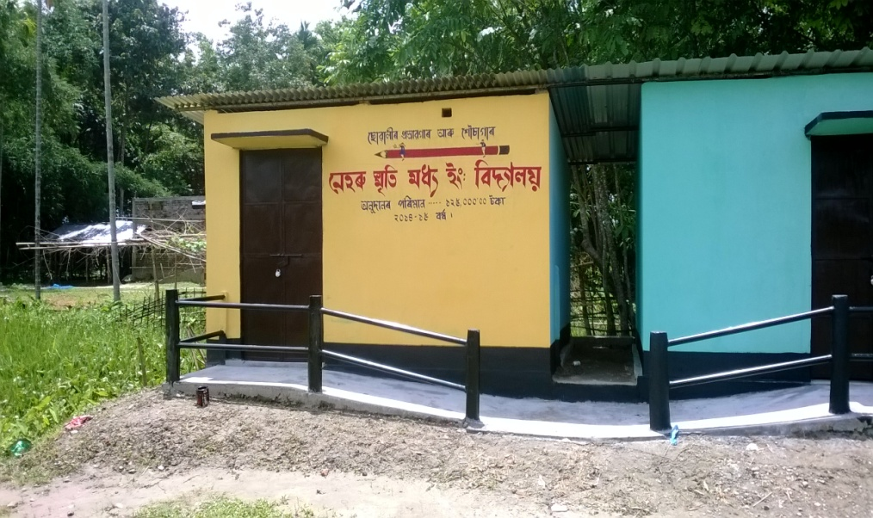
Charaidoloni LPS
Narayanpur Block
DISE Code 18120509402
Neheru Smrity MES
Nowboicha Block
DISE Code 18120604903

Slide 23
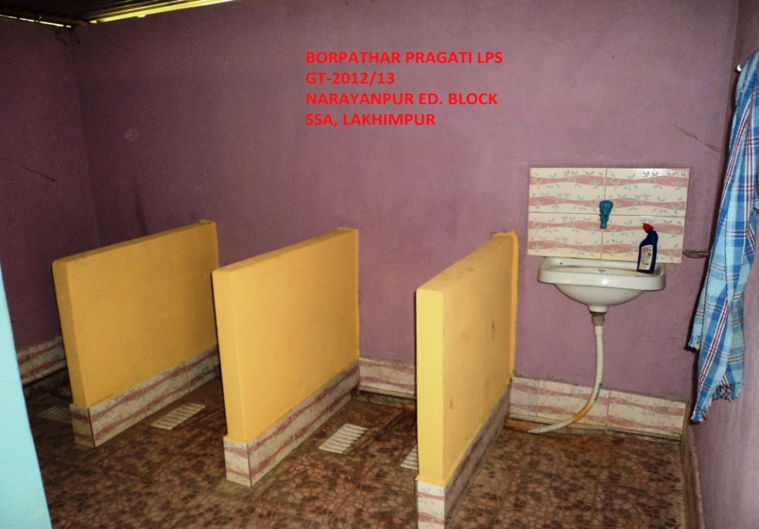
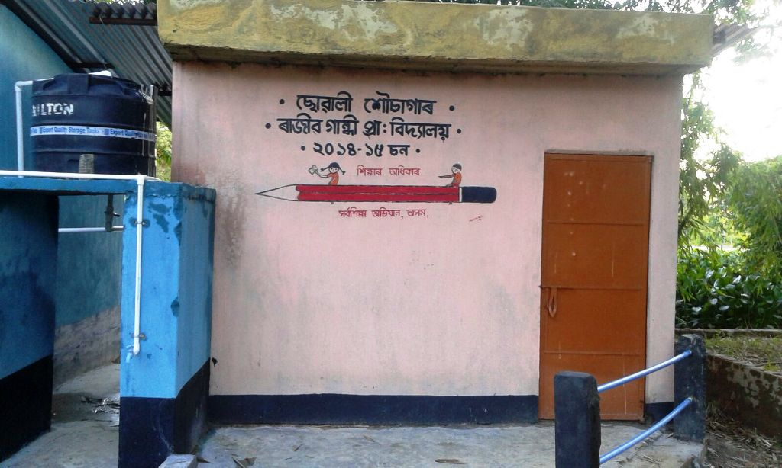
Borpathar Pragati LPS
Narayanpur Block
DISE Code 18120513502
Rajib Gandhi LPS
Bihpuria Block
DISE Code: 18120112412

Slide 24
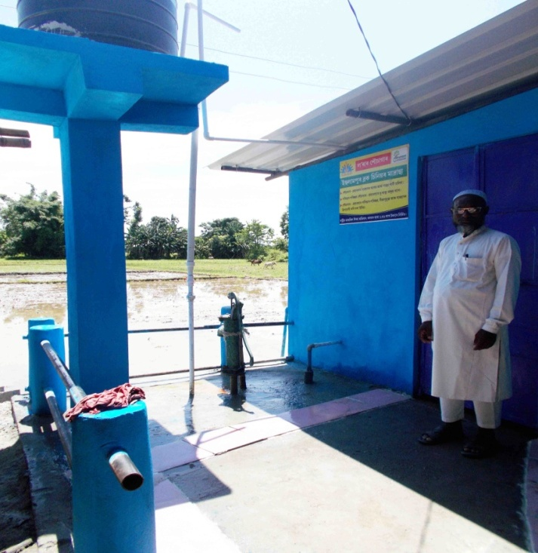
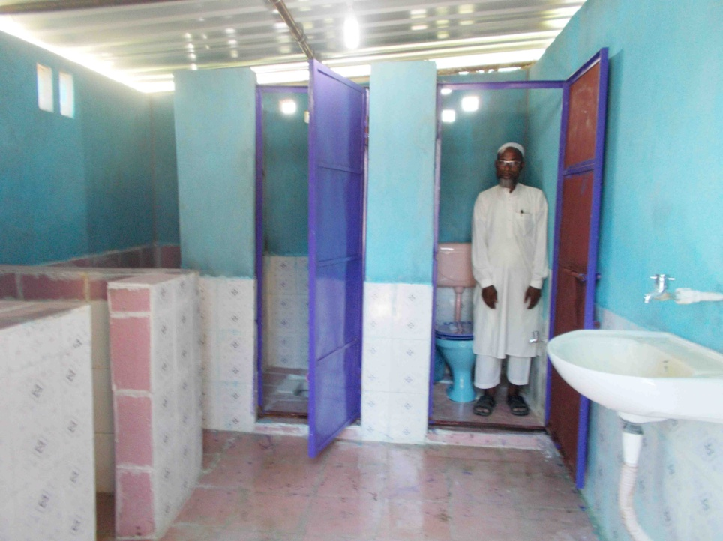
Islampur Block Sr. Madrassa, Bihpuria Block
DISE Code 18120115702
Inside of Islampur Block Sr. Madrassa, Bihpuria Block
DISE Code 18120115702

Slide 25
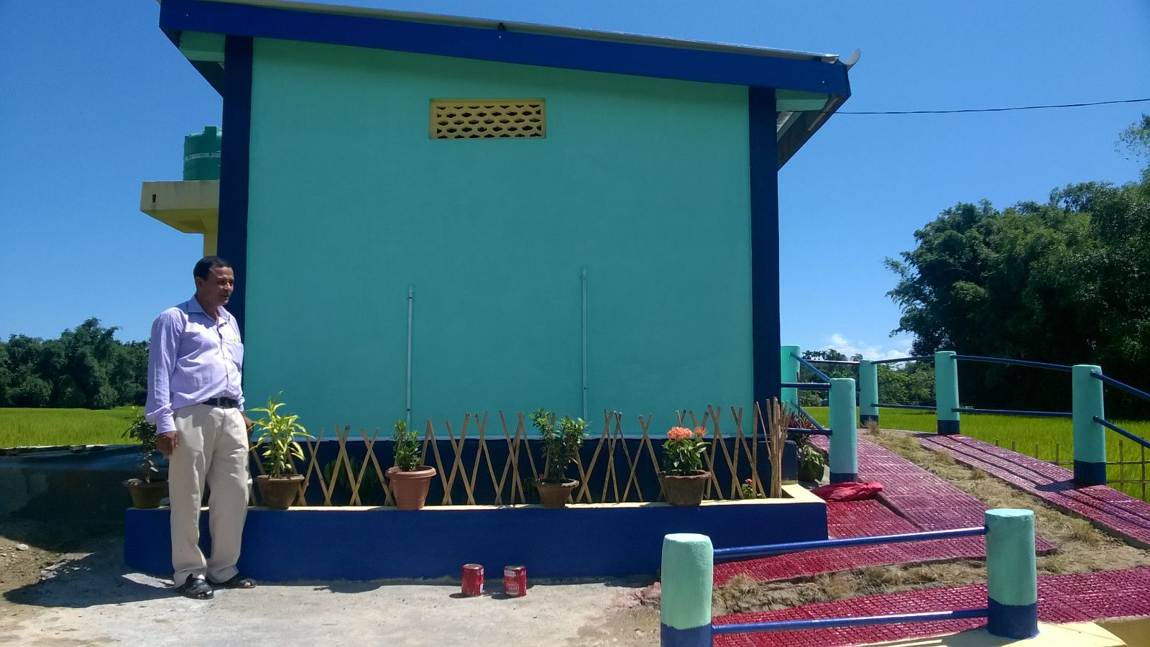
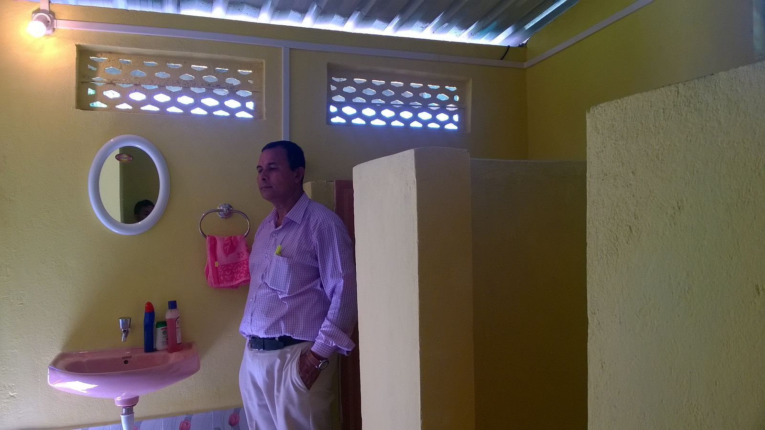
Bijoypur High School toilet, Narayanpur Block
DISE Code 18120503105
Inside of Bijoypur High School toilet,
Narayanpur Block
DISE Code 18120503105

Slide 26
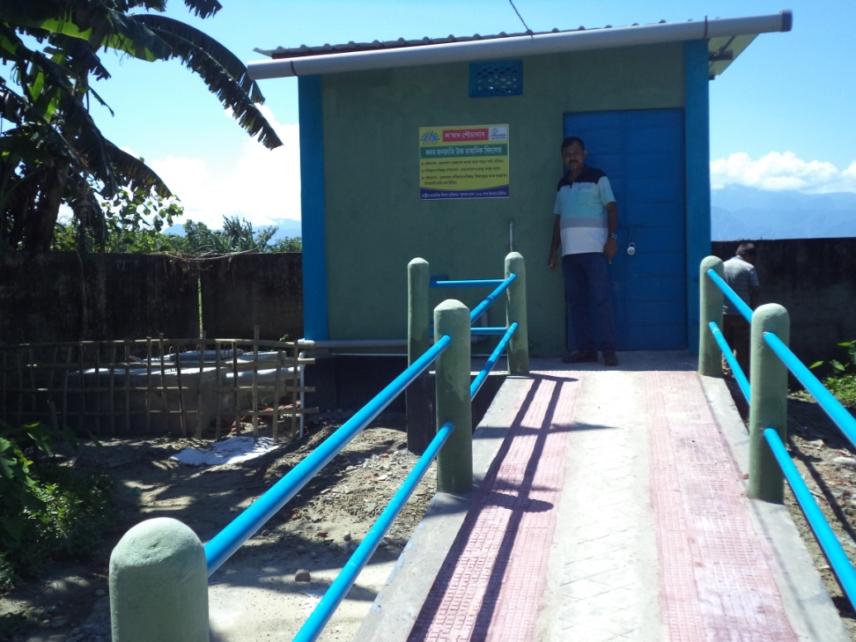
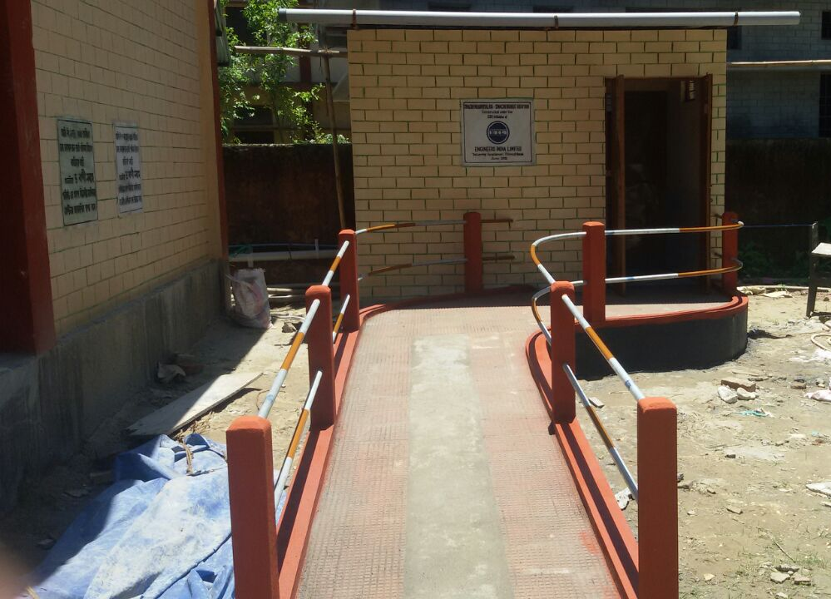
Kadam Janajati High School
Lakhimpur Block
DISE Code 18120411306
Panigaon OPD College
Nowboicha Block
DISE Code 18120612505

Slide 27
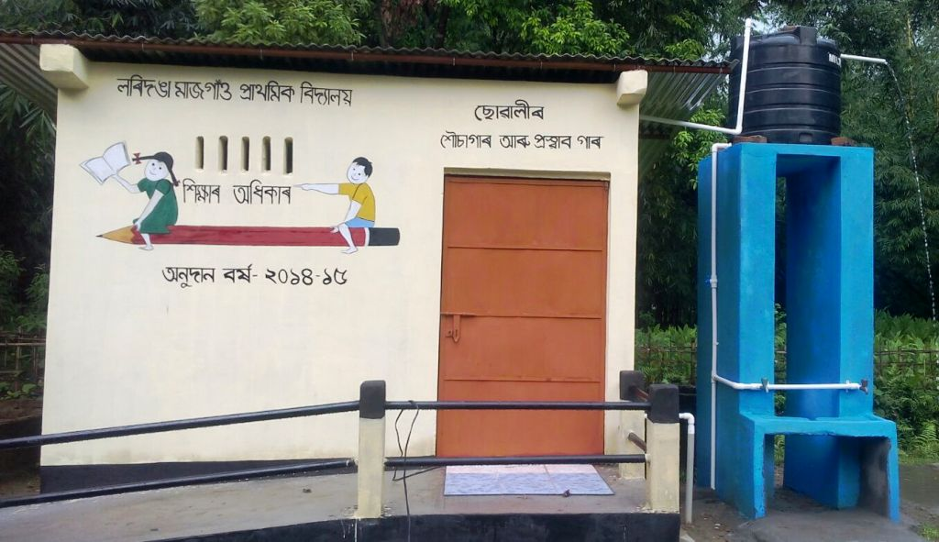
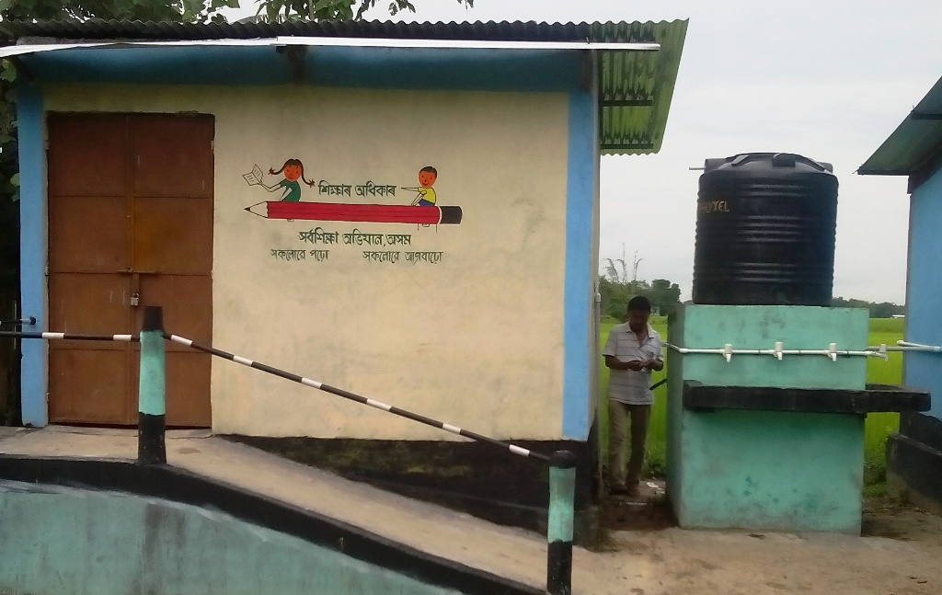
Loridinga Majgaon LPS
Bihpuria Block
DISE Code 18120108103
Pohumora Chungapara Milon MES
Nowboicha Block
DISE Code: 18120612401

Slide 28
Different Steps taken by the Administration:
For 100% completion of the programme following steps are taken in strict manner.
 One day Block level orientation programme with the head of the Institutions about the programme and for discussion about the plan and estimate.
 Transfer of fund to the concern SMDC’s.
 Instruction to all the Head of the institutions to organized the SMDC meeting and fix the date of starting and Ending.
One Day orientation of RMSA officials and officials of Inspector of Schools about the programme, Budget, Drawing and Estimate.
Continuous Supervision and Monitoring of Inspector of Schools, District Elementary Education Officers, RMSA and SSA officials along with the officials of Inspector of schools L.D.C., North-Lakhimpur.

Slide 29
 The NHPC officials had been monitoring the construction
Inspector of Schools cum DPC, RMSA,Lakhimpur has created a whats app group for day to day progress report.

Slide 30
THANK YOU

