Slide 1

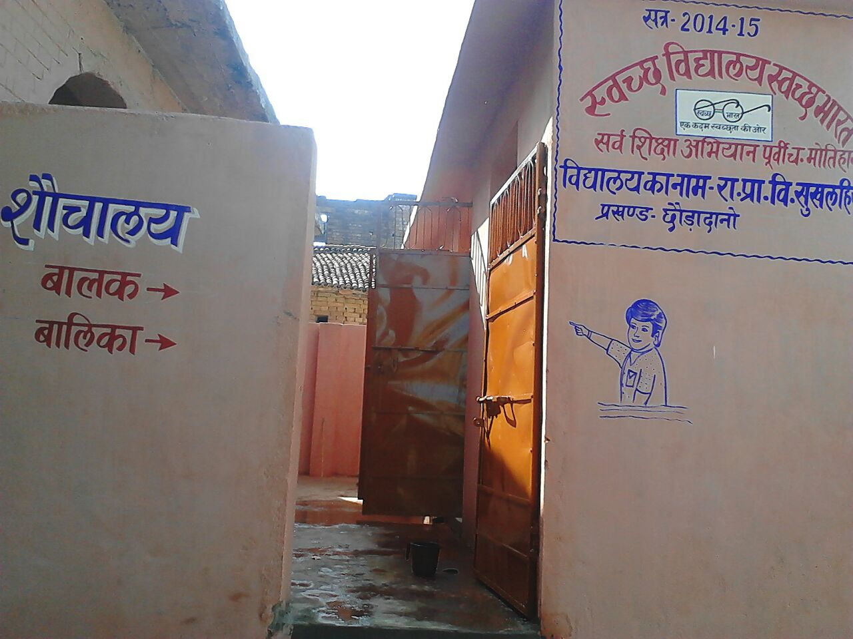
EXECUTION , IMPLEMENTATION & SUSTENABILITY
Anupam Kumar, IAS (2003)
District Magistrate
–cum –
Collector,
East Champaran, Bihar

Slide 2
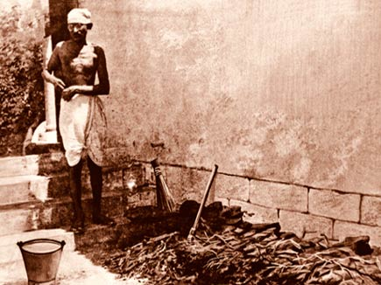
“Sanitation is more important than independence”.
“Champaran being the land of beginning of the great movement called “Satyagrah” of Mahatma Gandhi, deserves to fulfil his dream of Sanitation about which he used to say……
and against this backdrop we felt proud to be a part of National priority program “Swachh Bharat, Swachh Vidyalaya Abhiyan” ensuring a basic right of children and took the challenge of construction of toilets in all primary and middle schools of the district.

Slide 3
District Statistics
Total Population | Total Schools | Total Enrolment | Boys | Girls
5099371 | 3306 | 1112319 | 557202 | 555117

Slide 4
Status of Toilets
Agency | Target (2014-15) (Units) |  |  | Constructed |  | Already available
 | Total | Boys | Girls | Boys | Girls
SSA | 2707 | 1380 | 1327 | 793 | 744 | 1170
ONGC | 147 | 85 | 62 | 85 | 62 | 0
Mahindra Group | 3 | 2 | 1 | 2 | 1 | 0
HPCL | 269 | 145 | 124 | 145 | 124 | 0
Total | 3126 | 1612 | 1514 | 1025 | 931 | 1170
Toilets already available in rest of the schools

Slide 5
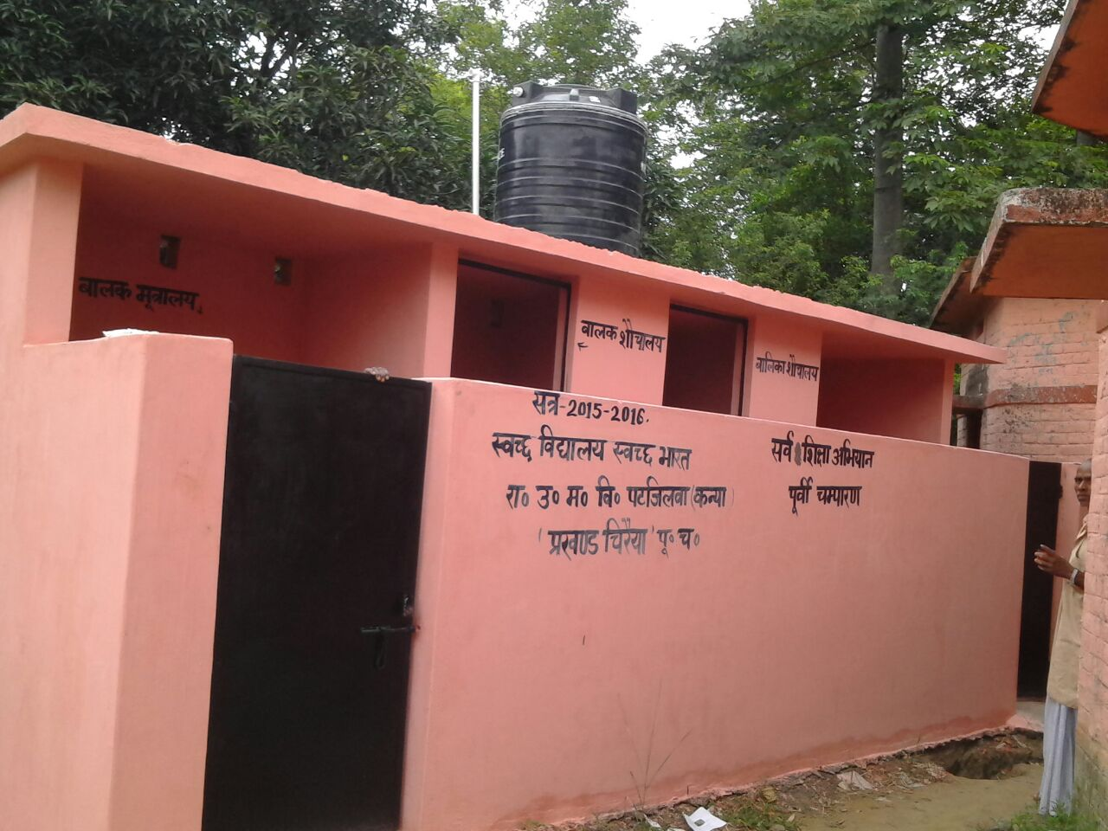
MISSION
With the huge target of 3126 toilets in 2736 primary & middle schools of the district in 2014-15, the task was completed within the time frame primarily due to decentralisation, community participation and effective monitoring with the help of technology.
Implementation through “Vidyalaya Siksha Samiti” was the hallmark of the programme as the PSUs involved in the implementation could achieve only 13.4% of the target.

Slide 6

Challenges
Enormity of target as the district being the largest in the state
Time constraint to meet the target
Accessibility problem in far-flung areas with respect to transportation and effective monitoring
Selection of implementing agency
Shortage of technical staff
Timely transfer of funds & its utilization
Weather conditions and other engagements

Slide 7

Journey started
Selection of VSS (Vidyalaya Siksha Samiti) as implementing agency
Transfer of funds ( Rs 1.57 Lacs per VSS) to the VSS through RTGS
Formation of three layer monitoring mechanism including a district control room
Organising awareness campaigns at school level
Training to VSS and Masons

Slide 8

Monitoring Mechanism
Department Level Monitoring Team
District Level Monitoring Team
District Control Room
Site visit by Senior officers
Vidyalaya Siksha Samiti (VSS)
BEO, BRC & CRC

Slide 9
Monitoring Approaches
Structural
Motivational
Functional

Slide 10

Monitoring Mechanism & Approaches
A three pronged approach to build an effective networking mechanism to successfully achieve the goal.
Structural:-With department’s support and monitoring through Video Conferencing at the top level, day to day monitoring was ensured at three levels
District level with the help of a district control room directly under the supervision of district collector
Field level through site visit by the senior officers of the District, Blocks and CRCs
School level through V.S.S. and other community organization like Gram Panchayats etc.

Slide 11
Monitoring Mechanism & Approaches….
Functional:-
With the help of technical wing of SSA technical aspects of quality construction and proper book keeping were ensured.
Motivational:
An innovative system of “Each Monitoring the Others’ Progress” was introduced by inducing a competitive environment and creating “Whatsapp” groups to upload the photos of stages of construction.

Slide 12

Implementing agency
PSU
VSS
100%
Achivment
Only 13.4% of the target was achieved by PSUs in last one year.
PSU’s unfinished task of construction of toilets in remaining toilet-less schools achieved by decentralising the entire process and selection of “Vidyalaya Siksha Samiti” consisting of the guardians of the children studying in the school as implementing agency paving the way to achieve 100% task before the stipulated time.

Slide 13

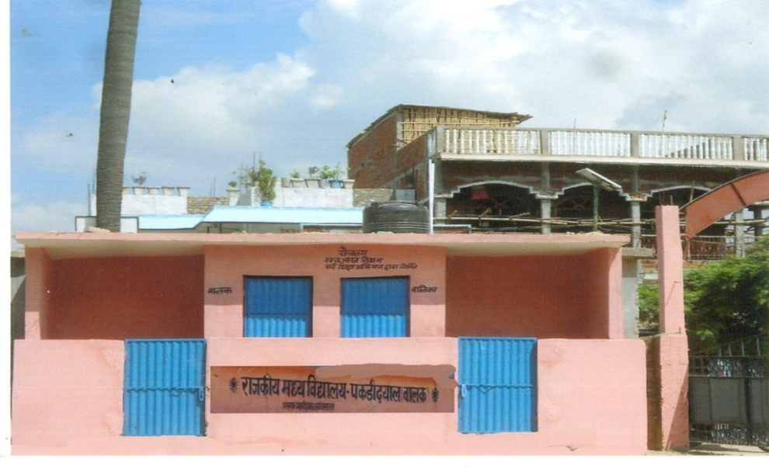
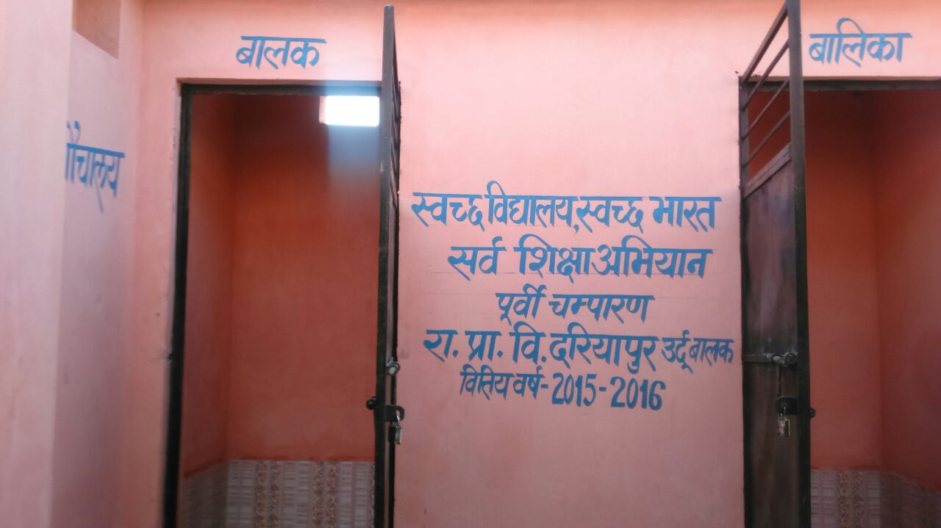
Timely Completion
Decentralised approach in selection of implementing agency meant simultaneous work at all schools and as a result 100% target was achieved within the given time frame.

Slide 14
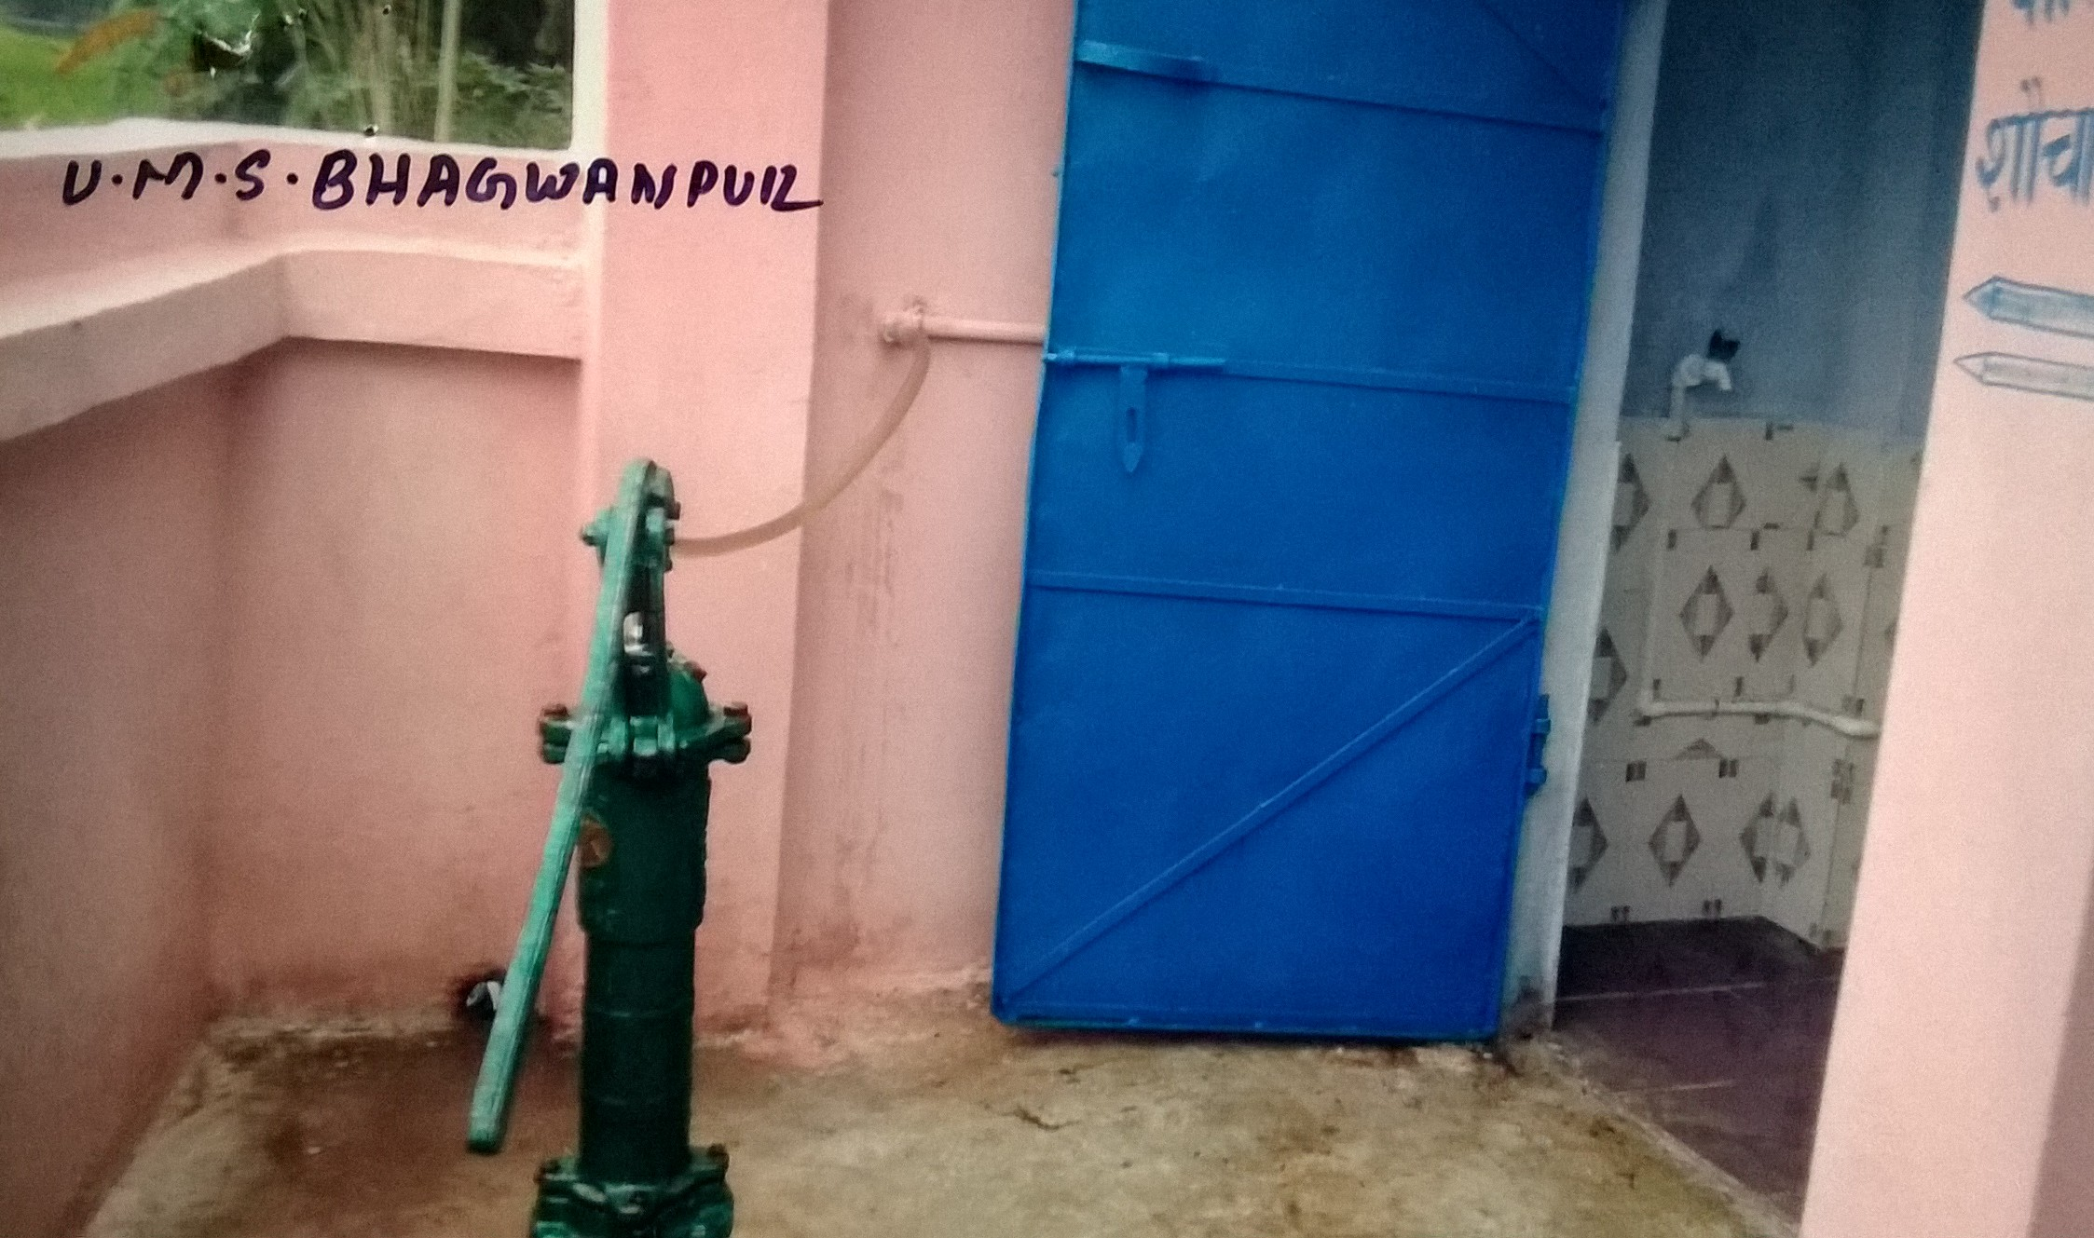
System improvements for maintenance & cleanliness
All stake holders were involved to improve the system. PHED’s technical staff was also instructed to regularly visit the schools and to ensure continuous working of hand-pumps.
VSS was instructed to do minor repairs as and when required through school development grants.
“Bal Sansad” along with class teachers were made responsible to ensure cleanliness.
Water tanks atop of the toilets were installed and with the help of the technology of “Manually Operated Pressure Pumps” supply of water to the tanks was ensured through hand pumps.

Slide 15

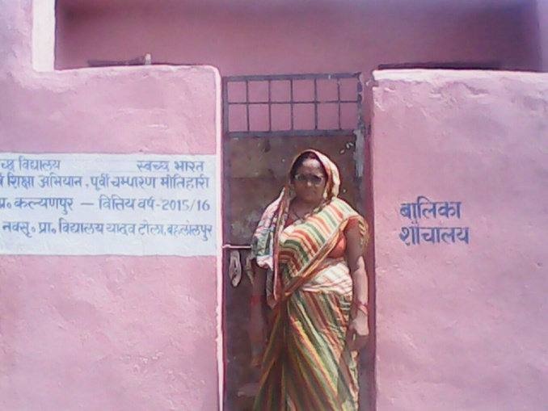
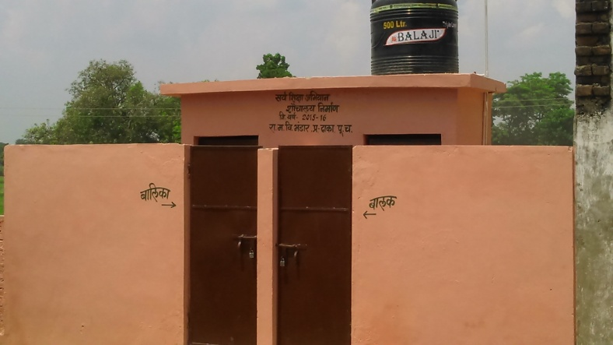
Community participation
As a matter of fact, the entire construction work was done by the VSS, a duly elected community organisation of parents/guardians of the children.
Apart from this “Gram Panchayats” were also involved for proper monitoring the scheme implementation as well as to ensure maintenance of previously constructed toilets and hand pumps.

Slide 16

Effecting Behavioural Change
Apart from the other steps, special efforts were made to change the behavioural pattern of the children in particular and the people in general.
Organizing special classes on cleanliness
Hand washing was made compulsory before serving and having midday meal and after returning from toilets.
Weakly seminar (Swachhta Goshthi) and debates being organised in every school involving community also.
Organizing prabhat pheris in the catchment areas of the school to create awareness among people.
Awareness campaign through wall writing, posters and nukkad nataks( Street Drama) has been launched
Littering here and there by the children has been discouraged

Slide 17
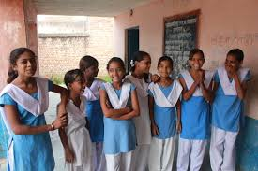
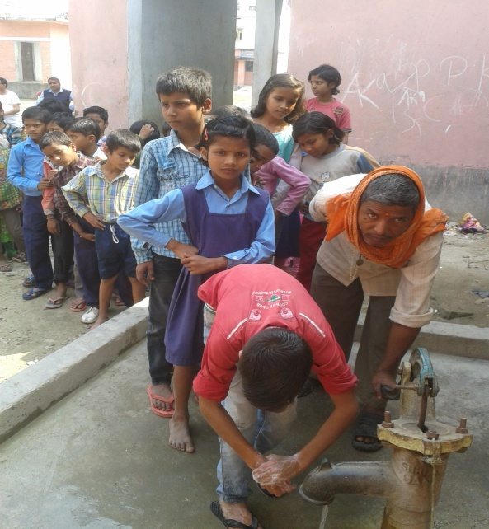
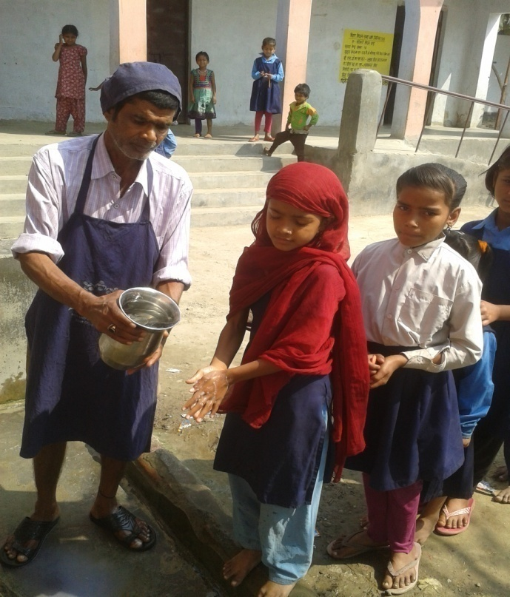
Impact
All these efforts resulted in qualitative improvement in attendance of students specially girls
Previously many girls used to leave the school after interval only to meet the call of nature more over during menstrual periods they could not attend the classes due to lack of separate arrangements to meet their needs. Now they not only attend the school daily but also remain in the schools through out the day.

Slide 18

Local policy intervention/Use of flexibility
The credit of success story of the scheme goes to mainly the involvement of the VSS comprising 22 members, a duly registered community organization.
They were given sufficient flexibility to construct the toilets as per local needs and availability of local masonry people and materials with technical support of SSA technical staff.
Facilitating grass root level decision making.

Slide 19

Innovations in Implementation
Dissemination of new innovative ideas and technology was the key point of whole “Abhiyan”. Such as
Decentralisation of implementing agencies
Community participation in implementation, monitoring and maintenance
Inducing competition amongst the “Siksha Samitis” to excel.
Use of social media like “Whatsapp” etc. in monitoring the scheme.
Awareness campaigns
Making the children both the “Tools and Targets” of the scheme.

Slide 20

Three significant positive things that helped
Active departmental support
Community participation (VSS)
Use of technology, specially in fund transfer and monitoring

Slide 21

Suggested improvements
Ensuring continuous running water and power supply to the schools by using solar energy.
Provision of hand washing infrastructure
“Divyang” friendly toilets are also required
Provision of automated flushing
Effective use of solid waste and waste water management technologies
Provision of attendant for kids

Slide 22

Ensuring Sustainability (Strategy for future)
Cleanliness being a daily and ongoing affair, it requires continuous monitoring and motivation to make it a habit. To ensure this we are planning to : -
Educate the parents through monthly parents meet.
To ensure regular maintenance through dedicated teams of technical and supervisory staff of SSA. Gram Panchayats to be actively involved and made responsible.
Monthly felicitation ceremonies for best performing “Bal Sansad” and school administration including VSS at CRC level, Block Level and District Level.
As a holistic approach development of entire school campus with plantation, lighting and use of waste water for irrigation of the plants
Using community support and CSR funds of Banks and PSUs for providing water purifiers and washbasins
Special Swachhta Award on Gandhi Jayanti to the best performing VSS

Slide 23


