Slide 1
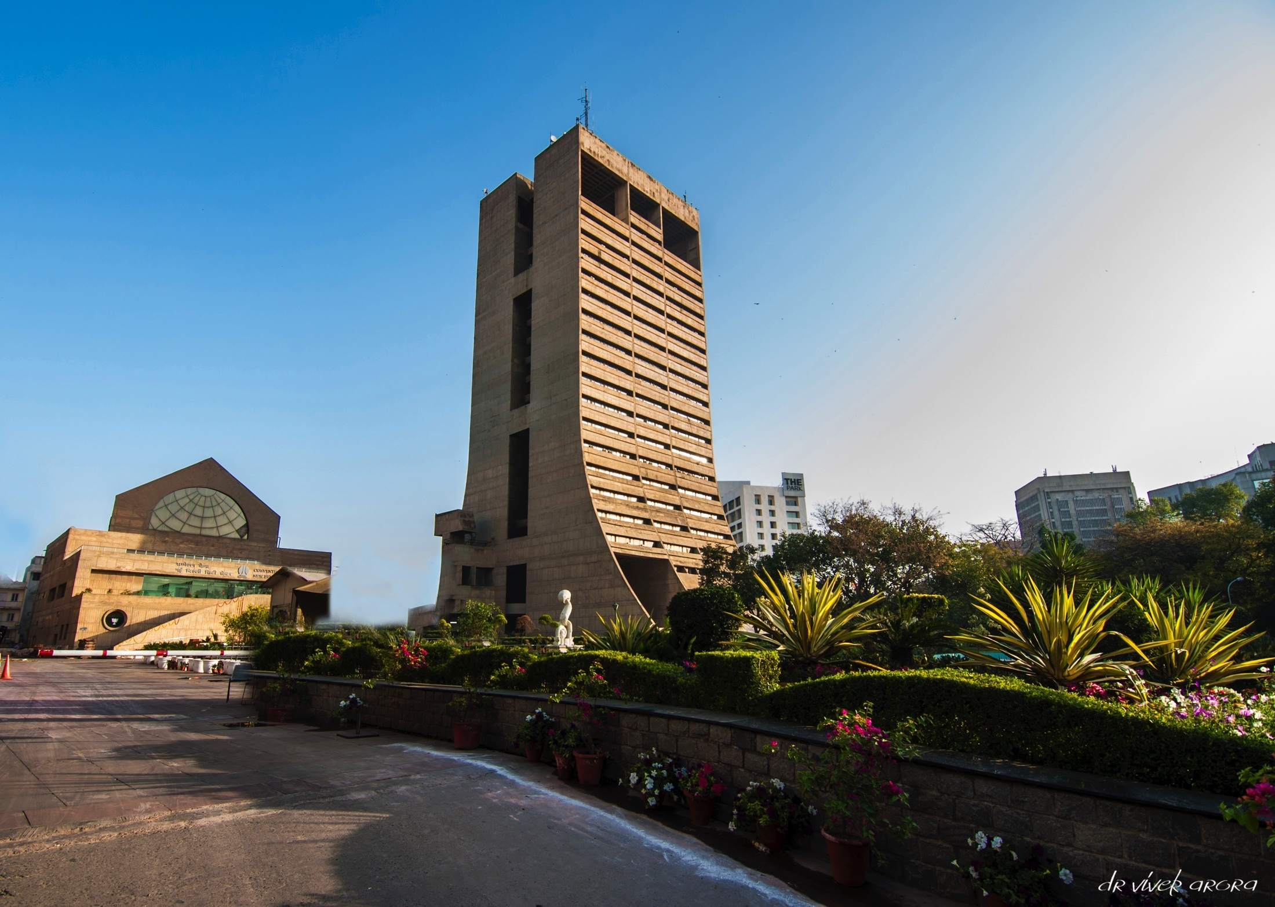
REGIONAL CONFERENCE at SRI NAGAR on May16–17, 2022
NEW DELHI MUNICIPAL COUNCIL
Seamless End to End Delivery of Services without Human Intervention

Slide 2
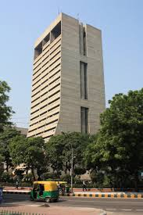
BRIEF PROFILE
The Imperial Delhi Committee constituted on 25th March, 1913
Raisina Municipal Committee formed in 1916
New Delhi Municipal Committee formed as a 1st Class Municipality in 1932
After commencement of the NDMC Act 1994, the Committee renamed as New Delhi Municipal Council
Area: 42.7 sq.km
Resident Population: 0.25 million
Floating Population: 1.6-2.0 million/ day
Population Density: 5850 pers. / sq. km
48% green cover against Delhi’s 21 %
Cleanest & greenest part of the capital

Slide 3
NDMC BEING DIGITAL MUNICIPAL ORGANIZATION
Digital India program, an initiative by Hon’ble Prime Minister emerged with the idea to provide government services to citizens electronically, create digitally literate citizens, and eventually transform India into a digitally empowered economy.
NEW DELHI MUNICIPAL COUNCIL working with the aim of transforming NEW DELHI MUNICIPAL COUNCIL into Digital Municipal Organization.
New Delhi Municipal Council (NDMC) has taken several IT based initiatives through technology intervention for strengthening of e-Governance and m-Governance to improve efficiency and effectiveness in providing civic services in an equitable, non-discretionary and transparent manner.

Slide 4
OBJECTIVES…
Developing Citizen Centric web applications and Mobile applications to minimize the physical contact with the citizen.
Developing Employees friendly applications for improving work efficiency.
To make web applications and Database more secure and robust to avoid cyber attack.

Slide 5
Various e-Services offered by NDMC
G2C
Government to
Citizen
Online Birth / Death Certificate
Online Payment of Utility Bills
Online Name Inclusion for New Born
Online Barat Ghar / Venue Booking
LoveMyTree: QR Code on Tree
UMANG
Online Medical Store – Stock Monitoring
E-Hospital
Online Inoculation Slot Booking (Yellow Fever Vaccination)
Property Tax
E-Waste
G2B
Government to
Businesses
Building Plan Approval
Online Mutation of Property
Online Health Trade License
Bill Tracking System (Vendor Payment Tracking)
Online Road cutting permission
G2E
Government to Employee
Pensioner Portal
Pay-slip / Form 16 / GPF / Pay-slip etc.
Online Vigilance NOC
GIS Mapping
Short-Term
Applications as per requirements
Yoga Day Registration
Swachh Survekshan Pledge
Swacha Survekshan Survey
School Admission Registration
Online JR/SR Doctor Vacancy

Slide 6
Key Initiatives and Impact. . .
Birth and Death
This service with in-built QR Code has been implemented free of cost, Further, inclusion of name in birth certificate after authentication of details using Aadhar details has also been started online to facilitate citizens. Till date 5 Lac plus birth & death certificates have been issued through online system.
The turnaround time for getting the certificates got reduced by 99%, from 7-10 days before online service was implemented to less than 5 minutes now.
Electricity and Water connections
The process of applying for electricity and water connections in NDMC has been digitized with definite timelines within which the departments concerned to grant sanctions to citizens applying for these services. This project has been designed to ease the application process and to prevent the citizen from having to run from pillar to post.
Physical interactions with site Engineers have been eliminated.

Slide 7
Key Initiatives and Impact. . .
Online Payment Facilities
As a part of Digital India Initiative of Government of India, NDMC has implemented various modes of online payment system like UPI, BHIM enabled Bharat QR, BBPS, NEFT/RTGS and Debit/Credit Cards.
Hassle free online payment. Enhancement of transparency.
Online Booking of NDMC Venues
The booking of NDMC Barat Ghars, water tankers, Community Centres, and different NDMC venues for Public Events has been made online.
Hassle free online registration without coming to NDMC facility centre physically. Till date 2061 consumers have been availed this facility.

Slide 8
Key Initiatives and Impact. . .
e-Hospital
NDMC has implemented e-Hospital application in collaboration which covers all the NDMCs Hospitals, Dispensaries, Poly-clinics, AYUSH Centres and Central Medical Store, and have modules such as Patient Registration (OPD & Emergency), Billing, ORS (Online Registration System), Lab, IPD (Admission/ Transfer/ Discharge), Pharmacy & Central Medical Store, etc.
Long queue in registration for OPD have been reduced. Citizen can view the stock position of medicine in real time. In last six months, total 2,99,114 patients have been registered through e-Hospital.
GIS
A geographic information system (GIS) is a system designed to capture, store, manipulate, analyze, manage and present spatial or geographic data. For visualization and better planning of services, NDMC launched GIS portal with 256 layers of different services. One can easily locate a Public Toilet, Clinics/ Dispensaries, Litterbins, Metro Stations, Police Stations, Pharmacies, ATMs etc.
Helping in Smart Planning to built citizen centric infrastructure like public toilet units. By using GIS Map & complaint received on App311, heat maps are being generated to find out the vulnerable area for vector borne disease like dengue & chikungunya. With this analysis, preemptive steps are taken to increase insecticide spraying to avoid hotspots resulting in fewer cases of chikungunya & dengue in the succeeding years.

Slide 9
Key Initiatives and Impact. . .
Public Toilet Unit
Successfully implemented a feedback mechanism in all PTU’s (350+) maintained by NDMC for effective governance.
A Complaint is raised on 3 successive bad review’s through PTU’s.
Turnaround Time is defined for resolution of the complaints.
Complaints can be raised using both touch interface and QR Code at PTU’s
Total No. of Complaints raised in FY 2021-22 : ~11K+
90% complaints resolved as per defined SLA
Consistent improvement in the complaint resolution time and compliance, as accountability improves
Significant improvements in the PTU cleanliness index
Single Sign On
SSO will enable both the citizens and NDMC Employees who to use single user ID password to access various citizen centric applications.
Improve Security level.
Hassle free access of Multiple services.
Centralized monitoring.

Slide 10
Key Initiatives and Impact. . .
E-Waste Collection
NDMC is a pioneer in implementing e-Waste Collections from Residents/ Government & Private offices in the NDMC Area.
Improper disposal of e-Waste is harmful to the environment because of the radiations emitted and the hazardous chemicals used.
This proper disposal saves residents from said hazards.
Transparent & Efficient Transaction: Customers can avail the facility by selling e-Waste, including computers, mobile phones, Air conditioners, Fridge, and Cables etc., on NDMC approved rates using m-application.
Real Time electronic transfer of funds to the customer on collection of e-Waste
No lower limit on the number of eWaste items to be disposed
Customer Dashboard to gives update to the resident (Collection Date, Reimbursement)

Slide 11
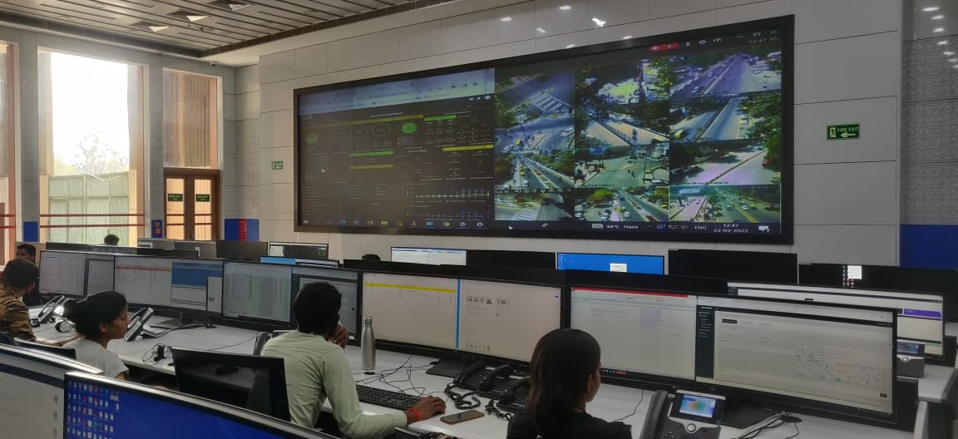
Integrated Command and Control Centre (ICCC)
ICCC
It is nodal point of availability of all online data and information related to online Services. It is established at Head Quarter Building, Palika Kendra. This state of the art and first of its kind ICCC, at present integrates twenty municipal services. This has brought in a paradigm change in delivery of citizen services.
Better management of all services. The ICCC w.e.f. 1st April 2019 to 31st December 2021 has received 69K complaints and the disposed rate for the same is equal to 98%+.

Slide 12
Mobile App for Citizen Centric Services

Slide 13
What is 311?
NDMC 311 App
Open Protocol for non-emergency service response used world wide
Why NDMC 311 was required?
Redressal of civic grievances
Information dissemination
Permanent solution to recurring problem
Smart Vision for Smart Governance

Slide 14
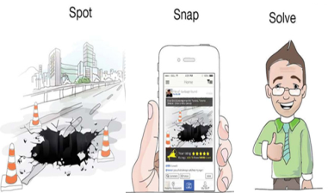
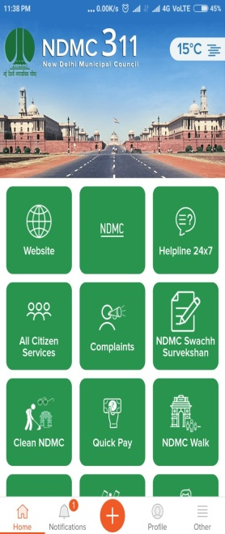
A brief of NDMC Citizen Interface (NDMC - 311)
Citizen Corner
Raise Complaints related to the municipality function
Book Citizen Facilities
Pay for all services including Utilities
BaratGhar, Swimming Pool, Inoculation Slot Booking, Birth and Death Certificate
Nearest Parking Space, Navigation to locations in NDMC (mapped with RFID)
Pay for all Utilities, Taxes, services etc.
Officers Corner
Unified dashboard of all complaints raised
Efficient tracking of complaint resolutions
Governance of officers
Assigning responsibilities
Attendance System (integrated with GPS)
Feature to generate m-Challan
Integration of Complaints with CRM
Birth and Death Certificate (with QR Code) Integrated with Blockchain Technology
Electricity and Water Bill Payment
Waste & e-Waste Management
40+ services integrated on NDMC 311, with Single Sign On for seamless User Experience
Viewing available parking spots in NDMC area
e-Hospital
Online Venue Booking of Community Hall / Barat Ghar

Slide 15
NDMC Citizen App – Unique Value Proposition
NDMC’s Citizen Centric App acts as a one stop solution to all Citizen Centric Grievances
While a lot of Smart Cities and Municipalities extend Citizen Centric Applications with all services integrated, NDMC has taken a step further by doing the following:
Integration of Officer Portal, for effective complaint redressal and governance of officers.
Seamless integration of interfaces of Swatch Bharat, UMANG etc. for effective timely redressal in the officer portal of the Citizen App.
30,000+ complaints received in FY 2021-22
6000+ inspection reports in FY 2021-22

Slide 16
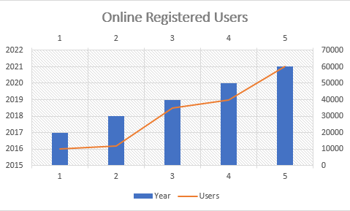
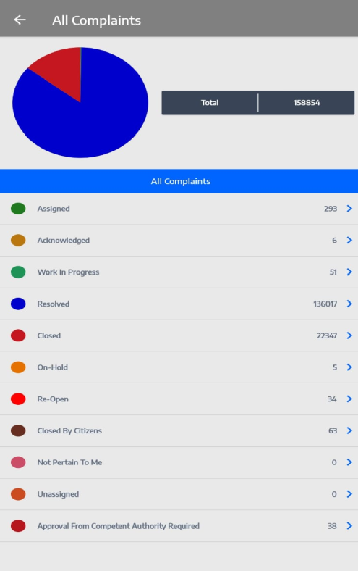
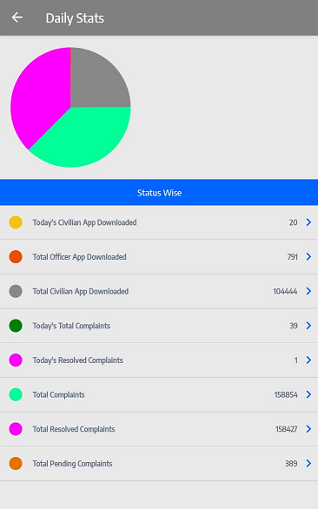
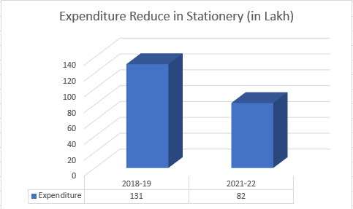
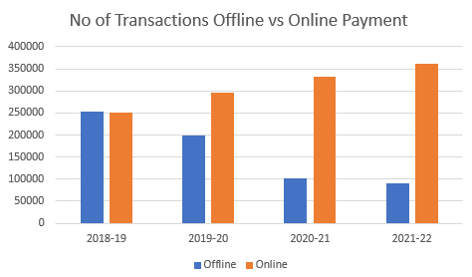
Impact of 311 App

Slide 17
Benefits of various IT based initiatives
Empowerment
Without the use of technology, the municipality used to suffer from a slew of issues including lack of transparency, ineffective governance and poor accountability of resident grievances. After implementing IT based solutions, resident is now empowered to demand his public services in a transparent and efficient manner.
Improvement
Service improvement is one of the cornerstones of digital transformation. Citizens enjoy a better service and their needs are met faster and more completely.
Convenience
Paperless processes provide constituents with on-demand access to applications, information and other services that traditionally require a trip to govt. offices. By digitizing operations, governments can more efficiently process claims, applications and license requests, resulting in higher public satisfaction. Remote Work & Business Continuity
Even on days when government offices are closed, e-services continue to be delivered. One can submit applications also. Enable employees to access crucial data, from any location, through any device, at any time.
Cut Cost
Digital document management eliminates the cost of printing and mailing documents to citizens. Online payment options also reduce transactions processing costs. Increased productivity resulting from digitization defers cost over the workforce.

Slide 18
Some other benefits
All the services of NDMC are now at Doorstep of citizens and can also be access through mobile on single click.
Citizen need not to come to any offices of NDMC for their work. The services can be access from anywhere anytime.
Faster delivery of services
Number of Citizen facilitation centre has been reduced from 5 number to 2 number.
Payment collection centres which were located at different location across NDMC area has been permanently closed.
Footfall at existing citizen facilitation centre has also been reduced more than 50%.
Transparency has been increased which subsequently has increased accountability.

Slide 19
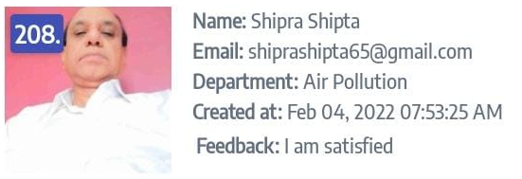
Citizen Feedback

Slide 20
e-Administration Initiatives
e-Office
Enhance transparency Increase accountability
Assure data security and data integrity.
Provide a platform for re-inventing and re-engineering the Government.
Promote greater collaboration in the workplace and effective knowledge management.
e-Sparrow
The APARs would be generated and transmitted online to the concerned officers for filling up of the self appraisal. The officer can then submit the self appraisal online through Digitally Signed Signature (DSC) or through E-sign.
e-HRMS
Online Attendance
The e-HRMS application was to facilitate the proper monitoring, manpower planning, recruitments, Postings, Promotion, Transfer based on employee skill set, service history which was earlier being done manually consuming lot of time and manpower in Government system.
Online Monitoring of daily attendance of employee
Timely disbursement of salary
Enhanced Transparency

Slide 21
Emerging Technology to be Implemented
Implementation of Block Chain Technology
In first phase, NDMC has implemented Block Chain technology in birth & death application including Hospital interface successfully and same shall be implemented in Property Tax and Estate applications.
Security in terms of integrity and authenticity of vital data.
Malware Resistant.
A trust across the parties
Artificial intelligent base CHATBOT
ChatBot facility on NDMC website will enable citizen to get faster response to their quires in a personalized manner with 24X7 availability.

Slide 22
Implementation of Cyber Security Measures in NDMC
Data Center
IT Security
Cyber security has proven to be a necessary investment for government organizations because it protects all categories of data from theft and damage. This includes sensitive data, personally identifiable information (PII), protected health information (PHI), intellectual property data and governmental information systems and helps prevent cybercriminals from gaining access to devices or the networks. NDMC is going to implement this for 360 degree cyber security
ISO 27001 Certification
On Boarding Cyber Swachhta Kendra
NDMC is taking various steps as per its own cyber security policy to get ISO 27001 Certification
Cyber Swachhta Kendra Government of India's Digital India initiative under the Ministry of Electronics and Information Technology (MeitY) to create a secure cyber Space by detecting botnet infections in India and to notify, enable cleaning and securing systems of end users so as to prevent further infections.

Slide 23
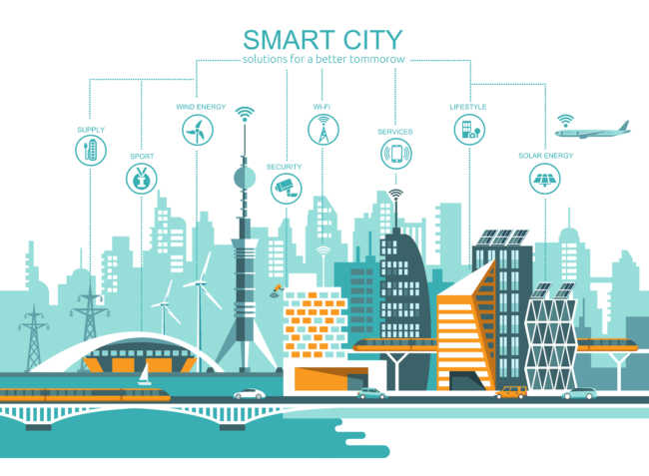
CMSSP is a web portal developed and hosted by the NDMC. The requirement to create a common knowledge sharing portal should be created to serve as a one-stop information portal that would not only highlight the best practices of various smart city projects in NDMC as well as other Urban Local Bodies (ULBs) of the country and abroad but also document their success and challenges in implementing smart city project. The portal candidly underscores the project experiences and highlights the steps taken by NDMC to overcome the challenges. The areas that require urgent attention is pointed out. The portal is created to be interactive by enabling the ULBs to exchange their ideas on a common platform. The overarching objective is the mutual learning for relevant stakeholders in the delivery of smart services and utilities for the overall well-being of the population and stride towards 21st century New India.
Common Municipalities Smart Service Portal (CMSSP)

Slide 24
Way Forward for other organizations/municipalities
Other organizations/municipalities may implement the concept of e-governance as implemented by NDMC. It is a great tool to improve service delivery, restoring public trust, ensure transparency, traceability and reduce human intervention. It can also help organizations to understand their citizens better and provide services more effectively and efficiently in a transparent way and find new solutions to policy challenges.
NDMC has developed more than 40+ online application for their citizen as well as their employee. Any organization can approach NDMC for functional and technical support. NDMC shall share its experiences with other organizations in developing these applications.

Slide 25
Steps to achieve target of seamless end-to-end
delivery of services
Identify your goals.
Build-up Networking Infrastructure.
Digitization of records.
Develop applications as per the need of various departments.
Continuous up-gradation of application on feedback of citizens.
Develop mobile application for wider reach of application.
Implement latest Technology innovations.

Slide 26
Challenges faced by NDMC during transformation process
No Change Management - Having a strong change management culture is vital for any organization success. Inertia to change is a major road block in implementation of any project.
Selection of Software & Technology – Selection of suitable application and technology as per end user requirement.
Driving Adoption of New Tools & Processes – New process and technologies often present challenges in the form of resistance to change from tenured employees who feel there is nothing wrong with the way they are currently doing things.
Continuous Evolution of citizen needs – Organizations are always evolving and Covid-19 pandemic accelerated this. Therefore digital transformation is not an easy process and intensive transformation efforts can take year to accomplish.
Lack of Proper computer Skills – For successful usage of IT based applications, department required employee having proper computer skills. To train end users intensive training programs for employees are required.

Slide 27
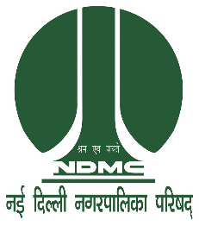
THANK YOU!

