Slide 1
Study on Evaluation of Output and Outcome of Training Institutes under Govt. of India
IIPA, New Delhi
27th Sept, 2021

Slide 2
Context
World changing rapidly, so do the Training requirements
Are CTIs keeping pace with changing Training Eco-system?
Whether these Institutes
(i) continue to be relevant in the changed scenario,
(ii) overlap between two or more of these Institutes
Relevance and relative importance of CTIs i.e. order of their ranking
Notes:
Links:
https://www.pexels.com/photo/close-up-of-human-hand-327540/

Slide 3
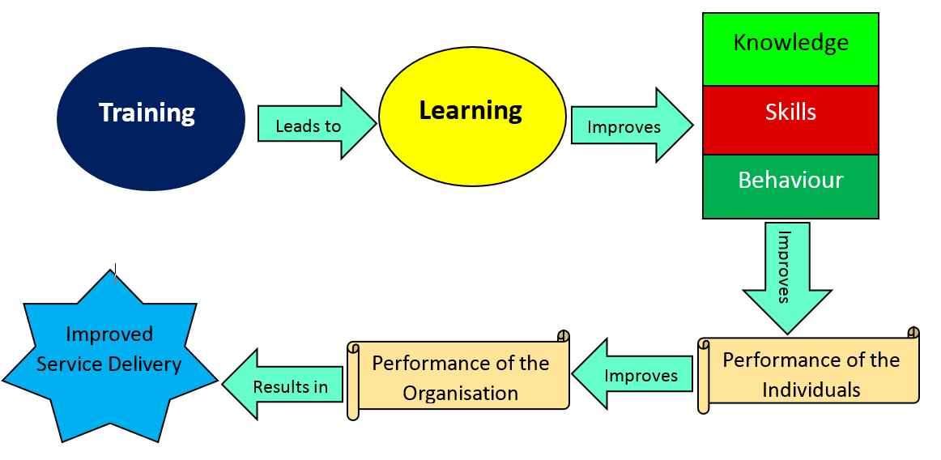
Advantages of Training

Slide 4
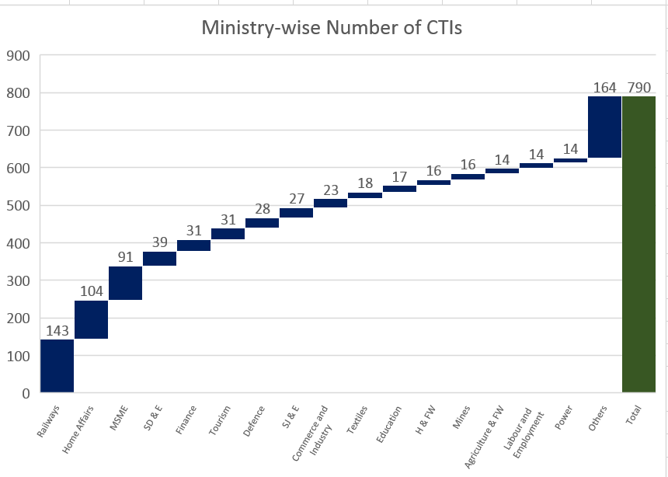
790 CTIs-Ministry-wise Numbers

Slide 5
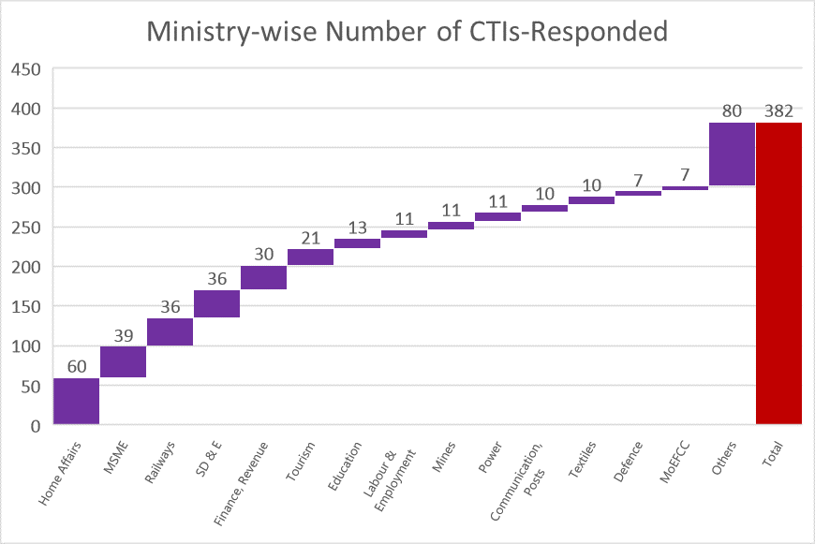
382 CTIs Responded-Ministry-wise Numbers

Slide 6
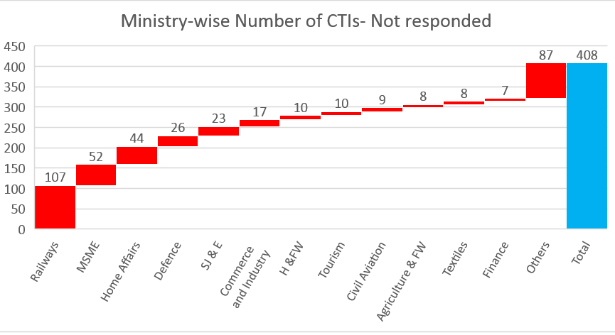
408 CTIs Not Responded-Ministry-wise Numbers

Slide 7
Financial Performance of CTIs (1/2)
Various CTIs put together incurred an expenditure of Rs 3634 crores annually, on an average, during 2017-18 to 2020-21 against a total revenues of Rs. 5494 crores received/generated by them from various sources
Each CTI incurs an expenditure of Rs 11.05 crores per annum against Rs 16.70 crores revenues generated/grants received by them
Implicit in it is that they generate a total surplus of Rs 1860 crores annually, at an average of Rs.5.65 crores per CTI per annum

Slide 8
Financial Performance (2/2)
Out of total annual average revenues of Rs. 5494 crores generated by all CTIs put together, Rs. 2902 crores received from GOI
The grants/other payments received by CTIs from GOI constitute 80% of their average annual expenditure and 53% of the total revenues generated by them

Slide 9
Average Receipts from the Government per CTI,
2017-18 to 2020-21

Slide 10
Average Total Revenues & Expenditure per CTI,
2017-18 to 2020-21

Slide 11
Commonality of Objectives
45 different sets of common objectives pursued by 235 CTIs,
on an average, 5.2 Common sets of Objective per CTI
(An Illustration)
OBJECTIVES
i) Initiating and coordinating Training Program in Power Sector to provide uninterrupted power supply
(254) National Power Training Institute, New Delhi, Ministry of Power
(259) National Power Training Institute (Western Region) Nagpur, Ministry of Power
(258) National Power Training Institute (Southern Region), Tamil Nadu, Ministry of Power
(257) National Power Training Institute, North East Region (NPTI-NER) Guwahati, Ministry of Power
(262) National Power Training Institute, Alappuzha, Ministry of Power
(256) National Power Training Institute (Eastern Region), Ministry of Power
(261) National Power Training Institute Power System Training Institute (Bangalore), Ministry of Power
(255) National Power Training Institute, Shivpuri, Ministry of Power
(260) National Power Training Institute, Nangal, Ministry of Power
(253)Hot Line Training Centre, Bangalore, Ministry of Power
(263) National Power Training Institute, Haryana, Ministry of Power

Slide 12
Classification of CTIs based on their Relative Scores
S.No. | Category | Composite Score | Number of CTIs
 | Achiever CTIs | 65 to 100 | 35
2. | Front Runner CTIs | 50 or more but less than 65 | 49
3. | Performer CTIs | 35 or more but less than 50 | 95
4. | Aspirant CTIs | less than 35 | 203
Total Number of CTIs |  |  | 382

Slide 13
Classification of CTIs by Their Ranks

Slide 14
Accomplishment of Objectives by CTIs

Slide 15
Capacity Building
Imparting online training imperative in the wake of Covid-19 pandemic. Only 85% of CTIs could develop digital material for training and 15% did not.
A total of 1.32 lakhs officers trained by various CTIs in a year, at an average cost of Rs 2.75 lakh per officer.
On an average, 346 officers were trained by each CTI per year.
A total of 36921 videos prepared by various CTIs, at an average of 97 videos per CTI in a year.
Over 31 lakhs books in all libraries of CTIs, at an average of 8121 books per CTI.

Slide 17
Land Used by CTIs
A total area of 20221 acres of land is used by various CTIs, at an average of 58 acres per CTI.
The Institutes who function from their own buildings possess 71 acres of land per CTI, on an average, compared to 26 acre per CTI used by those who function from rented/leased-in land.
88% of land owned by 72% of CTIs in contrast to 12% of land on lease/rent being used by 28% of CTIs.
Of the total land, 7283 acres i.e. 36% is under Aspirant CTIs, at an average of 42 acres per Aspirant CTI.

Slide 18
Recommendations
To provide any time-any where learning to train over 2 crores users, build iGOT-Karmayogi as an integral part of the Digital India stack as a social good for capacity building of all government employees
Increase collaboration and establishment of strong connect of CTIs with academia, eminent Institutions, industry and other private players
Some of CTIs have vast excellent resources but remain under-utilised. Efforts be made to put in place a meaningful collaboration amongst them
Of the total land of over 20,000 acres used by CTIs, 7283 acres i.e. 36% is under Aspirant CTIs, at an average of 42 acres per Aspirant CTI. It needs to be ensured that land is used judiciously and effectively.

Slide 19
Way Forward : IIPA Model of Competency Building (1/2)
Ethos | Ethics | Equity
People First Strategic Thinking Organisational Awareness Commitment to the Organisation Leading Others | Integrity Self Confidence Attention to Detail Taking Accountability | Consultation and Consensus Building Decision Making Empathy Delegation

Slide 20
Way Forward : IIPA Model of Competency Building (2/2)
Efficiency | Productivity
Results Orientation Conceptual Thinking Initiative and Drive Seeking Information Planning and Coordination Desire for Knowledge Innovative Thinking Problem Solving Developing Others Self-Awareness and Self-Control Communication Skills Team-Working | Office Management (Parichay) Human Resource Management (Disciplinary Work) Information Management (Court Matters) Compliance Management (Audit) Parliamentary Matters (Questions & Committee)

Slide 21
Thank you

