Slide 1
NeSDA 2021- Way Forward
Debabrata Mallick
Additional Secretary,
GA & PG Department,
Government of Odisha

Slide 2
Process Study
Identification of innovations in public service delivery systems
Identification of processes, systems and services to improve the well being of the common people.
Initiation of action research projects, macro level changes and innovations in the policies and practices across states.
Capacity Building of all Stakeholders through training programmes, conferences, seminars and publications
Development of a database of innovations and hosting in Public Domain for improving service delivery.

Slide 3



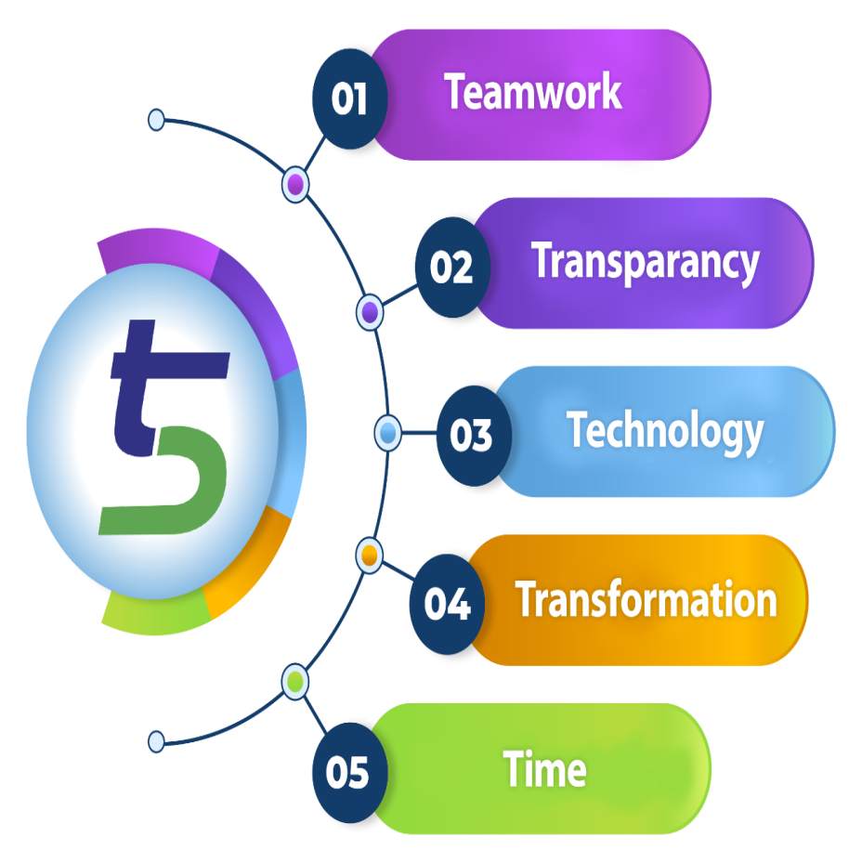




Transparency
Team work
Technology
Transformation
Time

Slide 4
Flagship e-Gov Projects of the State
Human Resources Management System (HRMS)
Litigation Management System (LMS)
Odisha Right to Public Services Act, 2012 (ORTPSA)-Odisha One Portal
Odisha State Workflow Automation System (OSWAS)

Slide 5
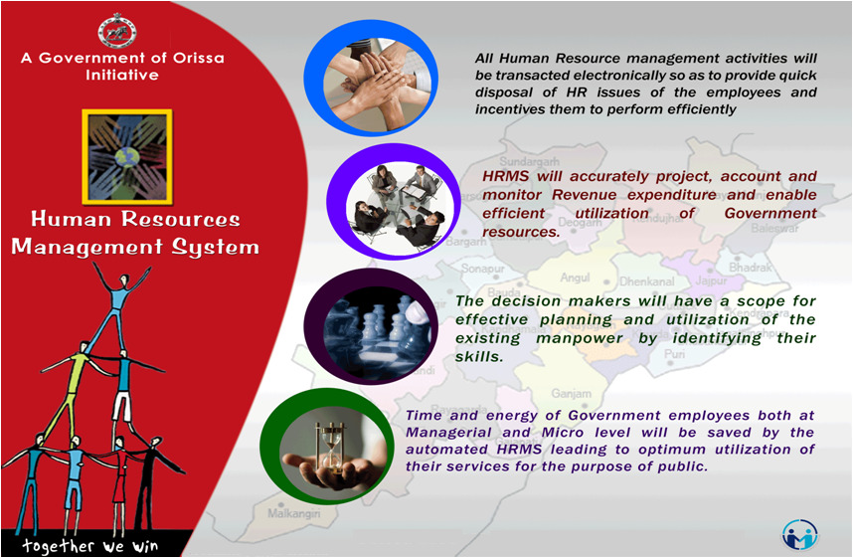
HRMS: FLAGSHIP PROJECT OF ODISHA

Slide 6
HRMS: KEY ISSUES
Wide Range of Stakeholder base
  40 Administrative Departments and 110 Heads of Department
  Total 7057 DDO Offices across 30 Districts
  80,000 Bills
  Approx. 6,50,000 Employees
Complexity of Business Logic in Adherence to
  All India Service Rules
  Odisha Service Code
  Odisha Treasury Code
  Odisha General Finance Rules
  Odisha (GPF) Rules
  New Pension Scheme
  Odisha Leave Rules
  Odisha Government Servants Conduct Rules

Slide 7
ACHIEVEMENTS
HRMS-1
  Development of HRMS Data Model
  Development of HR Legacy System
HRMS-2
  e-Service Book
  Payroll Automation and Single Page Paybill
  Integration with Integrated Financial Management System (IFMS)
  Online PAR submission for all Group A and B employees
  Online submission of Property Statement
  Online Training Management
  Online Leave,Loan/ Advance / Pay Revision/ Increment sanction
  Auto generation of Last Pay Certificate(LPC)
  Integration with Pension Management System (PMS)
  Integration with Quarter Management System (QMS)

Slide 8
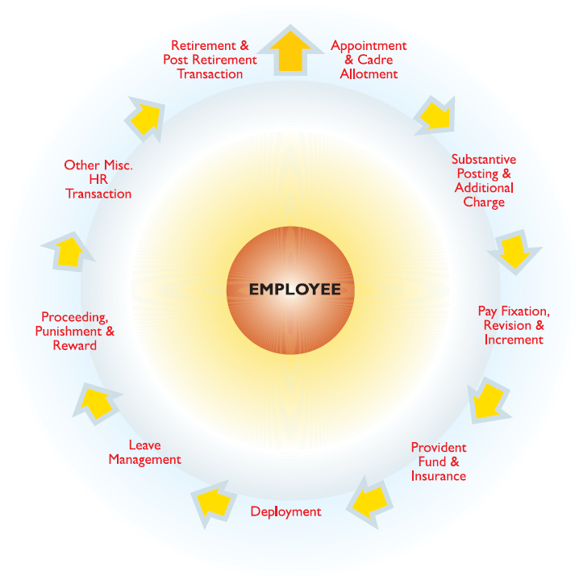
DATA MODEL AND LEGACY SYSTEM
HRMS FOLLOWS EMPLOYEE-LIFE-CYCLE APPROACH
TOTAL 78 HR FUNCTIONAL MODULES IDENTIFIED

Slide 9
LMS
Litigation Management System (LMS) is the application to monitor all the government cases of the Hon’ble High Court, Odisha, State Education Tribunal, Bhubaneswar and Deputy Solicitor General, Odisha.
LMS was launched on 24.06.2011 by Hon’ble Chief Justice, Orissa High Court.
Presently LMS is dealing with cases of High Court (Civil/Criminal), State Education Tribunal cases & Central Government Cases (DSGI Office).
Implementation of LMS in the office of Deputy Solicitor General of India, High Court of Orissa.

Slide 10
LMS WORK FLOW AUTOMATION

Slide 11
ACHIEVEMENTS OF LMS
SMS alert facilities for Contempt cases, Interim orders & judgments
Reflection of original case no. in the Misc case & Contempt Case filed.
Single sign-on facility for HRMS & LMS
All Police stations have been included in the LMS.
31 nos. of Corporations have been included in LMS.
Case wise/Court wise/Office wise MIS report
Daily cause list of High Court.
Periodically SMS message sent to all Law Officers of AG Office for tracking, tracing, filing and non filing of court files assigned to them
Case detail information with all documents in every stages in a single page.
Total case records sent to all Law officers before one hour of publication of final cause list.
To know about the case in nutshell / brief at any point of time.

Slide 12
Highlights of ORTPS Act
Transparency
Accountability
Timeliness

Slide 13
Structure in the Odisha Right to Public Services Act, 2012
STATE GOVERNMENT
REVISIONAL AUTHORITY
APPELLATE AUTHORITY
DESIGNATED OFFICER

Slide 14
Department wise Public services
Sl. No. | Department | Public Services
1 | Commerce & Transport (Transport) | 32
2 | Revenue & Disaster Management | 34
3 | Finance | 7
4 | Home | 33
5 | Health & Family Welfare | 9
6 | SS & EPD | 1
7 | ST & SC Development | 1
8 | Housing & Urban Development | 26
9 | School & Mass Education | 20
10 | Higher Education | 13
11 | Fisheries & ARD | 6
12 | Industries | 15
13 | MSME | 24

Slide 15
Department wise Public services
S l. No. | Department | Public Services
14 | Labour & ESI | 39
15 | Panchayati Raj & DW | 3
16 | Excise | 15
17 | General Administration & PG | 3
18 | Agriculture & FE | 15
19 | SD & TE | 30
20 | Cooperation | 16
21 | Forest & Environment | 28
22 | FS & CW | 7
23 | OLL &Culture | 2
24 | Energy | 12
25 | Textiles, H & H | 2

Slide 16
Department wise Public services
S l. No. | Department | Public Services
26 | Works | 8
27 | Commerce & Transport (Commerce) | 2
28 | Science & Technology | 2
29 | Sports & Youth Services | 2
30 | Steel & Mines | 9
31 | Electronics & IT | 1
 | Total | 417

Slide 17
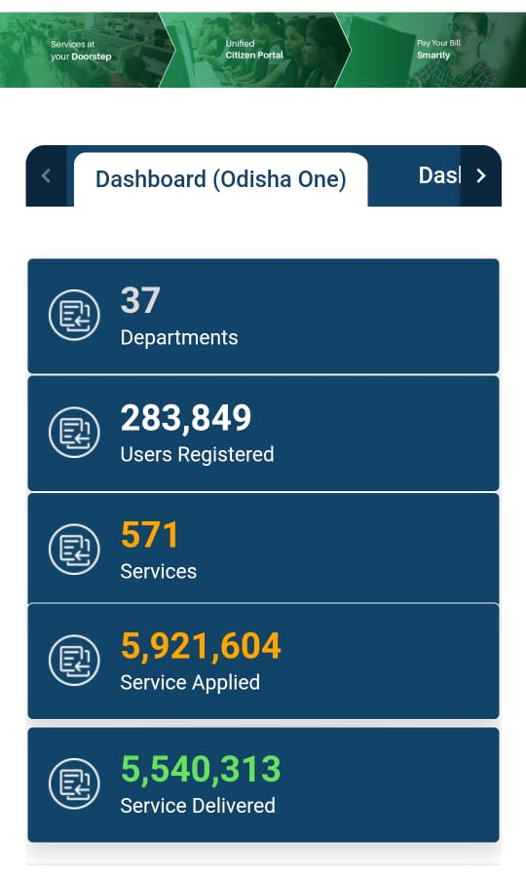
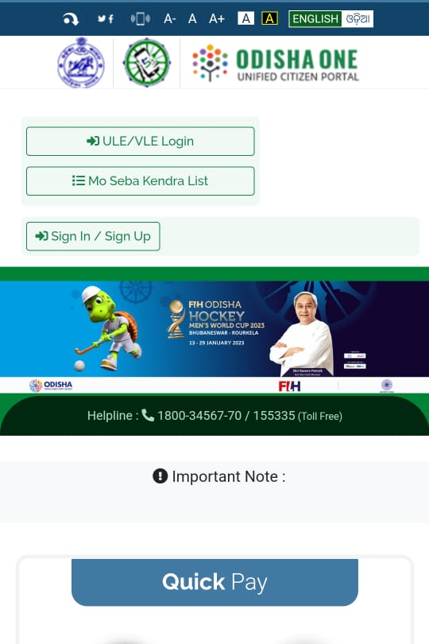
Odisha One

Slide 18
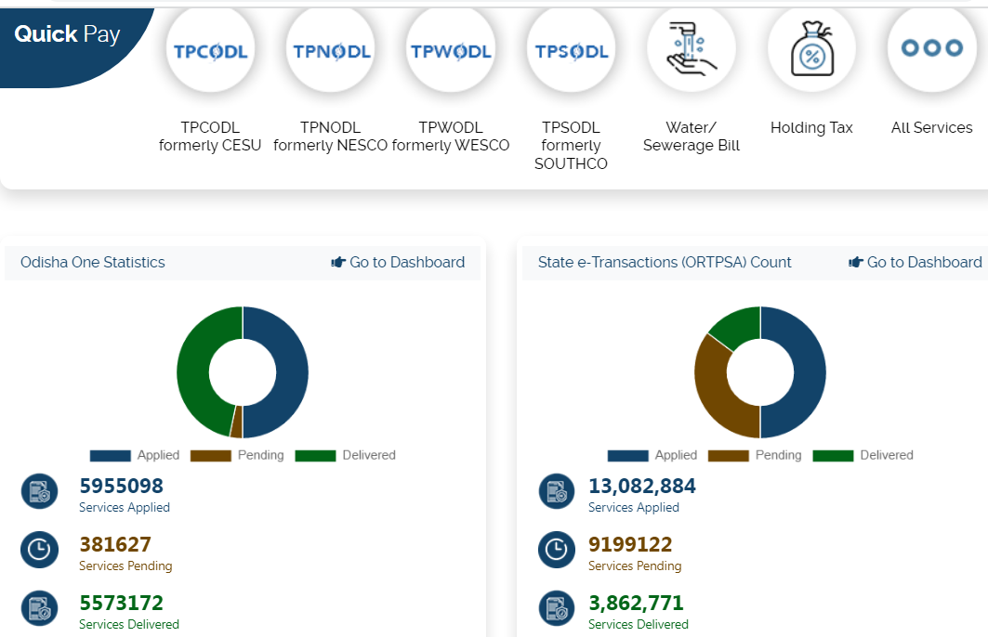
Odisha One

Slide 19
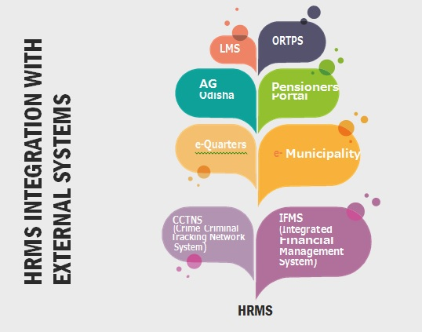
HRMS INTEGRATION

Slide 20
Way Forward
Study of different innovations having positively impact on the public service delivery, increased efficiency and led to cost reduction.
Development of eco-systems for cost-effective innovative ideas.
Encouragement for risk-taking experiments for innovations.
Development of policies for rewards to accelerate the process of innovation
New ideas for transformation in public service delivery
Recognition of talents
Designing relevant programmes and diagnostic studies etc.
Preparation of knowledge building case studies
Comparative analysis of innovations and experiences
ICT education at School
Use of Satellite Data for Public Service

Slide 21


Journey towards e-Services
Journey

Slide 22
Thank You

