Slide 1
National e-Governance Service Delivery Assessment (NeSDA) Regional Conference | Mumbai

Slide 2
National e-Governance Service Delivery Assessment
NeSDA is the first of its kind assessment in India and has been finalized after extensive stakeholder consultations to accurately assess the Indian eGovernance landscape
Objective
The overall objective of NeSDA is to assess States, Union Territories and Central Ministries on their effectiveness in delivering online services to citizens
Key Outcomes of the NeSDA Study
Assess eGovernance service delivery maturity – comparative analysis amongst States and UTs
Highlight good practices to learn and emulate for improving citizen centric services
Identify areas of improvement to enhance efficiency in eGovernance service delivery
2

Slide 3
The NeSDA Assessment Parameters
 | Accessibility |  |  | End Service Delivery
 | Content Availability |  |  | Integrated Service Delivery
 | Ease of Use |  |  | Status Request & Tracking
 | Information Security & Privacy
3

Slide 4
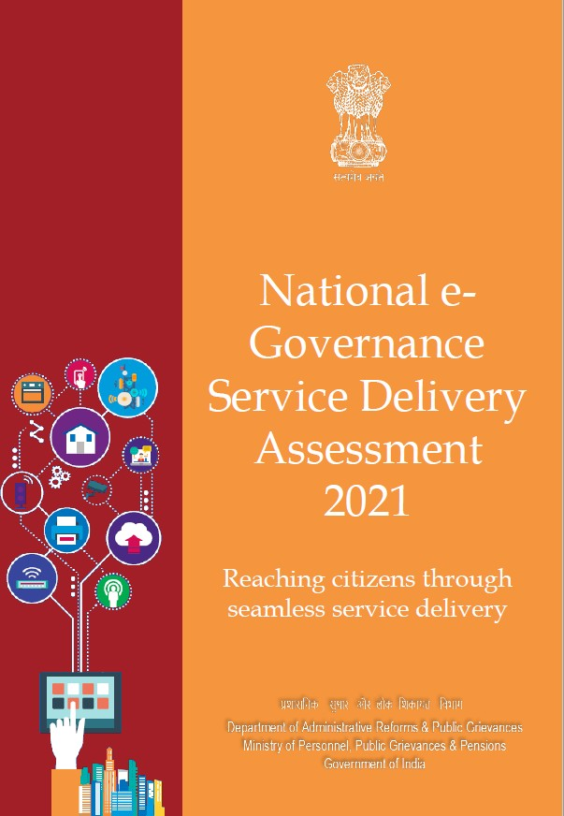
The NeSDA Framework
The NeSDA Framework builds on the UNDESA framework and has been customized to the India federal structure
Global Benchmarks
(UNDESA eGov survey – Online Service Index)
Focus Sectors
Finance
Labour & Employment
5. Local Governance & Utility
services
3. Education 6. Environment
4. Social Welfare (incl. Health & 7. Tourism Home Security)
Key G2C and G2B Online Services provided by States, UTs and Central Ministries
Assessment Parameters
State / UT / Ministry Portals
+
State / UT / Ministry Services Portals
Accessibility
Content Availability
6. Status Request & Tracking
3. Ease of Use 7. Integrated Service
Information Security Delivery & Privacy
End Service Delivery
4

Slide 5
National e-Governance Service Delivery Assessment
The NeSDA 2021 Journey
Data collection, synthesis and analysis over 15 months from Jan 2021 to Jun 2022
56 Services across 35 States and UTs and 27 Services across 11 Central Ministries assessed
Over 1 Lakh responses covering 1,400 Services across India analysed
Process conducted 100% online based on voluntary reporting by governments
5

Slide 6
NeSDA 2021 – Key Results – State and UT Portals
North-East & Hill States
Union Territories
Remaining States – Group A
Remaining States – Group B
State Name | Rank
Nagaland | 1
Meghalaya | 2
Assam | 3
Sikkim | 4
Tripura | 5
Himachal Pradesh | 6
Uttarakhand | 7
Mizoram | 8
Arunachal Pradesh | 9
Manipur | 10
UT Name | Rank
Jammu & Kashmir | 1
Andaman & Nicobar Islands | 2
Puducherry | 3
Delhi | 4
Chandigarh | 5
Ladakh | 6
State Name | Rank
Kerala | 1
Tamil Nadu | 2
Punjab | 3
Karnataka | 4
Telangana | 5
Goa | 6
Haryana | 7
Andhra Pradesh | 8
Maharashtra | 9
Gujarat | 10
State Name | Rank
Odisha | 1
Uttar Pradesh | 2
Bihar | 3
Jharkhand | 4
West Bengal | 5
Madhya Pradesh | 6
Chhattisgarh | 7
Rajasthan | 8
Note: Dadra & Nagar Haveli and Daman & Diu and Lakshadweep have not provided adequate data for the assessment for their UT Portals and hence they are not considered for analysis.

Slide 7
NeSDA 2021 – Key Results – State and UT Services Portals
North-East & Hill States
Union Territories
Remaining States – Group A
Remaining States – Group B
State Name | Rank
Meghalaya | 1
Tripura | 2
Assam | 3
Uttarakhand | 4
Himachal Pradesh | 5
Nagaland | 6
Arunachal Pradesh | 7
Mizoram | 8
Manipur | 9
Sikkim | 10
UT Name | Rank
Jammu & Kashmir | 1
Andaman & Nicobar Islands | 2
Delhi | 3
Chandigarh | 4
Puducherry | 5
Ladakh | 6
Dadra & Nagar Haveli and Daman & Diu | 7
State Name | Rank
Punjab | 1
Tamil Nadu | 2
Haryana | 3
Telangana | 4
Gujarat | 5
Kerala | 6
Karnataka | 7
Goa | 8
Andhra Pradesh | 9
Maharashtra | 10
State Name | Rank
Rajasthan | 1
Uttar Pradesh | 2
Madhya Pradesh | 3
Odisha | 4
West Bengal | 5
Jharkhand | 6
Bihar | 7
Chhattisgarh | 8
Note: Lakshadweep has not provided adequate data for the assessment of their UT Services Portals and hence it is not considered for analysis.

Slide 8
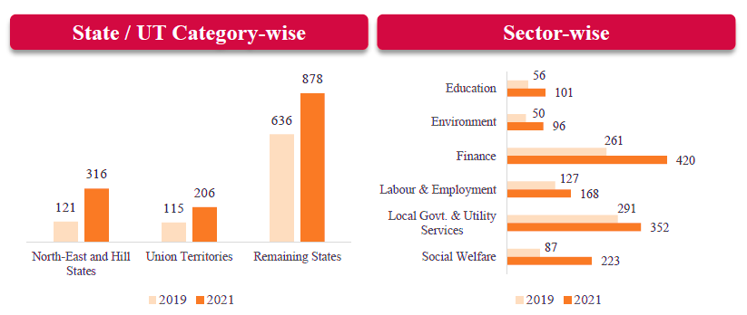
NeSDA 2021 – Key Takeaway #1: Increased Delivery of e-Services
The increase in mandatory e-Services delivered in 2021 is visible across all focus sectors and across all States and UTs
Punjab and Tamil Nadu are the leading States providing all 56 mandatory services
North-East and Hill States saw the largest percentage increase in number of services compared to 2019
The Social Welfare sector has seen the biggest percentage increase in number of services followed by Environment sector and Education sector

Slide 9
NeSDA 2021 – Key Takeaway #2: Rise of Integrated Portals
The use of integrated portals has enabled States and UTs to roll-out services faster and provide access to a greater number of e-Services
The integrated portals provide users a unified access point for a variety of services and tie into the best practices that NeSDA encourages.
Integrated portals provide intuitive navigation, uniform look and feel, unified access point for multiple services, better service availability - these factors enhance overall digital experience for the users.
Some of the notable integrated portals implemented by the States / UTs include:

Slide 10
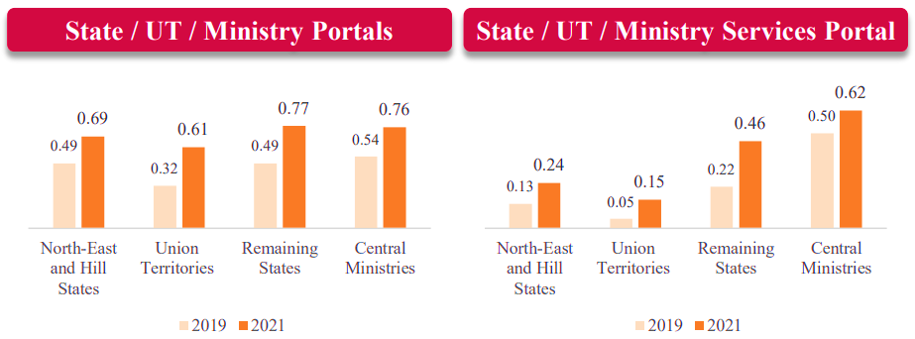
NeSDA 2021 – Key Takeaway #3: Improvement across Scores
NeSDA 2021 study saw an improvement in scores across all 7 parameters
Improvement was also seen for the scores of all 4 parameters for the State, UT and Central Ministry Portals.
The improvements were driven by the implementation of NeSDA 2019 recommendations coupled with increased delivery of e-Services across the country and a greater uptake of integrated / centralized portals by all governments..
Information Security & Privacy was the most improved aspect across all Portals.
Improvement in State, UT and Ministry Portals and Services Portals is as below –

Slide 11
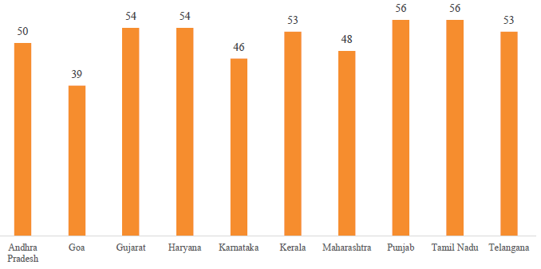
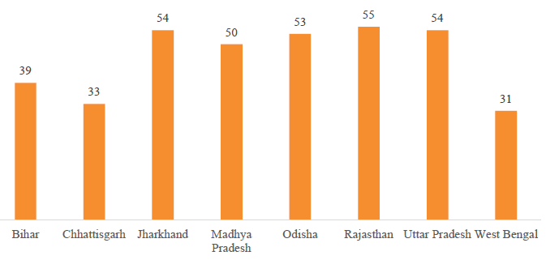
NeSDA 2021 – Mandatory Services Assessment (1/2)
Remaining States (Group A)
Remaining States (Group B)
Punjab and Tamil Nadu are the leading States delivering all 56 mandatory services online followed by Haryana and Gujarat are delivering 54 mandatory services online
Rajasthan is the leading State delivering 55 mandatory services online followed by Jharkhand, Uttar Pradesh and Odisha

Slide 12
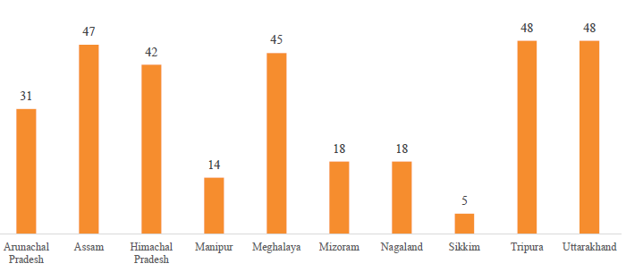
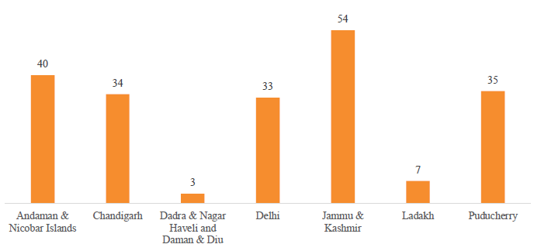
NeSDA 2021 – Mandatory Services Assessment (2/2)
North East and Hill States
Union Territories
Tripura and Uttarakhand are the leading States delivering 48 mandatory services online followed by Assam and Meghalaya
Jammu & Kashmir is the leading UT delivering 54 mandatory services online followed by Andaman & Nicobar Islands

Slide 13
NeSDA 2021
#1: STATUS OF ONLINE SERVICES IN STATES/UTS

Slide 14
NeSDA 2021
#2: STATUS OF ONLINE SERVICES IN STATES/UTS

Slide 15
NeSDA 2021
#3: STATUS OF ONLINE SERVICES IN STATES/UTS

Slide 16
NeSDA 2021
#4: STATUS OF ONLINE SERVICES IN STATES/UTS

Slide 17
NeSDA 2021 – Mandatory Services Offered Online

Slide 18
NeSDA 2021 – Total Services Offered Online

Slide 19
NeSDA 2021 – Way Forward
Saturation of e-Services
Rise in use of Integrated / Centralized Portals for delivery of e-Services
Provision of all 56 mandatory services
Adoption of integrated service delivery portals provides multiple benefits including faster rollout of services, consistent interfaces, reduced friction and increased trust
Suo-moto entitlement-based delivery of services
Improvement in scores of all seven assessment parameters
Improved scores across all parameters reflects the work done towards adoption of standards for uniformity in governance. Especially, improved score of service portals at par with state portal (~0.6)
Timely provision of e-services to the citizens as per their requirement, based on their lifecycle approach
Increase in delivery of total e-Services
Rise in number of services provided facelessly
More services to be provided facelessly, without any human interaction

Slide 20
Thank You

