Slide 1
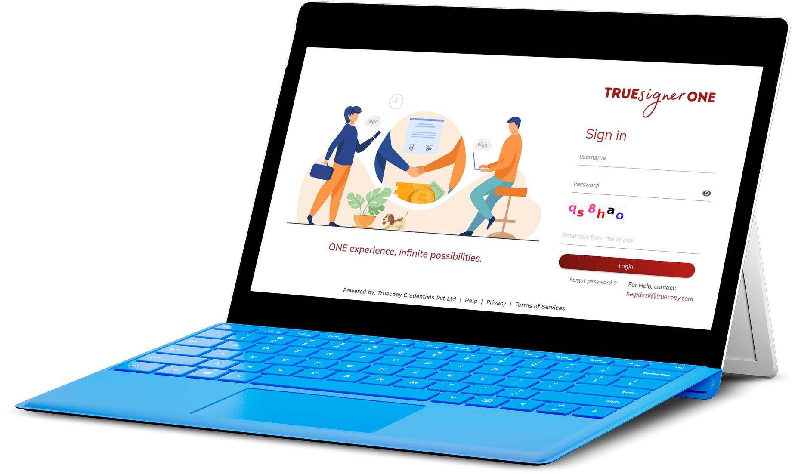
TRUECOPY CREDENTIALS
Mentored Company

Slide 2
WHO WE ARE
Based in Pune, serving clients pan India.
Digital Signature solutions as a means to secure documents, automate signatures, streamline business operations.
1600+ companies trust Truecopy with their signing requirements.
Billion+ signatures done.
Eliminate paper; Save trees; Protect the environment.

Slide 3
OUR MISSION
TO BUILD A DIGITAL SIGNATURE PLATFORM OF CHOICE FOR ORGANIZATIONS TO ISSUE AND EXCHANGE AUTHENTICATED DOCUMENTS IN A SECURE WAY GLOBALLY.

Slide 4
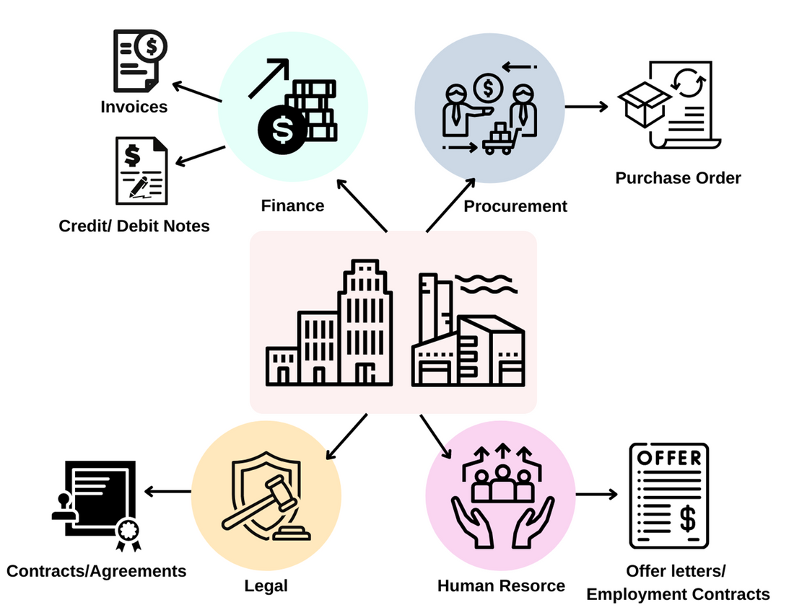
Verticals Served
Government
Manufacturing/OEM
Finserv
FMCG
Education
Infotech
Automotive
Chemicals
Construction
FMCD
Logistics/Packaging
Natural Resources
Textiles

Slide 5
TRUESigner ONE for
5 Lac
TRUESigner Enterprise
TRUESigner ONE
5,00,000 documents signatures from SAP per month
Seamless integration with SAP
Unlimited users
Digital signing of all
HR Documents
Bulk upload of documents
Paperless organization

Slide 6
FIRESIDE CHAT WITH
MR. KHUSHRU MISTRY
CIO & SVP,
EUREKA FORBES LTD

