Slide 1

From eGovernment to Smart Government
I N T E R N A T I O N A L
S Y M P O S I U M
Excellence in Public Service/
Public Administration
October 7 – 9, 2014,
New Delhi, India
Eng. Marwan Bin Haider
Executive Director of Planning & Development

Slide 2


Dubai – Business Hub in the Gulf Region
Dubai
Dubai
is one of the 7 Emirates in UAE
Has a population of 2.2 million
Has a forecasted nominal GDP of 107bn$ in 2014 with a 5% growth rate
Is a major business hub in the Middle East and Gulf Region
Key economic sectors are Tourism, Trade, Retail and Finance
Government is composed of 80+ entities with 20+ major departments and authorities

Slide 3
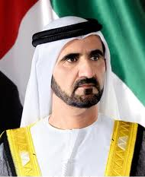
Dubai eGovernment and Electronic Shared Services (ESS) Initiative
H.H. Sheik Mohammed Bin Rashid Al Maktoum launched the Dubai eGovernment umbrella initiative in 2000
A centralized approach was adopted for the common aspects of core and administrative support services eEnablement, referred to as electronic shared services initiative or ESS
ESS initiative adopted an extensive whole-of-government approach for the common (synergistic) aspects of core and administrative (support) services electronic enablement
From eGovernment to Smart Government
Confidential - Category C
Source: DSG (Dubai Smart Government Department)

Slide 4
eTransformation & ESS Governance
The Executive Committee
Government Information Resources Planning (GIRP)
Dubai eGovernment Department (DeG)
Dubai Smart Government Department (DSG)
Strategic Management Office (SMO)
eServices
2000 - 2002
2002 - 2009
2009- 2013
2013- ….
Dubai eTransformation and ESS Governance evolved from temporary institutional mechanisms to a consolidated institution with a clear mandate having a government level CIO
From eGovernment to Smart Government
Confidential - Category C
Source: DSG (Dubai Smart Government Department)

Slide 5

Dubai Government eTransformation Approach
Dubai Smart Government uses a hybrid centralization
and decentralization approach
Dubai Government Implementation Guidelines
Electronic Shared Services (ESS)
Achieve customer focus by
  e/mEnablement of services
  Provisioning high-quality smart services to public customers
  Promoting awareness and usage of smart Services
Capture synergies during eServices provisioning (to achieve cost savings, faster time to market and higher quality) – Electronic Shared Services (ESS)
Encourage Departments to focus on their core business of services provisioning, regulatory aspects and administrative simplification
Dept. A
Dept. B
Dept. X
Dept. Y
Service 1
Service 1
Service 1
Service 1
Service 2
Service 2
Service 2
Service 2
………
………
………
………
………
Service N
Service N
Service N
Service N
Public Customers
From eGovernment to Smart Government
Confidential - Category C
5
Source: DSG (Dubai Smart Government Department)

Slide 6
ESS Innovation through Synergies
ESS Service Category | ESS Service Sub Category | Total Number of ESS in Sub-Category
Government Resources Planning (GRP) ESS | Asset Life Cycle Management | 2
 | Enterprise Project Management | 1
 | Financial Management | 11
 | Government Employee Self Services | 7
 | Human Resources Management | 4
 | Supply Chain Management | 8
 | Whole of Government eRecuritment Portal | 1
eServices Enabling ESS | Unified Contact Center | 1
 | Electronic Survey | 1
 | Government Statistics and Integrations | 2
 | Mobile Messaging | 3
 | Electronic Payment Solutions | 2
Infrastructure Enabling ESS | Government Information Network | 4
 | Messaging and Collaboration | 4
Public and Businesses ESS | eParticipation | 2
 | Public One Stop Shop Mobile Payment | 1
 | Public One Stop Shop Portal – dubai.ae | 1
 | Electronic Supplier Services | 1
A total of 56 ESS were implemented in various categories over the years in Dubai Government
From eGovernment to Smart Government
Confidential - Category C
Source: DSG (Dubai Smart Government Department)

Slide 7
ESS Benefits and Impact
One-Stop-Shop Portal for Public Services
Core Business Focus for Government Entities
Operational Efficiencies through Cost Savings
Operational Efficiencies through Automated Processes
Customer Satisfaction
Business Intelligence & Decision Support at the Government level
Ease of Government-level Policies Enforcement
Reduced Administrative Overhead
Knowledge Sharing across the Government
Contribution to ICT Sector Enhancement
Reduced Carbon Emissions
2013
82% Customer Satisfaction &
85% Customer Trust
Customer Satisfaction
Self-Financing
Operational Efficiencies
50+ ESS Operational in 40+ Entities in 10 Years
Economies of Scale & Scope
From eGovernment to Smart Government
Confidential - Category C
Source: DSG (Dubai Smart Government Department)

Slide 8
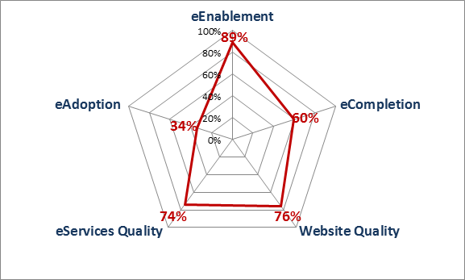
Dubai has achieved significant success in public services eEnablement as well
Services Enablement, Adoption & Quality Status – EoY’2013
From eGovernment to Smart Government
Confidential - Category C
Source: G%SS Data, DSG eTransformation Audit, DSG Dubai Government Websites Quality Evaluation, DSG Dubai Government eServices Quality Evaluation

Slide 9
ESS Outcomes – Some Facts and Figures
From eGovernment to Smart Government
Confidential - Category C
Source: DSG (Dubai Smart Government Department)

Slide 10
ESS lessons Learnt & Sustainability Factors
High level commitment and leadership
Solid strategy and governance
Target setting and measurements
Boosting the skills of staff
Customer engagement and participation
Customer trust, confidence & satisfaction
Reliable high-performance and robust infrastructure, Business Continuity
Services delivery through Service Level Agreements
Continuous improvement through enhancements
Quick wins and early buy-in
Self-financed through captured cost savings (easier to obtain approvals and funding)
Private Sector Partnerships
From eGovernment to Smart Government
Confidential - Category C
Source: DSG (Dubai Smart Government Department)

Slide 11



From eGovernment to Smart Government & Smart City
2000
2013
Traditional Government
eGovernment (eEnablement of Government Services and Processes)
Smart Government
& Smart City
eEnablement of Public Services
Electronic Shared Services (ESS) for Back-office Administration
From eGovernment to Smart Government
Confidential - Category C
Source: DSG (Dubai Smart Government Department)

Slide 12

Thank you

