Slide 1
E-OFFICE FOR GOVERNMENT OF SIKKIM
DEPARTMENT OF INFORMATION TECHNOLOGY
GOVERNMENT OF SIKKIM

Slide 2
WHY e-OFFICE IN SIKKIM?
ENHANCES TRANSPARENCY
DIGITAL GOVERNANCE
INCREASES ACCOUNTABILITY
DATA SECURITY AND DATA INTEGRITY
MAGNIFY THE PRODUCTIVITY
WORK FROM ANYWHERE AND ANYTIME
GOVERNMENT WORK CULTURE AND ETHICS TRANSFORMATION

Slide 3
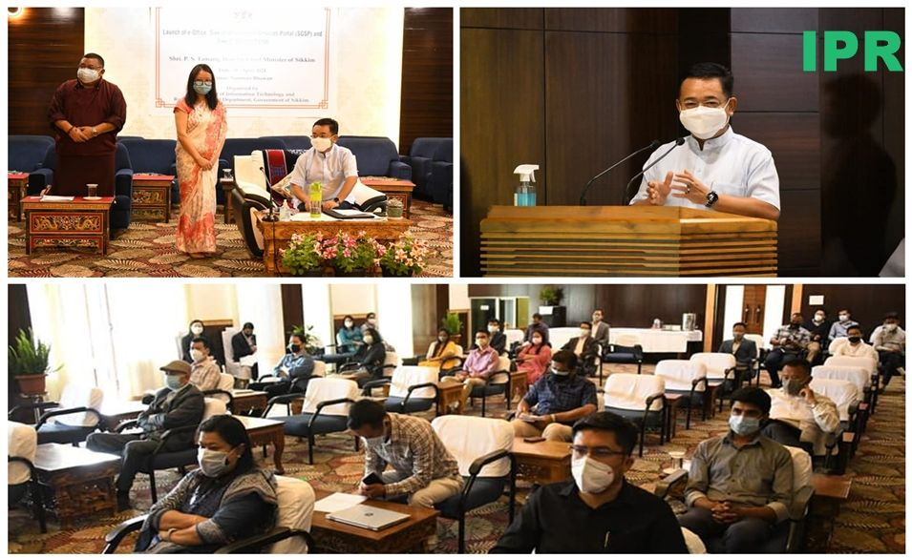
IMPLEMENTED BY THE DEPARTMENT OF INFORMATION TECHNOLOGY FOR THE GOVERNMENT OF SIKKIM
E-OFFICE IN SIKKIM
100 USERS e-OFFICE LITE ON PILOT BASIS WAS IMPLEMENTED IN THE DEPARTMENT OF INFORMATION TECHNOLOGY AND DISTRICT ADMINISTRATIVE CENTRE GANGTOK DISTRICT
INAUGURATED BY HON’BLE CHIEF MINISTER, GOVT. OF SIKKIM ON
30TH APRIL, 2021
HOSTED & MAINTAINED IN THE SIKKIM STATE DATA CENTRE (SDC)

Slide 4
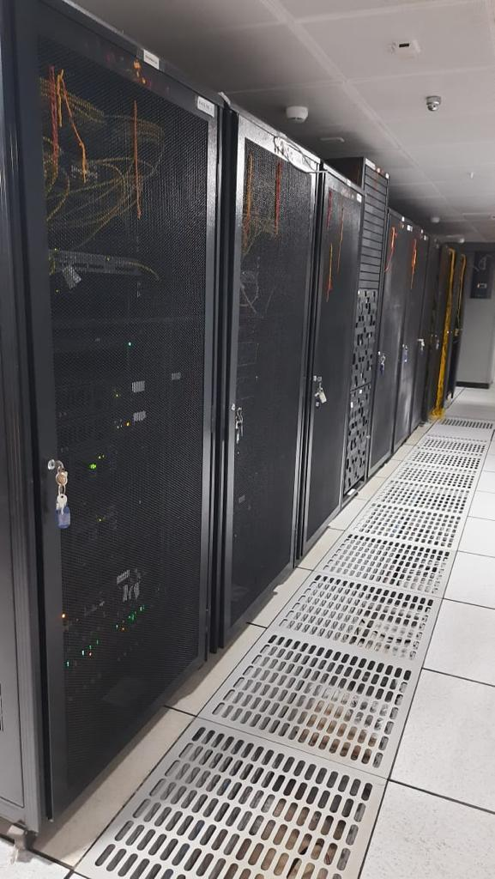
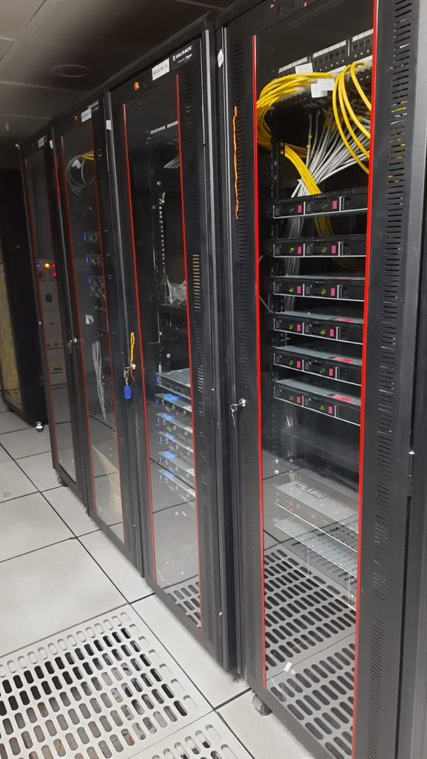
DEPARTMENT OF INFORMATION TECHNOLOGY PROCURED 3000 eOFFICE USER LICENSES UNDER STATE COLLABORATION INITIATIVES (SCI) SCHEME UNDER DARPG IN 2022
e-OFFICE UPGRADATION
SERVER COMPONENTS PROCURED & DEPLOYED IN THE SIKKIM STATE DATA CENTRE TO MIGRATE FROM eOFFICE 5.x to 7.x VER
MIGRATION HAS BEEN DONE WITH THE HELP OF EOFFICE PMU NEW DELHI
& SDC TEAM

Slide 5
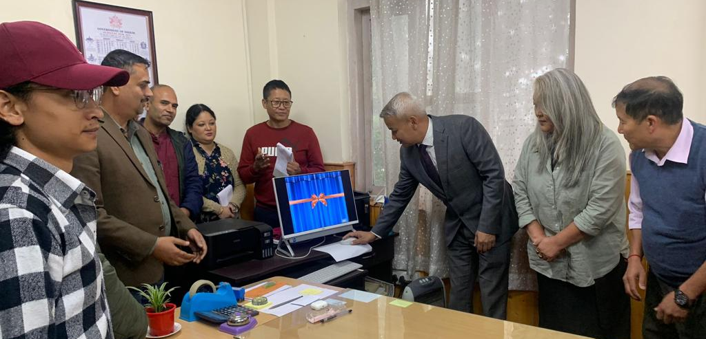
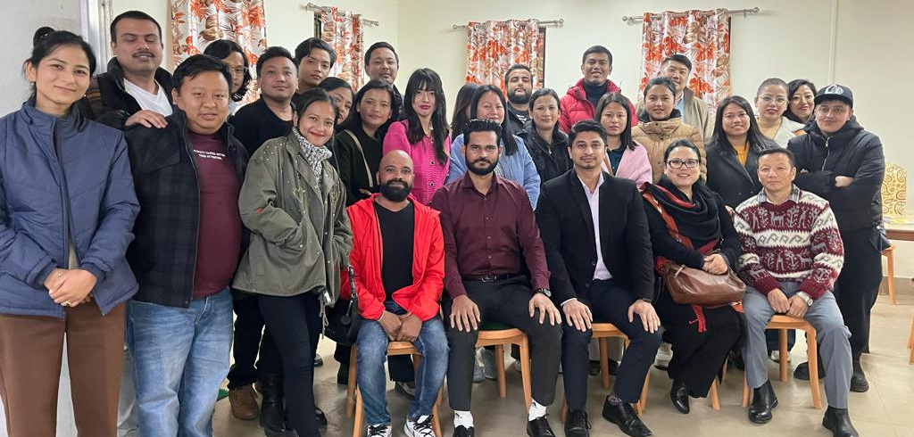
DEPLOYMENT OF e-OFFICE IN STATE GOVT. OF SIKKIM
eOFFICE SUCCESSFULLY DEPLOYED IN
SIX DEPARTMENTS WITH 400 PLUS USERS
DEDICATED AND EFFICIENT TEAM OF eOFFICE IN DIT AND SIKKIM STATE DATA CENTRE
REGULAR END-USER TRAINING AVAILABLE FROM EXPERINCED MASTER’S TRAINERS

Slide 6
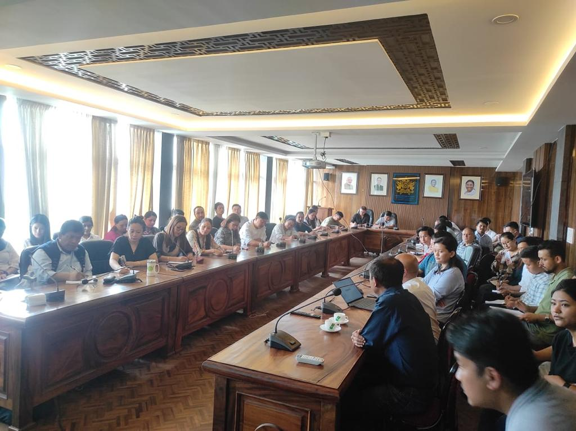
STATS of e-OFFICE IN SIKKIM
FILE CREATED -3251
RECEIPTS PROCESSED-1306781
ACTIVE USER- 400

Slide 7
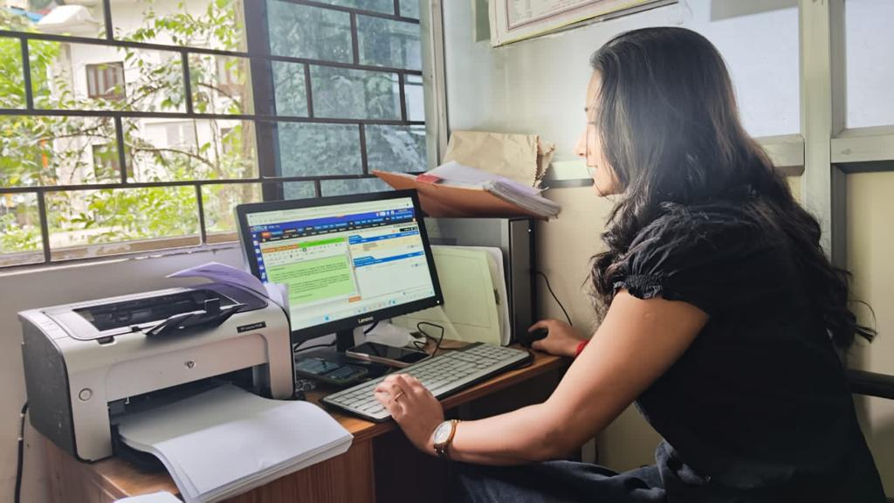
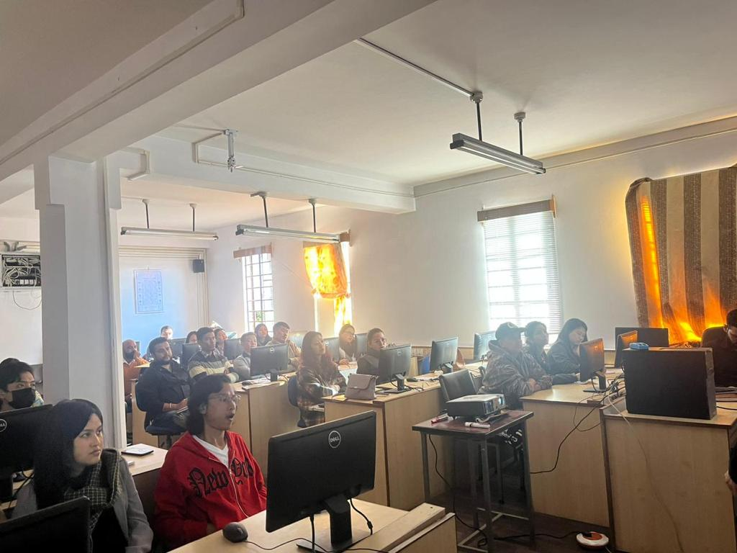
IMPLEMENTATION
DEPARTMENTS IMPLEMENTED
IT DEPTT
DISTRICT ADMINISTRATIVE
CENTRE,GANGTOK
TRANSPORT DEPTT
SKILL DEVELOPMENT DEPTT
SPORTS & YOUTH AFFAIRS DEPTT
URBAN DEVELOPMENT DEPTT

Slide 8
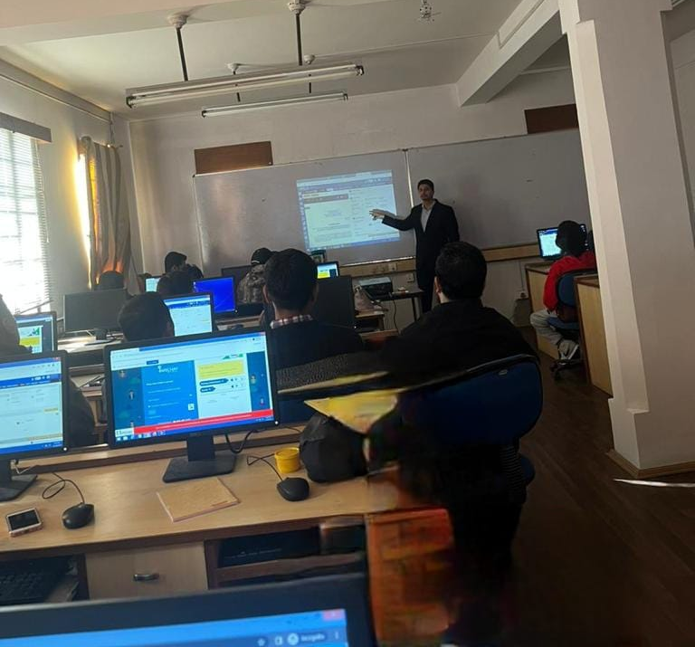
ROADMAP AHEAD
PHASE-I
ONGOING
PHASE-II
TASHILING SECRETARIAT, GANGTOK
DEPARTMENTS LOCATED IN GANGTOK
SORENG DISTRICT ADMINISTRATIVE CENTRE
PAKYONG DISTRICT ADMINISTRATIVE CENTRE
GYALSHING DISTRICT ADMINISTRATIVE CENTRE
MANGAN DISTRICT ADMINISTRATIVE CENTRE
NAMCHI DISTRICT ADMINISTRATIVE CENTRE

Slide 9
TESTIMONIALS
Files and letters handling in public department is a challenging task. Use of e-Office has made searching of files, receipt quickly and also monitor pending files. The workflows of the e-office exactly suits in Govt office structure.
I
I feel the biggest advantage using this e-office to get free from tons of papers. Each files contains note sheets, references, issues letters, drafts etc to handle cumbersome task. Paperless environment aids in contribution towards green Sikkim and reduction of carbon foot print.
Shri Samrat Pradhan, Joint Director, IT
Shri Tushar Nikhare, DC Gangtok
Since the launch of e-Office App, writing notes has become easy similar to an email. However ,in case of error in typing after the file is forwarded, there is no provision for correction of notes. Sharing and monitoring has become convenient and quick.
It gives me free hand to work from home during pandemic time. I strongly recommend all offices should be adopt e-office application.
Shri Karma Zimba Bhutia,
Joint Director, Motor Vehicle Section, Transport Department
Ms. Beena Chettri, Sr. Accounts Officer

Slide 10
TESTIMONIALS
The e-Office project has been very successful in bringing about a digital transformation to the day-to-day workings of the Department. The oft complained excused of "misplaced file" or "lost file" is no longer valid. Each file has an electronic number attached to track it..
It has improved efficiency in decision making and faster service delivery mechanism in my office and also drastically reduced the usage of paper.
Shri Raju Basnet, Secretary, Sports Department
Shri Raj Yadav, Secretary, Transport Department
Implementing eOffice system has brought about transparency and efficiency by digitalizing the internal office procedures through paperless working in my department
eOffice project implementation has increased accountability and helped me in faster clearance of files and it has been a very Citizen Friendly Initiative..
Shri Milan Rai,
Additional District Collector, Gangtok
Ms. Kumud Bhattarai, Additional, Motor Vehicle Section, Transport Department

Slide 11
Thank you

