Slide 1
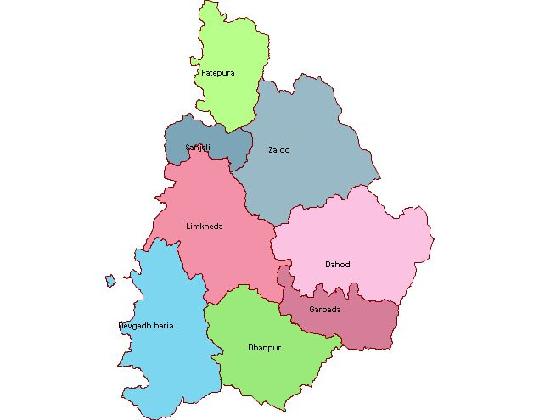
ASPIRATIONAL DISTRICT DAHOD
Project 2nd Innings
Vijay Kharadi,IAS
District Collector, Dahod, Gujarat

Slide 2
District Profile
Total Population (Census 2011) | 2127086
Proportion to Gujarat Population | 3.52%
ST population | 74.32%
SC population | 1.95%
Total Area | 3642 sq.km
Population density | 584 Sq.K.M
Sex ratio (Census 2011) | 990
Literacy Rate | 58.82%
Rural population | 90%

Slide 3
Sector – Education (30%)
S.No. | Indicator | Target | Mar-18 | Oct-18
1.1 | Transition rate from primary to upper primary school level | 100 | 92.51 | 100
1.2 | Transition rate from upper primary to secondary school level | 85 | 81.58 | 100
2 | Toilet access: percentage schools with functional girls’ toilets | 100 | 100 | 100
3.1 | Mathematics performance in class 3 | 72.98 | 63.43 | To improve learning outcome Project : 2nd Innings has been started
3.2 | Language performance in class 3 | 77.58 | 70.11
3.3 | Mathematics performance in class 5 | 71.41 | 61.88
3.4 | Language performance in class 5 | 74.16 | 65.55
3.5 | Mathematics performance in class 8 | 69.13 | 59.65
3.6 | Language performance in class 8 | 76.41 | 68.55

Slide 4
Sector – Education (30%)
S.No. | Indicator | Target | Mar-18 | Oct-18
5 | Percentage of schools with functional drinking water facility | 100 | 100 | 100
6 | Percentage of schools with functional electricity facility at secondary level | 100 | 100 | 100
7 | Percentage of elementary schools complying with RTE specified Pupil Teacher Ratio | 100 | 100 | 100
8 | Percentage of schools providing textbooks to children within 1 month of start of academic session | 100 | 100 | 100

Slide 5
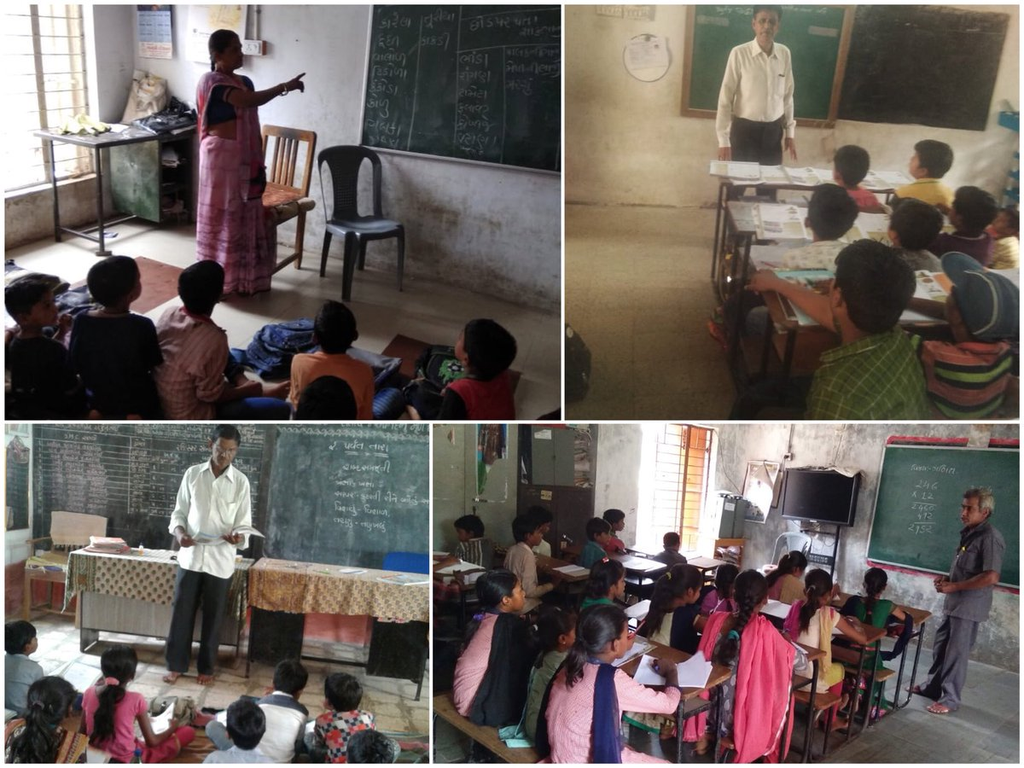
Project : 2nd INNING

Slide 6
NEED OF PROJECT
Improve learning outcomes
Decrease number of lower grade schools
Improve attendance of migratory student
Use wide experience of teaching
Improve quality of education

Slide 7
IMPLIMENTATION
Consultation of retired teachers
Listing of convinced retired teachers
Allocation of lower grades schools as per their convenience.

Slide 8
Utilization
Activity based learning using PRAGNA approach
Utilize wide experience of teaching.
Play supportive role in improving attendance also.
Mentoring younger teachers

Slide 9
OUTCOME
Improvement observed in learning outcome.
Progress observed in weaker children.
Overall impact was significantly higher among students taught by retired teachers.

Slide 10
SUCCESS STORY OF RETIRED TEACHER
Patel Shardaben was teaching in Bhil Central School, Muvaliya since last 25 years.
She showed her willingness in teaching after retirement also.
She has vast experience in teaching.
She has also experienced in teaching PRAGNA (Activity based learning) approach.
She has also vide experience in remedial teaching.
Vast experience in teaching of Language and Mathematics.

Slide 11
PROGRESS REPORT OF STUDENTS
NAME OF STUDENTS | PROGRESS REPORT IN READING
 | Gunotsav-8 | 16-8-18 | 6-9-18
PARMAR RAJESH K | 5 | 5 | 6
DAMOR DHAVAL J | 3 | 4 | 6
KATIJA SHIVAM P | 4 | 4 | 6
BAMANIYA NIRANJAN I | 4 | 4 | 7
BHABHOR RAHUL S | 4 | 5 | 7
PARMAR SWETA S | 6 | 6 | 8
BHURIYA SANDHYA G | 5 | 5 | 7
VAKHLA SANDHYA S | 6 | 6 | 8
MAVI PUJA M | 3 | 5 | 6
VAKHALA SANDHYA S | 4 | 4 | 6

Slide 12
PROGRESS REPORT OF STUDENTS
NAME OF STUDENTS | PROGRESS REPORT IN WRITING
 | Gunotsav-8 | 16-8-18 | 6-9-18
PARMAR RAJESH K | 7 | 7 | 8
DAMOR DHAVAL J | 4 | 5 | 7
KATIJA SHIVAM P | 4 | 4 | 7
BAMANIYA NIRANJAN I | 3 | 3 | 6
BHABHOR RAHUL S | 4 | 5 | 7
PARMAR SWETA S | 6 | 6 | 8
BHURIYA SANDHYA G | 5 | 5 | 7
VAKHLA SANDHYA S | 4 | 5 | 6
MAVI PUJA M | 4 | 5 | 7
VAKHALA SANDHYA S | 6 | 6 | 7

Slide 13
PROGRESS REPORT OF STUDENTS
NAME OF STUDENTS | PROGRESS REPORT IN MATHEMATICS
 | Gunotsav-8 | 16-8-18 | 6-9-18
PARMAR RAJESH K | 4 | 5 | 6
DAMOR DHAVAL J | 4 | 4 | 6
KATIJA SHIVAM P | 3 | 5 | 6
BAMANIYA NIRANJAN I | 4 | 4 | 6
BHABHOR RAHUL S | 4 | 4 | 6
PARMAR SWETA S | 4 | 6 | 6
BHURIYA SANDHYA G | 4 | 4 | 6
VAKHLA SANDHYA S | 4 | 4 | 6
MAVI PUJA M | 4 | 5 | 8
VAKHALA SANDHYA S | 6 | 6 | 7

Slide 14
IMPACT EVALUATION
Progress of students is significantly positive in reading, writing and mathematics.
Average marks of 10 students improve from 4.4 to 6.7 out of 10 marks in reading.
Average marks of 10 students improve from 4.7 to 7 out of 10 marks in writing.
Average marks of 10 students improve from 4.1 to 6.3 out of 10 marks in Mathematics.

